Slide 1
Cash out or dash out
Vivian do
University of California, Irvine
Ee 360

Slide 2
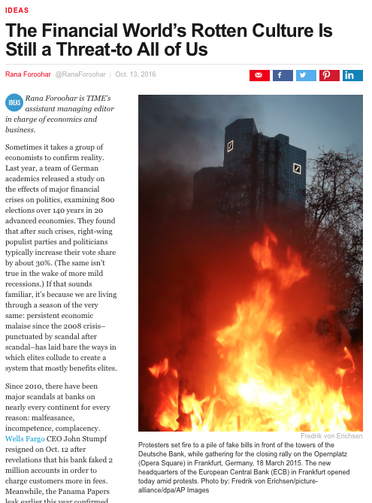
Time Magazine
Last year, a team of German academics released a study on the effects of major financial crisis on politics.
The persistent back to back scandals have proven that elites collude to create a system that mostly benefits elites.
Since 2010, there have been major scandals at banks on nearly every continent for every reason: malfeasance, incompetence, complacency, etc.

Slide 3
Wells fargo Scandal

Slide 4
Wells fargo Scandal: what happened?
Back in 2013, the LA Times started snooping into Wells Fargo’s aggressive sales tactics. This investigation sparked the interest of the CFPB.
The Consumer Financial Protection Bureau was created after the 2008 financial crisis to protect consumers from illegal bank practices.
Wells Fargo was fined $185 million, alleging that more than 2 million bank accounts or credit cards were opened or applied for without customers’ knowledge or permission between May 2011 and July 2015.
Notes:
This is the largest fine the CFPB had ever issued. The good news is that they are doing their job. The bad news is that the financial industry had just barely started to recover its reputation before this.

Slide 5
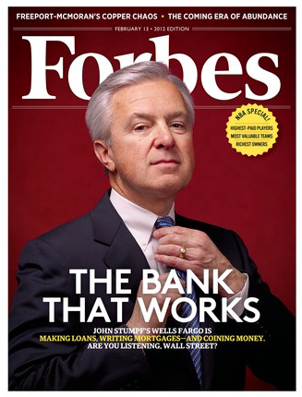
Wells fargo Scandal: how?
By opening hundreds of thousands of unauthorized credit cards, creating fake emails to open fake accounts, and moving funds without getting the permission first.
Years after the financial crisis, banks are still struggling. They have been trying to boost sales in the middle of bad time of the economy. This hasn’t been easy, which is why a lot of companies have been pushing more products on their existing customers.
The CFPB said Wells Fargo’s sales goals for employees, and the incentives that came with hitting them, caused employees to scam customers just to achieve a bonus.
Notes:
Before the scandal he was regarded as one of the best bankers in the industry. Successfully led Wells Fargo through the great financial crisis and became famous for pushing back on the idea his bank should be forced to participate in bank bailouts in 2008. Although Stumpf had let go of his million dollar compensation, lawmakers still weren’t happy. Stumpf was testified multiple times until he finally agreed to resign.

Slide 6
Deutsche bank
June 2016– Germany’s largest bank – was under investigation for doing illegal trades.
Illegally reduced its taxes by taking advantage of Euro tax loopholes.
Furthermore, their share priced plunged after the threat of a $14 billion fine.
Since 2008, it has paid more than nine billion dollars in fines and settlements for such improprieties.
Last year alone, Deutsche Bank was ordered to pay the U.S. and U.K. two and a half billion dollars, for its role in manipulating the London Interbank Offered Rate.
Notes:
Protestors set fire to a pile of fake bills in front of the towers of Deutsche Bank

Slide 7
JpMorgan Chase
“you scratch my back, I’ll scratch yours”
The US Government said the the bank has been hiring the kids and friends of Chinese officials in order to win big business deals.
This has been going on for about seven years and many of these hires weren’t qualified for their new jobs.
Yet, this hiring scheme increased the bank’s profits at least $35 million
A Justice Department official said that’s “corruption, plain and simple.” Now the bank has agreed to settle with the US gov for $264 million.
This is one of the first cases for this type of corruption but it may not be it’s last. The US gov is also investigating the hiring practices of other banks that do business in Asia like Goldman Sachs, Deutsche Bank, and UBS.

Slide 8
In conclusion
In each of the cases the companies were all faced with a fine, but what’s a small million dollar fine to a billion dollar company? Chump change. CEOs resigned from Wells Fargo and Detusche Bank, some were fined and some weren’t but there were no further penalties towards them.
“Cases like [these] foster the message that institutions and rich individuals can float above the system.” Italy, for example, has the largest “unofficial economy” which makes up about 27% of the nation’s total economy. Greece, Spain, and Portugal not far behind. Citizens of these countries tend to lose faith in the system and stop doing their civic duty, like paying taxes, filing for business permits, obeying the rule of law in general.
“People will never love paying taxes. But when they stop trusting the system altogether, the foundations of a country begin to crumble.”

Slide 9
references
http://time.com/4529456/the-financial-worlds-rotten-culture-is-still-a-threat-to-all-of-us/
http://abcnews.go.com/Business/timeline-wells-fargo-accounts-scandal/story?id=42231128
http://money.cnn.com/2016/09/26/investing/wells-fargo-stock-fake-account-scandal/index.html
http://www.nytimes.com/2016/11/18/business/dealbook/jpmorgan-chase-to-pay-264-million-to-settle-foreign-bribery-charges.html?_r=1
http://time.com/4529456/the-financial-worlds-rotten-culture-is-still-a-threat-to-all-of-us/

