Slide 1
Topic 9 Part 2
Price Discrimination
(Chapter 12)

Slide 2
Price Discrimination Summary
1st Degree
The monopolist charges each consumer the maximum price he/she is willing to pay.
2nd Degree
Price varies according to quantity demanded, i.e. quantity discount.
3rd Degree
The monopolist charges different prices for different consumer groups.

Slide 3
3rd Degree Price Discrimination
For the monopolist to implement the 3rd Degree PD, it has to be able to “screen” consumers.
Screening is a process for sorting consumers based on their characteristics.
These characteristics can be
Observable, e.g. sex and age.
Unobservable but inferable, e.g. PED and willingness to pay.

Slide 4
3rd Degree Price Discrimination
Two Interesting Screening Mechanisms
Time
Some consumers want to be the first who own the product.
Sellers price goods higher when they are first introduced.
Coupons and Rebates (a partial refund)
For example, you buy a printer ink cartridge for $20, when it is empty, you can send it to the seller and get a rebate of $2.
Consumer who take time to process rebates shows that they are price-sensitive.
Sellers will offer lower prices for these consumers.

Slide 5
3rd Degree Price Discrimination
3rd Degree Price Discrimination with Capacity Constraints
Capacity Constraints: Production or supply of goods is limited, e.g. seats of airlines, cars of car rentals, etc.
Suppose that the monopolist can produce up to Q’ units.
It is to supply Q’ units of output in two market segments.
How should it allocate Q’ between these two segments?

Slide 6
3rd Degree Price Discrimination
3rd Degree Price Discrimination with Capacity Constraints
Let Q1 be quantity supplied to Segment 1
Q2 be quantity supplied to Segment 2
It should allocate Q’ = Q1 + Q2
such that MR(Q1) = MR(Q2).
If MR(Q1) > MR(Q2), it can increase revenue and hence profit by supplying more quantity in Segment 1.

Slide 7
3rd Degree Price Discrimination

Slide 8
Third Degree Price Discrimination
Implementing the 3rd Degree Price Discrimination
Suppose the monopolist cannot “screen” consumers.
How can it ensure that the consumers targeted to pay the high price ACTUALLY pay the high price?
Versioning refers to a strategy of selling two or more versions of a product with different quality levels at different prices.
Versioning takes advantage of the trait that the least price-sensitive buyers tend to be the most quality-sensitive.

Slide 9
Third Degree Price Discrimination
Implementing the 3rd Degree Price Discrimination
Damaged Goods Strategy refers to a versioning strategy in which the firm creates a low-end version of its full-price good by deliberately damaging the product.
For example, one version of a 1990 IBM laser printer was “added” chips to slow down printing speed.
Other examples include goods in shopping outlets.

Slide 10
Tie-in Sales
Apart from Price Discrimination, ANY FIRMS with market power have another technique that can be used to “capture” surplus from consumers.
Definition: A tie-in sale occurs if customer can buy one product ONLY IF they agree to purchase another product as well. Examples include printers and ink cartridges, photocopiers and papers, computers and monitors, etc.
The firm can extend its market power from one product to the other.

Slide 11
Tie-in Sales – Bundling
Package tie-in sales (or bundling) occur when goods are combined so that customers cannot buy either good separately.
For example, one Disney Land ticket includes “admission fee” and “roller coaster fee”.
Bundling may be used in place of price discrimination to increase producer surplus when consumers have different willingness to pay for the goods sold in the bundle.
Bundling MAY NOT increase profit.

Slide 12
Tie-in Sales – Bundling
WITHOUT Bundling
Max. profit from computer = 500, i.e. sold to Customer 2.
Max. profit from monitor = 300, i.e. sold to Customer 1.
Max. total profit = 500 + 300 = 800.

Slide 13
Tie-in Sales – Bundling
WITH Bundling (MC = 1300)
At P* = 1800, BOTH customers buy the bundle.
Total Profit = 500 x 2 = 1000.
At P = 1900, ONLY Customer 2 buys the bundle.
Total Profit = 600.

Slide 14
Tie-in Sales – Bundling
WITHOUT Bundling
Max. profit from computer = 500, i.e. sold to Customer 2.
Max. profit from monitor = 300, i.e. sold to Customer 2.
Max. total profit = 500 + 300 = 800.

Slide 15
Tie-in Sales – Bundling
WITH Bundling (MC = 1300)
At P = 1600, BOTH customers buy the bundle.
Total Profit = 300 x 2 = 600.
At P* = 2100, ONLY Customer 2 buys the bundle.
Total Profit w/ Bundling = 800 = Total Profit w/o Bundling

Slide 16
Tie-in Sales – MIXED Bundling
Mixed Bundling is when firms allow customers to purchase components individually as well as in bundles.
The firm should sell only computer to Customer 4.
It should sell only monitor to Customer 1.
For Customers 2 and 3, it can offer bundles.

Slide 17
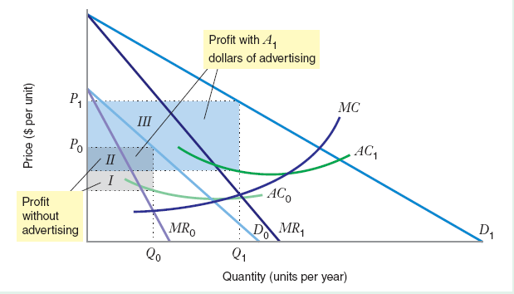
Advertising
The firm can capture surplus using non-price strategies such as advertising.

Slide 18
Advertising
Advertising comes with costs; therefore, for a firm to maximize profit, two conditions must hold:
1) Quantity is optimally chosen:
MR(Q) = MC(Q)
2) Expenditure on Advertising is optimally chosen:
MR(A) = MC(A)

Slide 19
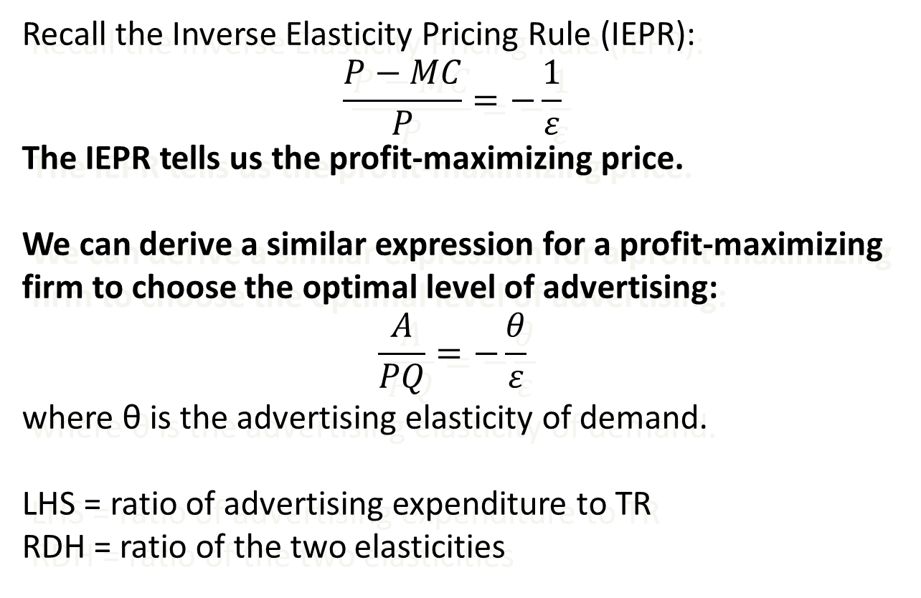
Advertising
Recall the Inverse Elasticity Pricing Rule (IEPR):
$$\frac{P−MC}{P}=−\frac{1}{ε}$$
The IEPR tells us the profit-maximizing price.
We can derive a similar expression for a profit-maximizing firm to choose the optimal level of advertising:
$$\frac{A}{PQ}=−\frac{θ}{ε}$$
where θ is the advertising elasticity of demand.
LHS = ratio of advertising expenditure to TR
RDH = ratio of the two elasticities

Slide 20
Advertising

