Slide 1
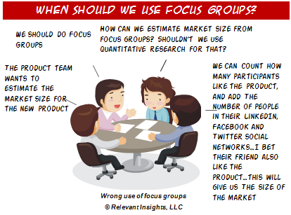
MK 322 Research Guideline Examples
By Ajarn Suwalya K.

Slide 2
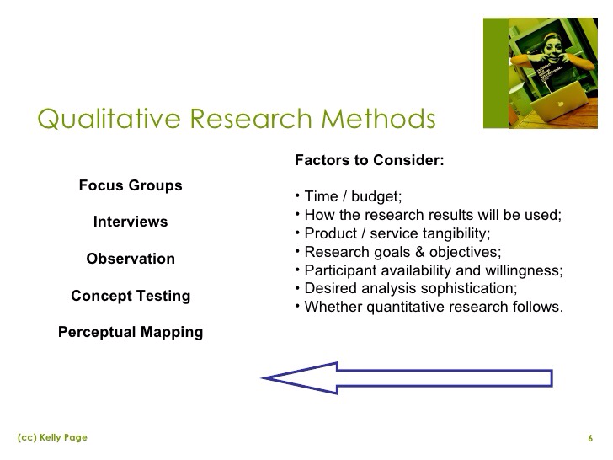

Slide 3
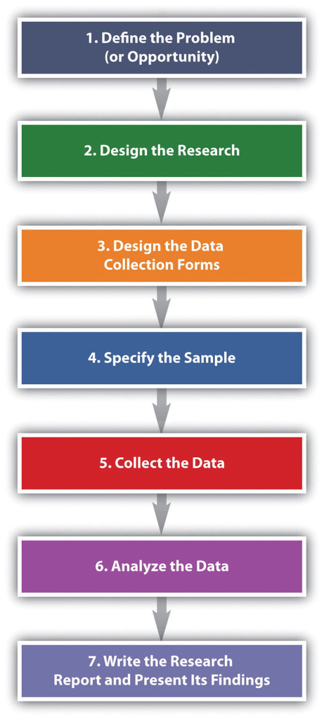

Slide 4


Slide 5
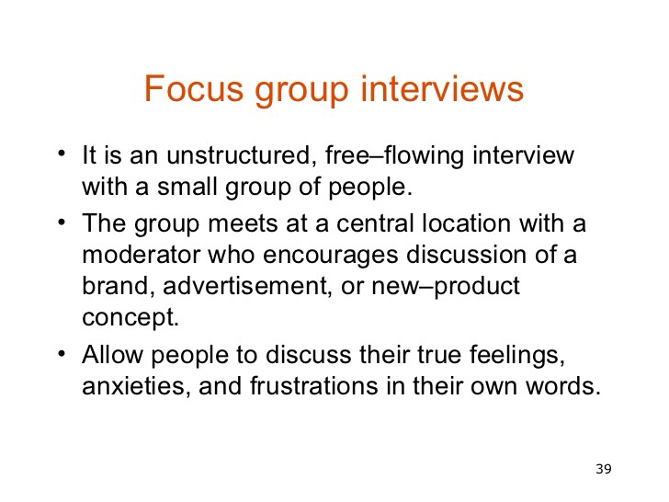

Slide 6
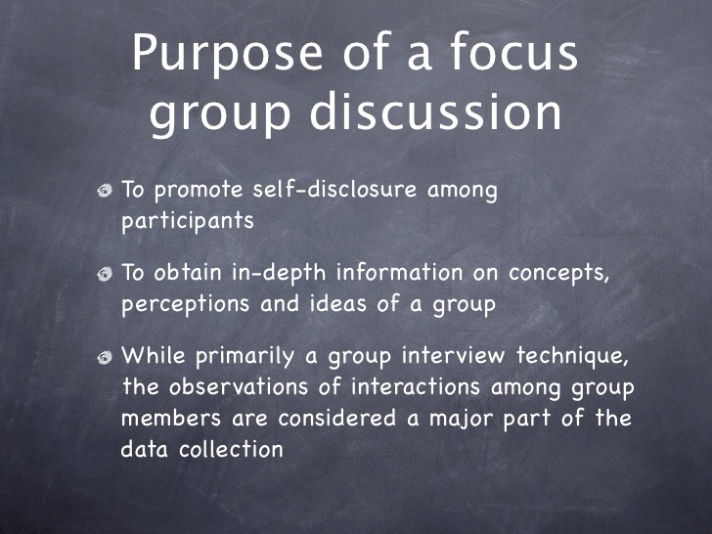

Slide 7


Slide 8
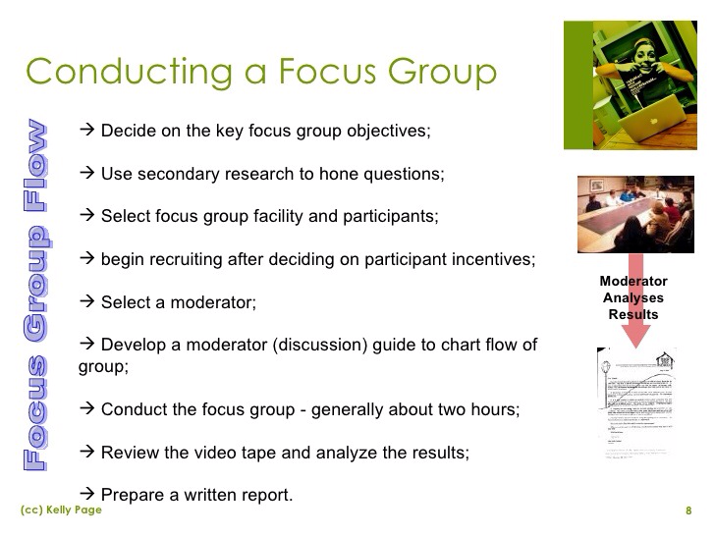

Slide 9
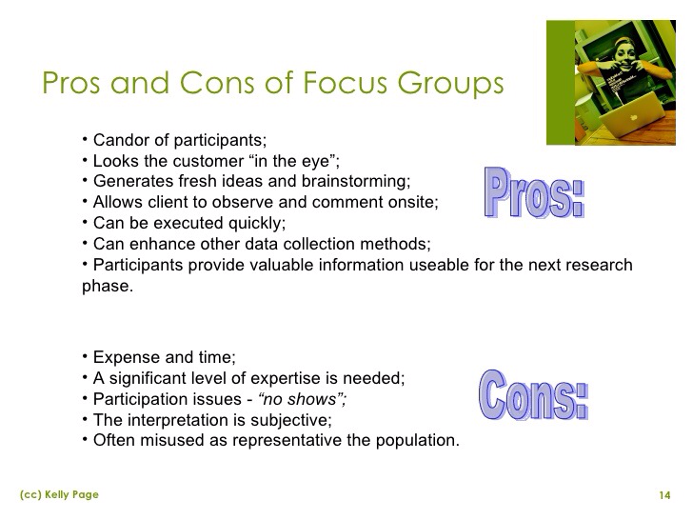

Slide 10
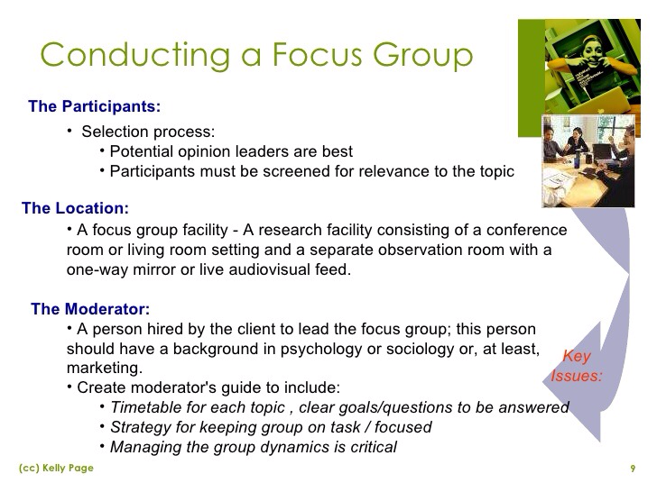

Slide 11
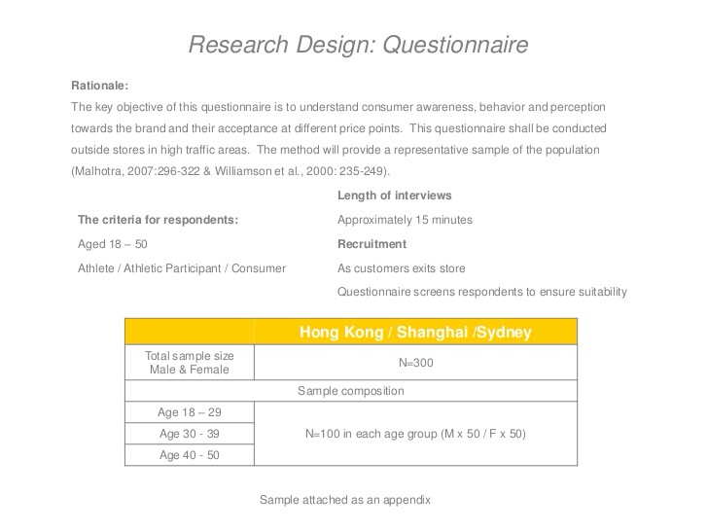

Slide 12
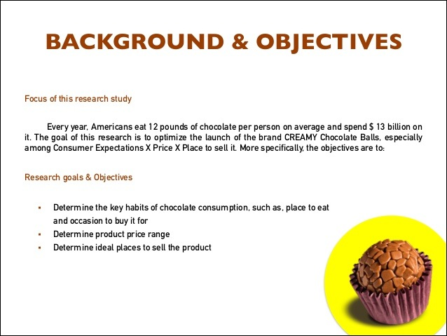

Slide 13
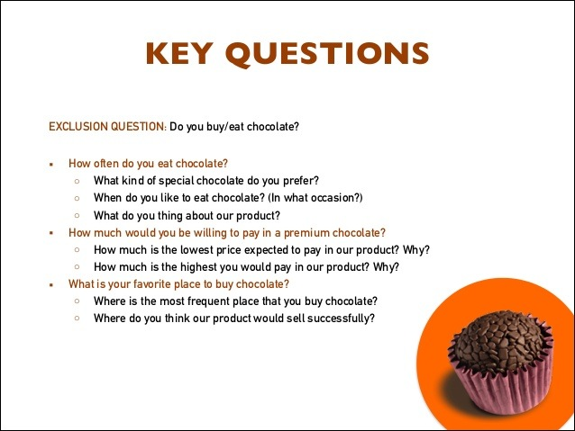

Slide 14
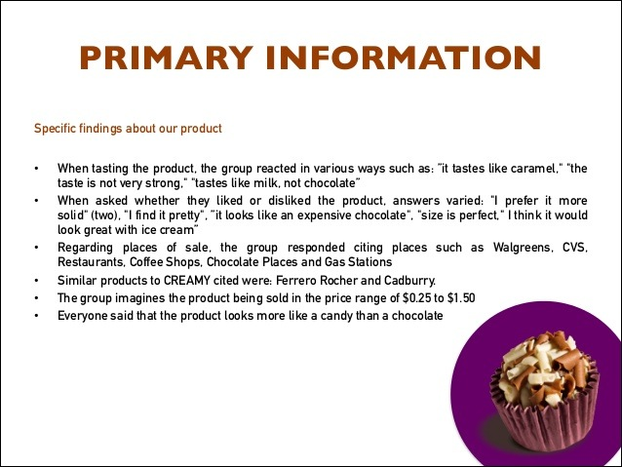

Slide 15
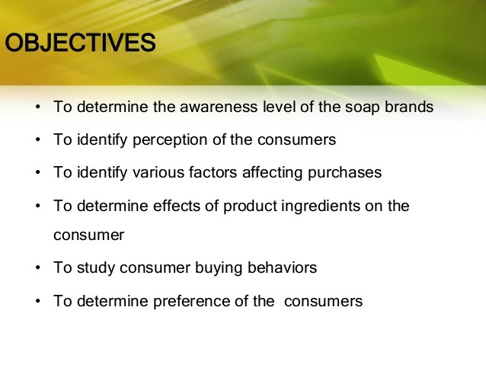

Slide 17
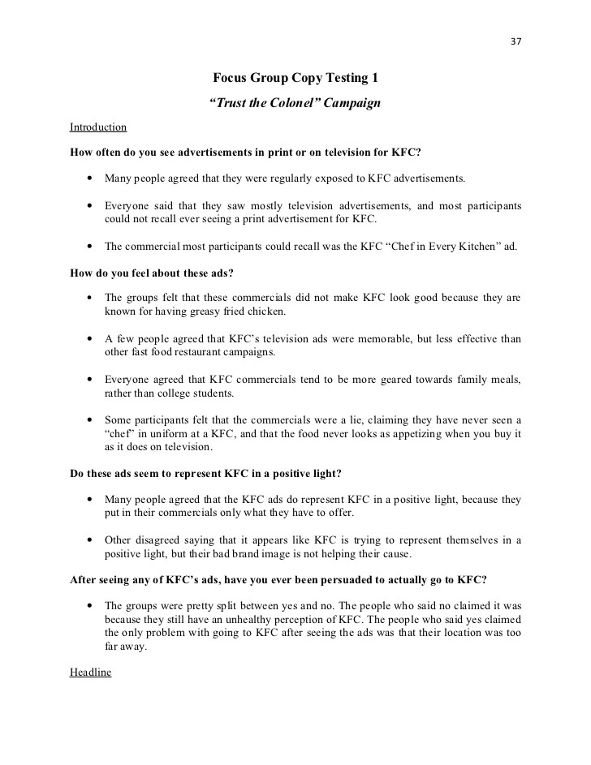

Slide 18
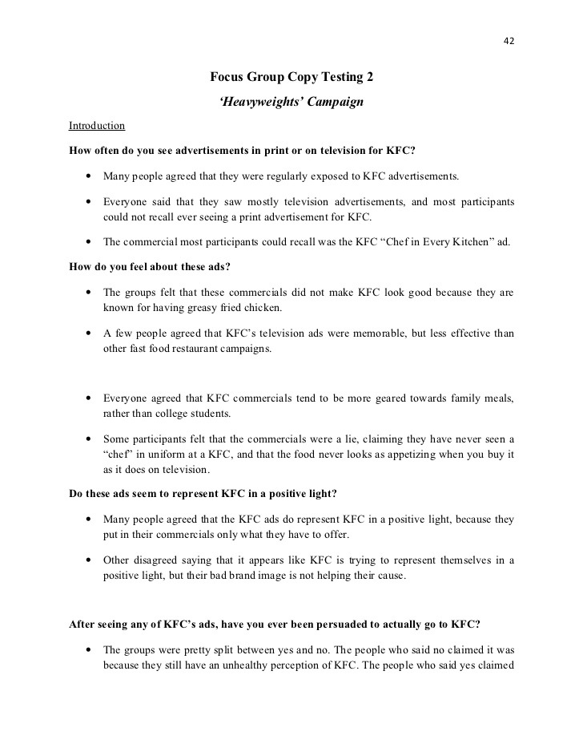

Slide 19
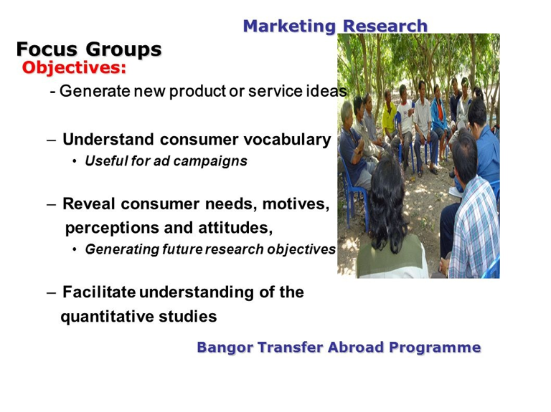

Slide 20
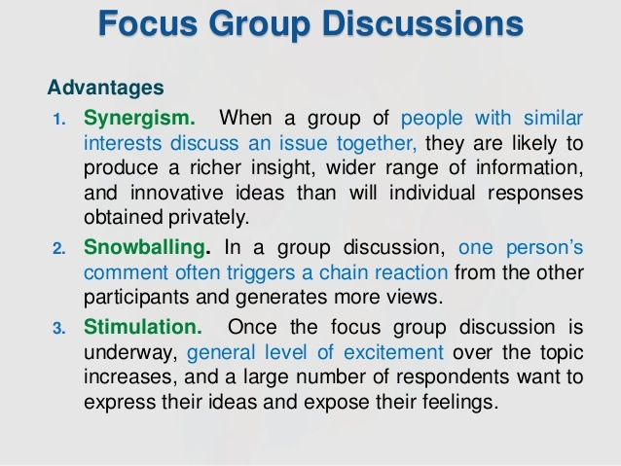

Slide 21
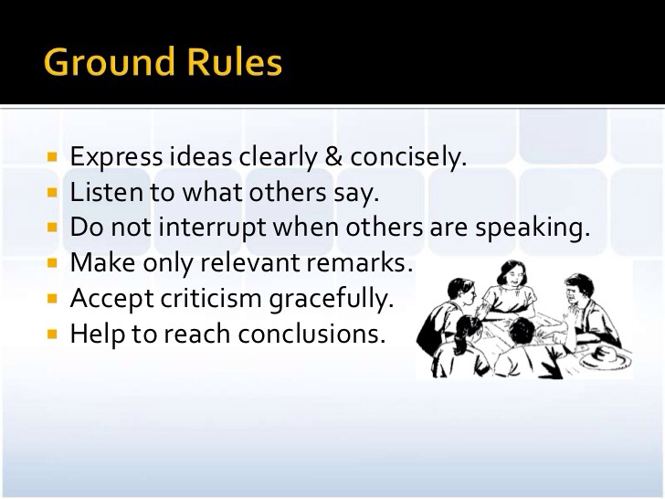

Slide 22
MK 312 Group Assignment…Due next week…
Research Aim, Objectives, and Questions
Each group is the write down your research aim.
Then write down 3 objectives in doing your research
Then you are to write 5 questions for each objective
with total of 15 questions
Please submit 3 ppt slides excluding cover max… 5 mins presentation.. we will have presentation next class...

Slide 23

RESEARCH…simple …
Research Aim: What do we want to find from this research?
Research Objectives: What ways can we achieve our aim?
Research Questions: What questions to ask consumers to achieve our objectives? (open ended questions)

Slide 24

Research Aim: What insights we want to find from this research?
Example: To launch fashion products the meet the needs of Thais Gen Z

Slide 25
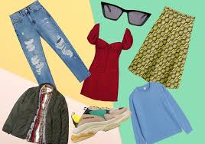
Research Objectives: What ways can we achieve the aim?
Research Aim: To launch fashion products the meet the needs of Thais Gen Z
Research Objectives:
Example: 1. To identify Gen Z shopping habits
2. To find what types of fashion influences Gen Z
3. What is the lifestyle of Gen Z

Slide 26
Research Questions: What questions to ask to achieve our objectives?
Research Objective: To identify Gen Z shopping habits
Research Questions:
1. Where do you normally shop?
2. When you shop what promotions do you look for?
3. What type of clothing and accessories do you normally buy?
4. When you go shopping do you go alone or with your friends, who do you go with?
5. How much do you spend when you go out shopping?

