Slide 1




Marketing Planning 312
Chapter 3 Part 3
Assessing the External Marketing Situation
By Ajarn Suwalya K.

Slide 2
Assessing the External Marketing Situation

Slide 3

Figure 1.1: The stages of building a
marketing plan

Slide 4

RBV vs. MOV
The Resource Based View (RBV) is an inside-out perspective
The Market Orientation View (MOV) is an outside-in perspective as illustrated below

Slide 5
RBV vs MOV
The Resource Based View (RBV) or Traditional Planning is an inside-out perspective
The Market Orientation View (MOV) or Customer - Focused Planning is an outside-in perspective as illustrated below

Slide 6
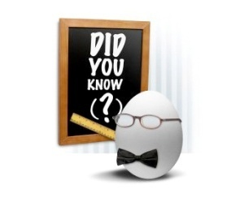
Ch. 3 Part 3 - Learning objectives
After studying this chapter you should be able to:
■ explain the elements in the PEST analysis
■ discuss the focal company’s relationships to the different actors in the value net
■ Porter's Five Forces Model
■ understand how the company can establish relationships to competitors

Slide 7
The marketing system at three levels
The whole marketing system can be divided into three levels, as follows (see Fig. 3.1 – next slide):
1 The focal company: understanding and analysing the internal situation
2 Industry level/value net: the focal company’s most important actors/stakeholders at this level are suppliers, partners / complementors, competitors and, of course, the customers.
3 Macro level: the most important changes taking place in the macro environment can be summarized in the so-called PEST analysis: P Political and legal factors, E Economic factors, S Socio-cultural factors, T Technological factors.

Slide 8
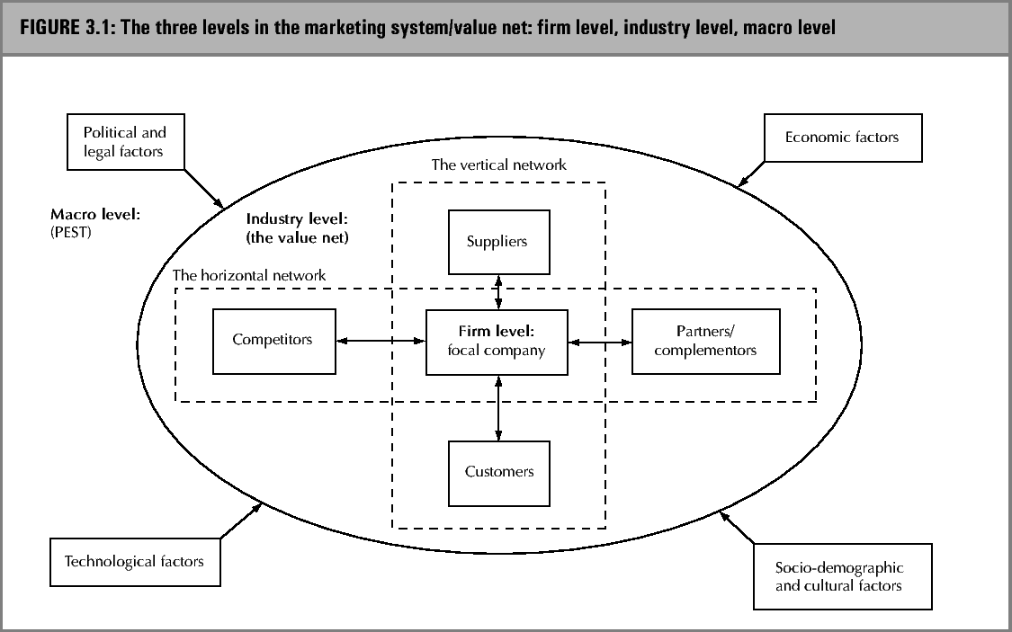
The marketing system / value net

Slide 9
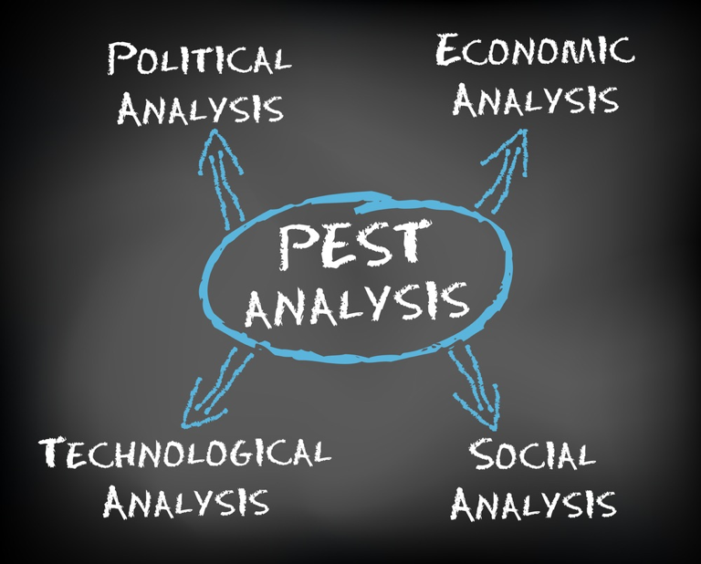
Pest Analysis

Slide 10
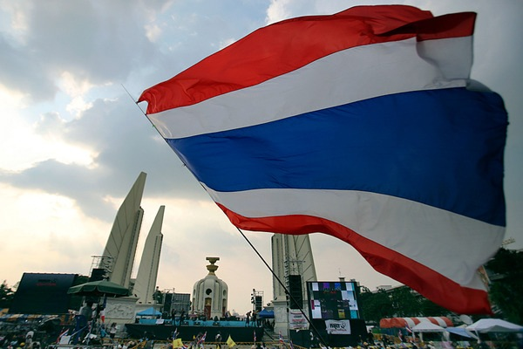
Political and Legal

Slide 11

Economic

Slide 12
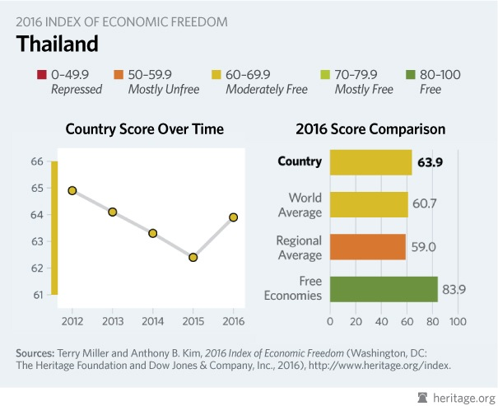
Economic

Slide 13
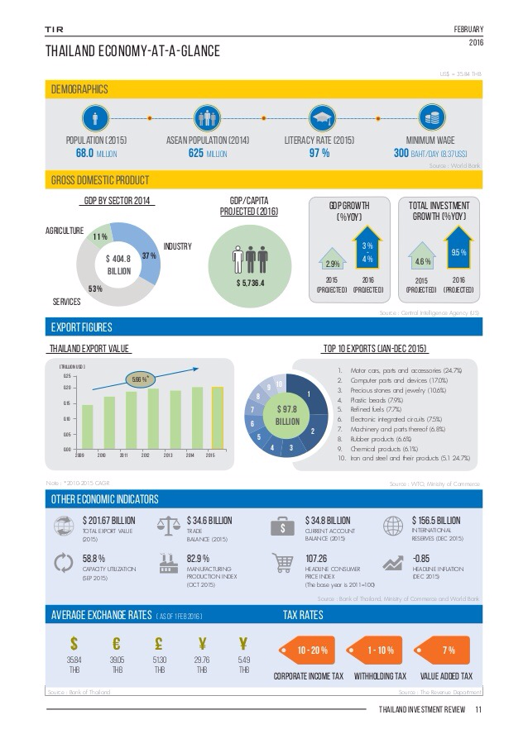
Economic

Slide 14

Economic

Slide 15
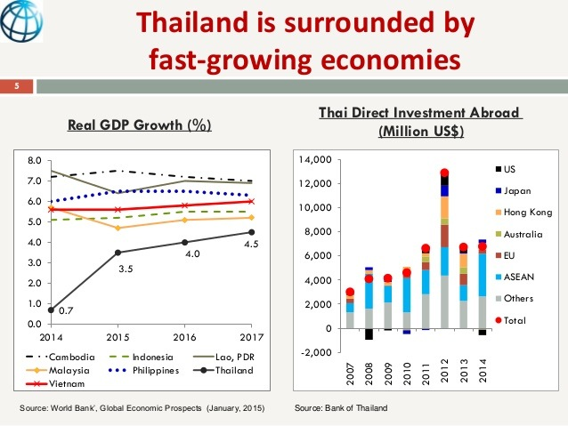
Economic

Slide 16


Socio-demographic and cultural environment
  Social Factors: a number of significant pressures on organization can be identified.
  Customers are becoming increasingly demanding of the products and services they buy.
  Customers demand, and expect, reliable products with quick, efficient service at reasonable prices.
  Furthermore there is little long-term stability in customer demand

Slide 17
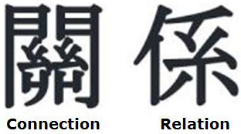

CULTURAL FACTORS
  American communicates in a low-context nature, which means that messages are explicit.
  Words carry most of the information in communication and one gets down to business quickly
  In high text , such as France,Japan, and most of the Middle East, less information is contained in the verbal part of the message.
  Much more information resides in the context of communication including background associations, and basic values of communicators (Hall, 1976)
  Thus making longer to conduct business because you need to know more about the business person before a relationship develops

Slide 18

Hofstede’s cultural dimensions
Descriptions of Hofstede’s five dimensions:
Power distance is the extent to which the less powerful members of society accept that power is, and should be, distributed unequally.
Uncertainty avoidance is the extent to which people try to avoid situations where expectations and outcomes are not clear.

Slide 19
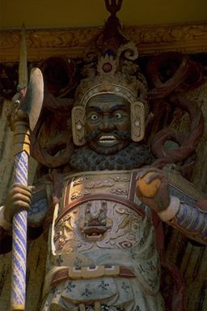
Hofstede’s cultural dimensions
Descriptions of Hofstede’s five dimensions (cont.):
Individualism describes the relationship between an individual and the groups to which he/she belongs.
Masculinity is aggressive and materialistic behaviour. Hofstede described this dimension as masculinity vs. femininity
Long-term orientation is the extent to which people within a culture have a long-term vs. a short-term outlook on work, life and other aspects of society

Slide 20
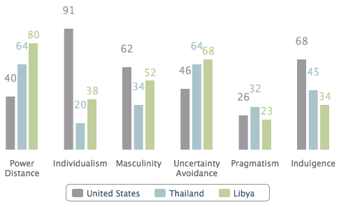
Hofested’s Cultural Dimensions

Slide 21


Exhibit 3.1 McDonald’s France: a faster penetration of the French market than expected

Slide 22
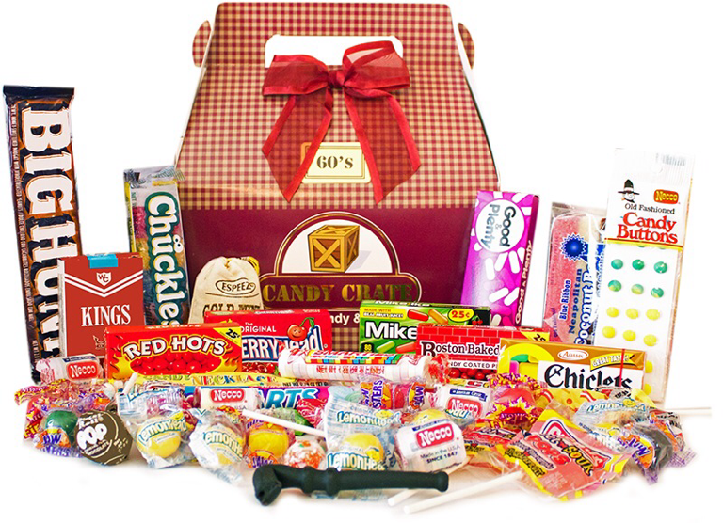
Exhibit 3.2 Cross-cultural ‘gift giving’ behavior and Masterfoods’ introduction of the Celebrations brand

Slide 23

Technological Factors
Technological factors:
  Newer technology has had a major impact on particular aspects of marketing.
  Computers, and their wide availability to management, have let to increased interest in sophisticated market modelling and decision support systems.

Slide 24

Value Net

Slide 25
Relations to actors in the industry value net
This task environment refers to the immediate external market where interactions which have a direct effect on our company take place.
Since the firm has relationships with different types of interdependencies, with different objectives for the development of the relationship, and so on, it is important organizationally to differentiate between how different relationships are handled.

Slide 26
The marketing system / value net

Slide 27

Relationships with suppliers
There seem to be three major strategic issues related to purchasing management:
1. The decision of whether to make an item in-house or to buy from external suppliers
2. The development of appropriate relationships with suppliers
3. The managing of the supplier base in terms of size and relationships between suppliers

Slide 28

Relationships with customers
In the relationship approach, a specific transaction between the focal company and a customer is not an isolated event, but takes place within an exchange relationship characterized by mutual dependency and interaction over time between the two parties.
An exchange relationship implies that there is an individual specific dependency between seller and the customer. The relationship develops through interaction over time and signifies a mutual orientation of two parties towards each other.

Slide 29



Relationships with partners/complementors
This kind of relationship is based on collaboration between manufactures of complementary functions and/or products/services.
Each partner has a strategic resource that the other needs –exchange supplier& customer.
Value chain activities developed: One manufacture – other market example: Diethelm

Slide 30
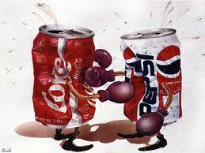
Relationships with competitors
Before entering any relationship with competitors, it is important to analyze the competition in so far as it will affect ease of market entry and potential profitability.
Factors to consider from competitors: number of size of competitors, capabilities (S&W), international marketing strategies, sales volume and relative market share, type of competitor (multinational – Microsoft, Unilever) vs. local

Slide 31

Porter's Five Forces Model
Originally developed by Harvard Business School's Michael E. Porter in 1979, the five forces model looks at five specific factors that determine whether or not a business can be profitable, based on other businesses in the industry.Sep 25, 2018

Slide 32
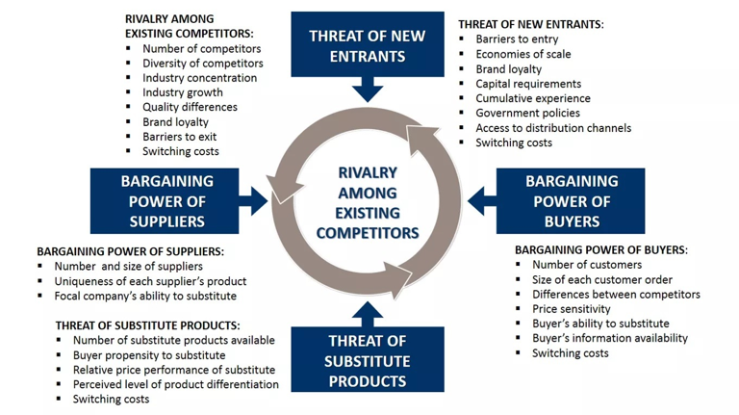
Porter's Five Forces Model

Slide 33
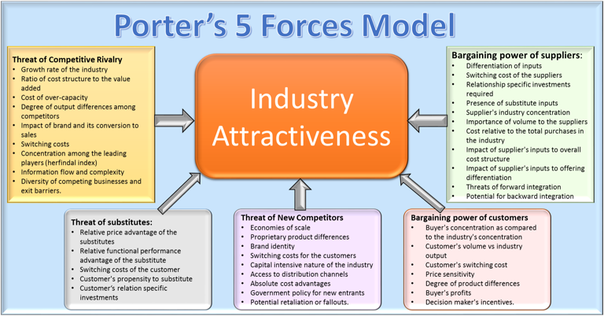

Slide 34

Exhibit 3.4 The nature of fashion markets

Slide 35
Group Homework #4
Fill in the PEST and value net chart for your focal company
Prepare a 7-10 mins powerpoint presentation due Sept.23

Slide 36
Individual Homework #3 due Sept. 23
1. You are to find current, most up-to-date information on the internet that does not relate to your project but should be based on individual interests.
2. Your assignment should be no more than 1 page.
3.It must have source or reference from the information researched..
4.It could include charts, graphs, photos etc
Choose a global or local service and answer the following questions?
1. How is PEST analysis used for the company? Please explain.
2. What is the most important dimension in the value net and how does it effect the company?

Slide 37


