Slide 1
Sign of the End of Times

Slide 2
What was September 11?

Slide 3
https://www.youtube.com/watch?v=gLBEYx1beYM

Slide 4
Brainstorming!
What is terrorism?
What inspires terrorist groups?
Why do people choose to commit terrorism or become a terrorist?
And how can it be solved?

Slide 5
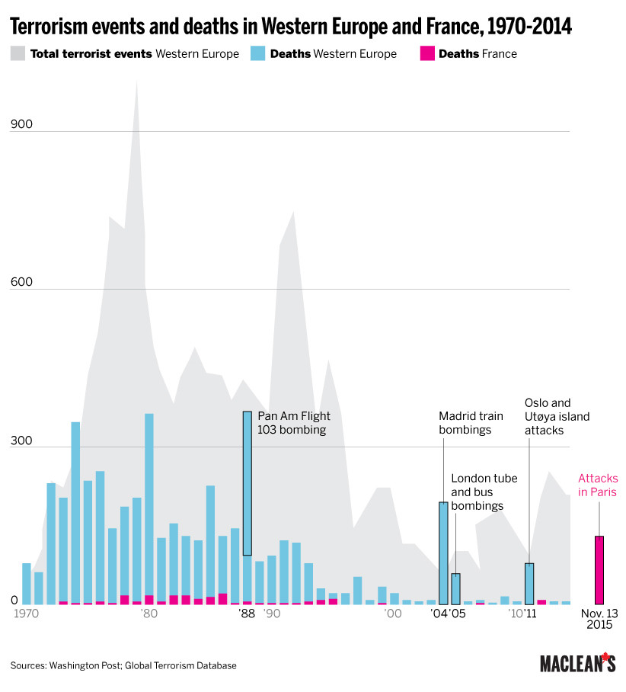

Slide 6
Definition of Terrorism
Terrorism equals political violence or violence for political purposes, with a goal to change the status quo.
  One part of a revolutionary strategy ... to seize political power from an existing government involving a consistent pattern of political violence or symbolism, with a deliberate intent to create a psychological effect on specific groups, thereby challenging their political behavior and attitudes. – Crenshaw

Slide 7
Is terrorism every OK?
“One man’s terrorist is another man’s freedom fighter”

Slide 8
Jihad
“Those who believe and suffer / exile and strive with might / and main, in God’s cause with their goods / and their persons / have highest rank in / the sight of God.” (Qur’an)

Slide 9
Jihad
“Those who believe and suffer / exile and strive with might / and main, in God’s cause with their goods / and their persons / have highest rank in / the sight of God.” (Qur’an)
A Jihad is “an individual’s holy struggle on behalf of Islam” Simple definition.

Slide 10
Jihad
“Those who believe and suffer / exile and strive with might / and main, in God’s cause with their goods / and their persons / have highest rank in / the sight of God.” (Qur’an)
A Jihad is “an individual’s holy struggle on behalf of Islam” Simple definition.
The question is, what is meant by “holy struggle” and how far should it go to be on “behalf of Islam”. This is interpreted by different people and scholars in different ways.

Slide 11
Jihad
Modern Islamist groups, led by leaders such as Ibn Tahir and Sayyid Qutb, who were the founding fathers of modern Islamic Extremism, claim that “Jihad is not an appendix to the other duties of a good Muslim, it is the main organ”

Slide 12
What inspires or influences terrorists?
Are these traits unique to Muslims?
Are all Muslims terrorists, or are all terrorists Muslim?
Would a world without Islam be a world without terrorism?

Slide 13
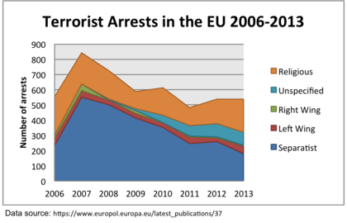

Slide 14
Non-Islamic terrorist attacks
Anders Breivik
IRA
Chechen Rebels
ETA

Slide 15
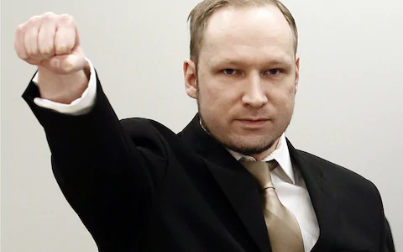
Anders Breivik
Far-right terrorist, white nationalist or ‘counter-jihadist’
Killed 78 people in Norway in 2011, mostly children on a political camp.
In his manifesto, he laid out his intent to fight against Islam, feminism, left-wing ideology.
His goal was to draw attention to his worldview and manifesto, to ‘market’ it.
https://www.youtube.com/watch?v=RrLe1kcaD8U

Slide 16

Anders Breivik’s Manifesto

Slide 17
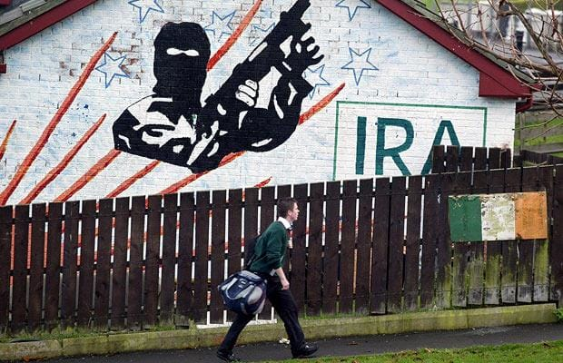
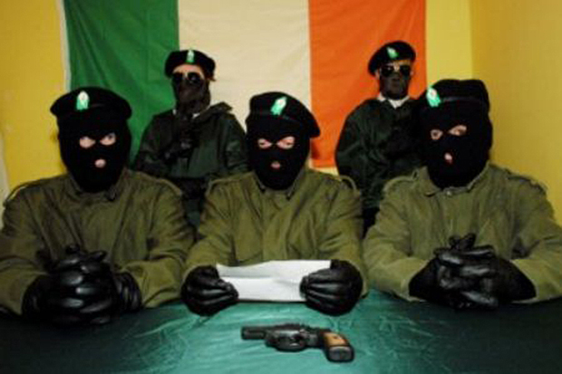
Irish Republican Army
Catholics and Protestants
1921 Ireland (majority Catholic) got its independence from the UK (majority Protestant)
However, Northern Ireland (majority Protestant) wanted to remain within the UK
Catholics living in Northern Ireland (capital city Belfast) were less well off economically and socially that Protestants.
Catholics protested in the streets for equality starting in the 1960s, but this provoked violent reactions from Protestants in Northern Ireland, which also brought in the UK government (mostly Protestant) police and military to deal with the growing problem.
The British military killed 14 unarmed protesters in 1972 at a protest which would later be called “Sunday Bloody Sunday”
Some Catholics, a minority in their community, under attack from the UK government and victims of socio-economic oppression, sought out violence (terrorism) to change the political status quo. They formed the IRA, an armed terrorist group which killed about 4000 people between the 1960s and 1990s.

Slide 18

Basque Nationalism
Unique ethnic, lingual and cultural group in Spain and France.
Very ancient, linguistically and (maybe) genetically differentiated from other Latin/Germanic peoples in Europe. 7000 years.
Minority group in Spain.
Seeks independence with its own Basque state

Slide 19
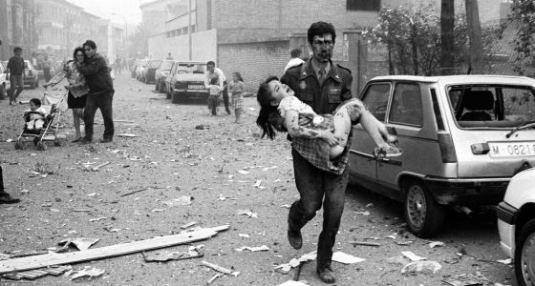
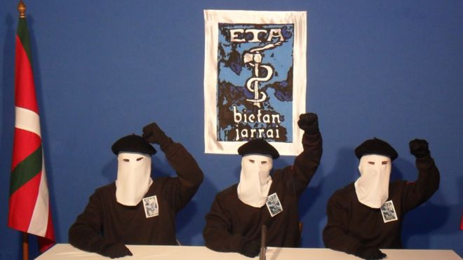
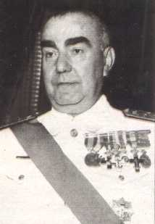
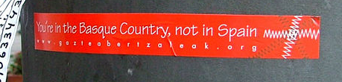
ETA – terrorist group seeking Basque independence
1991 Car Bomb Attack
10 dead
Prime Minister Blanco
Assassinated 1973

Slide 20
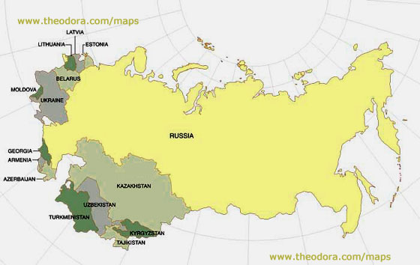
USSR devolves into independent states (1990s)

Slide 21
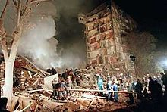
Chechens
Killed thousands of Russians seeking independence in 2 ‘wars’ with the Russian government
1999 Russian apartment bombings (300 killed)
Moscow Theatre Hostage Crisis (200 killed)

Slide 22
What do these groups all have in common?
They are not all ‘jihadists’ or Muslims
They are actually all in positions of weakness.
  “[t]errorism is a logical choice when oppositions have such goals and when the power ratio of government to challenger is high. The observation that terrorism is a weapon of the weak is hackneyed but apt.” – Crenshaw
Terrorists resort to political violence because of the asymmetry between the power of governments and their minimal ability to influence or have their voice heard in the political system.

Slide 23
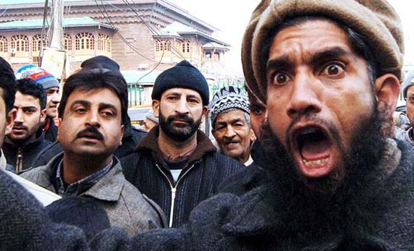
Why do people turn to terrorism?

Slide 24
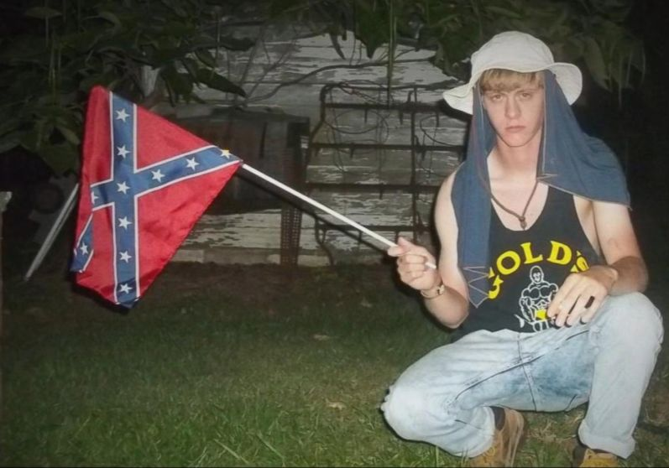
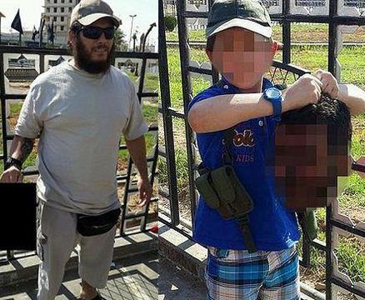
Why do people turn to terrorism?

Slide 25
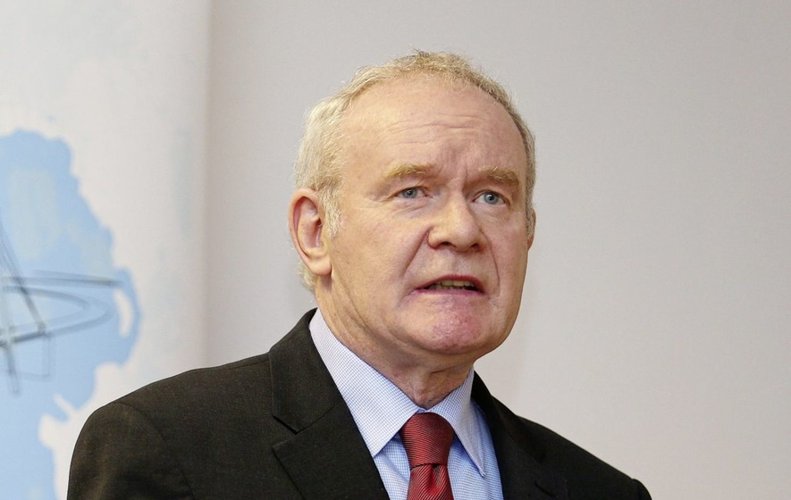
Why do people turn to terrorism?
Martin McGuinness, who was leader of the IRA, a terrorist group, became a Member of the British Parliament from 1997 once ‘the Troubles’ terrorist/guerilla war between the IRA and UK Government was reconciled in 1998.
He died in 2017.

Slide 26
Who is most susceptible to terrorism?

Slide 27

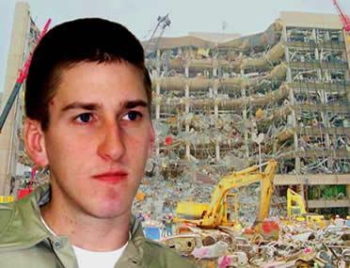
Salman Abedi, conducted attacks on Ariana Grande concert in Manchester, UK, 2017 (aged 23)
Timothy McVeigh, killed 168 after he bombed a Federal building in Oklahoma City, US, in 1995 (aged 20)

Slide 28
Threefold goals of ISIS
Re-establish an Islamic caliphate in the Middle East, with the goal of creating a global caliphate.
Plan and execute military activities and terrorist attacks.
Spread a message of hate (and their narrative of hope!) with the aim to inspire ISIS followers, lone wolfs, hidden cells of conducting their own terrorist attacks in their home countries.

Slide 29
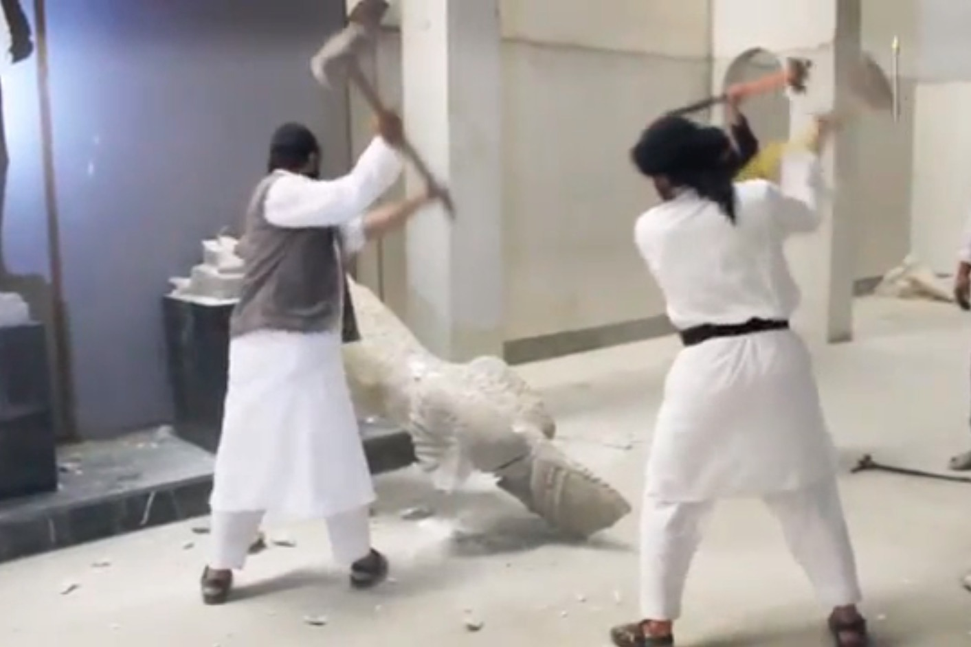
1. Re-establish an Islamic caliphate in the Middle East, with the goal of creating a global caliphate.
Threefold strategy in their territory
  They severely impose Islamic Law
  They provide ‘relative’ security and safety in return for money to fuel their rise. (Similar to the way mafia works!)
  They also provide municipal services (garbage, ID cards, taxes,
  policing etc.)
Have an incredibly attractive narrative
which has inspired tens of thousands of people to move to Syria and Iraq and fight for this new ‘state’

Slide 30
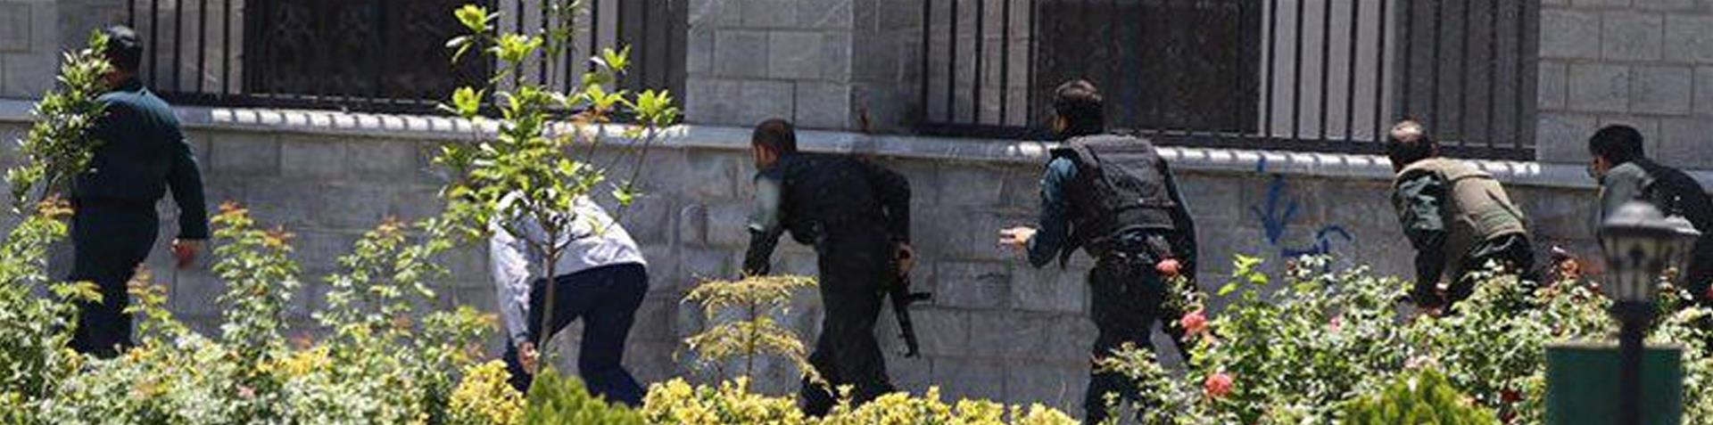
2. Traditional centrally planned terrorist attacks…
Coordinated training, funding and planning from a central heirarchy, where its members then conducted the planned terrorist attack as part of a broader organised violent political movement.
ISIS attack on Iranian Parliament,
(remember, Shia vs Sunni) in
Jun 2017

Slide 31
3. Inspire terrorist ‘franchises’
Lone wolves
Isolated terror cells
  Commit terror alone, isolated or outside of the command or hierarchical structure of the terrorist organization.
Terrorist groups inspire individuals or small groups (often familial groups) with their message, ideology or narratives, who then act as isolated ‘franchisees’ of the terrorist group.
  This is not a new phenomenon and is not restricted to Islamic terrorism (see Timothy McVeigh), but the ability to spread that message on social media or through technology has increased dramatically.

Slide 32
Solutions?
Social safety net
Protections and welfare for minorities
Quality education for youths
Security presence
Proactive policing

