Slide 1
Economics and Social Sciences
TU101 BE
Thorn Pitidol

Slide 2
What is economics?
Why do we need other social sciences to enrich economics?

Slide 3



Best-selling economics books

Slide 4
Economics as an understanding of human behavior
At the present, the development of economics has been oriented toward understanding how individuals and firms make “choice”
  Influenced by the “rational choice” perspective
  Advanced with mathematical tools
  Latest development via the “experimental” approach (behavioral economics)
But something about economics has also lost its significance

Slide 5

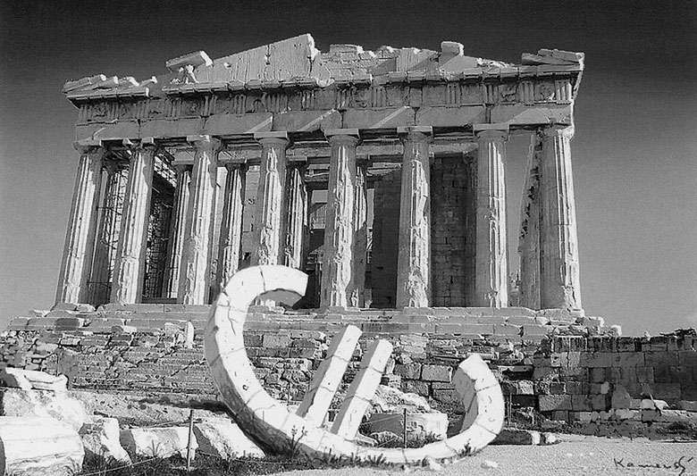
Economics’ “missing” task
Why aren’t these economic problems predicted and solved by economists?

Slide 6
Economics as an understanding of the “economy”
One must not forget that it is no less important for economics to help us understand the workings of the economy
  Economic conditions directly affect the livelihoods of epople
  Different aspects of the economy to be understood
    Financial System
    Works
    Government Policies
    Market
  Let’s ask a few questions about these aspects

Slide 7

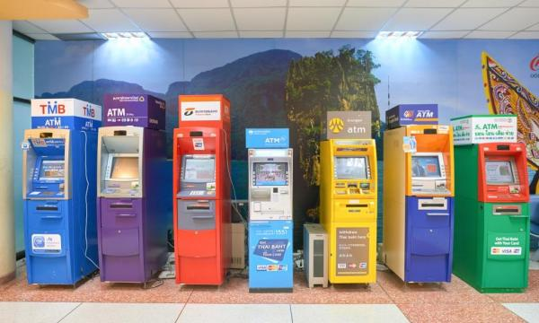
Economics as an understanding of the “economy”
Understanding the financial system
  How can the change in stock markets be explained?
  Why do we need banks?

Slide 8

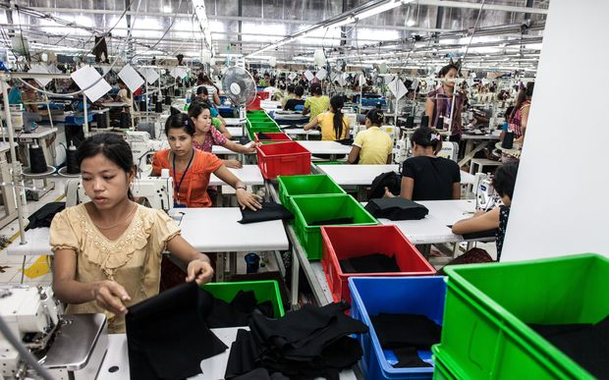

Economics as an understanding of the “economy”
Understanding works
  How much should workers be paid?
  Why do we receive different wages?
http://www.radionz.co.nz/news/national/314185/fashion-victims-the-true-cost-of-h-and-m-clothing
http://running.competitor.com/2015/07/photos/photos-how-new-balance-makes-running-shoes-in-america_131290

Slide 9


Economics as an understanding of the “economy”
Understanding the government
  Why different countries provide different level of welfare?
  How much taxes should you pay?
  Should the poor pay the same taxes as the rich?

Slide 10


Economics as an understanding of the “economy”
Understanding the market
  Why different levels of competition exist?
  Is monopoly a problem?

Slide 11
Economics and social-sciences
To have a better understanding of the economy, we need more than economics
  Every aspect of the economy is also shaped by social/political/cultural forces
  To gain a more complete understanding of an economy, other social sciences will be needed to complement economics

Slide 12
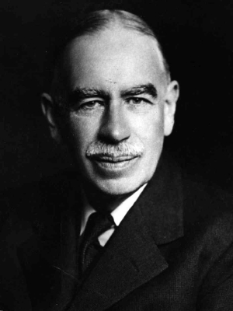
J.M.Keynes’ Wisdom
“The study of economics does not seem to require any specialized gifts of an unusually high order…An easy subject at which few excel! The paradox finds its explanation, perhaps, in that the master-economist must possess a rare combination of gifts. He must be mathematician, historian, statesman, philosopher—in some degree. He must understand symbols and speak in words. He must contemplate the particular in terms of the general and touch abstract and concrete in the same flight of thought. He must study the present in the light of the past for the purposes of the future.” (Keynes 1924: 321-322)

Slide 13
Capitalism: Then and Now
TU101 BE
Thorn Pitidol

Slide 14
What is “capitalism”
Capitalism: an economy in which production is organized in pursuit of profits
In contrast to
  Subsistence economy: produce for self-consumption
  Feudalism: produce for aristocrats
  Communism: state tells you what to produce

Slide 15
What is “capitalism”
The main components of capitalism
  Capitalists: own and use capitals in production, receive profits
    Capitals: machines, land, financial capitals
    Companies can be owned by many capitalists through “shares (stocks)”
  Labors: use labor in production, receive wages
  Markets: where goods and services are bought and sold

Slide 16
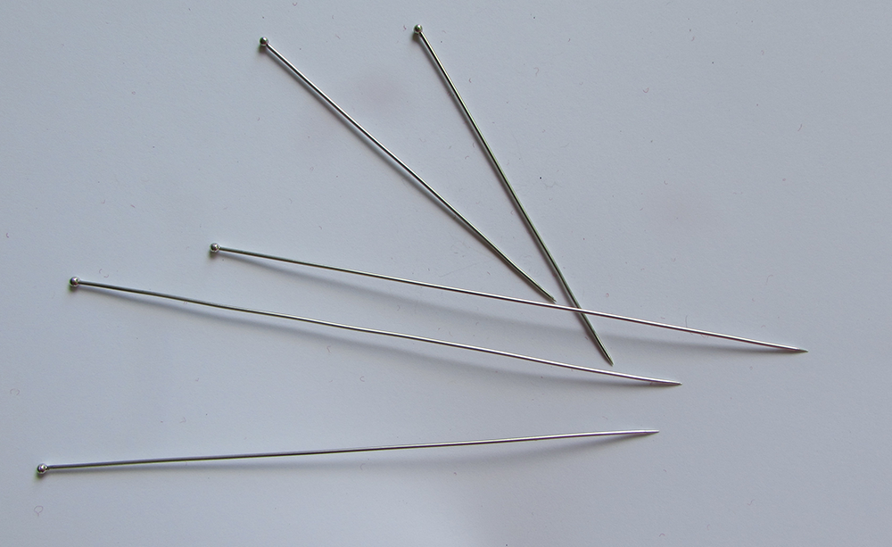
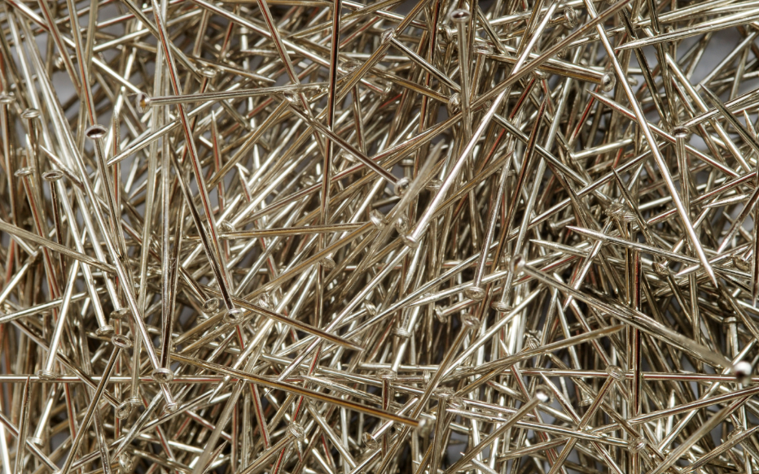
Capitalism: Adam Smith VS Today
Adam Smith’s Capitalism
Today Capitalism
Productivity with Smith’s division of labour
  = 4,800 pins per worker per day
Productivity today with division of labour and technology
  = 800,000 pins per worker per day
Productivity: measures of efficiency of production

Slide 17
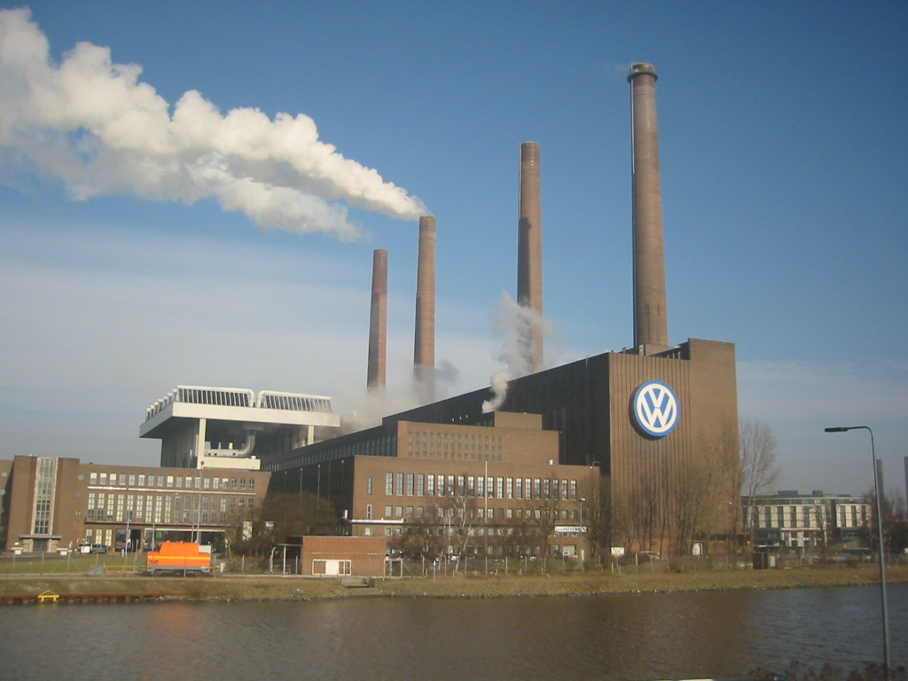
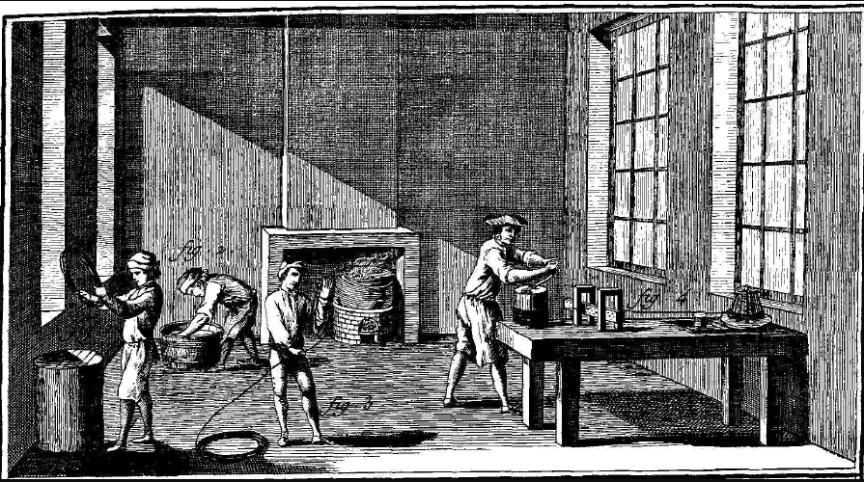
Capitalism: Adam Smith VS Today
Adam Smith’s Capitalism
Today Capitalism
Most factories and farms owned and run by a single or a small number of individuals
Most factories owned by “corporations” (shareholders), operated by CEOs
  Limited liabilities

Slide 18
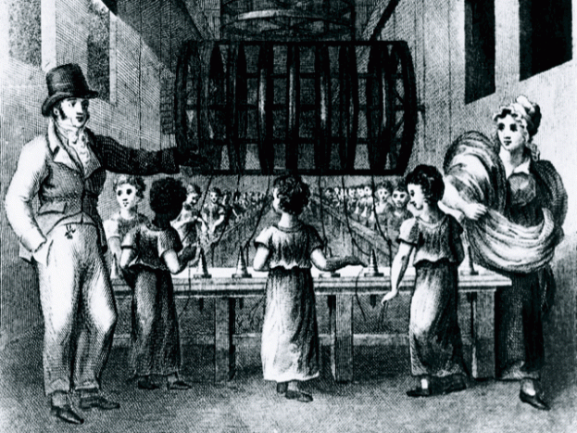
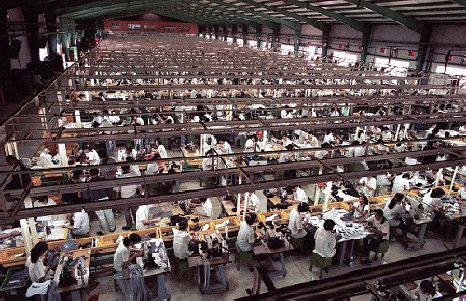
Capitalism: Adam Smith VS Today
Adam Smith’s Capitalism
Today Capitalism
Most were subsistent farmers or tenants of landlords
Slaves and child as labor
Most people are wage labors
Self-employed/government employees

Slide 19
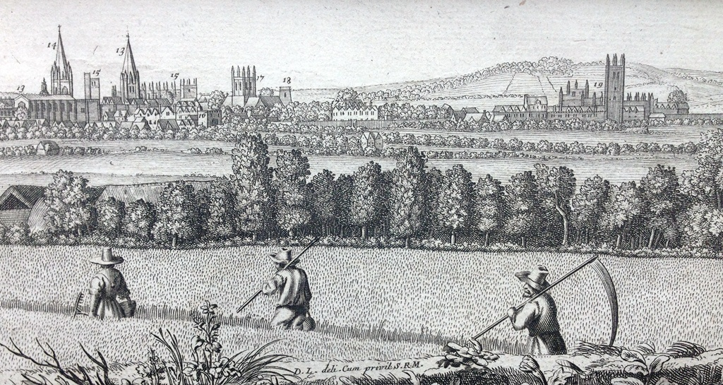

Capitalism: Adam Smith VS Today
Adam Smith’s Capitalism
Today Capitalism
Markets full of small producers serving local/national consumers
Markets full of large companies serving global market

Slide 20
Understanding Capitalism
The nature of capitalism changes with contexts
  Different times and different places create different variants of capitalism
  Economists need to pay attention to the contextual factors shaping the working of the economy

Slide 21
Capitalism: Key Phases and Events
Capitalism has moved through different period, each period gives it different factors shaping what it becomes today.
Key phases of capitalism
  Pre-capitalism (before 1500)
  Dawn of capitalism (1500-1820)
  Industrial Revolution (1820-1870)
  High noon (1870-1913)
  Turmoil (1914-1945)
  Golden Age (1945-1973)
  Discontinuity (1973-1979)
  Rise and Fall of Neo-liberalism (1980-Today)

Slide 22
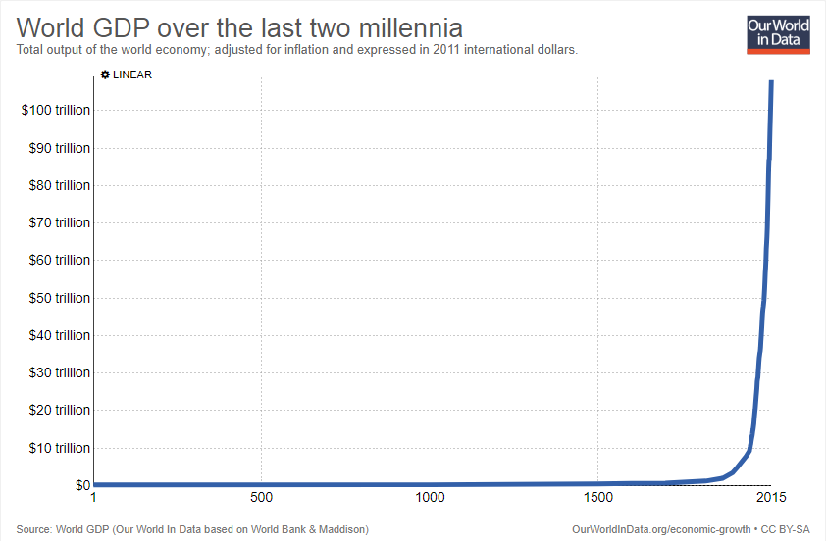
Pre-capitalism (before 1500)
Between 1000 and 1500, income per capita in Europe grew just 0.12 percent per year. Asia and Europe grew at just 0.04 per year.
https://ourworldindata.org/economic-growth#gdp-growth-since-1950

Slide 23
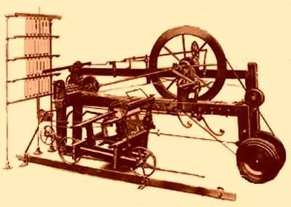
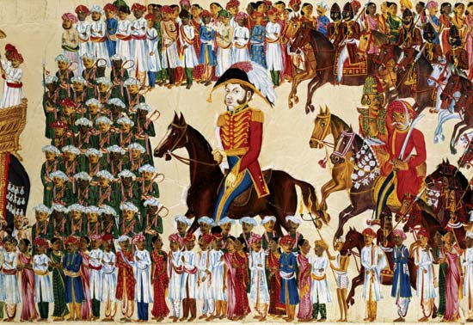
Dawn of capitalism (1500-1820)
Still a slow growth in this period (In Europe = 0.14 per year)
But two changes gave the first glimpse of capitalism
  (1) Development of sciences (2) Expansion of colonization
Weaving machine in textile production, 1779
East India Company, Company Rule in India 1757-1858

Slide 24
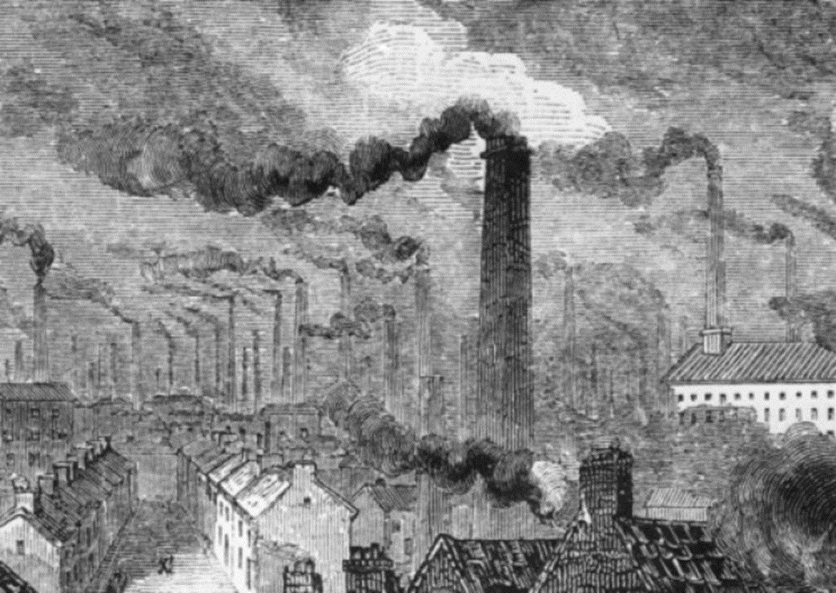
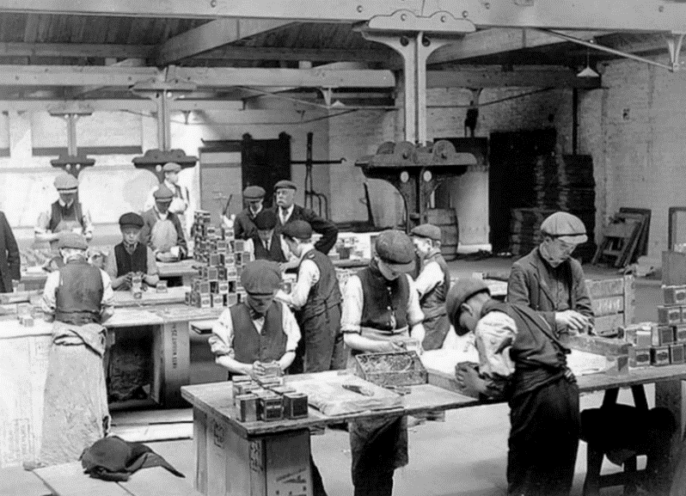
Industrial Revolution (1820-1870)
From 1820, economic growth accelerated throughout Europe (growth became 1 percent).
Proliferation of factories, expansion of labors
  70-80 hours of work per week were norm, child labour widespread
Manchester during Industrial Revolution
Life expectancy in poor area of Manchester was 17 years

Slide 25
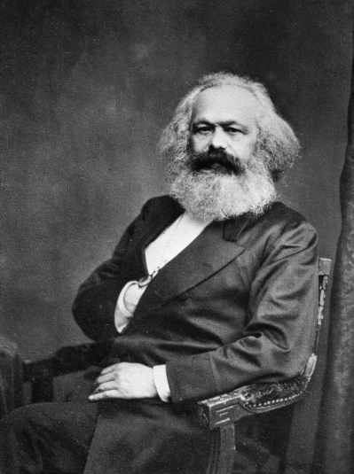
Industrial Revolution (1820-1870)
The misery of industrial revolution also provoked responses.
  Some turned against machines, some turned toward utopian communial vision.
  But the most significant response was from Karl Marx
    Marx’s ideas inspired the subsequent rise of socialism and communism.

Slide 26
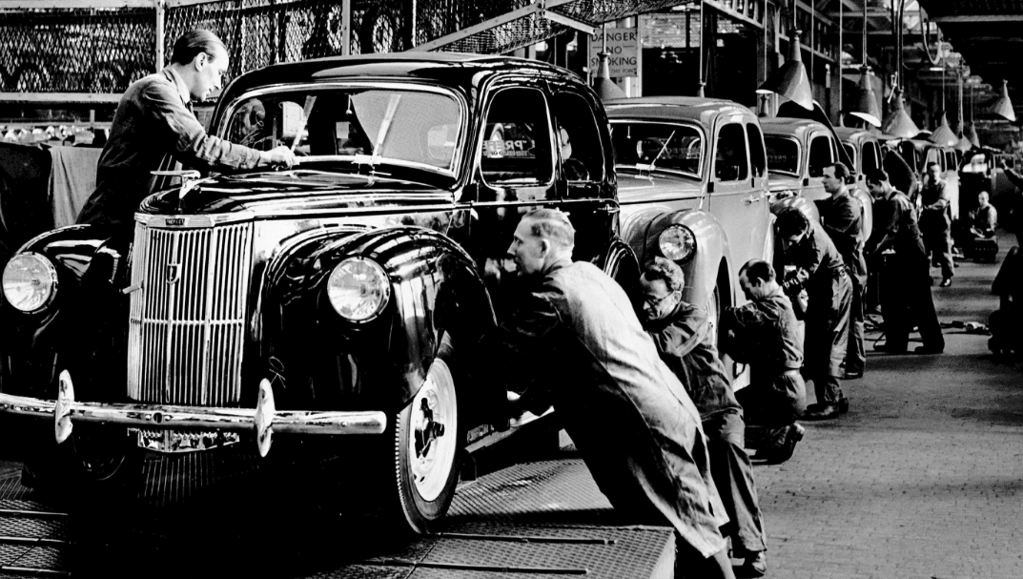
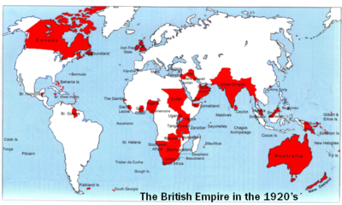
High noon of capitalism (1870-1913)
Further acceleration of capitalism. Supported by improvement in science and engineering, new technologies gave rise to heavy and chemical industries. This period saw the rise of
  Mass Production Imperialism and Free Trade

Slide 27
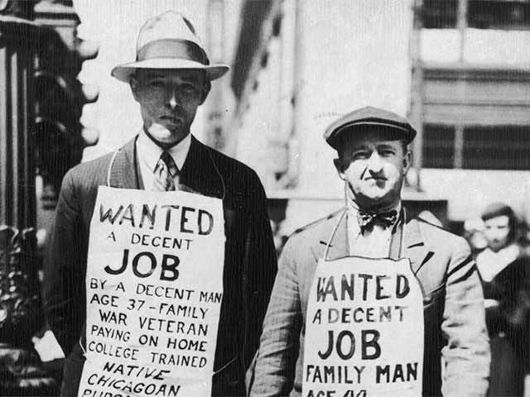
Turmoil (1914-1945)
2 World Wars and the “Great Depression” changed the landscape of capitalism
  This period also saw Russian Revolution (and revolution in Siam)
  During the Great depression (1929-1932), US output fell by 30 percent, unemployment rose from 3 to 24 percent.
  Laissez-faire doctrine was questioned. Reform of capitalism was sought.

Slide 28
Golden Age of Capitalism (1945-1973)
A period of sustained economic growth followed the end of World War Two.
  Keynesian economic policies reduced economic fluctuations
  Advance in technologies (adoption from military technologies).
  International economic institutions and cooperation started (IMF, World Bank)
  Rise in mixed economy and the welfare system
  Growth among developing countries kickstarted
The golden age shows that the potential of capitalism can be maximized when properly regulated and stimulated by the government

Slide 29
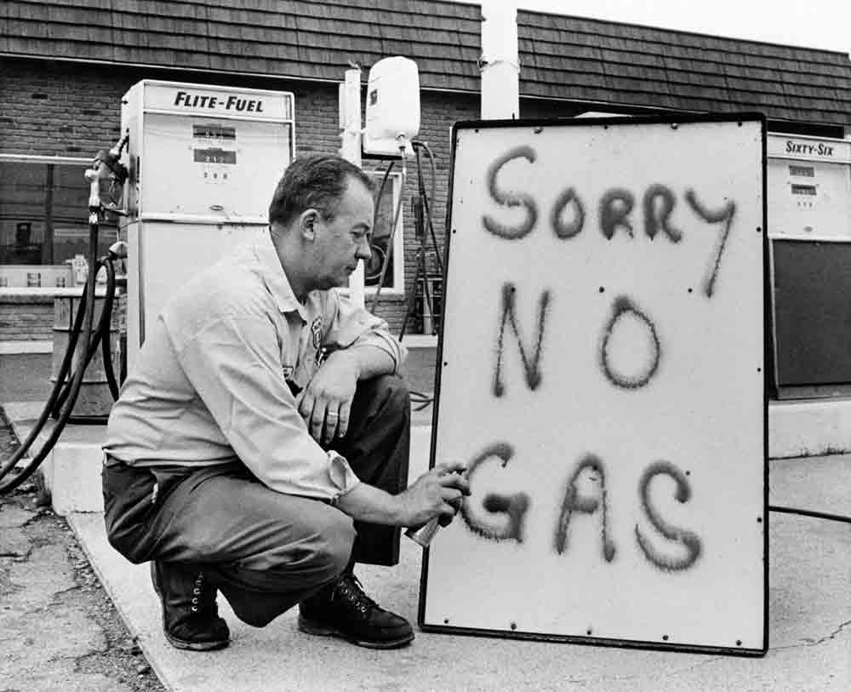
Discontinuity (1973-1979)
Oil shocks (1973 and 1979)disrupted economic growth all around the World
  A period of “stagflation” (stagnation + inflation) for most countries

Slide 30
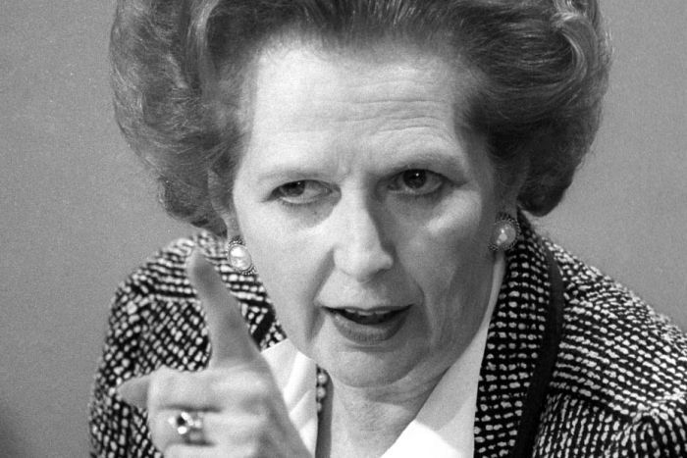
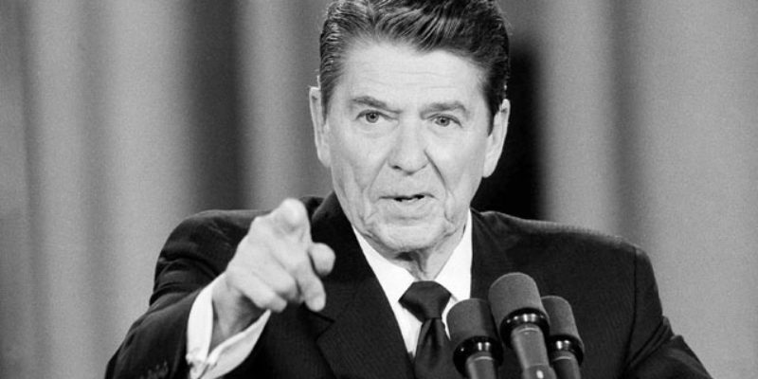
Rise and Fall of Neo-liberalism (1980-Today)
Economic recession from oil shocks allowed “neo-liberal” government to came to power
  Mixed economy abolished. Government roles in the economy retreated. Privatization of state enterprises. Labor unions suppressed.
  Trickle down economy: less taxes on the rich, less welfare to the poor.
Margaret Thatcher
Ronald Reagan

Slide 31

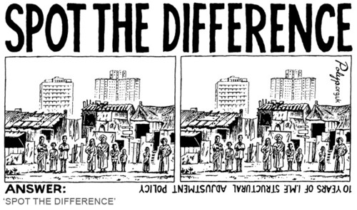
Rise and Fall of Neo-liberalism (1980-Today)
Neo-liberalism spread to developing countries via the roles of international economic institutions such as the IMF and the World Bank

Slide 32
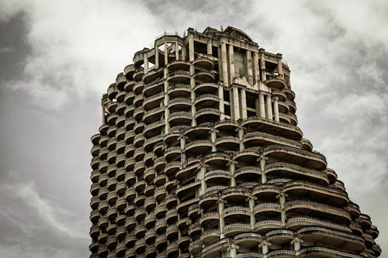
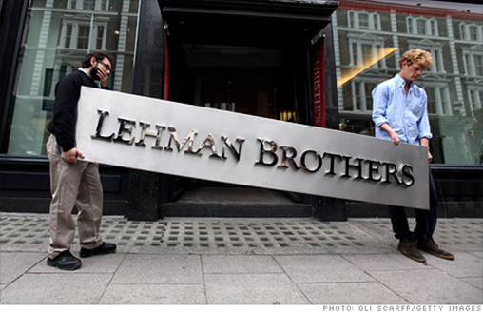
Rise and Fall of Neo-liberalism (1980-Today)
Globalization in 1990s disrupted by the 1997 Asian Financial Crisis.
2008 Global Financial Crisis led to a wave of criticism on neo-liberalism.
  From 2008 onwards, the world face a long period of global recessions.
  Problems in the EU, and now global political instability
Are we in the transition away from neo-liberalism?

