Slide 1
Inequality
Why? And What?
Thorn Pitidol
EE212, 2/2014

Slide 2
Topics
Inequality, Why?
Inequality of What?

Slide 3
Inequality, Why?
The concerns with inequality is intrinsically related to our view of the poor, and the view on the overall nature of the society.
  What are roots of poverty?
  Do you believe in social hierarchy?

Slide 4
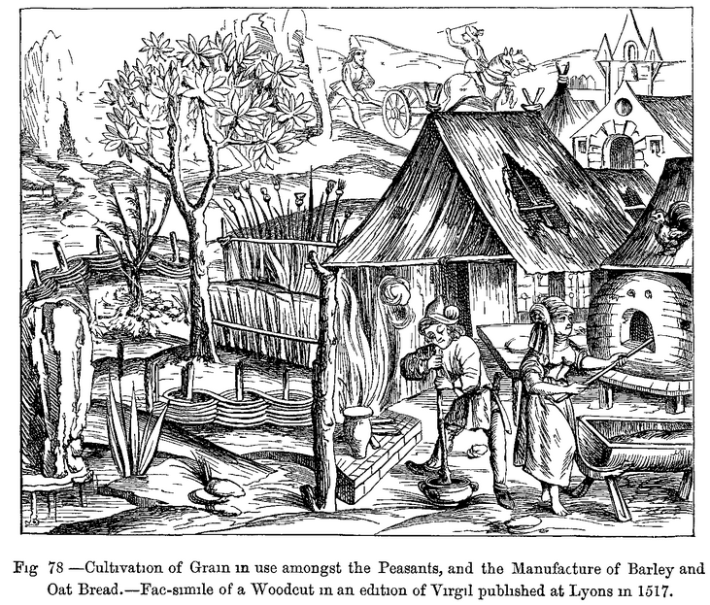
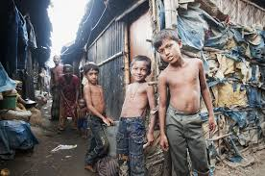
How do we see the poor?
Shifting view of the poor

Slide 5
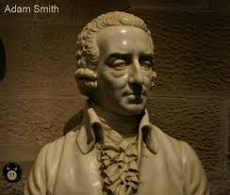
How do we see the poor?
Adam Smith’s view of the poor
“He has all the inconveniences of the soil and the season to struggle with, ... Thus he who as it were supports to the whole frame of society and furnishes the means of the convenience and ease of all the rest is himself possessed of a very small share and is buried in obscurity”.
(A.Smith, Lectures on Jurisprudence)

Slide 6
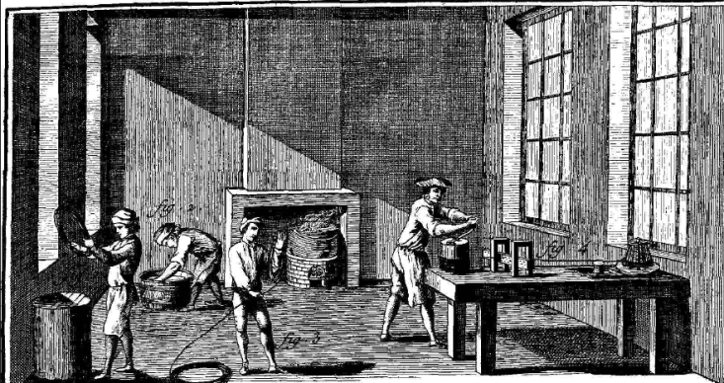
How do we see the poor?
Adam Smith’s view of the poor
Presenting the poor as “people with the same native abilities as everyone else”, Smith said; “the difference in natural talents in different men is, in reality, much less than we are aware of” (Smith, WN)

Slide 7
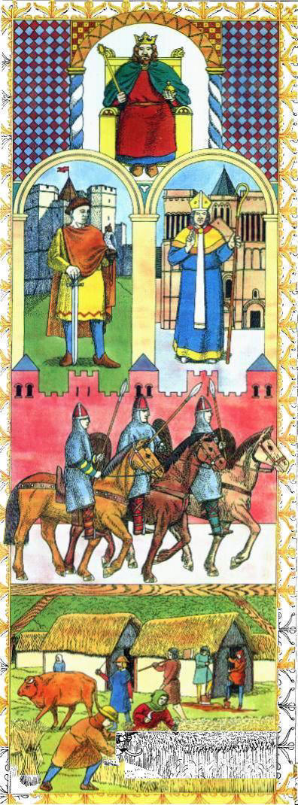


How do we see the society?

Slide 8
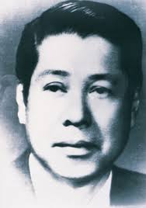
How do we see the society?
From Sri-Burapa’s Novel: Songkram Chivit (A Life of Struggles)
“I am born with a great sin, and that sin is poverty. I don’t know what I did to deserve being cursed with poverty…why do I have to be responsible for my past lives, in the lives that I had no opportunity to decide my actions.”

Slide 9
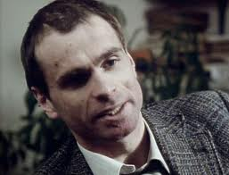
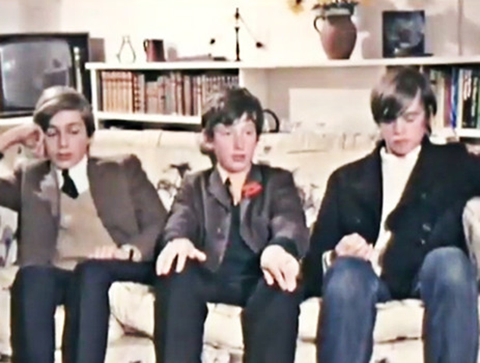
Inequality of What?
Meet John and Andrew
John
Andrew

Slide 10
Inequality of What?
Domains to consider inequality
Equal Person
Utilitarian perspective
Equal Rights
Libertarian
Equal Opportunities
Capabilities
or Outcome from the Same Effort
Equal Outcomes
Income or Wealth

Slide 11
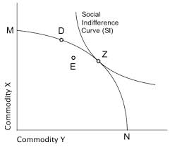
Inequality of What?
Equality in the utilitarian perspective
  Utilitarian perspective of social goods
    “Maximizing utility for all”
  Yet, underlying this view, there is also a premise of “giving an equal weight for each person”

Slide 12
Inequality of What?
Equality in the libertarian perspective
  Libertarian perspective of social goods
    “Equal rights and for all human, and protecting liberty for each of us”
  Nonetheless, there is also an argument for the access to “primary goods” to be counted as “rights”.

Slide 13
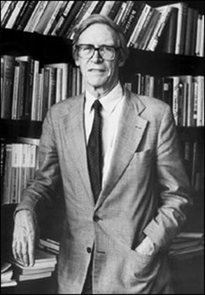
Rawlsian’s Justice as Fairness
Rawls’ view of equality
  Through a “view of ignorance” what will constitutes “a fair agreement for everyone” on equality.
  Liberty, in Rawls’ perspective, assures all citizens sufficient “means” to make effective use of their freedoms.
    This led to his view of “primary goods needed for all”.

Slide 14
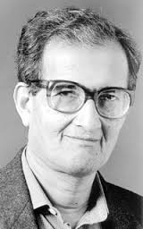
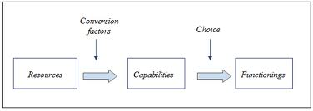
Inequality of What?
Equality in the pro-equal opportunities perspective
Amartya Sen’s Capability Approach
What matters is a person’s “freedom to achieve what he/she value in life”.
Freedom is seen as “capabilties” to achieve “functionings”
  Functionings refers to states and activities constitutive of a person’s well-beings and agency”

Slide 15

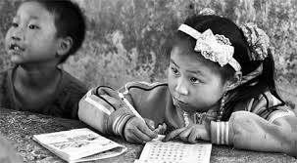
Inequality of What?
Equality in the pro-equal opportunities perspective
John Roemer’s Equal Opportunities as Equality for the Same Efforts
  People who are born into different circumstances but are interested in attaining a similar goal, “provided that they put in the same effort”, should be able to enjoy similar results.

Slide 16
Inequality of What?
Equality in the pro-equal outcomes perspectives
  Equality of income or wealth (which arguably could also be seen as constituting equal opportunities).
  Socialism is often conflated with the strong view on equality of outcomes. In fact, most considerations of equality don’t proceed this far.

