Slide 1
EE401 Political Economy
Chapter 5 Marxian Political Economy and Socialism
Part iii: Criticisms and Rebuttal
Ploy Thammapiranon 2/2017
BE, Thammasat University

Slide 2
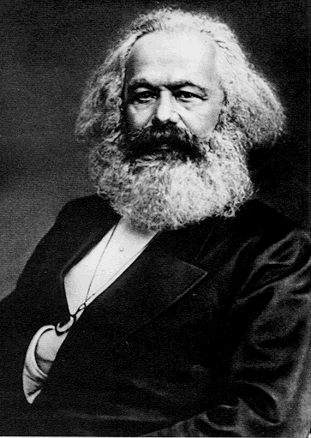
Marxian political economy and socialism
Introduction to Socialism
Branches of Socialism
Marxian Political Economy
Criticisms of Marx
Soviet and Mao’s Socialism
Rebuttal from Marxists

Slide 3
Key Concepts of Marxist Socialism
Production as the center of economics.
Capitalism is seen as a preparation of human development before reaching the communism.
In capitalism, capital allows those who own it to exploit the those who do not → private property matters
Historical nature is crucial to understand and investigate economic problems.
Class struggle is the force of historical change. Workers are powerful agents of social change.

Slide 4
4. Criticisms of Marx
Production requires capital and past savings by capitalists.
  Interest and profits as returns for capitalists
The reserve army of the unemployed.
  Unemployment has different causes and characteristics.
The impoverishment of the working class has not materialized.
  Shortages of labor under capitalism.
  Real wages and workers’ living condition have been rising rapidly since mid c.19.
  Technical progress and machines release workers from dirty, dangerous works.
4
4

Slide 5
4. Criticisms of Marx
The blurred division between workers and capitalists.
The tendency of the falling average profit rate.
Failure to compromise labor value with price (‘Capital III’).
  The actual exchange (price) ratios are not the same as the labor ratios of commodities.
  Rejection of contribution by non-labor inputs in creating value and non-wage incomes.
5
5

Slide 6
4. Criticisms of Marx
Marx’s solution is incomplete --- ‘the transformation problem’.
Marx’s theory on how to organize the alternative system to capitalism was inadequate.
Socialism emerged in countries where capitalism was hardly developed.
Capitalism does not collapse.
6
6

Slide 7
5. Soviet and Mao’s socialism
5.1 Marxist-Leninist Socialism (1922-1991)
Economic and social background:
  Developing country based on agriculture.
  Constant wars.
  Results: severe economic problem and lack of human resources.
    Before the revolution, the Soviat Union did not possess characteristics necessary for socialist revolution
    as suggested by Marx

Slide 8
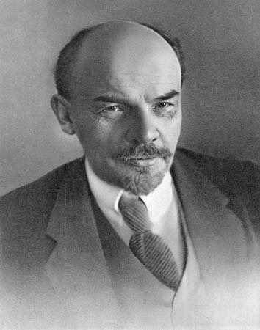
5. Soviet and Mao’s socialism
5.1 Marxist-Leninist Socialism (1922-1991)
Vladimir Lenin (1870-1924):
On Revolution
  Farmers will be an influential force in bringing political change.
On Socialism in the Soviet Union
  Only the proletariat party could resist the emergence of capitalism.

Slide 9
5. Soviet and Mao’s socialism
5.1 Marxist-Leninist Socialism (1922-1991)
Central planning
Develop and improve economic structure to achieve technological development and industrial revolution.
Nationalization of private property and abolition of market
Two crucial problems:
  Opposition from peasantry: They were strictly controlled and forced to hand their outputs to the government.
  The central planning system could not solve economic depression.

Slide 10
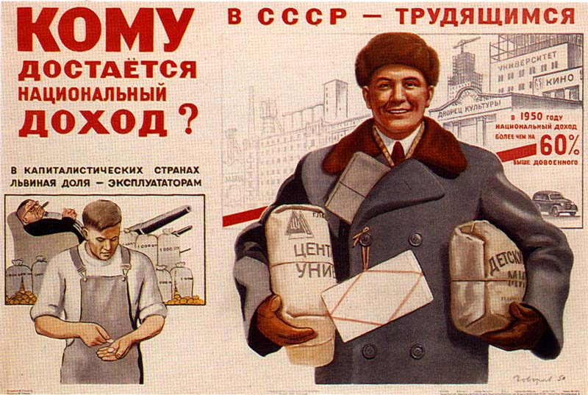

Slide 11
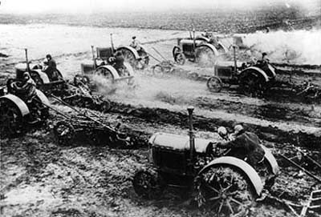
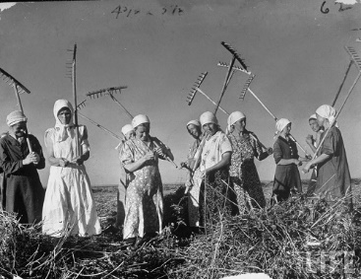

Slide 12
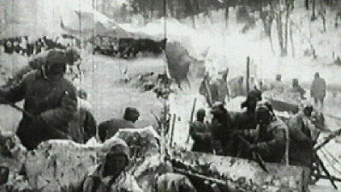
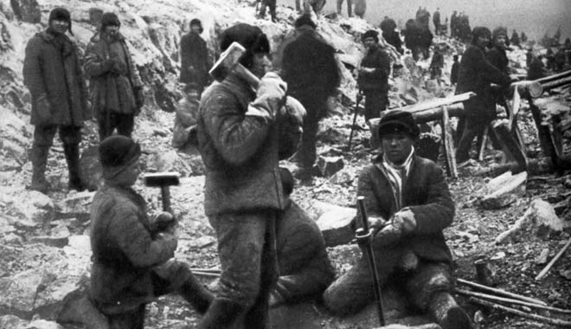

Slide 13
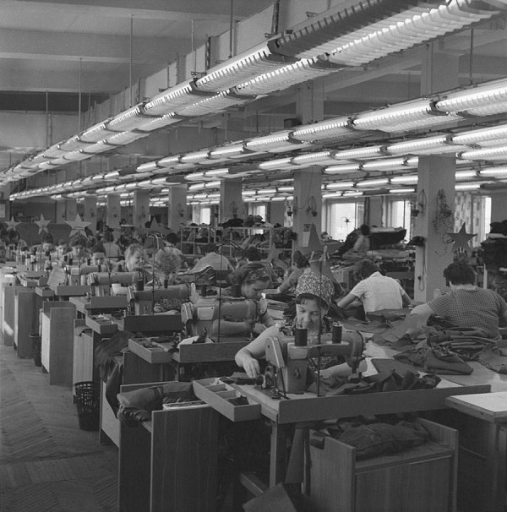

Slide 14
5. Soviet and Mao’s socialism
5.1 Marxist-Leninist Socialism (1922-1991)
Dissolution of Soviet Union
  Inefficiency and agricultural exploitation due to forced industrial development.
  During the end of 1970s and the early 1980s, structural problems of Socialism were obvious .
    Economic indices continuously declined while social indices did not improve.
    People expected that the government would distribute wealth and lift up their living conditions → more pressure on the government.
  The problems + energy crisis + political and economic reforms → the dissolution of Soviet Union.

Slide 15
5. Soviet and Mao’s socialism
5.2 Maoist Paradigm (1949-present)
Economic and social background:
  WWII and civil war.
  Major problems.
    Economic decline.
    Inequality, especially in agricultural sector.
    Foreign intervention.

Slide 16
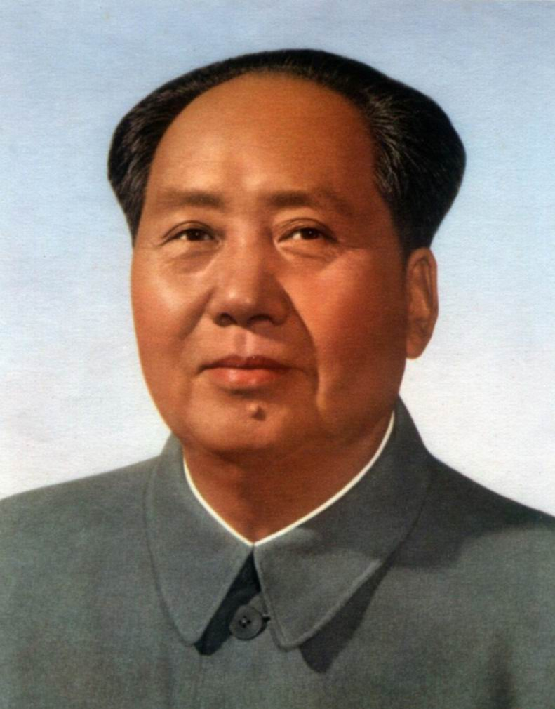
5. Soviet and Mao’s socialism
5.2 Maoist Paradigm (1949-present)
The Great Leap Forward:
  Objectives: (1) Material Abundance (2) Destroy income inequality
  Industrialization by focusing on heavy industry
    Shifting resources and surplus from other sectors to heavy industry
  Gradual collectivization
    Reallocation of land (1949-1950)
    Mutual aid teams of 5-15 households (1953)
    Collective farming associations (1954)
    Private ownership was abolished (1958)
The great famine with at least 45 million deaths

Slide 17
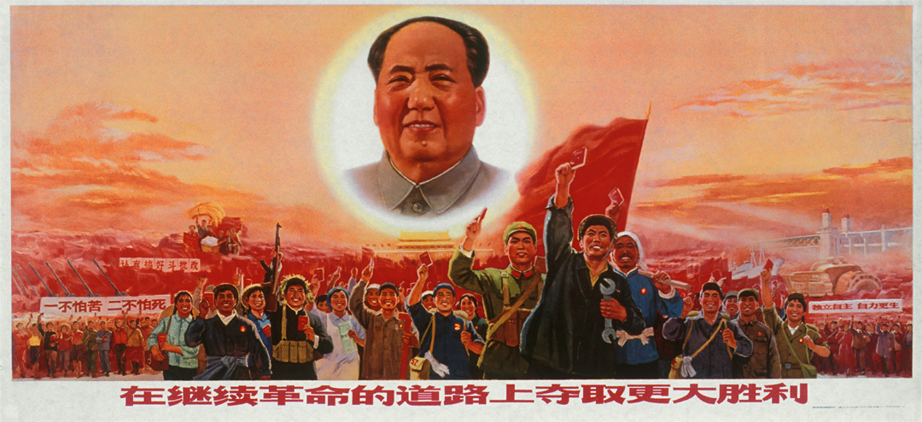

Slide 18
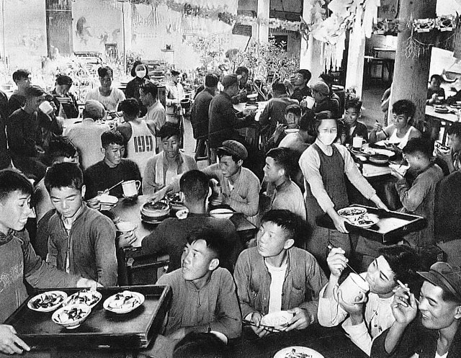

Slide 19
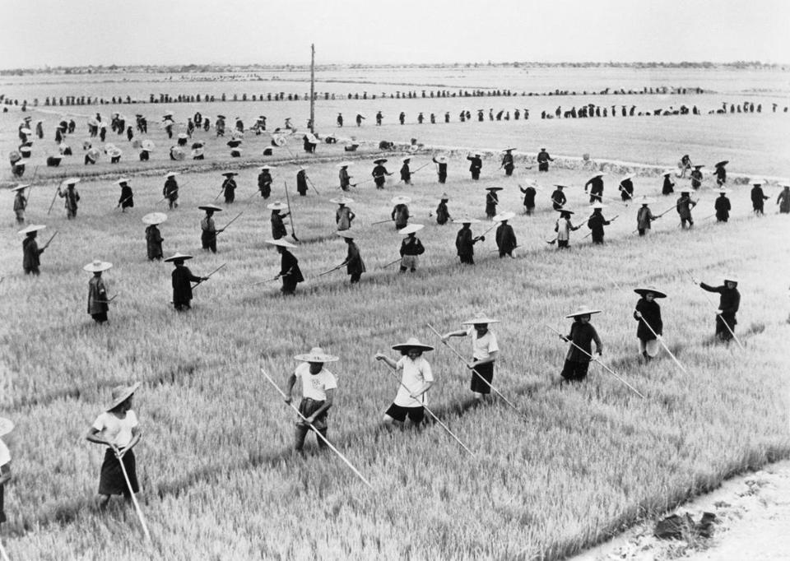

Slide 20
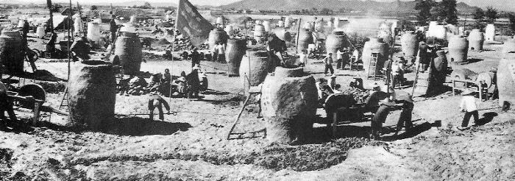
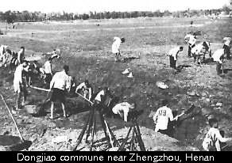
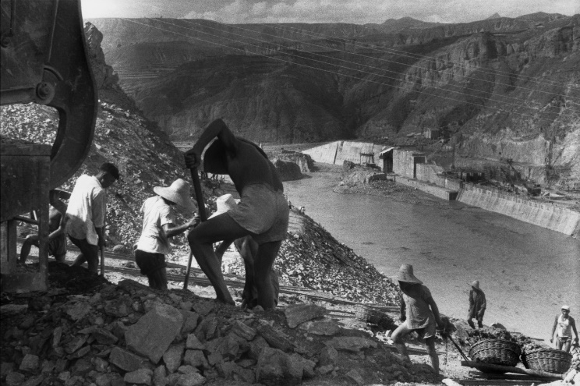

Slide 21
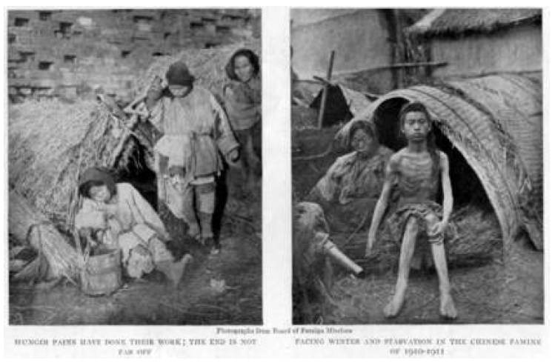

Slide 22
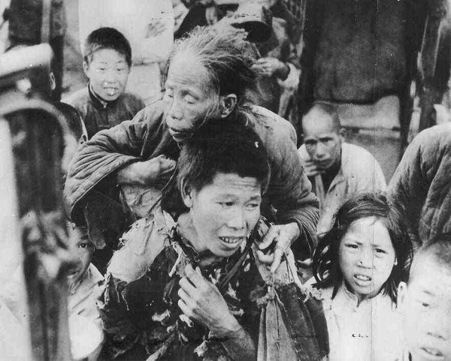

Slide 23
5. Soviet and Mao’s socialism
5.3 Key Characteristics
Private enterprises are banned. All industries belong to the State.
Agriculture consists of state farms (Soviet) and rural communes (China).
Collective life in factories and farms.
Production and trade decisions are made by the State Planning Agency.
  No price system in productive inputs.
  Domestic mobility is strictly controlled with internal passports.
Dictatorship of the Communist Party.

Slide 24
5. Soviet and Mao’s socialism
5.4 Problems of Socialism
Lack of incentives to economize on resource uses for the highest benefits.
No markets and price signals – No information for efficient resource allocation.
  Production side: Inability of planners and false information reported by workers.
  Consumption side: Only overall amounts of outputs were targeted.
Wasteful resource uses.

Slide 25
5. Soviet and Mao’s socialism
5.4 Problems of Socialism
Equivalent to 100% income tax rates.
Necessity of tight political control.
The economics of shortages: Consumer industries are neglected.
7) Belief in ‘social engineering’ leads to political totalitarianism.
  ‘To change persons’ by controlling upbringing, education, and social environment.
  The State or ‘Party’ knows best above individuals.
  Extreme forms involved mass murders to create ‘an ideal society’ (Stalin, Mao, Pol Pot).

Slide 27
5. Soviet and Mao’s socialism
5.5 Socialism as extractive institutions
Soviet and Mao’s socialism is a form of extractive economic institutions.
Extraction of the surplus to the State.
  Providing privileges for the Party elites.
  It can generate ‘growth bursts’ in the early years, then stagnation and decay.

Slide 28
6. Rebuttal from Marxists
Existing socialism is not what Marx envisaged.
Socialist revolution has been hijacked.
But what is then the socialist system?
How to allocate resources efficiently without a price system?

Slide 29
6. Rebuttal from Marxists
Marx’s warnings
Alienation and psychological misery.
  Individualism undermines emotional and social security.
  Sense of loss and isolation.
  Consumerism, greed, and fraud.
Unemployment is a critical problem for capitalism.
Modern Marxists focus on income distribution, racial issues, worker welfare.

