Slide 1







DEBIT AND CREDIT CARDS
1

Slide 2

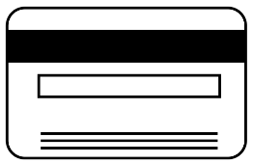
GLOBAL MARKET OVERVIEW
Huge global market size with 27+ billion cards in circulation
1
27,473,524,100
Cards in circulation worldwide
Brand
Shares
4
Cards per
person
Source: Euromonitor
History and Development
Value Proposition
Features
Business Model
Examples
Other Issues
Notes:
Payment industry is huge in the world. Total number of financial cards far exceed the number of people living on earth.

Slide 3

 | 2002 | 2005 | 2010 | 2015 | 2020
debit | 15,772.60 | 25,000.00 | 113,495.30 | 266,451.70 | 428,350.50
credit | 436,006.20 | 586,623.60 | 958,122.30 | 1,540,550.80 | 2,177,218.20
THAILAND MARKET OVERVIEW
Over 10% annual growth rate expected to continue for at least 5 years
1
2,606B
1,807B
CAGR: 10.14%
1,072B
612B
Total value transacted through credit/debit cards in Thailand, 2005 – 2020 (figures in Baht)
Source: Euromonitor, Bank of Thailand
History and Development
Value Proposition
Features
Business Model
Examples
Other Issues
Notes:
Even in Thailand, we see rapid growth rate in value transacted through credit and debit card networks, with CAGR of more than 10%

Slide 4





 | 2002 | 2005 | 2010 | 2015 | 2020
debit | 15,772.60 | 25,000.00 | 113,495.30 | 266,451.70 | 428,350.50
credit | 436,006.20 | 586,623.60 | 958,122.30 | 1,540,550.80 | 2,177,218.20
THAILAND MARKET OVERVIEW
Low correlation between share of financial cards and transaction processed
1
Transaction processed by credit card issues, 2016 (figures in billion Baht)
15.7%
14.7%
14.2%
13.5%
8.1%
Share of financial cards in circulation by issuer, 2016
Source: Euromonitor
History and Development
Value Proposition
Features
Business Model
Examples
Other Issues
Notes:
Broken down by issuer, we see that Kbank is the largest player. But key thing to note here, market share in cards does not correlate with value transacted

Slide 5
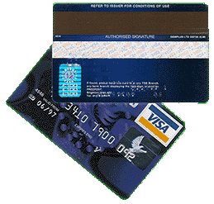
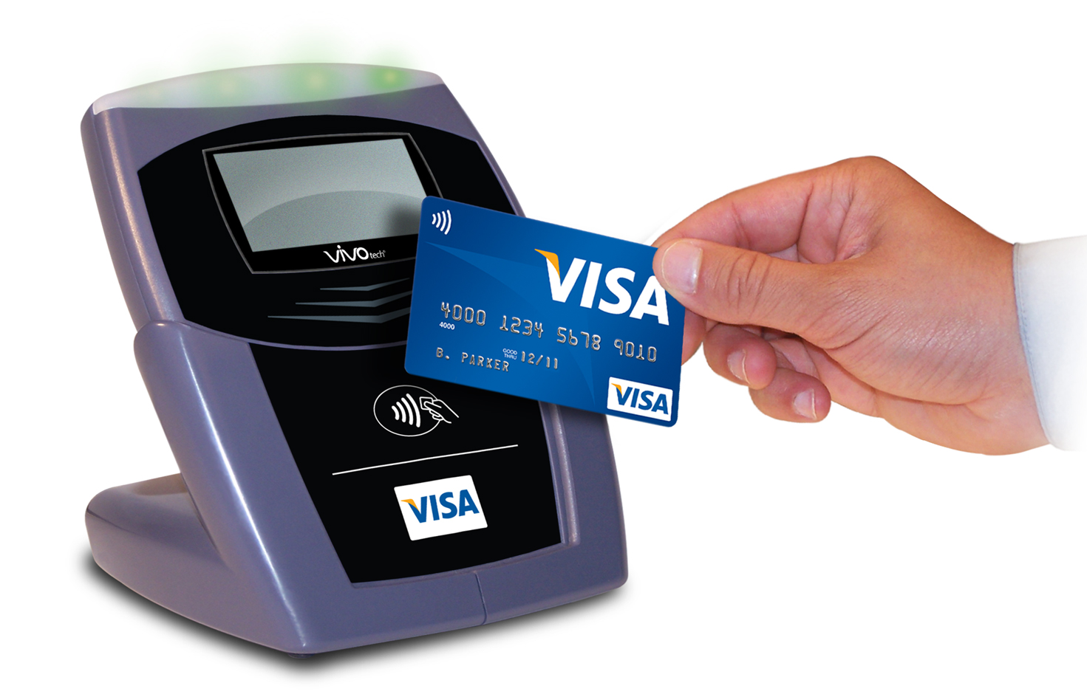
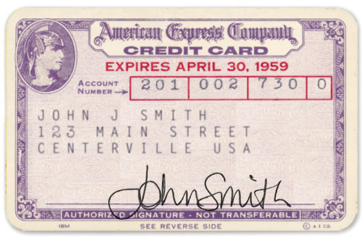
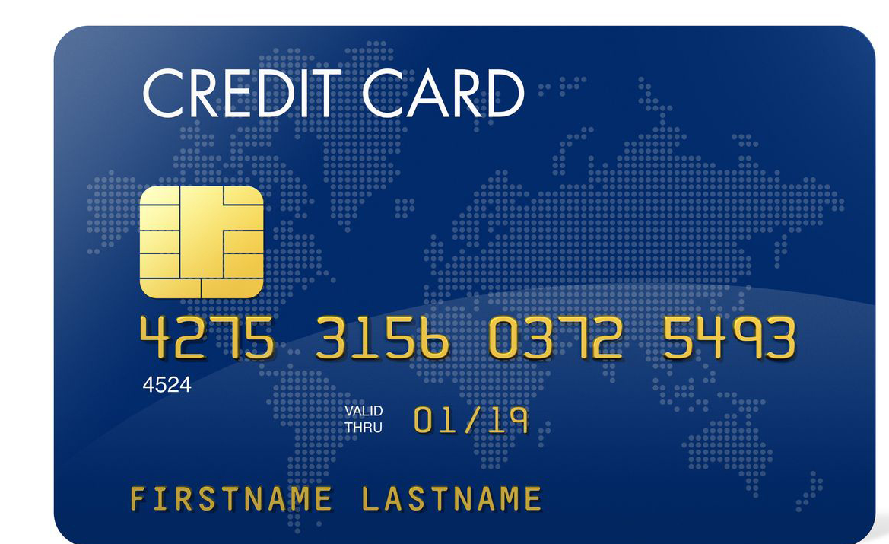
FORMS OF FINANCIAL CARDS
Development of cards prioritized security and convenience
1
Paper
card
Chipset
card
1946 - 1958
1958 - 1983
1983 - 1992
1992 onwards
Magnetic strip
Digital payment
Source: timetoast.com, Wikipedia
History and Development
Value Proposition
Features
Business Model
Examples
Other Issues
Notes:
So the payment service is undoubtedly significant to banks, but credit cards as we know it today has not always been a like a plastic card.
Digital payment: moving into nfc, and more recently biometrics, where visa uses fingerprint, retina. Also, the pervasive penetration of smartphones have allowed several companies, notably Alibaba and apple, to create payment systems using mobile phones.

Slide 6









VALUE PROPOSITION TO CUSTOMERS
Benefits hinge upon liquidity, added services, and exclusive incentives
1
Time
Convenience
Liquidity
Services
Insurance
Loans
Discounts
Reward points
Incentive benefits
History and Development
Value Proposition
Features
Business Model
Examples
Other Issues
Notes:
Time = faster payment
Convenience = easy to purchase goods and services
Liquidity = no need to have cash when enter into purchase
Services = e.g. bill payment
Insurance = credit cards usually come with insurance
Loans = credit history = easier to obtain personal loan; also: O/D when emergencies occur and you have no cash
Discount = well, discount when paying though the card
Reward points =
Incentive benefits = e.g. roadside service, hotel booking, airport lounge, etc.

Slide 7
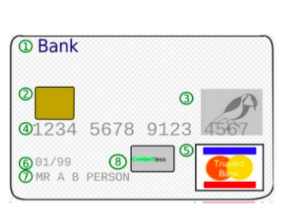
CARD COMPONENTS
1
Issuing bank logo
Hologram
EMV chip on smart cards
Credit card number
Expiration date
Card holder name
Contactless chip
Card brand logo
History and Development
Value Proposition
Features
Business Model
Examples
Other Issues

Slide 8


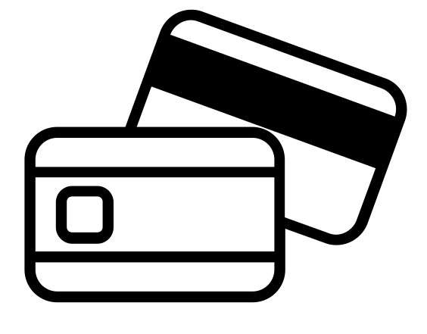

BUSINESS MODEL
Five stakeholders are involved in a processing of credit transaction
1
2
3
7
Merchant
Acquiring Bank
6
1
5
4
Customer
Issuing Bank
Source: http://revenuesandprofits.com/how-visa-makes-money-understanding-visa-business-model/
History and Development
Value Proposition
Features
Business Model
Examples
Other Issues

Slide 9
BUSINESS MODEL
Banks make money through merchant discounts and interchange fees
Merchant Discount
1
Interchange
$1.8
Other fees
$0.6
$97.4
Paid to merchant
Issuing Bank
Acquiring Bank
What happens to $100?
3
$$$
$$$
4
2
Forward to bank
Invoice
1
Source: http://revenuesandprofits.com/how-visa-makes-money-understanding-visa-business-model/
History and Development
Value Proposition
Features
Business Model
Examples
Other Issues

Slide 10



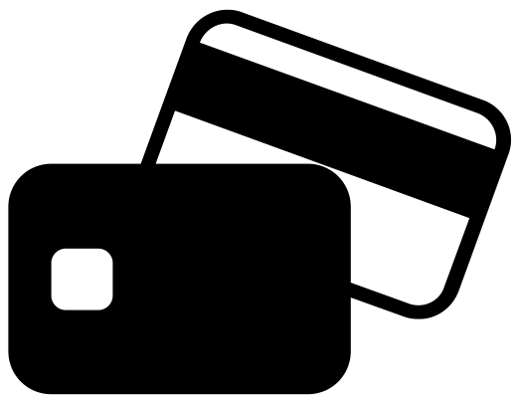



OTHER REVENUES
Banks also make money from added capabilities of card offerings
1
Cash Advance Fees
1-3% of the amount of withdrawal. With or without minimum withdrawal
Interest Fees
20% per annum
Entry and Annual Fees
0-15,000 Baht one-time fee
200-600 Baht annual fee
Balance transfer Fees
3% of total balance transferred
Late-Payment Fees
$25 for the first offense and $35 for subsequent late payments
Foreign transaction Fees
1%-2.5% of purchase price
Interbank Funds Transfer (Debit Only)
Transfers of up to 20,000.00 Baht - 25 Baht per transaction
Transfers of 20,000.01 – 50,000.00 Baht - 35 Baht per transaction
Source: Bank of Thailand
History and Development
Value Proposition
Features
Business Model
Examples
Other Issues

Slide 11
CREDIT VS DEBIT
1
CREDIT CARD VS DEBIT CARD
A tool to utilize an unsecured credit limit offered by a bank.
FUNCTION
A tool to access the funds in your personal bank account.
Apply to lender. Issued on basis of income, credit score, age
HOW TO QUALIFY
Open an account.
Useful if you don’t have cash and if you don’t have money in your bank account.
Useful if you don’t have cash, but not if you don’t have money in your bank account.
USE IN EMERGENCIES
Annualized interest rate: 30-40%
Annual fee
Penalty
Cash transaction fee.
COSTS
Annual fee
A short-term no-question-asked loan that is easy to acquire.
BEST FEATURE
Easy, convenient, and safe access to your own funds.
Source: Euromonitor, creditcrads.com
History and Development
Value Proposition
Features
Business Model
Examples
Other Issues
COSTS

Slide 12
CREDIT VS DEBIT
1
CREDIT CARD VS DEBIT CARD
Manage your finances better through smart use of the revolving credit facility.
UTILITY
Carry your entire bank balance in your hand with minimal risk of fraud or loss.
Timely payment boosts credit score; late payment lowers the score
CREDIT SCORE IMPACT
No impact
Must pay at least 5% of outstanding balance or higher, depending on issuer
REPAYMENT OPTIONS
No repayment required.
Assist in wealth cash flow management by utilizing the interest-free grace period
WEALTH CREATION
A tool of convenience with no scope for wealth creation.
Enjoy periodic revision of credit limit based on increase in annual income.
LIMIT ENHANCEMENT
No enhancement possible. Spend what you own and nothing more.
Source: Euromonitor, creditcrads.com
History and Development
Value Proposition
Features
Business Model
Examples
Other Issues
COSTS

Slide 13
CREDIT VS DEBIT
1
CREDIT CARD VS DEBIT CARD
Elaborate reward structure.
REWARD & POINTS
Earn points for each rupee spent. Redeem point for freebies.
A high risk card as you may end up using the costliest form of personal debt for frivolous and unnecessary expenses.
RISK
Open an account.
Safer, because in case of an issue, you can file a compliant to get it charged back.
Useful if you don’t have cash, but not if you don’t have money in your bank account.
SAFETY FOR
ONLINE TRANSACTION
Statement are generated, as per monthly usage
BILL & STATEMENT
Frequency depends on the saving account.
A short-term no-question-asked loan that is easy to acquire.
INTEREST
Easy, convenient, and safe access to your own funds.
Source: Euromonitor, creditcrads.com
History and Development
Value Proposition
Features
Business Model
Examples
Other Issues
COSTS

Slide 14

EXAMPLES OF REDIT CARDS
Bangkok Bank Platinum - Benefits
1
Exclusive Lifestyle Privileges
24-Hour Assistance
Airport lounges
Limousine services
Private golf carts @ BKK
Lounge Access:
Dusit Thani
Hilton
Central Embassy
Emquartier
Buy 1 Get 1 Free:
Dusit International Group
Bangkok Airways ticket
Roadside Assistance
Home Assistance
Concierge Services
Insurance Services
Overseas health & medical
Transport
Purchase protection
Up to 90 days after purchase
Max. of 400k per year
Source: Bangkok Bank
History and Development
Value Proposition
Features
Business Model
Examples
Other Issues

Slide 15
EXAMPLES OF REDIT CARDS
Bangkok Bank Platinum – Eligibility and fees
1
Eligibility
Fees
At least 20 years
Average monthly income of
at least 15,000 Bt. including
other regular earnings
At least 10 Mil Bt. Saving Account
After evaluating, bank office
will suggest the best credit card
for each customer.
Annual fee
Principle = 30,000 Bt.
Supplementary = 30,000 Bt.
Interest rate: 20% per year
Minimum Payment: 10% of the total amount of monthly statement
Repayment term w/o interest: Max. of 45 days from the transaction date
Source: Bangkok Bank
History and Development
Value Proposition
Features
Business Model
Examples
Other Issues

Slide 16
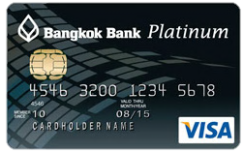
EXAMPLES OF REDIT CARDS
Bangkok Bank Platinum - Benefits
1
Exclusive Lifestyle Privileges
24-Hour Assistance
Thank you rewards
- Earn a point when spent
every 25 Bt.
Fly high with Royal Orchid Plus
Redeem two reward points
after accumulating a
minimum of 2,000 points
FlyerBonus points
Cash advance
Roadside Assistance
Home Assistance
Medical Assistance
Concierge Services
Insurance Services
Overseas health & medical
- Up to 6 Mil. Bt. including family
Source: Bangkok Bank
History and Development
Value Proposition
Features
Business Model
Examples
Other Issues

Slide 17
EXAMPLES OF REDIT CARDS
Bangkok Bank Platinum – Eligibility and fees
1
Eligibility
Fees
Entrance Fee = 1,000 Bt.
Annual fee
Principle = 3,000 Bt.
Supplementary = 3,000 Bt.
At least 20 years
Average monthly income of at least 15,000 Bt. including
other regular earnings
After evaluating, bank office will suggest the best credit card for each customer.
Interest rate: 20% per year
Minimum Payment: 10% of the total amount of monthly statement
Repayment term w/o interest: Max. of 45 days from the transaction date
Source: Bangkok Bank
History and Development
Value Proposition
Features
Business Model
Examples
Other Issues

Slide 18

DEBIT AND CREDIT CARDS
1

Slide 19
DEBIT AND CREDIT CARDS
1
5704640019
5704640092
5704640290
5704640340
5704640555
5704641785
5704642759

