Slide 1
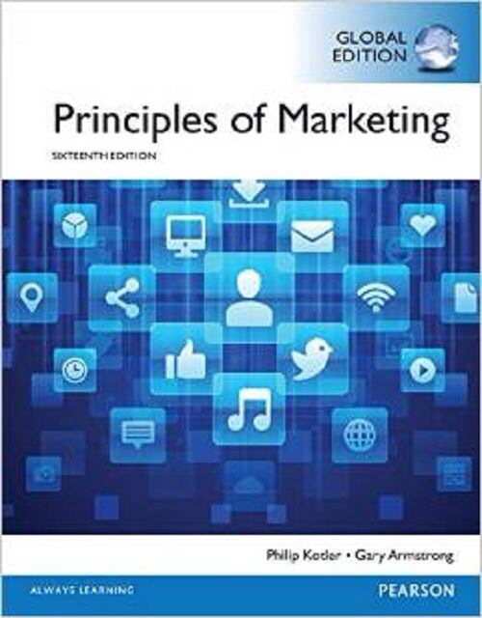
IMC Strategy I
CHAPTER 14-17 :Integrated Marketing Communications (IMC)
MK 202 Fundamentals of Marketing
By Aj.Suwalya K.

Slide 2
We will be covering 3 parts for IMC
Part I: Communicating Customer Value: Integrated Marketing Communications Strategy
Part II: Media Mix
Part III: Get Better Advertising

Slide 3
Part I: Communicating Customer Value: Integrated Marketing Communications Strategy

Slide 4
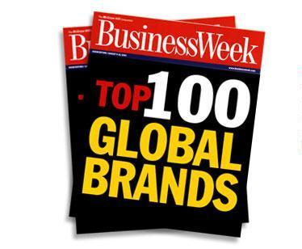
What are the strongest brands?

Slide 5
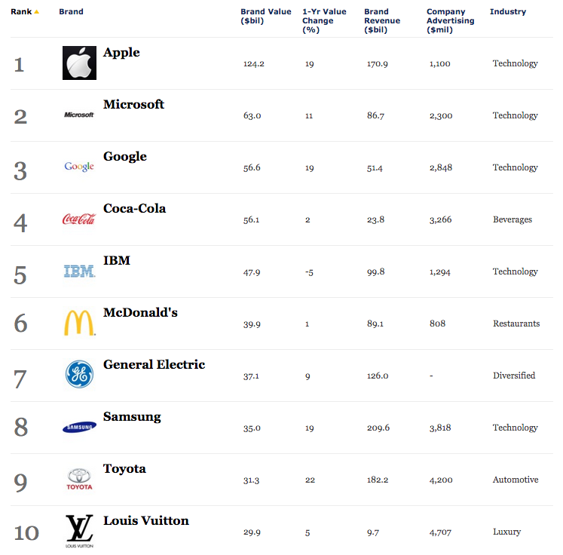
Forbes Top 10 Most Valuable Brands

Slide 6
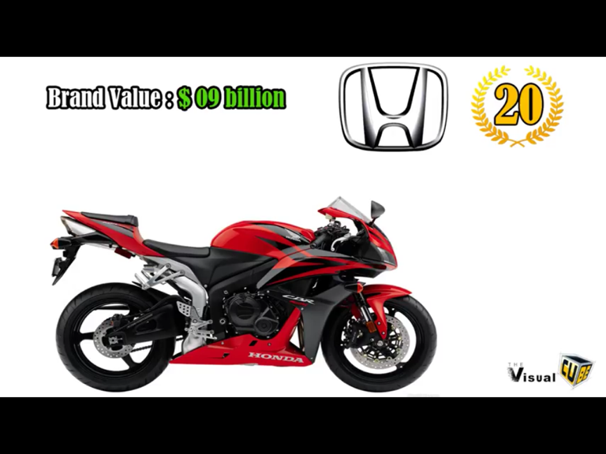


Slide 7
The Marketing Mix for Successful Brands
4P's
Product – Clear Positioning?
Price $$$$$
Place/Distribution
Promotions- Effective communications?

Slide 8

Top of Mind
Fast Food
Shampoo
Deodorant
Soft Drink
Cars

Slide 9
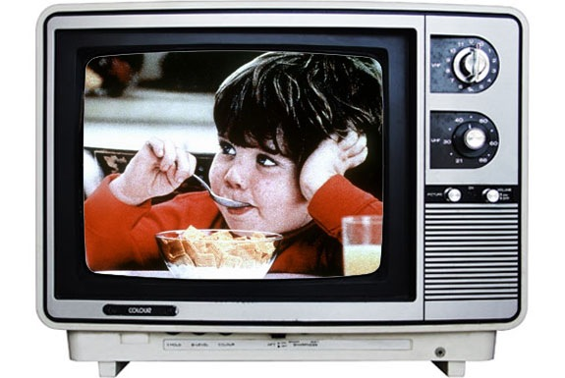
Words…What words come to your mind?
Feelings…How do you feel when watching the ad?

Slide 10
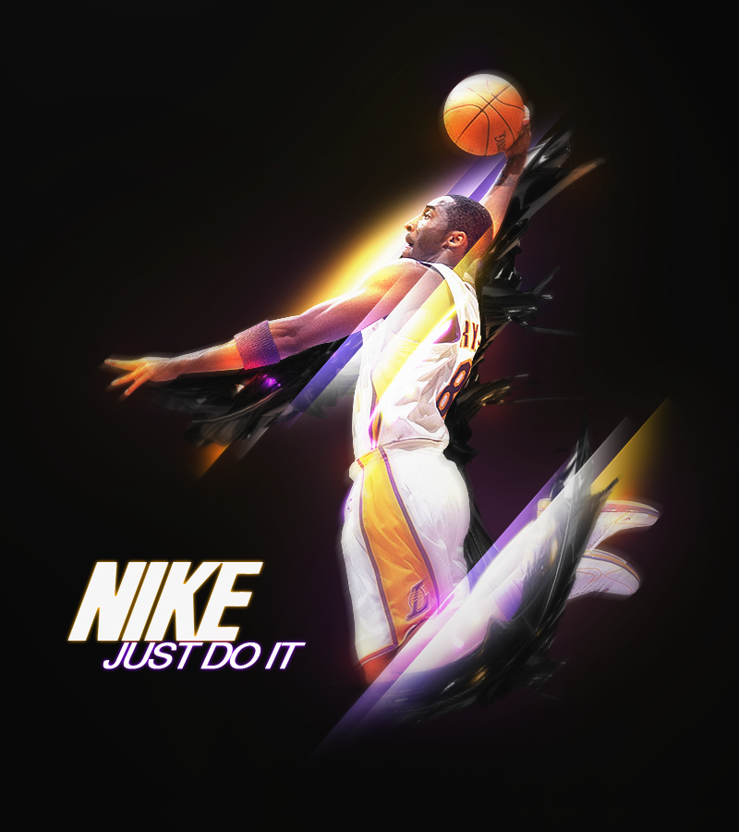
Brand Associations

Slide 11

Brand Associations

Slide 12
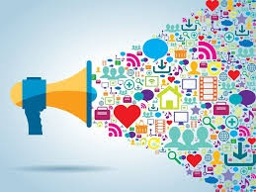
Promotion Mix
Marketing Communications Mix

Slide 13
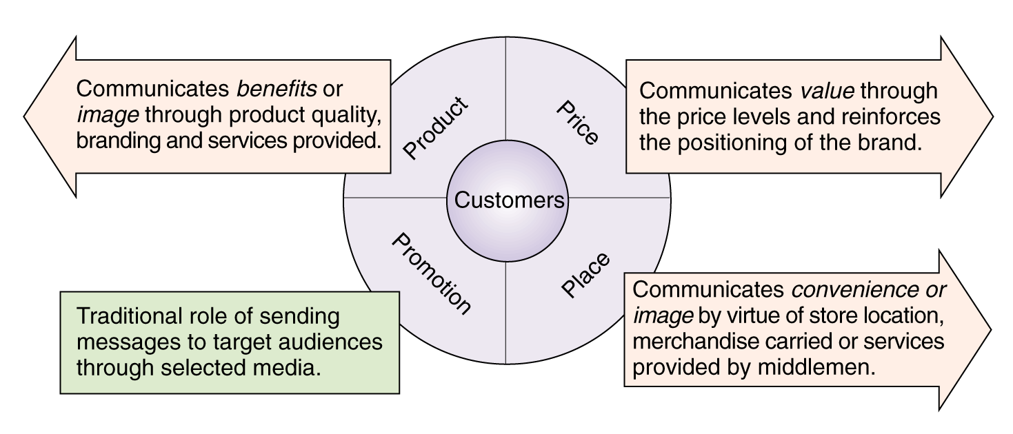
The “Communications Potential” of the Marketing Mix

Slide 14
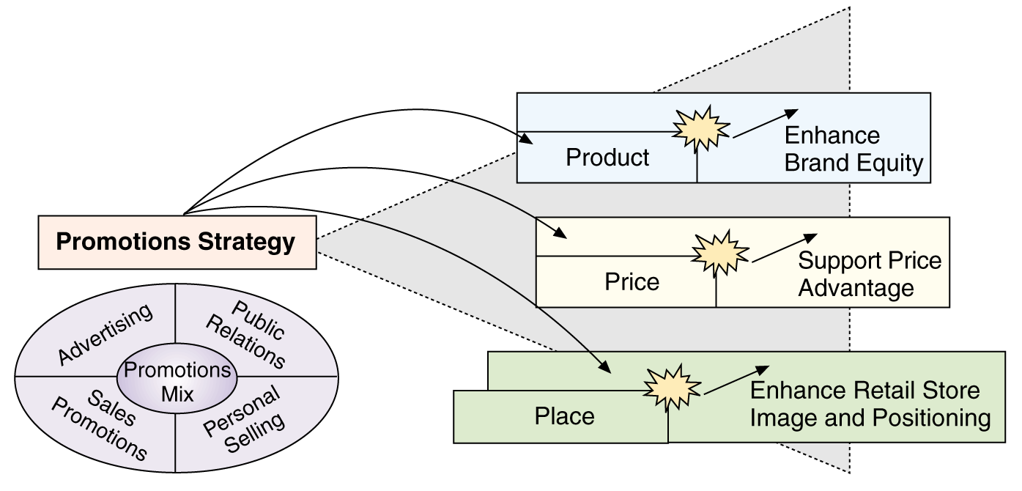
How Promotions Leverages Other Marketing Mix Variables

Slide 15
Promotional Mix
The specific blend of promotional tools that the company uses to persuasively communicate customer value and build customer relationships.

Slide 16
Promotional Mix
Advertising
  Any paid form of non personal presentation and promotion of ideas, goods, or services by an identified sponsor.
Sales Promotion
  Short-term incentives to encourage the purchase or sale of a product or service
Personal Selling
  Personal presentation by the firm’s sales force for the purpose of making sales and building customer relationships.

Slide 17
Promotional Mix
Public Relations (PR)
  Building good relations with the company’s various publics by obtaining favorable publicity, building up a good corporate image, and handling or heading off unfavorable rumors, stories, and events.
Direct And Digital Marketing
  Engaging directly with carefully targeted individual consumers and customer communities to both obtain an immediate response and build lasting customer relationships.

Slide 18
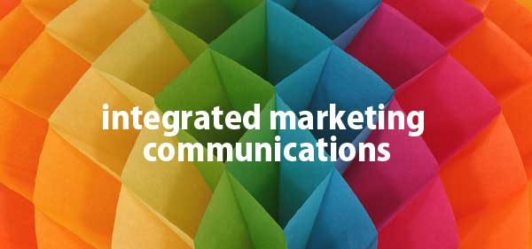
IMC

Slide 19
The Changing Communications Environment
Two factors are changing the face of today’s marketing communications:
As mass markets have fragmented, marketers
are shifting away from mass marketing
Vast improvements in information technology
are speeding the movement toward segmented
marketing

Slide 20
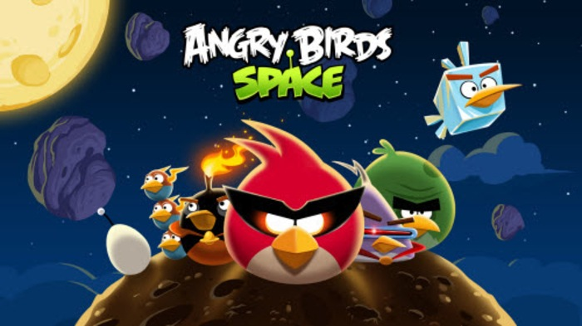
The new marketing communications model: Rovio Entertainment introduced the Angry Birds Space version of its popular game using only an online video campaign. The campaign reaped an astonishing 134 million views and 168,570 social shares.

Slide 21
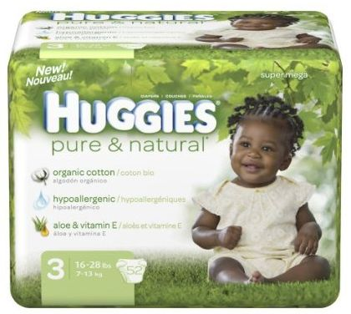

Kimberly-Clark:New IMC Approaches
Targets new and expectant mothers through mommy blogs, Web sites,
print and online ads, e-mail, in-store promotions and in-hospital TV programming.

Slide 22
Conflicting messages from different sources or promotional approaches can confuse company or brand images
The problem is particularly prevalent when functional specialists handle individual forms of marketing communications independently
The Need for IMC

Slide 23
The Need for IMC
Using IMC, the company carefully
integrates and coordinates its many
communication channels to deliver
a clear, consistent, and compelling
message about the organization
and its products

Slide 24


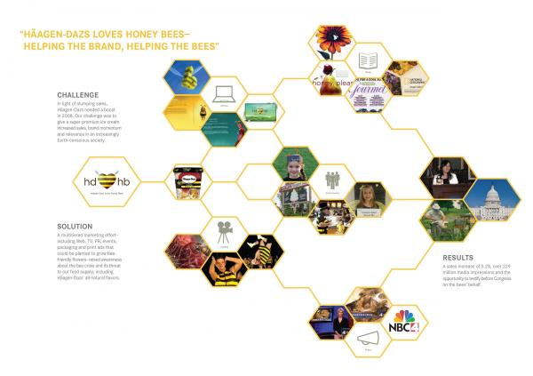
Haagen-Dazs: A Beautifully Integrated Marketing Communications Campaign
“Haagen-Dazs loves honey bees” integrated marketing campaign uses rich, well-coordinated blend of communications elements to successfully deliver Haagen –Dazs’ unique message and positioning.
“It’s the brand with heart and soul”, “We’re not only raising brand awareness, but making a difference in the world.”

Slide 25
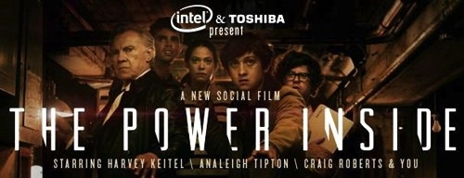
Real Marketing 14.1
Just Don't Call It Advertising:It's Content Marketing
Content marketing: Intel's and Toshiba's award-winning "Inside" social media film series blurs the line between advertising, social media, and entertainment, creating high levels of customer-brand engagement for the two brands.

Slide 26
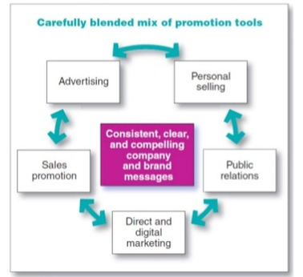
Figure14.1
Integrated Marketing Communications
Today’s customers are bombarded by company messages from all directions. For example, think about all the ways you interact with companies such as Nike, Apple, or Coca-Cola. Integrated marketing communications means that companies must carefully coordinate all these customer touchpoints to ensure clear brand messages.

Slide 27
The Communication Process
Communications efforts should be viewed from the perspective of managing customer relationships over time.
The communication process begins with an audit of all potential contacts a customer might have with the brand.
Effective communication requires knowledge of how communication works.

Slide 28
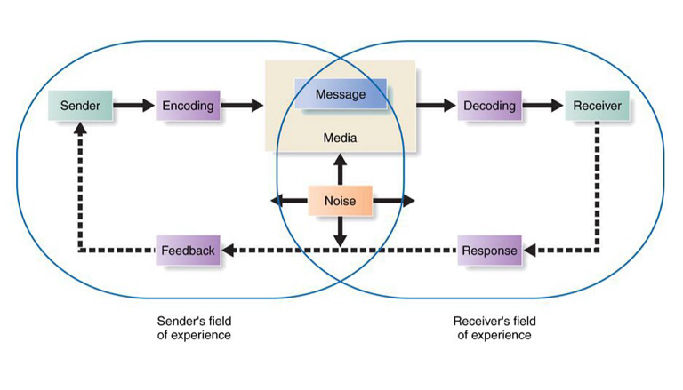
Figure14.2
Elements in the Communication Process
There is a lot going on in this figure. For example, apply this model to McDonald’s To create great advertising-such as long-running “I’m lovin it” campaign- McDonald’s must thoroughly understand its customers and how communication works.

Slide 29

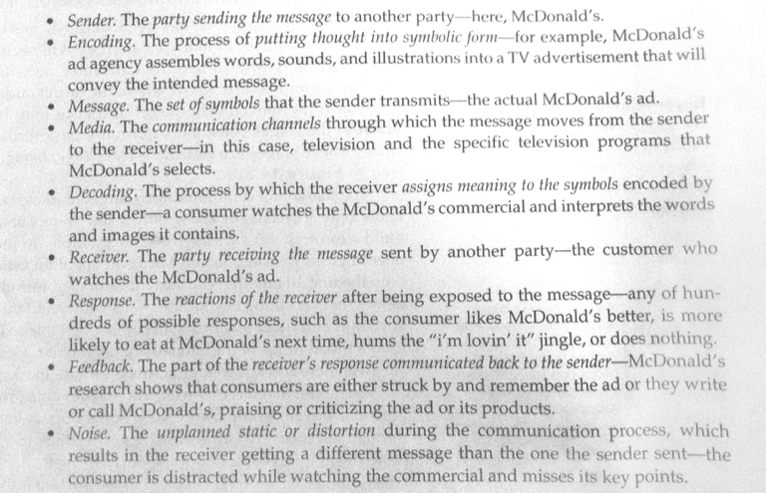

Slide 30
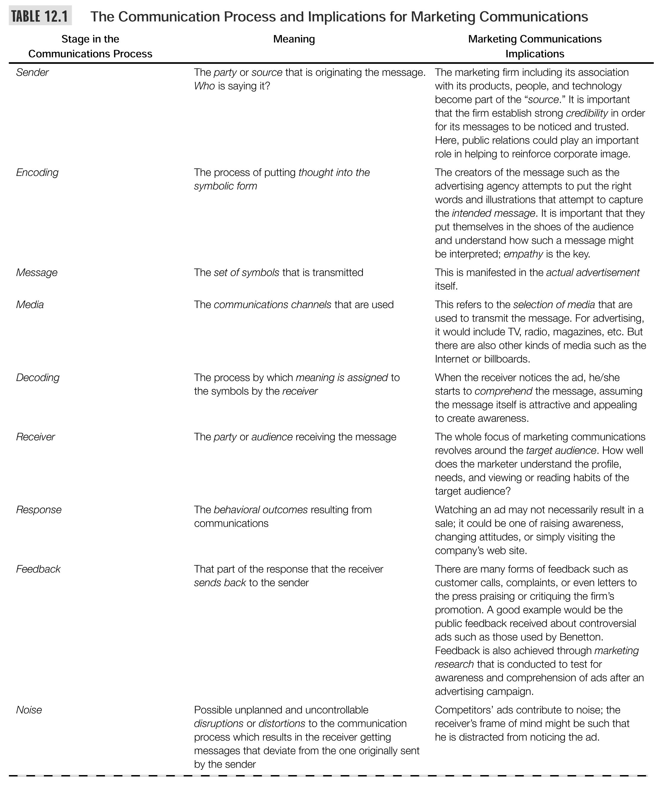

Slide 31

Developing Effective Communications

Slide 32

Developing Effective Communications
Step 1: Identifying the Target Audience
  Affects decisions related to what, how, when, and where message will be said, as well as who will say it

Slide 33
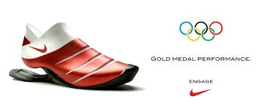
Developing Effective Communications
Step 2: Determining Communication
Objectives
  Six buyer readiness stages
Awareness
Knowledge
Liking
Preference
Conviction
Purchase

Slide 34
Developing Effective Communications
  Buyer readiness stages: the stages: The stages consumers normally pass through on the way to a purchase, including awareness, knowledge, liking, preference, conviction and finally the actually purchase.
A goal of marketing in general and of marketing
Communications in particular is to move target consumers
Through the buying process. Once again, it starts with understanding customer needs and wants
Believing this is the best
feeling
Awareness
Knowledge
Liking
Preference
Conviction
Purchase
Prefer over others

Slide 35
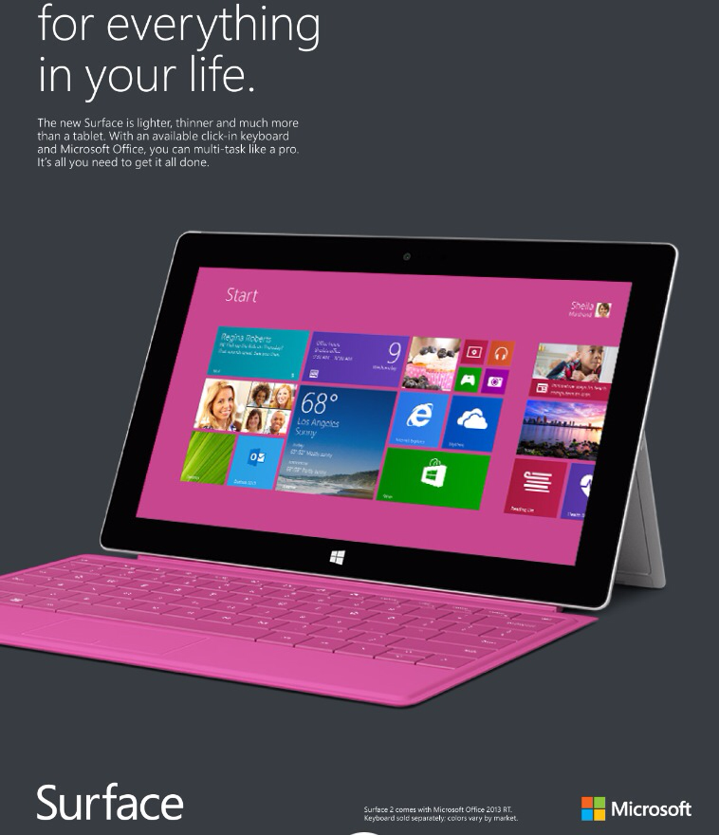
Moving customers through the buyer-readiness stages:Microsoft used an extensive $190 million marketing campaign to create awareness and knowledge for its innovative new Microsoft surface tablet.

Slide 36
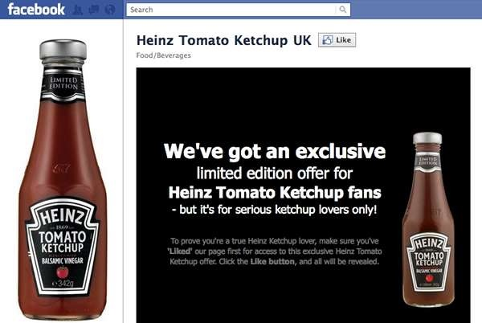
The new marketing communication model: Heinz introduced its new balsamic-vinegar-flavored ketchup using no traditional media, relying instead on its 825,000 Facebook followers to spread the word.

Slide 37
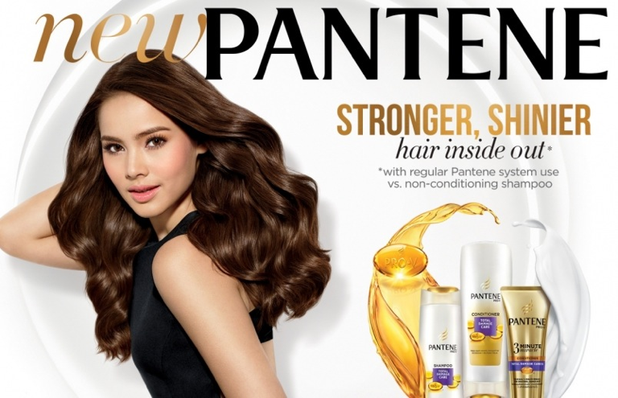
Developing Effective Communications
Step 3: Designing a Message
  Message content contains appeals or themes designed to produce desired results
    Rational appeals – Ex.Sunlight liquid Dishwash,shampoo?
    Emotional appeals – Ex. Jubilee Diamonds?
      Love, pride, joy, humor, fear, guilt, shame,excitement or Moral appeal

Slide 38

Emotional appeals: Budweiser's top-rated "Puppy Love" Super Bowl commercial said nothing about the qualities of Budweiser beer. But it made deep emotional connections between the Budweiser brand and viewers.

Slide 39


Slide 40
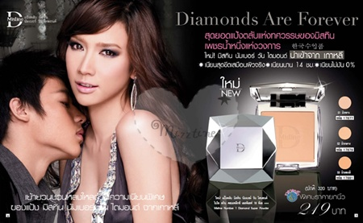
Developing Effective Communications
Step 3: Designing a Message
  Message Structure: Key decisions are required with respect to three message structure issues:
    Whether or not to draw a conclusion
    One-sided vs. two-sided argument
    Order of argument presentation
  Message Format: Design, layout, copy, color, shape, movement, words, sounds, voice, body language, dress, etc.

Slide 41
Developing Effective Communications

Slide 42
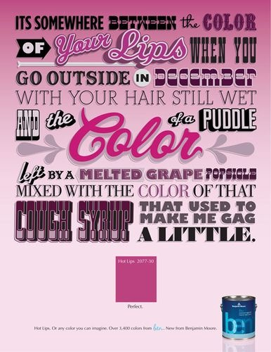
Message format: To attract attention and engage customers, marketers can use novelty and contrast, eye-catching headlines, and distinctive formats, as in this Benjamin Moore ad.

Slide 43
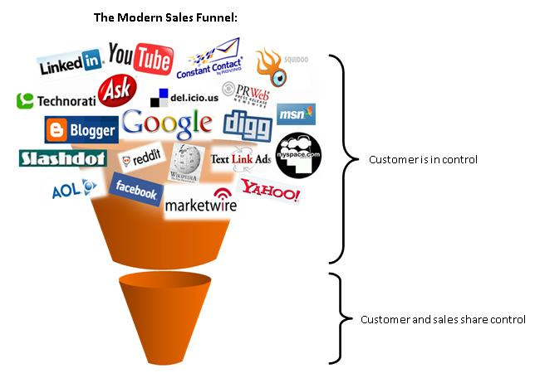

Developing Effective Communications
Step 4:
Choosing Media (Media Mix)
  Personal communication channels
    Includes face-to-face, phone, mail, internet chat communications, social media
    Word-of-mouth influence is often critical
    Buzz marketing cultivates opinion leaders
  Non-personal communication channels
    Includes media ie.TV, print ad, atmosphere, and events
    Selecting Media Source – celebrities, endorsers

Slide 44
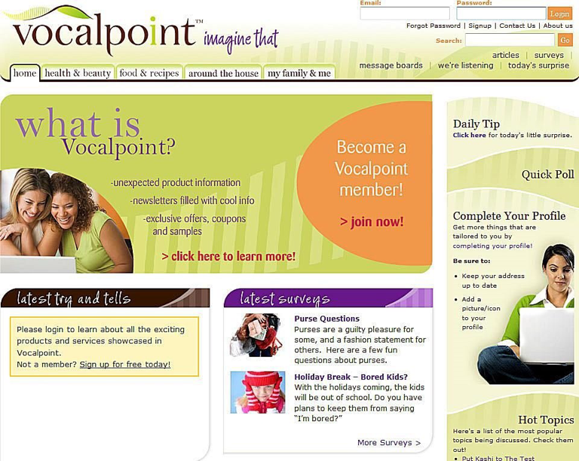
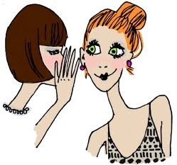

Buzz marketing: P&G has created a huge word-of-mouth marketing arm-Vocalpoint-consisting of 500,000 moms who create word-of-mouth for P&G and other brands.

Slide 45

Buzz marketing- social marketing firm BzzAgent turns a brand's actual users into influential brand advocates.

Slide 46
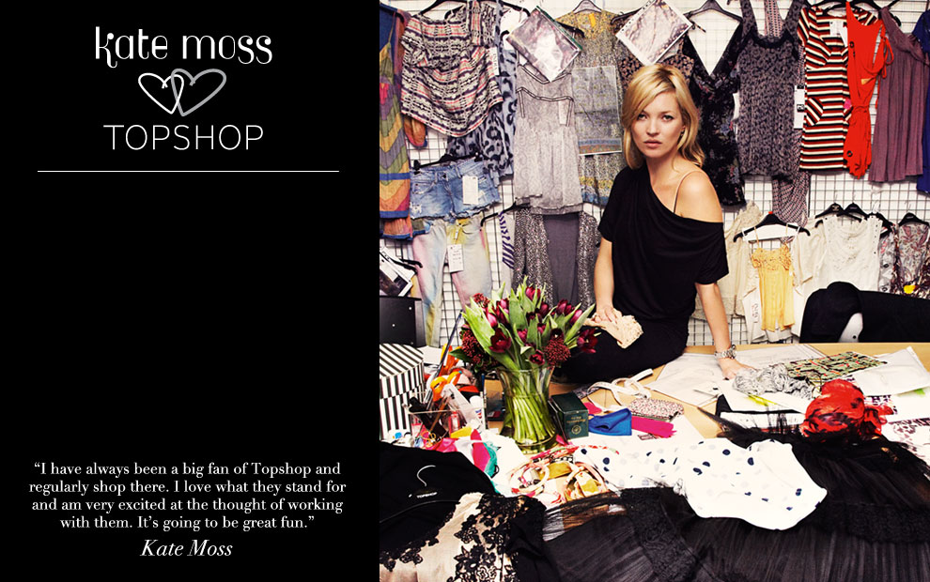
A range of clothing endorsed by model Kate Moss has been a huge selling point for retailer Topshop but allegations in her personal life could be damaging to their reputation and affect their sales.

Slide 47
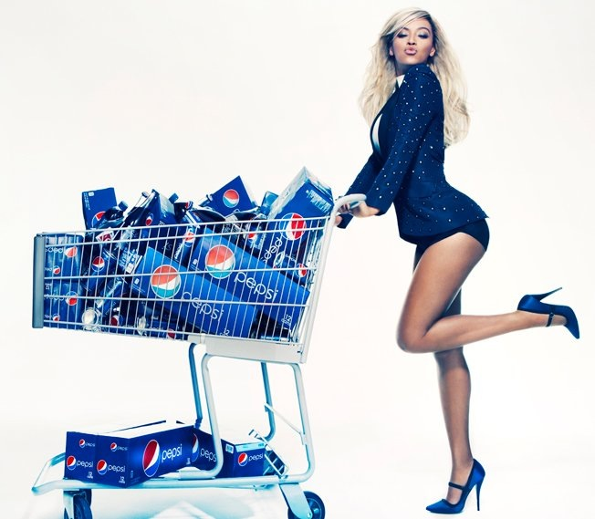
Using celebrity endorsers to represent brands-Beyoncé speaks for Pepsi.

Slide 48
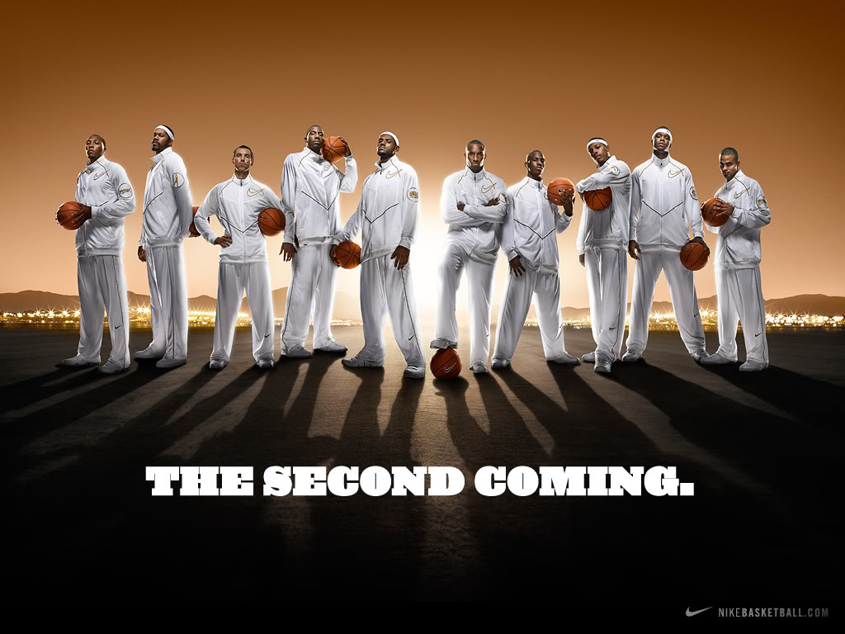
Celebrity endorsers: LeBron James, Kobe Bryant, and a host of other NBA superstars lend their images to Nike brands.

Slide 49
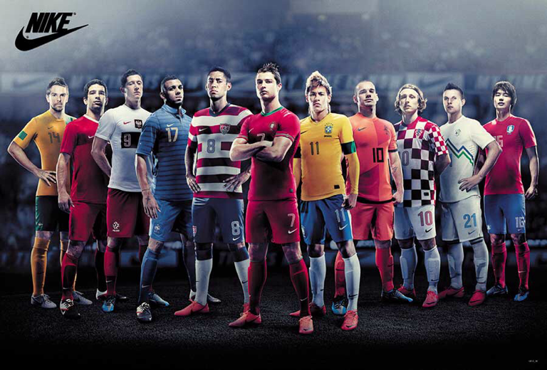

Slide 50
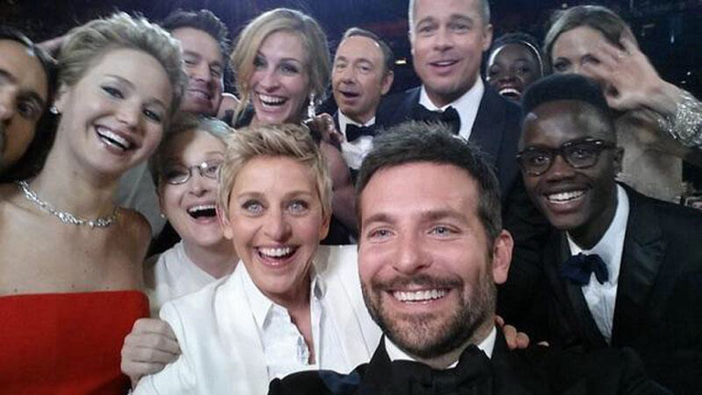
Real Marketing 14.2
Celebrity Endorsers: Finding the Right Celebrity for the Brand
Celebrity endorsers: Academy Awards host Ellen DeGeneres used a Samsung Galaxy Note 3 phone to tweet out epic selfies to her 25 million followers.One was retweeted a record 2.7 million times, crashing the Twitter network.

Slide 51

Socially Responsible Marketing
Marketers should go beyond what is “legal” and communicate openly and responsibly with customers. Good customer relationships are built on honesty and trust.

Slide 52
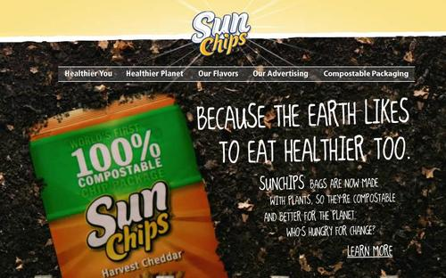
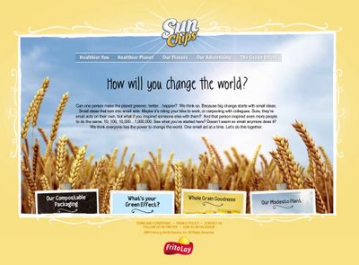
Socially Responsible Marketing
Promoting socially responsible actions:
Frito-Lay ran ads promoting the compostable
Packaging for its SunChips brand. It also promoted a program challenging consumers to create their own videos encouraging positive change in the world which it ran on national TV.

Slide 53

Promoting socially responsible programs and actions: Nature Valley promotes a lot more than just Granola Bars and other healthy snacks.It also promotes strong commitment to preserving nature," We love nature and having fun in it," says the brand

