Slide 1
PROBLEM OF BANGKOK TAXI
PROBLEM OF BANGKOK TAXI
Indonesia Group .
Ploynapat S. 5504641274
Puthita Y. 5504641407
Techit I. 5704642288
Teetat N. 5704642304
Thanatcha A. 5704642338

Slide 2
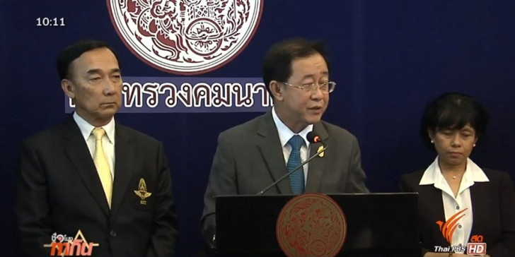
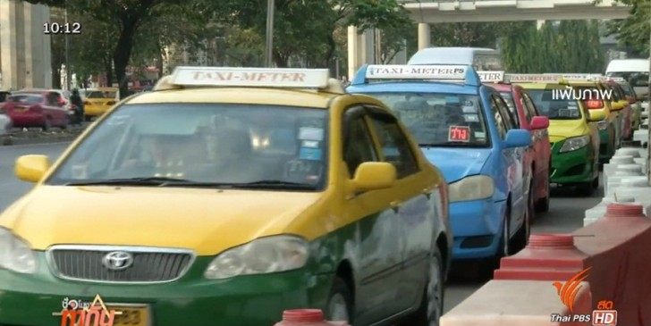
NEWS: Taxi Fare Hike Further Delayed
The Transport Ministry will delay the plan to raise taxi fare rates by 5% in the second phase as it earlier promised with taxi drivers in July.
Source: Thai PBS (4th September 2015)
Notes:
ACM = Air Chief Marshal

Slide 3
NEWS: Taxi Fare Hike Further Delayed
Due to 3 concerns:
People’s cost of living has increased
The price of natural gas for vehicles is uncertain
Passengers’ satisfaction on taxi service is pretty low
Notes:
Then let’s think what will happen if this plan is passed

Slide 4
Graphic Illustration
Price
S
P2
E
P1
Excess Supply
D
Quantity
QD
Q1
QS
Notes:
พูดเรื่องว่า ถ้ามี excess supply แล้วมันเป็นไงด้วย

Slide 5
Where Do the Consumers Go Then?
Alternative Services
Alternative Taxi Services
Other Types of Transports

Slide 6



Alternative Taxi Services
Uber Taxi
All Thai Taxi
Grab Taxi

Slide 7
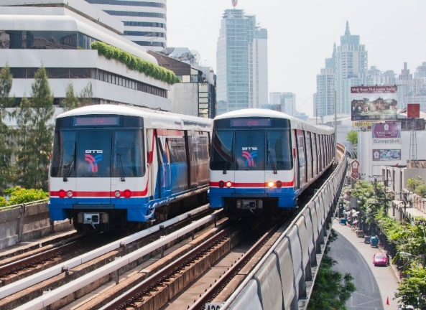
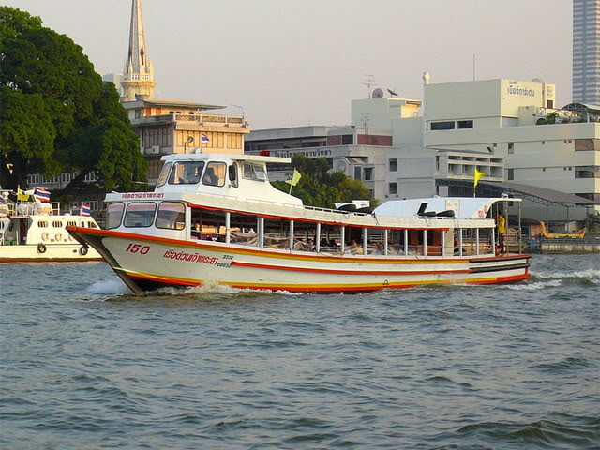
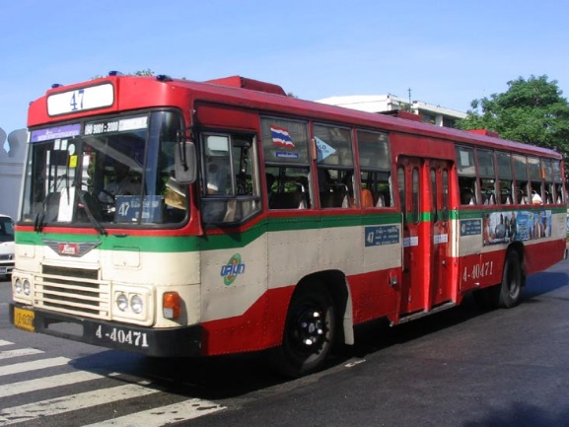
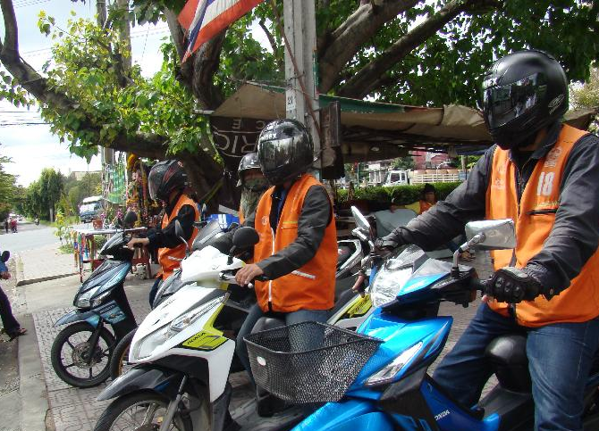
Other Types of Transportation
BTS/
MRT
Boat
Bus
Motor-cycle

Slide 8
So, What Could the Taxi Do to Get Rid of the Excess Supply?
Due to 3 concerns:
People’s cost of living has increased
The price of natural gas for vehicles is uncertain
Passengers’ satisfaction on taxi service is pretty low
Notes:
Passengers’ satisfaction is the problem that taxi could solve

Slide 9
So, What Could the Taxi Do to Get Rid of the Excess Supply?
The problems concerned by consumers:
Overpricing
Denying a passenger
Unsafety
Inappropriate Manner
SOLVE THESE PROBLEMS!
To increase the quality of the taxi then the consumers will be more willing to pay for the services.
Therefore, the demand for Bangkok taxi services will increase.

Slide 10
Demand Curve Shifts To The Right
Price
S
E’
P2
E
P1
D’
D
Quantity
QD
Q1
QS
Notes:
Otherwise

Slide 11
Otherwise, the Supply Has to Decrease
S’
Price
S
E’’
P2
E
P1
D
Quantity
QD
Q1
QS
Notes:
By decreasing the production >> lay off /// some taxi might have to leave the market

Slide 12
In Conclusion…
The taxi should improve their service quality so that the demand for the taxi service will increase.
Otherwise, the market will adjust to get rid of the excess supply by decreasing the supply. That is, some of taxi drivers will have to leave the market.

Slide 13
Your Opinions?
What will you do when the price of taxi service increases but its quality also increases?
Will you still use the (normal) taxi services or change to use other alternatives
(Uber, Grabtaxi or other types of transport)?

