Slide 1
International Payment Services
GROUP 5

Slide 2
OUTLINE
What are international payment services?
What are the components of international services?
Examples of international services.

Slide 3

International Payment Services?
Whenever you need to make international payment across borders, banks can find the best method that more secure, efficient and fast.
Services of the banks that make international transactions between two parties become more possibly comfortable.

Slide 4
International Payment Services
Western Union
CHIPS
MoneyGram
Fedwire
SWIFT

Slide 5






Western Union
What is Western Union ?
Financial services corporation that specializes in the transfer of money from one location to another location. The company is based out in the United States, but processes financial transactions from across the world.
Notes:
Method of transferring money abroad to a specific beneficiary by telex/swift instruction to foreign banks.

Slide 6
Features of Western Union
CASH
QUICK
WORLDWIDE
EVERYDAY AND EVERY TIME

Slide 7
Western Union
Features:
• Money can be picked up as cash.
• All done conveniently from your account every day
and every time.
• Domestic and international account-to-cash transfers.
• Money in Minutes.

Slide 8
How to send money
1
COMPLETE THE ‘TO SEND MONEY’ FORM
2
PAY FOR YOUR MONEY TRANSFER
3
SIGN AND RECEIVE YOUR RECEIPT
4
5
INFORM YOUR RECEIVER
TRACK YOUR MONEY

Slide 9
How to receive money
1
CONFIRM THAT THE MONEY IS READY FOR PICK UP
2
VISIT THE AGENT LOCATION
3
COMPLETE THE 'TO RECEIVE MONEY' FORM
4
5
REVIEW AND SIGN THE RECEIPT
RECEIVE YOUR MONEY

Slide 10



MoneyGram
What is MoneyGram ?
- Provide a secure way to send and receive money to and from other people worldwide and it also make sure that your money gets to where it’s needed quickly.
- A worldwide money transfer services, working closely with specially chosen agents in 300,000 locations across 197 countries.

Slide 11
Features of MoneyGram
QUICK
CONVENIENT
AVALIABLE TO EVERYONE
EASY
PERSONAL

Slide 12
MoneyGram
Features
• It’s quick : your money is where it’s needed in just 10 minutes.
• It’s convenient : with 300,000 money transfer agents around the
world.
• It’s available to everyone : you don’t need a bank account or
credit card.
• It’s easy : just visit a MoneyGram agent and complete one simple
form.
• It’s personal : you can add a complimentary 10-word
message.

Slide 13
How to send money
1
Find a MoneyGram agent
2
Taking some personal identification with you.
3
Complete a simple ‘send’ form and hand this to the MoneyGram agent along with the money you want to send and the transfer fee. You may also include a free 10-word message on the form.
4
5
You will be given a reference number.
Contact the person to whom you’re sending the money, and give him or her the reference number. In just 10 minutes the money will be ready to collect.

Slide 14
How to receive money
1
2
3
Complete our simple ‘receive’ form and show your identification .You will then be given your money.
Ask the person who is sending you money to give you your reference number
Taking some identification and your reference number with you.

Slide 15

SWIFT (Society for Worldwide Interbank Financial Telecommunication)
What is SWIFT ?
- SWIFT provides a network that enables financial institutions worldwide to send and receive information about financial transactions in a secure, standardized and reliable environment.
- More than 10,000 financial institutions and corporations in 212 countries around the world use SWIFT to exchange millions of standardized financial messages every days.
- Financial messaging system, not a payment system
  “ Messaging System”
Notes:
SWIFT transports financial messages in a highly secure way^{[how?]} but does not hold accounts for its members and does not perform any form of clearing or settlement.

Slide 16
Features of SWIFT
PROVIDE FINANCIAL GUARANTEE
CONVENIENT
TRANSFER MESSAGES QUICKLY
LOWER COSTS

Slide 17
SWIFT (Society for Worldwide Interbank Financial Telecommunication)
What you need to make a SWIFT Funds Transfer
The full name of the person or company you wish to pay
The full name and branch address of the destination bank
The BIC (Bank’s Identifier Code) or SWIFT code, plus the
account number (or IBAN for European accounts) of the
account to which you are transferring funds. You will need to
ask the payee for this information
The amount and currency you wish to transfer
Notes:
Method of transferring money abroad to a specific beneficiary by telex/swift instruction to foreign banks.

Slide 18
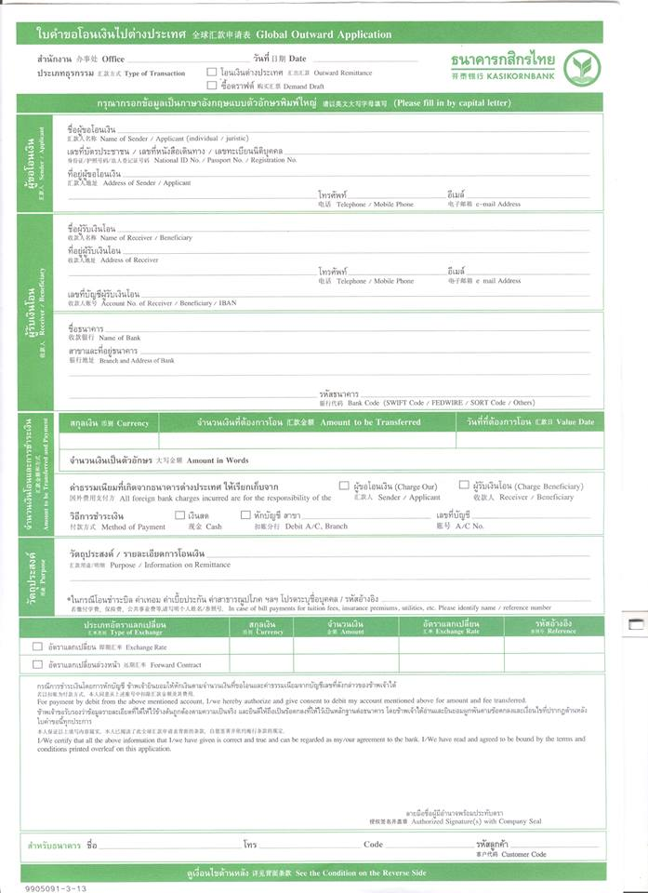

Slide 19
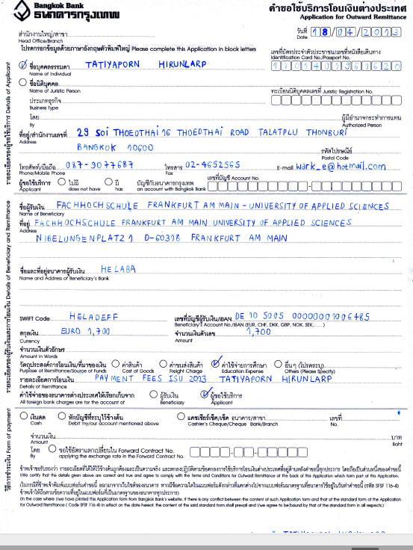
SWIFT (Society for Worldwide Interbank Financial Telecommunication)

Slide 20


Payment System in U.S
Fedwire
CHIPS

Slide 21
Fedwire (Federal Reserve Wire Network)
What is Fedwire ?
- A real-time gross settlement system (RTGS) of fund and security transfer of central bank money used in the United States by its Federal Reserve Banks to settle final payments in U.S. dollars electronically between its member institutions.
- Fed operates (1) Fedwire Funds Service (2) Fedwire Security Services( i.e. govt. bonds).
- The payments transferred over Fedwire are often related to domestic transactions. In case of international, the SWIFT code or routing number is required.
“ Payment System”

Slide 22
Fedwire (Federal Reserve Wire Network)
FLEXIBILITY OF ALTERNATIVES
WIDE NETWORK
SECURITY AND RELIABILITY
FINAL AND IRREVOCABLE
REAL TIME PROCESSING

Slide 23
Fedwire (Federal Reserve Wire Network)
Features:
• Flexible online access alternatives
• Access to a broad network of approximately 7,500 financial
institutions and government agencies
• Real-time processing
• Final and irrevocable transfer of securities and funds
• Security and reliability
Notes:
Method of transferring money abroad to a specific beneficiary by telex/swift instruction to foreign banks.

Slide 24
CHIPS (Clearing House Interbank Payments System)
What is CHIPS ?
- CHIPS is a transfer system doing clearing house for dollar payments. CHIPS is owned by financial institutions, and any banking organization.
- The payments transferred over CHIPS are often related to international interbank transactions.
- CHIPS is Netting Engine not the real-time gross settlement system.
“ Clearing System”

Slide 25
CHIPS (Clearing House Interbank Payments System)
CONVINIENT
RELIABILITY AND SECURITY
SASTISFIED THE BANK’S NEEDS
FACILITATE INTERNATIONAL PAYMENT
Notes:
Method of transferring money abroad to a specific beneficiary by telex/swift instruction to foreign banks.

Slide 26
CHIPS (Clearing House Interbank Payments System)
Features:
  Reliable for the customer (Backed by almost 40 years of reliable operation) and High securities (CHIPS participant was required to maintain a branch or an agency in New York City)
  Satisfied the needs of banking industry (The clearing system match the need of each industry)
  Served a lot of financial institution (serves more than 45 foreign and domestic banks that representing 21 countries.)
  Handles over 95 percent of all international dollar payments.
Notes:
Method of transferring money abroad to a specific beneficiary by telex/swift instruction to foreign banks.

Slide 27
Fedwire and CHIPS
Comparing Fedwire and CHIPS
 | Fedwire | CHIPS
Ownership | Federal Reserve Banks (FED) | Privately owned (New York Clearing House Association)
Purpose | Mainly used for domestic transfer | Mainly used for international transfer
Payment format : | SWIFT BASED | SWIFT BASED
Settlement | Real time gross settlement System (RTGS) | Netting engine
Cost | More expensive | Cheaper
Notes:
Method of transferring money abroad to a specific beneficiary by telex/swift instruction to foreign banks.

Slide 28
THANK YOU
Notes:
Method of transferring money abroad to a specific beneficiary by telex/swift instruction to foreign banks.

