Slide 1
Financial Statements and some applications
Pawin Siriprapanukul (pawin@econ.tu.ac.th)

Slide 2
Financial Statements
Financial statements are summaries of the general ledger
There are 3 key financial statements
  Balance Sheet
  Income Statement
  Cash Flow Statement

Slide 3
Balance Sheet

Slide 4
Balance Sheet
Expresses the relationship that is the basic to the double-entry accounting system:
  Assets = Liabilities + Equity
For example,
Balance Sheet
Assets | Liabilities
Current Assets | Current Liabilities
Cash | Accounts Payable
Account Receivable | Long-term Liabilities
Inventory | Long-term Debt
Long-term Assets
Fixed Assets | Equity
Intangibles | Stock
 | Retained Earnings

Slide 5
Assets, Liabilities and Equity
Assets are things that you own (Uses of Funds)
Liabilities are things that you owe other people (Sources of Funds)
Equity is the difference between the two (Sources of Funds)

Slide 6
Information from the balance sheet
Who owns the business?
  When you have debt, the lenders own the business
  When you have stock, the stockholders own the business
  When you have retained earnings, the business owns the business
How liquid is the organization?
  Liquid organizations have assets that can flow wherever they want them to go
  Cash is the most liquid asset
  Other liquid assets can be sold for cash easily and without significant loss in value

Slide 7
Information from the balance sheet
How lean and mean is the organization running?
  Working capital = current assets – current liabilities
  It reflects resources that you have tied up in your business
  Working capital should be small or negative
    Accounts receivable should be small
    Inventory should be small
    Accounts Payable should be large
  A true calculation of working capital should take out cash for emergency and look only at the cash needed to operate on a regular basis

Slide 8
Balance Sheet: An Application on Bank Management

Slide 9
The Bank Balance Sheet
It must be the case that:
  total assets = total liabilities + equities
Banks makes profits by charging an interest rate on their holdings of securities and loans that is higher than the expenses on their liabilities.

Slide 10
Balance Sheet of All Commercial Banks in Thailand
(As of Nov 2009)
Source: http://www.bot.or.th/Thai/Statistics/FinancialInstitutions/CommercialBank/Pages/StatAssetsandLiabilities.aspx#

Slide 11
Bank Operation
Banks make profits by selling liabilities (e.g. deposits) with one set of characteristics and using the proceeds to buy assets (e.g. loans) with a different set of characteristics. ➔ Asset transformation.
Normally, banks borrows from short-dated deposits and lends through long-term loans.

Slide 12
Principles of Bank Management
1. Liquidity Management
2. Asset Management
  Managing Credit Risk
  Managing Interest-rate Risk
3. Liability Management
4. Capital Adequacy Management

Slide 13
Asset Management:
Managing Interest Rate Risk
If a bank has more rate-sensitive liabilities than assets, a rise in interest rates will reduce bank profits and a decline in interest rates will raise bank profits

Slide 14
Asset Management:
Managing Interest Rate Risk
First National Bank
Assets Liabilities
Rate-sensitive assets $20 m Rate-sensitive liabilities $50 m
Variable-rate loans Variable-rate CDs
Short-term securities MMDAs
Fixed-rate assets $80 m Fixed-rate liabilities $50 m
Reserves Checkable deposits
Long-term bonds Savings deposits
Long-term securities Long-term CDs
Equity capital

Slide 15
Asset Management:
Managing Interest Rate Risk
Gap Analysis
GAP = rate-sensitive assets – rate-sensitive liabilities
= $20 – $50 = –$30 million
When i ↑ 5%:
1. Income on assets = + $1 million
(= 5% × $20m)
2. Costs of liabilities = +$2.5 million
(= 5% × $50m)
3. Δ Profits = $1m – $2.5m = –$1.5m
= 5% × ($20m – $50m) = 5% × (GAP)
Δ Profits = Δ i × GAP

Slide 16
Asset Management:
Managing Interest Rate Risk
Duration Analysis
% Δ value ≅ –(% point Δ i) × (DUR)
Example: i ↑ 5%, duration of bank assets = 3 years, duration of liabilities = 2 years;
% Δ assets = –5% × 3 = –15%
% Δ liabilities = –5% × 2 = –10%
If total assets = $100 million and total liabilities = $90 million, then assets ↓  $15 million, liabilities ↓ $9 million, and bank’s net worth ↓  by $6 million
Strategies to Manage Interest-rate Risk
1. Rearrange balance-sheet
2. Interest-rate swap
3. Hedge with financial futures

Slide 17
Capital Adequacy Management
1. Bank capital is a cushion that helps prevent bank failure
2. Higher is bank capital, lower is return on equity
ROA = Net Profits/Assets
ROE = Net Profits/Equity Capital
EM = Assets/Equity Capital
ROE = ROA × EM
Capital ↑, EM ↓, ROE ↓
3. Tradeoff between safety (high capital) and ROE
4. Banks also hold capital to meet capital requirements
5. Managing Capital:
A. Sell or retire stock
B. Change dividends to change retained earnings
C. Change asset growth

Slide 18
The Income Statement

Slide 19
The Income Statement
The basic formula
  Revenues – Costs = Profit
Different types of costs
  Direct costs are costs that you can logically and easily trace to the creation of the product
  Indirect costs are all the other costs incurred in marketing, selling, and designing the product
    E.g. advertising, rent, utilities, rent, travel, sales, legal, etc.

Slide 20
Income Statement Model
Income Statement
Sales
Less cost of goods sold
Gross Margin
Less operating costs
Operating Margin
Less taxes, others
Net Profit

Slide 21
Information from the Income Statement
Income Statement
 | Year 1 | Year 2
Sales | 100 | 100
Less cost of goods sold | 70 | 80
Gross Margin | 30 | 20
Less operating costs | 20 | 10
Operating Margin | 10 | 10
Less taxes, others | 5 | 5
Net Profit | 5 | 5

Slide 22
EBIT and EBITDA
EBIT (Earning Before Interest and Taxes)
  Net profit + interest + taxes
EBITDA (Earning Before Interest, Taxes, Depreciation, and Amortization)
  EBIT + Depreciation + Amortization
Why do we need EBIT and EBITDA?
  They reflect better the performances of the management
  Taxes, for example, are not under management control

Slide 23
GPM, NPM, ROA, and ROE
Gross Profit Margin (GPM)
  GPM = Gross Profit / Sales
Net Profit Margin (NPM)
  NPM = Net Profit / Sales
Return on Assets (ROA)
  ROA = Net Profit / Total Assets
Return on Equity (ROE)
  ROE = Net Profit / Equity

Slide 24
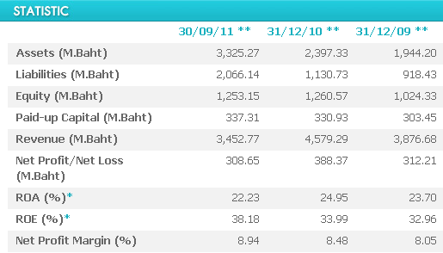
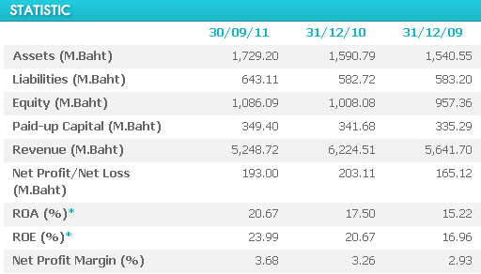
Two Businesses
Business 1
Business 2

Slide 25
The Cash Flow Statement

Slide 26
The Cash Flow Statement
The cash flow statement tells you how much cash you had at the beginning of the month and how much cash you had at the end of the month
The cash flow statement will not be the same as the income statement
Net profit does not need to be the same as the final balance of cash

Slide 27
Cash Flow Statement Model
Cash Flow Statement
Beginning CASH
Plus CASH collected
Less CASH paid
Ending CASH

Slide 28
Classifying Cash Flows into Three Categories
Indirect Method Statement of Cash Flows
Cash Flows from operating activities
Net profit
Adjustments to reconcile income
Depreciation
(Increase) Decrease in A/R
(Increase) Decrease in inventory
Increase (Decrease) in A/P
Cash Flows from investing activities
Purchase of plant
Cash Flows provided by financing activities
Sale of stock
Borrowing
Change in cash

Slide 29
Information from the Cash Flow Statement
How the company is generating its cash.
  From selling goods and services or from selling equity or from borrowing
How the organization used its money.
  Is it spending large amount on equipment, or selling off its equipment?
How liquid the organization is.
Is the net profit reported on the income statement ever realized in cash?

