Slide 1
MK 312 Group Homework Assignment
Directions to creating your new concept
Please revisit your Determinant Gap Map
Please revisit your Relationship Analysis
Then choose 4 unique combinations from your relationship analysis to develop your new product concept like my egg concept examples given in class.

Slide 2
MK 312 Group Homework Assignment
Directions to creating your new product
Create 4 new product concepts- remember there should be new need/benefit, Form and Technology for new product.
Also set price for your new product
Translate all product ideas into Thai
Design your concept Boards with photos, pics that effectively communicates your idea.- Please make sure that all slides are cohesive
( not one stands out or be more beautiful or you will be given a bias answer)

Slide 3
MK 312 Group Homework Assignment
Handouts Due Next Week
Revised Gap Map
Revised Relationship Analysis Page
Chosen 4 combinations from your Relationship Analysis Page
4 Concept Boards – with photos, pricing and thai version
Target Group Profile of Interviewees
Presentation on 4 New Concept Boards in English and Thai Next Week ( you should have 4- 8 powerpoint slides for 2 languages)

Slide 4
Criteria for Concept Test
Please make sure you meet these criteria when designing your concept boards
1. Uniqueness of the concept
2. Believability of the concept
3. Importance of the problem
4. Their interest in the concept
5. Is it realistic, practical and useful?
6. Their reaction to the price
7. Problems they see in use

Slide 5
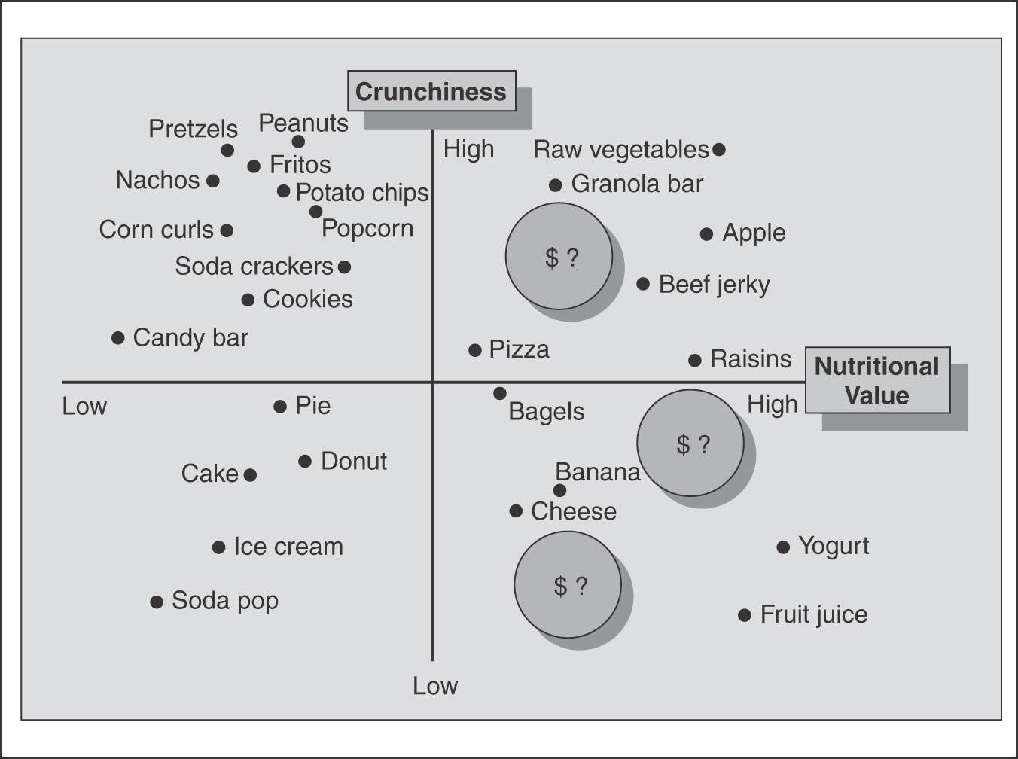
A Determinant Gap Map
Figure 6.2

Slide 6


Slide 7
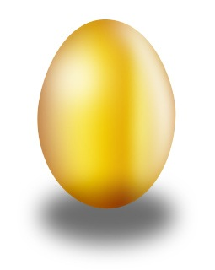
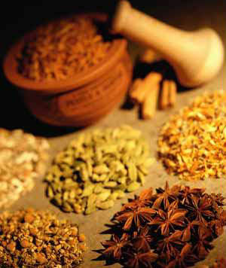
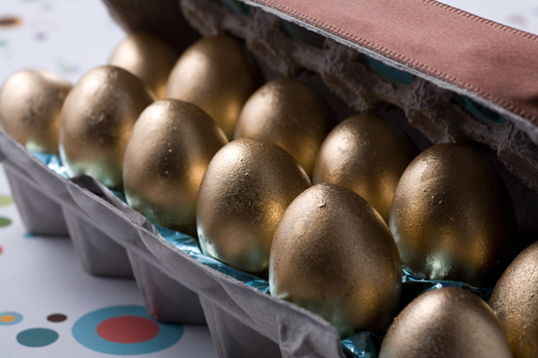
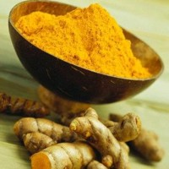
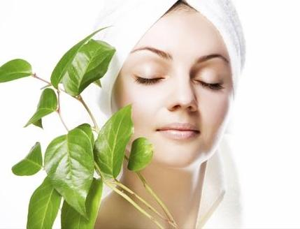
My Example: Concept 1: Beauty Egg
English Version:
You don’t have to eat salads every meal just to look and feel beautiful. Yes, we have a Beauty Egg just for your that will make your skin look so healthy and radiant, plus eating will be an extreme pleasure. The Beauty Egg which contains Tumeric known for centuries have always been an important part of Chinese herbal medicine and Ayurvedic medicine in India. Its main ingredient curcumin doesn’t only give a delicious golden shimmering coloring to the egg, but also is an antioxidant, lowers cholesterol levels and helps improve blood circulation. You’ll definitely have a delicious egg meal packed with natural proteins and antioxidants guaranteed to give your skin a healthy glow. You could choose to buy eggs that come both in raw form so you to cook according to your recipes and hard boiled to be readily eaten. The egg costs 29 Baht each.
Thai Version

