Slide 1
Topic 2 Part 2
Consumer Choice
(Chapter 4)

Slide 2
Review – Corner Solution
Generally, people consume positive amounts of X and Y.
In this case, such bundle is said to be an interior solution.
But, some people choose to consume ONLY one good.
In this case, such bundle is said to be a corner solution.

Slide 3
Review – Corner Solution
When the optimality condition “MUx/Px = MUy/Py” holds, we will have an interior solution.
This is because this condition implies the bundle where the IC and BL are tangent (their slopes are equal).
This in turn implies that such bundle is affordable and gives the highest utility.

Slide 4
Review – Corner Solution
Suppose that MUx/Px > MUy/Py.
This means spending one dollar on X will give higher MU.
Hence, we should consume more X.
Note that when X increase, MUx falls, equating
MUx/Px = MUy/Py, and the optimal bundle is reached.
What if there is NO bundle such that
MUx/Px = MUy/Py?

Slide 5
Review – Corner Solution
Suppose that MUx/Px > MUy/Py for all affordable bundles.
This means that, for every bundle we can buy, $1 spent on X will ALWAYS give higher MU than $1 spent on Y.
Therefore, we should spend money on X, i.e. we should consume only X.
This is what a corner solution means.

Slide 6
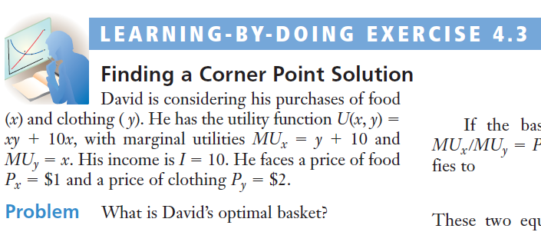
Review – Corner Solution
Recall the INSENSIBLE interior solution of X = 15 and Y = -2.5.
Hence, an interior solution is ruled out.
But how can we find the corner solution?

Slide 7
Review – Corner Solution
Finding the Corner Solution
To do so, we need to compare MUx/Px and MUy/Py.
If MUx/Px > MUy/Py, we consume only X.
If MUx/Px < MUy/Py, we consume only Y.

Slide 8
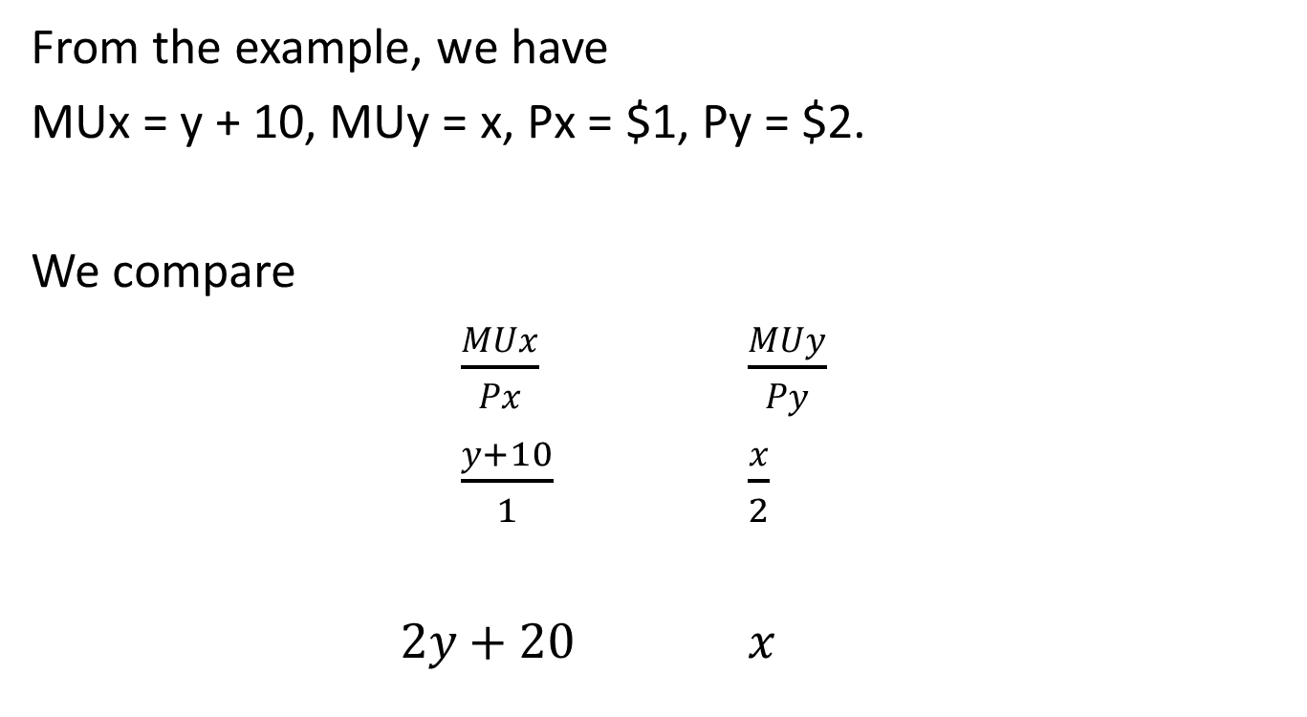
Review – Corner Solution
From the example, we have
MUx = y + 10, MUy = x, Px = $1, Py = $2.
We compare
$\frac{MUx}{Px}$ $\frac{MUy}{Py}$
$\frac{y+10}{1}$ $\frac{x}{2}$
$2y+20 x$
> OR <

Slide 9
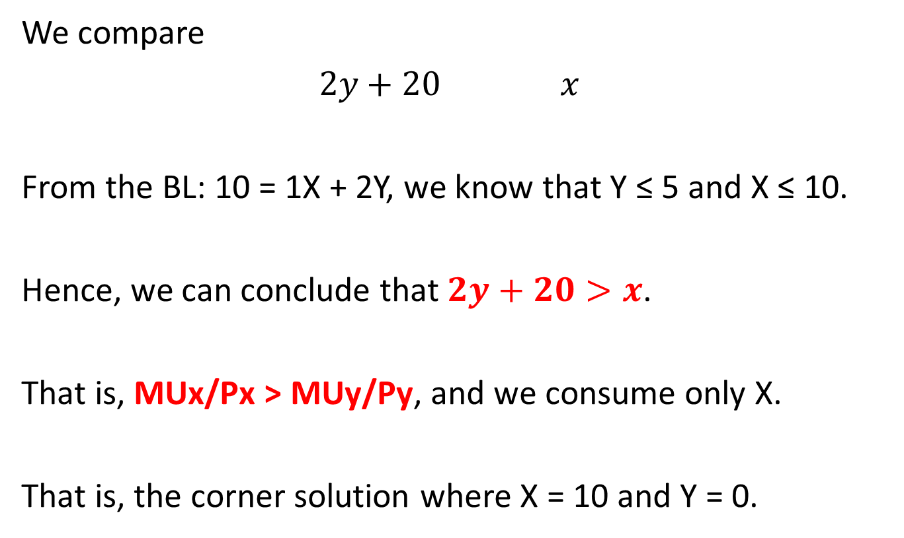
Review – Corner Solution
We compare
$2y+20 x$
From the BL: 10 = 1X + 2Y, we know that Y ≤ 5 and X ≤ 10.
Hence, we can conclude that $2y+20>x$.
That is, MUx/Px > MUy/Py, and we consume only X.
That is, the corner solution where X = 10 and Y = 0.

Slide 10
Choice with Composite Goods
In previous analysis, a consumer has two choices: good X and good Y.
We will introduce a Composite Good.
Suppose that good Y represents a composite good, then good Y includes every other good except good X.

Slide 11
Choice with Composite Goods
We will plot a composite good in place of good Y, i.e. on the vertical axis.
We assume that its price is $1, i.e. Py = 1.
Hence, the slope of the budget line becomes
–Px/Py = –Px/1 = –Px.

Slide 12
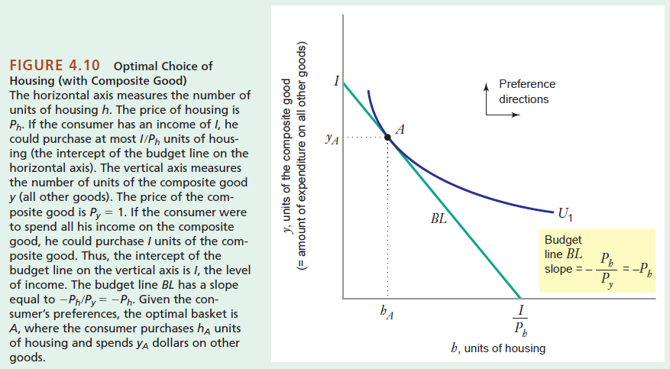
Choice with Composite Goods

Slide 13
App: Coupons and Cash Subsidies
Governments often have programs (coupons and subsidies) aimed at helping the poor purchase more essential goods, e.g. food, housing, and education.
Cash Subsidies is essentially an increase in income of a consumer, shifting his/her BL to the right.
Coupons/Vouchers permit consumers to buy more of a specific good only, partly shifting his/her BL to the right.

Slide 14
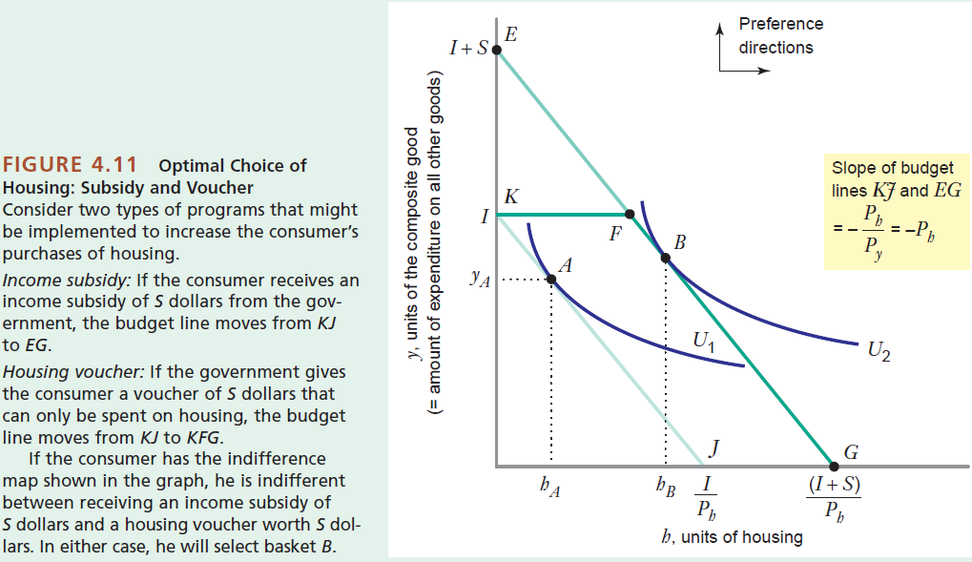
App: Coupons and Cash Subsidies

Slide 15
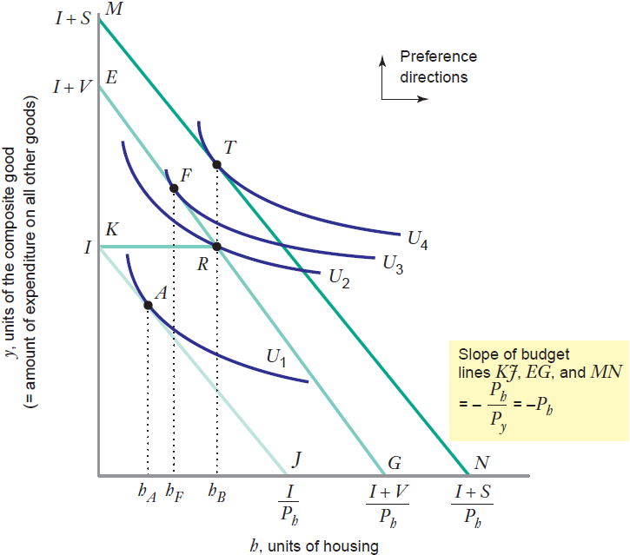
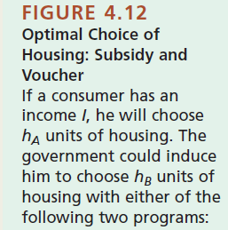
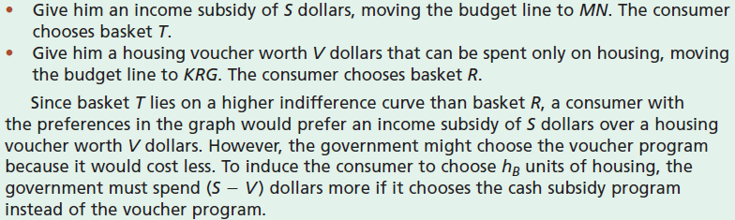

Slide 16
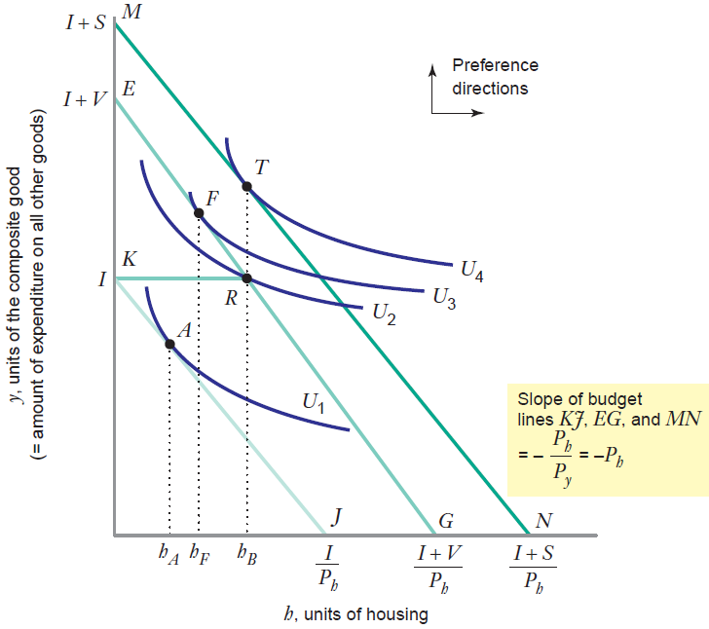
A is the original bundle.
T is the bundle when the govt gives a cash subsidy of S.
F is the bundle when the govt gives a cash subsidy of V.
R is a bundle when the govt gives a housing voucher of V.
F gives higher utility than R. But, at F, the consumer buys less housing.
Suppose the govt wants h_{B} units of housing to be consumed. It can save money of S-V if it chooses a voucher program instead of a cash subsidy.

Slide 17
App: Coupons and Cash Subsidies
Key Points
Since a cash subsidy allows a consumer to buy whatever he wants and whatever he needs, this program tends to give higher utility.
Coupons/Vouchers will save cost for the government, and are effective when the government wants to increase the consumption of a specific good.

Slide 18
App: Join a Club (Membership)
A consumer can pay a membership fee to join a club (e.g. restaurants), and gets some discount (e.g. on food).
Suppose that a consumer has income of $300.
With $300, he can buy the maximum amount of
300 units of Y (composite good).
He can buy X for 20$ each. With $300, he can buy the maximum amount of 15 units of X.

Slide 19
App: Join a Club (Membership)
He can pay a membership fee of $100 to get the discounted price of X from $20 to $10 each.
Now, he has $200 to spend on Y. This decreases the
Y-intercept of the budget line.
Since X is cheaper, he can buy more X (up to 20 units). This increases the X-intercept of the budget line.

Slide 20
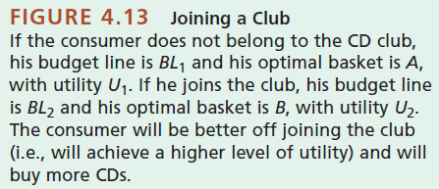
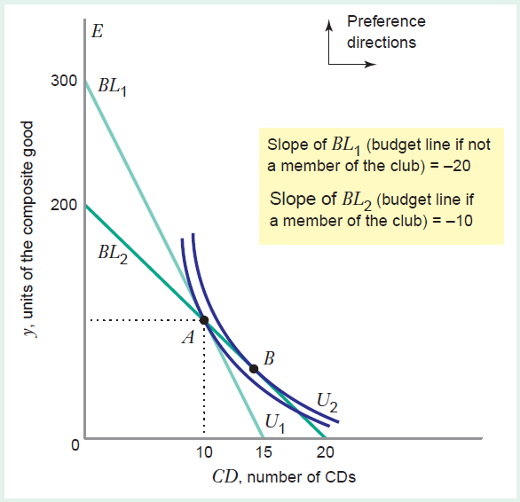
Before joining a club…
At A (original optimal bundle), we have MUx/Px = MUy/Py.
That is, MUx/20 = MUy.
After joining a club…
Px falls from $20 to $10.
At A, now we have
MUx/10 > MUy.
In this case, we should buy more X, i.e. move to B (new optimal bundle).
This will give us higher utility.

Slide 21
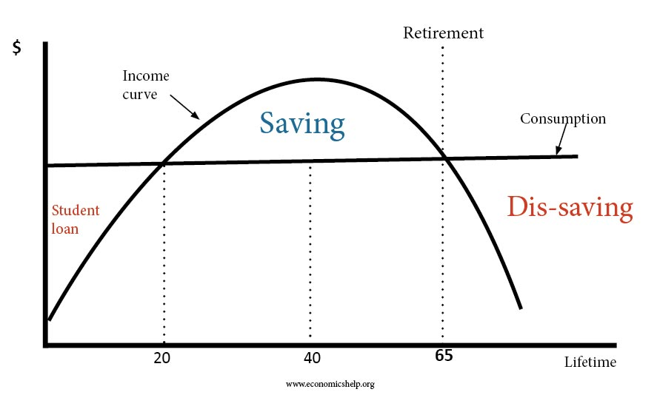
App: Borrowing and Lending
We want to “smooth” consumption because we don’t want to be too poor when young and old. We want to have stable income over life. This is why people borrow and save/lend.

Slide 22
App: Borrowing and Lending
Using composite goods, we can modify the model of consumer choice to allow for borrowing and lending.
In the first year, our income is I₁. In the second year, our income is I₂. Assume that I₂ > I₁.
Hence, we can buy I₁ units of composite goods in the first year, and I₂ units of composite goods in the second year.
That is, we consume more in the second year.

Slide 23
App: Borrowing and Lending
Note that I₂ > I₁ . Without borrowing and lending,
MU_{first year} > MU_{second year} .
Thus, our utility is not maximized. We should consume more in the first year.
We can smooth consumption by borrowing in the first year and paying back (with interest rate) later.
This is so that MU_{first year} = MU_{second year} , and our utility will be maximized.

Slide 24
App: Borrowing and Lending
Let r denote the interest rate.
If we were to spend all incomes in the second period, we can buy I₂ + I₁×(1+r) units of composite good.
If we were to spend all incomes in the first period, we can buy I₁ + I₂/(1+r) units of composite good.
Hence, the slope of budget line is
I₂ + I₁×(1+r) (1+r)
I₁ + I₂/(1+r)

Slide 25
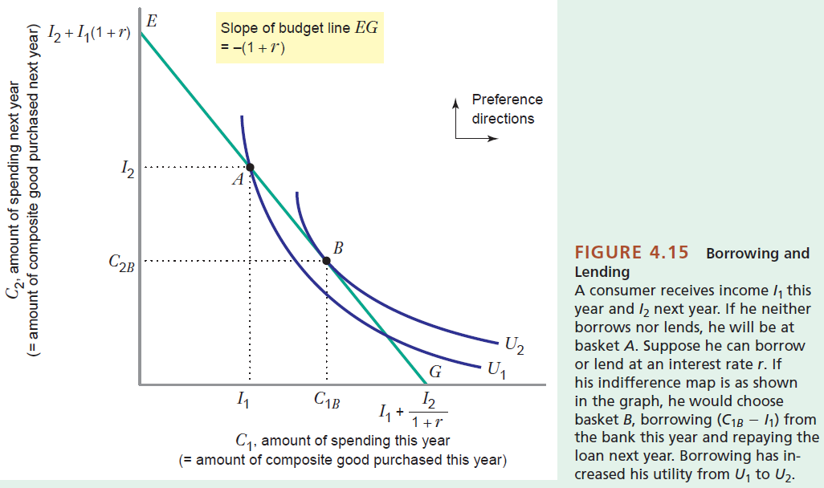
App: Borrowing and Lending

Slide 26
App: Quantity Discounts
A Quantity Discount is offered to buyers to induce them to buy in a larger quantity.
Consider the example of the power company, who charges $11 per unit of X (electricity) for the first 9 units and charges $5.5 per unit for additional units.
Hence, for X ≥ 9, the budget line becomes flatter because more X can be bought.
The consumer has income of $440 to be spent on X and Y (composite goods) whose price is $1 per unit.

Slide 27
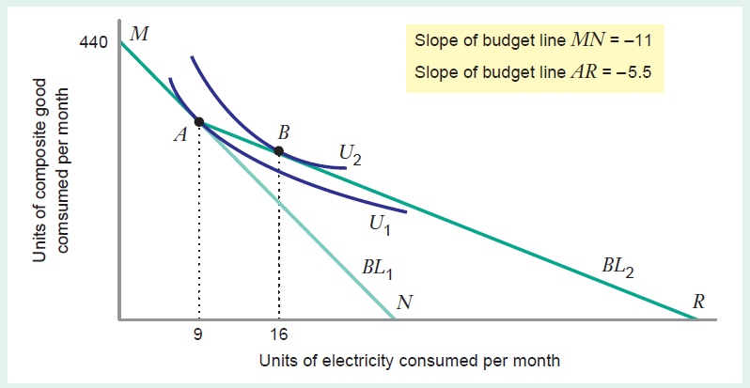
Before Quantity Discount…Px = 11
At A (original optimal bundle),
MUx/Px = MUy/Py
MUx/11 = MUy
After Quantity Discount…Px = 5.5
Now, at A (original optimal bundle),
MUx/5.5 > MUy
Thus, the consumer should consume more X until MUx/5.5 = MUy,
i.e. move from A to B.

Slide 28


