Slide 1
Agricultural transformation
EE463 Globalization and international development
Faculty of economics
Thammasat university

Slide 2
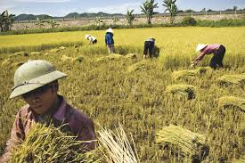
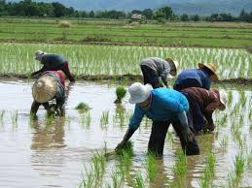
Characteristics of the agricultural sector
Agriculture sector’s share of GDP
Agriculture sector’s share of labor force
Characteristics of the agricultural production function
Much of agriculture production is consumed by producers
Agriculture’s role as a resource reservoir: labor is relatively cheap

Slide 3

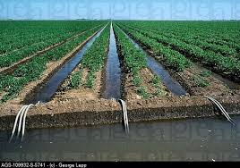
characteristics of agricultural production
Seasonality: minimizes farmer’s costs, at the same time timing (planting, harvesting) is important
Geographic dispersion: agriculture is distributed through wide areas which requires effective marketing
Sources of risk: price fluctuations and weather changes
Sources of technological change: Productivity growth is driven by technological change; developing and disseminating technology is a big challenge

Slide 4
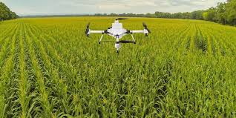
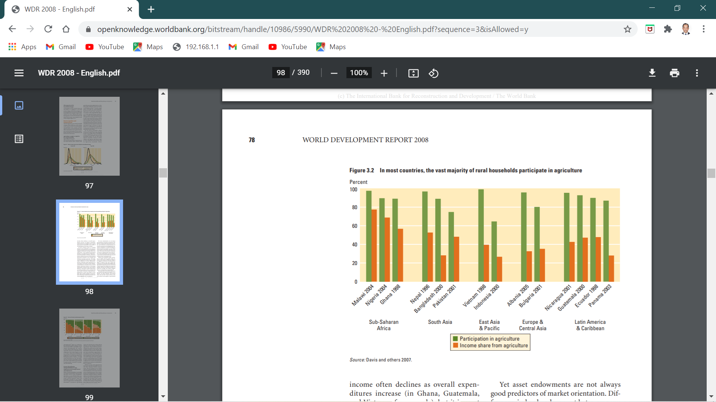
Structural transformation
Despite the importance of agriculture, the overall trend worldwide is that agriculture share of GDP is declining.
Initially at low levels of income, agriculture sector dominates in terms of share of GDP and employment.
As economies grow, agriculture accounts for a smaller share while the share of manufacturing and services increases
This is followed by a demographic transition whereby birth rates and death rates become lower

Slide 5
Agriculture Participation and income share

Slide 6
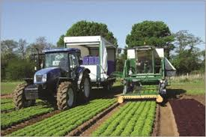
Phases of structural transformation
Phase 1: Increase in agricultural output per worker creates surplus in rural economy
Phase 2: Surplus is transferred to non agricultural sector (taxes, payment for agriculture inputs)
Phase 3: Integration of agriculture and non agriculture factors and market linkages; triggering rural-urban migration supported by improved mobility
Phase 4: agriculture sector is fully integrated into the economy

Slide 7
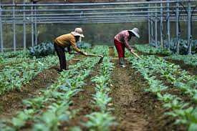
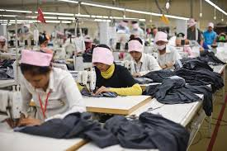
Labor surplus model (lewis, 1954)
Agriculture production is subject to diminishing returns because crops require land and land is fixed. To increase production, farmers move to poorer land
The agriculture sector has a large labor force, more than necessary to produce food. The surplus labor could be shifted to the industrial sector without reducing agricultural output
Employment will continue to shift from the agricultural to industrial sector until the decrease in agricultural employment will result in a decrease in agricultural output

Slide 8
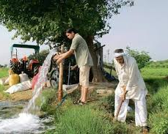
Agriculture and poverty alleviation
Economic growth tends to reduce poverty; however the effectiveness varies by country
In general, agricultural growth is more effective in reducing poverty compared to industrial growth because in most developing countries people are disproportionately concentrated in rural areas and most are poor

Slide 9
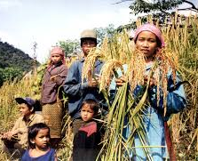
Agriculture and poverty alleviation
Pro-poor growth policies should include developing the agricultural sector
For agricultural producers, the effect on poverty alleviation depends on access to assets/land.
For rural workers it depends on access to increased employment opportunities; for consumers, greater supplies of food help bring down food prices

Slide 10
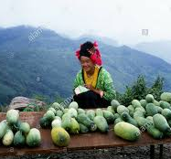
Agriculture and poverty alleviation
What specific opportunities does agricultural growth provide for pathways out of poverty?
First: subsistence oriented farmers increase their farm outputs
Second: engage in rural labor markets especially for non-farm work; non farm work can be used to invest in improved farming
Third: migrate to the urban economy; remittances back to rural areas can support household consumption and investment

Slide 11
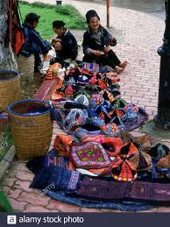
summary
The agriculture sector is unique from other sectors in the economy: it has a relatively large share of GDP and employment, has unique features of the agricultural function, a large share of sector’s output is consumed by producers, and agriculture’s role as a reservoir of resources
Structural transformation: dominant role of agriculture gradually recedes and replaced by industry and services. For the economy to grow, agriculture sector needs to improve productivity.

Slide 12
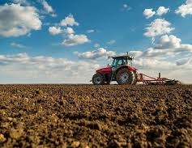
summary
Growth in agricultural productivity plays an important role in facilitating the release of labor and capital from agriculture for employment in industry and services
Agricultural growth is more effective in reducing poverty compared to industrial growth because in most developing countries people are disproportionately concentrated in rural areas and most are poor

