Slide 1
Wrap up session
EE463 Globalization and international development
Faculty of economics
Thammasat university

Slide 2

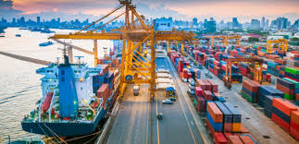
What is development? Globalization?
Growth = rise in national output
Development = growth + improvement in human well-being; requires structural change
Globalization: integration of national economies into the world economy; through trade, investments, movement of goods and people and technology

Slide 3
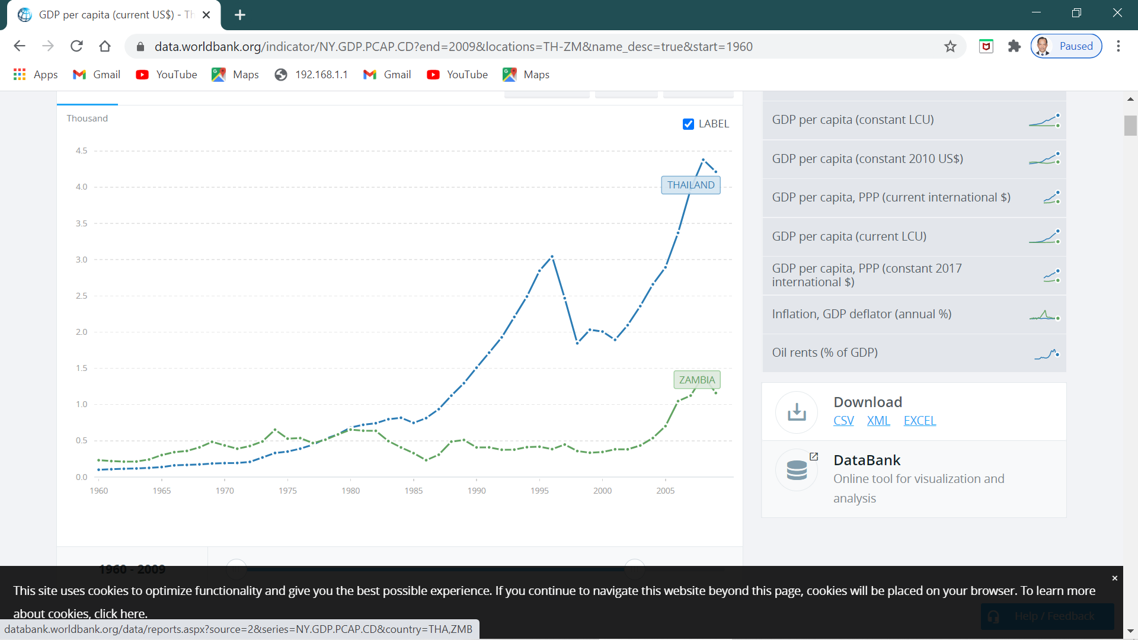
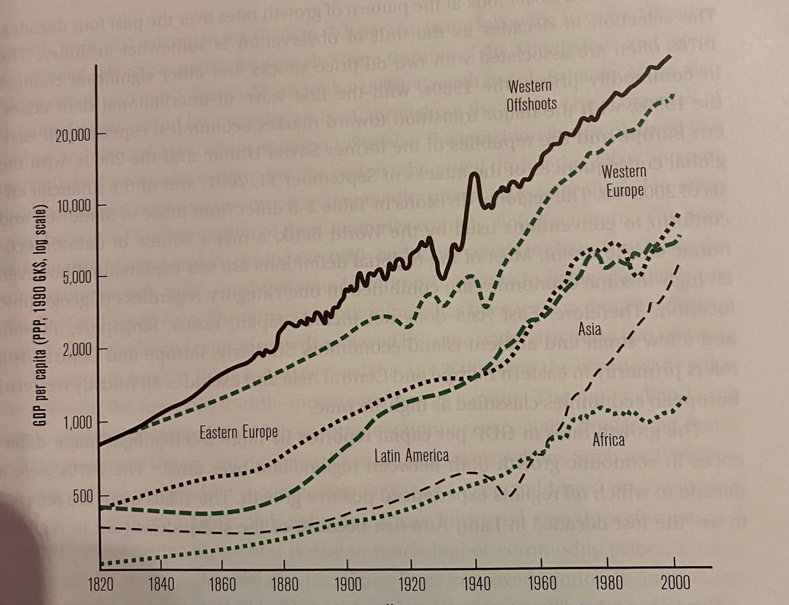
growth and development
Countries can grow or decline, depending on political system, demographics, trade, capital movements and technology
To develop from low-income to a high-income status, a country should be able to sustain economic growth for a long period of time, accompanied by structural change
Economic growth without development: wealth is concentrated in the hands of a few

Slide 4

Measuring growth and development
Growth is measured in GDP, GNP, GNI or output per capita
Development is measured by change in output together with human development and environmental indicators. Example: HDI

Slide 5


What determines economic growth?
Factor accumulation: increasing the size of the capital stock and/or increasing the labor force
Productivity growth: improving efficiency and introducing technological change

Slide 6
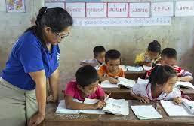
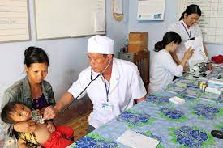
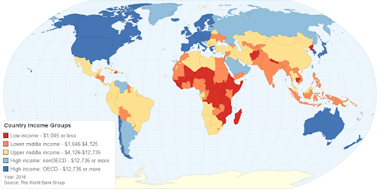
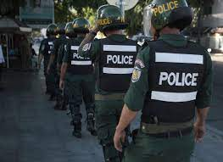
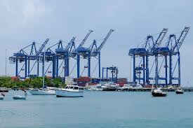
Drivers of economic growth
Investments in health and education
Effective governance and institutions
Favorable business environment
Trade openness
Favorable geography

Slide 7
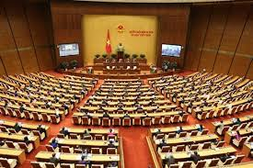
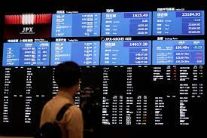
The state and market
The role of the state and market has been a central focus of debate
Adam Smith: economy is self-regulating; the state should not interfere
However the free market create externalities; the state should therefore address these through regulations, penalties and subsidies
Developing countries in general need strong government

Slide 8
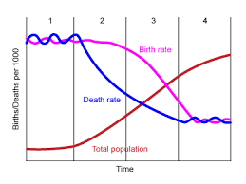
Demographic transition
Stage 1: High birth and death rates; no net population increase
Stage 2: Death rate declines quicker than birth rate; due to improved nutrition and availability of food supplies; this results in a net population increase
Stage 3: Declining birth and death rate: small net population increase
Stage 4: Birth rates decline faster than death rates: population growth close to 0

Slide 9
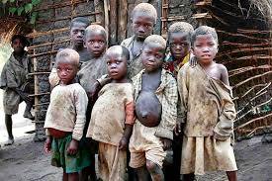
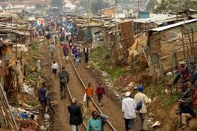
Poverty and inequality
Worldwide poverty is declining; however absolute numbers remain high
Raising people out of poverty requires economic growth; without economic growth people will remain poor
Economic growth alone is not sufficient; equitable distribution of income is also important
Measures of income inequality: Lorenz curve, Gini coefficient and frequency distribution

Slide 10
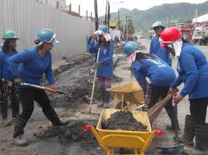
Poverty Alleviation strategies
Promote market-oriented growth by ensuring macroeconomic stability; opening up to trade and investments in infrastructure and improving credit markets
Invest in human capital by promoting health and education; provide basic services to the poor
Develop social safety nets for the poor and vulnerable

Slide 11
Key development sectors
and cross-cutting areas

Slide 12
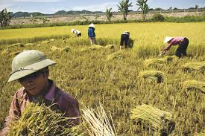

Agriculture
Low productivity: relatively large share of labor but low share of GDP
Subsistence: a large share of output is consumed by producers
Structural transformation: dominance of agriculture recedes and replaced by industry and services.
Economic growth requires improved agricultural productivity and excess labor to move to industry and services

Slide 13


Human development
Health and education are prerequisites for increases in productivity and expanded human capabilities
Greater health capital improves returns to investment in education; education enables increases in knowledge and skills
The rise in earnings of workers in advanced industrialized countries was due to the growth in human capital

Slide 14
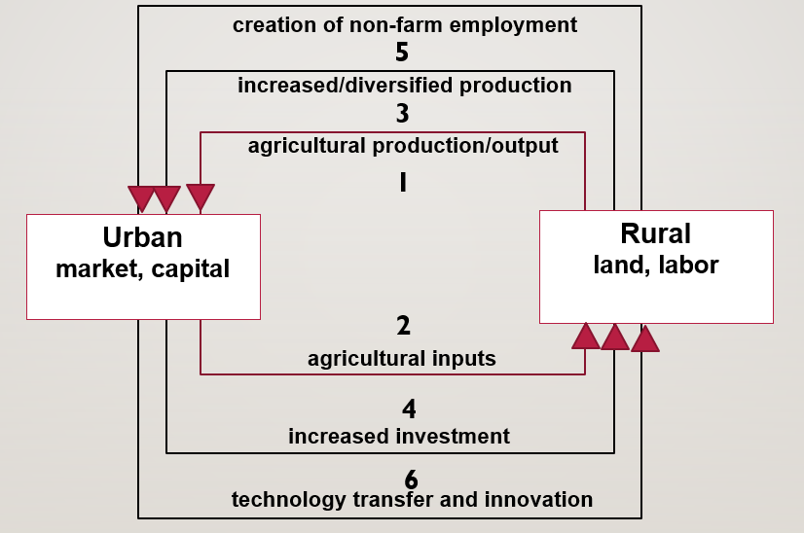
Urban and rural development
Cities provide economies of scale and agglomeration and cost advantages to producers and consumers; concentration of investments, infrastructure, and facilities
Rural transition: increased non-farm work, improved mobility, social change, rural diversification
Strengthened urban-rural linkages lead to increased economic growth

Slide 15
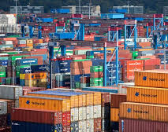
trade
Trade increases the amount of goods a country can consume, the quality and variety of goods and generates needed foreign currency
While trade provides opportunities for economic growth but there are winners and losers in the process
Types of trade policies: import substitution and export-led growth

Slide 16
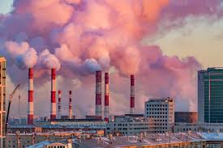

Environmental sustainability
Relationship between economic growth and the environment is complex
As economic activities increase, more pressure is put on the environment
However technology can be used to address environmental issues through efficiency with which we use resources
Sustainable development: development that meets the needs of the present generation without compromising the ability of future generations to meet their needs

Slide 17
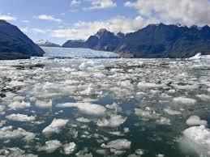
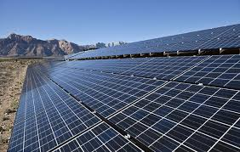
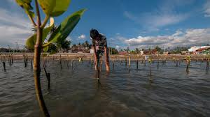
Climate change
Destruction of the forests and gas emissions contribute to climate change caused by global warming
Mean global surface temperature has risen by approximately 1.1°C; this impacts weather patterns, sea level and people’s livelihoods and wellbeing
To minimize the effects of climate change, steps must be taken: mitigation (reduce long term risks) and adaptation (adjust processes)

Slide 18
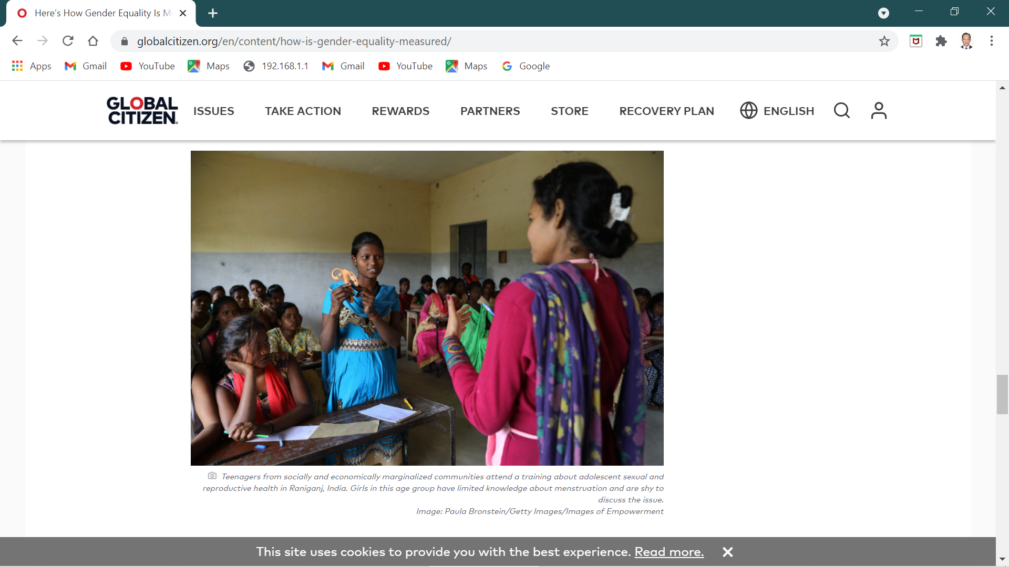
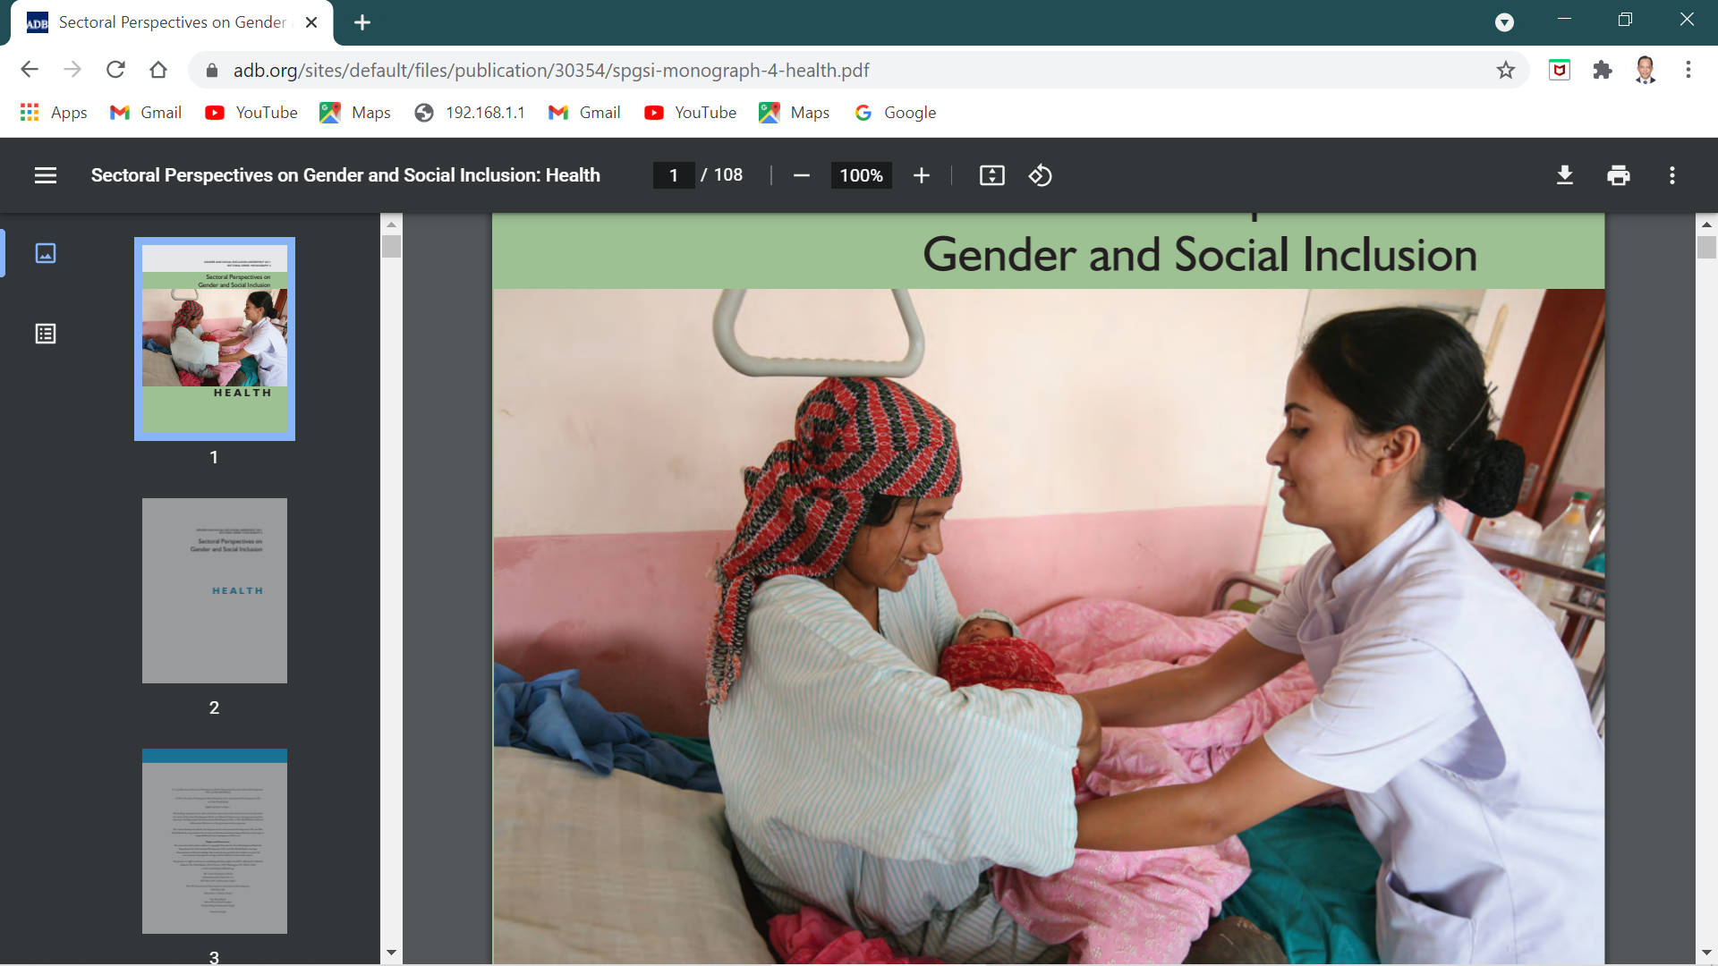
Gender
Absence of women’s participation means that the potential contribution of half of the population is unutilized, which signifies an economic loss
However there still exist systemic bias which prevents women’s participation: inequality, abuse, exclusion, and discrimination
Gender mainstreaming seeks to avoid the creation or reinforcement of inequalities, which can have adverse effects on both women and men

Slide 19
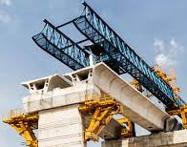
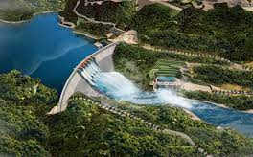
Foreign aid
Foreign aid: financial flows, technical assistance and commodities provided by one organization or country to another country for development purposes
It could have a positive impact on economic growth and development or a negative impact because of increased debt; it also depends on conditions set by the receiving government

Slide 20
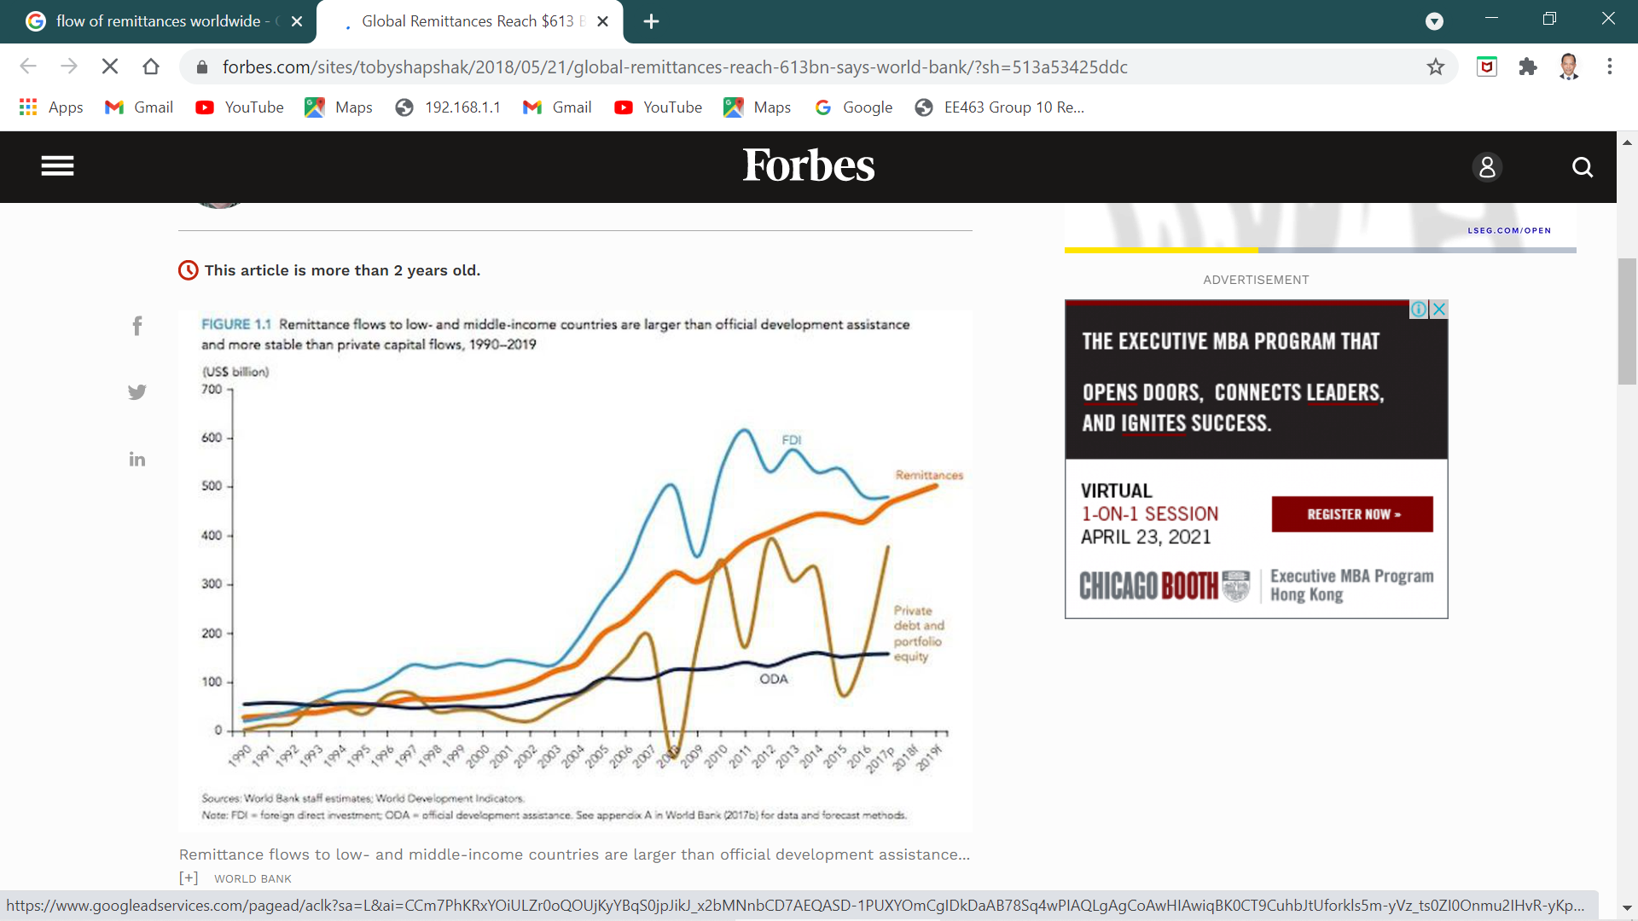
International Capital flows
Private foreign investments: foreign direct investments and portfolio investments
Official development assistance: transfers for development purposes
Remittances: payments from citizens abroad
Non-development aid

Slide 21
Summary: what we learned
Development
Countries develop and decline over time. When national outputs increase there is economic growth. When there are less outputs the economy contracts
Economic development occurs when economic growth is accompanied by improved living standards, institutions and governance. Sustained economic development in the long term enables the transformation of a poor country to an advanced country; long term contraction leads to economic decline
Several indicators are used to measure economic growth (GDP, GNP, GNI or per capita output) and economic development (HDI; literacy, mortality and poverty rates; and other socioeconomic indicators). These are not perfect, but used as proxy measures

Slide 22
Summary: what we learned
Globalization
The world is increasingly becoming interconnected. National economies are becoming integrated with the world economy through movement of capital, people and goods; communications and information; technology; and various types of transactions
Countries manage their relationships with other countries based on their national interests; the compatibility or incongruence of these interests lead to policy decisions on whether to engage in collaboration, conflict or war
Globalization creates winners and losers in the process; aside from the benefits, it also creates inequality, marginalization and conflicts

Slide 23
Summary: what we learned
Socioeconomic aspects in understanding economic development
Understanding how and why an economy develops or declines cannot be separated from the underlying socioeconomic conditions; there is a need to understand changes that occur through time
Demographic change: composition, trends, and size of population
Poverty and inequality: the extent of absolute and relative poverty, poverty rate and distribution of wealth in society
Indicators of human well being, in particular, health (mortality, life expectancy) as well as education (coverage, enrolment, retention, literacy rates)
Role of the state and market: the extent these key actors play a role in economic development

Slide 24
Summary: what we learned
The economy comprises key development sectors, each contributing in their own ways. These have been discussed at length throughout the course:
Agriculture
Health
Education
Transportation
Urban development
Trade
Others: Finance, Manufacturing, Public Administration, Tourism, Services

Slide 25
Summary: what we learned
There are also cross-cutting areas that apply to all sectors
Environment
Climate change
Gender
Governance
Capital flows

Slide 26
Why Study development economics?
Development economics helps us better understand domestic and world affairs
It equips us with analytical skills needed in the job market; its flexibility also helps the individual to adapt to various specialized areas
Due to its multidisciplinary nature, it provides policymakers a holistic view of the issues on hand, which greatly aids the decision-making process
It is uses multiple methods of inquiry, drawing from a variety of other fields

