Slide 1


RESEARCH GUIDELINES
Forumulating Questions
Example from MK 201
By Ajarn Suwalya K.

Slide 2
MK 201 Group Assignment…Due next class…
Research Aim, Objectives, and Questions
Each group is the write down your research aim.
Then write down 3 objectives in doing your research
Then you are to write 5 questions for each objective
with total of 15 questions
Please submit 3 ppt slides excluding cover max… 5 mins presentation.. we will have presentation next class...

Slide 3

RESEARCH…simple …
Research Aim: What do we want to find from this research?
Research Objectives: What ways can we achieve our aim?
Research Questions: What questions to ask consumers to achieve our objectives? (open ended questions)

Slide 4
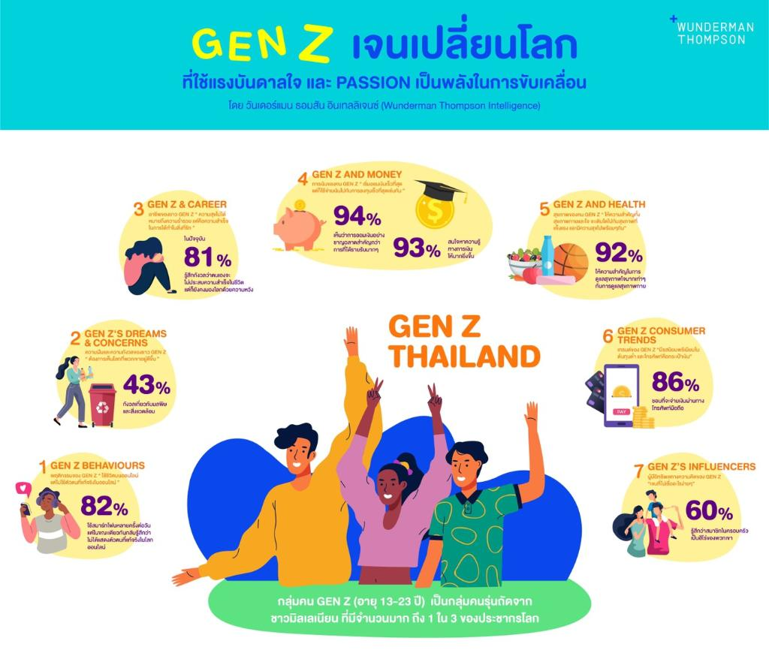
Research Aim: What insights we want to find from this research?
Example: To launch fashion products the meet the needs of Thais Gen Z

Slide 5

Research Objectives: What ways can we achieve the aim?
Research Aim: To launch fashion products the meet the needs of Thais Gen Z
Research Objectives:
Example: 1. To identify Gen Z shopping habits
2. To find what types of fashion influences Gen Z
3. What is the lifestyle of Gen Z

Slide 6
Research Questions: What questions to ask to achieve our objectives?
Research Objective: To identify Gen Z shopping habits
Research Questions:
1. Where do you normally shop?
2. When you shop what promotions do you look for?
3. What type of clothing and accessories do you normally buy?
4. When you go shopping do you go alone or with your friends, who do you go with?
5. How much do you spend when you go out shopping?

Slide 7
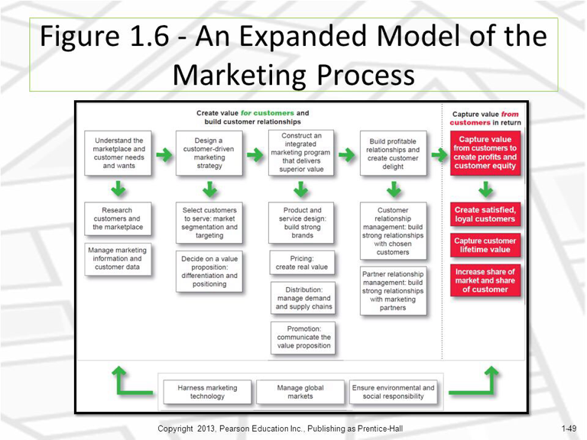
This is where the marketing process starts ….companies must identify and understand needs and wants!

Slide 8
Some tips …
No need to think about new product yet.
But you can ask on what product they wish not here in the market and why ...should be included to get new ideas.
Don't ask what you already know , not new or fresh. Your secondary data used for your group assignments have been great but not enough ...insights are deep and fresh...
You may want to find out more about trends , consumer pain point( problem., Opportunities, competitors, consumer usage habits or lifestyle, etc.
At this point get your research aim, objective and questions clear first ka...baby steps ...next class will discuss about your consumer in-depth research assignment.

Slide 9
Today's post is geared towards entrepreneurs who are launching a new product or service in the consumer space. It will show you key questions you can ask potential customers to determine if your business idea is feasible. Below are 20 questions to consider for your consumer market research survey:
Demographic Questions (this should not be included in research aim)
What is your age?
What is your gender?
What is your household size?
What is your household income?
What is your profession?
What is your education level?
Where do you live?
Psychographic Questions
You may want to ask about their interests, hobbies, opinions or anything else that will help you learn more about your customers.
Top 20 Consumer Market Research Questions | Cvent Blog

Slide 10
Buying Pattern Questions
Do you ever purchase _______?
If so, who in your household makes the buying decision?
Where do you go when you are looking for _______?
How often do you purchase _______?
How long does it take you to make a buying decision?
What is your typical budget for _______?
How far would you travel to make the purchase?
Benefits Questions
What features do you look for when you purchase _______?
What specific benefits do you look for in _______?
What problems motivate you to purchase _______?
What needs are you trying to meet when you purchase _______?
How do you hope _______will make your life better?
These questions can provide a jumping point for your consumer market research efforts.
Top 20 Consumer Market Research Questions | Cvent Blog

