Slide 1

BA 291 – Introduction to Business Management
By Aj. Parichat Jantori

Slide 2
Why study business?
Develop Skills for career success
Understand business activities
Importance of profitability
  Individual businesses
  Local and regional economic impact
  Global economic impact

Slide 3
Business
Business
Individuals or organizations trying to earn a profit by providing products that satisfy people's needs
Product
A good or service with tangible and intangible characteristic that provide satisfaction and service
Tangible Goods
Automobile
Computer
Loaf of bread
Television
  Intangible Goods
  Dry cleaning
  Photo processing
  Checkup at doctor’s
  Movie star performance

Slide 4
The goal of Business
The primary goal of all business is to earn a profit
Profit
The reward for the risks that businesses take in providing products
The different between what it costs to make and sell a product and what a customer pay for it (price)
V - P
Value creation: Performing activities that increase the value of goods or services to customers
V
V-C
P - C
P
C
C
Notes:
Value: when customers find consistently useful of a product or service and are willing to pay more for this features
Emotion benefits – people are feeling good to have it. Status symbol
The function or products features are need. People recognize it as necessary.

Slide 5
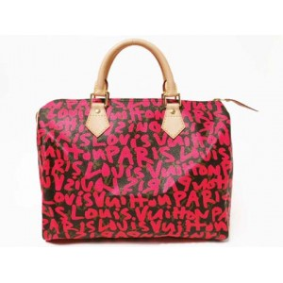
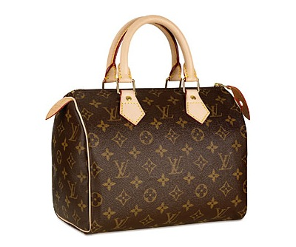
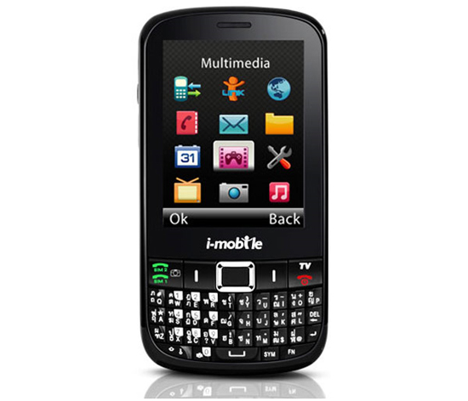
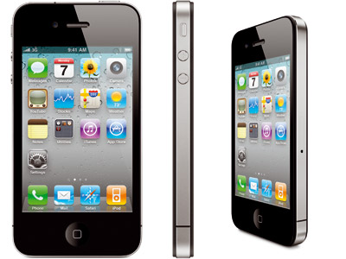

Slide 6
Organization
A deliberate arrangement of people to accomplish some specific purpose.
People
Purpose
Structure
Notes:
ยกตัวอย่าง อะไรคือองค์การ
คณะพาณิชยศาสตร์และการบัญชี (Thammasat business school)
Thammasat University
กระทรวงต่างประเทศ Foreign ministery
สมาคมศิษย์เก่าคณะพาณิชย์
โรงเรียนสวนกุหลาบวิทยาลัย The Traim udom students alumni
วัดพระเชตุพล วิมลมังคลาราม
บริษัท GMM Grammy The GMM Grammy company
คนขับรถเมล์ กับกระเป๋า The bus driver and the ticket sellers in a bus
คนยืนรอข้ามถนนร่วมกัน 5 people wating at the traffic light to cross the road
สมาคมผู้ค้าหมูแห่งประเทศไทย The assosication of thai farmers
สหภาพแรงงาน labour union
โต๊ะ ก ไก่ the ก ไก่ table

Slide 7
Organization
Are all the organizations businesses?
profit organization
A business or other organization whose primary goal is making money (a profit)
non-profit organization
Nonprofit organizations provide goods and services but do not have the fundamental purpose of earning profits.
Amnesty International, The Red Cross, UNESCO, World Wide Fund of Nature, SOS Children‘s Villages

Slide 8
Stakeholders
To achieve and maintain profitability, business have found that they must serve their stakeholders by producing quality products, operating efficiently and being socially responsible.
person, group, organization, or system who affects or can be affected by an organization's actions
Groups that have a stake in the success and outcomes of a business

Slide 9
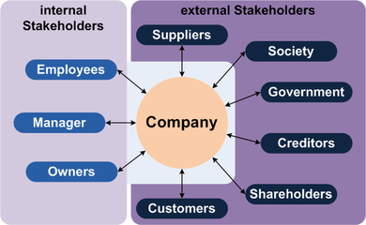
Stakeholders

Slide 10
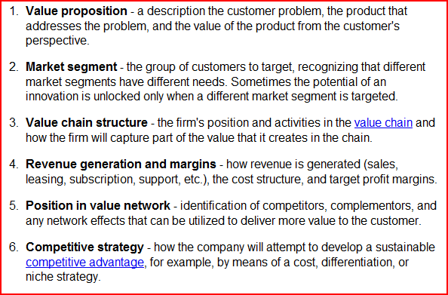
Business model
Business model is a plan implemented by a company to generate revenue and make a profit from operations

Slide 11
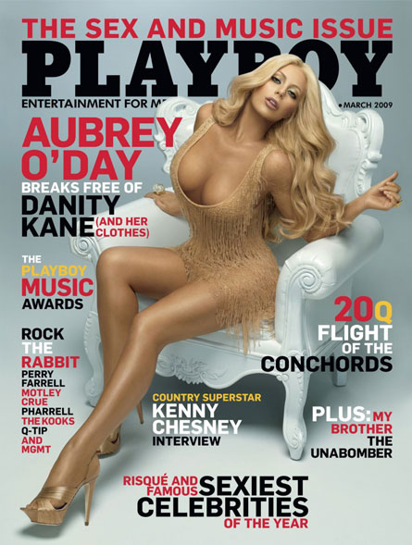
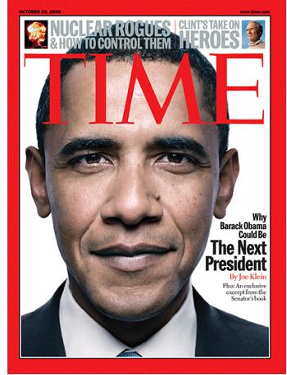
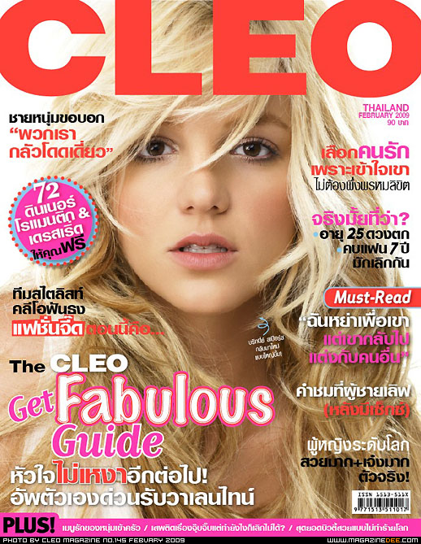

Slide 12
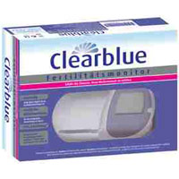



Slide 13
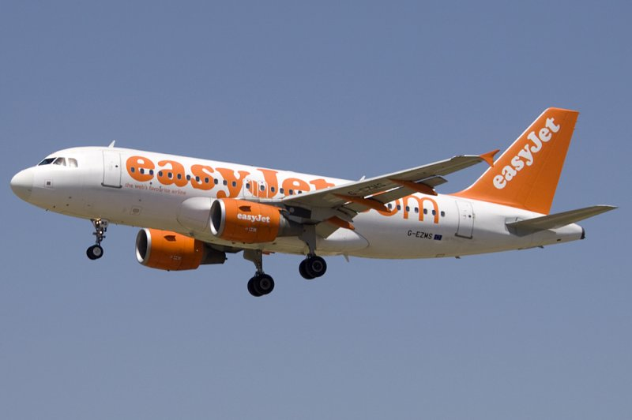
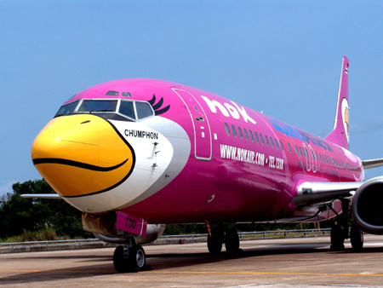

Slide 14
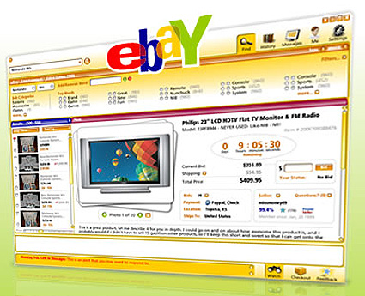
Notes:
http://en.wikipedia.org/wiki/Online_auction_business_model
The strategic advantages of this business model include:
No time constraints. Bids can be placed at any time (24/7). Items are listed for a number of days (usually between 1 and 10, at the discretion of the seller), giving purchasers time to search, decide, and bid. This convenience increases the number of bidders.
No geographical constraints. Sellers and bidders can participate from anywhere that has internet access. This makes them more accessible and reduces the cost of "attending" an auction. This increases the number of listed items (ie.: number of sellers) and the number of bids for each item (e.g.: number of bidders). The items do not need to be shipped to a central location, reducing costs, and reducing the seller'sminimum acceptable price.
Intensity of social interactions. The social interactions involved in the bidding process are very similar to gambling. The bidders wait in anticipation hoping they will "win." Much like gambling addiction, some bidders may bid primarily to "play the game" rather than to obtain products or services. This creates a highly loyal customer segment. This can also skew the prices of items/services/goods in the auction.
Large number of bidders. Because of the potential for a relatively low price, the broad scope of products and services available, the ease of access, and the social benefits of the auction process, there are a large number of bidders.
Large number of sellers. Because of the large number of bidders, the potential for a relatively high price, reduced selling costs, and ease of access, there are a large number of sellers.
Network economies. The large number of bidders will encourage more sellers, which, in turn, will encourage more bidders, which will encourage more sellers, etc., in a virtuous circle. The more the circle operates, the larger the system becomes, and the more valuable the business model becomes for all participants.
Captures consumers' surplus. Auctions are a form of first degree price discrimination. As such, they attempt to convert part of the consumers' surplus (defined as the area above the market price line but below the firm's demand curve) into producers' surplus.
[edit]

Slide 15
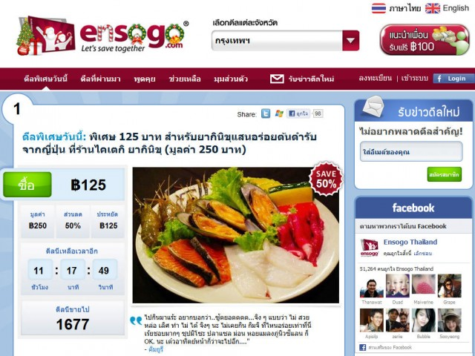
Notes:
http://en.wikipedia.org/wiki/Group_buying

Slide 16
The economic foundations of business
Economics – The study of how resources are distributed for the production of goods and services within a social system
- How to fulfill an unlimited demand for goods and services with a limited supply of resources
Resources
  Natural resources (land, forests, minerals, water)
  Human resources (labor)
  Financial resources (capital)

Slide 17
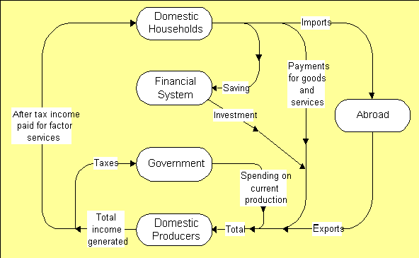
Micro- and marcoeconomics

Slide 18
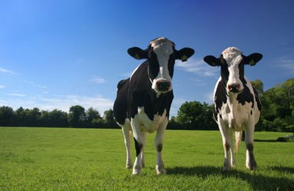
Economic system
You have two cows. Give one cow to your neighbor.
You have two cows. Give both cows to the government, and they may give you some of the milk.
You have two cows. Sell one cow and buy a bull.
(Boone & Kurtz; 2005)

Slide 19
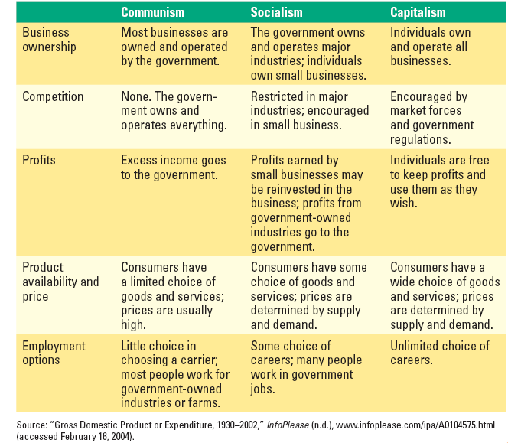
Economics system
A description of how a particular society distributes its resources to produce goods and service.

Slide 20
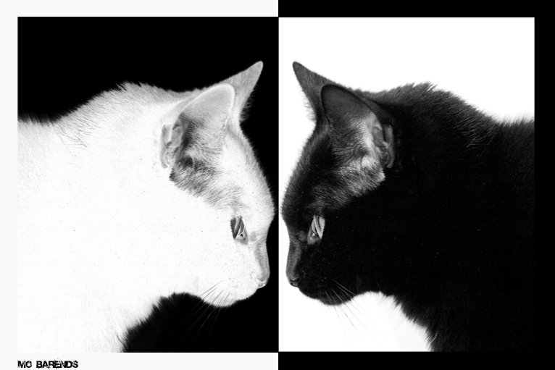
Mix economies
“No matter if it is a white cat or a black cat; as long as it can catch mice, it is a good cat”
Notes:
Mix economies . Have elements from more than one economic system

Slide 21
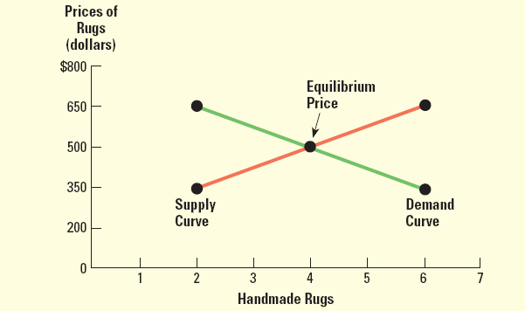
The forces of demand and supply
Demand -- number of goods/services consumers buy at given price at a specific time
Supply -- number of products businesses will sell at different prices at a specific time
Equilibrium price—The price at which the numbers of products that business are willing to supply equals the product consumers are willing to buy at a specific time
Notes:
Downward slope: The law of demand: the higher the price of a good, the less people will demand that good.
Upward slope: The law of supply: the higher the price, the higher the quantity supplied. Producers supply more at a higher price because selling a higher quantity at a higher price increases revenue.
http://www.investopedia.com/university/economics/economics3.asp

Slide 22
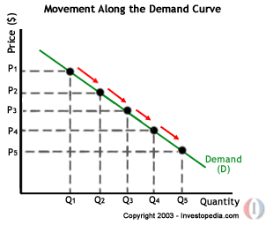
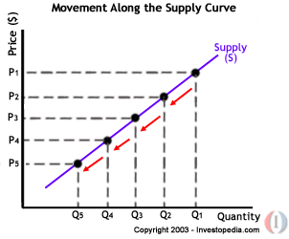
A movement along demand and supply curve
a movement along the demand curve will occur when the price of the good changes and the quantity demanded changes in accordance to the original demand relationship
a movement along the supply curve will occur when the price of the good changes and the quantity supplied changes in accordance to the original supply relationship.

Slide 23
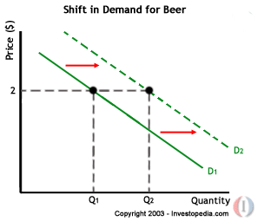
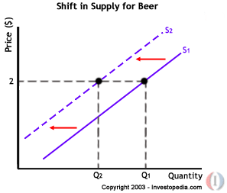
A shift in a demand and supply curve

Slide 24
The elasticity of demand
P
Inelastic
Elastic
P
P‘
Q
Notes:
http://www.investopedia.com/university/economics/economics4.asp

Slide 25
Factors Affecting Demand Elasticity
The availability of substitute
Time
Amount of income available to spend on the good
Price
type of goods (luxury goods, necessary goods, durable goods)
Notes:
ยกตัวอย่าง ยืดหยุ่นมาก ยืดหยุ่นน้อย
เป็นการดูว่า ถ้าราคาสินค้าเปลีย่น ความต้องการซื้อหรือปริมาณที่ผู้บริโภคซื้อจะเปลี่ยนไปมากขนาดไหน del q/ del p
สินค้ามี่ความยืดหยุ่นมาก เมื่อ เป็นสินค้าราคาแพง สินค้าฟุ่มเฟือย ทดเทนได้ง่าย เป็นสินค้าคงทน
สินค้าที่มีความยืดหยุ่นน้อย สินค้าที่มีความจำเป็นต่อชีวิตประจำวัน ทดแทนได้ยาก ราคาต่ำ
สินค้าที่มีความยืดหยุ่น เป็นศูนย์ คือเป็นของที่คนต้องซื้อต้องใช้จริงๆ

Slide 26
The nature of competition
Competition- the rivalry among businesses for consumers
Monopolistic competition – small number of businesses little difference in products
Oligopoly– very few businesses selling a product
Monopoly – There is only one business providing a product in a given market.
Pure competition – many small businesses in same product market
Notes:
Pro/ con of each type?

Slide 27
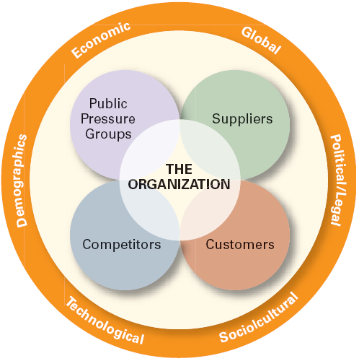
Business environment

Slide 28
Political/ Legal Forces
Political Risks
Expropriation of corporate assets without prompt and adequate compensation
Forced sale of equity to host-country nationals, usually at or below depreciated book value
Discriminatory treatment against foreign firms in the application of regulations or laws
Barriers to repatriation of funds (profits or equity)
Loss of technology or other intellectual property (such as patents, trademarks, or trade names)
Interference in managerial decision making
Dishonesty by government officials, including cancelling or altering contractual agreements, extortion demands, and so forth
Notes:
How can political situations affect your business?
Policy, tax
Political stabiliy and the investment atmosphere

Slide 29
Political/ Legal Forces
Trade restriction
Import Tariff – a tax levied by a nation on goods imported into the country
Exchange controls – regulations that restrict the amount of currency that can be bought or sold
Quota – a restriction on the number of units of a particular product that can be imported into a country
Embargo– a prohibition on trade in a particular product
Dumping – the act of a country or business selling products at less than what it costs to produce them
Notes:
How can political situations affect your business?
Policy, tax
Political stabiliy and the investment atmosphere

Slide 30
Political/ Legal Forces
Dumping
Fair trade organisations warn against newly increased European Union (EU) quotas for milk production and continued high export subsidies, which will lead to increased milk and butter dumping on world markets.
EU Ministers have renegotiated the CAP, which due to heavy subsidies consumes around 50% of Union budgets, and had a special tough time reaching a solution on milk quotas, which some countries wanted abandoned altogether
This will lead to cheaper milk in the EU and an even greater pressure to export dairy products. Excessive diary products will increasingly be "dumped" at the world markets, the organisations predict.
This kind of dumping does not do anything to fight poverty and hunger. Especially when it comes to milk, EU policies are ruining local development.

Slide 31
Legal Forces
Business related law
- Company law
Product safety and liability, labeling requirement
Tax law
Regulations on accounting
Labor law
Environment law

Slide 32
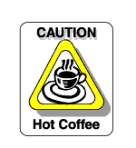
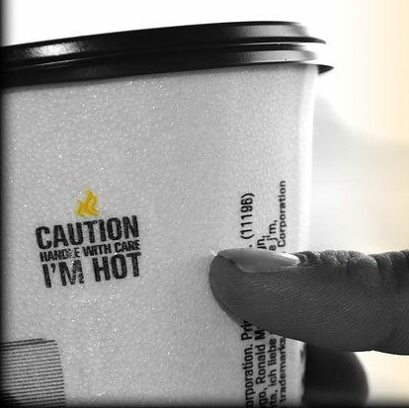
Legal Forces
Liebeck v. McDonald's Restaurants (McDonald's coffee case and the hot coffee lawsuit)
a woman who was heavily burned by hot coffee purchased from fast food restaurant McDonald's was rewarded $2.86 million.
Her attorneys argued that McDonald's coffee was "defective," claiming it was too hot and more likely to cause serious injury than coffee served at any other establishment

Slide 33
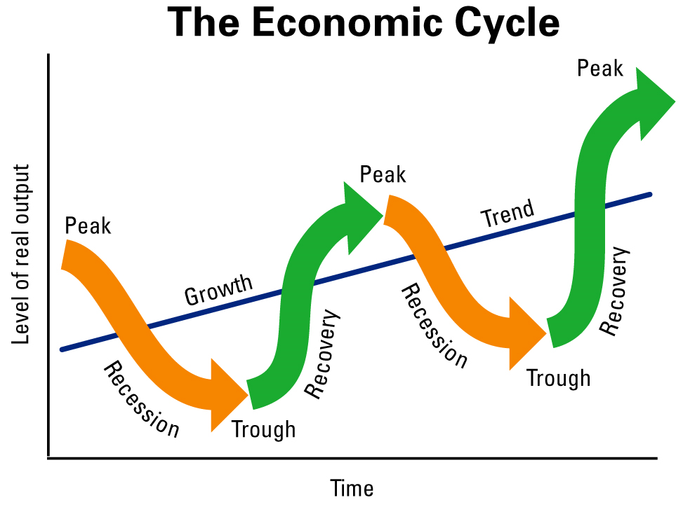
Economic forces
Economic cycle
Business decisions and consumer behavior differ at various stages of the business cycle:
  Prosperity—High consumer confidence, businesses expanding
  Recession—Cyclical economic contraction lasting for six months or longer
  Depression—Extended recession
  Recovery—Declining unemployment, increasing business activity
Notes:
How do you do diagnostic your economic health?
Using indicator

Slide 34
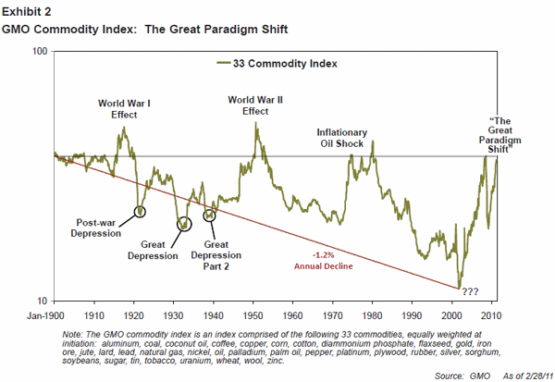
Commodity Index

Slide 35
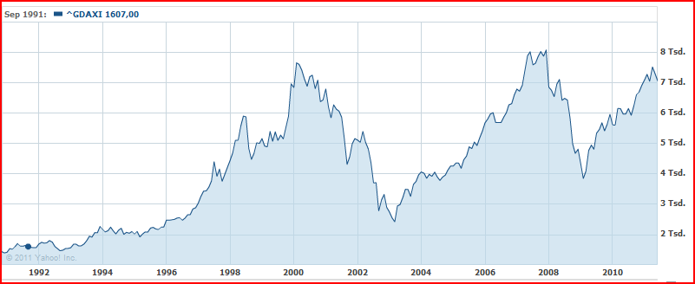
The development of stock market (DAX)
9-11
Subprime

Slide 36
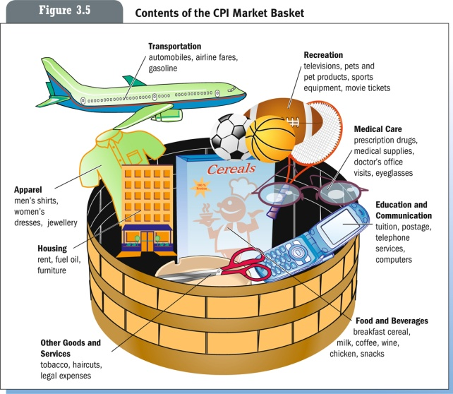
Inflation
Inflation: The rate at which the general level of prices for goods and services is rising, and, subsequently, purchasing power is falling (Consumer price index)
Core inflation: a measure of inflation which excludes certain items that face volatile price movements
Headline inflation: measure of the total
inflation within an economy

Slide 37
Cause of inflation
Demand-pull inflation caused by increases in aggregate demand due to increased private and government spending
Cost-push inflation, also called "supply shock inflation," is caused by a drop in aggregate supply (potential output). This may be due to natural disasters, or increased prices of inputs.
Built-In inflation is often linked to the "price/wage spiral".

Slide 38
Interest Rate
The fee charged by a lender to a borrower for the use of borrowed
money, usually expressed as an annual percentage of the principal
Repurchase rate
deposit rate: current account, saving account, time deposit
Loan rate: MLR, MOR, MRR

Slide 39
Unemployment rate
Frictional unemployment: is the time period between jobs when a worker moves from one job to another.
Seasonal unemployment: Unemployment expected at a given time of year
Cyclical unemployment: occurs when there is not enough aggregate demand in the economy.
Structural unemployment: occurs when a labor market is unable to provide jobs for everyone who wants one because there is a mismatch between the skills of the unemployed workers and the skills needed for the available jobs

Slide 40
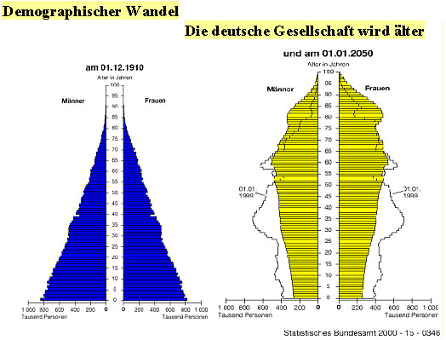
Demographics condition
Physical characteristics of a population such as:
Gender
Level of education
Geographic location, Immigration
Income
Family composition
Age

Slide 41


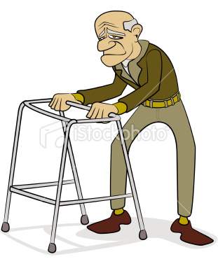
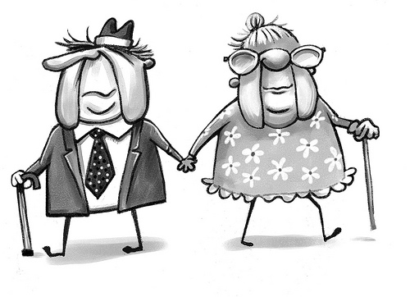
Your task:
Think about the recent demographic trend in Thailand and try to identify your market opportunities.
Notes:
http://sawangkanives.com/

Slide 42
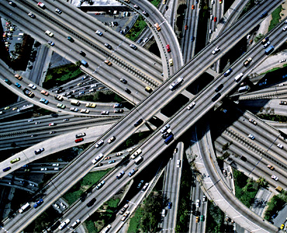
Infrastructure
Infrastructure
The physical facilities that support economic activities, including railroads, highways, ports, airfields, utilities, power plants, schools, hospitals, and commercial distribution systems.

Slide 43
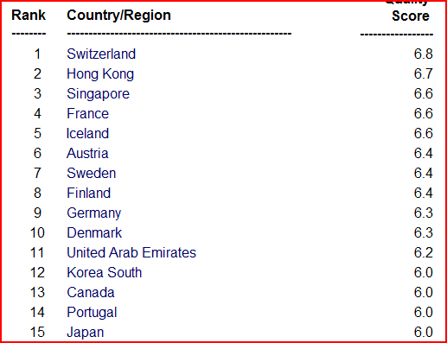
Quality of overall infrastructure ranking
Source: World Economics Forum, 2011
Notes:
Thailand Platz 41

Slide 44
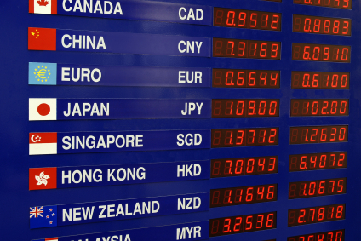
Exchange Rates
The ratio at which one nation’s currency can be exchanged for another nation’s currency
Appreciation: An increase in the value (money) of an asset over time
Depreciation: A decrease in the value of an asset over time

Slide 45
Exchange Rate
„The euro briefly traded as low as Y108 on Monday, its weakest level since November 2001. The resulting loss of buying power among European consumers is a serious problem for Japanese exporters such as Sony, whose profit forecast for the year to March 2011 assumes an average exchange rate of Y125 to the euro. The divergence could cost the electronics group Y100bn this year.” […]
The financial turmoil in Europe, which is hitting the euro, is creating additional problems for Japanese companies. Hitachi, for example, has said some of its projects are being delayed by financing issues. The weaker euro, which has lost 5.9 per cent against the yen over the past month, also makes European manufacturers more competitive. […]” (Financial Times, 8.06.2010)

Slide 46
Exchange Rate
One of the world’s largest airlines, Japan Air lines (JAL), is also one of the best customers of Boeing. JAL orders an aircraft two to six-years before the plane is actually needed and normally pays Boeing a 10 percent deposit when ordering. The bulk of the payment is made when the aircraft is delivered. In the interval between placing an order and making final payment, the value of the yen against the dollar may change. This can increase or decrease the cost of an aircraft […]
Sources: Hill, C. (2002): Global Business, McGrawHill, P. 258.

Slide 47
Currency Exposure
Transaction exposure: the extent to which the income from individual transactions is affected by fluctuations in foreign exchange values
Translation exposure: the impact of currency exchange rate changes on the reported financial statements of a company
Economic exposure: the extent to which a firm’s future international earning power is affected by changes in exchange rates

Slide 48
Socio-Cultural Forces
Culture
The sum total of beliefs, rules, techniques, institutions, and artifacts that characterize human populations.
Consists of learned patterns of behavior common to the members of a given society.
The unique lifestyle of a particular group of people.
Notes:
In business negotiating
Doing business abroad: see the VDO
http://www.youtube.com/watch?v=sSLPEwvVvN0&feature=related

Slide 49
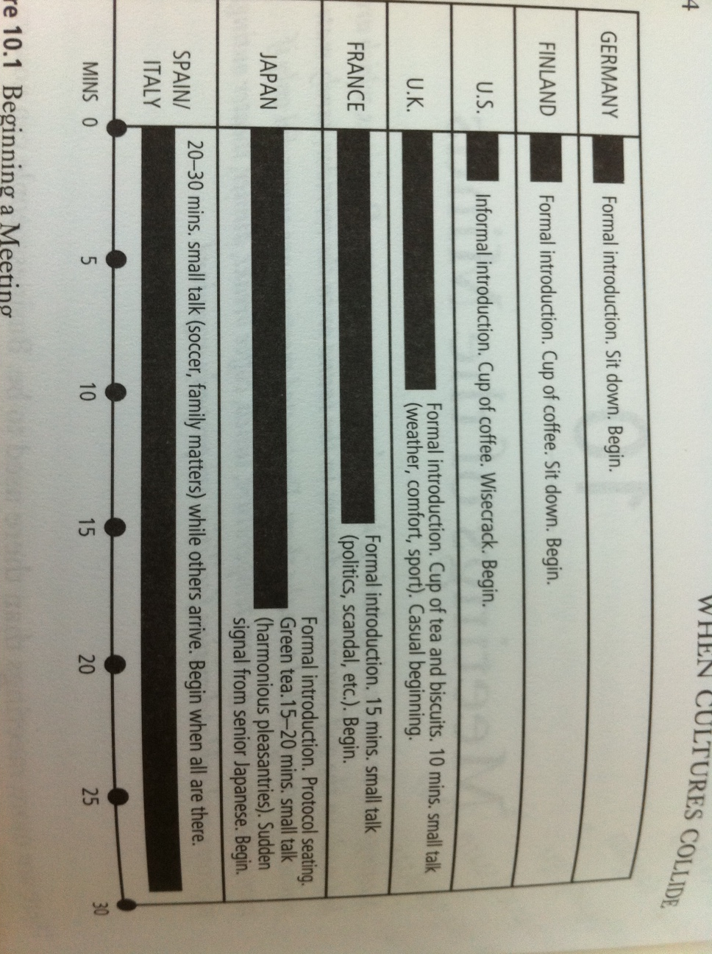
Culture
Structure of Meeting

Slide 50
Technological Forces
Technology can be defined as the method or technique for converting inputs to outputs in accomplishing a specific task.
Changes in the technological environment have had some of the most dramatic effects on business. A company may be thoroughly committed to a particular type of technology, and may have made major investments in equipment and training only to see a new, more innovative and cost-effective technology emerge.

Slide 51
Internal environment
The internal environment of an organization contains the internal resources (funding, employee, skills, know-how)and possesses internal capabilities (process, management system) and core competencies. The organization needs to conduct the internal analysis figure out loopholes in resources, capabilities, and core competencies.
This enables the firm to devise suitable strategies for closing the gaps in the aforesaid internal components

Slide 52
Getting Involved in International Business
International Business: the buying, selling, and trading of goods and services across national boundaries.
Exporting and Importing are entry-level strategies
  Importing is the process of bringing in goods produced abroad
  Exporting is the act of selling your goods overseas
Licensing
A trade agreement in which one company (licensor) allows another company (licensee) to use its company name, products, patents, brands, trademarks, etc. in exchange for a fee or royalty.
Franchising
Franchising is a form of licensing where a company (franchiser) agrees to provide a franchisee a name, logo, operational guidelines, products, etc, in return for a financial commitment and the agreement to conduct business in accord with the franchiser’s standard of operations.

Slide 53
Getting Involved in International Business
Contract Manufacturing -- The hiring of a foreign company to produce a specified volume of the initiating company’s product to specification; the final product carries the domestic firm’s name
Joint venture – the sharing of the costs and operation of a business between a foreign company and a local partner
Direct investment – the ownership of overseas facilities

Slide 54
Getting Involved in International Business
The relocation of business processes to a lower-cost overseas location is offshoring
  Not initiating business but gaining cost savings
  Extremely controversial
Outsourcing
  refers to the process of contracting to a third-party
  Advantages: Concentrate on core business, core competence, Cost reduction, Increase efficiency and quality
  Disadvantages: Lost of managerial control, bad image, Security and confidentiality issues

