Slide 1

Key Elements to join
Music Streaming Services
Spotify VS other services

Slide 2



01 - Introduction
Start in the early of 1990s
20 century
Every platform has to create their own uniqueness of the feature to attract customers.The intense competition among music streaming platforms is now making consumers more difficult to choose the right style for themselves. However, the variables that affect consumer decisions are adjusted to create the key differentiate of each company.
Present time
Notes:
With music being one of the central pillars of culture, alterations to the music industry often have acute social effects and are manifested in day-to-day life.
Music streaming industry start since the early of 1990s.
Up until the present time with technological advancement
The increasing trend of the industry emerge new company and every music streaming services develop at most of their capability to capture market as much as they possible
Every of their main feature quite similar, but they need to create their own uniqueness of the feature to attract customers.
The intense competition among themselves is now making consumers more difficult to choose the right style for themselves as well.
The variables that affect consumer decisions are also adjusted to create the key differentiate.

Slide 3
01 - Introduction
Start in the early of 1990s
20 century
Spotify was launched to tackle the issues of music piracy, offering a seemingly infinite, catalog of music for audiences Rather than get paid per download, artists would receive part of a royalty payment each time their song was streamed.
Spotify's business model relied on driving revenue from
1) advertisements played on Spotify's free version
2) subscription fees incurred to access Spotify's ad-free Premium service.
At that time even Spotify was not the first platform to emerge but their best quality rapidly gained much attraction from new users until now.
Present time

Slide 4
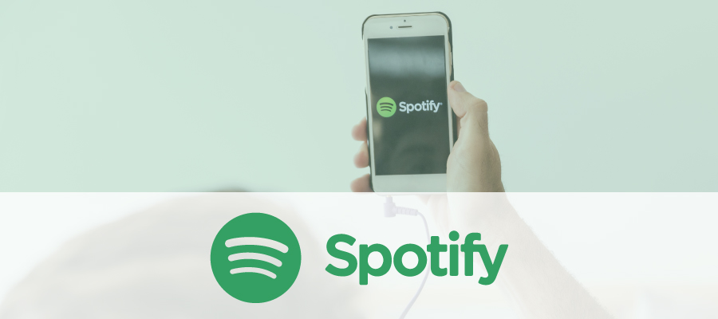
01 - Introduction
Music streaming service market (globally)
32% over last two years
34% of Market share
Even not the first emerged company, but hold large market share since then
HIGHEST
intense competition among
music streaming platforms
WHAT VARIABLES ??
affect user decision to choose platform
Notes:
From previous research the music streaming market expand for more than 32 % over last 2 years
According to last year record of global streaming market share, Spotify got the highest market share at 34%
Although each music streaming platform already create their unique point, they are currently face challenges to find how to gain more user
and what are their exact key differentiation to attract customer like Spotify?

Slide 5
02 - Objective
What key elements affect customer decision in choosing music streaming service?
What are those relationships between each music streaming service and its consumer’s behavior?
What reasons behind those decisions?
How does Spotify match up to its competitors?
Notes:
The research will revolve around these questions from the study objective

Slide 6
03 - Literature Review
RATTAPON JANGWAN (2016)
Consider user who subscribe for free accounts and those who have paid monthly flat rate for the services
About 60% of thai people have low disposable income compared to other Asian countries.
Thai people have low willingness to pay for monthly subscriptions for two reasons.
there is still widespread of piracy in the country.
the cost of mobile data needed to use for the services is relatively high compared to their income level.
The current cost of using a paid account for online music streaming services are averagely only suitable for the income level of high-end smartphone users.
Advertising on music streaming is still relatively low compared to other markets

Slide 7
03 - Literature Review
Alexander Benlian, Jonathan Dörr, Thomas Hess,
and Thomas Wagner
Identified the music piracy which made the transition from illegal to legal listening
Their research found that the provider identifies music as a service or MaaS and offers benefits that piracy does not.
First, they found that customers who spend most of their time listening to a lot of music may enjoy streaming services
more because of the increased sound quality of the legal streaming sites.
Secondly, consumers' interest to purchase depend on their willingness to pay simultaneously
with their ability to pay for the product and services.
Through willingness and ability to pay and also change in purchasing habits, it influences diverse elements such as
cultural factors, social factors, psychological factors, personal factors, the influence of family members, economic factors and social media. These factors are not considered by marketers but in fact should be taken into account to determine
how far the factors that affect consumer behavior consumer purchases (Kotler & Keller, 2012).

Slide 8
03 - Literature Review
Linus Adolfsson and Eric BonFré(2020),
Analyze the competitive advantage of each music steam service,
empirical data would focus to understand the source of its clearly
Freemium
Product & Feature
Catalogue
Brand
initial selling advertisements
tested to find out what the customers wanted
focus on domestic song preference
can gain more market share in that region
awareness, consideration,
and net promoter score (NPS)
Firstly, freemium models have always been used as an initial selling advertisement. That is why it requires a constant balancing between providing a sufficiently good experience for its free users whilst providing enough value-add for its premium users.
Secondly, the library of songs and albums offered to customers could possibly be important as much as the key differentiation. The one who focuses on domestic songs can gain more market share in that region.
Thirdly, with an intense innovative environment among music streaming services, features were initially tested to find out what the customers wanted.
Fourthly, music streaming providers overall track various metrics related to its brand, such as awareness, consideration, and net promoter score (NPS). Being the top-of-mind brand associated with music streaming is very important, as long as of course the NPS for it is positive.

Slide 9
04 - Theoretical Framework
Porter’s Five Competitive Force
New Entry
How easy the competitors could possibly come in the same industries.
Suppliers
Buyers
This is determined by how easy it is for your suppliers to increase their prices.
How easy it is for buyers to drive your prices down.
Competitive Rivalry
Substitutes
This looks at the number and strength of your competitors.
This refers to the likelihood of your customers finding a different way of doing what you do.

Slide 10
04 - Theoretical Framework
4P marketing
4C marketing
product
consumer
need and want
The difference is that 4C focus on what customer perceive
Their need
Their situation
Their experience
Their satisfaction
provides
price
cost
represents
place
convenience
provides
promotion
communication
enables
Notes:
4P marketing is one of the fundamental theories in business proposed by E. Jerome McCathy, an american marketing professor who wants to consult and manage systematic marketing. However many other marketers saw this theory as too much focusing on product and internal factors are possibly control based on budget, human resource and innovation.
Thus 4C was introduced to adjust the uncontrollable external factors, for instance, economic problems, competition, consumer belief and preferences.
These two theories are applied to business called marketing mix. 4P included product, price, place and promotion while 4c included consumer, cost, convenience and communication which paired respectively.

Slide 11
05 - Methodology
Secondary researched data
Porter’s 5 forces
To find each service competitive advantage.
Marketing Mix
To compare their key differentiate.
Primary researched data
Survey
To find consumer behavior and reason affecting their decision
Notes:
For the secondary data collecting, I use the porter five force as a tool for analyzing the current industry profitability and attractiveness by using the outside-in perspective, as well as marketing mix to compare their features and benefits and what are their the production and marketing strategy. For the primary data collecting, I had conduct the online survey to collect user behavior and attitude behind their choosing decision.

Slide 12
06 - Results and Conclusion
Respondent’s Demographic |  | n | %
Age | under 18 years old | 67 | 19.1
 | 19-25 years old | 132 | 37.7
 | 26-30 years old | 34 | 9.7
 | above 30 years old | 117 | 33.4
Occupation | student | 132 | 37.7
 | employee | 107 | 30.6
 | employer/ business owner | 34 | 9.7
 | freelance | 27 | 7.7
 | government officer | 20 | 5.7
 | other | 30 | 8.6
Income/ Monthly salary | less than 15,000 baht | 148 | 42.4
 | between 15,000 and 35,000 | 123 | 35
 | more than 35,000 | 79 | 22.6
Notes:
The demographic data results highest percentage in aged 19-25 years old, in occupation who were student and in income which less than 15,000 baht

Slide 13
Respondent’s Consumption Behavior |  | n | %
Mobile operating system | IOS | 219 | 62.6
 | Android | 131 | 37.4
What is your current music streaming service? | Spotify | 181 | 51.7
 | Youtube | 94 | 26.9
 | Apple music | 32 | 9.1
 | Joox | 40 | 11.4
 | Google music | 2 | 0.6
 | Amazon music | 1 | 0.3
 | Tidal | 0 | 0
 | Other | 0 | 0
Notes:
In consumer behavior part, most of people were using iOS operating system and use Spotify at highest percentage follow by YouTube
Spotify listeners are twice as engaged as YouTube users and five times as engaged as joox and apple music users.

Slide 14
Do you use a premium subscription? | yes | 199 | 56.7
 | no | 151 | 43.3
How long do you spend time on that service in a day? | less than 1 hour | 94 | 26.86
 | between 1 and 4 hour | 189 | 54
 | more than 4 hour | 67 | 19.14
How much is your reasonable price for music streaming subscription? | 59-99 baht | 197 | 56.29
 | 100-159 baht | 116 | 33.14
 | 160-199 baht | 25 | 7.14
 | above 200 baht | 12 | 3.43
Notes:
Most of people told that they pay for the subscription and use the service for 1-4 hour a day
And their reasonable price were mostly vote for at 59-99 baht followed by 100-159

Slide 15
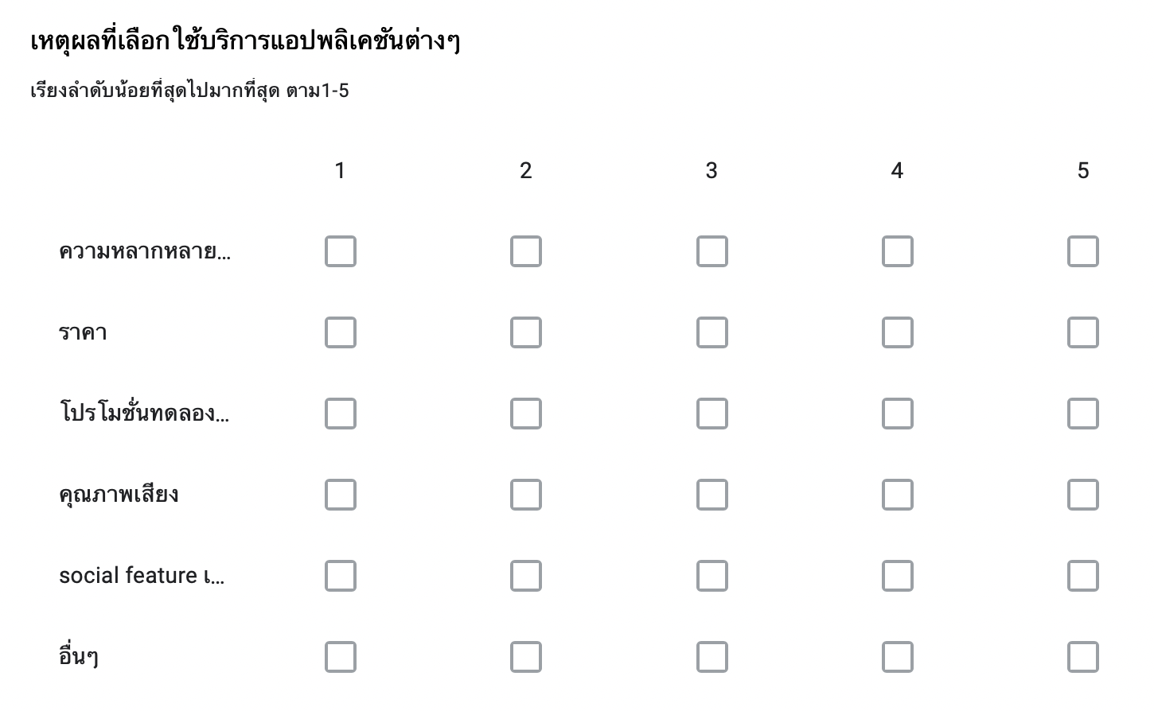
Rate the reason affect your decision in choosing Music Streaming Service

Slide 16
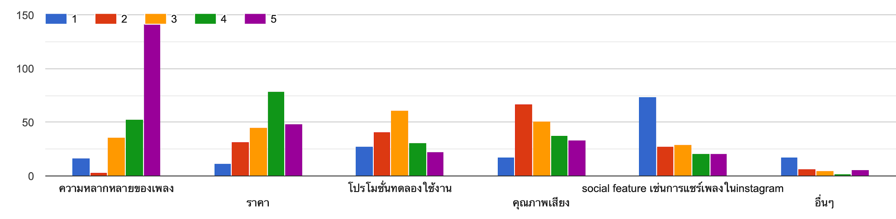
Reason behind consumer decision | Scale voted |  |  |  |  | Mode
 | 1 | 2 | 3 | 4 | 5 | rate | n (respondent)
Music library | 17 | 3 | 36 | 53 | 142 | 5 | 142
Price | 11 | 32 | 45 | 79 | 48 | 4 | 79
Free trial | 28 | 41 | 61 | 31 | 23 | 3 | 61
Music quality | 18 | 67 | 50 | 38 | 34 | 2 | 67
Social feature | 73 | 28 | 29 | 21 | 19 | 1 | 73
Given multiple selections to respondents about reason to choose each service, most of respondent concern about the diversity of music library.
Notes:
The last question of the survey is for finding reason behind consumer decision. Given multiple selections to respondents about reason to choose each service, the strongest impact comes from the music library range, followed by price, free trial promotion, music quality and the social feature.

Slide 17
Reason behind consumer decision | Mode of 199 subscribed users |  |  | Mode of 151 normal users
 | rate | n | % | rate | n | %
Music library | 5 | 70 | 35.17 | 5 | 42 | 21.10
Price | 4 | 40 | 20.10 | 5 | 32 | 21.19
Free trial | 3 | 29 | 14.57 | 3 | 18 | 29.03
Music quality | 2 | 28 | 14.07 | 2 | 23 | 32.39
Social feature | 1 | 37 | 18.59 | 1 | 20 | 40.82
In terms of the reason behind the user's decision for choosing each music streaming service, respondents were given multiple selections to rate scale of answer options (1-5 from less to the most accurate preference) from these reasons; music library, price, free trial, music quality, social feature, etc. The table shows that the music library had the highest exposure toward all respondents at 40.57% followed by 22.57% of who aware about price, 20.85% of who aware of social feature, 19.14% of who aware of music quality and 17.43% of who aware of free trial promotion.
However, if we separately consider subscriber and non-subscriber, the percentage from overall voters from each category shows that unsubscriber are more concerned about price as much as the music library.

Slide 18
What is your current music streaming service? | Do you use a premium subscription? | Average scale
 |  | Music library | Price | Free trial | Music quality | Social feature
Spotify | yes | 4.65060241 | 3.342857143 | 2.685714286 | 2.9875 | 2.4
 | no | 4.428571429 | 4.292682927 | 4 | 3.291666667 | 3
Youtube | yes | 3.780487805 | 3.37037037 | 2.857142857 | 2.55 | 2.5
 | no | 3.885714286 | 3.285714286 | 2.772727273 | 2.958333333 | 1.913043478
Apple music | yes | 4.133333333 | 3.821428571 | 2.4 | 2.965517241 | 2.074074074
 | no | - | - | - | 4 | -
Joox | yes | 4 | 2.857142857 | 3 | 3.142857143 | 1.857142857
 | no | 3.857142857 | 3.3 | 3.166666667 | 3.333333333 | 2.631578947
Google music | yes | 3 | - | - | - | -
 | no | 5 | 3 | 4 | 2 | -
Amazon music | yes | 3 | - | - | - | -
 | no | - | - | - | - | -
For more specifically, using the pivot table to determine the average score of reason behind customer decisions among users of each application and to find the relationships of each demographic category.
Even the table shows that unsubscriber are more hesitant about monthly price, both paid and not paid users still got an alike number of percentages.

Slide 19
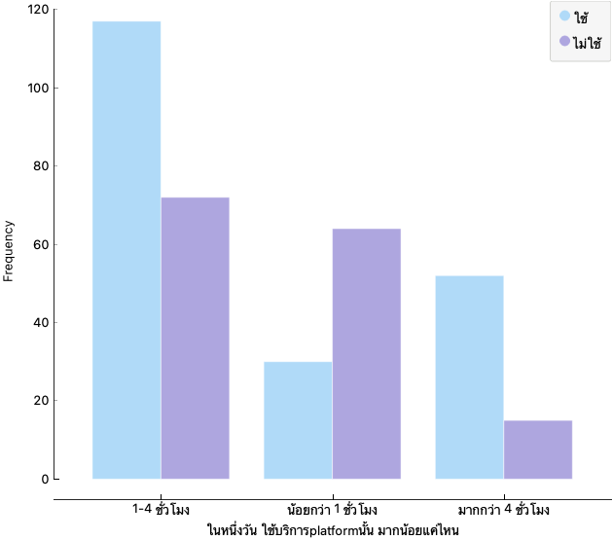
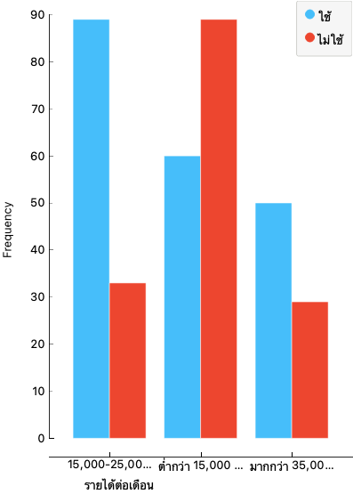
There is a barrier to entry for paid users. The theoretical discussion about the challenge faced by streaming providers. Those who earn less than 15,000 per month and who spend time on music streaming service per day less than one hour a day would not prefer to pay for subscription. Secondly, the reason behind the fact that people may not choose apple music over others is because there is no free subscription.
Notice point

Slide 20
Comparing Marketing Mix
Comparing point | Spotify | Apple Music | Joox | Youtube
Price | 129-209 THB | 69-295 THB | 59-139 THB | 95-239 THB
Free trial | 1 month | 3 month | daily sharing on social media or 1 month | 1 month
Devices | IOS, Android, Windows, Mac | IOS, Android, iTunes | IOS, Android, Web Player | IOS, Android, Web Player
Song quality | Highest - 320 Kbps High - 160 Kpbs Normal - 96 Kpbs Low - 24 Kpbs | High - 256 Kpbs Normal - 128 Kpbs | Highest - 20-30 MB High - 6-10 MB Moderate - 3-4 MB Normal - 1-2 MB Low - 0.5-1 MB | High - 256 Kpbs Normal - 128 Kpbs Low - 48 Kpbs
Distinctive feature | Ai create playlist Recommend new song | Lots of thai song Highest quality | Less internet used server | Large music libraries (international new and old song) Algorithm for user data
Notes:
If we see from the marketing mix comparing table of each application’s, their main feature are similar, they are all provide large library of international song, and their Standard price are the same.
But each one of them have their own distinctive point.

Slide 21
SPOTIFY’s porter 5 force
Rivals
Spotify stays in the industry with a medium to high risk due to plenty of competitors. Currently, the main competitors are Apple music, JOOX, and Youtube. The streaming costs are close which make it low switching cost. The number of music streaming lines and people who subscribe to them are increasing day by day.
Supplier
Bargaining Power
Restricted amount of artist are against publishing their songs on Spotify.
However, the company revenue has been growing since launch of subscription services and international expansion. Moreover, whereas Spotify main competitors rely on single machine learning, Spotify developed three predominant machine learning strategies to create more satisfying features.
Buyer
Bargaining Power
Spotify is now facing low to high bargaining power of buyers. Even they have the standard of providing all users for free accounts and offer a premium service but Spotify customers can choose to stay at the freemium version or switch to the premium version, or switch to another brand.
Threat of substitute
The substitutes for Spotify can be its competitors or radio streams, however, the largest potential risk can be Spotify itself because of their own free version. Even Spotify could generate their revenue from the ads, but it would be better to have more reach to the premium customers.
Threat of new entry
Technical barriers are low because they already have great market shares, so it would be pretty hard to enter the industry and gain market share, but content rights negotiate can be hard with all studios.
Notes:
I will sum up the topic with spotify competitive force compare to others
It can be conclude that competitive rival is in the moderate level
Since there are plenty competitor apart from apple music, joox and youtube
But there is no price war
Supplier bargaining power is also still in the moderate level since Only restricted amount of people are against to publish their songs on Spotify and itis because they are against music streaming services, so there is nothing special for Spotify. revenue has been growing since launch of subscription services and the international expansion.
Moreover, Spotify longer-term focus is to further ‘personalize’ the model, rather than relying on the existing technique of bucketing by ‘similarities.’ Spotify developed three predominant machine learning strategies to create more satisfying features.
Buyer bargaining power is low
even it doesn’t attract all customer segment, but there is only Joox offers this kind of rich library for free and without ads on every devices.
And another noticeable point is YouTube, unlike other types of music streaming, which mostly had for others entertaining purposes, they are able to compete with newer types from its new feature (YouTube premium).
For Threat of new entry
Technical barriers are low because already have great market shares, so it would be pretty hard to enter the industry and gain market share, but content rights negotiate can be hard with all studio
Threat of substitute is high
The substitutes for Spotify can be its competitors or radio streams, however the thing is that in Spotify you have the opportunity to individualize your own playlist for free even if you are seeing ads on your stream every time. Moreover, threat could be its own freemium version over the premium subscription. Even Spotify could generate their revenue from the ads, but it would be better to have more premium customers.

Slide 22
07 - Results and Conclusion
Music Streaming Industry can be called an oligopolistic market and firms should be careful while making decisions since there is a mutual interdependence between competing firms.
The competition among them is up and running because people tend to bend towards the application which matches their preference and lifestyle.
As we see from the survey result, the reason behind consumer decision of all applications is quite similar. The differences between application’s marketing mix would be their key factor in creating competitive advantage.

Slide 23
07 - Results and Conclusion
Machine learning at Spotify is a source of product differentiation in the music streaming industry.
Companies are implementing machine learning to add elements of personalization to increase their value proposition to customers and artists.
With these opportunities for management to extract value from its machine learning capabilities Spotify could further differentiate its product and maintain its leadership position in the music streaming space.
Notes:
Conclude the topic why spotify attract more customer than other
Music streaming services today largely rely on a model of providing an extensive catalog of music of roughly 30M tracks for ad-free listening for about $10 monthly.
Machine learning at Spotify is a source of product differentiation in the music streaming industry.
companies are implementing machine learning to add elements of personalization to increase their value proposition to customers and artists.
With these opportunities for management to extract value from its machine learning capabilities
Spotify could further differentiate its product and maintain its leadership position in the music streaming space.

