Slide 1
MK341 – Class #1
Course overview & introduction

Slide 2
My introduction (1/2)
BBA in Marketing and Management from The University of Portland – Portland, Oregon, USA
MBA in International Business from Thunderbird, The American Graduate School of International Management – Glendale, Arizona, USA
7 years of experience in Customer Relationship Management (CRM) / customer satisfaction & loyalty
13 years of experience in innovation research
Worked in research agencies in the USA, Canada, and Thailand
Worked as the Client Consulting Director for ACNielsen/The Nielsen Company
Now work as the Research Director, Innovation Service Line Leader for Ipsos

Slide 3
My introduction (2/2)
Lectured at:
  King Mongkut's University of Technology Thonburi – MBA program
  Thammasat Business School, Thammasat University – MBA, Executive MBA, International BBA programs
  Graduate School of Business, Bangkok University – MBA program
  Mahidol University International College (MUIC) – International BBA program
  Graduate School of Communication Arts and Management Innovation, National Institute of Development Administration (NIDA) – MA program
  Faculty of Commerce and Accountancy, Chulalongkorn University – Master’s Degree in Brand and Marketing (English program)

Slide 4
Your introduction
What are your name and nickname?
Why did you sign up for this class?
What do you expect to get out of this class?
What innovative things have you been involved in or are interested in?
What do you plan to do for work after graduation?
Name
(Nickname)

Slide 5
Session | Date | Topics | Requirements
1 | August 17 | Course Overview & Introduction Quick Introduction to Market Research and How It Relates to Innovation | (Super easy) Reading (just 2 pages) Individual homework for the next class
2 | August 24 | Introduction to Innovation Innovation vs. Renovation (Group exercise) New Innovation Testing Methodologies | 4 articles to read for the next class
3 | August 31 | Secrets to Successful Innovation Breaking into Groups – Brainstorming and Selecting a Product to Innovate | Each team to pick a product to innovate which will be used as the group assignment
4 | September 7 | Ideation: Using Projective Techniques to Come up with New Product Ideas & Screening Those New Ideas Quantitatively (Group exercise) | Each team to have a winning product idea (voted by the rest of the class) to continue further development 4 articles to read for the next class
5 | September 14 | Concept Creation & Concept Test (Group exercise) | Each team to develop a final concept for their innovation 2 articles to read for the next class
6 | September 21 | Product Test – Analyzing Product Test Data (Group exercise) | Each team to submit their product test analysis using the Pyramid Principle 1 article to read for the next class
7 | September 28 | Pricing Strategy
8 | October 12 | Consumer Personas (Group exercise) | Each team to come up with consumer persona for their innovation
9 | October 19 | Consumer Segments | 1 article to read for the next class (maybe more ☺)
10 | October 26 | Any spill-over topics / Group Assignment Discussion & Clarification | Make sure you completely understand what you have to deliver as part of your go-to-market strategy! 35% of your grade depends on it!
11 | November 2 | Guest Speaker #1 – Sis2Sis
12 | November 9 | Guest Speaker #2 – True
13 | November 16 | Guest Speaker #3 – Srinanaporn Marketing Public Company Limited
14 | November 23 | Guest Speaker #4 – Design Thinking
15 | November 30 | Go-to-market Strategy (Group exercise) & Wrap-up
Final Exam | December 8 | 09:00-12:00 hrs. | Essay-type questions covering key aspects throughout the course. This is 10% of your grade (not enough to save you at this point!)

Slide 6
Evaluation methods
Individual Contributions to the Class Learning Environment: 30%
Individual Homework Assignments: 25%
  Bringing relevant examples to class
  Readings
Group Assignment: 35%
  Group Assignment: Pretty early on, students will be divided into groups to start working on ideating new ideas which they will have to screen and carry forward into concept creation as well as into the later stages of the innovation process. Before the final exam, they will have to wrap all the different phases together to create a go-to-market strategy for their innovation. Each phase will be graded separately, with the most weight given to how comprehensive the final go-to-market strategy is.
Final Exam: 10%
  Essay-type questions covering key aspects throughout the course

Slide 7
Things to remember about participation
Regular participation is a necessary condition for an “A” in this class.
  But don’t just speak up for the sake of speaking up – content is key!
There are no stupid questions in this class.
  There can be stupid answers…only from me. ☺
Regular meaningful participation can substantially improve your grade
(if it’s below an A).
Participation extends to the group assignment.
  No one team member should be the only speaker for the team all the time!

Slide 8
attendance
Attendance will be taken at the beginning of each class.
Students are strongly encouraged to arrive on time and to take a reasonable amount of time during the break so that we can manage the class time as well as the content to be covered.
Note that a significant portion of your overall grade will be based on your classroom participation. In-class exercises and discussions are critical in absorbing the key concepts of the class, and students are expected to come prepared for each exercise assigned to them in the previous class.
If you cannot attend a class for any reason, I would appreciate it if you e-mail me to let me know, so I can suggest ways to make up for that.

Slide 9
Questions? Concerns?
My goal is for you to learn something about innovation and hopefully have fun in the process!

Slide 10
Let’s get started!
Quick introduction to market research and how it relates to innovation

Slide 11
Quick Overview of Different Research Methodologies (1/2)
Primary research vs. Secondary research
Qualitative vs. Quantitative
Door-to-door interviews
  Main advantages: Can probe questions; easier to ensure “correct” respondents; easier to keep respondents engaged for longer questionnaire; easier to enforce instructions; can show a variety of stimulus (e.g., concept boards, VDO demo, etc.)
  Main disadvantages: Time consuming; difficult to recruit; costly; covering a wide geography needs a lot of resources
Telephone interviews
  Main advantages: Quick turnaround; not expensive to buy telephone lists; can probe questions; easier to enforce instructions
  Main disadvantages: High rejection rate; respondents not engaged/not paying attention to the questions asked; cannot show stimulus

Slide 12
Quick Overview of Different Research Methodologies (2/2)
Mail surveys
  Main advantages: Good for a large geography; generally do not require a lot of resources; economical
  Main disadvantages: Cannot ensure “correct” respondents; cannot enforce strict instructions (data quality problems); time consuming; lost or never returned
Web surveys
  Main advantages: Very quick turnaround; good for a large geography; easier to enforce instructions; can show a variety of stimulus (e.g., concept boards, VDO demo, etc.); quick access to the data
  Main disadvantages: Not representative of the population at large in terms of demographic profile of the respondents; may be filtered out as SPAM/junk mail and never reach the intended recipient
Central location test
  Main advantages: Not very costly; very quick turnaround
  Main disadvantages: High rejection rate; high overstatement; may not be representative; only works for very short questionnaires

Slide 13
Various Uses of Market Research Information for innovation
  Idea generation
  Competitive assessment
  Concept screening, testing, and optimization
  Product testing
  Pricing study

Slide 14
#1 Idea Generation
Ask from the source. Talk to your consumers!
  Get consumer insights in addition to client’s marketing and R&D
    What do consumers look for in a product? Likes? Dislikes?
    What are their unmet needs?
  Should aim to have a representative sample
    Example: Body lotions
Qualitative in nature
  Focus groups, workshops, in-depth interviews
  The “qualitative” helps to form the questions for the “quantitative.”
    Identify areas of focus

Slide 15
#2 Competitive Assessment
Assess the marketplace and the competition
Identify “white space” (unmet consumer needs)
Use in-market/secondary data/research to assess the size/nature of the marketplace and of the competition
  What is the current size and value of the market?
  What are the products currently available in the market? Which products are best sellers?
    What are the different price points and varieties offered?
  How many units are sold per month/per quarter/per year?

Slide 16
#2 Competitive Assessment –
Brand Loyalty
A. Awareness
B. Usage 6 Months
C. Usage most often
Conversion ratio (B/A)
Loyalty ratio (C/B)
Highest awareness
Strong awareness and trial for a non-mass brand
Strongest profile in category
High awareness but weak trial conversion and loyalty
Issues with conversion and loyalty
Strong trial and loyalty, but room
to build awareness

Slide 17
#2 Competitive Assessment –
Brand territories
Liquid Hand Soap
For Children
Aesthetics
Value
Cleansing
Beauty
Gentleness
Moisturization
How does the competition stack up?

Slide 18
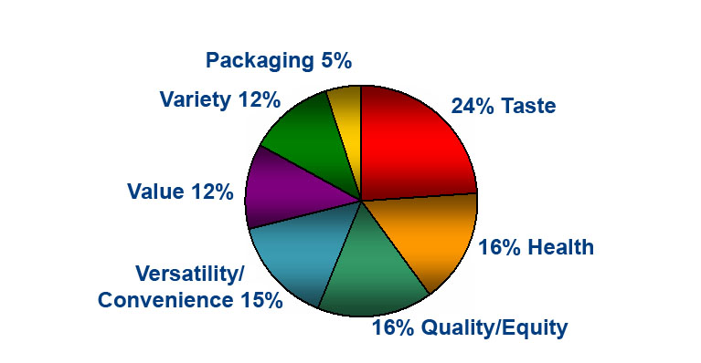
#2 Competitive Assessment –
Market Drivers (1/2)
Category Driver Analysis
Fruit Juice Category
What factors drive purchase decisions?

Slide 19
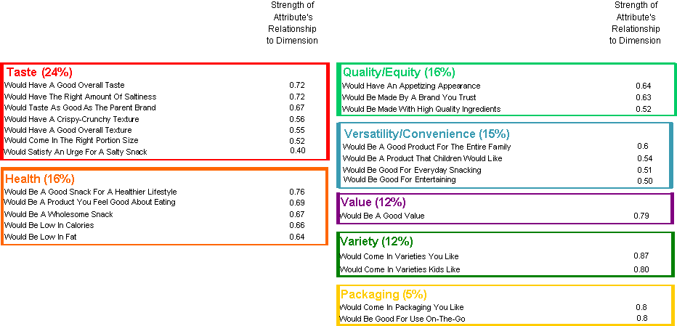
#2 Competitive Assessment –
Market Drivers (2/2)
Category Driver Analysis
Fruit Juice Category
Which attributes are most important?
Derived through Factor Analysis

Slide 20
#2 Competitive Assessment –
Performance by Brand
Performance by Brand
Liquid Hand Soaps - All Respondents
Relative Strength
Relative Weakness

Slide 21
#2 Competitive Assessment –
Consumer Demographic Profile
Typical demographic profile questions
  Age
  Marital status
  Income
  Education
  Job position
  Number of people in household
Targeted questions
  Brand awareness
  Brand usership
  Questions specific to the test initiative
Help you know your consumers better!

Slide 22
#3 Concept Screening, Testing, and Optimization
Concept screening – to prioritize concepts for development
Concept testing – to understand potential and aid future development
  Test different concept names
  Test different communication messages
  Test different packaging
  Test different advertising themes / positioning
Methodology
Recruit
respondents
Show
concept stimulus
Administer the survey

Slide 23

Concept Board Example
Brand Name / Headline
Picture of the
test product
Main Idea
Varieties, Size, and Price

Slide 24

#3 Concept Screening, Testing, and Optimization
ITP
Relevance
Expensiveness
Differentiation
Go/
ITP
Rework/
Concept Name
Rework/
Concept Name
ITP Index
ITP Index
Score %
Stop
Score %
Index
Index
Index
Stop
150
53
H
ML
H
Concept 1
53
Concept 1
140
49
H
H
MH
Concept 2
49
Concept 2
120
42
M
ML
H
Concept 3
42
Concept 3
110
39
ML
MH
MH
Concept 4
39
Concept 4
110
39
ML
MH
H
Concept 5
39
Concept 5
85
30
MH
MH
L
Concept 6
30
Concept 6
M
Concept 7
80
M
H
L
Concept 7
28
ML
H
M
Concept 8
70
25
M
Concept 8
50
18
L
MH
L
Concept 9
18
Concept 9
ITP Index: Represents the quality of the concept compared to potential competition
ITP Score %: Represents the size of the opportunity, as a % of target, assuming 100% awareness and 100% distribution

Slide 25
#3 Concept Screening, Testing, and Optimization
What drives/limits consumer interest?
Dislikes
Likes
Spontaneous likes (open-ended)
Taste/flavour
Health/nutrition
Package/container
Brand equity
Texture/consistency
Price/economy
Uses
Category acceptance/rejection
Miscellaneous
Nothing liked/ disliked

Slide 26
#3 Concept Screening, Testing, and Optimization
Attribute Rating and Impact on Trial

Slide 27
#4 product testing
Can be done only if test products are available
To fully understand the product’s short-term and longer-term volume potential
  Test both the concept and the product
    More accurate results than concept testing
To see if product performance matches expectations
To identify the best benefits to include in the product
To identify any necessary changes in the product that would maximize its potential
  Taste, fragrance, texture, packaging, color, etc.

Slide 28

#4 product testing
Particularly useful for new, innovative products

Slide 29
#4 product testing
Concept evaluation phase
Product evaluation phase
Placement period depends on the product category.
Recruit
respondents
Show
concept stimulus
Administer the survey
Place qualified respondents with items they claim they will try
In-home
usage
Follow-up
survey

Slide 30
#4 Product Testing – T-plot

Slide 31
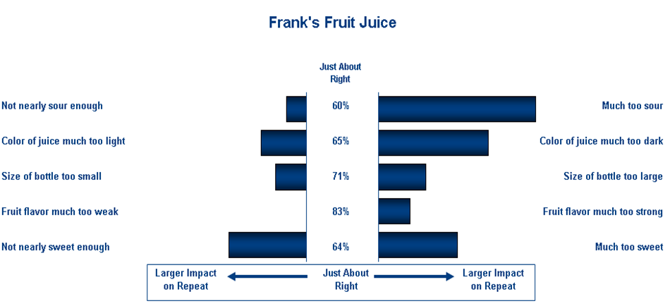
#4 product testing – penalty analysis

Slide 32
#4 product testing – turf
Frank’s Fruit Juice
Percent of
Line Size
Orange Juice
Apple Juice
Grape Juice
Mango Juice
Likely Triers
Best Single Variety
1
0
0
0
68%
0
1
0
0
61%
0
0
1
0
51%
0
0
0
1
47%
Best Two Varieties
1
0
1
0
91%
1
0
0
1
88%
0
1
1
0
86%
1
1
0
0
84%
Best Three Varieties
1
1
1
0
98%
1
0
1
1
98%
1
1
0
1
96%
0
1
1
1
95%
All Four Varieties
1
1
1
1
100%

Slide 33
#5 Pricing Study
Business issue – The need for a pricing study
  Manufacturers face many pressures to increase prices on products.
      Profit pressures
      Higher product costs
      Higher marketing costs
  Often, for new brands, products are priced based on the company’s desired margins.
  Later, prices are changed (often repeatedly) in-market to try and improve profit or share.
  It pays to launch a new item at its optimal price.

Slide 34
#5 Pricing Study
Pricing study is used to identify the optimal price point which would maximize both volume and revenue potential.
  What happens to volume as the price changes?
  Sometimes the planned price is actually too low!
Stimulus used is the concept board without price information.
Respondents are asked at what price the product would be considered…
    A very good value
    An average value
    A somewhat poor value

Slide 35

#5 Pricing Study –
Concept Board Without Price Information
New! Heart Healthy All-Natural Entrees
Introducing New Heart Healthy All-Natural Entrees
Each new Heart Healthy All-Natural Entrée offers:
Pure Ingredients – only high quality, natural ingredients that are minimally processed like vegetables picked at their sun-ripened best and all-natural chicken. No additives, preservatives, or artificial anything, ever.
True sustenance – nutritionally-rich ingredients like our unique blend of 7 whole grains high in protein, micronutrients, and fiber to provide lasting nourishment
Naturally flavorful – unique combinations that respect food’s natural taste and texture. We take great care to prepare our select ingredients in ways that retain nutrients while unlocking the flavors that nature already provides through methods such as marinating and grilling.
Enjoy all 8 varieties of New Heart Healthy All-Natural Frozen Entrees…pure, sustaining and naturally flavorful meals.
Each entrée – 10 oz.

Slide 36
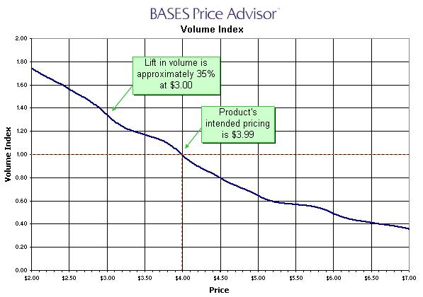
#5 Pricing Study

Slide 37
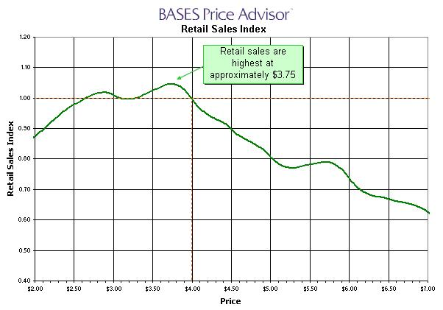
#5 Pricing Study

Slide 38
Next steps…
Each class from this point on will zoom into each of the topics introduced today.
  I EXPECT 100% attendance on classes with guest speakers. It is difficult to invite them!
Please take notes as appropriate on the key topics discussed as some of them will be in your final exam.
Supplemental readings will be assigned as applicable. You are all EXPECTED to read the article(s) – don’t worry they are pretty short and not very boring – and come discuss them in the next class.
  IF participation is horrible (please no!), then you all will be required to write a brief summary focusing on the key points of the articles you read.
    More work for you (to write), more work for me (to check) – so let’s just make it simple for everyone and discuss actively. ☺

