Slide 1
Introduction to Thailand, Cambodia, Laos, Myanmar and Vietnam

Slide 2
Objectives
To afford the students to learn about the basic fact and information of Thailand, Cambodia, Laos, Myanmar, and Vietnam.
To afford the students to compare different aspects of each country.
To enhance student skill in applying basic economic theory to categorize each country level of development.

Slide 3
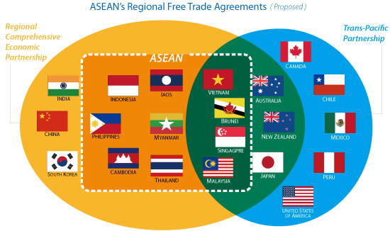
Big Picture on Trade: RCEP, TPP, and ASEAN
Source: ADB

Slide 4
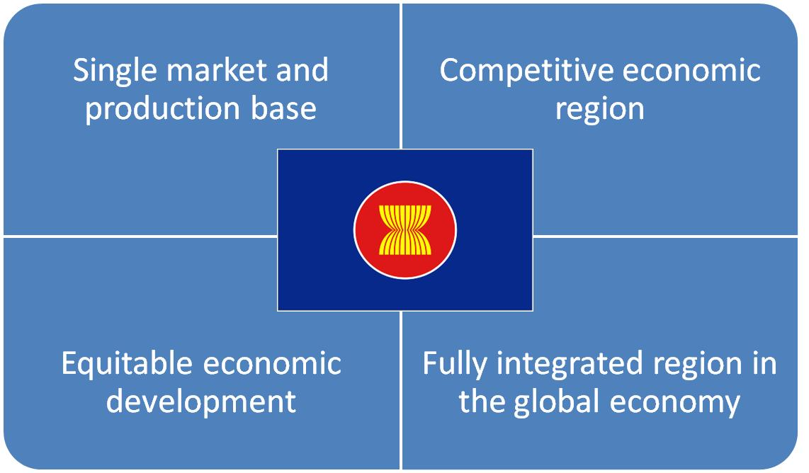
ASEAN Economic Community(AEC)
Source: ASEAN secretariat

Slide 5
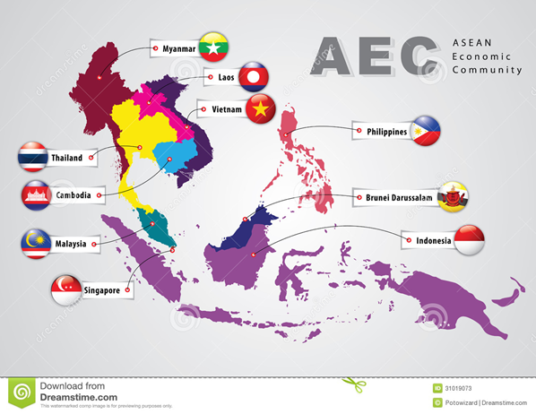
AEC
Source: ASEAN secretariat

Slide 6
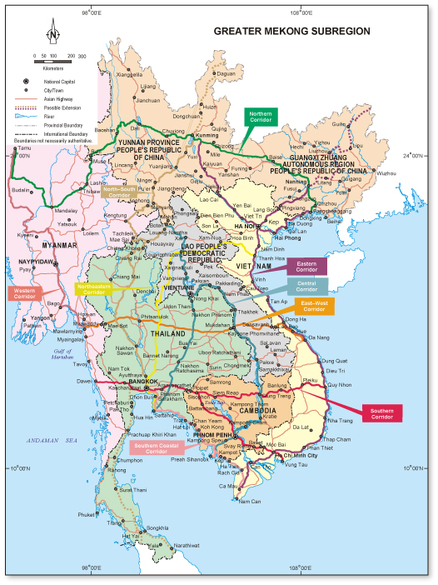
Greater Mekhong Sub-region: Land Bridge
Source: BOI Thailand

Slide 7
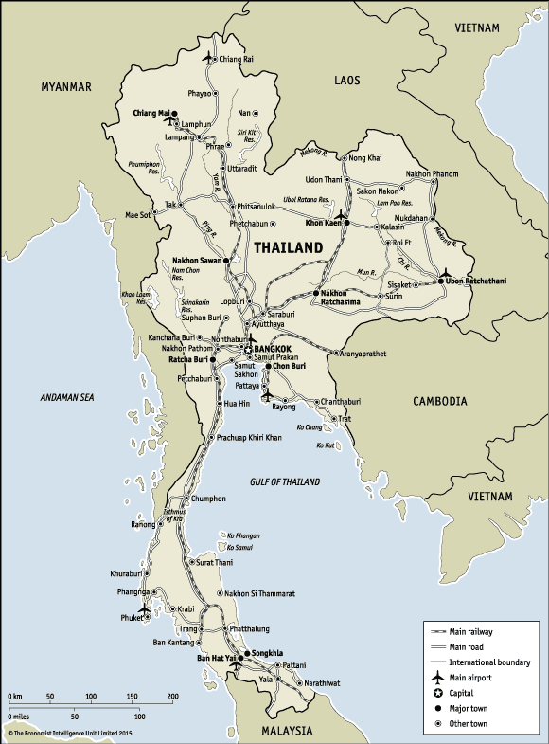
Thailand
Source: The Economist

Slide 8
Thailand: CIA fact book and EIU
A unified Thai kingdom was established in the mid-14th century. Known as Siam until 1939, Thailand is the only Southeast Asian country never to have been colonized by a European power. A bloodless revolution in 1932 led to the establishment of a constitutional monarchy. In alliance with Japan during World War II, Thailand became a US treaty ally in 1954 after sending troops to Korea and later fighting alongside the United States in Vietnam.

Slide 9
Thailand: CIA fact book and EIU
Thailand since 2005 has experienced several rounds of political turmoil including a military coup in 2006 that ousted then Prime Minister THAKSIN Chinnawat, followed by large-scale street protests by competing political factions in 2008, 2009, and 2010. THAKSIN's youngest sister, YINGLAK Chinnawat, in 2011 led the Puea Thai Party to an electoral win and assumed control of the government.

Slide 10
Thailand: CIA fact book and EIU
A blanket amnesty bill for individuals involved in street protests, altered at the last minute to include all political crimes - including all convictions against THAKSIN - triggered months of large-scale anti-government protests in Bangkok beginning in November 2013. In early May 2014 YINGLAK was removed from office by the Constitutional Court and in late May 2014 the Royal Thai Army staged a coup against the caretaker government.

Slide 11
Thailand: CIA fact book and EIU
The head of the Royal Thai Army, Gen. PRAYUT Chan-ocha, was appointed prime minister in August 2014. The interim military government created several interim institutions to promote reform and draft a new constitution. Elections are tentatively set for early 2016. Thailand has also experienced violence associated with the ethno-nationalist insurgency in Thailand's southern Malay-Muslim majority provinces. Since January 2004, thousands have been killed and wounded in the insurgency.

Slide 12
Demographic
67,741,401
Thai 95.9%, Burmese 2%, other 1.3%, unspecified 0.9% (2010 est.)
Buddhist (official) 93.6%, Muslim 4.9%, Christian 1.2%, other 0.2%, none 0.1% (2010 est.)

Slide 13
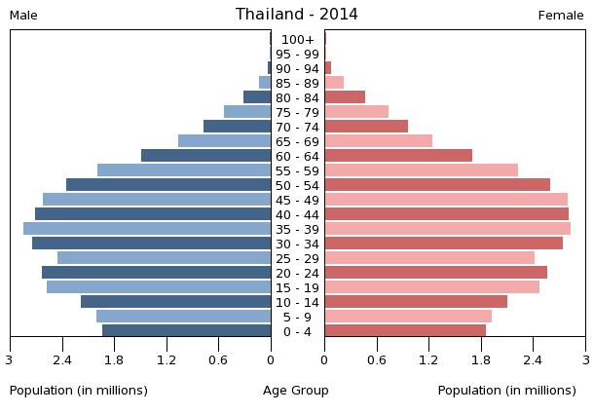
Aging Society

Slide 14
Drinking Water Source
improved:
  urban: 96.7% of population
  rural: 95.3% of population
  total: 95.8% of population
unimproved:
  urban: 3.3% of population
  rural: 4.7% of population
  total: 4.2% of population (2012 est.)

Slide 15
Economy
With a well-developed infrastructure, a free-enterprise economy, generally pro-investment policies, and strong export industries, Thailand has had a strong economy due in part to industrial and agriculture exports - mostly electronics, agricultural commodities, automobiles and parts, and processed foods.
Thailand attracts nearly 2.5 million migrant workers from neighboring countries. The Thai government in 2013 implemented a nation-wide 300 baht ($10) per day minimum wage policy and deployed new tax reforms designed to lower rates on middle-income earners.

Slide 16
Economy
The Thai economy has weathered both internal and external economic shocks in recent years. The global economic recession severely cut Thailand's exports, with most sectors experiencing double-digit drops. In late 2011 Thailand's recovery was interrupted by historic flooding in the industrial areas in Bangkok and its five surrounding provinces, crippling the manufacturing sector.

Slide 17
Economy
Government approved flood mitigation projects, worth $11.7 billion, were started in 2012 to prevent a repeat. Thai growth slowed in 2013 and has remained low since, as the country faced political uncertainty and a coup in May 2014. The interim government is implementing a special $11 billion short-term stimulus package and has approved a budget of more than $80 billion to aid an economic rebound.

Slide 18
Economy
GDP (purchasing power parity)
$990.1 billion (2014 est.)
$980.7 billion (2013 est.)
$953.1 billion (2012 est.)
note: data are in 2014 US dollars
GDP per capita
$14,400 (2014 est.)
$14,400 (2013 est.)
$14,000 (2012 est.)
note: data are in 2013 US dollars

Slide 19
GDP composition
household consumption: 53.4%
government consumption: 13.7%
investment in fixed capital: 25.4%
investment in inventories: 0.9%
exports of goods and services: 76.8%
imports of goods and services: -70.2%
(2014 est.)
agriculture: 12.2%
industry: 43.3%
services: 44.5% (2014 est.)

Slide 20
Agriculture and Industry
rice, cassava (manioc, tapioca), rubber, corn, sugarcane, coconuts, soybeans
tourism, textiles and garments, agricultural processing, beverages, tobacco, cement, light manufacturing such as jewelry and electric appliances, computers and parts, integrated circuits, furniture, plastics, automobiles and automotive parts; world's second-largest tungsten producer and third-largest tin producer

Slide 21
Labor Force
39.51 million (2014 est.)
  agriculture: 38.2%
  industry: 13.6%
  services: 48.2% (2011 est.)
Unemployment rate
  1% (2014 est.)
  0.7% (2013 est.)

Slide 22
Inequality
lowest 10%: 2.8%
highest 10%: 31.5% (2009 est.)
Gini coefficient
  39.4 (2010)
  42 (2002)

Slide 23
Export and Import
Export
$232 billion (2014 est.)
$225.4 billion (2013 est.)
Partner
China 11.9%, US 10.1%, Japan 9.7%, Hong Kong 5.8%, Malaysia 5.7%, Singapore 4.9%, Indonesia 4.8%, Australia 4.5% (2013)
Goods
electronics, computer parts, automobiles and parts, electrical appliances, machinery and equipment, textiles and footwear, fishery products, rice, rubber

Slide 24
Export and Import
Import
$218.5 billion (2014 est.)
$219 billion (2013 est.)
Partner
Japan 16.4%, China 15%, UAE 6.9%, US 5.9%, Malaysia 5.3% (2013)
Goods
capital goods, intermediate goods and raw materials, consumer goods, fuels

Slide 25
Basic Infrastructure
Railways:
  total: 4,071 km
  standard gauge: 29 km 1.435-m gauge (29 km electrified)
  narrow gauge: 4,042 km 1.000-m gauge (2008)
  country comparison to the world: 43
Roadways:
  total: 180,053 km (includes 450 km of expressways) (2006)
  country comparison to the world: 28

Slide 26
Basic Infrastructure
Merchant marine:
  total: 363
  foreign-owned: 13 (China 1, Hong Kong 1, Malaysia 3, Singapore 1, Taiwan 1, UK 6)
  registered in other countries: 46 (Bahamas 4, Belize 1, Honduras 2, Panama 6, Singapore 33) (2010)
  country comparison to the world: 28
Ports and terminals:
  major seaport(s): Bangkok, Laem Chabang, Map Ta Phut, Prachuap Port, Si Racha
  container port(s) TEUs): Bangkok (1,305,229), Laem Chabang (5,731,063)

Slide 27
Concerned problems: Trafficking
Thailand is a source, transit, and destination country for men, women, and children subjected to forced labor and sex trafficking; victims, who are most often from neighboring countries (especially Burma) but also China, Vietnam, Russia, Uzbekistan, India, and Fiji, migrate to Thailand in search of economic opportunities but are forced, coerced, or defrauded into labor in fishing, low-end garment production, factories, domestic work, street begging, or the sex trade.

Slide 28
Trafficking
Men from Burma, Cambodia, and Thailand who are forced to work on fishing boats have reportedly been kept at sea for years; migrants, members of ethnic minorities, and stateless persons are most vulnerable to forced labor and debt bondage; sex trafficking of Thai and migrant children and sex tourism remain significant problems; Thailand is a transit country for victims from North Korea, China, Vietnam, Pakistan, and Burma destined for exploitation in third countries, including Malaysia, Indonesia, Singapore, Russia, South Korea, the US, and Western European countries

Slide 29
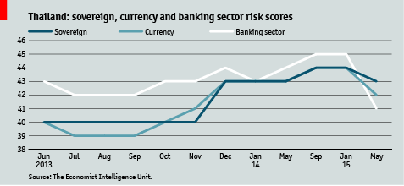
Risks

Slide 30
Thailand Trade with CLMV
The geo-centric location of Thailand in ASEAN places it in a position to drive trade and investment with its CLMV neighbors. Although Thailand’s cross-border trade partnerships have historically been dominated by Malaysia, which accounted for 60% of Thailand’s total border trade in 2013, Thailand’s trade with CLMV had doubled during the previous five years, accounting for around US$6.4 billion.

Slide 31
Thailand Trade with CLMV
This substantial increase in volume was driven by rapid economic growth in Thailand’s CLMV neighbors and rising Thai-outbound investment. Although Thai exports are facing new competition from China and Japan, Thailand’s CLMV imports continue to increase. Primary imports include hydroelectricity from the Lao PDR, natural gas from Myanmar, computers and parts, electrical machinery, plants and plant products, mining products and scraps, textiles, chemical fertilizers and pesticides, and paper pulp and paper.

Slide 32
Main Drivers
Accelerated economic development of CLMV countries;
Declining tariff levels under the ASEAN Free Trade Agreement;
Increasing urbanization and new Special Economic Zones along the borders;
Thai-outbound investment to expand production chains regionally; and
Financial support mechanisms from Thailand’s Department for International Trade Promotion and the Export-Import Bank.

Slide 33
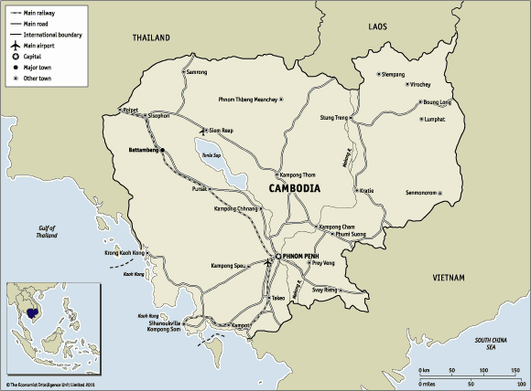
Cambodia
Source: The Economist

Slide 34
Cambodia: CIA fact book and EIU
Following Japanese occupation in World War II, Cambodia gained full independence from France in 1953. In April 1975, after a five-year struggle, communist Khmer Rouge forces captured Phnom Penh and evacuated all cities and towns. At least 1.5 million Cambodians died from execution, forced hardships, or starvation during the Khmer Rouge regime under POL POT.

Slide 35
Cambodia: CIA fact book and EIU
A December 1978 Vietnamese invasion drove the Khmer Rouge into the countryside, began a 10-year Vietnamese occupation, and touched off almost 13 years of civil war. The 1991 Paris Peace Accords mandated democratic elections and a ceasefire, which was not fully respected by the Khmer Rouge. UN-sponsored elections in 1993 helped restore some semblance of normalcy under a coalition government.

Slide 36
Cambodia: CIA fact book and EIU
A blanket amnesty bill for individuals involved in street protests, altered at the last minute to include all political crimes - including all convictions against THAKSIN - triggered months of large-scale anti-government protests in Bangkok beginning in November 2013. In early May 2014 YINGLAK was removed from office by the Constitutional Court and in late May 2014 the Royal Thai Army staged a coup against the caretaker government.

Slide 37
Cambodia: CIA fact book and EIU
The most recent local (Commune Council) elections were held in Cambodia in 2012, with little of the pre-election violence that preceded prior elections. National elections in July 2013 were disputed, with the opposition party boycotting the National Assembly. The political impasse was ended nearly a year later, with the opposition CNRP agreeing to enter parliament in exchange for ruling party commitments to electoral and legislative reforms..

Slide 38
Demographic
15,458,332
Ethnic groups:
  Khmer 90%, Vietnamese 5%, Chinese 1%, other 4%
Religions:
  Buddhist (official) 96.9%, Muslim 1.9%, Christian 0.4%, other 0.8% (2008 est.)

Slide 39
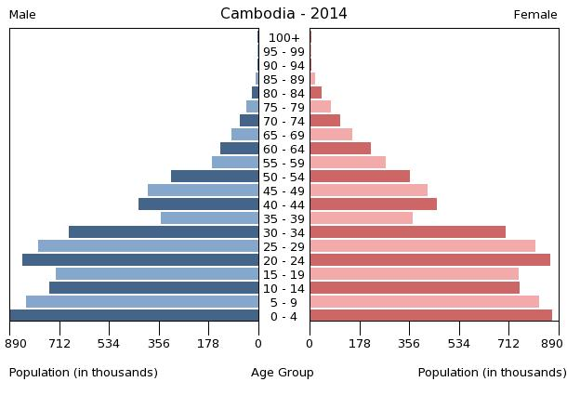
Aging Society

Slide 40
Drinking Water Source
improved:
  urban: 93.9% of population
  rural: 65.6% of population
  total: 71.3% of population
unimproved:
  urban: 6.1% of population
  rural: 34.4% of population
  total: 28.7% of population (2012 est.)

Slide 41
Economy
Since 2004, garments, construction, agriculture, and tourism have driven Cambodia's growth. GDP climbed at least 7% per year between 2011 and 2014. The garment industry currently employs about 500,000 people and accounts for some 70% of Cambodia's total exports.
In 2005, exploitable oil deposits were found beneath Cambodia's territorial waters, representing a potential revenue stream for the government, if commercial extraction becomes feasible. Mining also is attracting some investor interest and the government has touted opportunities for mining bauxite, gold, iron and gems.

Slide 42
Economy
The tourism industry has continued to grow rapidly with foreign arrivals exceeding 2 million per year since 2007 and reaching over 3 million visitors in 2012. Cambodia, nevertheless, remains one of the poorest countries in Asia and long-term economic development remains a daunting challenge, inhibited by endemic corruption, limited educational opportunities, high income inequality, and poor job prospects.

Slide 43
Economy
The Cambodian Government is working with bilateral and multilateral donors, including the Asian Development Bank, the World Bank and IMF, to address the country's many pressing needs; more than 50% of the government budget comes from donor assistance. A major economic challenge for Cambodia over the next decade will be fashioning an economic environment in which the private sector can create enough jobs to handle Cambodia's demographic imbalance. Worker unrest over labor conditions and the minimum monthly wage will prove challenging.

Slide 44
Economy
GDP (purchasing power parity):
  $50.25 billion (2014 est.)
  $46.88 billion (2013 est.)
  $43.64 billion (2012 est.)
  note: data are in 2014 US dollars
GDP per capita
  $3,300 (2014 est.)
  $3,100 (2013 est.)
  $2,900 (2012 est.)
  note: data are in 2013 US dollars

Slide 45
GDP composition
household consumption: 77%
government consumption: 7.3%
investment in fixed capital: 18.4%
investment in inventories: 1.5%
exports of goods and services: 60.8%
imports of goods and services: -65%
agriculture: 32.7%
industry: 25.5%
services: 41.8% (2014 est.)

Slide 46
Agriculture and Industry
rice, rubber, corn, vegetables, cashews, cassava (manioc, tapioca), silk
tourism, garments, construction, rice milling, fishing, wood and wood products, rubber, cement, gem mining, textiles

Slide 47
Labor Force
Labor force:
  7.9 million (2011 est.)
  country comparison to the world: 60
Labor force - by occupation:
  agriculture: 55.8%
  industry: 16.9%
  services: 27.3% (2010 est.)
Unemployment rate:
  0% (2011 est.)
  0.3% (2010 est.)
  country comparison to the world: 1

Slide 48
Inequality
Household income or consumption by percentage share:
  lowest 10%: 3%
  highest 10%: 37.3% (2007)
Distribution of family income - Gini index:
  37.9 (2008 est.)
  41.9 (2004 est.)
  country comparison to the world: 72

Slide 49
Export and Import
Exports:
  $6.806 billion (2014 est.)
  $6.53 billion (2013 est.)
  country comparison to the world: 107
Exports - commodities:
  clothing, timber, rubber, rice, fish, tobacco, footwear
Exports - partners:
  US 28.6%, UK 8.8%, Germany 8.5%, Canada 7.6%, Japan 5.9%, Vietnam 5.2% (2013)

Slide 50
Export and Import
Imports:
  $10.05 billion (2014 est.)
  $9.489 billion (2013 est.)
  country comparison to the world: 102
Imports - commodities:
  petroleum products, cigarettes, gold, construction materials, machinery, motor vehicles, pharmaceutical products
Imports - partners:
  Thailand 27%, China 22%, Vietnam 19.3%, Singapore 7.2%, Hong Kong 6% (2013)

Slide 51
Basic Infrastructure
Railways:
  total: 690 km
  narrow gauge: 690 km 1.000-m gauge
  note: under restoration (2010)
  country comparison to the world: 102
Roadways:
  total: 39,618 km
  paved: 2,492 km
  unpaved: 37,126 km (2009)
  country comparison to the world: 88

Slide 52
Basic Infrastructure
Merchant marine:
  total: 544
  foreign-owned: 352 (Belgium 1, Canada 2, China 177, Cyprus 4, Egypt 4, Estonia 1, French Polynesia 1, Gabon 1, Greece 2, Hong Kong 10, Indonesia 2, Ireland 1, Japan 1, Lebanon 5, Russia 50, Singapore 3, South Korea 10, Syria 22, Taiwan 1, Turkey 15, UAE 2, UK 1, Ukraine 35, Vietnam 1) (2010)
  country comparison to the world: 21
Ports and terminals:
  major seaport(s): Sihanoukville (Kampong Saom)
  river port(s): Phnom Penh (Mekong)

Slide 53
Concerned problems: Trafficking
Cambodia is a source, transit, and destination country for men, women, and children subjected to forced labor and sex trafficking; Cambodian men, women, and children migrate to countries within the region and, increasingly, Africa for legitimate work but are subsequently subjected to sex trafficking, domestic servitude, debt bondage, or forced labor, often in the fishing industry; poor Cambodian children are subject to forced labor, including domestic servitude and forced begging.

Slide 54
Trafficking
In Thailand and Vietnam, Cambodian and ethnic Vietnamese women and girls are trafficked from rural areas to urban centers for sexual exploitation; Cambodian men are the main exploiters of child prostitutes, but men from other Asian countries, the US, and Europe travel to Cambodia for child sex tourism.

Slide 55
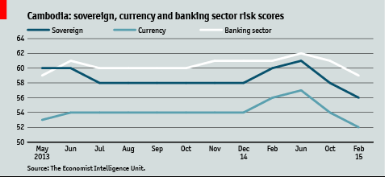
Risk

Slide 56
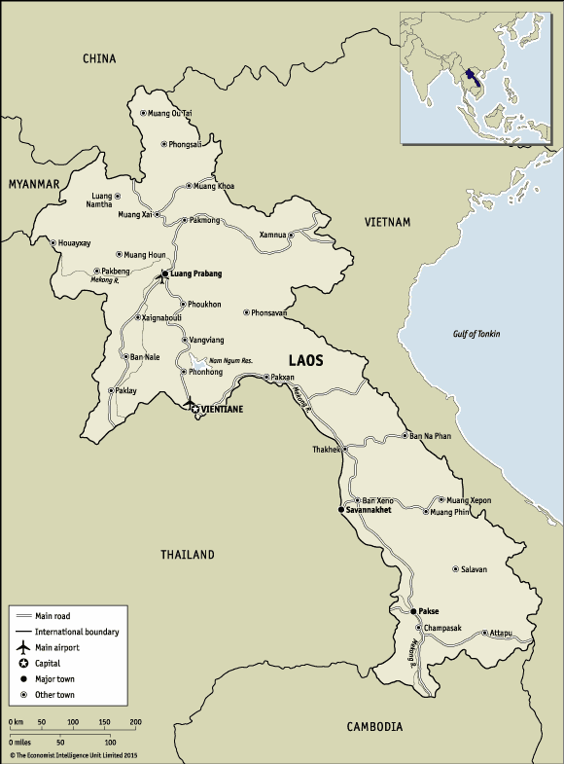
Laos
Source: The Economist

Slide 57
Laos: CIA fact book and EIU
Modern-day Laos has its roots in the ancient Lao kingdom of Lan Xang, established in the 14th century under King FA NGUM. For 300 years Lan Xang had influence reaching into present-day Cambodia and Thailand, as well as over all of what is now Laos. After centuries of gradual decline, Laos came under the domination of Siam (Thailand) from the late 18th century until the late 19th century when it became part of French Indochina.

Slide 58
Laos: CIA fact book and EIU
The Franco-Siamese Treaty of 1907 defined the current Lao border with Thailand. In 1975, the communist Pathet Lao took control of the government ending a six-century-old monarchy and instituting a strict socialist regime closely aligned to Vietnam. A gradual, limited return to private enterprise and the liberalization of foreign investment laws began in 1988. Laos became a member of ASEAN in 1997 and the WTO in 2013.

Slide 59
Demographic
6,803,699 (July 2014 est.)
Ethnic groups:
  Lao 55%, Khmou 11%, Hmong 8%, other (over 100 minor ethnic groups) 26% (2005 census)
Religions:
  Buddhist 67%, Christian 1.5%, other and unspecified 31.5% (2005 census)

Slide 60
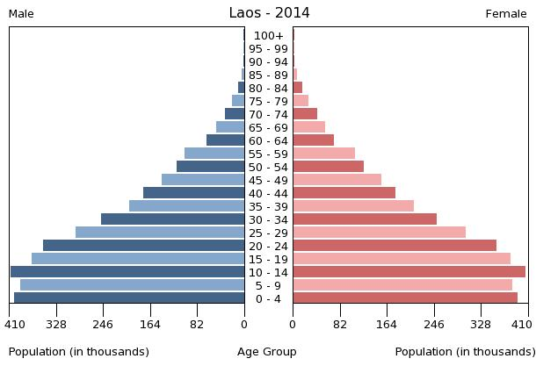
Aging Society

Slide 61
Drinking Water Source
improved:
  urban: 83.7% of population
  rural: 64.9% of population
  total: 71.5% of population
unimproved:
  urban: 16.3% of population
  rural: 35.1% of population
  total: 28.5% of population (2012 est.)

Slide 62
Economy
The government of Laos, one of the few remaining one-party communist states, began decentralizing control and encouraging private enterprise in 1986. The results, starting from an extremely low base, were striking - growth averaged 6% per year from 1988-2008 except during the short-lived drop caused by the Asian financial crisis that began in 1997. Laos' growth exceeded 7% per year during 2008-13.
Despite this high growth rate, Laos remains a country with an underdeveloped infrastructure, particularly in rural areas. It has a basic, but improving, road system, and limited external and internal land-line telecommunications. Electricity is available in 83 % of the country.

Slide 63
Economy
Laos' economy is heavily dependent on capital-intensive natural resource exports. The labor force, however, still relies on agriculture, dominated by rice cultivation in lowland areas, which accounts for about 25% of GDP and 73% of total employment. Economic growth has reduced official poverty rates from 46% in 1992 to 26% in 2010.
The economy also has benefited from high-profile foreign direct investment in hydropower dams along the Mekong river, copper and gold mining, logging, and construction though some projects in these industries have drawn criticism for their environmental impacts.

Slide 64
Economy
Laos gained Normal Trade Relations status with the US in 2004 and applied for Generalized System of Preferences trade benefits in 2013 after being admitted to the World Trade Organization earlier in the year. Laos is in the process of implementing a value-added tax system. Simplified investment procedures and expanded bank credits for small farmers and small entrepreneurs will improve Laos' economic prospects.

Slide 65
Economy
The government appears committed to raising the country's profile among investors, but suffered through a fiscal crisis in 2013 brought about by public sector wage increases, fiscal mismanagement, and revenue shortfalls. The World Bank has declared that Laos' goal of graduating from the UN Development Program's list of least-developed countries by 2020 is achievable, and the country is preparing to enter the ASEAN Economic Community in 2015.

Slide 66
Economy
GDP (purchasing power parity):
  $34.48 billion (2014 est.)
  $32.12 billion (2013 est.)
  $29.73 billion (2012 est.)
  note: data are in 2014 US dollars
  country comparison to the world: 116
GDP - per capita (PPP):
  $5,000 (2014 est.)
  $4,700 (2013 est.)
  $4,500 (2012 est.)
  note: data are in 2013 US dollars
  country comparison to the world: 167

Slide 67
GDP composition
household consumption: 69.6%
government consumption: 13.9%
investment in fixed capital: 39.1%
investment in inventories: 0%
exports of goods and services: 37.3%
imports of goods and services: -59.9%
agriculture: 23.7%
industry: 32.2%
services: 44.1% (2014 est.)

Slide 68
Agriculture and Industry
sweet potatoes, vegetables, corn, coffee, sugarcane, tobacco, cotton, tea, peanuts, rice; cassava (manioc, tapioca), water buffalo, pigs, cattle, poultry
mining (copper, tin, gold, gypsum); timber, electric power, agricultural processing, rubber, construction, garments, cement, tourism

Slide 69
Labor Force
Labor force:
  3.445 million (2014 est.)
  country comparison to the world: 100
Labor force - by occupation:
  agriculture: 73.1%
  industry: 6.1%
  services: 20.6% (2012 est.)
Unemployment rate:
  1.3% (2012 est.)
  1.9% (2010 est.)
  country comparison to the world: 6

Slide 70
Inequality
Household income or consumption by percentage share:
  lowest 10%: 3.3%
  highest 10%: 30.3% (2008)
Distribution of family income - Gini index:
  36.7 (2008)
  34.6 (2002)
  country comparison to the world: 82

Slide 71
Export and Import
Exports:
  $2.791 billion (2014 est.)
  $2.448 billion (2013 est.)
  country comparison to the world: 131
Exports - commodities:
  wood products, coffee, electricity, tin, copper, gold, cassava
Exports - partners:
  Thailand 33.3%, China 25.1%, Vietnam 11.5% (2013)

Slide 72
Export and Import
Imports:
  $4.074 billion (2014 est.)
  $3.452 billion (2013 est.)
  country comparison to the world: 141
Imports - commodities:
  machinery and equipment, vehicles, fuel, consumer goods
Imports - partners:
  Thailand 56%, China 26.1%, Vietnam 6.7% (2013)

Slide 73
Basic Infrastructure
Roadways:
  total: 39,568 km
  paved: 530 km
  unpaved: 39,038 km (2007)
  country comparison to the world: 89
Waterways:
  4,600 km (primarily on the Mekong River and its tributaries; 2,900 additional km are intermittently navigable by craft drawing less than 0.5 m) (2012)
  country comparison to the world: 23

Slide 74
Concerned problems: Trafficking
Laos is a source and, to a lesser extent, transit and destination country for men, women, and children subjected to forced labor and sex trafficking; Lao economic migrants may encounter conditions of forced labor or sexual exploitation in destination countries, most often Thailand; Lao women and girls are exploited in Thailand’s commercial sex trade, domestic service, factories, and agriculture.

Slide 75
Trafficking
Lao men and boys are victims of forced labor in the Thai fishing, construction, and agriculture industries; some Vietnamese and Chinese women and girls are subjected to sex trafficking in Laos while others are trafficked through Laos to neighboring countries, particularly Thailand; some Lao adults and children are subject to sex and labor exploitation domestically.

Slide 76
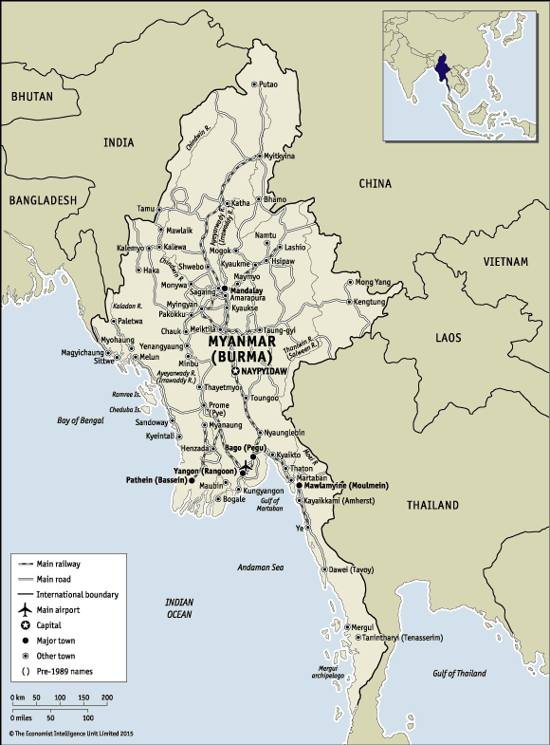
Myanmar
Source: The Economist

Slide 77
Myanmar: CIA fact book and EIU
Various ethnic Burmese and ethnic minority city-states or kingdoms occupied the present borders through the 19th century. Over a period of 62 years (1824-1886), Britain conquered Burma and incorporated the country into its Indian Empire. Burma was administered as a province of India until 1937 when it became a separate, self-governing colony; in 1948, Burma attained independence from the British Commonwealth.

Slide 78
Myanmar: CIA fact book and EIU
Gen. NE WIN dominated the government from 1962 to 1988, first as military ruler, then as self-appointed president, and later as political kingpin. In response to widespread civil unrest, NE WIN resigned in 1988, but within months the military crushed student-led protests and took power. Multiparty legislative elections in 1990 resulted in the main opposition party - the National League for Democracy (NLD) - winning a landslide victory

Slide 79
Myanmar: CIA fact book and EIU
Instead of handing over power, the junta placed NLD leader (and Nobel Peace Prize recipient) AUNG SAN SUU KYI (ASSK) under house arrest from 1989 to 1995, 2000 to 2002, and from May 2003 to November 2010. In late September 2007, the ruling junta brutally suppressed protests over increased fuel prices led by prodemocracy activists and Buddhist monks, killing at least 13 people and arresting thousands for participating in the demonstrations.

Slide 80
Myanmar: CIA fact book and EIU
In early May 2008, Burma was struck by Cyclone Nargis, which left over 138,000 dead and tens of thousands injured and homeless. Despite this tragedy, the junta proceeded with its May constitutional referendum, the first vote in Burma since 1990. Parliamentary elections held in November 2010, considered flawed by many in the international community, and the NLD boycotted, saw the ruling Union Solidarity and Development Party garner over 75% of the seats. Parliament convened in January 2011 and selected former Prime Minister THEIN SEIN as president.

Slide 81
Myanmar: CIA fact book and EIU
Although the vast majority of national-level appointees named by THEIN SEIN are former or current military officers, the government has initiated a series of political and economic reforms leading to a substantial opening of the long-isolated country. These reforms have included releasing hundreds of political prisoners, concluding negotiations on a draft nationwide ceasefire with the country’s various ethnic armed groups, pursuing legal reform, and gradually reducing restrictions on freedom of the press, association, and civil society.

Slide 82
Myanmar: CIA fact book and EIU
At least due in part to these reforms, ASSK was elected to parliament in April 2012, and now serves as chair of the Committee for Rule of Law and Tranquility. Most political parties have begun building their institutions in preparation for the next round of general elections, scheduled for late in -2015. The country served as chair of the Association of Southeast Asian Nations (ASEAN) for 2014.

Slide 83
Demographic
55,746,253
  note: estimates for this country take into account the effects of excess mortality due to AIDS; this can result in lower life expectancy, higher infant mortality, higher death rates, lower population growth rates, and changes in the distribution of population by age and sex than would otherwise be expected (July 2014 est.)
  country comparison to the world: 25
Ethnic groups:
  Burman 68%, Shan 9%, Karen 7%, Rakhine 4%, Chinese 3%, Indian 2%, Mon 2%, other 5%
Religions:
  Buddhist 89%, Christian 4% (Baptist 3%, Roman Catholic 1%), Muslim 4%, Animist 1%, other 2%

Slide 84
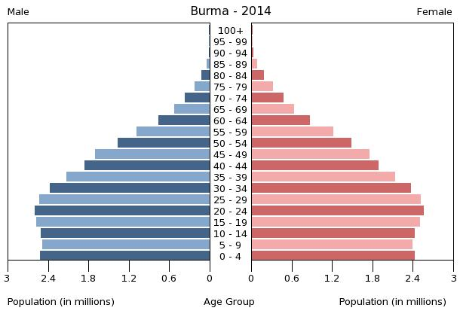
Aging Society

Slide 85
Drinking Water Source
improved:
  urban: 94.8% of population
  rural: 81.1% of population
  total: 85.7% of population
unimproved:
  urban: 5.2% of population
  rural: 18.9% of population
  total: 14.3% of population (2012 est.)

Slide 86
Economy
Since the transition to a civilian government in 2011, Burma has begun an economic overhaul aimed at attracting foreign investment and reintegrating into the global economy. Economic reforms have included establishing a managed float of the Burmese kyat in 2012, granting the Central Bank operational independence in July 2013, and enacting a new Anti-corruption Law in September 2013. The government’s commitment to reform, and the subsequent easing of most Western sanctions, has begun to pay dividends.

Slide 87
Economy
The economy accelerated in 2013 and 2014. And Burma’s abundant natural resources, young labor force, and proximity to Asia’s dynamic economies have attracted foreign investment in the energy sector, garment industry, information technology, and food and beverages. Foreign direct investment grew from US$1.9 billion in FY 2011 to US$2.7 billion in FY 2012.

Slide 88
Economy
Despite these improvements, living standards have not improved for the majority of the people residing in rural areas. Burma remains one of the poorest countries in Asia – nearly one-third of the country’s 60 million people live in poverty. The previous government’s isolationist policies and economic mismanagement have left Burma with poor infrastructure, endemic corruption, underdeveloped human resources, and inadequate access to capital, which will require a major commitment to reverse.

Slide 89
Economy
The Burmese government has been slow to address impediments to economic development such as an opaque revenue collection system and antiquated banking system. Key benchmarks of sustained economic progress would include modernizing and opening the financial sector, increasing budget allocations for social services, and accelerating agricultural and land reforms.

Slide 90
Economy
GDP (purchasing power parity):
  $244.3 billion (2014 est.)
  $225.2 billion (2013 est.)
  $208 billion (2012 est.)
  note: data are in 2014 US dollars
  country comparison to the world: 59
GDP - per capita (PPP):
  $4,800 (2014 est.)
  $4,400 (2013 est.)
  $4,100 (2012 est.)
  note: data are in 2013 US dollars
  country comparison to the world: 170

Slide 91
GDP composition
household consumption: 82%
government consumption: 3.8%
investment in fixed capital: 19.3%
investment in inventories: 0.3%
exports of goods and services: 23.7%
imports of goods and services: -29.1%
agriculture: 37.1%
industry: 21.3%
services: 41.6% (2014 est.)

Slide 92
Agriculture and Industry
rice, pulses, beans, sesame, groundnuts, sugarcane; fish and fish products; hardwood
agricultural processing; wood and wood products; copper, tin, tungsten, iron; cement, construction materials; pharmaceuticals; fertilizer; oil and natural gas; garments, jade, gems

Slide 93
Labor Force
Labor force:
  35.23 million (2014 est.)
  country comparison to the world: 18
Labor force - by occupation:
  agriculture: 70%
  industry: 7%
  services: 23% (2001)
Unemployment rate:
  5.1% (2014 est.)
  5.2% (2013 est.)
  country comparison to the world: 52

Slide 94
Inequality
Population below poverty line:
  32.7% (2007 est.)
Household income or consumption by percentage share:
  lowest 10%: 2.8%
  highest 10%: 32.4% (1998)

Slide 95
Export and Import
Exports:
  $10.31 billion (2014 est.)
  $9.033 billion (2013 est.)
  note: official export figures are grossly underestimated due to the value of timber, gems, narcotics, rice, and other products smuggled to Thailand, China, and Bangladesh
  country comparison to the world: 95
Exports - commodities:
  natural gas, wood products, pulses, beans, fish, rice, clothing, jade and gems
Exports - partners:
  Thailand 35%, China 24.5%, India 11.9%, Japan 6.6%, South Korea 4.2% (2013)

Slide 96
Export and Import
Imports:
  $12.53 billion (2014 est.)
  $10.51 billion (2013 est.)
  note: import figures are grossly underestimated due to the value of consumer goods, diesel fuel, and other products smuggled in from Thailand, China, Malaysia, and India
  country comparison to the world: 91
Imports - commodities:
  fabric, petroleum products, fertilizer, plastics, machinery, transport equipment; cement, construction materials, crude oil; food products, edible oil
Imports - partners:
  China 40%, Thailand 20.3%, Singapore 12.2%, Japan 5.7% (2013)

Slide 97
Basic Infrastructure
Railways:
  total: 5,031 km
  narrow gauge: 5,031 km 1.000-m gauge (2008)
  country comparison to the world: 36
Roadways:
  total: 34,377 km (includes 358 km of expressways) (2010)
  country comparison to the world: 93

Slide 98
Basic Infrastructure
Merchant marine:
  total: 29
  foreign-owned: 2 (Germany 1, Japan 1)
  registered in other countries: 3 (Panama 3) (2010)
  country comparison to the world: 86
Ports and terminals:
  major seaport(s): Moulmein, Sittwe
  river port(s): Rangoon (Rangoon River)

Slide 99
Concerned problems: Trafficking
Burma is a source country for men, women, and children trafficked for the purpose of forced labor, and for women and children subjected to sex trafficking in other countries; poor economic conditions have led to increased legal and illegal migration of Burmese adults and children to East Asia, the Middle East, South Asia, and the US where they are subject to forced labor and sex trafficking; men are forced to work in the fishing, manufacturing, and construction industries, while women and girls are forced into prostitution or domestic servitude.

Slide 100
Trafficking
Some Burmese economic migrants and Rohingya asylum seekers have become forced laborers in Thailand; military personnel and insurgent militia unlawfully conscript child soldiers and continue to be the leading perpetrators of forced labor inside the country; Burmese children are also forced to work in tea shops, home industries, on plantations, and as beggars.

Slide 101
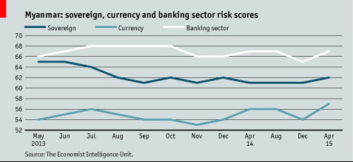
Risk

Slide 102
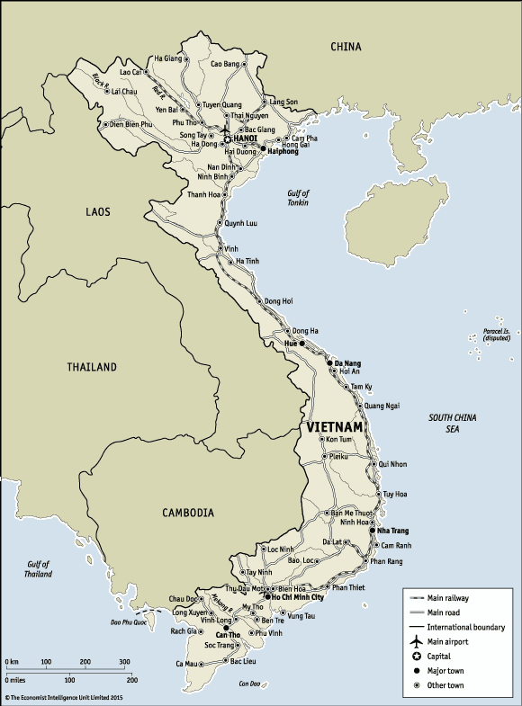
Vietnam
Source: The Economist

Slide 103
Vietnam: CIA fact book and EIU
The conquest of Vietnam by France began in 1858 and was completed by 1884. It became part of French Indochina in 1887. Vietnam declared independence after World War II, but France continued to rule until its 1954 defeat by communist forces under Ho Chi MINH. Under the Geneva Accords of 1954, Vietnam was divided into the communist North and anti-communist South.

Slide 104
Vietnam: CIA fact book and EIU
US economic and military aid to South Vietnam grew through the 1960s in an attempt to bolster the government, but US armed forces were withdrawn following a cease-fire agreement in 1973. Two years later, North Vietnamese forces overran the South reuniting the country under communist rule.

Slide 105
Vietnam: CIA fact book and EIU
Despite the return of peace, for over a decade the country experienced little economic growth because of conservative leadership policies, the persecution and mass exodus of individuals - many of them successful South Vietnamese merchants - and growing international isolation. However, since the enactment of Vietnam's "doi moi" (renovation) policy in 1986, Vietnamese authorities have committed to increased economic liberalization and enacted structural reforms needed to modernize the economy and to produce more competitive, export-driven industries.

Slide 106
Vietnam: CIA fact book and EIU
The communist leaders maintain tight control on political expression but have demonstrated some modest steps towards better protection of human rights. The country continues to experience small-scale protests, the vast majority connected to either land-use issues, calls for increased political space, or the lack of equitable mechanisms for resolving disputes. The small-scale protests in the urban areas are often organized by human rights activists, but many occur in rural areas and involve various ethnic minorities such as the Montagnards of the Central Highlands, H’mong in the Northwest Highlands, and the Khmer Krom in the southern delta region.

Slide 107
Demographic
93,421,835 (July 2014 est.)
  country comparison to the world: 15
Ethnic groups:
  Kinh (Viet) 85.7%, Tay 1.9%, Thai 1.8%, Muong 1.5%, Khmer 1.5%, Mong 1.2%, Nung 1.1%, others 5.3% (1999 census)
Religions:
  Buddhist 9.3%, Catholic 6.7%, Hoa Hao 1.5%, Cao Dai 1.1%, Protestant 0.5%, Muslim 0.1%, none 80.8% (1999 census)

Slide 108
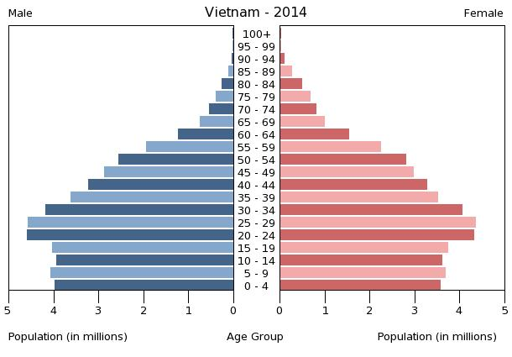
Aging Society

Slide 109
Drinking Water Source
improved:
  urban: 98.2% of population
  rural: 93.6% of population
  total: 95% of population
unimproved:
  urban: 1.8% of population
  rural: 6.4% of population
  total: 5% of population (2012 est.)

Slide 110
Economy
Vietnam is a densely-populated developing country that has been transitioning from the rigidities of a centrally-planned economy since 1986. Vietnamese authorities have reaffirmed their commitment to economic modernization in recent years. Vietnam joined the World Trade Organization in January 2007, which has promoted more competitive, export-driven industries.

Slide 111
Economy
Vietnam became an official negotiating partner in the Trans-Pacific Partnership trade agreement in 2010. Agriculture's share of economic output has continued to shrink from about 25% in 2000 to 18% in 2014, while industry's share increased from 36% to 38% in the same period. State-owned enterprises account for about 40% of GDP. Poverty has declined significantly, and Vietnam is working to create jobs to meet the challenge of a labor force that is growing by more than one million people every year.

Slide 112
Economy
The global recession hurt Vietnam's export-oriented economy, with GDP in 2014 growing at 5.4%, one of the slower growth rates since 1999. Exports have grown strongly in 2013-14; several administrative actions brought the trade deficit back into balance. Between 2008 and 2011, Vietnam's managed currency, the dong, was devalued in excess of 20%, but its value has remained relatively stable since then.

Slide 113
Economy
Hanoi has oscillated between promoting growth and emphasizing macroeconomic stability in recent years. In February 2011, the government shifted from policies aimed at achieving a high rate of economic growth, which had stoked inflation, to those aimed at stabilizing the economy, through tighter monetary and fiscal control. Although Vietnam unveiled a broad, "three pillar" economic reform program in early 2012.

Slide 114
Economy
Proposing the restructuring of public investment, state-owned enterprises, and the banking sector, Hanoi’s progress in meeting its goals is lagging behind its proposed schedule. Vietnam's economy continues to face challenges from an undercapitalized banking sector and non-performing loans weigh heavily on banks and businesses. Vietnam is a member of the 12-nation Trans-Pacific Partnership free trade agreement negotiations.

Slide 115
Economy
GDP (purchasing power parity):
  $509.5 billion (2014 est.)
  $482.9 billion (2013 est.)
  $458.1 billion (2012 est.)
  note: data are in 2014 US dollars
  country comparison to the world: 37
GDP - per capita (PPP):
  $5,600 (2014 est.)
  $5,400 (2013 est.)
  $5,200 (2012 est.)
  note: data are in 2013 US dollars
  country comparison to the world: 163

Slide 116
GDP composition
household consumption: 66.3%
government consumption: 6.3%
investment in fixed capital: 23.7%
investment in inventories: 2%
exports of goods and services: 85.1%
imports of goods and services: -83.4%
  (2014 est.)
agriculture: 17.9%
industry: 38.1%
services: 44% (2014 est.)

Slide 117
Agriculture and Industry
rice, coffee, rubber, tea, pepper, soybeans, cashews, sugar cane, peanuts, bananas; poultry; fish, seafood
food processing, garments, shoes, machine-building; mining, coal, steel; cement, chemical fertilizer, glass, tires, oil, mobile phones

Slide 118
Labor Force
Labor force:
  54.07 million (2014 est.)
  country comparison to the world: 12
Labor force - by occupation:
  agriculture: 48%
  industry: 21%
  services: 31% (2012)
Unemployment rate:
  3.1% (2014 est.)
  3.6% (2013 est.)
  country comparison to the world: 25

Slide 119
Inequality
Household income or consumption by percentage share:
  lowest 10%: 3.2%
  highest 10%: 30.2% (2008)
Distribution of family income - Gini index:
  37.6 (2008)
  36.1 (1998)
  country comparison to the world: 77

Slide 120
Export and Import
Exports:
  $147 billion (2014 est.)
  $132.1 billion (2013 est.)
  country comparison to the world: 34
Exports - commodities:
  clothes, shoes, electronics, seafood, crude oil, rice, coffee, wooden products, machinery
Exports - partners:
  US 17.6%, China 11.8%, Japan 9.9%, South Korea 5%, Germany 4.4%, Malaysia 4.2% (2013)

Slide 121
Export and Import
Imports:
  $138.6 billion (2014 est.)
  $123.4 billion (2013 est.)
  country comparison to the world: 32
Imports - commodities:
  machinery and equipment, petroleum products, steel products, raw materials for the clothing and shoe industries, electronics, plastics, automobiles
Imports - partners:
  China 32%, South Korea 13.9%, Singapore 7.2%, Japan 6.9%, Hong Kong 5%, Thailand 4.6% (2013)

Slide 122
Basic Infrastructure
Railways:
  total: 2,632 km
  standard gauge: 527 km 1.435-m gauge
  narrow gauge: 2,105 km 1.000-m gauge (2008)
  country comparison to the world: 64
Roadways:
  total: 206,633 km
  paved: 148,338 km
  unpaved: 47,130 km (2013)
  country comparison to the world: 24

Slide 123
Basic Infrastructure
Merchant marine:
  total: 579
  registered in other countries: 86 (Cambodia 1, Kiribati 2, Mongolia 33, Panama 43, Taiwan 1, Tuvalu 6) (2010)
  country comparison to the world: 20
Ports and terminals:
  major seaport(s): Cam Pha Port, Da Nang, Haiphong, Phu My, Quy Nhon
  river port(s): Ho Chi Minh (Mekong)
  container port(s) (TEUs): Haiphong (1,018,794), Saigon New Port (3,071,777)

Slide 124
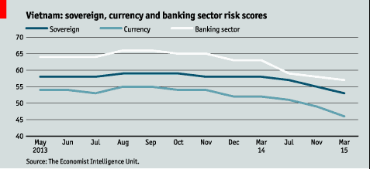
Risk

Slide 125
Discussion Questions
Compare and Contrast each countries demographic structure. Discuss its implications on labor force and economy.
Despite the use of WATER as an indicator of development, are there any good indicators out there? Discuss.
What are the differences in export structure of Thailand, and CLMV countries? Why?
What is the key infrastructure in international trade within the region? Why?
Why does trafficking becomes the most concerned issues within the region? Provide your opinion.

