Slide 1



MK 333/326 International Marketing
Final Project 1
By Ajarn Suwalya K.

Slide 2

MK 333/326 Final Project
Product Development Guidelines
Each group to draft out products to import and export from project country
We will have break out session next session to discuss your direction
A draft concept will be fine at this stage
Below are guidelines to be used to develop
your final product concepts
Notes:
1

Slide 3
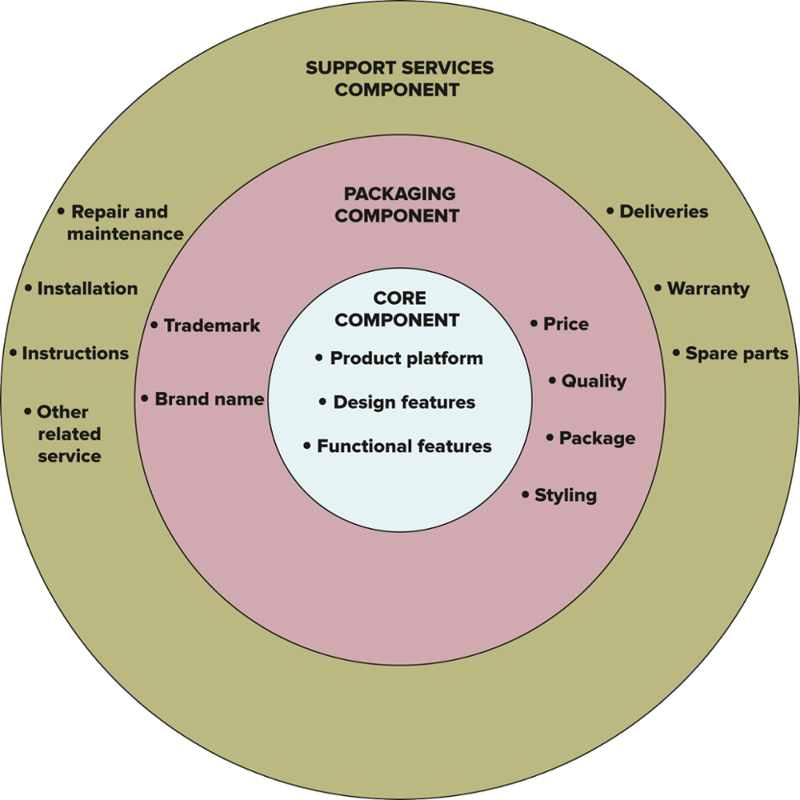
Exhibit 13.3 Product Component Model
Jump to long description.
Notes:
The Product Component Model is a useful guide for examining the adaptation requirements of products destined for foreign markets.
A product should be carefully evaluated on each of the three components to determine any mandatory and discretionary changes that may be needed.

Slide 4


