Slide 1
Issues in Gender
YOUR LOGO
Faculty of Economics, Thammasat University
Notes:
© Copyright Showeet.com – Creative & Free PowerPoint Templates

Slide 2
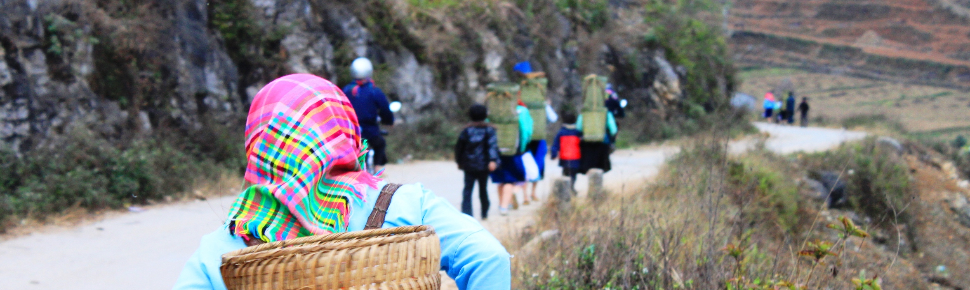
Sector issues in gender
YOUR LOGO
Notes:
© Copyright Showeet.com – Free PowerPoint Templates

Slide 3
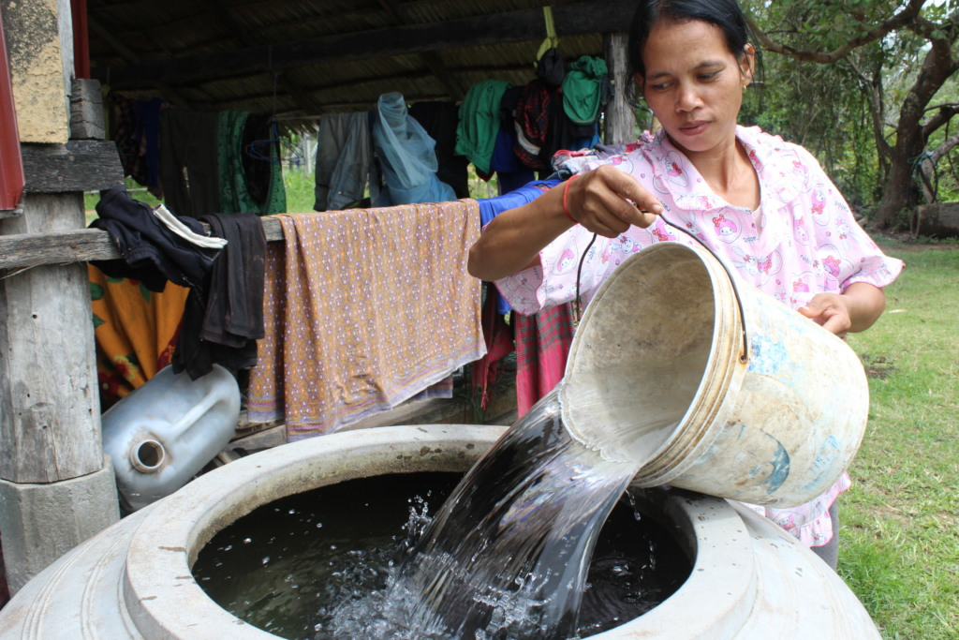
Water supply and gender
Women have knowledge on:
Water resource location and quality
Storage methods
Improving water management
Access to safe drinking water and sanitation
In most rural areas, women are tasked to fetch and manage water for their families

Slide 4
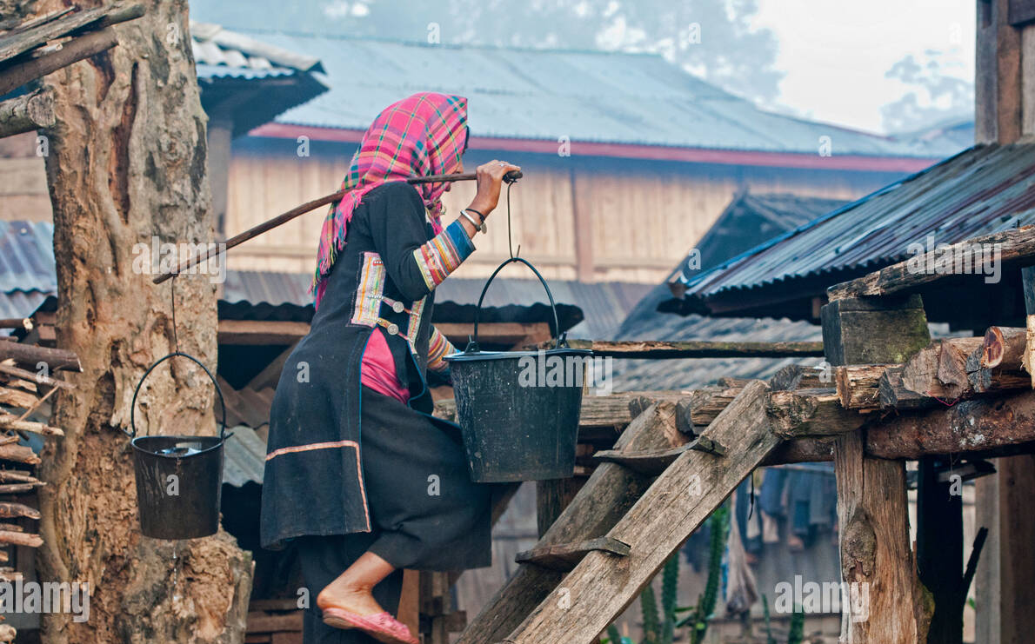
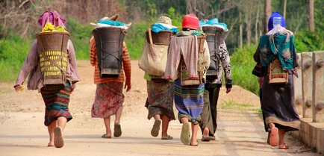
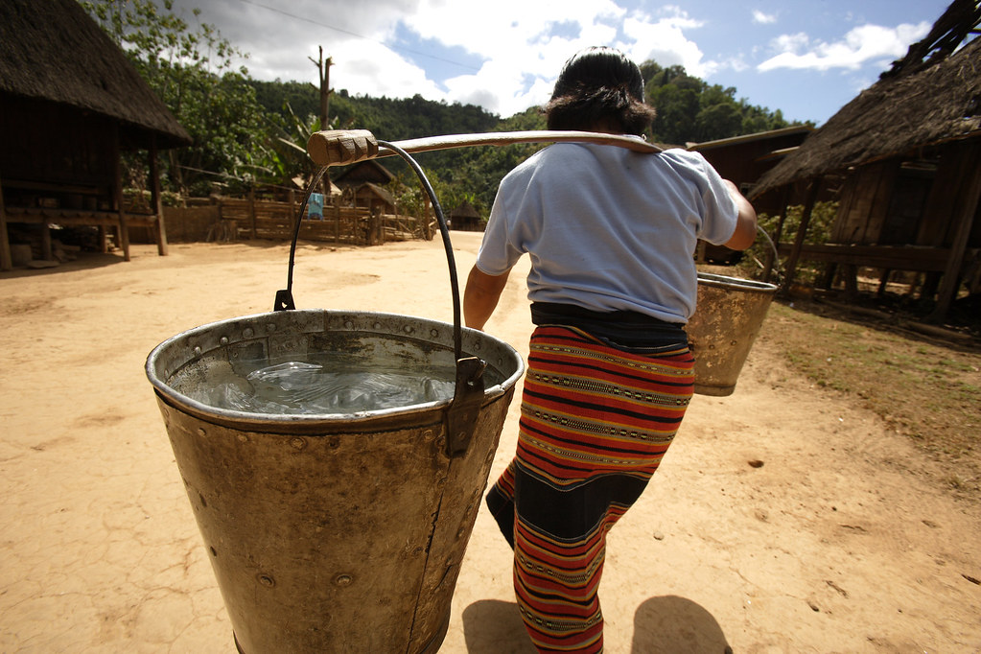
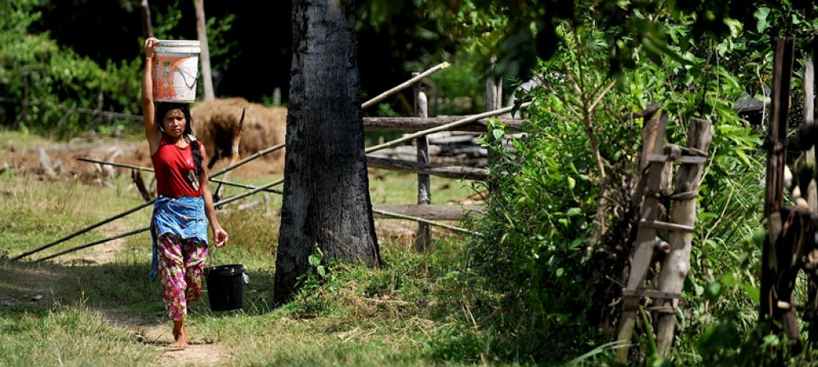

Slide 5
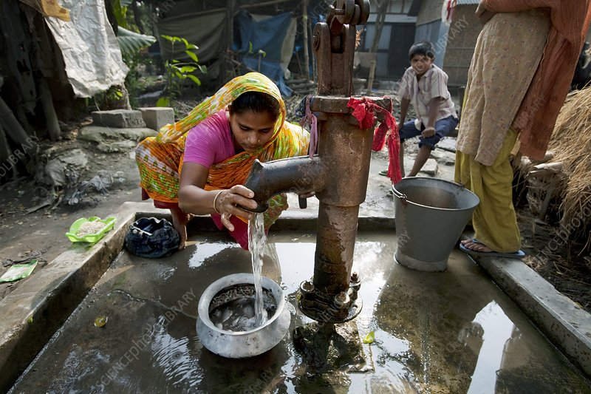
Efforts to address water supply needs
Reduced time from fetching water frees women’s time for productive activities, adult education, empowerment activities, and leisure
Convenient access to water and sanitation facilities reduce risk to women of sexual harassment while gathering water

Slide 6
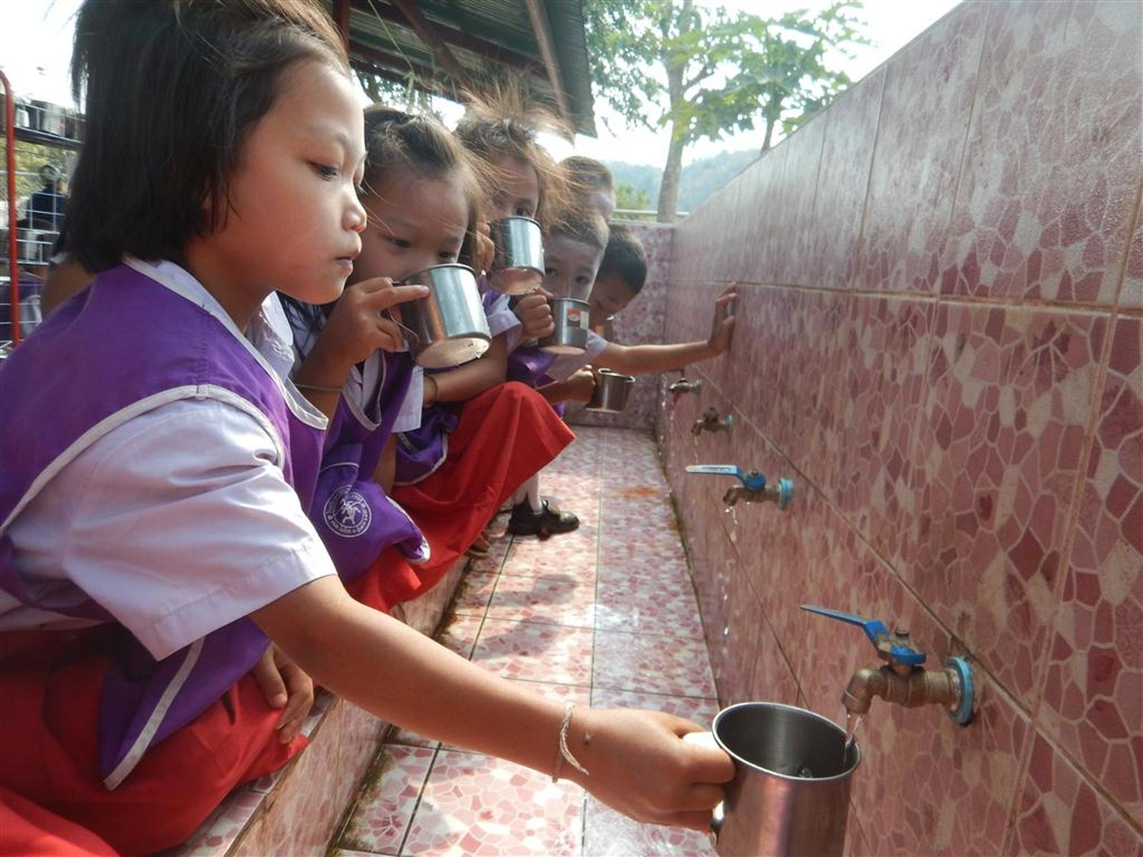
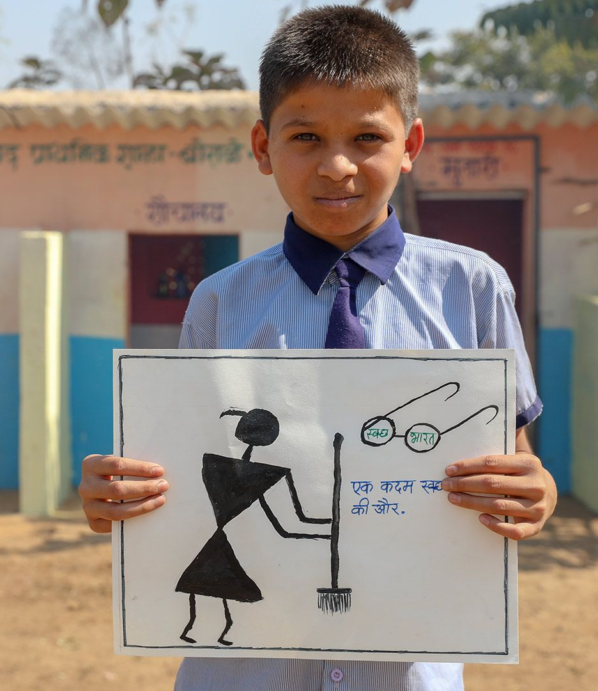
Improved water supply and sanitation

Slide 7

Unequal gender benefits in health
Men and women do not benefit equally in terms of health
Poor women and girls are least likely to have access to appropriate care or to seek adequate treatment.

Slide 8
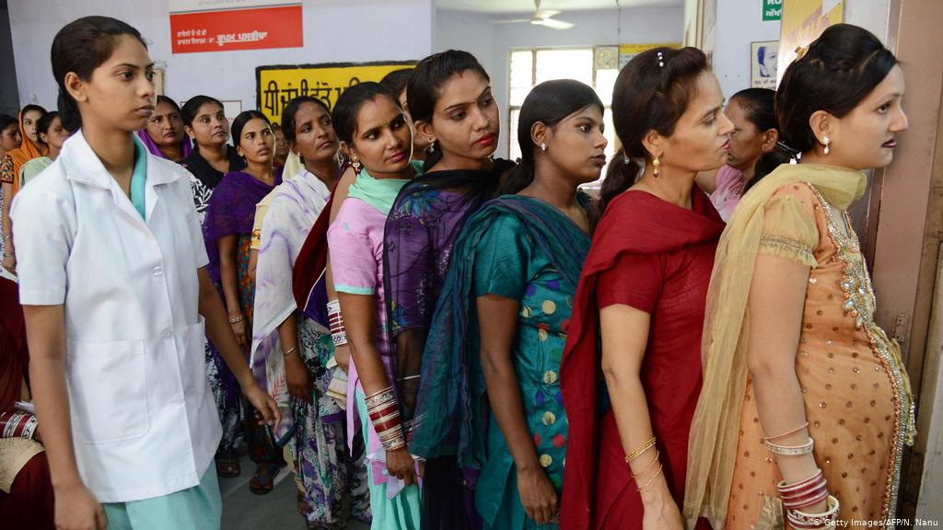
Health practices in many countries
Women are responsible for providing health care for their families
Women do not avail of health services unless health-care providers are female, accessible, and culturally sympathetic, available or obtain information to improve their health and that of their families

Slide 9
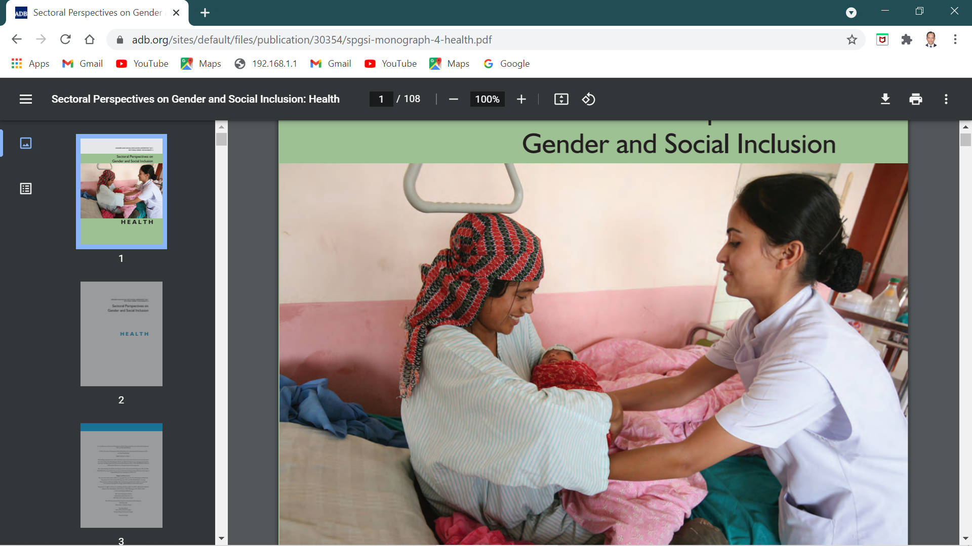
Health and gender
Poor public health systems; ineffective quality of health care makes women spend more time to care for their families
Need for a strong focus on women: the promotion of effective woman-to-woman services for maternal and child health.

Slide 10

Agriculture and gender
Gender plays a vital role from the farm to market
In particular: women’s role as agriculture producers and in ensuring food and nutritional security
Relative to men, women have less access to productive assets such as land and financial and extension services

Slide 11
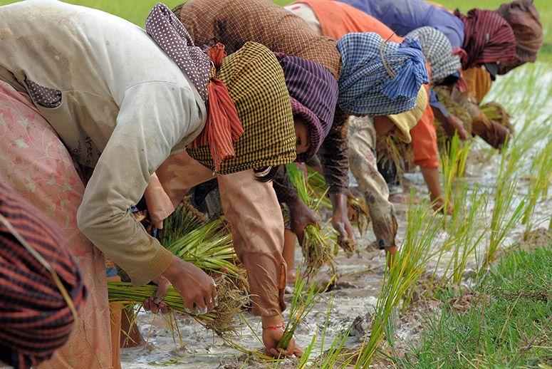
Agriculture and gender
Women tend to lack political voice
Gender inequalities result in less food being grown, less income earned, and higher levels of poverty and food insecurity

Slide 12
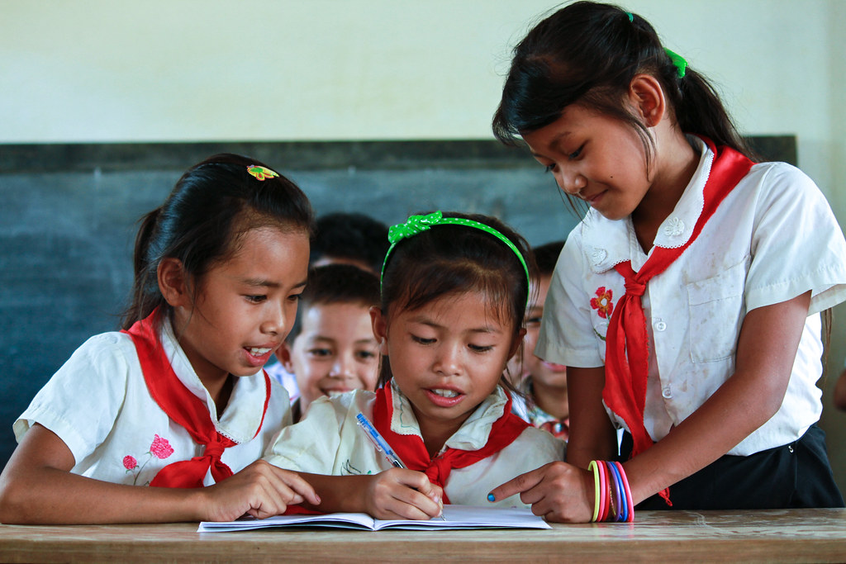
Education and gender
Girls and women face multiple barriers to education:
Distance to school, cultural norms and practices, school-related gender-based violence and forced marriage
Keeping girls in school and ensuring they can learn in a safe and supportive environment leads to many benefits for girls themselves, their families, their communities and societies

Slide 13
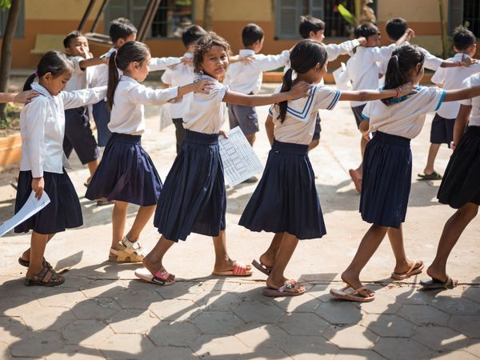
Education and gender
In 1990, 86 girls were enrolled in primary school for every 100 boys, compared with 67 girls in1960
The female labor force rate has grown at twice the rate of the male labor force; today 30% of women over 15 years are in the formal labor force in developing countries

Slide 14
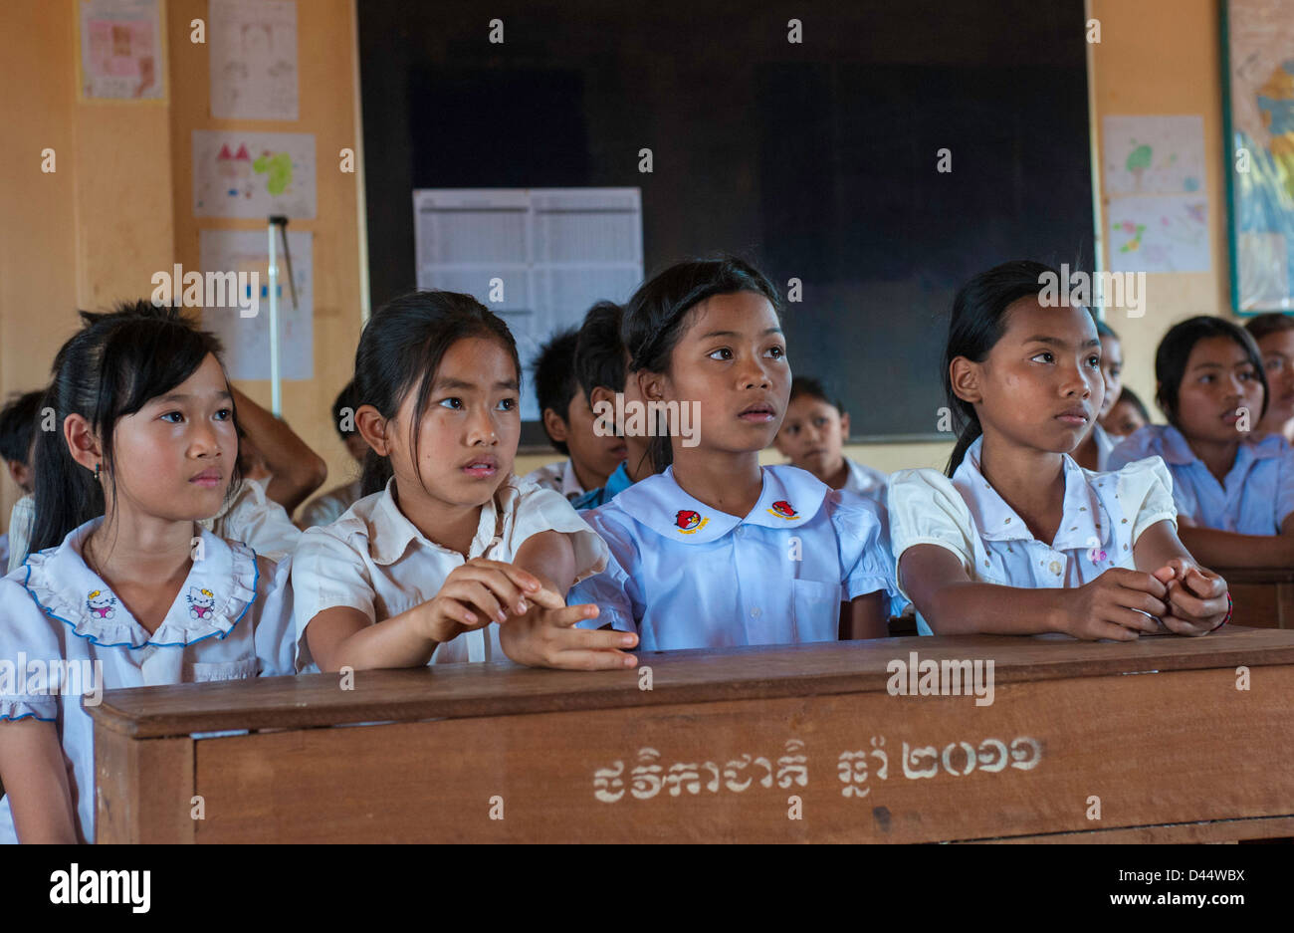
Education and gender
While progress has been made, there is still room for improvement
More young girls and women are attending primary and secondary school, but less than half are going on to attend college
Women are also still fighting to be fully represented in the job market

Slide 15
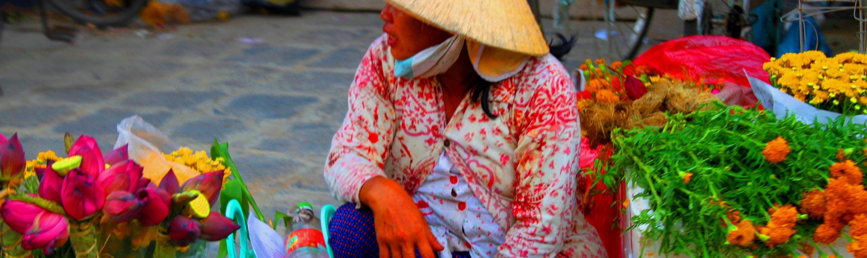
Gender in clmv
YOUR LOGO
Design Option #5
Notes:
© Copyright Showeet.com – Free PowerPoint Templates

Slide 16

Gender representation
There are still too few qualified women in elected political positions, as appointed justices, and those in educational institutions
Women make up less than one-quarter of all public sector employees. There are far fewer women than men in technical line ministries.
What society considers as “proper” roles for men and women explains why there is gender gap in the work place.

Slide 17
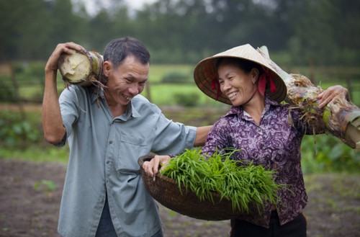
Gender mainstreaming
Progress has been achieved in integrating gender in economic development strategies and plans; government has secured the rights of female employees through advocacy and policy intervention
Wages of men and women with upper secondary and university education differ significantly; gender disparities in employment remain extensive, primarily because of traditional attitudes about “appropriate” occupations for women and men

Slide 18
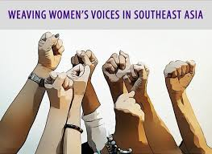
Women’s legal rights
Knowledge of legal rights is low among both women and men, but women tend to be comparatively disadvantaged because they are more isolated than men
However legal frameworks to protect women have been strengthened in CLMV countries; the proportion of women elected as members of parliament increased

Slide 19
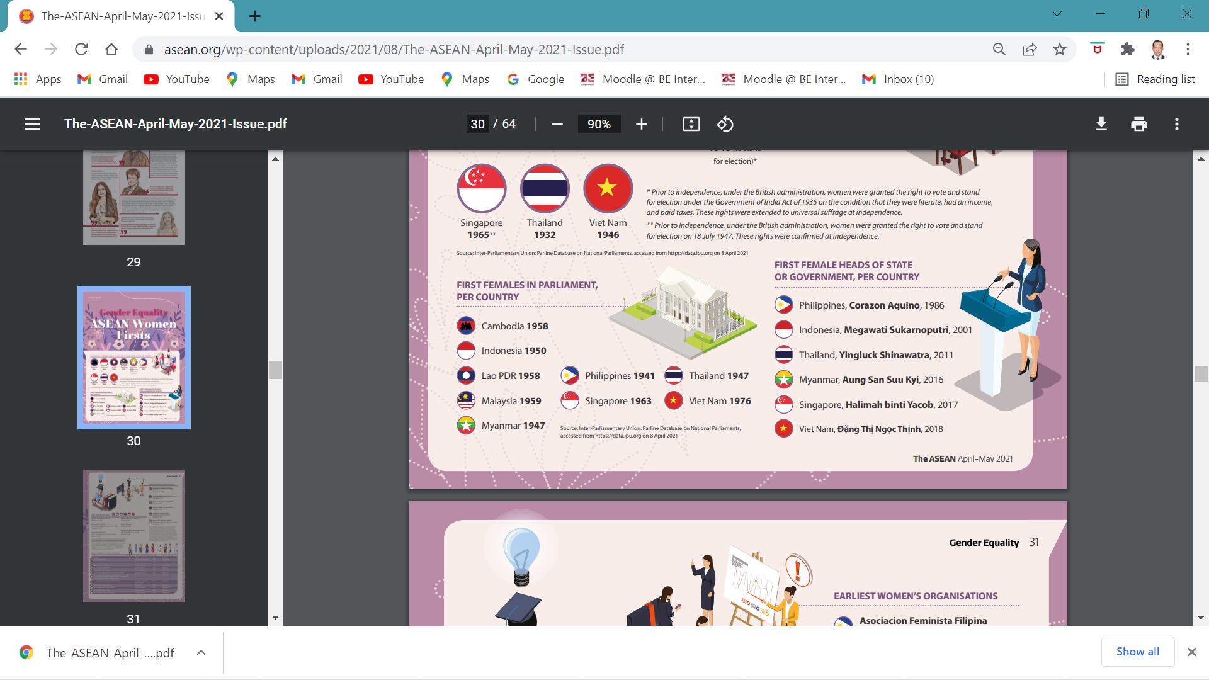
Limited representation of women in high level positions

Slide 20

Violence against women
Gender-based violence, particularly rape, is on the rise; domestic violence is not discussed publicly, and incidents of spousal abuse are rarely reported
Poor women are more vulnerable to violence compared to women who are better-off; lack of awareness of rights and lack of power increase a woman’s vulnerability to exploitation and abuse

Slide 21
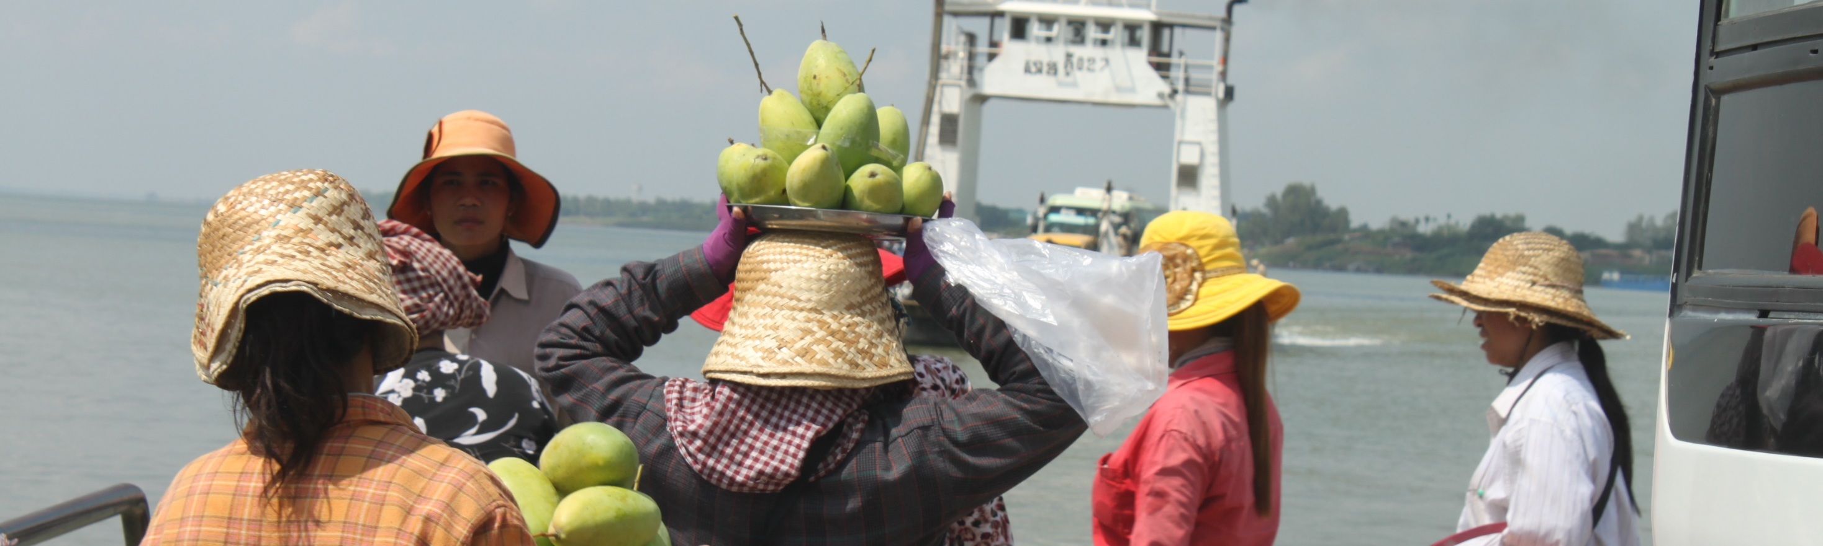
CONCLUSION
YOUR LOGO
Notes:
© Copyright Showeet.com – Free PowerPoint Templates

Slide 22
Conclusion
Gender issues cut across various development sectors; acknowledging and understanding issues that arise is important to resolve these issues
Resolving these issues will benefit not only women, but also society as a whole
Despite progress in mainstreaming gender and gender equality in CLMV, several issues remain; these include gender representation, women’s economic empowerment, equality in the labor force, and violence against women

Slide 23
Thank You !
Merry Christmas!
Notes:
© Copyright Showeet.com – Creative & Free PowerPoint Templates

