Slide 1
Asian Financial Crisis

Slide 2


THAILAND
Causes
The deficit of current account
The foreign debt problem (financial liberalization)
The bubble of the real estate business
The speculative attack on Thai baht
What’s Happen?
The dramatic depreciation of Thai currency
The massive layoffs in many sectors, Ex: fianance, real estate
BOT used all of the foreign reserves to hold the balance of Thai currency
Thailand had to loan money from IMF
Notes:
Cause >>>
The deficit >>> The shrink of the export of thailand which is the one of the main income channel of the country
The foreign debt >>> the financial liberalization that makes it easier to borrow money from foreign countries, Thai fixed it currency at 25THB per USD, that makes Thai investor invest with no risk. borrowers borrow and pay back with the same exchange rate
The bubble > because the fixed of the exchange rate of the foreign currency that motivate the investor to borrow money from foreigners, there is huge of investment project in Thailand then it bubbles
The speculative >>> from the problems of thai economy as i said, foreign investor see the opportunity to attack thai baht by จอส โซรอส, he sold huge amount of THB in the market to make THB depreciate, then Thailand has to used reserve to fix the exchange rate until the reserve run out, this effect THB to increase from 25 to 56 baht per dollar in one night
What’s happen >>>>
the massive layoff > the increasing of unemployment rate for both Thai people and foreigners as well.
BOT > but it is not enough, BOT has to borrow from other financial institution such as SCB or any financial fund company until it’s be finished.
From 1985 to 1996, Thailand's economy grew at an average of over 9% per year, the highest economic growth rate of any country at the time. Inflation was kept reasonably low within a range of 3.4–5.7%.^{[30]}The baht was pegged at 25 to the U.S. dollar.
On 14 May and 15 May 1997, the Thai baht was hit by massive speculative attacks. On 30 June 1997, Prime Minister Chavalit Yongchaiyudh said that he would not devalue the baht. However, Thailand lacked the foreign reserves to support the USD–Baht currency peg, and the Thai government was eventually forced to float the Baht, on 2 July 1997, allowing the value of the Baht to be set by the currency market. This caused a chain reaction of events, eventually culminating into a region-wide crisis.^{[31]}
Thailand's booming economy came to a halt amid massive layoffs in finance, real estate, and construction that resulted in huge numbers of workers returning to their villages in the countryside and 600,000 foreign workers being sent back to their home countries.^{[32]} The baht devalued swiftly and lost more than half of its value. The baht reached its lowest point of 56 units to the U.S. dollar in January 1998. The Thai stock market dropped 75%. Finance One, the largest Thai finance company until then, collapsed.^{[33]}
On 11 August 1997, the IMF unveiled a rescue package for Thailand with more than $17 billion, subject to conditions such as passing laws relating to bankruptcy (reorganizing and restructuring) procedures and establishing strong regulation frameworks for banks and other financial institutions. The IMF approved on 20 August 1997, another bailout package of $2.9 billion.
By 2001, Thailand's economy had recovered. The increasing tax revenues allowed the country to balance its budget and repay its debts to the IMF in 2003, four years ahead of schedule. The Thai baht continued to appreciate to 29 Baht to the U.S. dollar in October 2010.

Slide 3


The recovery
Thailand had to loan money from IMF for 17,200 million USD
The increasing of tax revenue
Having new policy to encourage tourism sector
Having more safety financial policy
Notes:
increase tax >>> to balance the budget and repay debt to IMF
having new policy >>> stimulate the foreigners to travel in Thailand, this will increase the revenue
Having more safety >>> Control loan in the country, debt, and the bubbles

Slide 4


SOUTH KOREA
What brought the crisis ?
Inflation
Appreciation of Korean Won
Recession of the world economy
1.
Current account deficit
Policies to finance the growing deficit
Amending the Foreign Exchange Management Act.
Deregulating restrictions on asset and liability management of FIs.
Liberalizing short-term capital inflows
“Weak regulation and supervision”
Notes:
there are 3 main factors that brought the crisis to south korea
1.current account deficit
korea’s current account balance started to deteriorate because of rising inflation, appreciation of the korean won and the recession of the world economy.
the government encourage capital inflows to finance the growing current account deficit by amending foreign exchange management act, remove restrictions on asset and liability management of financial institutions and choose to liberalize short term capital inflows ahead of long term capital inflows. → but the regulation and supervision was weak. so the situation has got even worse

Slide 5



2.
3.
Failed to bailout
Contagion
The government “would not dare to allow a big horse to die”
Thailand devalued its currency and markets fell all over Asia.
BUT, The government refused to bailout a chaebol group and delayed in providing bailout for some chaebol
Investors began taking money out of South Korea and tightening credit.
Beginning of bankruptcy proceeding for Hanbo, Sammi, Jinro, and others.
Foreign reserves were dwindling dangerously low and many korean companies unable to pay off loans
* Chaebol = large industrial conglomerate
Notes:
2. faild to bailout
in korea, there had been widely accepted notion that the gov would not dare to allow a big horse to die which mean that a large conglomerate whose survival had serious consequences in terms of the stability of the whole economy would receive bailout
but, the gov refused this notion bc they believe that a chaebol (large conglomerate) that usually invested in heavily in wasteful projects and maintained huge debt burdens should stand on its own feet and there were no resource to provide help to chaebols
the consequence was many chaebols such as Hanbo, sammi, jinro and others started to default and went bankrupt.
3. contagion
after thailand devalued its currency and markets fell all over asia. investors began taking their money out of korea and tightening credit because they sew many problems with korean companies such as massive debt burdens
this make the foreign reserve decline dangerously low. without a supply of credit, korean companies unable to pay back loan and face defaulting and the entire economy came close to collapse.

Slide 6


Policy response
IMF provided US$58.4 billion as a bailout package
Kim Dae Jung’s economic and financial reforms
  Adopting free floating exchange rate
  Passing laws that require companies to be audited and obtain loan publicly
  Allowing M&A by foreigner and removing barriers on foreign investment
  Passing new fiscal and monetary policies
  Recapitalizing banks
  Reforming Chaebol
Notes:
The South Korean government had go begging to the International Monetary Fund for a $58 billion loan---the biggest IMF rescue package ever---but even that wasn't enough. Japan, the United States and other countries coughed up more money to prevent the South Korean economy from totally collapsing.
as a president, Kim Dae Jung did the economic and financail reformation
-he floated the won, korean currency
-he passed laws that required Korean companies to be audited and required to them to obtain loans publically rather than secretly.
-get rid of laws that limited foreign investment and allowing foreigners to take over whole companies
-passed new fiscal and monetary policies, deregulation, economic transparency, bank reforms, major liberalizations in trade and capital inflows.
-recapitalized banks, set up a public asset-management company to get rid of bad loans.
-restructured and reformed chaebols

Slide 7



Recovery
  Won was allowed to float freely
  Interest rates was allowed to rise
  Reserves of foreign currency increased
  Easier for foreign investors to enter South Korea
  Encouraging foreign investment and improving the structure and governance of Korean corporations
  Foreign capital began pouring in the country
  Many chaebols are mandated by the government, allowed to fail, break up or come under foreign ownership.
South Korea was able to bounce back and resume the soaring growth rates with double of GDP since 1998
Notes:
as the government removed barriers on foreign investment and adopt free float exchange rate, the currency was allowed to float freely and allow interest rate to rise
it was easier for foreign investors to enter South Korea which encourage foreign investment
reserves of foreign currency increased and the Foreign capital began pouring in the country, mostly by exporting to the US
from chaebols reforms, many of the them are mandated by the gov, allowed to fail, break up, or come under foreign ownership.
eventually, South Korea was able to bounce back and resume the soaring growth rates that have enabled its gross domestic product to double since 1998

Slide 8
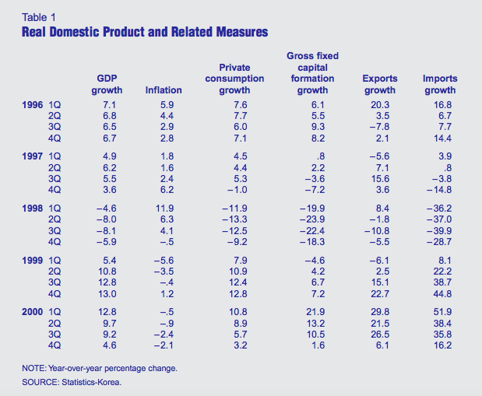

Slide 9
Malaysia
Cause
Foreign withdrawn their investment
Poor management and policy
Lack in risk management
What’s Happen
Depreciation of ringgit per USA dollar from 2.42 to 4.88
The biggest stock price plummeted among the Asian countries.
Declining in FDI
Increasing in inflation rate from 2.7% in 1997 to 5.3% in 1998
Increasing in unemployment rate
Notes:
https://pdfs.semanticscholar.org/7e43/e25b5fcfe16370b468e3b754cf9efc1a6b5b.pdf
https://www.unescap.org/sites/default/files/Bulletin02-ch3.pdf
When the Asian economic crisis occurred, a majority of the lenders took back their loans and this caused the capital to outflow without any control. (Capital Outflow, Current Account deficit), since there is financial crisis in Thailand because they think that this area is not stable to invest anymore.
Poor management of government and commercial bank policy to response with occurrence above.
Lack in risk management with huge mismatches between the asset and liabilities of enterprises, leading them to assume excessive liquidity, interest rate and currency risks. For example, the over investment of government in mega project to support high GDP of the country.
Unemployment, During the financial crisis, between January and December 1998, the
total number of workers retrenched was 83,865 or 7.4%, in normally it should be between 1-3%
Exchange rate while borrowing and lending with foreign was fixed at lower than it should be
The Malaysian economic was vulnerable due to the unsustainable pace of economic growth and over-valued exchange rates.
Au: Firstly Malaysia have good economic when the asian fin. crisis occurs its cause malaysia’s currency dropped so hard cuz gov.and bank have poor policy or not correct policy to counter the effect therefore malaysia economic worsen.+Asia was characterized by a concentrated shareholdings system. Non-competitive product markets and weak legal protection as well as governance by large shareholders rather than managers had reduced opportunities for managements to specialize, poor diversification of investments, and increased risks of expropriation of outside shareholders by insiders.

Slide 10

Recovery
Improved international reserves position
Stabilization and Reformation
Danaharta (remove NPL)
Danamodal (strengthen financial institution)
Merger of financial institution
Corporate Debt Restructuring Committee
Improve bond market
Notes:
to make their currency more strengthen.
remove Non-Performing loan which is the loan that the borrower is not making interest payments or repaying any principal.

Slide 11

PHILIPPINES
Why?
Many Asian economies had pegged their currencies to the U.S. dollar. Except for Philippines
Philippines was not as badly affected as its Asian neighbors and was quicker to recover.
Exchange Rates Pegged to the U.S. Dollar
Notes:
Philippines was not as badly affected as its Asian neighbors and was quicker to recover.Philippines was likely to be the least affected of the Asian countries.
https://www.jri.co.jp/english/periodical/rim/1999/RIMe199902philippines/
it is because of these factors
1. Exchange Rates Pegged to the U.S. Dollar -
Many Asian economies had pegged their currencies to the U.S. dollar. except for Philippines,

Slide 12
2) Excess Debt and Profitability and Bankruptcy
The debt/equity ratio of samples of Asian companies as of the end of 1997 - the Philippines debt/equity ratio was the lowest at 1.9 (when Japan was 4.3)
3) Strong Financial System
The Philippines had much less short-term foreign currency borrowings, and half of the foreign currency liabilities of the private sector were to its residents/depositors.
Notes:
2) Excess Debt and Profitability and Bankruptcy
The debt/equity ratio of samples of Asian companies as of the end of 1997 -shows that the Philippines debt/equity ratio was the lowest at 1.9; (Japan was 4.3).
3) Strong Financial System
The Philippines had much less short-term foreign currency borrowings, and half of the foreign currency liabilities of the private sector were to its residents/depositors, and most of the FCDU loans were to exporters, who are providing a natural hedge.Compared to the others, most of the loans in the Philippine banks were made to the more productive sectors of the economy such as manufacturing. Its loans to the real estate sector were relatively smaller, and the growth in real estate investment was basically due to real demand.

Slide 13
Consequences
The Lending Booom
Exchange rate collapsed the country experienced a significant real exchange rate depreciation
financed investment in internationally tradable sectors
increasing exports (as well as substituting domestically produced goods for imports)
Notes:
the exchange rate collapsed the country experienced a significant real exchange rate depreciation,
This difference in the sectoral pattern of lending had implications for how the economy was able to respond to the crisis.
When the exchange rate collapsed the country experienced a significant real exchange rate depreciation, as did other countries in Southeast Asia.
However, to greater extent that the others, the lending boom in the Philippines had financed investment in internationally tradable sectors. Because of excess capacity in the tradables sector and less impairment of corporate balance sheets meant the Philippines was better able to exploit the real exchange rate depreciation, increasing exports (as well as substituting domestically produced goods for imports).
And as a consequence, the Philippines was able to generate the big reduction in its current account deficit through exporting (and thereby maintaining the level of domestic output), rather than through a compression of imports

Slide 14

Singapore
Causes
Trade Channel (Export Competiveness - Regional Demand)
What’s Happened
Economic Growth Slowdown
Higher Unemployment
Falling Asset Price

Slide 15
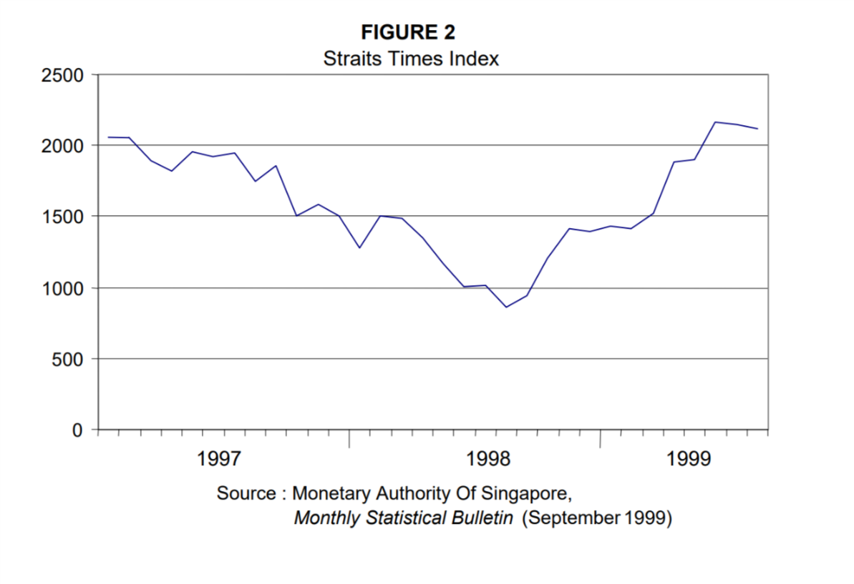

Slide 16
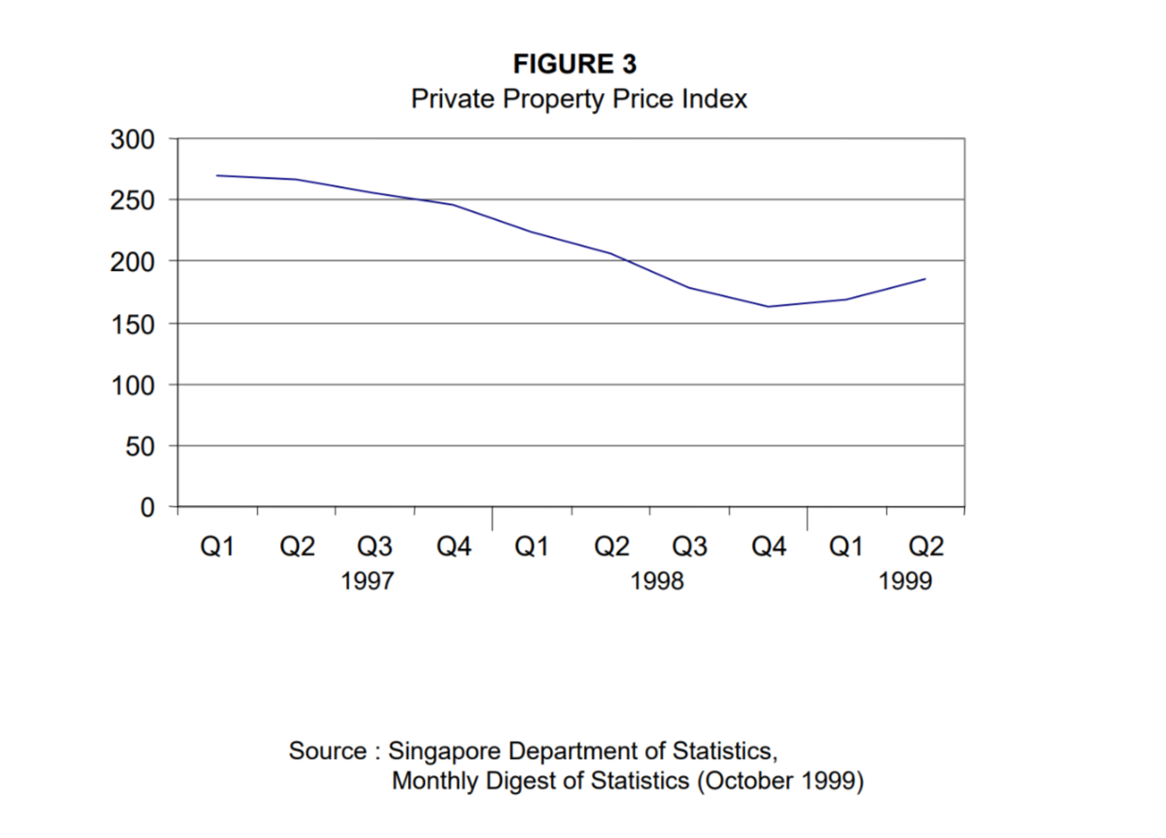

Slide 17

Singapore
Policy Responses
Singapore Dollar Devaulation
Direct Cost Cutting
Expansion Fiscal Policies
Financial Sector Reforms
Recovery
Rebound with a remarkable 5.4 % growth in 1999
Budget surplus of 3.2$ billion USD in early 1999
The value of Singapore Dollar returned to pre-crisis level in 1999

Slide 18
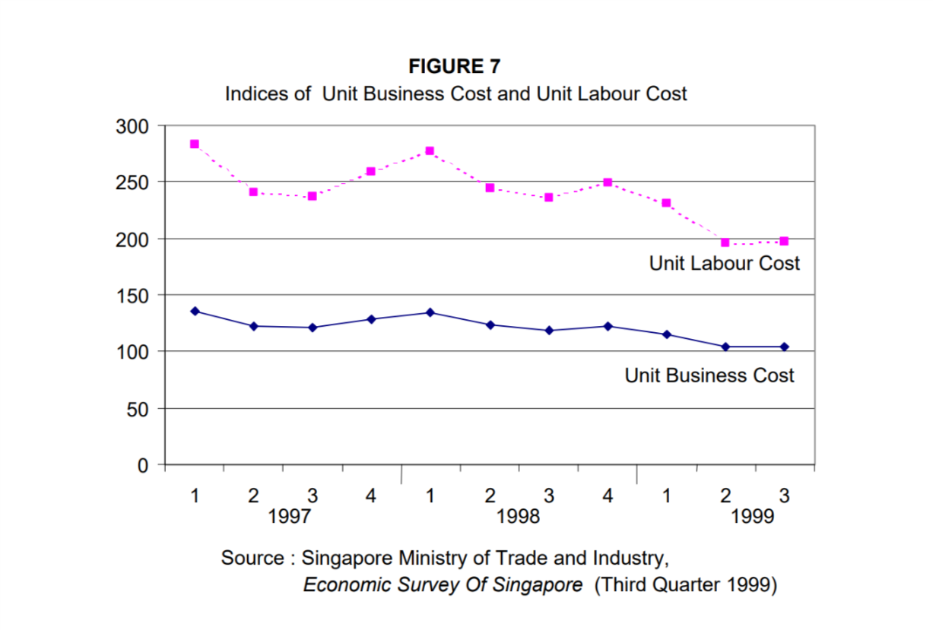

Slide 19
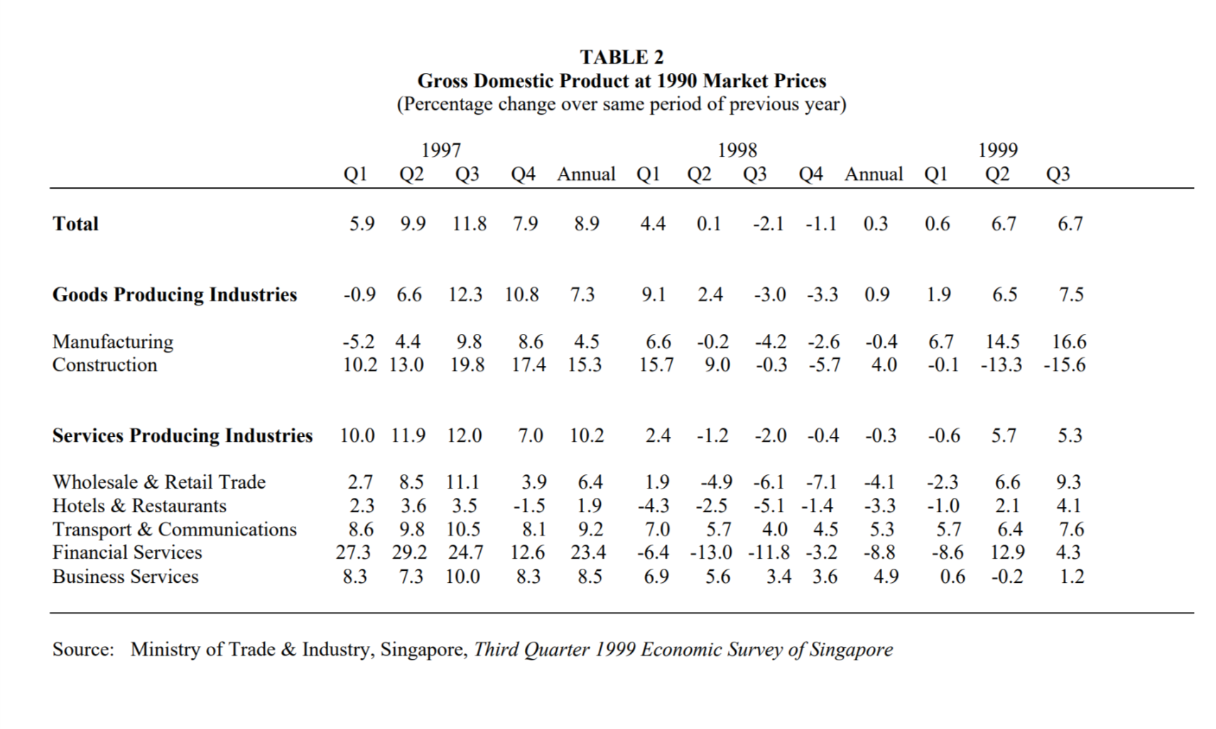

Slide 20





What cause Indonesia financial crisis?
Indonesia
Political stability
Debt structuring
ฺBanking system

Slide 21
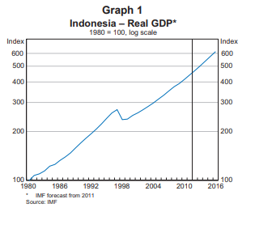
Political stability

Slide 22
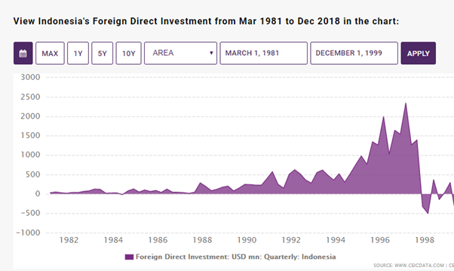

Slide 23
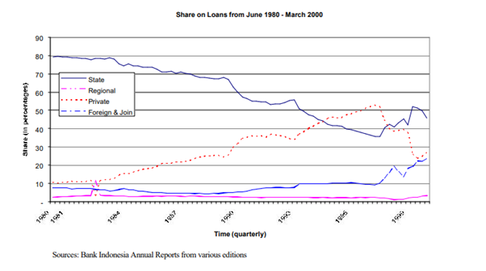
Debt structuring

Slide 24
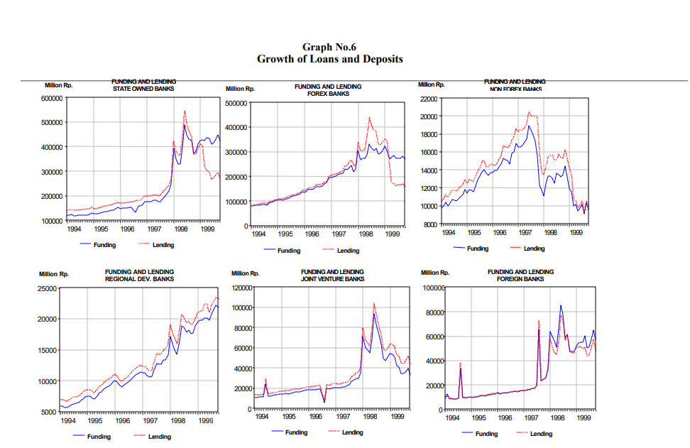
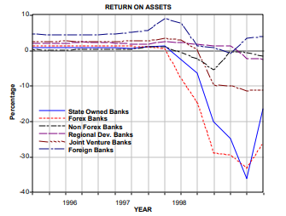
Banking system

Slide 25



What’s the effects from Indonesia crisis?
-Inflation
-Depreiation in Rupiah currency
-High Job losses and unemployment
-poverty

Slide 26
Recovery
Inflation under control : Inflation remains under control within Bank Indonesia's target range of 5-7 percent for 2007.
Need for tangible results : The government therefore aims to boost GDP growth to at least 7 percent to realize tangible improvements in social conditions
higher investment : Increasing infrastructure investment is thus a key priority of the government including, the private sector through public-private partnerships, and a sound framework.
Long-term financing : Developing domestic capital markets and the nonbank financial sector should improve the availability of financing

Slide 27
THANK YOU
Q&A

