Slide 1
CLMV migrant workers in their countries
Part 2 B (slide 47-76)

Slide 2
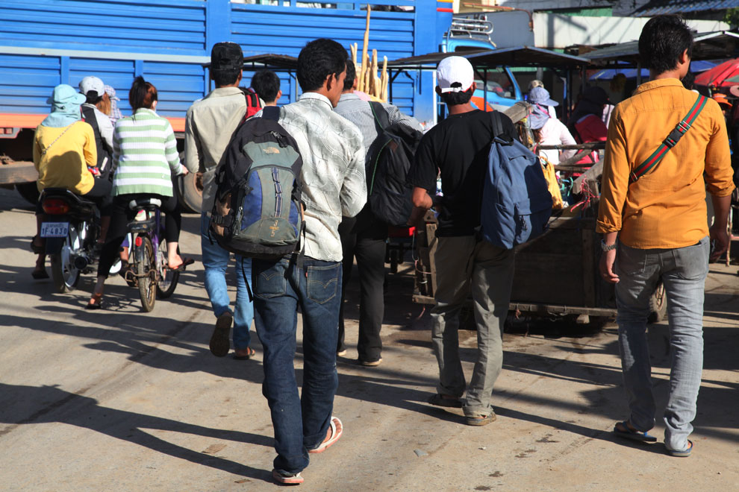
Cambodia Profile
Total population is 14,676,591 which includes 7,555,083 females
Unemployment rate: 2.7% (NIS 2013)
Population in Severe Poverty 16.4% (HDR)
The percentage of working age population (aged 15-64 years) increased from 62% to 65.6%
The young population working age group (aged 15-24 years) grow average annual rate of 3%
Estimated 300,000 per year will enter to the labour market
World Bank estimates there are 346,710 emigrates, which represents 2.5% of total population ??
The number of undocumented Cambodian workers are unknown

Slide 3
Implementation of Cambodian Government Policies on sending migrants abroad
Established Manpower Training and Oversee Sending Board (MTOSB) in 2007
Established Labor Migration Taskforce in 2007
Established an Inter-Ministerial Task Force for Migration (IMTM) in 2006
49 registered private recruitment agencies in Cambodia to send workers to Japan, Korea, Malaysia and Singapore (2013)
Only 42 recruitment agencies have licenses to recruit Cambodian Migrant worker to Thailand

Slide 4
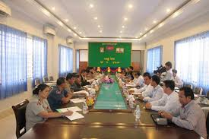
Collaboration with government and non-government agencies
Established the National Task Force to Combat Human Trafficking (2007) and issued a Sub-Decree on establishment of National Committee to Lead the Suppression of Human Trafficking, Smuggling, Labor Exploitation and Sexual Exploitation in Women and Children S.T.S.L.S.(2009)
There are seven working group established:
Prevention
Protection
Law Enforcement
Justice
International Coordination
Child Affairs
Migrant Worker

Slide 5
Cambodian Migrant Workers to Thailand
Year | 2006 | 2007 | 2008 | 2009 | 2010 | 2011 | 2012 | 2013 | 2014
Male | 226 | 3,935 | 1,425 | 1,968 | 6,304 | 10,624 | 16,551 | 8,840 | 3,275
Female | 219 | 1,735 | 691 | 1,575 | 4,920 | 6,123 | 9,839 | 4,628 | 1,966
Total: | 445 | 5,670 | 2,116 | 3,543 | 11,224 | 16,837 | 26,390 | 13,468 | 5,241
Deployment of Cambodian migrant workers (2006 to May 2014) Source: MoLVT ????
Type of registration | Male | Female | Total
MoU | 50,652 | 35,976 | 86,628
National Verification (NV) | 63,913 | 41,106 | 105,019
One Stop Service Center (OSSC) | 334,242 | 362,096 | 696,338
Grand Total | 448,807 | 439,178 | 887,985
Source: NV and MOU (Office of Foreign Workers Administration, October 2014); )SSC (Department of Local Administration, October 6, 2014)

Slide 6
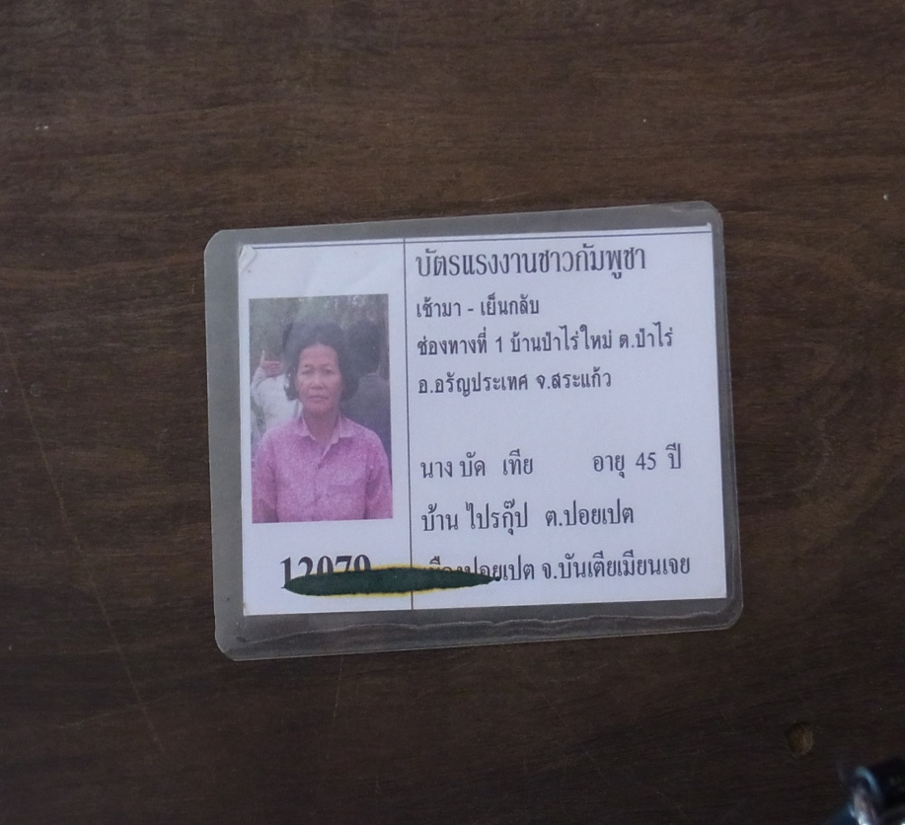
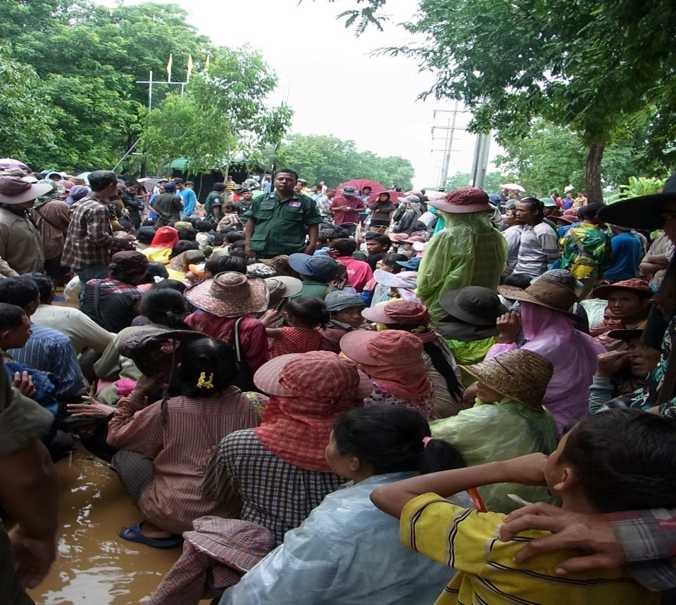
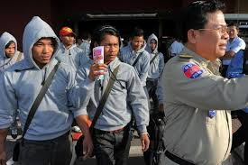
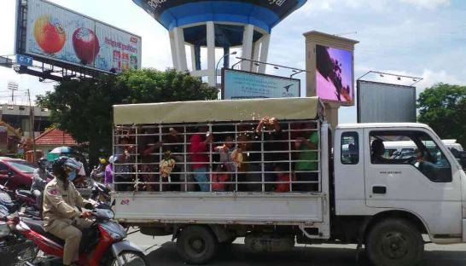

Slide 7
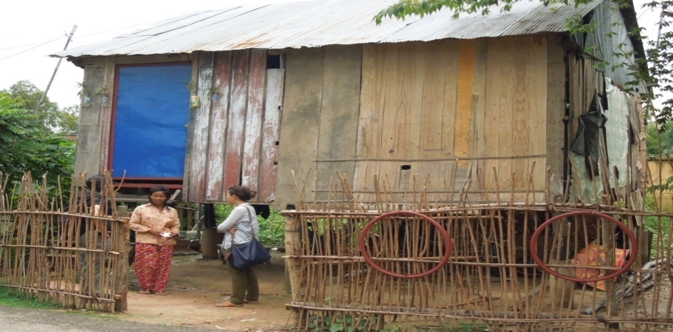
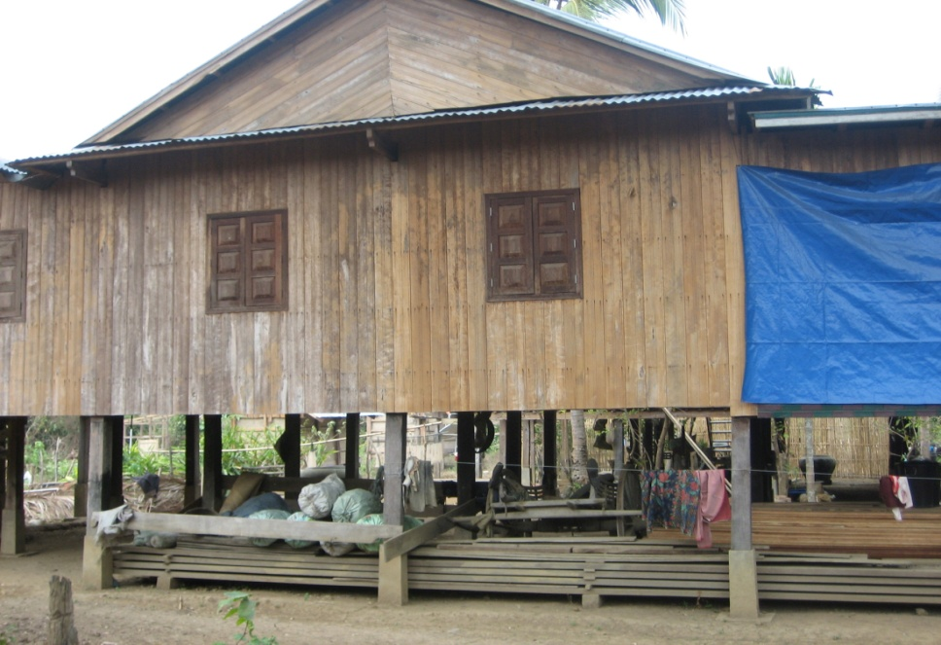
Impact of remittance from Cambodian Workers in Thailand
Food
Daily activities for household
Health care
Debt from migrate
School materials
Buy Motorcycle
Buy land
Building house or renovation
Marriage or funeral

Slide 8
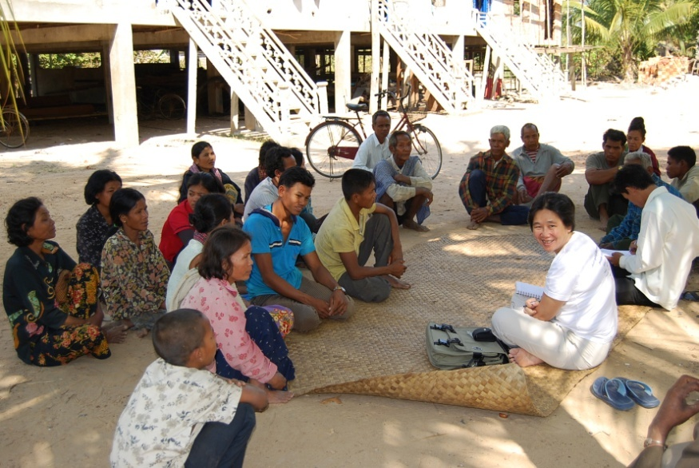
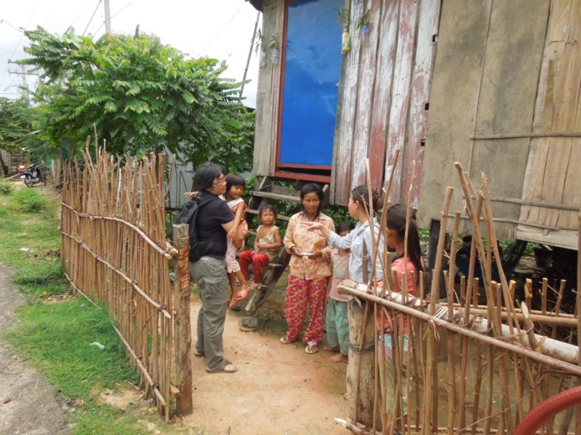
Concluding Remarks
Migrant workers went through informal channel, cheap and rapid (negative impact: high risk of fraud, to be trafficked or exploited)
Unknown or under-estimate number of Cambodian undocumented migrant to Thailand and other countries (lack of proper database)
Informal remittance system used by migrant workers, trust and rapid
Limited skill transfer (most of migrant worker work at construction, farm, fish factories and fishing boat)

Slide 9
Lao PDR
Population - 6.7 mil. and labour force - 5.2 mil.
Second smallest at 230,800km2; (Cambodia, 176,520 km2; Vietnam, 310,070; Thailand, 510,890 km2; and Myanmar, 653,290 km2)
Most of Lao MWs to Thailand are illegal, difficult to monitor and determine their accurate number;
In 2014, there are 268,696 MWs in Thailand (NV =33,013, MOU =21, 994 and OSSC = 213,689) consisting of 105,620 women or 39 percent.

Slide 10
Lao PDR Regulatory framework and brokers
Decision on Migration (Ministry of Home Affairs Ref. 633, 14 September 2012): principles, rules and regulations on the internal migration of the general population;
Decree No. 68/PMO: Export of Laotian Workers (28 May 2002);
Directive No. 2417/MLSW on the Rights and Responsibilities of Employees, Employers and Recruitment Agencies (29 July 2002)
Directive No. 3824/MLSW (December 2002) on Prohibitions on Foreign Employment for Lao Nationals
MOU Between Lao PDR and RTG on Employment Cooperation (2002)

Slide 11
Lao PDR Regulatory framework and brokers
Managing and overseeing labour migration in Lao PDR belong mainly to :
  Ministry of Labour and Social Welfare (MoLSW),
  Ministry of Public Security (MPS);
  Ministry of Foreign Affairs (MFA); and
  Ministry of Health (MoH).
  One of the key roles of the MoLSW is the oversight of the country’s fifteen employment service enterprise (ESE) or (RAs), two of which are state-owned.

Slide 12
Lao PDR Regulatory framework and brokers
5 private RAs - well established and legitimate; the rest -- unprofessional, committing such negative acts like failing to screen the prospective migrant workers and not knowing enough of the employers and relying only on brokers.
A key labour official did not see any problems with the RAs in general, attributing MWs’ woes as their own faults;
The oldest started in 2005 and now has fourteen employees in its main office in Vientiane and ten more branches representing the company in six border provinces; has placed around 25,000 Lao workers.

Slide 13
Lao PDR Poverty reducing impacts of labour migration
Remittances : living conditions, household income and agricultural activities (USD 64 million)
Gained skills and new experiences which they use in local jobs
Savings for capital to start a small business
Build a new house or buy land
Negative impacts
Trafficking cases involving serious injury and trauma and disease resulting in the families’ spending considerable amounts for health care;
Loss of labour at home; and,
Break up of families;
2,196 trafficking survivors were returned

Slide 14
Myanmar
One of the least developed countries with the second lowest GDP per capita in ASEAN (US$ 824 in 2011 but at PPP $3,542 which is higher than Cambodia’s PPP$2,857);
Population -61.6 mil. and labour force - 40.8 mil.
Type | Migrant workers
 | Total | M | F
MOU | 140,342 | 84,562 | 55,780
NV | 946,946 | 597,980 | 348,966
OSSC | 623,648 | 343,006 | 280,642
Total | 1,710,936 | 1,025,548 | 685,388
 | 100 | 59.9 | 40.1
Majority of Myanmar migrants are illegal (NV and OSSC are former illegal migrants)
43.6 percent are women
Proportion of women are higher in illegal groups

Slide 15
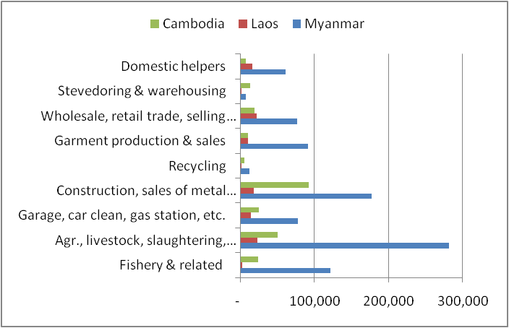
Myanmar –Skill demand
low-skilled, low-wage sectors such as agriculture, fisheries and seafood processing, and domestic work as well as in the garment and textile industry on the Thai-Burmese border

Slide 16
Myanmar-Regulatory framework
Outdated Overseas Employment law of 1999
National Plan of Action for the Management of International Labour Migration, 2013-2017 (NPA)
  specific actions and policy options under four strategic areas of labour migration management:
  1) protection (improve working conditions and the life situation of migrants and families in Thailand;
  2) governance of labour migration;
  3) labour migration and development; and
  4) research
  not been officially passed
  key labour official did not know anything about the plan

Slide 17
Myanmar – Regulatory framework
The Law Relating to Overseas Employment No. 3/99 ;
Outlines requirements for licensing of service agents and certification of workers intending to work abroad;
Prescribes duties and rights of service agents and migrant workers;
No clear implementing rules and regulations; and
Obsolete, did not take into account developments that transpired in more recent years, such as the 2003 MoU;
Will be revised.

Slide 18
Myanmar -Situation
Female migrants reported lower levels of income more than male migrants. Among the lowest income group, there were nearly twice as many females than males
There were clear differences in the income level and working conditions between border provinces and non-border provinces. In Tak, 91.5 percent reported receiving less than the minimum wage. Among them, 47.7 percent received less than half of the minimum wage
Undocumented migrants reported lower levels of income and worse working conditions than documented migrants

Slide 19
Myanmar - Impacts
In 2013, remittances from Thailand USD 127 million;
For basic needs: daily consumption, health and medical services, education, etc., without any scope for investments and other productive purposes;
Education opportunities;
Negative impacts ;
Irregular migration is fraught with many risks, including exploitation during the whole cycle of the migration process.
Complex procedures and prohibitive fees can both discourage people from migrating formally and at the same time create opportunities for brokers to take advantage of unwary potential migrants who are not aware of their rights and procedures for recruitment and placement.

Slide 20
Vietnam
In 2013 - population 89.7 mil. and - labour force 69.4 mil., unemployment rate 1.9 percent (ADB)
Middle-income country;
Labour export has been Vietnam’s socio-economic development strategy since beginning of Doi Moi (1986);
Has sent about 80,000 workers abroad per year and a stock of emigration between 2001-2010 of about 800,000;
Notes:
(US Census Bureau – population for July 1, 2013 is estimated at 92.5 mil.; Labour Force Survey of Vietnam, the labour force of Vietnam in 2013 was 53.2 million)

Slide 21
Vietnam
Major destinations include Taiwan, Malaysia, the Republic of Korea, Japan, South Africa;
Women accounts for 42 % of organized migrant workers in 2013
Most MW from Vietnam to Thailand are illegal;
Estimated at 50,000 Vietnamese unorganized MW in Thailand.
Because they are unorganized, the official data on their number and characteristics are not available.

Slide 22
Vietnam: Regulatory framework
Focus on creating favourable conditions for qualified labor migration and increasing numbers of professional workers with technical skills.
Targets
  To increase the numbers of migrants by 10 % every year from 2009-2015, 8-10 % from 2016-2020;
  To increase the number of vocationally trained migrants by 5 % every year; and, To reach the 100% rate of trained migrants in 2020.
The government of Vietnam is waiting for MOU with Thai government on sending workers to Thailand;
The private sector (Association of Tourism in Ha Tinh) is arranging MOU with local government of Thailand to send workers trained in Tourism.

Slide 23
Vietnam: Regulatory framework
regulatory framework for labour migration
  Law No. 72/2006/QH, on Vietnamese workers working abroad under contract;
  Decree No. 126/2007/ND-CP detailing and guiding the implementation of numbers of articles of the Law;
  Decree No. 144/2007ND-CP on sanctioning of administrative violations in the sending of Vietnamese workers abroad for employment and;
  Decision No. 71/2009/QD-TTg approving the project on supporting poor districts in promoting the sending of workers abroad for sustainable poverty reduction in the period of 2009-2020

Slide 24
Vietnam:Management of labour migration
MOLISA ---- the management of labour export.
Within MOLISA, DOLAB – authorizing labour export licenses, auditing and inspecting labour export activities, and dealing with violations of related provisions, as well as conducting research and advising MOLISA on strategies, plan, and legislation involving labour export;
A sending agency/broker organization must be a 100% Vietnamese enterprise with legal capital of at least 5 billion Dong (about US$250,000).

Slide 25
Vietnam:Management of labour migration
In 2010, there were 167 sending agencies consisting of private enterprises, state-own enterprises and joint private-state enterprises.
Most of sending agencies are member of Vietnam Association of Manpower Supply (VAMAS), an association of sending agencies;
All workers except MW are members of Vietnam General Confederation of Labour (VGCL) who is the sole national trade union center in Vietnam;

Slide 26
Situation of VN migrant workers to Thailand
Most of VN MW to Thailand are illegal, travel on their own without recognition of the government. They are classified as “unorganized”;
In two communes close to Thailand border, Thanh Hoa and Ha Tinh:
  In 2013, 919 migrants from Thanh Hoa went to Thailand for employment (51 percent of which were women);
  917 migrants from Ha Tinh (37 percent of which were women);
  In 2012, 4,623 migrants from Ha Tinh to Thailand. (38 percent of which were women).
  The work they had in Thailand includes domestic help, sales, restaurant workers, and mechanic

Slide 27
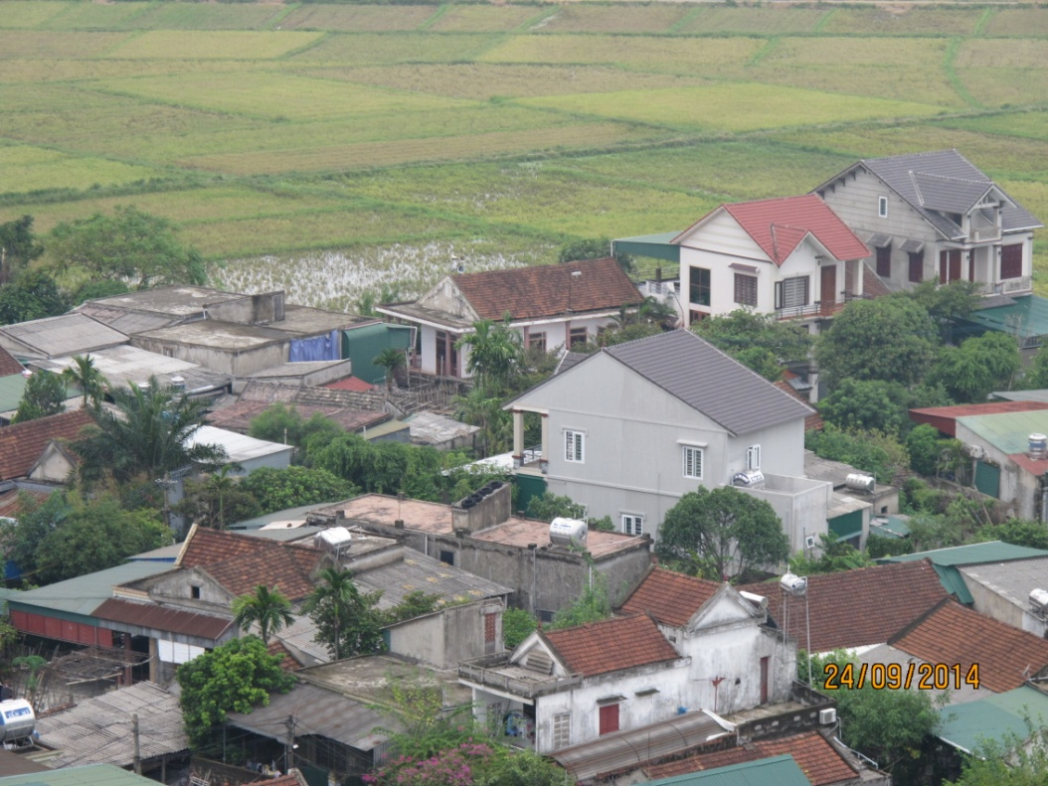
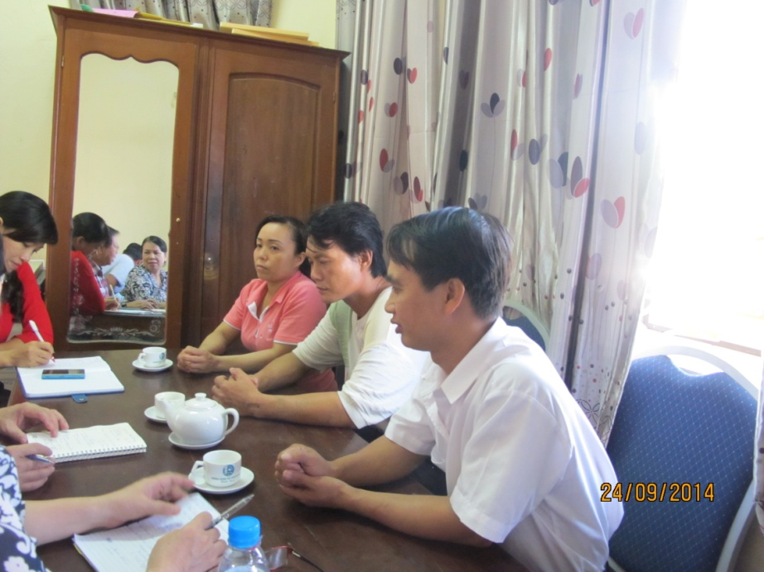
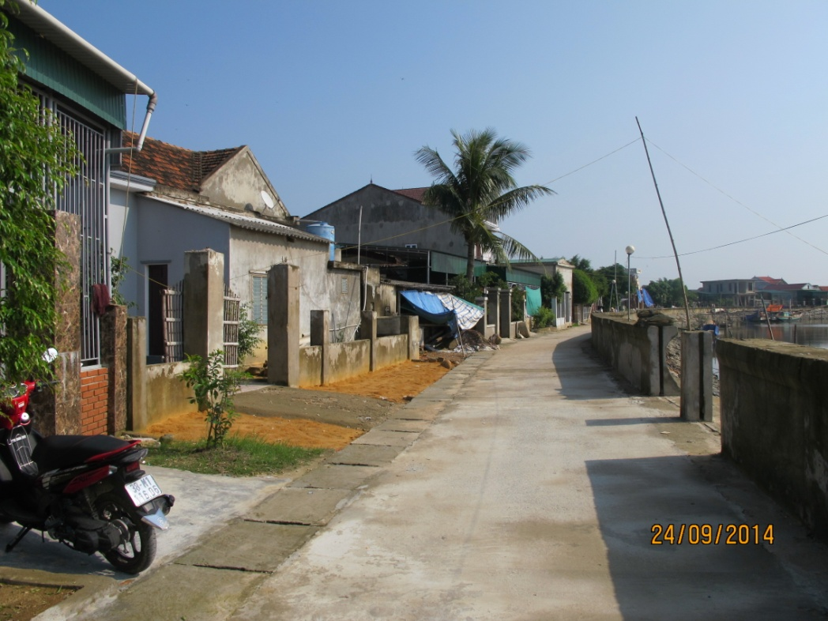
Situation of VN migrant workers to Thailand
Ha Tinh Province
Returned MW
Thach Long Commune

Slide 28
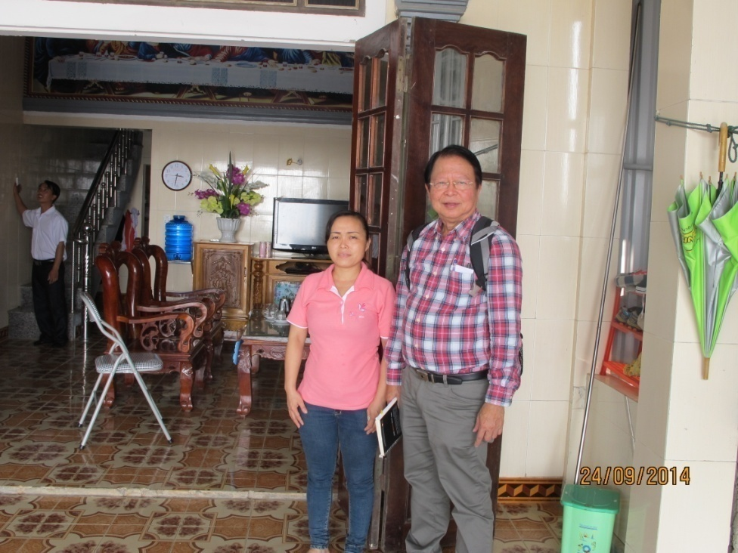
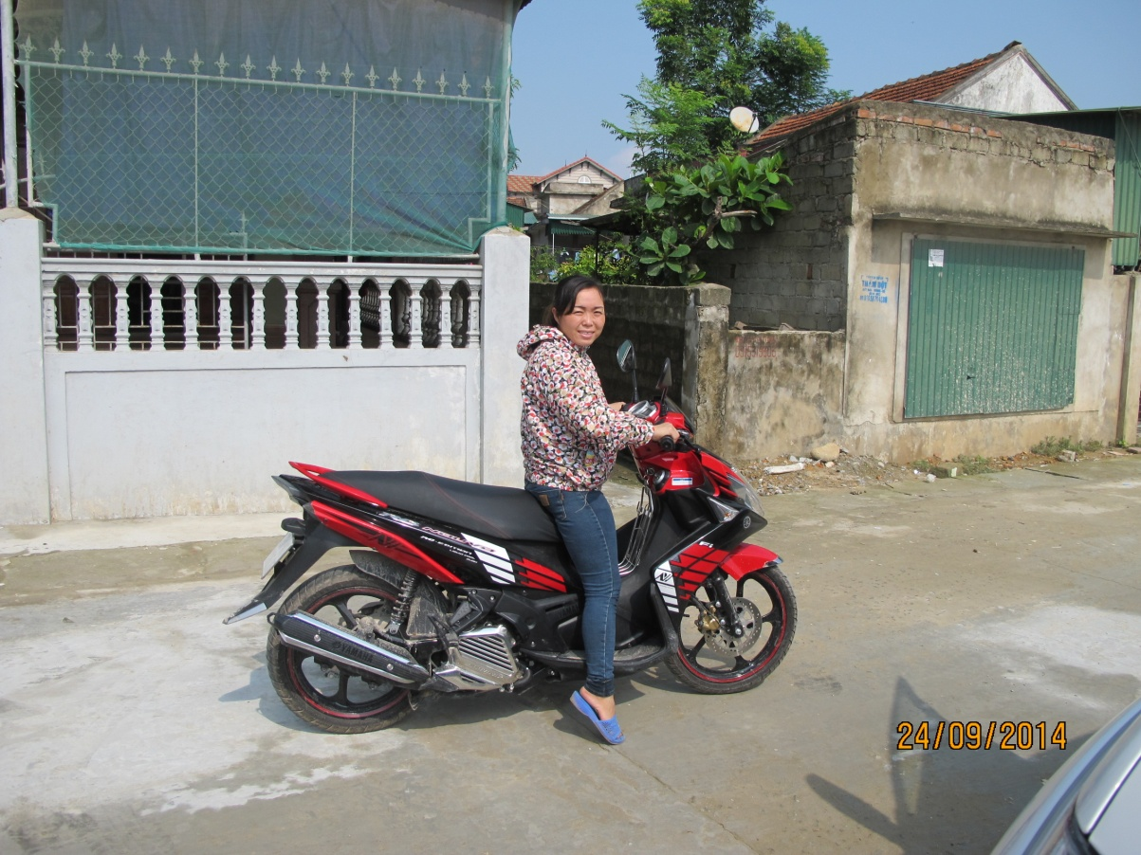
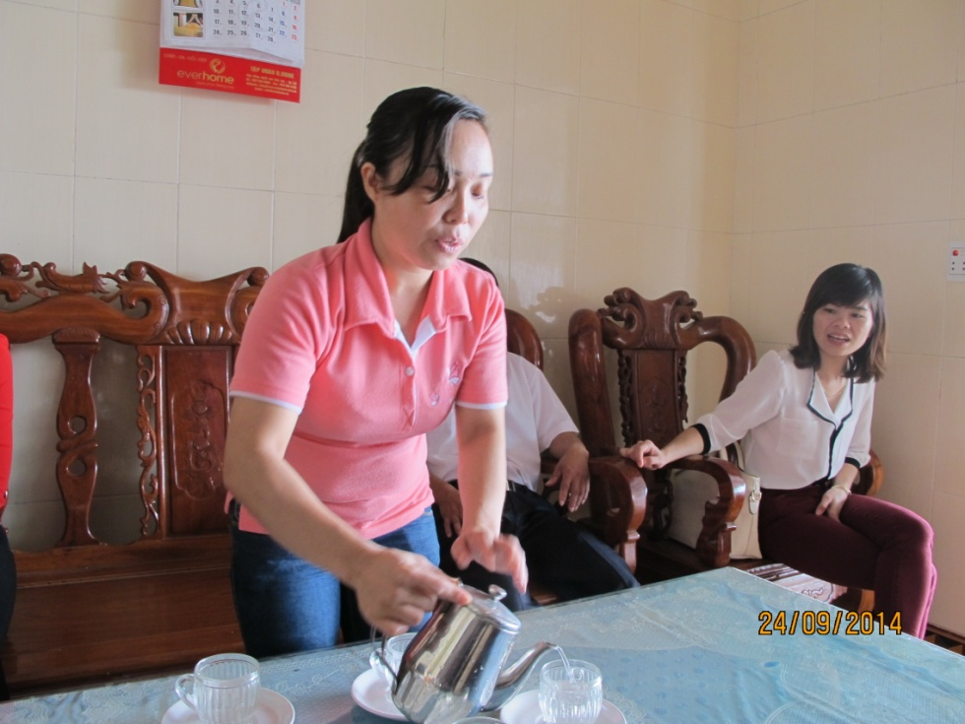
Situation of VN migrant workers to Thailand
Assets from remittances showing a success story

Slide 29
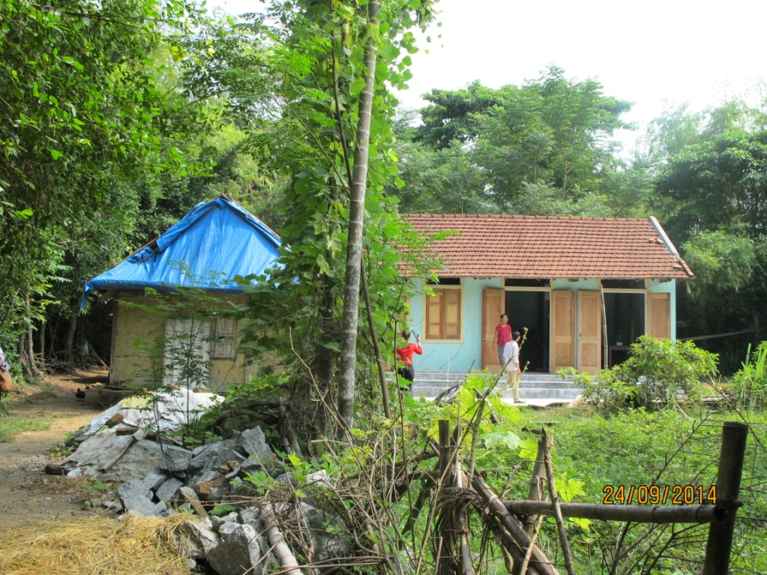
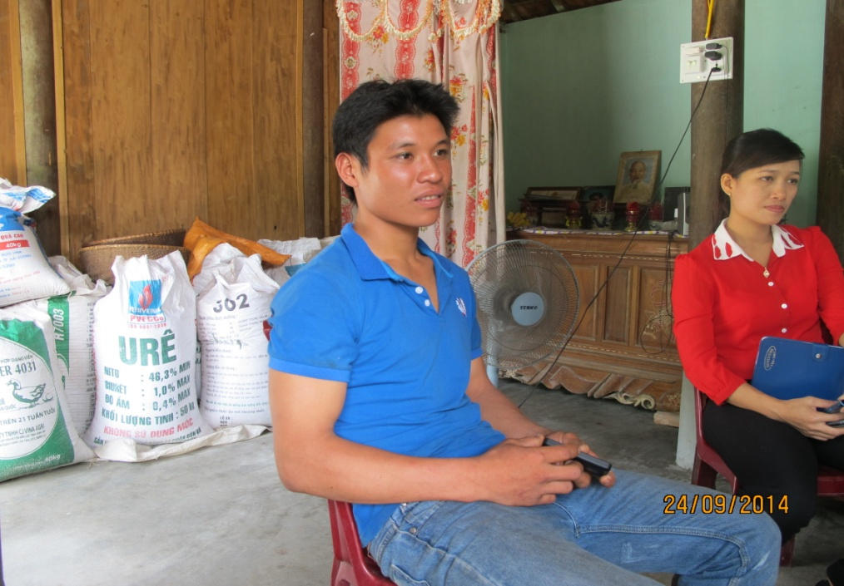
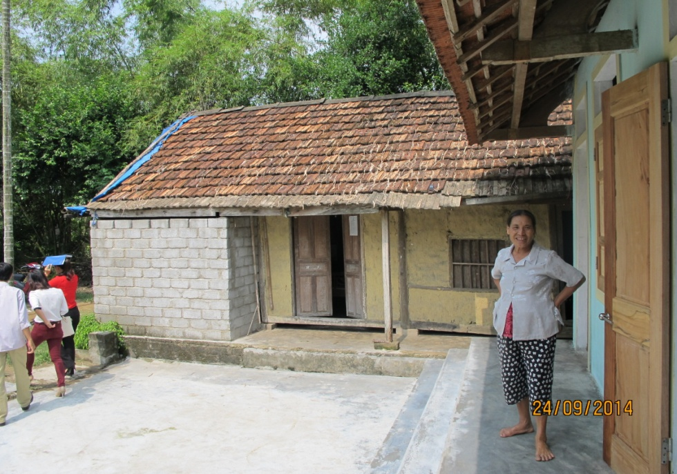
Situation of VN migrant workers to Thailand
A young mechanic, working in a rolling door shop, Rayong. No work permit, was arrested and fined. Cannot go back because fee is so high.

Slide 30
Recommendations
Have migration policy aimed at minimizing irregular migrants so that regulation and management become more efficient.
Not only migration policy but also integration policies – not only regulation but protection and facilitation, placing increasing importance of human rights.
Minimize costs and maximize benefits of regular migration, cost sharing mechanism may be developed.
Strengthen the enforcement of existing integration institutions and programs.

Slide 31
Recommendations
5. Educate not only migrants and their dependents but also employers and government authorities.
Reform a migration management authority with responsibility for oversight of both in-migration and out-migration of highly skilled and low-skilled labor migration, and registered and unregistered workers.
Enhance skills and standards among skilled workers to meet international standards.
enforce labor standards to all workers in Thailand, regardless of nationality.

Slide 32
National Policies on Sending Migrant Workers
Issued a Sub-degree 57 on sending Cambodian migrant workers abroad (1995), which is replaced by Sub-degree 190 (2011)
Issued Sub-degree 70 on Creating Manpower Training and Overseas sending board (2006)
Issued Prakas (circulation) on Education on HIV/AIDS, safe migration and labor rights for Cambodian migrant workers going abroad (2006).
Issue Private recruitment agencies code of conduct (2009)
Adopted minimum service standard contract (between potential migrant and pre-recruitment agency) (2012)
Issued Sub-degree 195 on Issuance of Normal Passport to Cambodian Migrant Workers legally employed abroad (2013)
Issued Sub-degree 205 on the reduction of passport fee to 4$ (June 20, 2014)
Prakas No. 2574 on the format and procedure in issuing of normal passport for student and Cambodian migrant worker (2014)

