Slide 1
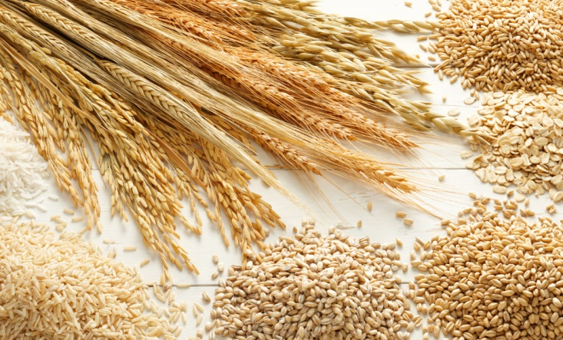
Corn Laws
1815 – 1846
United Kingdom

Slide 2
Before 1815
Grain regulations, taxes, and tariffs since medieval times
Not too strict and efficient
After Napoleonic wars, grain prices felt
Debates over new Corn Laws, mostly from British landlords to deal with the falling grain prices

Slide 3
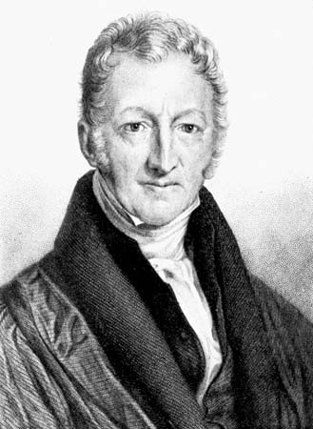
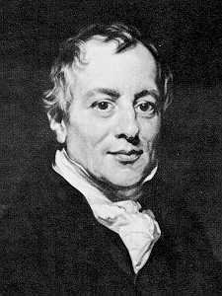
Two sides
Thomas R. Malthus (1766-1834)
David Ricardo (1772-1823)
National Security
Labor focusing on manufacturing is not good for peace and stability
Fall in corn prices is destabilizing
Need for new, stricter corn laws
Stability of corn price is in favor of producer and consumer
Fan of Adam Smith‘s Wealth of Nations
Against protectionism and for free trade, especially for agriculture
Comparative Advantage model
Against new corn laws
Profits go to landlords instead of the emerging industrial capitalists
Profits will not be invested wisely
will lead to a Stagnation of Britain‘s economy

Slide 4
New Corn Laws
Passed in 1815, backed by the government of Liverpool and large numbers of landlords (in the Parliament)
Raised tariffs on corn (grain)
Economists state out that Corn laws are a threat to the British economy
David Ricardo came up with his arguments (1822)

Slide 5
Anti-Corn Law League
Founded in 1838
Publishing „Blue Book“ that deals with effects of the corn laws
Quoted in major newspaper, even reprinted in America

Slide 6
New Prime Minister – End of Corn Laws?
Robert Peel because Prime Minister in 1841
Studied Ricardo and Smith, proponent of free trade
Did not repeal it at first
Lowered the Tariffs
Two opposing parties:
Landlords and Manufacturers

Slide 7
End of Corn Laws!
Poor Harvest in Britain and famine in Ireland, 1845
Scarcity and starvation finally led to a change in the government‘s plan
Plan is to abolish the Corn Laws by 1849 after 3 years of gradual reduction of the tariffs
With a significant majority the Member of Parliament voted for this plan

Slide 8
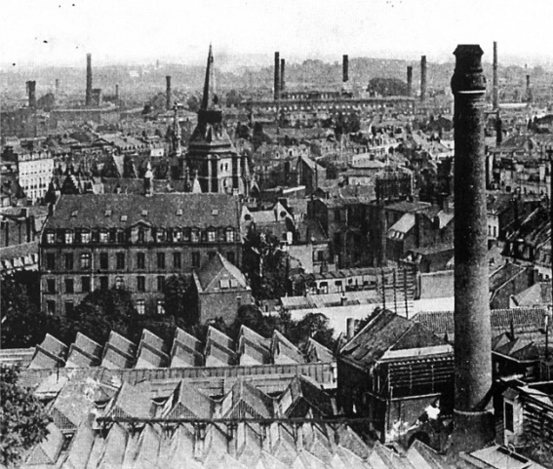
The Follow-up
Decreasing grain prices
Increasing imports of grain
20 years later, due to cheaper transportation by railway and steam-boat, America and Russia became the top exporter of grain
Unlike other countries, Britain did not impose new Corn Laws to protect its agriculture
Importance of Britain‘s agriculture shrinked drastically
Eventually Britain‘s economy changed from agriculture to manufacturing

Slide 9
References
http://www.econlib.org/library/Enc/bios/Ricardo.html
http://isites.harvard.edu/fs/docs/icb.topic637538.files/Schonhardt%20Bailey.pdf
https://en.wikipedia.org/wiki/David_Ricardo
http://www.dartmouth.edu/~dirwin/docs/Peel.pdf

