Slide 1

MK 322 Retail Management
Chapter 17: Store Layout, Design, Visual Merchandising Part II
By Ajarn Suwalya K.

Slide 2
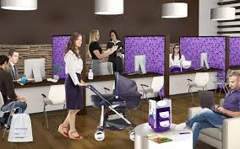
Space Management

Slide 3
Space Management
The space within stores and on stores' shelves and fixtures is a scarce resource
Key resource decisions involved
The allocation of store space to merchandise categories and brands
The location of departments or merchandise categories in the store
The size of the store
Notes:
1

Slide 4
Space Allocated to Merchandise Categories
Some factors retailers consider when deciding how much floor or shelf space to allocate to merchandise categories and brands are
The productivity of the allocated space - sales per square foot and sakes per linear foot
The merchandise's inventory turnover- GMROI
The impact on overall store sales
The display needs for merchandise
Notes:
1

Slide 5
Location of Merchandise Categories and Design Elements
Demand/destination merchandise refers to products that customers have decided to buy before entering the store
Decompression zone – welcomed with introductory displays, graphics
Turn right – strike zone – creates customers first impression and store offering; retailers display new and compelling merchandise
Notes:
1

Slide 6
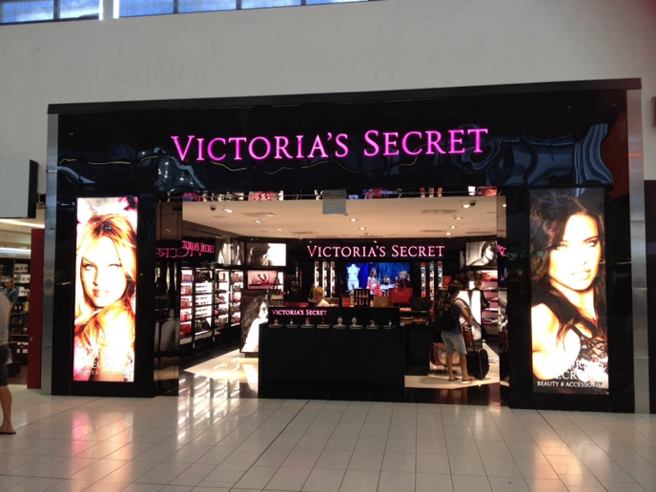
Location of Merchandise Categories and Design Elements
Notes:
1

Slide 7
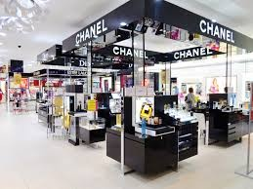
Impulse Merchandise
Impulse products or products purchased without planning
Fragrance, cosmetic in department stores, magazines in supermarkets are located near the front of store
Seen by everyone and draw people
Notes:
1

Slide 8
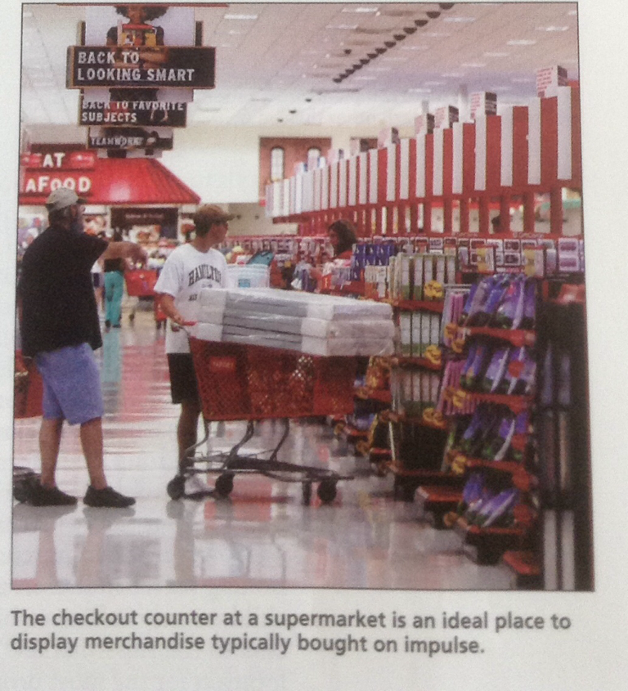
Impulse Merchandise
Notes:
1

Slide 9
Demand and Promotional Merchandise
Placed at back left-hand corner of store
So pulls cutomer through store, increase visibility of other products along the way
Supermarkets put eggs, milk, bread at the back
Beauty salons, children's merchandise, furniture are demand or destination thus located in light traffic areas
Notes:
1

Slide 10
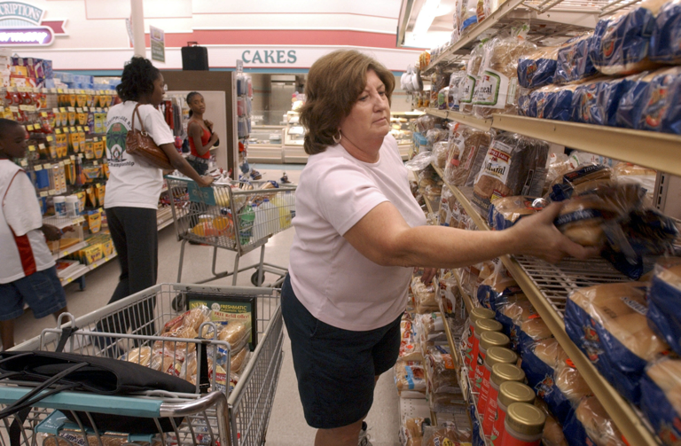
Demand and Promotional Merchandise
Notes:
1

Slide 11
Special Merchandise
Located in light traffic areas
Examples include women's lingerie in remote areas for private shopping experience
Furniture
Curtains need significant wall space
Shoes require easily accessible storage rooms
Notes:
1

Slide 12
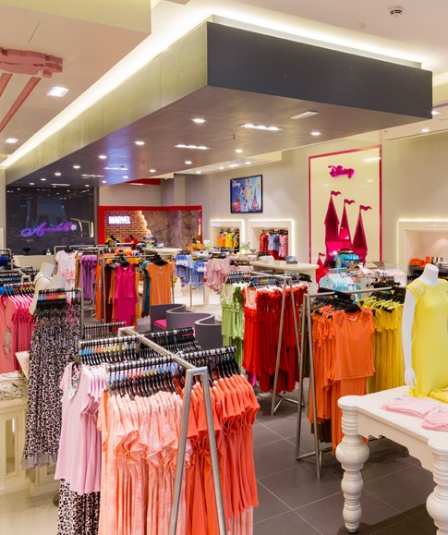
Special Merchandise
Notes:
1

Slide 13
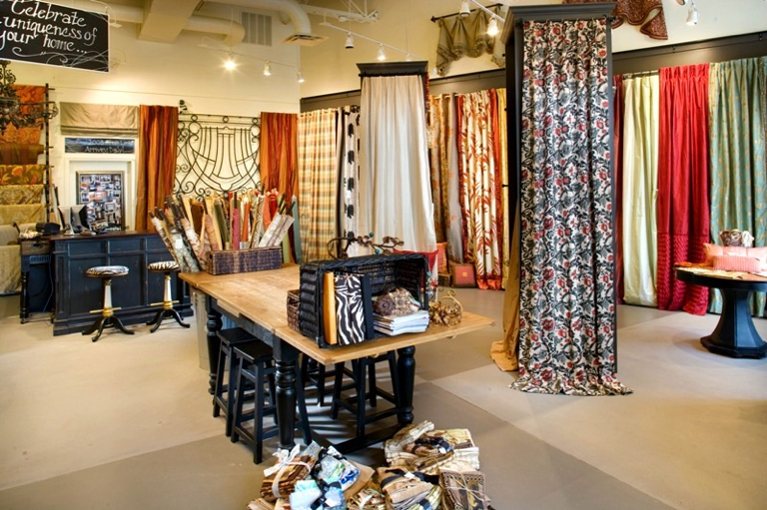
Special Merchandise
Notes:
1

Slide 14
Category Adjacencies
Complement categories next to each other
Cross selling encouraged
For example Aisle of cereal with end cap of fresh bananas
Beer and Diapers?
Halo Effect-placing packaged goods next to healthy vegetables
Notes:
1

Slide 15
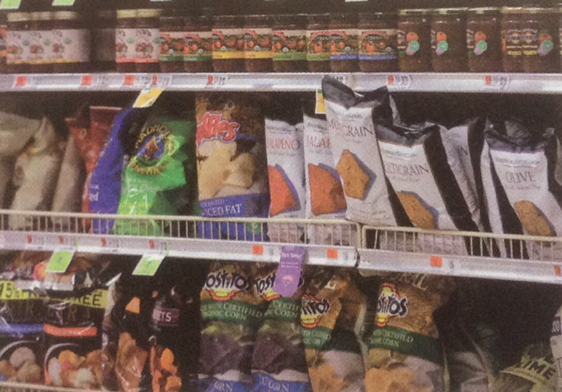
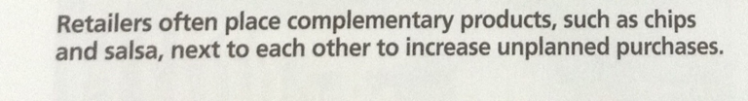
Category Adjacencies
Notes:
1

Slide 16
Location of Merchandise Within a Category
Retailers use variety of rules
Limited problem solving or habitual decision making?
Supermarkets display merchandise on four shelves
-Most profitable on 3rd shelf- eye level
- Smaller group appeals-4th shelf
- Bulky items on bottom shelf
Notes:
1

Slide 17
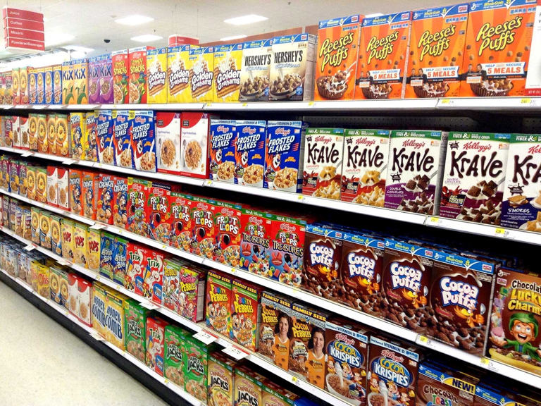
Location of Merchandise Within a Category
For ceral 2nd shelf prime location for profitable cereal brands – children?
Notes:
1

Slide 18
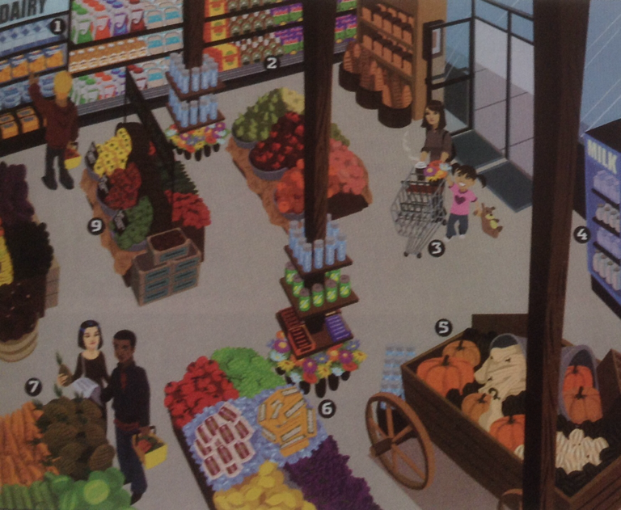
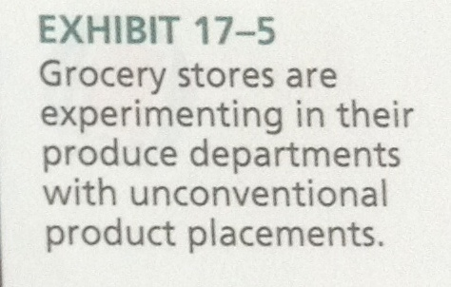
Location of Merchandise Within a Category
Notes:
1

Slide 19
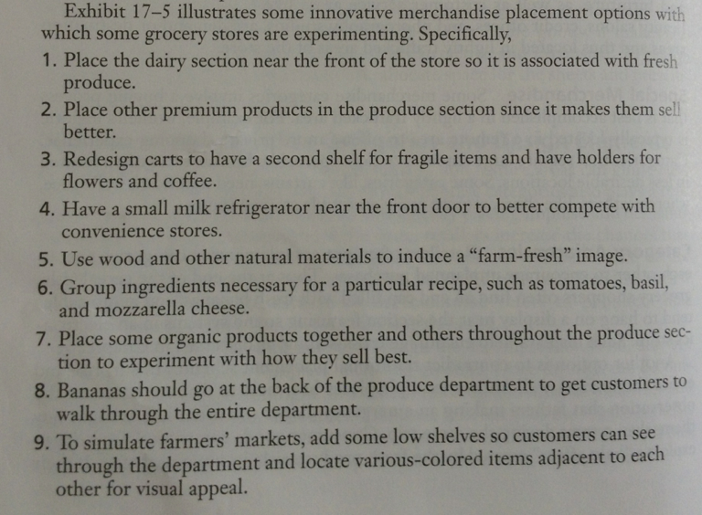
Location of Merchandise Within a Category
Notes:
1

Slide 20
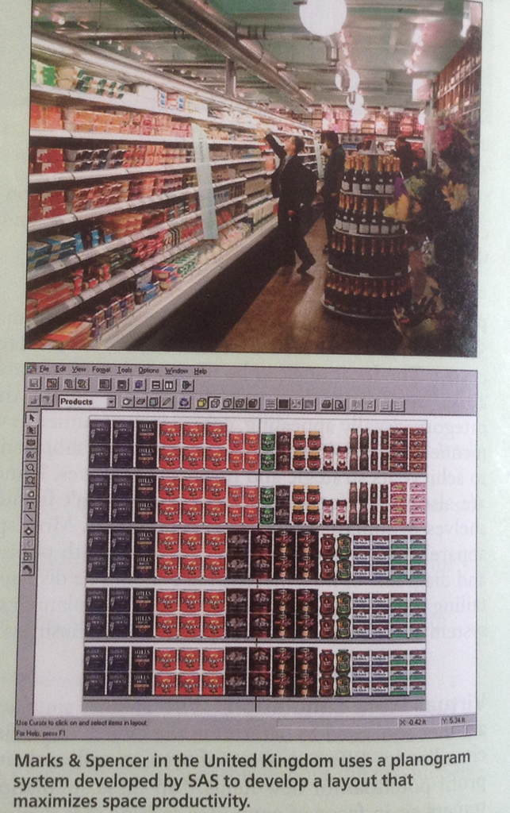
Planograms
Is a diagram that shows how are where specific SKU should be placed on retail shelves or displays to increase customer purchases
Notes:
1

Slide 21
Visual-Store Simulation
Tool used to determine the effects of placing merchandise in different areas of the store and evaluating the profit potential for new item
Notes:
1

Slide 22
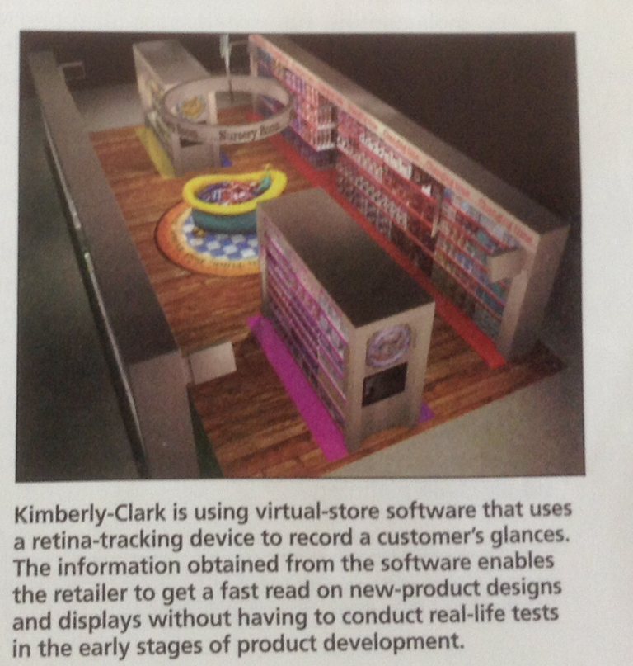
Visual-Store Simulation
Notes:
1

Slide 23
Videotaping Consumers
Research method used to assess customer reactions to planograms, involve tracking customers in actual store environments
Videotaping consumer moments
Microsoft's Kinetic sensors provide a less intrusive option
Notes:
1

Slide 24
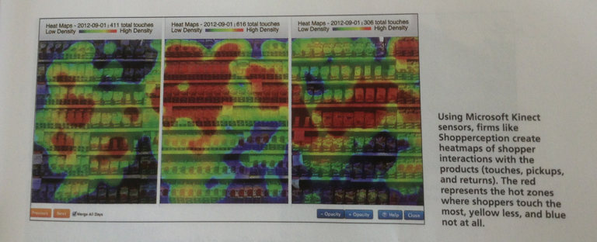
Videotaping Consumers
Notes:
1

Slide 25
Determining Store Size
Bigger not always better
SKU availability
Walmart vs Walmart Express
Are modern consumers – time pressured, price-sensitive, and computer savvy – likely to embrace new, smaller store format that cannot offer one-stop shopping or unlimited selection?
Notes:
1

Slide 26
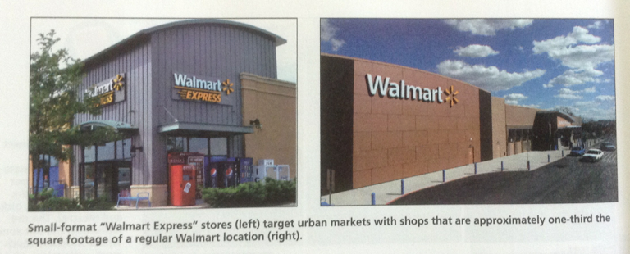
Determining Store Size
Notes:
1

Slide 27


