Slide 1
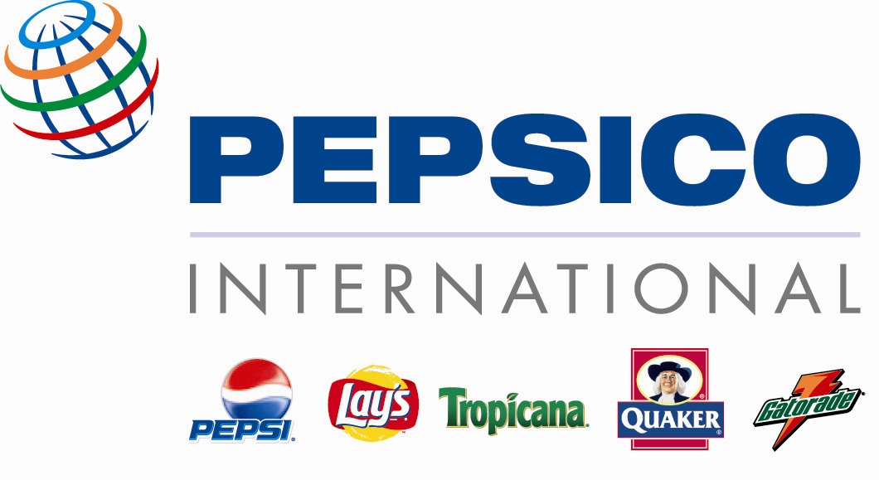
Food Processing Industry
Case Study: Pepsi Grows Potatoes in China*
All information is from “Pepsi Grows Potatoes in China” by Lu Jiangyong and Tao Zhigang

Slide 2
Source: http://finance.yahoo.com

Slide 3
Source: http://finance.yahoo.com

Slide 4
China Agribusiness
In late 1970s, Deng Xiaoping replaced the communal system with the household responsibility system.
Most farms are small (household level).
Most farmers in China chose to grow fruits.
  The country grew 50% vegetables, 16% fruits in the world.
  Growth of agribusiness partly supported by growth of super-, hyper-markets in the world.

Slide 5
China Agribusiness
In 1988, Simplot (world’s largest potato processors) entered China to produce French Fries.
  Difficult because farms are small (no economy of scale, hard to control for quality)
  Efficient size = 250 acres, average farm size = 1.5 acres. So, had to be cooperatives.
  Needed the type that are long with shallow eyes and has high sugar content.
  Chinese government does not allow import of raw potatoes or potato seeds.

Slide 6
China Agribusiness
Simplot could finally opened a processing plant in 1992.
There also exist other agribusiness groups that enjoyed economy of scale in China.

Slide 7
China’s Food Processing Industry
China’s food processing industry grows at 13.1% between 1980 – 2000.
  30% of food is processed
  For western countries, about 80% of food is processed.
  There are many small food processors in China, 14% of them are foreign enterprises.
Rapid growth of supermarkets opens an opportunity for the processed food industry.

Slide 8
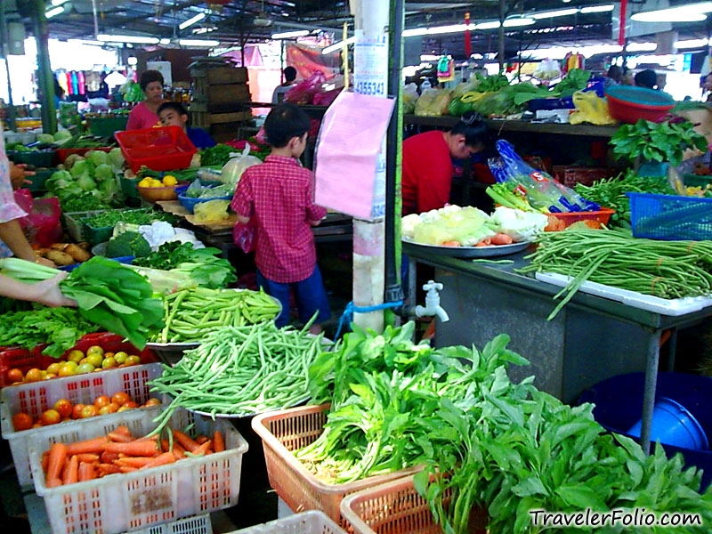
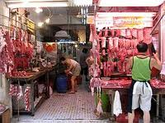
Wet markets

Slide 9
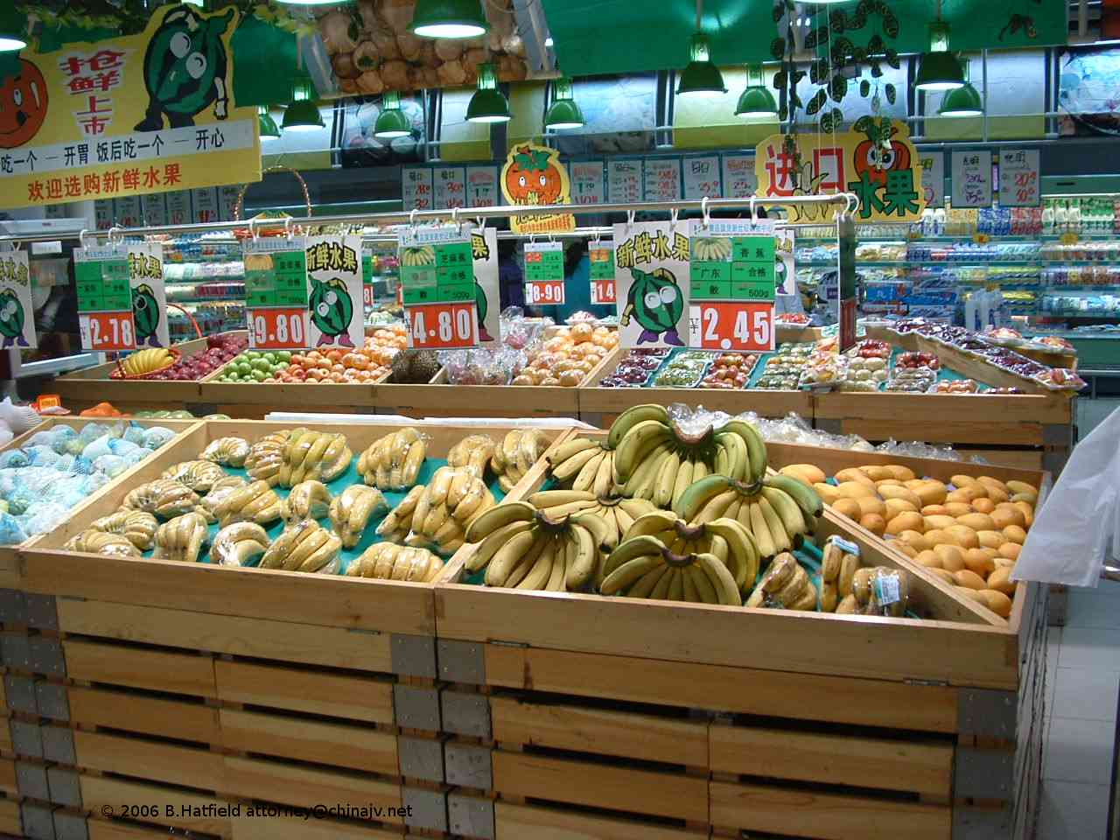
Chinese supermarkets

Slide 10
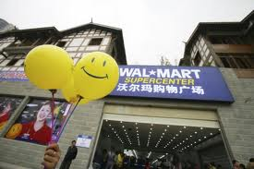
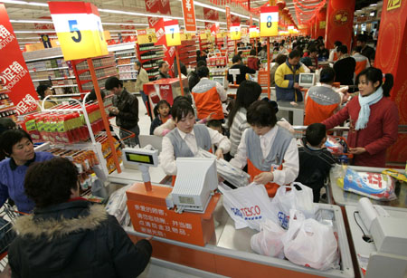
Chinese supermarkets

Slide 11
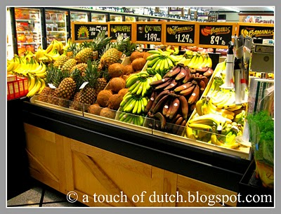
American supermarkets

Slide 12
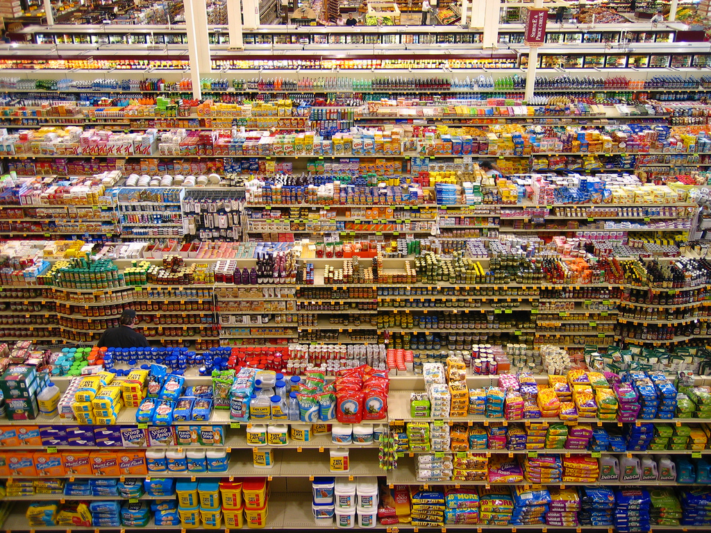
American supermarkets

Slide 13
China’s Infrastructure
Poor infrastructure
  Not enough electricity to store produces in remote areas
  Poor railway system
  But the highway system is developing fast

Slide 14
China’s Potato Industry
Back in 2004, China produced about 20% of the world’s potatoes.
Potatoes consumption/head = 18 kg
  Western Europe = 90 kg
  US = 60 kg
Still, 70% of frozen potatoes in China are imported. Why?

Slide 15
China’s effort to promote the food processing industry
In 2002, China launched a 5-year program to promote the food-processing industry (including potatoes).
  Potatoes chips
  Frozen chips

Slide 16
Economics Background
Vertical Integration
Outsourcing
In this case study, we will analyze how they are implemented in the real world.

Slide 17
Economics Background
Vertical Integration – firms at different levels of the supply chain merge.
                OR
farmers
farmers
processors
processors
retailers
retailers

Slide 18
Economics Background
Outsourcing– downstream firms buy from upstream firms.
                -- Lays used to buy Potatoes from
                Black Gold Potatoes
                -- Meji buys raw milk from milk farmers
                -- 7-Eleven buys pasteurized milk from Meji and sell in their stores.
farmers
processors
retailers

Slide 19
Stake Holders
Pepsico
Chinese Government
Chinese Consumers
Lay’s competitors (Pringles)
Lay’s competitors (Local competitors)
Black Gold Farms (a potato company)
Chinese Potatoes farmers

Slide 20
Questions for Pepsico
What kind of products do you sell?
What is Pepsico’s most powerful competitor?
What strategies did Pepsico adopt in order to maximize profit? (hint: did it compete head-to-head with Coca Cola? Or do something else?)

Slide 21
Questions for Pepsico
What kind of products does Pepsico sell?
  Pepsi
  KFC
  Lays
  Tropicana
  etc.
  (mostly processed food)

Slide 22
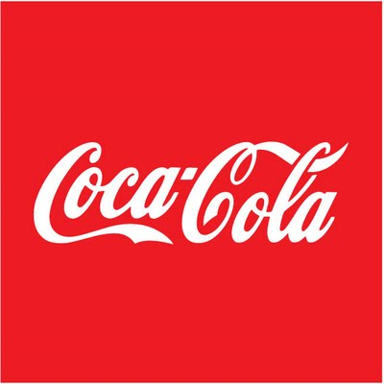
Questions for Pepsico
What is Pepsico’s most powerful competitor?
  If you have to name only one, then it should be

Slide 23
Questions for Pepsico
What strategies did Pepsico adopt in order to maximize profit?
  Avoid rigorous price-cutting competition
  Differentiate its products
  Diversify its types of products
    Tropicana
    Quaker Oats Meal
    Lays

Slide 24
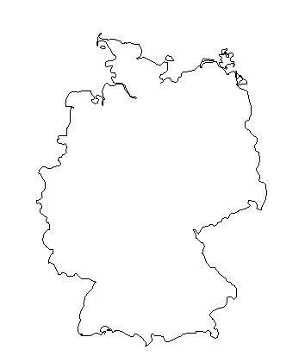
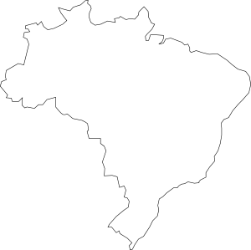
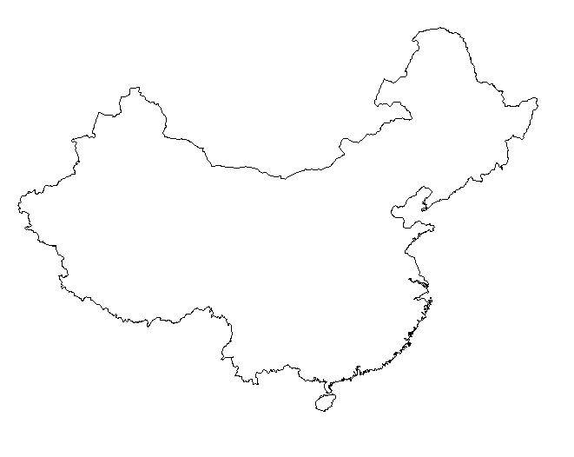
The Chinese Market?

Slide 25
Questions for potato consumers
How big is the market for potato chips in China?
Would potato chips suit the taste of the Chinese?
What do the consumers like to eat?
Which Lays’ flavor is your favorite?
Will your consumption of processed potatoes grow in the future? Explain.

Slide 26
Questions for Pringles
How tough is the competition in this market?
What does Pringles sell?
How big is your business?
Does Pringles have a competitive advantage over Lays or other potatoes competitors?

Slide 27
Questions for Lay’s competitors
How tough is the competition in this market?
Do you see Lay’s as a threat to your business? Do you think you would survive in the long run? Why or why not?
Is there any barrier to entry?

Slide 28
Questions for the Chinese government
How easy it is to do a business in China?
How easy it is to find a large amount of standardized raw potato in China?
Is the supply of potato secured?
Does the government allow import of potato? Or potato seeds?

Slide 29
Chinese Potatoes farmers
What is the average size of your farm?
What type of potato does Lays look for?
What type of potato does McDonalds and KFC look for?
Can you usually satisfy these consumers’ demand?

Slide 30
Questions for Black Gold Farms
What kind of business do you do? Where are you based at?
What is your relationship with Pepsico?
Did you succeed with what Pepsico asked you to do? Why or why not?
    <www.blackgoldpotato.com>

Slide 31
Questions for Pepsico as Lays
What have Pepsico done in order to increase its supply of potatoes?
Which strategies succeed? Which strategies fail?
Describe how PepsiCo’s Demonstration Farm work.

Slide 32
What are the options for Pepsico?
Vertically Integrate/Restraint
(grows potatoes by itself or do contract farming)
Buy from the market or middle man
Outsource the growing of potatoes
  Hire a company like Black Gold to supply
Do a mixture of the above options

Slide 33
Questions for your paper
Assess a strategy of integration versus outsourcing of Pepsi in securing raw material for its chip plants in China.
Analyze and comment on Pepsi’s decision to bring in its US supplier to run its potato farm in China.
Formulate a long-term strategy for Pepsi in sourcing potatoes for its chip plants in China.

Slide 34
Useful tips
Study what other firms have done in order to solve the limited supply problem.
  Nestle – grows its own coffee in Yunnan province.
Study what Pepsico has done in order to solve the limited supply problem at other countries.
Use information in the CP case to help.

