Slide 1
Brief History of East Asia Political Economy Before Colonization Era
Chinese World Order

Slide 2
Important Points
Westphalian
  Several sovereign states that are equal or quasi equal in terms of economic size or power.
  Competition
Chinese world orders or East Asia
  Hierarchical
  Moral (Confucius and Buddhist)
  International arrangement that is not complete.

Slide 3
Similarities among East Asia
Hierarchical
  Tianxia
  Class and strata
  Sakdina system
Believe in national superiority
  Declare war based on this
Emperor and King
  Descendant from heaven
  Son of God

Slide 4
Similarities among East Asia
Tribute System and Trade in disguise
  Tributary State
  The weak has to pay tribute to the strong for protection and to reinforce national superiority
  International trade flourished.
Use of Force and War
  To enforce above system.
  To declare supremacy

Slide 5
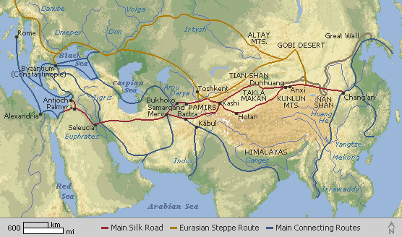
m

Slide 6
Comparative Political Economy
China
  Believe to be the first state in East Asia since Xia Dynasty 2500-1540 BC
  Confucianism (551-479) BC
    Practice and cultivation of virtues and benevolences, righteousness, filial piety, and loyalty as the basis of personal ethic and politics.
    Taoism: searches for immortality, and retreat from the world.
  Centralized and Reformed in 221 BC

Slide 7
China
Centralized and Reformed in 221 BC
First true emperor
Autocratic and omnipotent ruler
  Weakness of emperor system or monarchy___________________
    Sui dynasty.
“Tide can raise and rock the Boat”
  Social Stability and order
  Low Tax
  Agricultural production

Slide 8
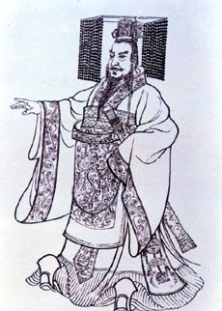

Slide 9
China
High premium on Stability
  From Free Trade to no trade (Ming Dynasty)
    http://www.international.ucla.edu/article.asp?parentid=10387
  No Income to develop the economy
  No Threat to develop the industrialization
  No Army to fend off British
    Opium War

Slide 10
Korea
Dangun Wanggeom was the legendary founder of, the first kingdom, around present-day Korean Peninsula. He is said to be the grandson of heaven, and to have founded the kingdom in 2333 BC.
Social Strata
  Yangban
  Chungin
  Slaves

Slide 11
Korea
Confucianism
The mutual relationship between King and Yangban
Threats from outside

Slide 12
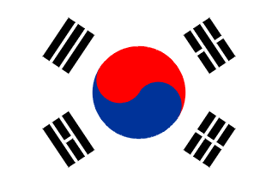

Slide 13
Japan
Emperor
Social Strata
  Emperor
  Shogun
  Samurai
  Merchant
  peasant
Unification in Tokugawa Shogunate
  Bakufu and Daimyo subordinate

Slide 14
Japan
Samurai ways and Zen
Threats and war
  China
  China and Korea
Open and Close Trade
  Why?

Slide 15


Slide 16
Southeast Asia
Thailand, Myanmar, Vietnam, Cambodia, and Malaysia.
Similarities
  Kingship
  Social Strata
    King
    Bureaucrat
    Commoner
    Slave

Slide 17
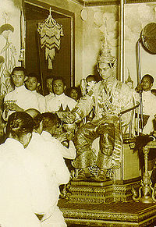

Slide 18
Southeast Asia
Free Trade
Rise and Fall of each Kingdoms
War was prevalent only in Thailand and Myanmar
Not much of China influence?

Slide 19
Why the West rise and beginning of colonization?
Asian was barbarian and know nothing about technology?
Asian was incompetent, repressive, coercive and unified?
1600s

Slide 20
1600s
Ming dynasty had ruled china more than 300 years
Japanese Unification
Thailand, the long reigned of Ayutthaya kingdom
Korea(1592), the devastating invasions of Korea by the previous Japanese warlord, Toyotomi Hideyoshi

Slide 21
Europe1600s
After the long period of war and exploration
Competitive international system in Europe at the critical juncture.
  Technology
  Economic
  Social
  Political Transformation

Slide 22
1600s-1800s
Decline of Feudal relations in Western Europe
Technological advancement in metallurgy armaments and basic industry.
Decline in Authoritarian regime and shift to a more participatory regime

Slide 23
Decline of Feudal relations in Western Europe
Implications
  Free up the labor
  Labor were abundant and cheap wage was highly acceptable.
  Competition in Labor market lead to ____________________?
  Power base of Authoritarian regime reduced.

Slide 24
Technological advancement in metallurgy armaments and basic industry.
Platform for Entrepreneurial activities
Income level were sufficient to encourage investment in physical capital and technology
New production relations

Slide 25
Monarchy to Constitutional Monarchy
Gentry, Merchant,Proto-Industrialists, overseas traders, and financiers had more saying in economy.
Property rights
New growth enhancing institutions
  Groups of interest could work for market incentive.
  If the Monarchy was in the way, they could solve the problem.

Slide 26
Colonization
is the building and maintaining of colonies in one territory by people from another territory.
Why?
  Economic factors are important
  Capitalist overproduction
  Bankers and financiers’ support
  Trade
  _______________

Slide 27
Legacies of Western Colonialism
Strong and supportive state is required for national security.
Creations of certain states: Indonesia, Malaysia, Philippines, and Singapore.
Integration of East Asia to world trade
Institutions, education, technology, and cultures
Mass migration of Chinese population was possible

