Slide 1

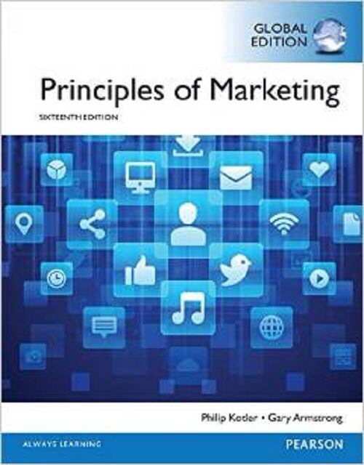
Distribution Channels Strategy I
CHAPTER 12: Delivering Customer Value
MK 202 Fundamentals of Marketing
By Aj.Suwalya K.

Slide 2
Objective Outline
Objective 1: Explain why companies use marketing channels and discuss the functions these channels perform
Objective 2: Discuss how channel members interact and how they organize to perform the work of the channel.
Objective 3: Identify the major channel alternatives open to a company.
Objective 4: Explain how companies select, motivate, and evaluate channel members.
Objective 5: Discuss the nature and importance of marketing logistics and integrated supply chain management.

Slide 3
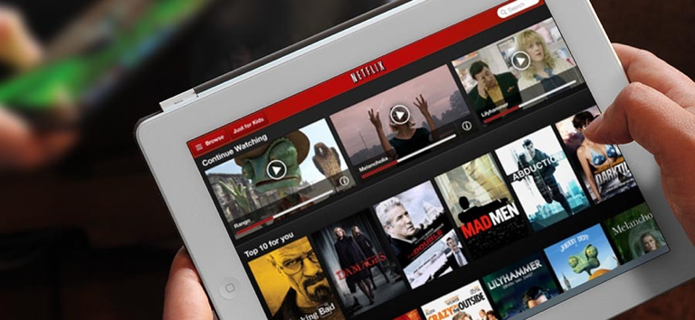
Netflix’s Channel Innovation:
Finding the Future by Abandoning the Past
Netflix’s innovative distribution strategy: From DVD by mail, to Watch Instantly, to video streaming on almost any device, Netflix has stayed ahead of the howling pack by doing what it does best- revolutionize distribution. What's next?

Slide 4

Adidas.com/originals
Unite all originals
Value delivery network: In making and marketing even just its adidas originals line, adidas manages a huge network of people within the company plus thousands of outside suppliers, resellers, and marketing firms that must work together to create customer value and establish the line's "unite all originals"positioning.

Slide 5
Objective 1
Supply Chains and the Value Delivery Network
The Nature and Importance of Marketing Channels

Slide 6
Supply Chains and the Value Delivery Network
Value Delivery Network: A network composed of the company, suppliers, distributors and ultimately, customers who partner with each other to improve the performance for the entire system in delivering customer value.
Marketing channel (or distribution channel): A set of interdependent organizations that help make a product or service available for use or consumption by the consumer or business user.

Slide 7
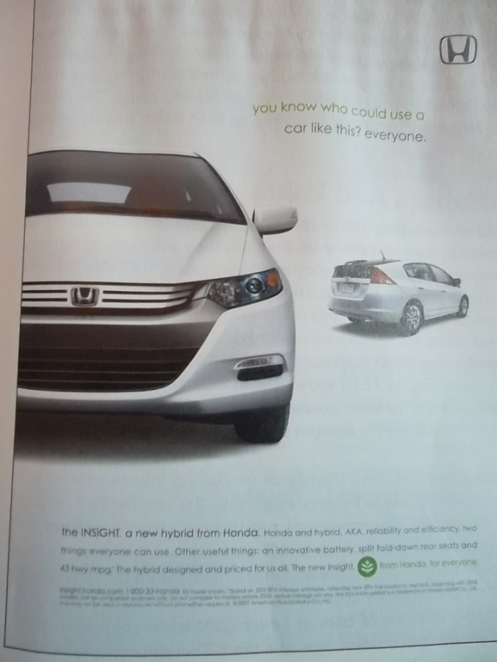
Value delivery network: In making and marketing just one of its many models, say, the Honda Insight hybrid – Honda manages a huge network of people within Honda plus thousands of suppliers and dealers outside the company who work together to give customers an innovative car “from Honda to Everyone’

Slide 8
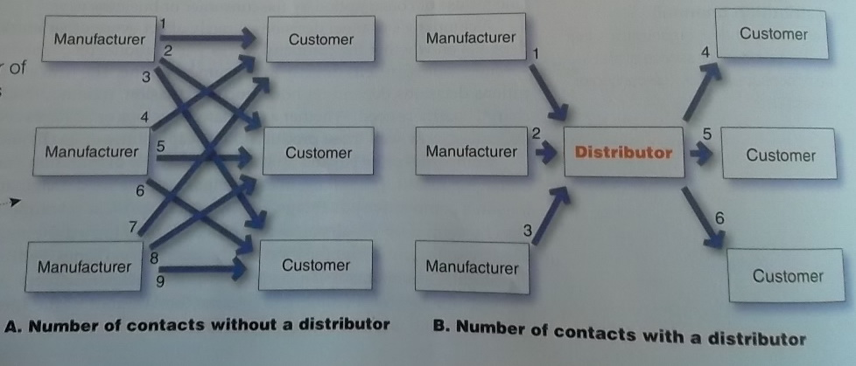
Supply Chains and the Value Delivery Network
How Channel Members Add Value
Figure 12.1 How a Distributor Reduces the Number of Channel Transactions
Marketing channel intermediaries make buying a lot easier for consumers. Again, think about life without grocery retailers. How would you go about buying that 12 pack of Coke or any o f the hundred of other items that you now routinely drop into your shopping cart?

Slide 9
Supply Chains and the Value Delivery Network
Members of the marketing channels perform many key functions. Some help to complete transactions:
Information: Gathering and distributing information about consumers, producers, and other actors and forces in the marketing environment needed for planning and aiding exchange.
Promotion: Developing and spreading persuasive communications about an offer.
Contact: Finding and communicating with prospective buyers.

Slide 10
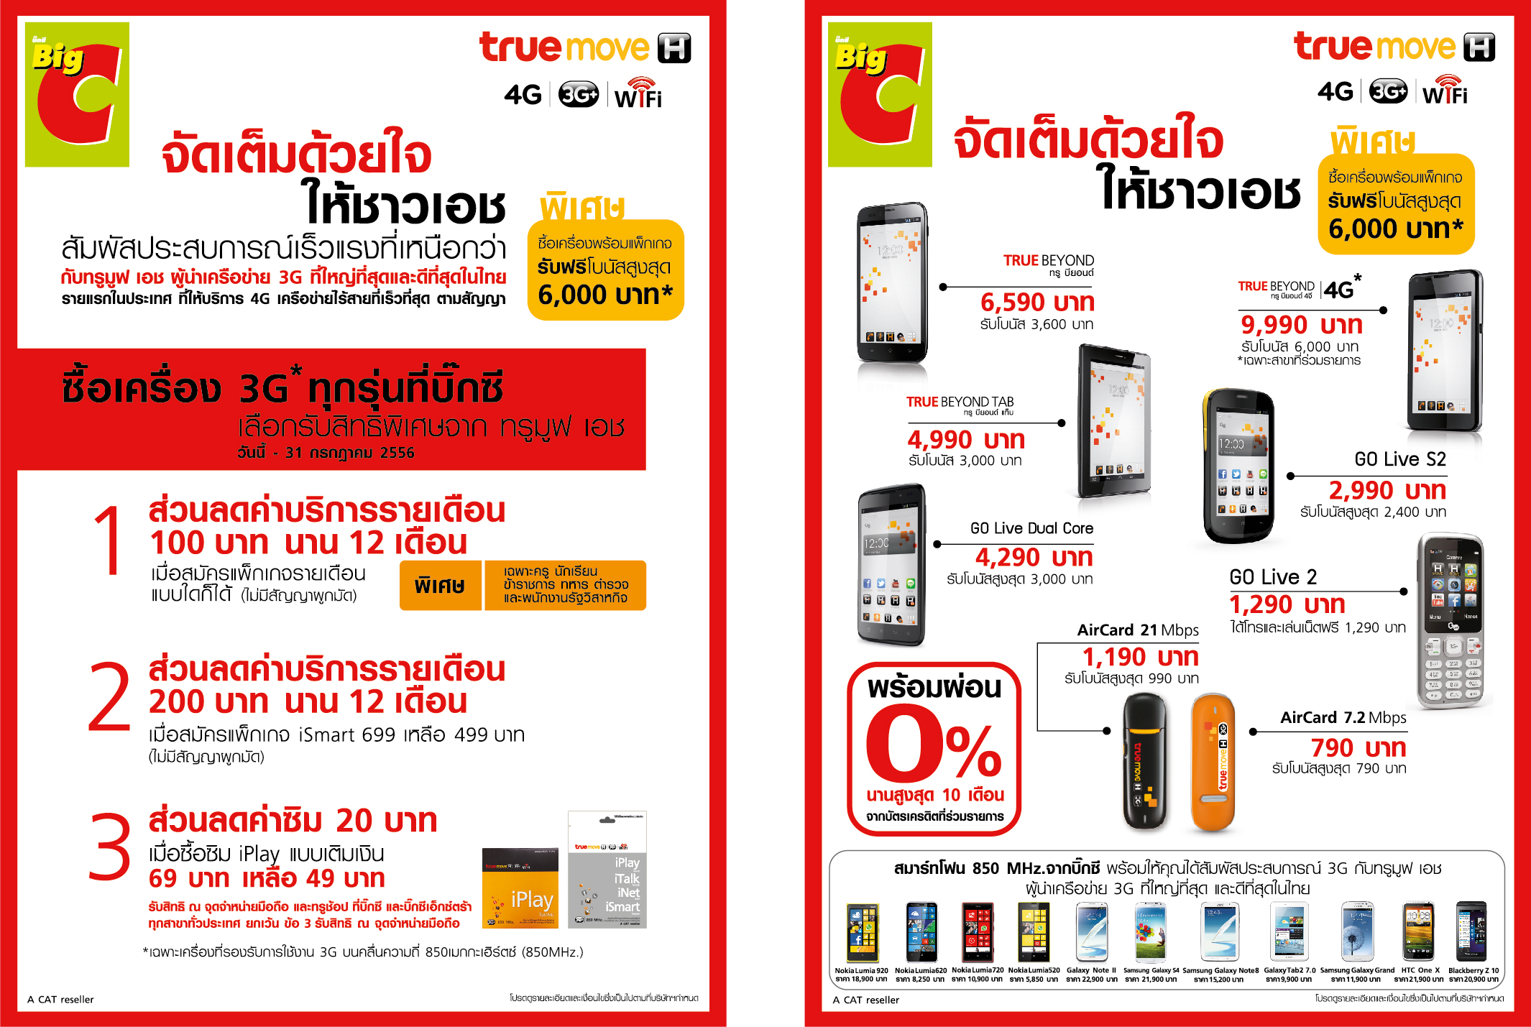

Slide 11
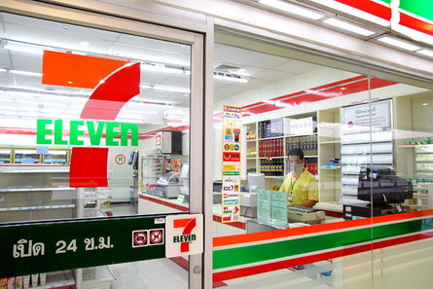
Supply Chains and the Value Delivery Network
Matching: Shaping offers to meet the buyer’s needs, including activities such as manufacturing, grading, assembling and packaging.
Negotiation: Reaching an agreement on price and other terms so that ownership or possession can be transferred.

Slide 12
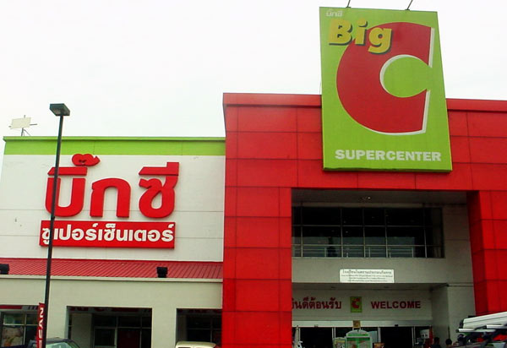
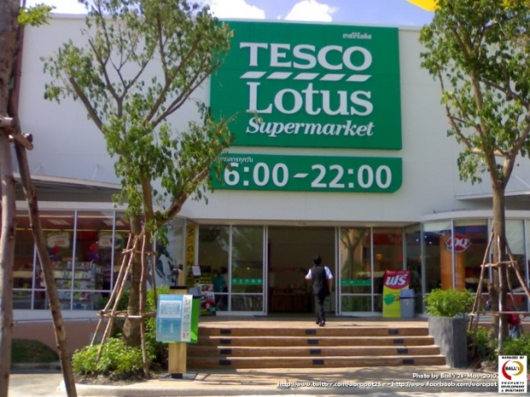
Supply Chains and the Value Delivery Network
Others help fulfill the completed transactions:
Physical distribution: Transporting and storing goods.
Financing: Acquiring and using funds to cover the costs of the channel work.
Risk taking: Assuming the risks of carrying out the channel work

Slide 13
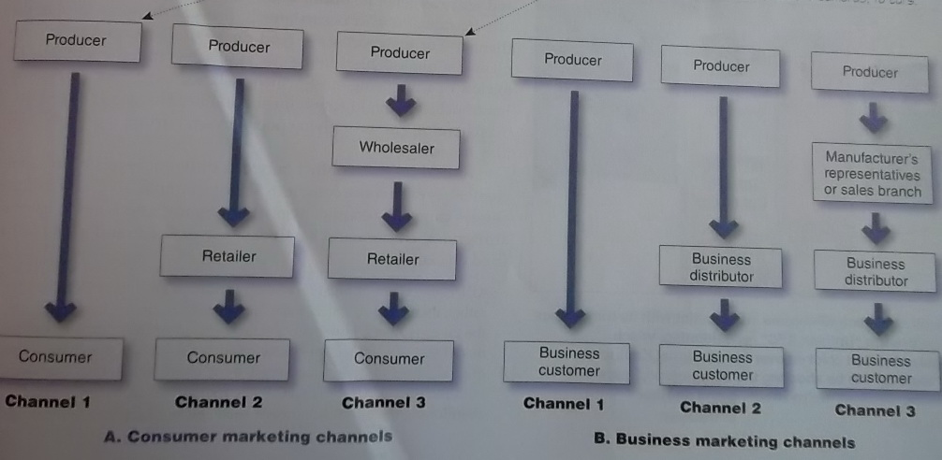
Supply Chains and the Value Delivery Network
Number of Channel Levels
Figure 12.2 Consumer Business Marketing Channels
Using indirect channels, the company uses one or more levels of intermediaries to help bring its products to final buyers. Examples: most of the things you buy-everything from toothpaste, to cameras, to cars.
Using direct channels a company sells directly to consumers (no surprise there). Examples: GEICO and AMWAY.

Slide 14
Supply Chains and the Value Delivery Network
Channel level: A layer of intermediaries that performs some work in bringing the product and its ownership closer to the final buyer.
Direct marketing channel: A marketing channel that has no intermediary levels.
Indirect marketing channel: A marketing channel containing one or more intermediary levels.

Slide 15
Objective 2
Channel Behavior and Organization

Slide 16
Channel Behavior and Organization
Channel Behavior
Channel conflict: Disagreements among marketing channel members on goals, roles, and rewards- who should do what and for what rewards.
Horizontal conflict: occurs among firms at the same level of channel. For example Ford dealers
Vertical conflict: conflict between different levels of the same channel. For example KFC

Slide 17
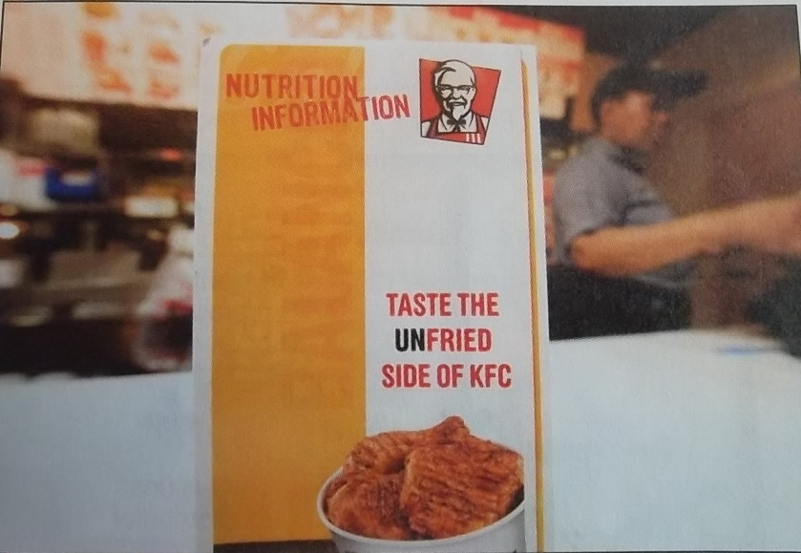
Channel Conflict: KFC came into conflict with its franchisees over the brand’s “Unthink KFC” repositioning, which emphasized grilled chicken over its traditional Kentucky fried. “We ought to be shooting the competition, “ says one franchisee.”Instead, we’re shooting one another.”

Slide 18
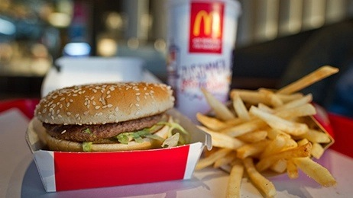
Channel Conflict: Growing McDonald's franchisee discontent may explain the increasing lack of smiles on the faces of both McDonald's cashiers and customers. " There's a huge connection" between franchisee satisfaction and customer service.

Slide 19
Channel Behavior and Organization
Vertical Marketing Systems (VMS)
Conventional distribution channel: A channel consisting of one or more independent producers, wholesalers, and retailers, each a separate business seeking to maximize its own profits, perhaps even at he expense of profits for the system as a whole.
Vertical marketing system (VMS): A channel structure in which producers, wholesalers, and retailers act as a unified system. Once channel member owns the others, has contracts with them, or has so much power that they all cooperate.

Slide 20
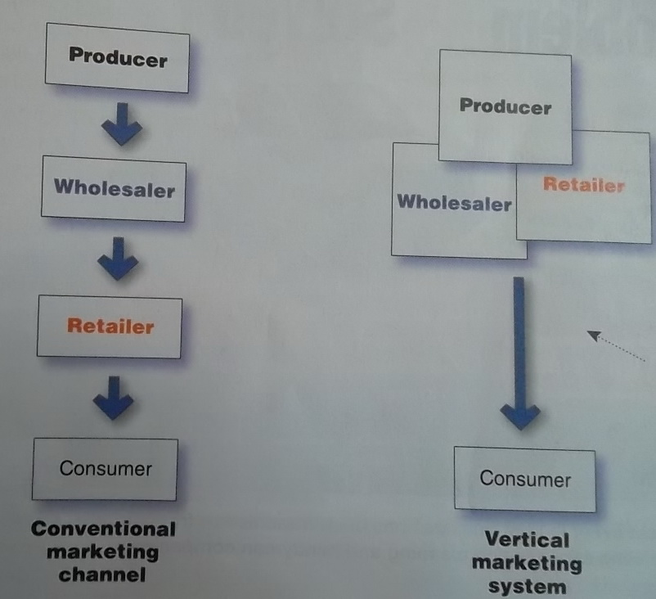
Figure 12.3 Comparison of Conventional Distribution Channel with Vertical Marketing System
Vertical marketing system- here’s another fancy term for a simple concept. It’s simply a channel in which members at different levels (hence, vertical)work together in a unified way(hence system) to accomplish the work of the channel.

Slide 21
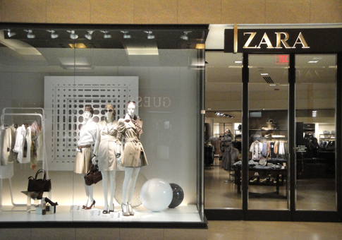
Channel Behavior and Organization Vertical Marketing Systems (VMS)
Corporate VMS: A vertical marketing system that combines successive stages of production and distribution under single ownership- channel leadership is established through common ownership. Ex.Zara

Slide 22
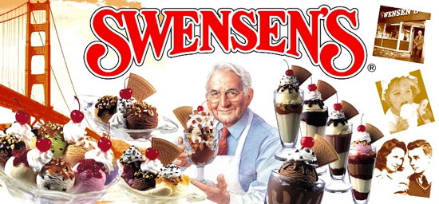
Channel Behavior and Organization Vertical Marketing Systems (VMS)
Contractual VMS: A vertical marketing system in which independent firms at different levels of production and distribution join together through contracts. Most common is franchise organization.

Slide 23
Channel Behavior and Organization Vertical Marketing Systems (VMS)
Franchise organization: A contractual vertical marketing system in which a channel member, called a franchisor, links several stages in the production-distribution process
There are 3 types:
  Manufacturer sponsored retailer franchise system- Ford and its network of independent franchised dealers.
  Wholesaler franchise system- Coca-Cola licenses bottlers(wholesalers) in various world markets who buy Coca-Cola syrup concentrate and then bottle and sell the finished product to retailers locally.
  Service-firm-sponsored retailer franchise system – Burger King and its nearly 12,300 franchisee-operated restaurants around the world.

Slide 24
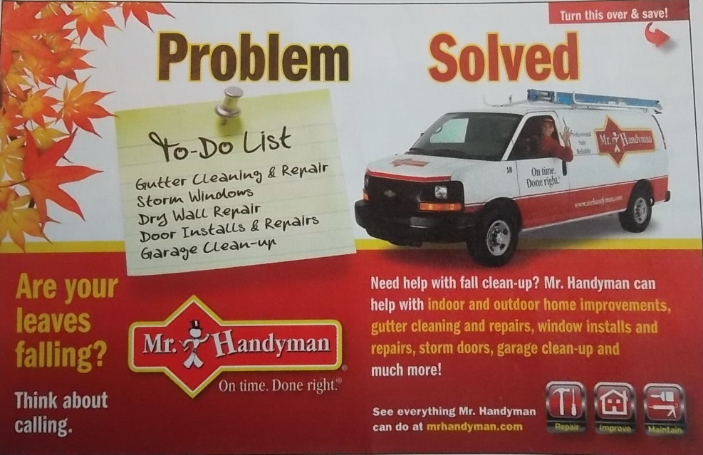
Franchise systems: Almost every kind of business has been franchised- from motels and fast-food restaurants to dating services and cleaning and handyman companies.

Slide 25

Franchise systems: Almost every kind of business has been franchised. For example, Anytime Fitness, where you can "Get to a healthier place, "brings convenient, affordable, and fun fitness to nearly 2.5 members through 3,000 franchise outlets around the nation and the world.

Slide 26
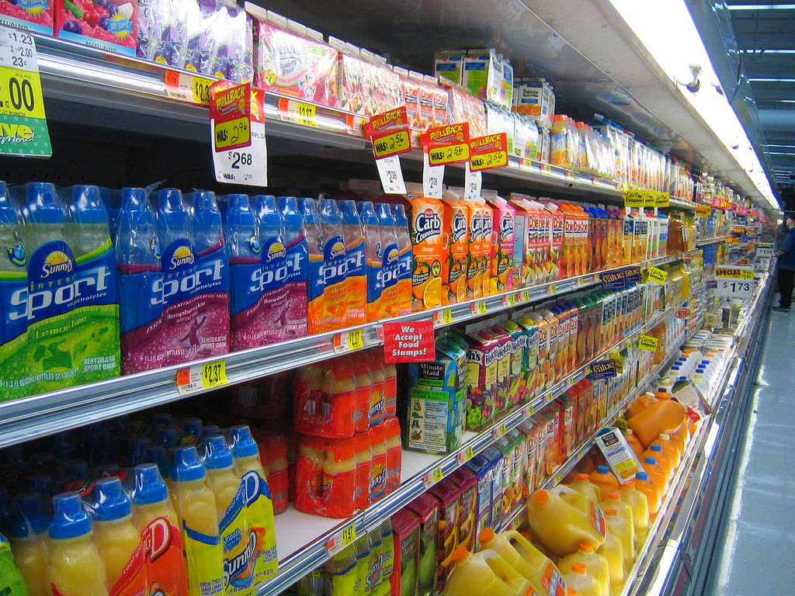
Channel Behavior and Organization Vertical Marketing Systems (VMS)
Administered VMS: A vertical marketing system that coordinates successive stages of production and distribution through the size and power of one of the parties.
  GE, P&G and Kraft command unusual cooperation from many resellers regarding displays, shelf space, promotions, and price policies.

Slide 27
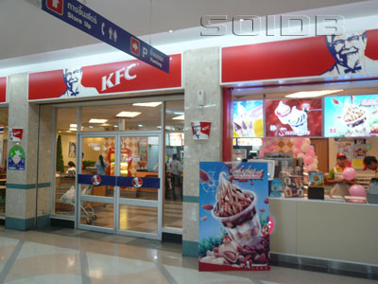
Channel Behavior and Organization
Horizontal Marketing Systems
Horizontal Marketing Systems: A channel arrangement in which two or more companies at one level join together to follow a new marketing opportunity.

Slide 28
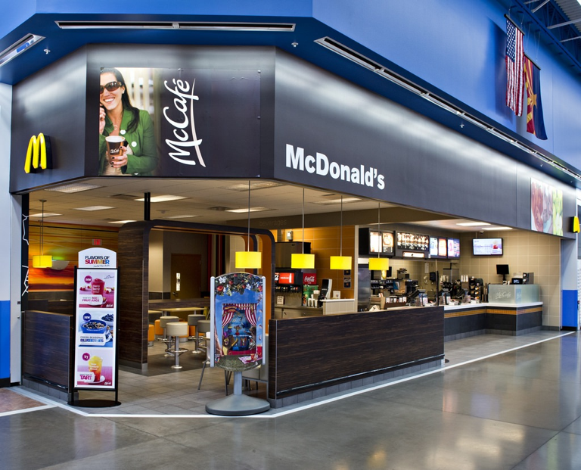
Horizontal marketing channels: Mcdonald’s places “express versions of its restaurants in Walmart stores. McDonald’s benefits form Walmart’s heavy store traffic and Walmart keeps hungry shoppers from needing to go elsewhere to eat.

Slide 29
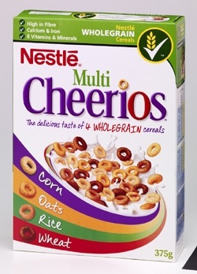
Horizontal marketing channels: General Mills and Nestle operate a joint venture- Cereal Partners Worldwide-that markets General Mills Big G cereal brands outside North America.

Slide 30
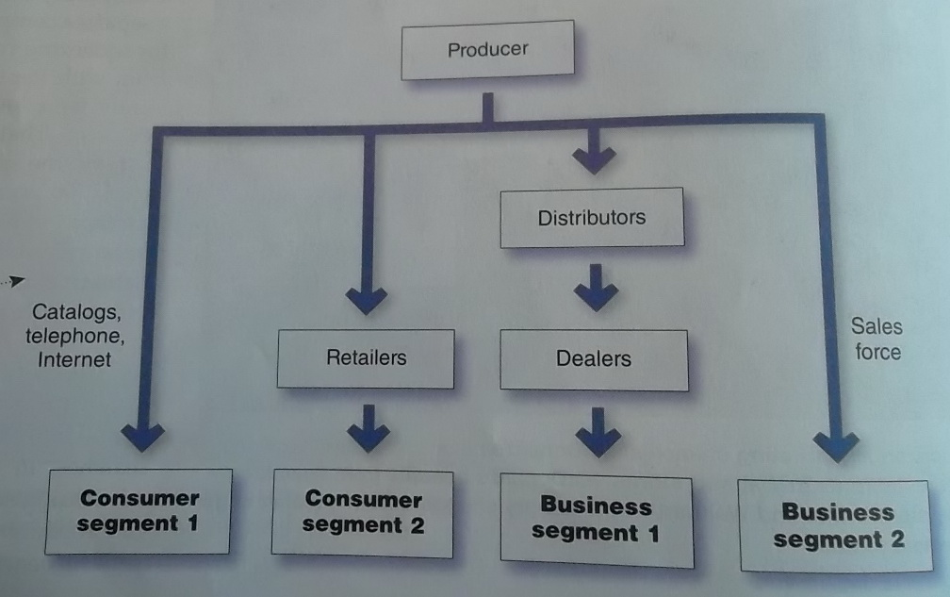
Channel Behavior and Organization
Multichannel Distribution Systems: A distribution system in which a single firm sets up two or more marketing channels to reach one or more customer segment
Figure 12.4 Multichannel/Distribution System
Most large companies distribute through multiple channels. For example, you could buy a familiar green and yellow John Deere lawn tractor form a neighborhood John Deere dealer or from Lowe’s. A large farm or forestry business would buy larger John Deere equipment from a premium full-service John Deere dealer and its sales force.

Slide 31
Changing Channel Organization
Disintermediation: the cutting out of marketing channel intermediaries by product or service producers or the displacement of traditional resellers by radical new types of intermediaries.

Slide 32

Changing Channel Organization
Disintermediation: Resellers must innovate or risk being swept aside. For example, Barnes and Nobel, the giant that helped put so many independent booksellers out of business, now faces disintermediation at the hands of online booksellers and digital e-book downloads.

Slide 33
Objective 3
Channel Design Decisions

Slide 34
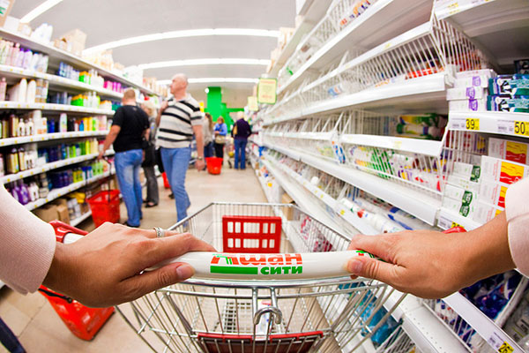
Channel Design Decisions
Marketing Channel Design: Designing effective marketing channels by analyzing customer needs, setting channel objectives, identifying major channel alternatives, and evaluating those alternatives.

Slide 35

Channel Design Decisions
1. Analyzing Consumer Needs
Meeting customer’s channel service needs: Your local hardware store probably provides more personalized service, a more convenient location, and less shopping hassle than a huge Home Depot or Lowe’s store. But it may also charge higher prices.

Slide 36
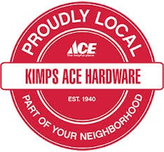
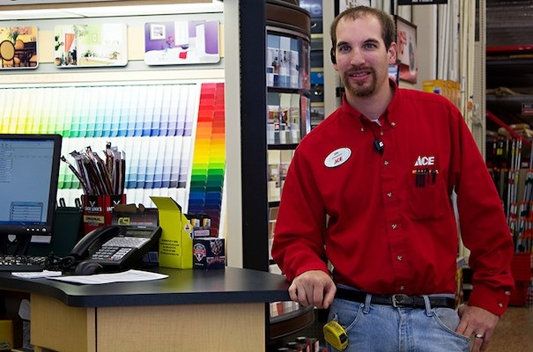
Meeting customer’s channel service needs: Ace Hardware positions itself as "The helpful place." To loyal Ace customers, the convenience of smaller stores and the personal service they receive are well worh Ace's somewhat higher prices.

Slide 37
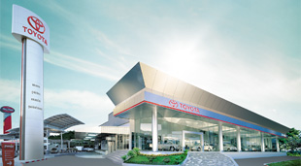
Channel Design Decisions
2. Setting Channel Objectives
  Target level of customer service?
  Influenced by nature of the company
3. Identifying Major Alternatives
  A. Types as Intermediaries
  B. Number of Marketing Intermediaries
    Intensive distribution: Stocking the product in as many outlets as possible
    Exclusive distribution: Giving a limited number of dealers the exclusive right to distribute the company’s products in their territories
    Selective distribution: The use of more than one but fewer than all of the intermediaries who are willing to carry the company’s products.

Slide 38

Exclusive distribution: Breitling watches- positioned as "Instruments for Professionals"and with prices to match- are sold by only a few authorized dealers in a given market area.

Slide 39
Channel Design Decisions
  C. Responsibilities of Channel Members
    Mutual services and duties must be spelled out carefully especially in franchised and exclusive distribution channels. For example McDonald’s.
4. Evaluating the Major Alternatives
  Economic criteria- compares the likely sales, costs, profitability of different channel alternatives.
  Adaptability criteria: channels often involve long term commitment, wants to keep channels flexible so they could adapt to environmental changes.

Slide 40
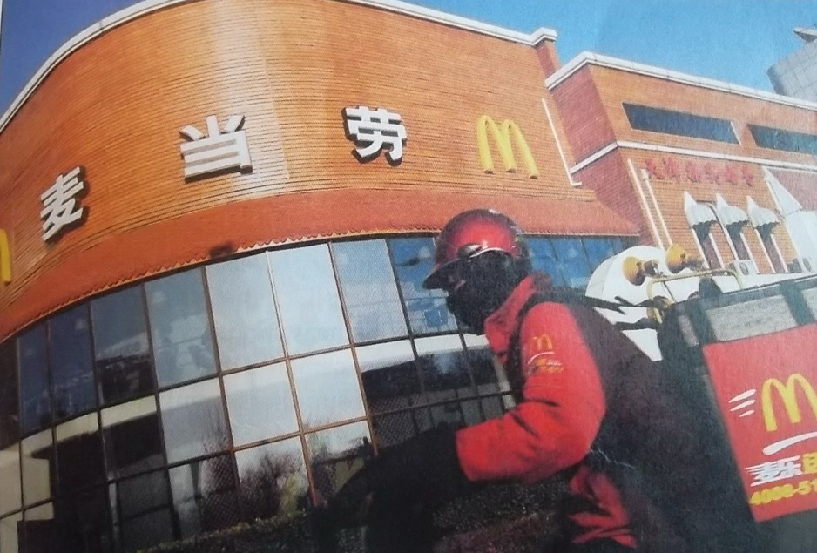
Channel Design Decisions
Designing International Distribution Channels
  The McDonald’s delivery guy: In cities like Beijing, Seoul, and Cairo, armies of motorbike delivery drivers outfitted in colorful uniforms and bearing food in specially designed boxes strapped to their backs make their way through bustling traffic to deliver Big Macs.

Slide 41
Objective 4
Channel Management Decisions
Public Policy and Distribution Decisions

Slide 42
Channel Management Decisions
Marketing channel management: Selecting, managing, and motivating individual channel members and evaluating their performance over time.
Selecting Channel Members
Managing and Motivating Channel Members
  Partner relationship management
Evaluating Channel Members
  Regularly check channel member performance against standards such as sales quotas, average inventory levels, customer delivery time, treatment of damages and lost goods, cooperation in company promotion and training programs, and services to the customer.

Slide 43

Selecting Channels:Even established brands may have difficulty keeping desired channels.CVS Caremark's decision to stop selling cigarettes left tobacco companies seeking new sales channels

Slide 44
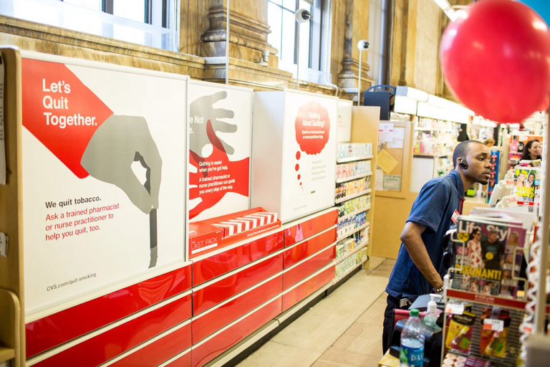
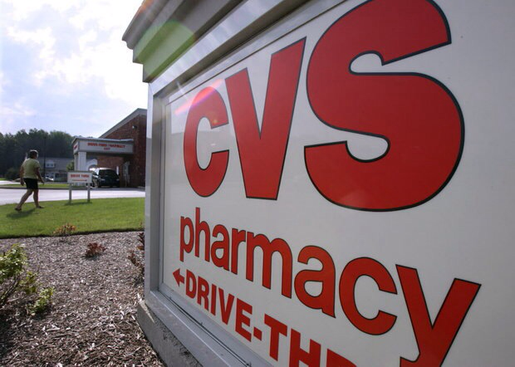
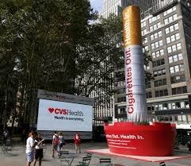
Selecting Channels:Even established brands may have difficulty keeping desired channels.CVS Caremark's decision to stop selling cigarettes left tobacco companies seeking new sales channels

Slide 45
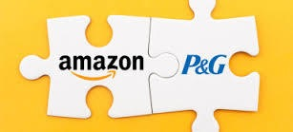
Real Marketing 12.1
Amazon and P&G: Taking Channel Partnering to a New Level
Partnering in the distribution channel:Under Amazon's Vendor Flex program, P&G and Amazon share warehouse facilities, creating distribution cost and delivery advantages for both partners.

Slide 46
Channel Management Decisions
Public Policy and Distribution Decisions
  Exclusive distribution: when a seller allows certain outlets to carry its products.
  Exclusive dealing: when the seller requires that these dealers not handle competitor products.
  Exclusive territorial agreements: The producer many agree not to sell to other dealers in a given area, or the buyer may agree to sell only in its own territory.
    Normal under franchise system-> increase enthusiasm and commitment

Slide 47
Marketing Logistics and Supply Chain Management
Nature and Importance of Marketing Logistics
Marketing logistics (or physical distribution): Planning, implementing, and controlling the physical flow of materials, final goods, and related information form points of origin to points of consumption to meet customer requirements at a profit.
Supply chain management: Managing upstream and downstream value-added flows of materials, final goods and related information among suppliers, the company, resellers and final consumers.

Slide 48
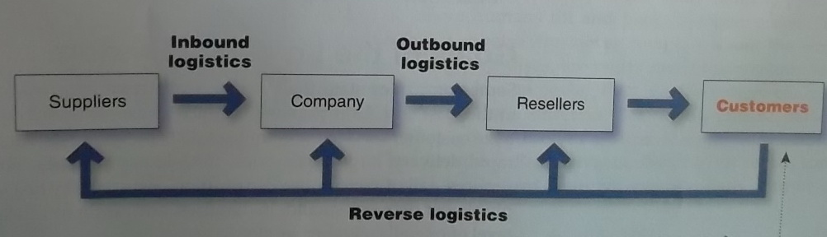
Marketing Logistics and Supply Chain Management
Figure 12.5 Supply Chain Management
Managing the supply chain calls for customer-centered
thinking. Remember it’s also called the customer-value delivery network.

Slide 49
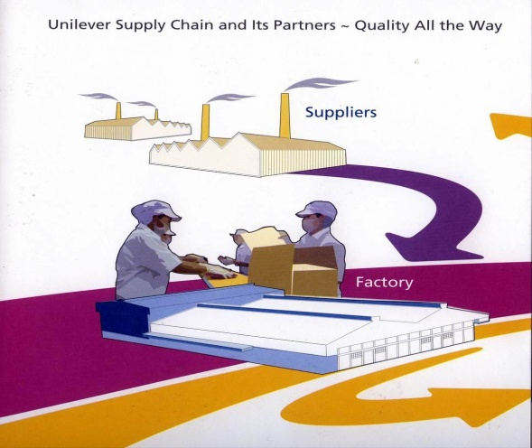
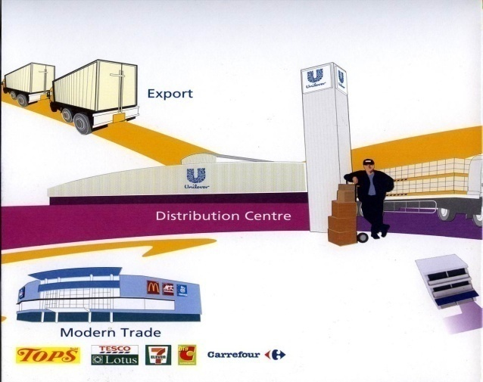


Slide 50
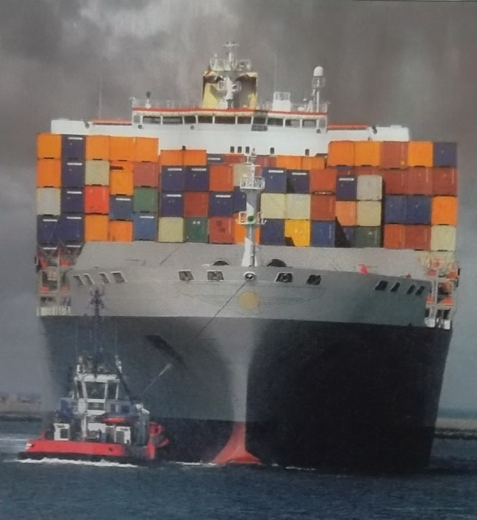
Marketing Logistics and Supply Chain Management
Logistics: As this huge stockpile of shipping containers suggests, American companies spent $1.1 trillion last year-7.7 percent of U.S. GDP- to bundle, load, unload, sort, reload, and transport goods.

Slide 51
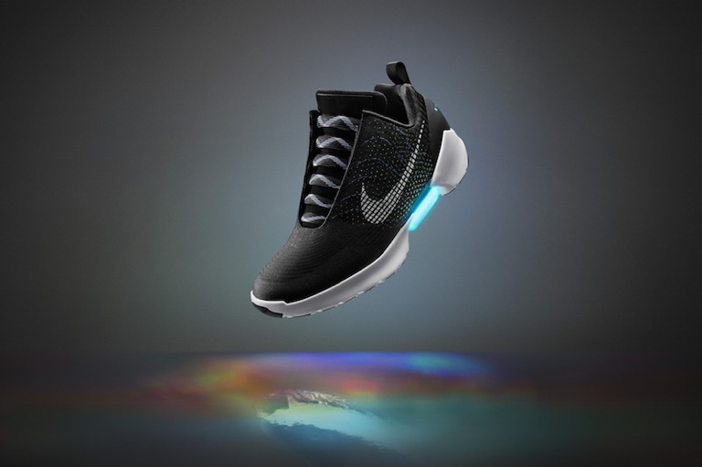
Real Marketing 12.2
Greening the Supply Chain: It's the Right Thing to Do- and It's Profitable, Too
The Higg Index
Sustainable Apparel Coalition
Green supply chains: Nike has developed a sweeping strategy for greening its supply chain. The Higg Index lets Nike work with suppliers and distributors to reduce the supply chain's environmental footprint,

Slide 52
Marketing Logistics and Supply Chain Management
Goals of Logistics System
  Provide a targeted level of customer service at the least cost.
  Maximize profits not sales
Major Logistics Functions
1. Distribution center: A large, highly automated warehouse designed to receive goods from various plants and suppliers, take orders, fill them efficiently, and deliver goods to customers as quickly as possible.

Slide 53
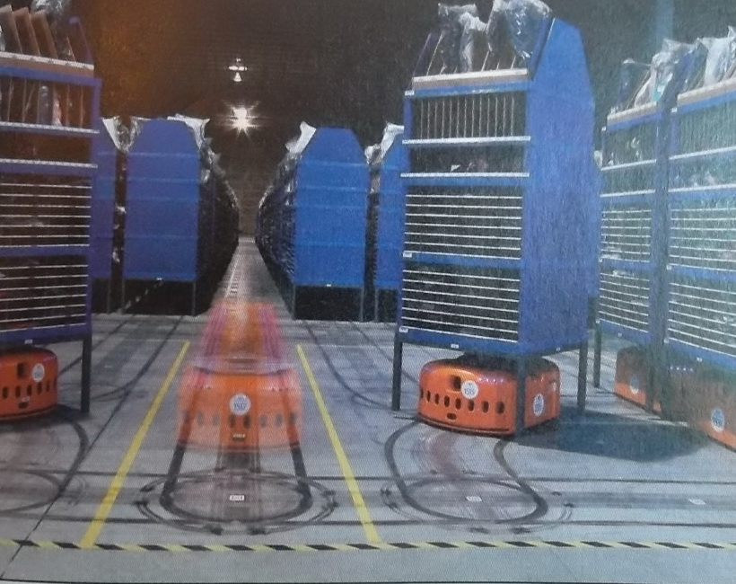
Marketing Logistics and Supply Chain Management
  High-tech distribution centers: Staples employs a team of super-retrievers-in day-glo orange- to keep its warehouse humming.

Slide 54
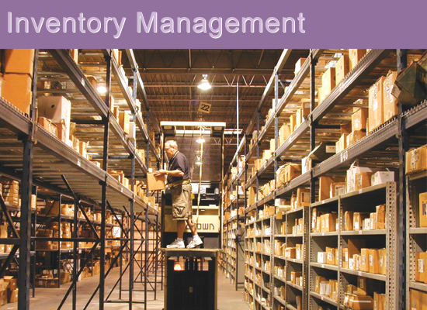
Marketing Logistics and Supply Chain Management
2. Inventory Management
  Carrying too little , too much?

Slide 55
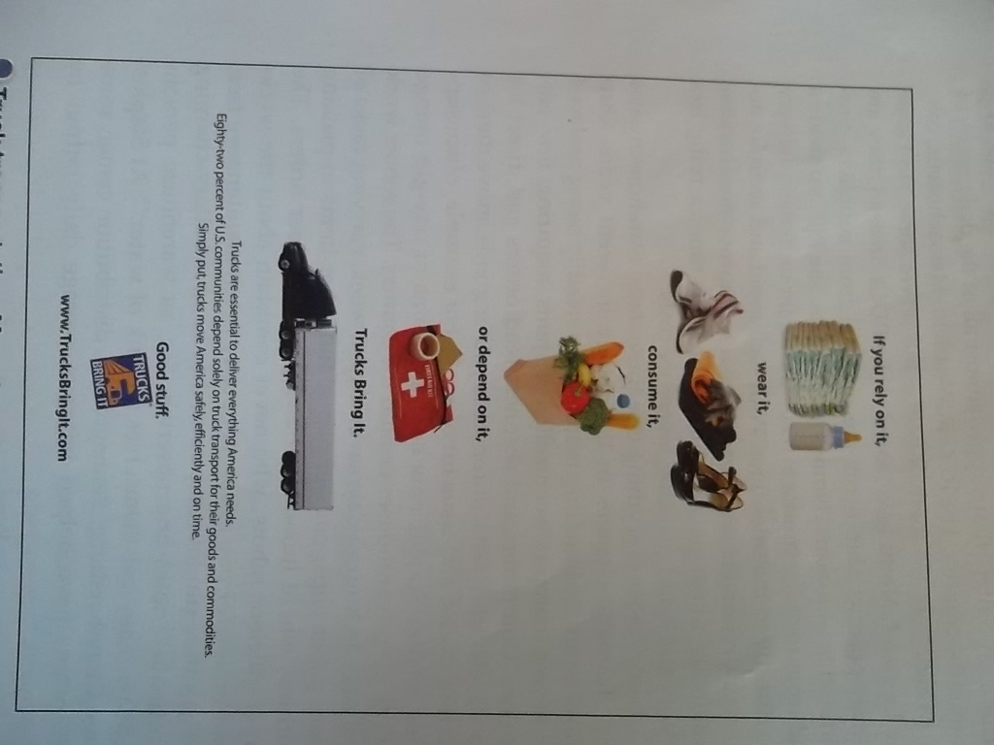
Marketing Logistics and Supply Chain Management
3. Transportation
  The choice of transportation carriers affects the pricing of products, delivery performance, and the condition of goods when they arrive.
Truck transportation: More than 80 percent of American communities depend solely on the trucking industry for the delivery of their goods. “Good stuff. Trucks bring it.”

Slide 56
Marketing Logistics and Supply Chain Management
Intermodal transportation: Combining two or more modes of transportation.
  12 percent of total cargo ton-miles in US are moved via multiple modes
  Piggyback – use of air and trucks
  Fishyback – water and trucks
  Trainship – water and rail
  Airtruck – air and truck
  Advantages for example Piggyback cheaper than truck alone, but also provides flexibility and convenience.

Slide 57
Marketing Logistics and Supply Chain Management
Logistics Information Management
  Electronic data interchange (EDI): the digital exchange of data between organizations which primarily is transmitted via the internet. Example Walmart require EDI links to more than 100,000 suppliers
  Vendor-managed inventory (VMI) systems or continuous inventory replenishment systems.
    Customers share real time data on sales and current inventory levels with the supplier. Example Walmart, Home Depot, P&G

Slide 58

Marketing Logistics and Supply Chain Management
Integrated Logistics Management: The logistics concept that emphasizes teamwork-both inside the company and among all the marketing channel organizations- to maximize the performance of the entire distribution system.
Cross-Functional Teamwork Inside the Company
Building Logistics Partnerships

Slide 59
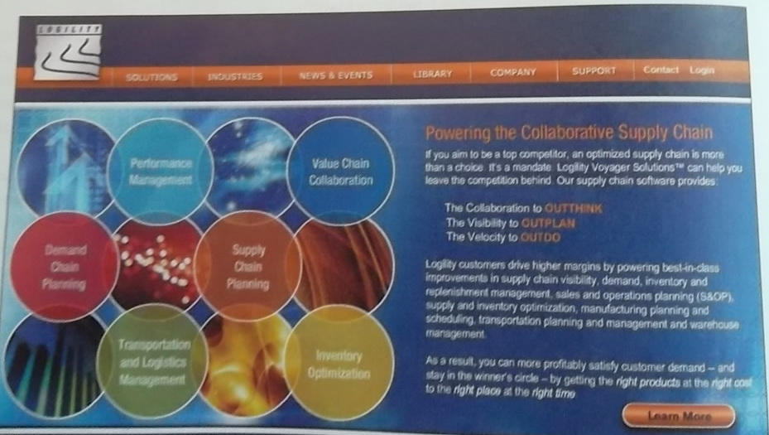
Marketing Logistics and Supply Chain Management
Integrated logistics management: Many companies now employ sophisticated, system-wide supply chain management software, available from companies such as Logility.

Slide 60
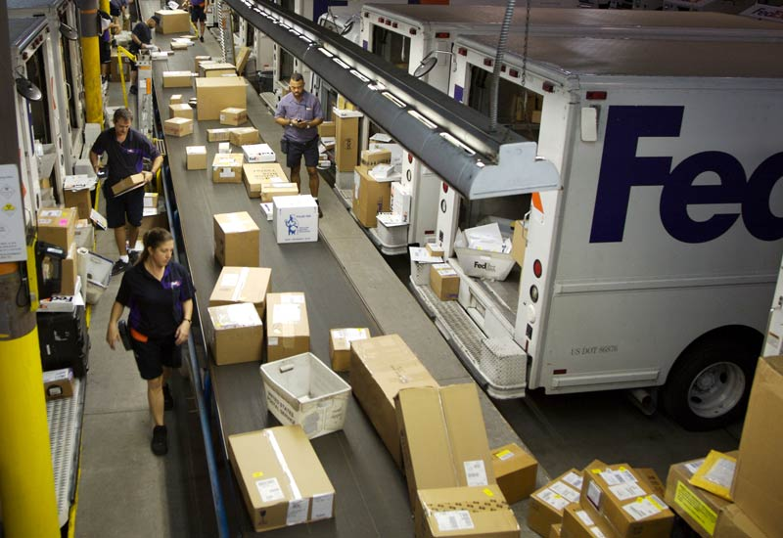
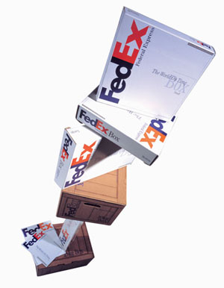
Marketing Logistics and Supply Chain Management
Third-Party Logistics (3PL) provider: An independent logistics provider that performs any or all the functions required to get a client’s product to market.
UPS Logistics, FedEx Logistics, DHL Logistics

