Slide 1





The Effect of Wage Policy on Nurse’s Labor Supply

Slide 2


Problem
Many countries face a continuing
shortage in nurses’ labor supply.
Objective
To find whether or not an increasing in wage
extracts more labor supply from nurses by
using a unique matched panel data to estimate
wage elasticities.

Slide 3



Introduction
1
Health sector = labor intensive
(Industry with a large portion of labor demanded especially for highly trained and specialized labor)
2
Several countries suffer to a shortage of key
health personnel.
* UK and Scandinavian countries report a scarcity of
nurses within the health sector
3
The nurses’ unions claim that wages are too low.
But, several studies in US and UK report that
wage elasticity for nurses are low, meaning that
the increasing in wage increases the supply of
nurses just a little.
(Nurses respond only weakly to changes in wages)

Slide 4
Consider the existing studies:
The reason for the shortage of nurses may be because
Longer of working hours
An unwillingness to work rises
several decide to leave nursing altogether

Slide 5

The problem with existing studies is that
they are often based on
1. cross sections
2. missing information on variables of importance for the nurses’ work decisions
Note : Cross-sectional data is data on one or more variables collected at a single point in time

Slide 6
3 Econometric Issues to Concern
1
Wage cannot be considered as exogenous
variable in labor supply equation.
Wage
MFC
Supply of Labor
In UK and Scandinavian countries, market of health personnel is considered as “Monopsonist”
(There are few large buyers)
Wₑ
W*
Shortage
MRP
Working hrs.
L*
Lₑ
Lₐ

Slide 7




Nurses work under different
contractual arrangement.
Nurses often work shift hours and the degree of shift work vary considerably.
(Night duty, late duty, weekend duty)
This will cause wage to be larger than basic wage
Therefore, it affects total labor supply negatively
Shift work = ทำงานเป็นกะ

Slide 8

3
Selection bias and unobserved heterogeneity
Observe only nurses who hold jobs in specific health care institutions.

Slide 9

If we do not control these problems,
BIASED ESTIMATORS will OCCUR.
Therefore, applying “Panel Data Set” makes
it possible to correct these problems.

Slide 10
Panel Data is data in which we observe repeated
cross-sections of the same individuals or the same
cross-sectional unit is surveyed over time
This paper observed data for 6 years (1993-1998)
Panel data is better at detecting and measuring effects that cannot be observed
in either cross-section or time-series data.
Panel data enables the study of more complex behavioural
Panel data can minimise the effects of aggregation bias

Slide 11
This paper investigates the labor supply of
nurses by accessing information about
individual characteristic including:
1) Health care institution
(where each nurse works)
2) Actual working hours
3) Type of contract for each nurse

Slide 12
Data Used
Consist of administrative data for the years
1993-1998 collected from different
Statistics Norway (SSB) provides
detailed background information
on all individuals who have completed their nursing education
- Whether the individual works
or not
- Where the individual works
- Yearly income
NALRA register contains very
detailed individual information on
- Standard wages over time
- Compensation for work outside
normal hours
- Total number of hours worked
- Workplace of the nurse
- Kind of job
NALRA sub- sample contains detailed wage and
contractual information on 19,638 individuals over 5 years,
totalling 69,122 observations

Slide 13
NARLA sub-sample of female nurses
Average age of nurses = 37 years old
Average years of experience = 12.5 years

Slide 14
NARLA sub-sample of female nurses

Slide 15
NARLA sub-sample of female nurses

Slide 16

Basic Labor Supply model
Wage
Labor supply
= The total number of hours that labor is willing and able to supply at a given wage rate
Number of working hours
Number of working hours = f(wage rate)
Elasticity of labor supply (wage elasticity)
= Measures the extent to which labor supply
responds to a change in wage rate in a given
time period.
$$\frac{\% ∆ Working hours}{\% ∆ Wage}$$

Slide 17
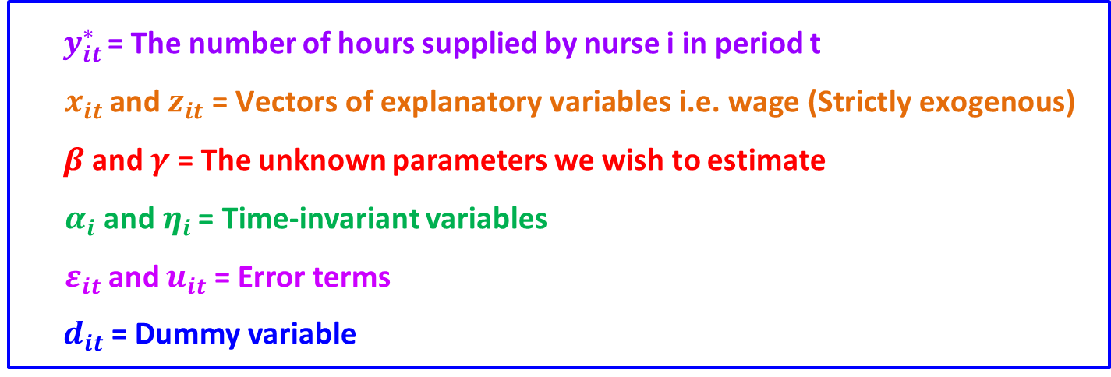
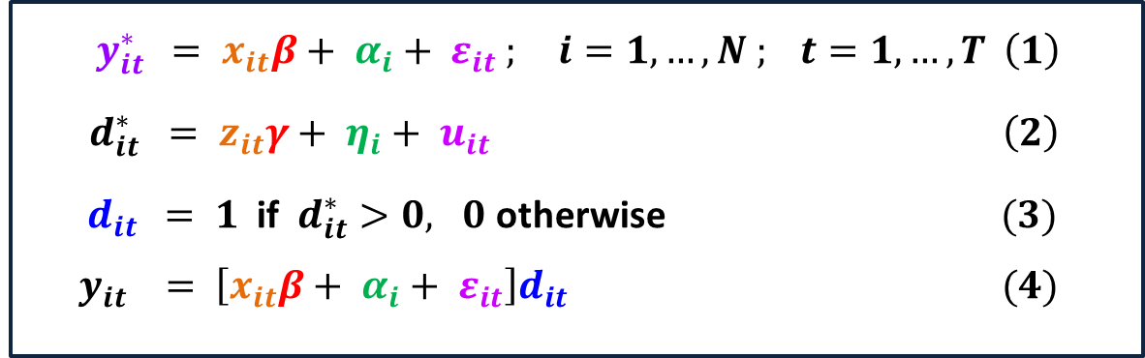
Econometric Model and Estimation Method
Consider the following model:
$y_{it }^{∗} = x_{it}β+ α_{i}+ ε_{it} ; i=1,…,N ; t=1,…,T \left(1\right)$
$d_{it}^{∗} = z_{it}γ+ η_{i}+ u_{it} \left(2\right)$
${ d}_{it} = 1$if $d_{it}^{∗}>0, 0$ otherwise $(3)$ ${ y}_{it } = \left[x_{it}β+ α_{i}+ ε_{it}\right]d_{it} (4)$
${ y}_{it }^{∗}$= The number of hours supplied by nurse i in period t
$x_{it }\text{and} z_{it}\text{ = }\text{Vectors} \text{of} \text{explanatory} \text{variables} \text{i}\text{.}\text{e}\text{. }\text{wage}\text{ (}\text{Strictly} \text{exogenous}\text{) }$
$β$ and $γ$ = The unknown parameters we wish to estimate
$α_{i}$ and$η_{i}$ = Time-invariant variables
$ε_{it}$and $u_{it}$= Error terms
${ d}_{it}$ = Dummy variable

Slide 18
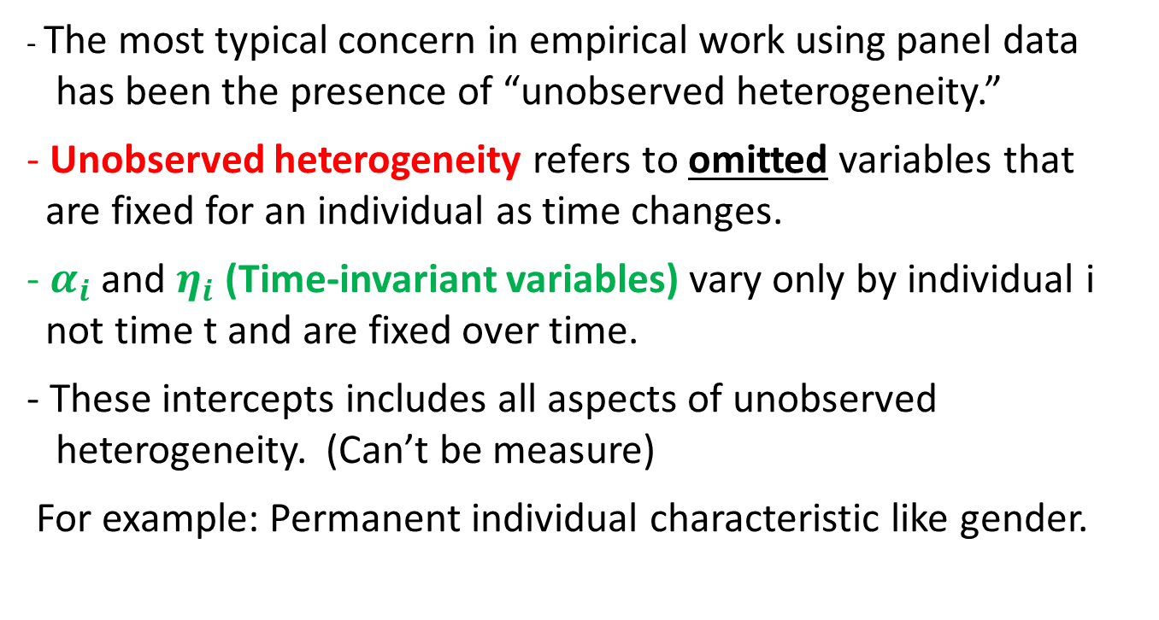
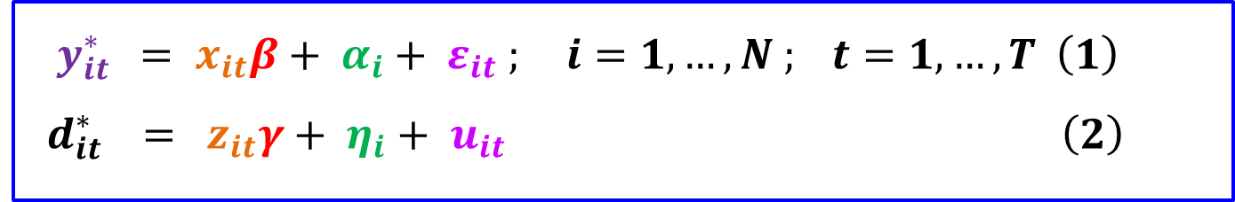
$y_{it }^{∗} = x_{it}β+ α_{i}+ ε_{it} ; i=1,…,N ; t=1,…,T \left(1\right)$ ${ d}_{it}^{∗} = z_{it}γ+ η_{i}+ u_{it} \left(2\right)$
- The most typical concern in empirical work using panel data
has been the presence of “unobserved heterogeneity.”
- Unobserved heterogeneity refers to omitted variables that
are fixed for an individual as time changes.
- $α_{i}$ and $η_{i}$ (Time-invariant variables) vary only by individual i
not time t and are fixed over time.
- These intercepts includes all aspects of unobserved
heterogeneity. (Can’t be measure)
For example: Permanent individual characteristic like gender.

Slide 19
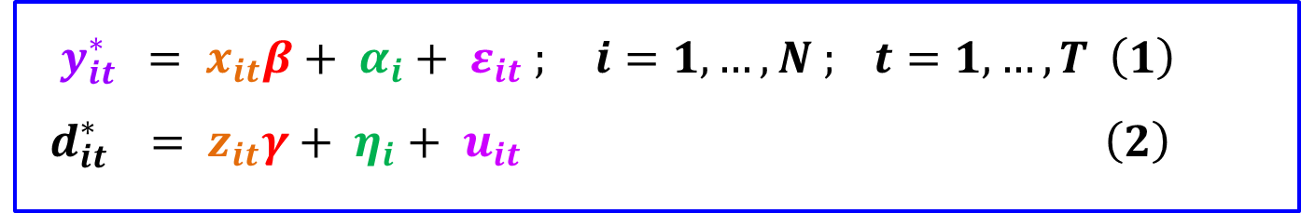
$y_{it }^{∗} = x_{it}β+ α_{i}+ ε_{it} ; i=1,…,N ; t=1,…,T \left(1\right)$ ${ d}_{it}^{∗} = z_{it}γ+ η_{i}+ u_{it} \left(2\right)$
Estimate equation (1) by using Ordinary Least Squares (OLS)
will result in biased and inconsistent estimates of the
parameters of interest since unobserved effects occur.
In linear panel data models, these unobserved effects may be "differenced" out, using ("fixed-effects") approach.
The fixed effect (Unobserved heterogeneity) from the main equation is eliminated by taking time differences on the observed selected variables.

Slide 20
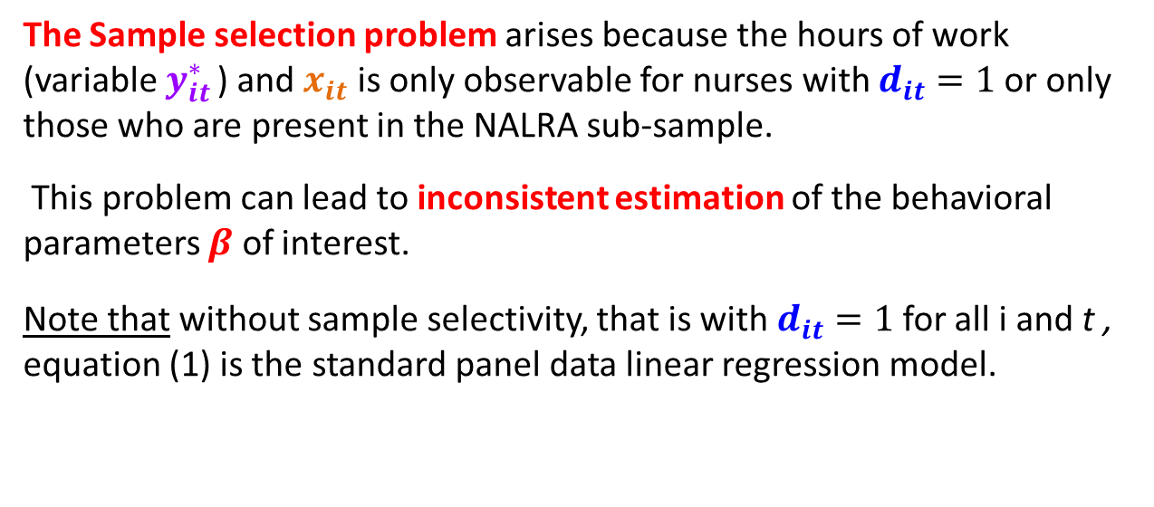
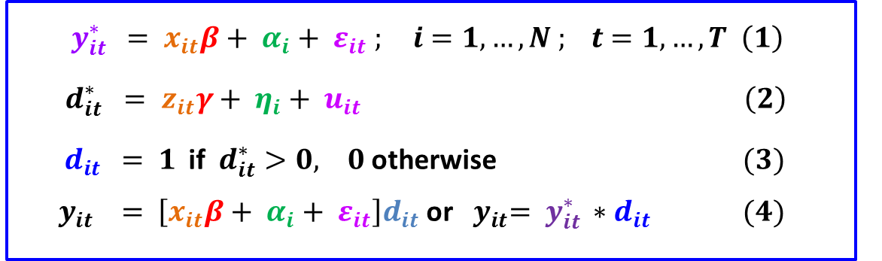
Sample Selection Bias = Systematic error by reason
of collecting data from sample instead of population
$y_{it }^{∗} = x_{it}β+ α_{i}+ ε_{it} ; i=1,…,N ; t=1,…,T \left(1\right)$
$d_{it}^{∗} = z_{it}γ+ η_{i}+ u_{it} \left(2\right)$
${ d}_{it} = 1$if $d_{it}^{∗}>0, 0$ otherwise $(3)$ ${ y}_{it } = \left[x_{it}β+ α_{i}+ ε_{it}\right]d_{it}$ or ${ y}_{it}=$ $y_{it }^{∗}{∗d}_{it} (4)$
The Sample selection problem arises because the hours of work (variable $y_{it }^{∗}$) and $x_{it}$ is only observable for nurses with $d_{it}=1$or only those who are present in the NALRA sub-sample.
This problem can lead to inconsistent estimation of the behavioral parameters $β$ of interest.
Note that without sample selectivity, that is with $d_{it}=1$for all i and t , equation (1) is the standard panel data linear regression model.

Slide 21
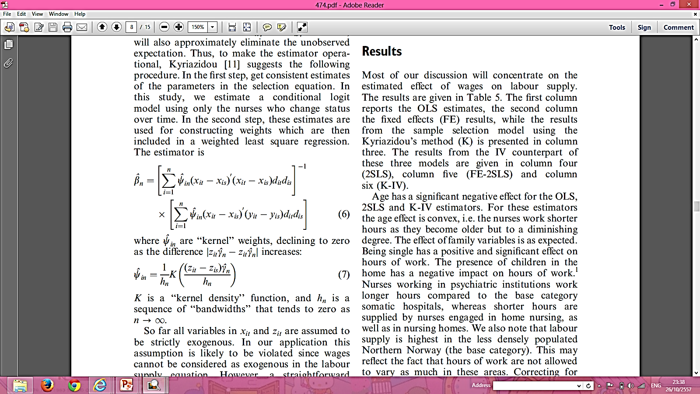
Kyriazidou’s Model (Ekaterini Kyriazidou)
By using this model, both 1) Unobserved heterogeneity and 2) Sample Selection Bias can be eliminated.
Therefore, time differencing the outcome equation
(K model) will eliminate not only its unobservable individual effect but also the sample selection effect.

Slide 22
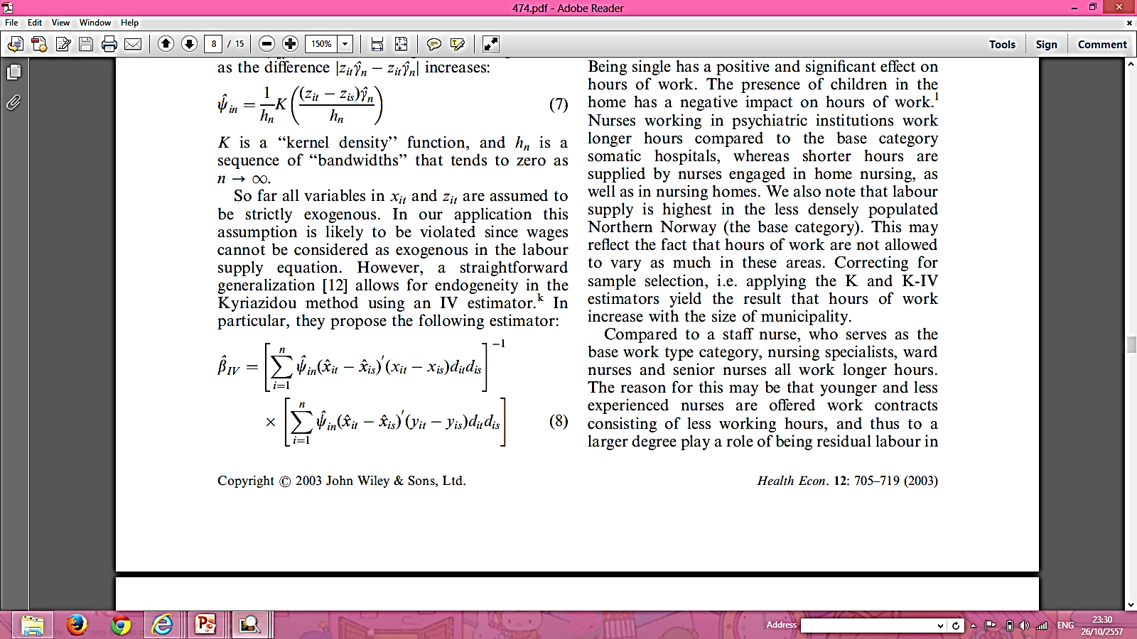
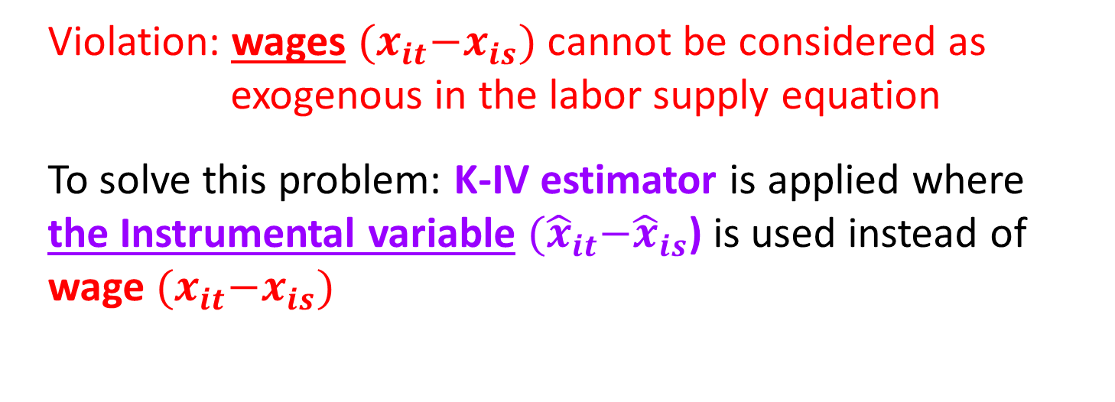
So far all explanatory variables are assumed to be strictly exogenous.
Violation: wages ${(x}_{it}−x_{is})$ cannot be considered as
exogenous in the labor supply equation
To solve this problem: K-IV estimator is applied where
the Instrumental variable ${(\hat{x}}_{it}−{\hat{x}}_{is}$) is used instead of
wage ${(x}_{it}−x_{is})$

Slide 23
K-IV estimator provides the most efficient result
No heterogeneity problem
Guarding against sample selection
Correcting the wage problem
(It is considered as endogenous variable)
No possible endogeneity
= the correlation between the explanatory variable and the error term

Slide 24
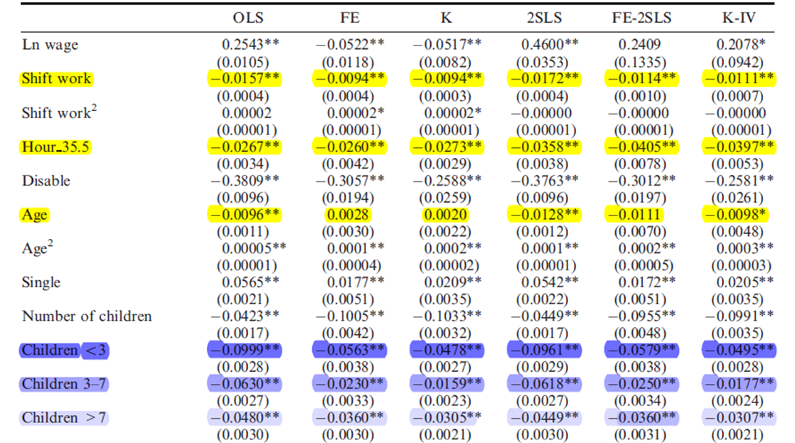
Result
Notes:
3 อันแรก ไม่มีในอันอื่นแต่เราคอนเซิน

Slide 25
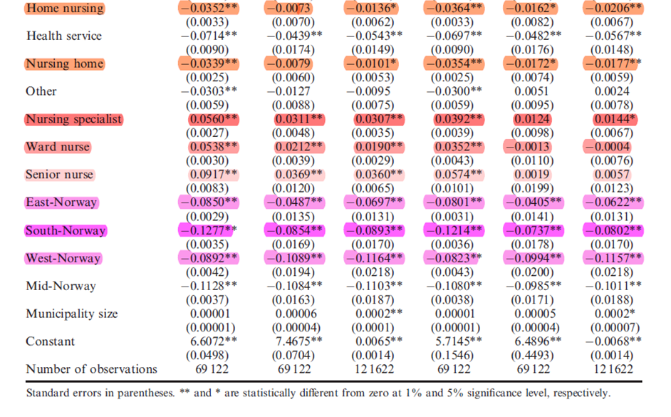
Result

Slide 26
Result
We have OLS, 2SLS , FE , FE-2SLS ,
K , K-IV models
Individual characteristics of nurse
  Has negative effect OLS, 2SLS and K-IV estimators showing that nurse work shorter hours
  as they become older
Age
  Has positive effect significantly on working hours
Single status
Children
  Has negative effect significantly on hour

Slide 27
Nurse in psychiatric institution work longer hour compared to somatic hospitals.
Specific Institution
Nursing home and home nursing both have shorter hours of work because the negative effect.
Specialist nurse has more working hour than the unskilled nurse as we see that the result is positive to working hours.
The result of working hour will increase
if we correct the sample selection problem with the size of municipality using K and K-IV.

Slide 28
Specific Institution
Staff nurse is becoming the residual labor
because the budget constraint of institution which
determine how much they may work so staff nurse
is demanded in short term.
Specialized nurse I.E. nurse specialist, ward nurse,
senior nurse has positive effect as they get more
reward and interesting task so the working hour
is longer due to the contractual arrangement that
indicates the different hour of working.

Slide 29
Shift work
Has negative effect on hour of work because they
has shorter maximum working hour written down
in contract ( 35.5 hours per week)
In less density of population area, as we note that
in Northern Norway, the base category has highest
supply of nurse , the far away has less working hours
as the effect of Southern Norway is negative, and
accordingly the east and the west.
Area

Slide 30
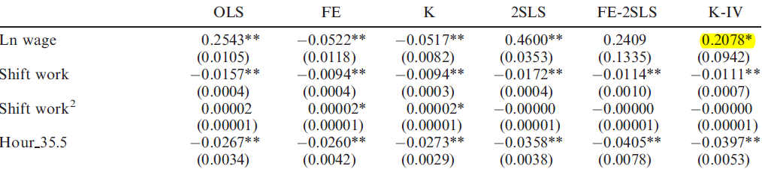
Result
- K-IV gives preferred estimators of the nurses’ labor supply.
Since, it guards against sample selection and control for types
of contracts as well as endogeneity in determination of wages
and hour-of-work.
- Therefore, wage elasticity are positive and significant and estimated to be around 0.21

Slide 31
Conclusion
The magnitude of the wage elasticity depends on the
estimator chosen
By using OLS estimator, the wage elasticities are small
which is similar to the existing studies from UK and USA.
(Possible endogeneity occurs)
By using FE and K estimators (controlling for nurse heterogeneity and correcting sample selection),
a negative and significant wage elasticity is obtained.

Slide 32
Conclusion
By using K-IV estimators, larger positive and significant wage elasticities were obtained.
Another important result from this analysis is that contractual arrangements as represented by shift work are also important for hours of work.
The reason is that the work contract specifies working
conditions and payment, including standard hours of work and
compensation for work outside of normal working hours.

Slide 33
Conclusion**
To sum up, wages do matter for nurses’ labor supply but that individual characteristics of nurse including several institutional aspects, and contractual arrangements also play important roles for how many hours of work are performed.
Besides, the health institutions’ financial situation and governing structures may be important.

Slide 34

Example in the real world
Shortage of nurse in Thailand
Chronic shortages of professors and lecturers in the nursing sector is a pressing concern that threatens the sustainability and attractiveness of Thailand's medical services in the long term, says the Thailand Nursing and Midwifery Council.
She said Thailand has faced a shortage of nursing lecturers for the past decade, and as services expand in cities and rural areas, both the quantity and quality of new nursing graduates may be at stake.
48% of nurses who are hired as temporary staff in public hospitals leave their jobs in the first year, and about 25% of nurses leave in the second year. Most of those nurses are drawn into private hospitals The Thai Journal of Nursing Council indicated earlier this year that more than 31,000 nurses are needed to fill gaps in public hospitals. The report predicted the nursing shortage will worsen over time.

Slide 35

Example in the real world
Shortage of nurse in Thailand
The launch of the Asean Economic Community (AEC) in 2015 and the government's medical hub project could worsen the drain of public sector nurses, Ms Jintana said The AEC and the government's medical hub project would attract more nurses into the private sector as they opt for higher-paid foreign positions or take jobs in private.
(Source: Bangkok Post, HEALTH, Temp nurse upgrade 'will halt exodus',
12/12/2012, Paritta Wangkiat, link)

Slide 36
Shortage of nurse in Thailand (Model)
Wage
MFC
Supply of Labor
Wₑ
W*
Shortage
MRP
Labors ( NS)
L*
Lₑ
Lₐ

Slide 37



There is not enough nurses willing to work at the low wage rate that monopsonist hospital (public hospital) are willing to pay.

Slide 38



Slide 39
MEMBER
Jenjira Jirawitchaya (5504640334)
Patcharee Penchan (5504641001)
Ploynapat Somniyamrat (5504641274)
Sawaros Sasanarakij (5504641597)
Siritipa Suwanpol (5504641654)

