Slide 1

EE366/EE382 Economics of Services Sector
CHAPTER 6
Supply, Demand and Market Equilibrium in service
Dr. Nessara Sukpanich

Slide 2
Supply, demand and market equilibrium in service
1. Service costs
  1.1 Production costs of non-storable goods
  1.2 Distribution costs of non-transportable goods
  1.3 The basic trade-off and the resulting market areas
  Reading: Jansson (2013) Chapter 3, 4, 5
2. Supply and demand at system level and market equilibrium
  3.1 The system cost function
  3.2 The system demand function
  3.3 Market equilibrium
  Reading: Jansson (2013) Chapter 7
3. Demand for service (macro perspective)
  2.1 Demand for service consumption and its income elasticity
  2.2 Intermediate demand for service
  Reading: Zhou (2016) chapter 4

Slide 3
1. Service costs
Conventional microeconomic cost theory treats production costs and distribution costs as one, in analysis of service sector look at both costs separately and together.
Non-storability of immaterial goods
  Concern about production costs of non-storable goods
  Variability of demand cannot be met by the buffer stock → concern about peak-load pricing
  Random fluctuations of demand → the application of queuing theory
Non-transportable goods
  Concern about distribution costs of non-transportable goods

Slide 4
Source: Jansson (2013), Figure 3.1, P.32
The General Shape of long-run total production cost (LRTC_{prod}) and long-run average production costs (LRAC_{prod})
C
LRTC_{prod}
Initially, with increasing return to scale (IRS) production, LRTC_{prod} increase digressively with respect to q
Then, with constant return to scale (CRS), LRTC_{prod} increase proportionately with respect to q
After that, with decreasing return to scale (DRS) production, LRTC_{prod} increase progressively with respect to q
LRAC_{prod} is in U-shaped form, relative flat part of LRAC_{prod} corresponds to the part where LRTC_{prod} increases nearly proportion to q
There could be case that LRAC_{prod} is closed to L-shape form
TOTAL COST
q
C
AVERAGE COST
LRAC_{prod}
q
1st interval
2nd interval
3rd interval

Slide 5
Source: Jansson (2013), Figure 3.1, P.32
The General Shape of long-run total production cost (LRTC_{prod}) and long-run average production costs (LRAC_{prod})
C
LRTC_{prod}
Observations in the 3rd output interval is less likely to occur in reality. A production plant with such a large capacity would not be realistic since the same output could be produced at lower cost per unit of output by two plants
Observations in the 1st output interval is less likely to occur in reality. Low capacity plants (of storable and transportable goods) could not exist if it is possible to produce such goods for substantially lower average cost at plants with higher capacity
However, low capacity, relatively high cost plants are kept in operation as long as the price (or marginal revenue) > current cost
Mainstream price theory focuses on the second output interval.
TOTAL COST
q
C
AVERAGE COST
LRAC_{prod}
q
1st interval
2nd interval
3rd interval

Slide 6
Two extreme cases of the shape of LRTC_{prod} and output relationship
$
$
LRTC_{prod}
LRTC_{prod}
q
q
LRTC_{prod} = aq
LRTC_{prod} = F
Small-scale operations are natural
Represented by simple service such as manual car wash, shoeshine service in the street
Could Still incur small-scale-disadvantages (like higher queuing costs)
Public good characteristics –>
……………………………………………………………….
Examples: ____________________________________________________________________________________________________________________________________
inexhaustible (non-rival), non-excludible
Source: Jansson (2013), Figure 3.2, P.34

Slide 7
Combination cases
LRTC_{prod} = F + aq
LRTC_{prod} = F + aq^{α} + kq whereas 0<α<1
LRTC_{prod} = az + aq = a (z + q)
F or az represents “public” factor of production or fixed cost such as costs of R&D, costs of preparing final manuscript for publishing a book
aq represents costs that are strictly proportional to output
aq^{α} represent costs that increase digressively with output

Slide 8
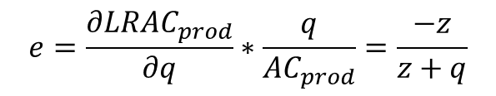
Total production costs, given the elasticity α, α < 1
$
$
LRTC_{prod} = a_{i}q^{α}
(a₁)
(a₂)
(a₃)
(a₄)
q
Total production costs,
given the scale-elasticity indicator z
$
(a₁)
LRTC_{prod} = a_{i} (z + q)
“az” represent fixed cost
“a” represent slope of LRTC_{prod}
“z and q” indicates plant size economies
total cost elasticity = e+1
Total production cost elasticity with respect to q is continuously increase from low positive values towards unity in the limit
(a₂)
(a₃)
(a₄)
$$e=\frac{∂{LRAC}_{prod}}{∂q}∗\frac{q}{{AC}_{prod}}=\frac{−z}{z+q}$$
q
Source: Jansson (2013), Figure 3.5a and Figure 3.6b, P. 45

Slide 9
Small-scale diseconomies
Two main causes of small-scale disadvantages
A relatively high F-value
  Normally services produced by technical sophisticated, industrial methods such as airport service, high speed train, etc.
Services of a relatively low unit cost (low-value service)
  not require sophisticated production apparatus
  pre-booking system would be too cumbersome
  the main cause of small-scale disadvantages is non-storability
  So, random arrival of customers gives rise to high queuing costs unless the rate of capacity utilization is initially kept low.

Slide 10
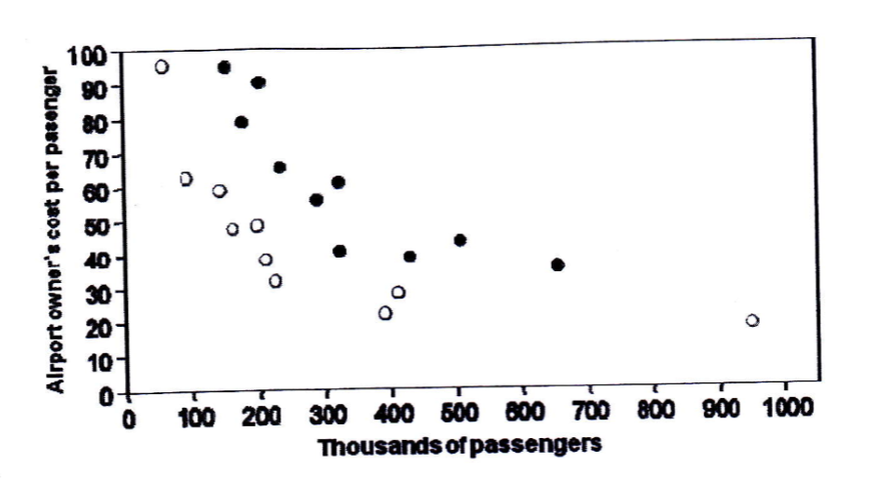
Empirical evidence of small-scale diseconomies
Airport service
Regional airport cost per passenger versus passenger volume
Data sample:
20 regional airports in Sweden
2 categories
  State-owned civilian airports
  Military and/or municipal-owned airports
Source: Jansson (2013), Figure 3.3, P. 40
Results
From graph: airports in the range of 100,000 to 200,000 passengers per year are five times more costly per passenger than airports serving one million passengers
Corresponds to regression results: an elasticity of the average airport cost with respect of output = -0.67

Slide 11
Empirical evidence of small-scale diseconomies
Airport service
Results of logarithm regression of average airport cost on passenger volume
Explanatory variables | Coefficients | t-values
Constant | 12.02 | 20.57
Passenger volume | -0.67 | -14.22
Dummy for airport category | 0.53 | 9.25
Source: Jansson (2013), Table 3.2, P. 41
Data sample:
20 regional airports in Sweden
2 categories
  State-owned civilian airports
  Military and/or municipal-owned airports
Results: An elasticity of the average airport cost with respect of output = -0.67

Slide 12
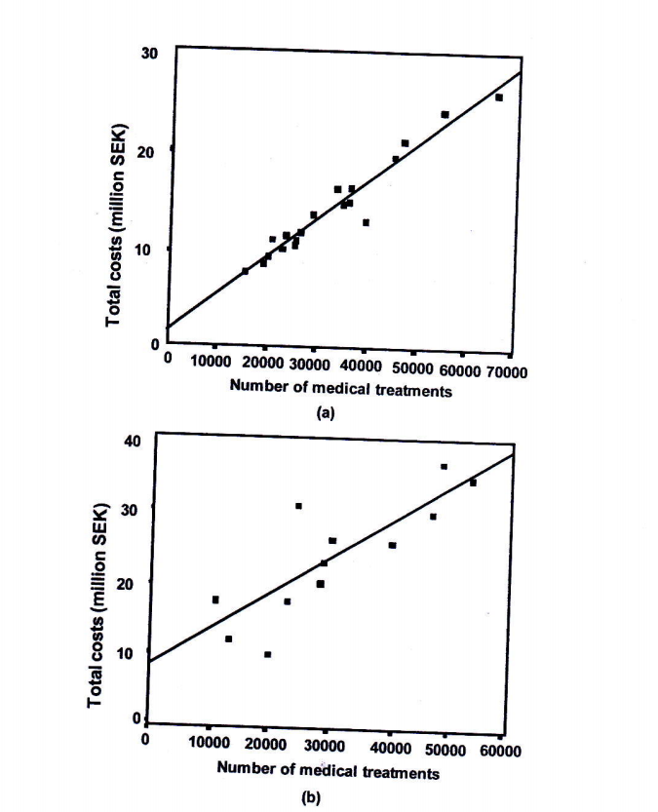
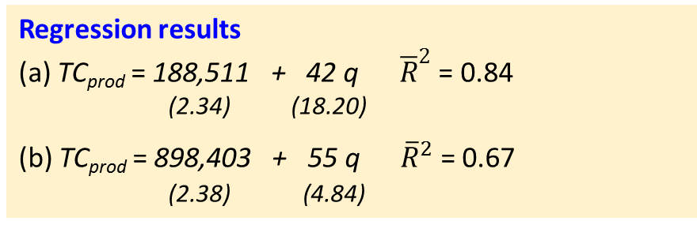
Empirical evidence of small-scale diseconomies
Variable Elasticity Cases (LRTC elasticity with respected to q)
Long-run total production cost and output functions for public health centres in
Ӧstergӧtland, a south eastern county (top chart)
The northernmost part of Sweden (bottom chart)
Huge difference in density of demand in the two areas
The annual number of treatments per km² is 70
The annual number of treatments per km² is 4
Regression results
(a) TC_{prod} = 188,511 + 42 q ${\overline{R}}^{2}$ = 0.84
(2.34) (18.20)
(b) TC_{prod} = 898,403 + 55 q ${\overline{R}}^{2}$ = 0.67
(2.38) (4.84)
Assuming a linear long-run total cost function, the total cost elasticity (e+1) with respect to output is non-constant, and goes up with increases in output volume with two following range
0.78 < e+1 < 0.94
0.38 < e+1 < 0.75
Source: Jansson (2013), Figure 3.6, P. 47

Slide 13
Empirical evidence of small-scale diseconomies
A word of caution
In reality we seldom see the small scale disadvantages fully reflected in the service producer’s production function costs alone.
They are to some extent passed on to the users, either in the form
of a low quality of service (e.g. longer expected queuing time, higher
travel costs for the users or both)
In modeling work based on empirical cross-section study
  it is essential to take a wide view, and include both the producer and user costs in the analysis
  At least make sure that the quality of service is kept constant when examining the economies of scale and similar production and distribution system concerned

Slide 14
Discussion
Do you think there exist the situation of small-scale diseconomies in your group service industry? Explain.
Do you think how do the shape of your group service industry LRTCprod and LRACprod look like? And explain why do you think they look like that.

Slide 15
Source: Jansson (2013), Chapter 4
Distribution costs of non-transportable goods
Distribution costs in this part focuses on “transport cost” of “non-transportable services” (although indeed distribution costs is much wider concept than transportable cost)
What distinguishes “services” from “material goods” is the relative importance of the “cost of personal transport in order for producer and consumer to meet and carry out the simultaneous production and consumption”.

Slide 16
Source: Jansson (2013), Chapter 4
Distribution costs of non-transportable goods
Bridging the special separation of service producers and consumers
(4 categories)
1. Consumer goes to service production plants
  Example: ____________________________________________
  Normally, consumers bear all the transport costs
  Two-stage travel:
  such as ___________________________________________________
2. Concerning producer services
  Producers goes (drives) to the consumer’s place (may bring necessary tools with them and go to consumers.
  Example __________________________________________________
  __________________________________________________________

Slide 17
Source: Jansson (2013), Chapter 4
Distribution costs of non-transportable goods
Bridging the special separation of service producers and consumers
(4 categories), cont.
3. Producers and consumers meet half way
  Example: __________________________________________________
4. Transport
  Transport itself is a service that is both non-storable and non-transportable. So bears with it relatively high distribution costs
  Transport infrastructure service (such as, airport, train station, motorway etc.) _____________________________________________
  Public transport (such as, bus ,train) ____________________________
  Transport for hire (such as called taxi) __________________________

Slide 18
Source: Jansson (2013), Chapter 4
Distribution costs of non-transportable goods
Bridging the special separation of service producers and consumers
(4 categories), cont.
Two borderline cases (not include in distribution models that follow)
Public utilities (such as electricity, water supply, etc.)
  Water is material enough to be storable and transportable (via water pipeline) and could be viewed as good
  Electricity is arguably immaterial and non-storable, but could be transportable via electricity cable
  In general transportable costs are high in relation to production costs (normally distribution systems are tailor-made in each case)
Information and communication
  In case where information can be stored on tape or disc, printed on paper or written in a letter, it becomes transportable good. Such goods can give rise to service, e.g. when a reel of film is enjoyed as a movie in a cinema)
  Communication means the transportation of information (e.g. by telephone wire or by wireless distribution). A telephone conversation does not require a meeting, but simultaneity in time is necessary for the production and consumption of information (distinct from email)

Slide 19
Source: Jansson (2013), Chapter 4
Generalized Travel Cost with Respect to Distance
When it comes to personal transport to obtain service, or service producer to go to the consumer’s place and provide service, the resistance of distance is more pronounced than for trade of goods
(one main reason for this is that non-motorized modes of
transport, which nearly extinguished for goods transport still
play an important role in the case of consumer services)
Here explains “Individual modes of travel” and “Public transport generalized cost”

Slide 20
Source: Jansson (2013), Chapter 4
Individual modes of travel
There are limits for walking and cycling, the limits varies widely between individuals
The reasonable cycling distance is longer than walking distance
When heavy or bulky goods are to be carried the car is indispensable
The generalized cost (GC) of travel on foot increases progressively with distance (sometimes use a quadratic functional form)
Local transport modal choice studies indicate that walking time on the margin is valued (that is costs) between 1.5 to twice as much as car driving or bus riding time cost.
Unfortunately, there is no firm empirical evidence of the exact rate of increase with distance, either of walking time cost or of the cycling time cost
Note: Time cost of each travel mode is travelers’ willingness to pay for saving time under a particular circumstance for that mode of travel.

Slide 21
Source: Jansson (2013), Chapter 4
Individual modes of travel
When it comes to motorized mode of transport, it is well known from travel demand, and value of time research (for example in SIKA, 2008), that the time cost is about twice as high for long-distance travel compared to short-distance travel. This reflects a gradually rising cost of travel time, when the journey takes more than 1 or 2 hours.
A linear approximation of travel time cost function up to a journey time of about one hour seems justified in the case of car travel (more in literature regarding travel demand and time cost)

Slide 22
Source: Jansson (2013), Chapter 4
Individual modes of travel
The distance independent part of the generalized cost of a car trip include
  ______________________________________________________
  ______________________________________________________
  ______________________________________________________
  ______________________________________________________
  ______________________________________________________
  ______________________________________________________
  ______________________________________________________
  ______________________________________________________

Slide 23
Source: Jansson (2013), Chapter 4
Distribution cost: Hexagonal market area
The main disadvantages of car travel compared to walking or biking is
_________________________________________________________________
In the areas where parking fees are substantial, the ordinate of the starting-point of the GC_{car} in figure 4.3 would be relatively high, which could considerably extend the distance range within which walking and/or cycling have lower generalized costs than travel by car
Whereas walking and cycling can be assumed free of monetary costs, car use causes substantial monetary costs that can be influenced by petrol taxes and road pricing. That means the slope of the GC_{car} could be steeper. This will boost the non-motorized modes and the public transport alternatives if there is one.

Slide 24
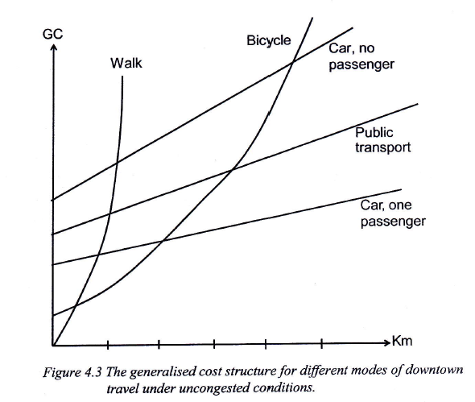
The generalized cost structure for different modes of downtown travel under uncongested conditions
Individual modes of travel
Source: Figure 4.3 in Jansson (2013), P.59

Slide 25
Source: Jansson (2013), Chapter 4
Individual modes of travel
After the initial stage where the cost of walking is increasing progressively with distance, the all mode GC is more or less proportional to distance when the different modes are represented only in their respective niche range
A linear approximation of all the GC-curve seems reasonable with one exception: the effort of a walk with a burden is increasing progressively with distance. In that case a quadratic functional form is more adequate
In the case of long-distance travel, further consideration may include value of time differs between different modes of travel due to comfort differences. Time cost per hour tends to increase with total travel time

Slide 26
Source: Jansson (2013), Chapter 4
Individual modes of travel
The research based on the Norwegian national travel survey RVU2001 (Samferdsel nr3, 2003) shows that
For travel to/from work walking is the main mode of transport up to a distance of 1 km, where walking and car travel are equally frequent
For a distance 3 km walking is almost down to zero
The parking price and availability at the place of work is quite important for the modal split.
  For work trips up to 3 km, the share of walking and cycling rises from 36% to 80% when the parking goes from “free, always available” to “no parking”
Cycling is not as common in hilly Norway as in Denmark, Holland and northern Germany, as well as generally in Sweden.
In small and medium-sized towns where travel distances are relatively short, cycling is more important than public transport in Sweden, from south to north

Slide 27
Source: Jansson (2013), Chapter 4
Public transport generalized cost
The cost structure of public transport is more complex than modes of individual transport
Public transport is an important service itself
The necessary access and regress trips at either end constitute the distribution costs of public transport services
The strong dependence of the public transport generalized costs on trip volume along a particular route is a distinguishing characteristics
Given the transport infrastructure, the individuals modes of transport (walk, bicycle, and private car) are constant cost activities for low to medium rates of the infrastructure capacity utilization. As the capacity limit is approached, car transport (in particular) shows accelerating increasing costs.
The public transport infrastructure also has capacity limit, but before this limit is approached, the generalized cost per trip is steadily falling in the whole preceding range of infrastructure of capacity utilization due to the “Mohring effect” and marked economies of vehicle size (see for example Nash and Matthews, 2005 and Jansson et al. 2013)

Slide 28
Source: Jansson (2013), Chapter 4
Public transport generalized cost
“Mohring Effect”
Mohring (1972) argues that urban public transport exhibits considerable economies of scale if users' waiting time is included in the cost function.
The ”Mohring effect” is the observation that, if the frequency of a transit service (e.g., buses per hour) increases with demand, then a rise in demand shortens the waiting times of passengers at stops and stations.
Because waiting time forms part of the costs of transportation, the Mohring effect implies increasing returns to scale for scheduled urban transport services.
The implication is that without subsidisation, frequencies will be lower than socially optimal.

Slide 29
Source: Jansson (2013), Chapter 4
Distribution cost per unit of service
Important factors in Distribution cost of non-transportable goods
  ______________________________________________________
  ______________________________________________________
  ______________________________________________________
Distinction between producer and consumer services matter
  Consumer service: Households are customers. It is more reasonable to assume that the customer are evenly spread, so that the total number of potential customers will increase approximately in proportion to the size of the market area
  Producer service: Their customers are other firms and/or public authorities that are located in the central cities to a large extent. So, producer service firms typically form clusters in the central city or in science parks because they want to be close to each other
Here, producer services are left out of consideration for a moment

Slide 30
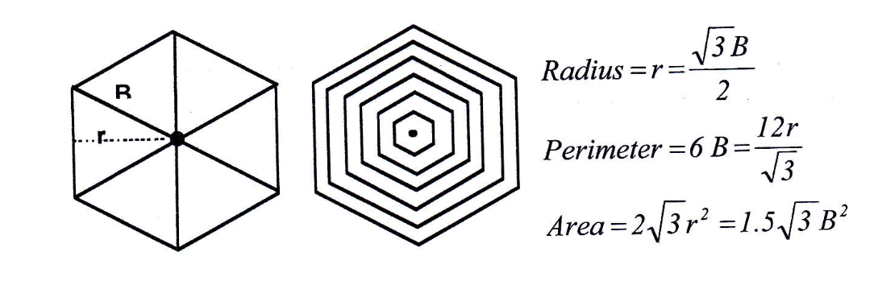
Distribution cost per unit of service
Shape of market area: it is of very little consequence for the present analysis whether circular, square or hexagonal market areas are assumed as long as the density of demand is constant over space
Hexagonal market area
B is base of each triangle
Source: Figure 4.4 in Jansson (2013), P.62

Slide 31
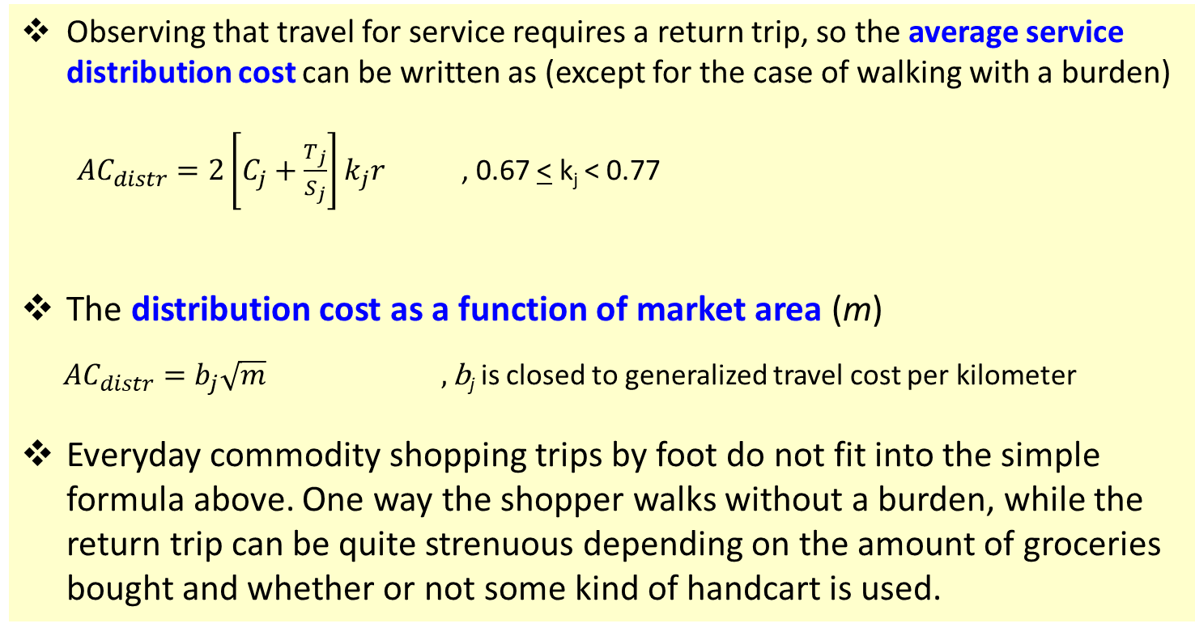
Source: Jansson (2013), Chapter 4
Distribution cost: Hexagonal market area
Observing that travel for service requires a return trip, so the average service distribution cost can be written as (except for the case of walking with a burden)
${AC}_{distr}=2\left[C_{j}+\frac{T_{j}}{S_{j}}\right]k_{j}r$ , 0.67 < k_{j} < 0.77
The distribution cost as a function of market area (m)
${AC}_{distr}=b_{j}\sqrt{m} ,\text{b}\text{j}$ is closed to generalized travel cost per kilometer
Everyday commodity shopping trips by foot do not fit into the simple formula above. One way the shopper walks without a burden, while the return trip can be quite strenuous depending on the amount of groceries bought and whether or not some kind of handcart is used.
j = different modes of transport
C_{j} = vehicle cost per km
T_{j} = Time cost
S_{j} = speed

Slide 32
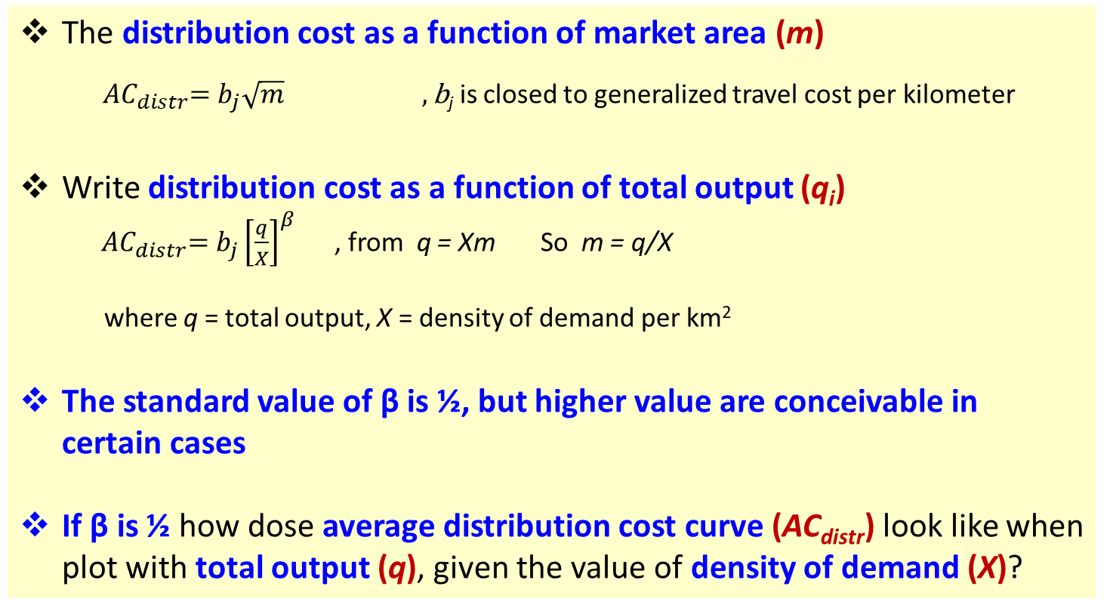
Source: Jansson (2013), Chapter 4
Distribution cost: Hexagonal market area
The distribution cost as a function of market area (m)
${ AC}_{distr}=b_{j}\sqrt{m} ,\text{b}\text{j}$ is closed to generalized travel cost per kilometer
Write distribution cost as a function of total output (q_{i})
${ AC}_{distr}=b_{j}{\left[\frac{q}{X}\right]}^{β}$ , from q = Xm So m = q/X
where q = total output, X = density of demand per km²
The standard value of β is ½, but higher value are conceivable in certain cases
If β is ½ how dose average distribution cost curve (AC_{distr}) look like when plot with total output (q), given the value of density of demand (X)?

Slide 33
Parameter values in the distribution cost function
MODE of travel | Vehicle cost (C), €/km | Value of time (T), €/h | Speed (S), km/h | Geometric constant (k) | b
Walking within walking distance | - | 9 | 5 | 0.72 | 1.4
Cycling within cycling distance | - | 6 | 15 | 0.72 | 0.3
Car driving for private purpose in urban area | 0.3 | 5 | 40 | 0.77 | 0.4
Car driving on business in urban area | 0.3 | 20 | 40 | 0.77 | 0.7
Long-distance car driving for private purpose | 0.2 | 10 | 85 | 0.77 | 0.3
Source: Table 4.1 in Jansson (2013), P.64, original data from SIKA (2008) and traffic planning rules-of-thumb

Slide 34
Source: Jansson (2013), Chapter 4
Optimal market area
Earlier we learned about production and cost functions of individual service provider
  production cost function f(q)
  distribution cost function g(m)
Now we try to combine these two cost functions and examine the result of basic trade-off to determine the optimal market area of a particular service producer.
Market area is the central concept of spatial economics and typically left out of consideration in mainstream economics, where instead the market form in the sense of competitive conditions in different industries is fundamental
In this part, we focus on the concept of market areas. It is explained why the sizes of market areas of different service providers are systematically very different.

Slide 35
Source: Jansson (2013), Chapter 5
Optimal market area
Assumptions (Fundamental model)
A particular country is divided into a number of regions, such that each region can be assumed to have a reasonably uniform population density
There are densely populated, mainly urban areas, and there are more or less sparsely populated regions.
One region is now considered a possible market to be supplied with a particular service.
Start from a situation in which there is no supply at all of this service in the region concerned, and take the point of view of a producer considering the establishment of a single plant.
Relevant questions are
  What production capacity should be chosen and
  How large market area should be covered in the distribution to minimize the sum of the average production and distribution costs.
If the whole region is to be supplied with the service concerned similar plants should be established in the middle of market areas of the same size until the total area of the region concerned is covered

Slide 36
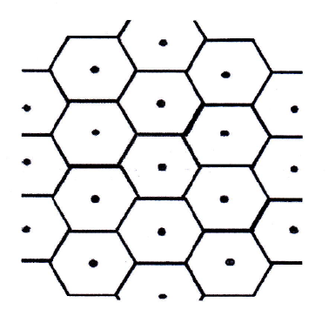
Slice of a service-supply system in a uniformly populated region
Source: Figure 5.1 in Jansson (2013), P.68

Slide 37
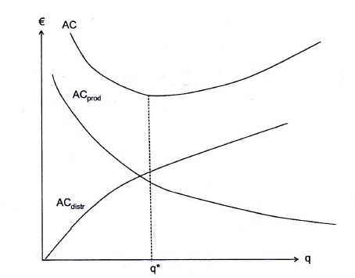
The basic trade-off between the production and distribution costs
Source: Figure 5.2 in Jansson (2013), P.69

Slide 38
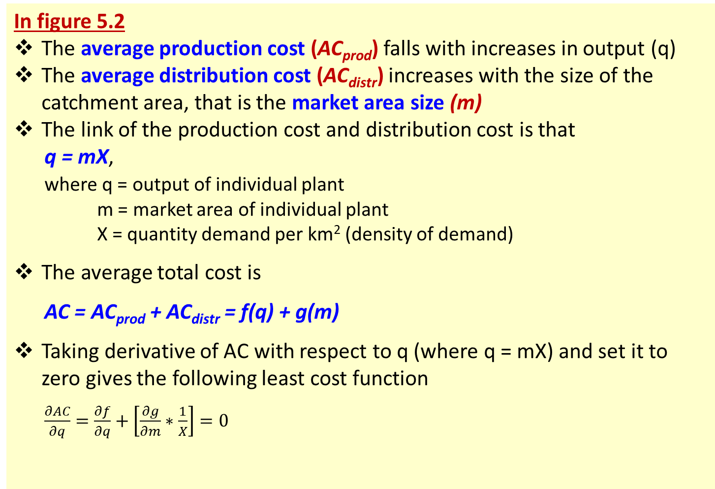
Source: Jansson (2013), Chapter 5
Optimal market area
In figure 5.2
The average production cost (AC_{prod}) falls with increases in output (q)
The average distribution cost (AC_{distr}) increases with the size of the catchment area, that is the market area size (m)
The link of the production cost and distribution cost is that
q = mX,
where q = output of individual plant
m = market area of individual plant
X = quantity demand per km² (density of demand)
The average total cost is
AC = AC_{prod} + AC_{distr} = f(q) + g(m)
Taking derivative of AC with respect to q (where q = mX) and set it to zero gives the following least cost function
$\frac{∂AC}{∂q}=\frac{∂f}{∂q}+\left[\frac{∂g}{∂m}∗\frac{1}{X}\right]=0$

Slide 39
Source: Jansson (2013), Chapter 5
Optimal market area (catchment areas for public service providers)
In a welfare state (like Sweden)
  a majority of the total service consumption is tax-financed
  These services are provided free of charge
  Therefore, it is natural to regard X (density of demand or quantity demand per km²) as given, and just consider the number of plants in the service supply-systems that minimizes the total production and distribution costs of given level of demand.
It is quite interesting that the average market area size is widely different between service sub-sectors
  Typical neighborhood services: e. g. nurseries, primary school and public health centers.
  City district level: e.g. high school, a sports ground and a public swimming pool
  City level: e.g. municipal library, a theatre and various local authorities rendering different services to the citizens, and some cases a university
  County wide market area: e.g. big hospitals with a comprehensive range of facilities.
  National level: e.g. major museums, the opera, the national theatre, the supreme court (typically located in the capital)

Slide 40
Source: Jansson (2013), Chapter 5
Optimal market area (catchment areas for public service providers)
Why average market area size is widely different between service sub-sectors?
  Jurisdiction: the reception areas of schools, health care centers, and so on should be confined to the administrative areas of the financing body (such as different municipalities, countries, or state)
  Based on model of the production and distribution cost trade-off (explained in the next slides)

Slide 41

Source: Jansson (2013), Chapter 4
Distribution cost: Hexagonal market area
Observing that travel for service requires a return trip, so the average service distribution cost can be written as (except for the case of walking with a burden)
${AC}_{distr}=2\left[C_{j}+\frac{T_{j}}{S_{j}}\right]k_{j}r$ , 0.67 < k_{j} < 0.77
The distribution cost as a function of market area (m)
${AC}_{distr}=b_{j}\sqrt{m} ,\text{b}\text{j}$ is closed to generalized travel cost per kilometer
Everyday commodity shopping trips by foot do not fit into the simple formula above. One way the shopper walks without a burden, while the return trip can be quite strenuous depending on the amount of groceries bought and whether or not some kind of handcart is used.
j = different modes of transport
C_{j} = vehicle cost per km
T_{j} = Time cost
S_{j} = speed

Slide 42
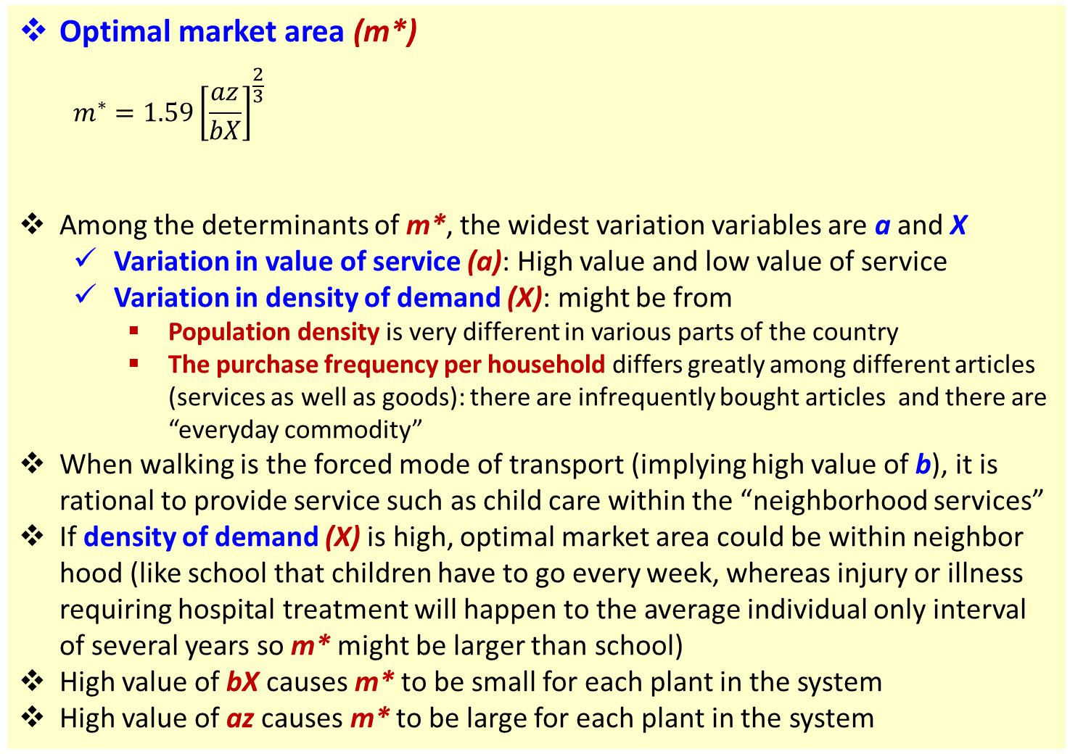
Source: Jansson (2013), Chapter 5
Optimal market area (catchment areas for public service providers)
Optimal market area (m*)
  $$m^{∗}=1.59{\left[\frac{az}{bX}\right]}^{\frac{2}{3}}$$
Among the determinants of m*, the widest variation variables are a and X
  Variation in value of service (a): High value and low value of service
  Variation in density of demand (X): might be from
    Population density is very different in various parts of the country
    The purchase frequency per household differs greatly among different articles (services as well as goods): there are infrequently bought articles and there are “everyday commodity”
When walking is the forced mode of transport (implying high value of b), it is rational to provide service such as child care within the “neighborhood services”
If density of demand (X) is high, optimal market area could be within neighbor hood (like school that children have to go every week, whereas injury or illness requiring hospital treatment will happen to the average individual only interval of several years so m* might be larger than school)
High value of bX causes m* to be small for each plant in the system
High value of az causes m* to be large for each plant in the system
a = unit value of service
z = the plant size economies
b = mode-specific travel cost indicator
x = density of demand
m = market area

Slide 43
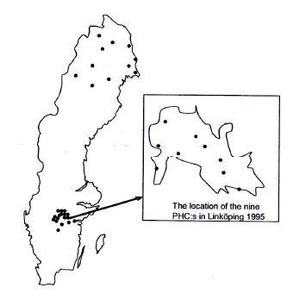
The location of public health centres (PHCs) in different parts of Sweden.
Supply system in the case of PHCs in three areas of different parts of Sweden
The sparsely populated, most northerly region of Sweden (county of Norrbotten)
The relatively densely populated county of Östergötland
The built-up area of Linköping, the chief town of Östergötland
Compared to Norrbotten,
  the density of demand of Östergötland is 17 times higher
  the density of demand of Linköping is 747 times higher
Compared to Linköping
  the average travel distance for PHC patients in Östergötland is 4 times longer
  the average travel distance for PHC patients in Norrbotten is 25 times longer
Source: Figure 5.3 in Jansson (2013), P.72

Slide 44
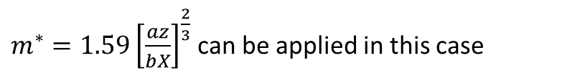
Catchment areas of Public Health Centres.
District | Density of demand: annual number of patients/km² | Average catchment area, km²
 |  | actual | Model estimated
(1) The county of Norrbotten | 4 | 7855 | 9503
(2) The county of Östergötland | 67 | 485 | 499
(3) The town of Linköping | 2986 | 13 | 17
$m^{∗}=1.59{\left[\frac{az}{bX}\right]}^{\frac{2}{3}}$ can be applied in this case
Source: Table 5.1 in Jansson (2013), P.73, original source from Wall (2001)

Slide 45
Source: Jansson (2013), Chapter 5
Market areas of private service provider
Optimal market areas could be found based on three approaches
  Supply system cost-minimization
  Chamberlinian monopolistic competition
  Clustering

Slide 46
Source: http://papers.ssrn.com/sol3/papers.cfm?abstract_id=730523
Chamberlinian Monopolistic Competition Model
Every one of the firms have some monopoly power, but entry drives monopoly profits to zero.
The concept gets its name from Edward Chamberlin
Example Chamberlinian monopolistic competition: Book market
  A publisher has a factual monopoly over certain titles via intellectual property rights.
  However, this doesn't lead to high monopoly profits on any particular titles as close substitutes still remain. A best-seller cookbook for Asian cuisine still competes with other cookbooks about Asian cuisine as well as the whole cookbook genre

Slide 47
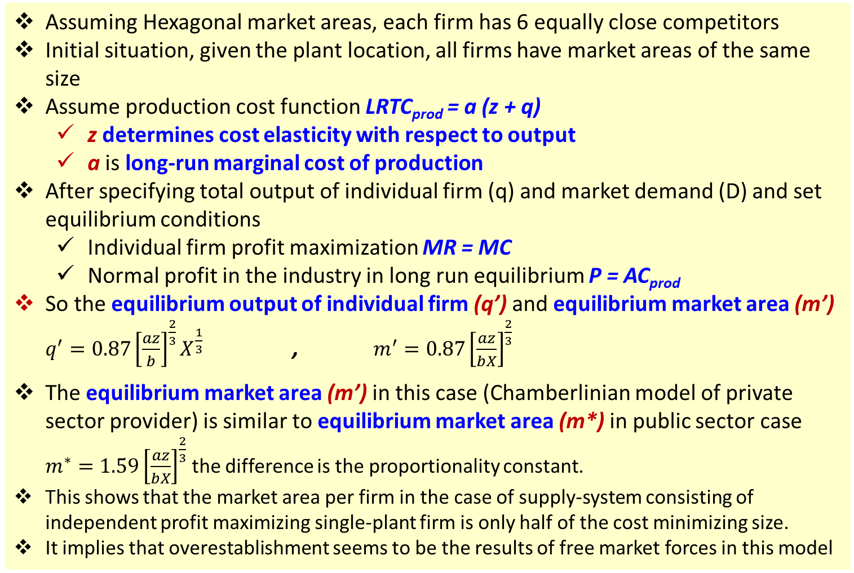
Source: Jansson (2013), Chapter 5
Chamberlinian model of the spatial industrial organization
Assuming Hexagonal market areas, each firm has 6 equally close competitors
Initial situation, given the plant location, all firms have market areas of the same size
Assume production cost function LRTC_{prod} = a (z + q)
  z determines cost elasticity with respect to output
  a is long-run marginal cost of production
After specifying total output of individual firm (q) and market demand (D) and set equilibrium conditions
  Individual firm profit maximization MR = MC
  Normal profit in the industry in long run equilibrium P = AC_{prod}
So the equilibrium output of individual firm (q’) and equilibrium market area (m’) $q^{′}=0.87{\left[\frac{az}{b}\right]}^{\frac{2}{3}}X^{\frac{1}{3}}$ , $m^{′}=0.87{\left[\frac{az}{bX}\right]}^{\frac{2}{3}}$
The equilibrium market area (m’) in this case (Chamberlinian model of private sector provider) is similar to equilibrium market area (m*) in public sector case $m^{∗}=1.59{\left[\frac{az}{bX}\right]}^{\frac{2}{3}}$ the difference is the proportionality constant.
This shows that the market area per firm in the case of supply-system consisting of independent profit maximizing single-plant firm is only half of the cost minimizing size.
It implies that overestablishment seems to be the results of free market forces in this model

Slide 48
Source: Jansson (2013), Chapter 5
The costs of clustering
The concept of “agglomeration benefits”
The observed concentrations of firms/plants in some new industries
Clusters are normally formed by producer service firms.
In the case of consumer services where agglomeration benefits can be assumed to be negligible.
The basic trade-off model,
  the question is “if the total costs, including all of the user efforts, were substantially higher in a cluster than with an evenly dispersed pattern of plant location, the latter pattern tends to arise”
  A comparison of the average total cost of an even dispersal of plants of an industry and a cluster of firms’ plant
The simple model’s assumptions
  It is assumed that customers are evenly spread over space
  The transportation cost per kilometer is the same everywhere
  We start from the cost-minimizing pattern of location, where each firm/plant has a market area of its own. Then we take 5 plants and put them in the middle of the total area covered by those five.
Sensitivity analysis shows that
  The unit value (a) and the demand density (X) are the most important factors

Slide 49
Relative additional cost (percentage) of a cluster of five compared to a total cost-minimizing dispersal of plants
Unit value proxy, a | Demand density, X
 | 1 | 10 | 100 | 1000 | 10000
1 | 117 | 110 | 98 | 80 | 57
10 | 98 | 80 | 57 | 35 | 19
100 | 57 | 35 | 19 | 10 | 6
1000 | 19 | 10 | 6 | 2 | 1
10000 | 6 | 2 | 1 | 0 | 0
Source: Table 5.2 in Jansson (2013), P.78
Note:
The table shows the relative cost additions for a wide range of unit value (a) and the demand density (X)
The calculation assume general travel by car, and total cost elasticity with respect to output or the plant size economies variable (z) is set as 5, value from previous research

Slide 50
Source: Jansson (2013), Chapter 5
The costs of clustering
From Table 5.2: interesting points are
It is striking how difference the figures are in the upper left and the lower right parts.
It does not matter very much if a number of providers of very high-value service (high value of a) are located in the same street in a densely populated town or city.
On the other hand, it is obvious that it would be very cost inefficient to allow a considerable number of low-value service providers in a more sparsely populated area to form a cluster

Slide 51
3. Supply and demand at the system level
When we learn about supply of service we talk about
  Average production cost function f(q) ,q is quantity of service
  Average distribution costs of the circle of consumers provided for by a representative service producer g(m), m is market area of a service provider
  The system analysis required for considerable trade-off between production and distribution costs, optimal market areas by assuming a constant density of demand (X)
In this part we will relax the constant density of demand assumption and look at
  The system cost function
  The system demand function
  Market equilibrium

Slide 52
Source: Jansson (2013), Chapter 7
The system cost function
The purpose of this section is to derive a long-run (total adjustment) system cost function
The production and distribution cost trade-off is the core of this derivation
Now, the density of demand (X), which kept constant in the previous discussion, is the central variable and determinant of the system cost

Slide 53
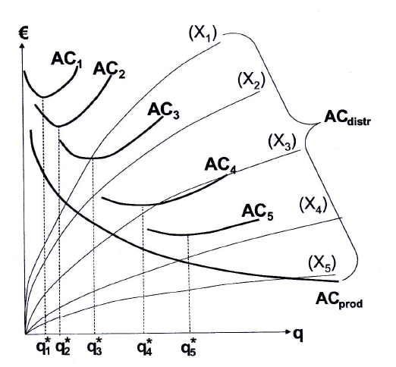
The production and distribution cost trade-off with respect to plant output for achieving the minimum average total cost for different values of the demand density (X_{i})
Source: Figure 7.1 in Jansson (2013), P. 91

Slide 54
Source: Jansson (2013), Chapter 7
The system cost function
Based on Figure 7.1 in Jansson (2013),
The figure shows how to move from the costs of an individual plant to the system cost level
It is not the regional demand that matters but the density of demand (X)
The figure shows a bundle of AC_{distr} curves, each associated to a particular level of the density of demand (X)
The higher the value of X the lower the distribution cost per unit. So the AC_{distr} successively falling as X increasing (from X₁ to X₂, X₃, X₄, X₅)
The AC_{distr} have a shape that follows from assuming that the trip cost is proportional to distance
Where the slope of a particular distribution cost curve is equal to the absolute value of the slope of AC_{prod}, the cost-minimizing plant output (q*) is found for that particular demand density (X)
Note: The last point is from when we learned about basic trade-off between
average production cost and average distribution cost (explanation of
Figure 5.2 and relevant equations in Jansson (2013), chapter 5

Slide 55
Source: Jansson (2013), Chapter 7
The system cost function
Generalised Costs
In general, system cost is the sum of the producer costs and user costs
The users normally have to go to the place of production to get service, so far from what we learned this was called “distribution”
The cost to the user of taking possession of non-transportable goods consequently includes both the ordinary price charged by the producer at the place of production and the distribution cost borne by the user.
A corresponding complementary addition must be added to the demand side. This is standard procedure in transport economics, where “generalized cost” replaces price as the main argument in the demand function.
Generalised cost function is
GC = P + AC_{distr} + c
C is other possible user cost item that should be included in the generalized cost in supply and demand analysis of non-storable and non-transportable goods
  For this kind of good, production and consumption must be done not only at the same place but also simultaneously, which means consumer must sacrifice their time in the production → consumer time cost
  However, for now we ignore c by assuming that c is a constant which does not affect the basic producer and user cost trade-off

Slide 56
Source: Jansson (2013), Chapter 7
The system demand function
The demand function that matches the system supply function is that the dependent variable should be the density of demand (X), the quantity of demand per km². As long as it can be assumed that the uniformly populated region in question is large enough to house a fair number of plants/firms
P.S. If the region concerned is a limited urban area, the appropriate
demand function can be defined to represent the whole town, and
the dependent variable (Q) stands for the demand of all people in
the whole town
The idea is that the result of the interplay of supply and demand in a particular region of uniform population density results in the same price charged and quantity produced at all plants in the region, and the focus is on the demand density

Slide 57
Source: Jansson (2013), Chapter 7
The system of demand function
A product of two factors
Now we explicitly specify the market demand function at the system level as a products of two factors
X_{i} = h(GC) * D_{i}
X_{i} = demand for a particular product per km² in region I
h(GC) = demand of the representative consumer
D_{i} = density of population in region i
In a national perspective, the demand of a representative consumer can be assumed to be the same for each particular product all over the country, while the population density obviously displays a very wide variation
For the choice of production plant capacity in the case of most transportable goods these extreme wide variations are relatively inconsequential because of low transport costs, but certainly a main concern for providing non-transportable goods

Slide 58
Source: Jansson (2013), Chapter 7
Market equilibrium
Based on Figure 7.2 in Jansson (2013)
Demand function and demand curve
From Demand function or density of demand (X) is from multiplying the individual demand by the population density
X_{i} = h(GC) * D_{i}
X_{i} = demand for a particular product per km² in region I
h(GC) = demand of the representative consumer
D_{i} = density of population in region i
  This means that the slope of the demand functions becomes successively flatter the higher the population density
    Non-urban regions represented by the three steep demand functions (X₁, X₂, and X₃)
    An urban region represented by the flatter demand function (X_{n})
  It is the individual demand of representative consumer that determines the elasticity of demand function of each particular region

Slide 59
Source: Jansson (2013), Chapter 7
Market equilibrium
Based on Figure 7.2 in Jansson (2013)
Demand function and demand curve
It can be assumed that each regional demand has the same starting point at the GC-axis called “reservation GC” such as the cost of a taxi trip of the same length if we consider demand and supply of local bus transport
In an actual case study of a particular region, just one regional demand is applicable. The regional demand must not be aggregated for matching the supply curve (for the study of the D&S of bus transport service, it would not make sense because the demand for local bus transport in one part of town cannot be satisfied by local bus transport in another part, let alone in another town)

Slide 60
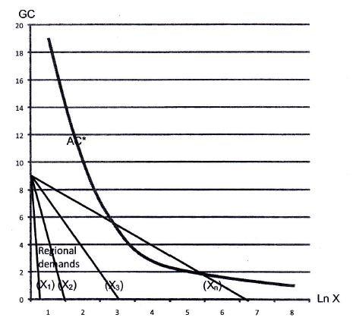
Typical supply and demand constellation for non-transportable goods in regions of different population density.
Source: Figure 7.2 in Jansson (2013), P. 99

Slide 61
Source: Jansson (2013), Chapter 7
Market equilibrium
Based on Figure 7.2 in Jansson (2013)
The system cost function and the AC-curve
The AC-curve is a constant-elastic average system cost function (representing a local bus transport system estimated in Jansson et al. (2013).
The system cost function can be assumed to be applicable everywhere, but it is just that different sections of the function would be relevant for different regions depending on the actual density of demand (X)

Slide 62
Source: Jansson (2013), Chapter 7
Market equilibrium
Based on Figure 7.2 in Jansson (2013)
Market equilibrium
Market equilibrium could be obtained where a regional demand curve and the supply curve intersect or at least tangent to each other
In Figure 7.2, it is only one demand curve in the bunch of regional demands that the requirement for equilibrium is met
This means to suggest that many regions in the sparsely populated parts of Sweden lack local bus transport altogether. Only the urban demand curve gives rise to a viable market.

Slide 63
Source: Jansson (2013), Chapter 7
Market equilibrium
The crucial difference
The difference between graph for non-transportable goods (Figure 7.2) and the structure of supply and demand of easily transportable goods
The easily transportable good case,
  The quantity along the horizontal axis does not represent density of demand (X) but the total demand facing the whole industry concerned (Q) which is a function of P since the distribution cost, including the cost of transport to wholesalers and retailers, is internalized in the producer’s total costs.
  The industry demand is the aggregate of all the regional demand functions
  The long-run AC curve can be assumed to be horizontal (constant) because it represents the plane section of a U-shaped curve of one or more producers operating at the minimum cost level
The non-transportable case (in Figure 7.2)
  The quantity along the horizonal axis is the density of demand (X)
  The regional demand is expressed as demand densities which cannot be added. Each local market must be dealt with one by one

Slide 64
2. Demand for services
Motive analysis of demand
Demand for service consumption and its income elasticity
Intermediate demand for service
  Reading: Zhou (2016) chapter 4

Slide 65
Source: Zhou (2016), Chapter 4
Demand for service consumption and its income elasticity
Factors that might affect demand for service consumption (macro level)
For example

Slide 66
Demand for service consumption and its income elasticity
Income elasticity of demand
Lower income groups have ________elasticity of demand for basic necessities
Higher income groups would consider durable consumer goods and services.
According Maslow’s hierarchy of needs and Engel’s law,
  When income level is relatively low, most of consumer spending goes to food, clothing, shelter and other basic needs.
  As income level rises, people spend more in meeting needs for security, social interaction, earning respect, self-realization, etc. These needs are mostly based on services.
  So it is possible that the proportion of service in consumer spending will increase as income rises
Note: Maslow’s hierarchy of needs:
  Maslow categorized people’s needs into “physiological”, “safety”, “belongingness” and “love”, “esteem” and “self-actualization” ascending like hierarchy, a developmental process from lower to higher levels.
  Maslow distinguishes the different layers of demand, but not distinguish between product demand and service demand
Source: Zhou (2016), Chapter 4

Slide 67
Demand for service consumption and its income elasticity
Income elasticity of demand
Note: Engel’s law
  an observation in economics stating that as income rises, the proportion of income spent on food falls, even if absolute expenditure on food rises. In other words, the income elasticity of demand of food is between 0 and 1.
  The law was named after the statistician Ernst Engels (1821–1896).
Like product, service consumption of the same kind may have different layers of demand. Example??
Source: Zhou (2016), Chapter 4

Slide 68
Demand for service consumption and its income elasticity
Income elasticity of demand for service
To analyze income elasticity of demand for service, Zhou (2016) modified the categorization of people’s needs to “basic necessity”, “improvement”, “well-off”, “affluent” and “advanced” from low to high; at the same time, further differentiating product-based material needs and service-based non-material needs.
Zhou (2016) makes 4 assumptions
  Hypothesis 1: When product and service are in parallel levels of needs, their income elasticity will be basically the same; when the two are in different levels of needs, there will be visible differences in their income elasticity.
  Hypothesis 2: For both product and service, their primary needs have relatively low income elasticity while their secondary needs have relatively high income elasticity; so the higher the level of needs is, the higher the income elasticity is.
  Hypothesis 3: On any level of needs, product and service, in terms of types and sizes of demand, each has its own specific composition; corresponding to different level of needs, product and service, in terms of types and sizes of demand, are different.
  Hypothesis 4: In the composition of types and sizes of demand, the ratio of service demand increases geometrically as the level of needs advances; the ratio of product demand decreases geometrically as the level of needs reduces.
Source: Zhou (2016), Chapter 4

Slide 69
The hierarchy and structure of needs for product and service consumption
Source: Figure 4.1 in Zhou (2016)
According to Zhou (2016),
As the level of needs advances, types and sizes of product demand tend to decrease demonstrating a pyramidal structure, while those of service demand tend to increase demonstrating an inverted pyramidal structure.
The higher the level of needs, the higher the income elasticity.
As the level of needs goes up, the service demand ratio on the basis of the gradual increase of income elasticity will increase geometrically and will gradually play a dominant role in consumption demand.
Conclusion: As the income level increases and the level of needs goes up, types and sizes of service demand continuously extend and have higher income elasticity, which means that people’s consumption demand leans towards service and service with higher income elasticity, causing the proportion of service industry to rise and promoting economic development.

Slide 70
Intermediate demand for service
Final demand for service always plays a dominant role in the aggregate demand for service and an important role in promoting the development of the service
However, the growth of income-based final demand for service, especially consumer demand is comparatively steady, approximately at a uniform speed, despite some fluctuations when certain spending spree rises.
In the circumstances of insignificant changes in consumptive demand structure, the accelerated development of the service industry is mainly promoted by rapid increase of intermediate demand for service.
As production systems, production factors and production links change, service activities penetrate into every part of the production links and complement with commodities in the industrial process, which makes the intermediate demand for service the most dynamic and the fastest-growing demand and renders service output a crucial factor in the economic development and operation and gives it a gradually prominent status in the service economy.
Source: Zhou (2016), Chapter 4

Slide 71
Intermediate demand for service
Factors that might affect intermediate demand for service (macro level)
Specialization of social production and technological advancement: in both manufacturing and service sectors
  In manufacturing, due to the development of the complexity and diversity of material production and the specialized division of labor in production, some service functions separate themselves from manufacturing to form independent producer services.
  As the sizes of the service industry grows, the intermediate demand for service between sectors within the service industry will increase, developing a powerful reproductive capacity in the service economy.
Level of economic development (income)?:
  In the agricultural era, the specialization of social production was low. When the industrial era came, with the development of roundabout production, the specialization of social production gradually enhanced and even suggested an accelerated feature. According to this logic, the intermediate demand for service derived from the specialization of social production is ultimately determined by the level of economic development (income level).
  However, it may not be appropriate to directly use the theory of income elasticity of demand to explain the growth of intermediate demand for service and the development of producer service.
Source: Zhou (2016), Chapter 4

Slide 72
Discussion
Do you think your group service industry is “consumer service” or “producer service” (In other words, it is related to “final demand for service” or “intermediate demand for service”)
What could be factors affect demand of your group service industry
How can you apply the concept of “hierarchy of needs of product and service consumption” to your group service industry.
Do you think your group service industry has high or low income elasticity of demand.

