Slide 1
☺Example ☺

Slide 2
Consumption-Income Relationship in the United States, 1960-2005
Y= personal consumption expenditure (PCE)
X= GDP
Both measured in 2000 billions of dollars

Slide 3
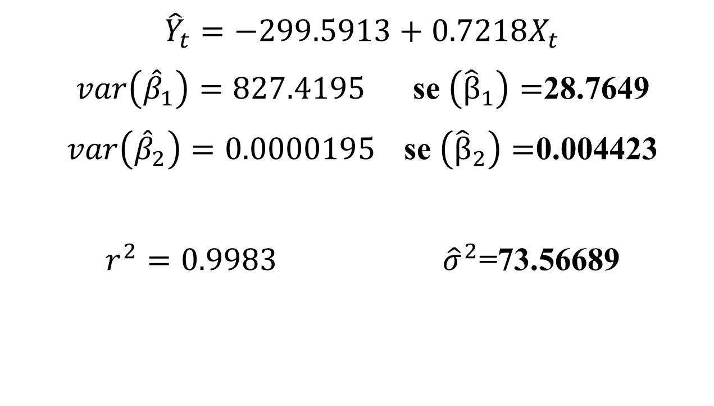
$${\hat{Y}}_{t}=−299.5913+0.7218X_{t}$$
$var\left({\hat{β}}_{1}\right)=827.4195$ se $\left({\hat{β}}_{1}\right)=$28.7649
$var\left({\hat{β}}_{2}\right)=0.0000195$ se $\left({\hat{β}}_{2}\right)=$0.004423
$r^{2}=0.9983$ ${\hat{σ}}^{2}$=73.56689

Slide 4
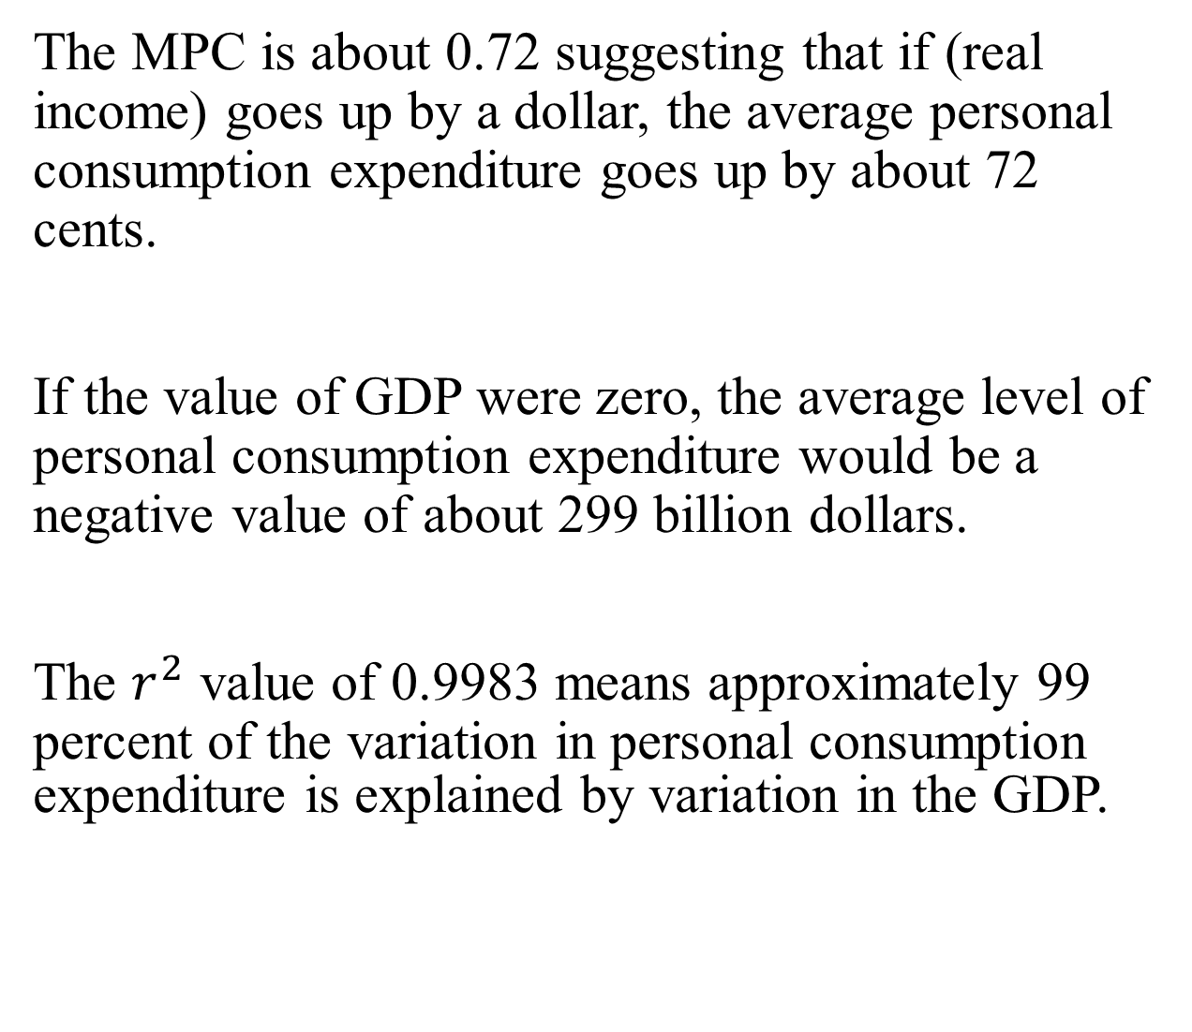
The MPC is about 0.72 suggesting that if (real income) goes up by a dollar, the average personal consumption expenditure goes up by about 72 cents.
If the value of GDP were zero, the average level of personal consumption expenditure would be a negative value of about 299 billion dollars.
The $r^{2}$ value of 0.9983 means approximately 99 percent of the variation in personal consumption expenditure is explained by variation in the GDP.

Slide 5
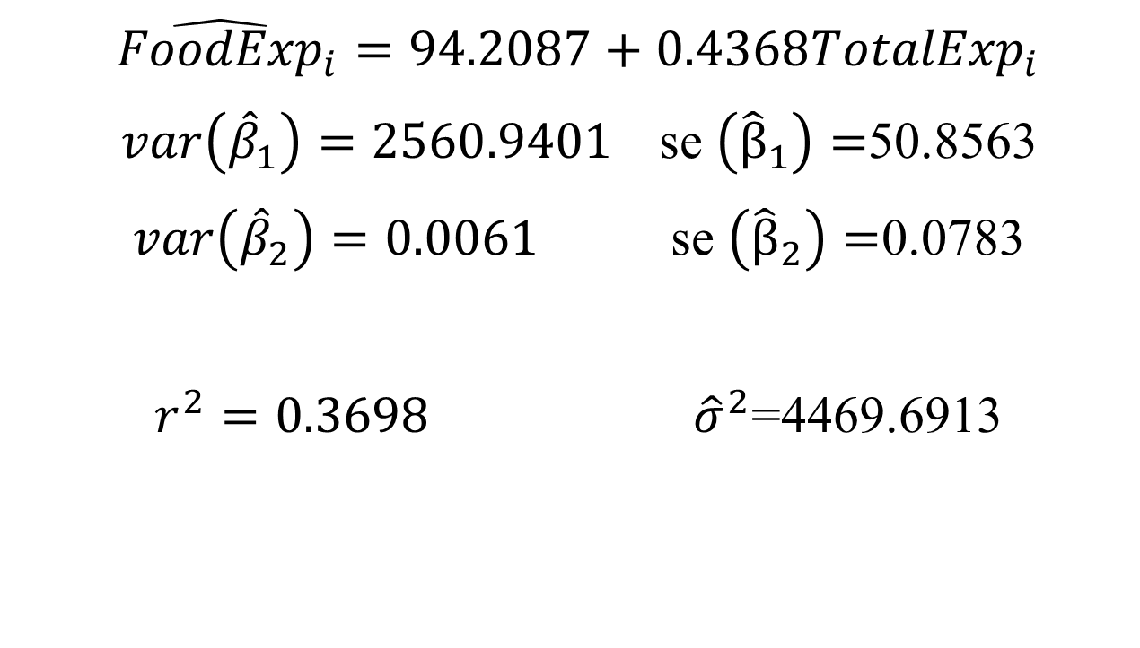
Food Expenditure in India
$${\hat{FoodExp}}_{i}=94.2087+0.4368{TotalExp}_{i}$$
$var\left({\hat{β}}_{1}\right)=2560.9401$ se $\left({\hat{β}}_{1}\right)=$50.8563
$var\left({\hat{β}}_{2}\right)=0.0061$ se $\left({\hat{β}}_{2}\right)=$0.0783
$r^{2}=0.3698$ ${\hat{σ}}^{2}$=4469.6913
Both figures in rupees

Slide 6
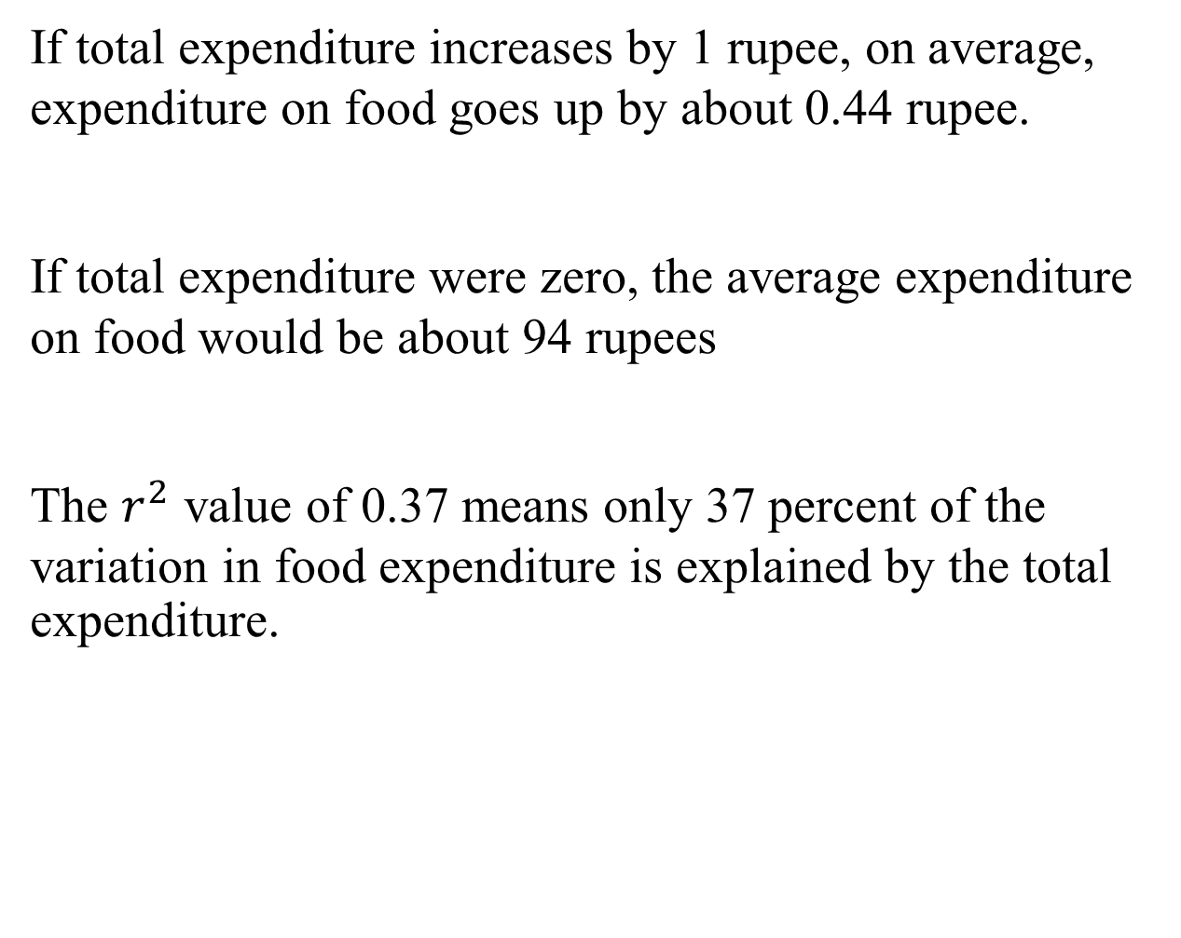
If total expenditure increases by 1 rupee, on average, expenditure on food goes up by about 0.44 rupee.
If total expenditure were zero, the average expenditure on food would be about 94 rupees
The $r^{2}$ value of 0.37 means only 37 percent of the variation in food expenditure is explained by the total expenditure.

Slide 7
Source
Gujarati, D.N. (2009) Basic Econometrics. 5th ed. Singapore, McGraw-Hill.

