Slide 1
FN 221: Personal Finance
Thanachote Rungsitivat, CFA, FRM

Slide 2
Consumer Credit
Credit is an arrangement to receive cash, goods, or services now and pay for them in the future
Consumer credit refers to the use of credit for personal needs (except a home mortgage) by individuals and families, in contrast to credit used for business purposes
In January, you pay a bill for electricity that you used in December.

Slide 3
Choices
Draw on savings
Use Present earnings
Borrow against expected future income
Each of these alternatives has trade-offs

Slide 4
Uses and Misuses of Credit
Using credit to purchase goods and services may allow consumers to be more efficient or more productive or to lead more satisfying lives
  Medical emergency may leave a person strapped for funds.
  It may be possible to buy an item now for less money than it will cost later.
  But it probably is not reasonable to borrow for everyday living expenses or finance a Mercedes Benz when an Eco-car is all your budget allows.
Using credit increases the amount of money a person can spend to purchase goods and services now. But the trade-offs is that it decreases the amount of money that will be available to spend in the future. However, many people expect their incomes to increase an therefore expect to be able to make payments on past credit purchases and still make new purchases.

Slide 5
Questions you should consider
Do I have the cash I need for the down payment?
Do I want to use my savings for this purchase?
Does the purchase fit my budget?
Could I use the credit I need for this purchase in some better way?
Could I postpone the purchase?
What are the opportunity costs of postponing the purchase (a possible increase in price?)
What are the dollar costs and the psychological costs of using credit (interest, other finance charges, being in debt, etc.)

Slide 6
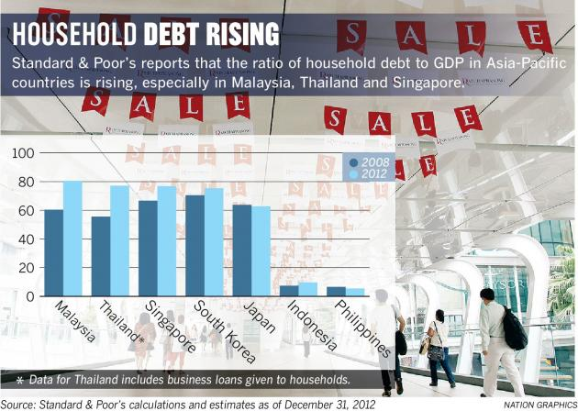
Economy

Slide 7
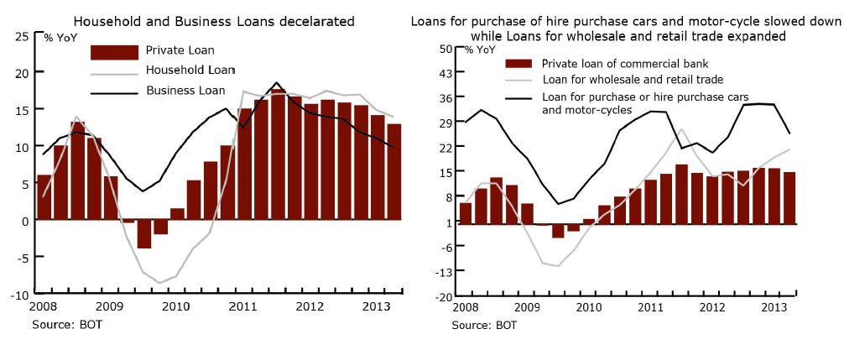
Thailand

Slide 8
Advantages of Credit
Consumer credit enables people to enjoy goods and services now
Credit card permit the purchase of goods even when funds are low.
Credit is more than a substitute for cash – many of the services it provides are taken for granted. Every time you turn on water tap, flick the light switch, use mobile phone – you are using credit.
It is safer to use credit – having credit card while travel rather than large sum of cash.
The use of credit cards can provide up to 45 days of float.
Benefits of credit card such as emergency services, fitness, discounts, etc.

Slide 9
Disadvantages of Credit
Temptation to overspend.
Failure to repay may result in loss of income, valuable property, reputation
Slower progress toward financial goals
It does not increase total purchasing power.
There is interest to it. Paying for purchases over a period of time is more costly than paying for them with cash. Be careful with compounding effect of interest on interest.

Slide 10
Types of Credit
Closed-End Credit
  Used for specific purpose and involves a specified amount (eg. Mortgage loans, Automobile loans, Installment loans)
  It usually involve a written agreement for each credit purchase. A down payment or trade-in may be required, with the balance to be repaid in equal monthly payments over a period of time. Generally, the seller holds title to the merchandise until the payments have been completed.
  Most common types of closed-end credit:
    Installment sales credit – make down payment and usually sign a contract to repay the balance plus interest and service charge in equal installments over a specific period
    Installment cash credit – direct loan of money for personal purposes – home improvements or vacation expenses. No down payment and make payments in specified amounts over a set period.
    Single lump-sum credit – a loan that must be repaid in total on a specific day.

Slide 11
Types of Credit
Open-End Credit
  Normally used to make small purchases at different store. Examples are credit card and overdraft lines.
  You can use open-end credit to make any purchases you wish if you do not exceed your line of credit – the maximum amount of credit the lender has made available to you.
  You may have to pay interest or other finance charges for the use/having of such credit.
    Credit card
    Smart Cards
    Debit Cards
    Gift Cards
    Travel/ Oil Card
    Home Equity Loans
    Car for Cash

Slide 12
Measuring Your Credit Capacity
You first need to make your budget
  Should include also the basic necessities such as rent, food, clothing
  Also spare some amount for other durable goods, such as new phones, etc if needed or maintenance of those goods.

Slide 13
Can you Afford a Loan?
Ask yourself
  Whether you can meet all of your essential expenses and still afford the monthly loan payments (including interest)
  What you plan to give up to make the monthly loan payment? Are you prepared to make this trade-off?

Slide 14
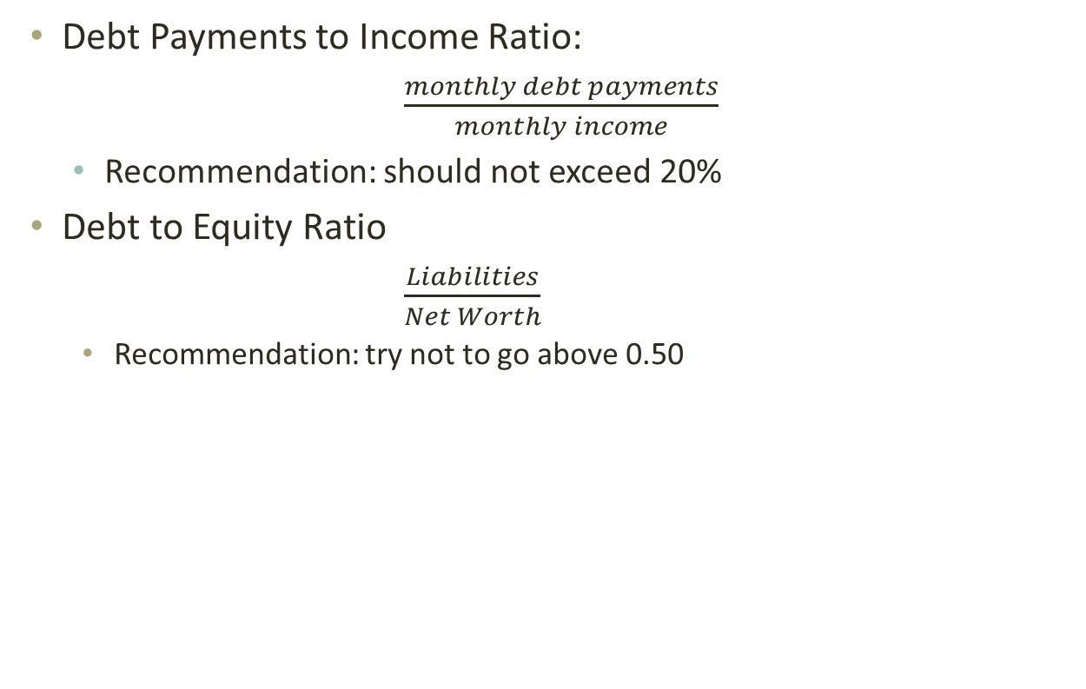
General Rules of Credit Capacity
Debt Payments to Income Ratio:
  $\frac{monthly debt payments}{monthly income}$
  Recommendation: should not exceed 20%
Debt to Equity Ratio
  $\frac{Liabilities}{Net Worth}$
    Recommendation: try not to go above 0.50

Slide 15
Cosigning a Loan
Think before you give an answer if someone asks you to cosign a loan
You are being asked to guarantee this debt. Think carefully before you do. If the borrower doesn’t pay the debt, you will have to. Be sure you can afford to pay if you have to, and that you want to accept this responsibility.
You may have to pay up to the full amount of the debt if the borrower does not pay. You may also have to pay late fees or collection costs, which increase this amount.

Slide 16
Building and Maintaining your Credit Rating
National Credit Bureau
  The concept to establish a credit data center started in 1961. The Thai Banker’s Association discussed with Bank of Thailand that there should be a center to exchange the data of the clients of commercial banks to reduce the risk of giving a loan and prevent the damages that may happen to commercial banks. Bank of Thailand was asked to be the center to gather all the data. Then Bank of Thailand has started the central credit registration since 1964. After that, it had continuously been developed until 1995, the government by the Ministry of Finance, Bank of Thailand, and the Securities and Exchange Commission, Thailand, made up a plan of financial system development together. It was about establishing the credit data center on the proportion of financial organizations that support the financial system development.

Slide 17
National Credit Bureau
The establishment of the credit data center was divided into 2 sections including a section set up by the Government Housing Bank that established Thai Credit Bureau Co., Ltd. and Bank of Thailand together with the Thai Banker’s Association established Central Information Services Co.,Ltd. Both companies were established with the same objective including being the center to gather clients’ data to help reduce the risk and increase the efficiency of giving loans and to prevent bad debt or non-performing loan problems in the economic system.

Slide 18
National Credit Bureau
In 2005 Central Credit Information Services Co., Ltd. merged the business with another credit data company, Thai Credit Bureau Co., Ltd. Central Credit Information Services Co., Ltd. had bought all the shares of Thai Credit Bureau Co., Ltd. and increased the capital to 250 million baht. The company name was changed to National Credit Bureau Co., Ltd. on May 19, 2005, of which shareholders include the shareholders of Thai Credit Bureau Co., Ltd. and banks as well as government financial institutes. The portion of the shareholders after the merger consists of Thai commercial banks hold the same portion of the shares totaling 24.5%, Business Online PCL. and TransUnion Inc. hold the same portion of 12.25% totaling 24.50%. The total of shares held by the shareholders of the former Central Credit Information Services Co., Ltd. are of 49%. The shareholders of Thailand Credit Data Co., Ltd. hold the portion of 30% including Government Housing Bank 15% and PCC Capital Co., Ltd.15%. The rest of another 21% are held by government financial institutes including Government Savings Bank, Dhipaya Insurance PCL., and Small and Medium Enterprise Development Bank of Thailand hold the share portions of 9%, 6% and 6% respectively.

Slide 19
National Credit Bureau
There are two reports: Consumer Credit report and Commercial Credit Report
Who provide such information?
  Banks and Specialized Financial Institutions
What do they provide?
  Credit Limit that they provide and if you make repayments on time
You are asked to get it (or the bank can get it for you) whenever you apply for credit from the bank

Slide 20
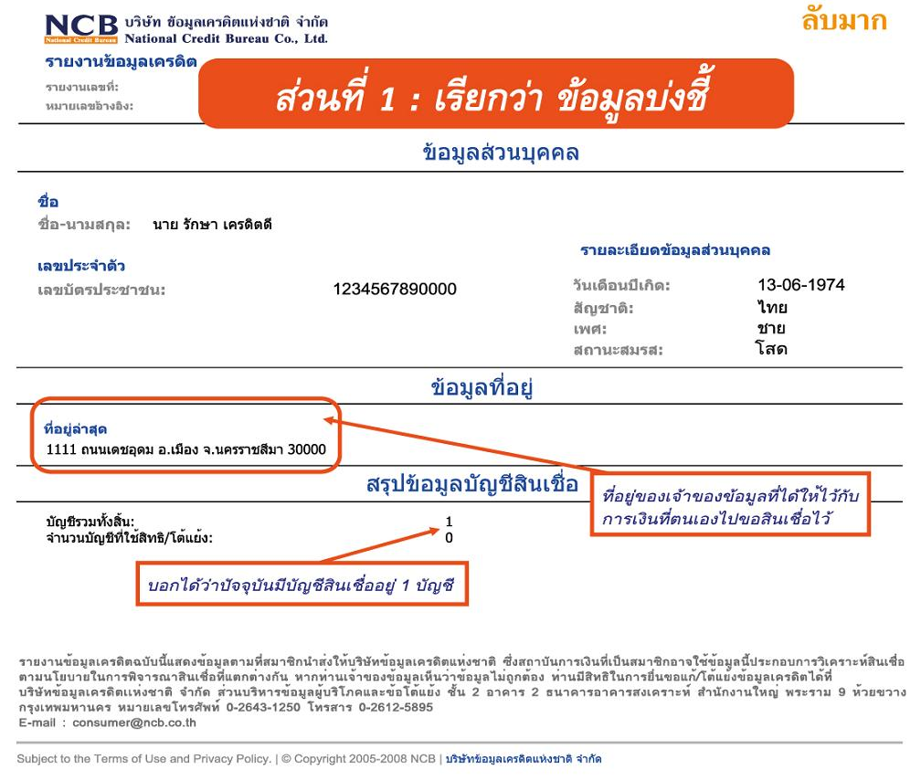
NCB Report

Slide 21
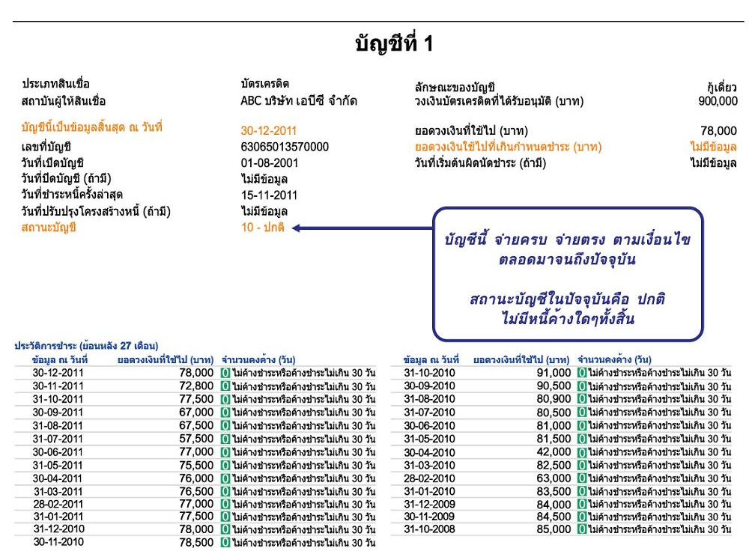
NCB Report

Slide 22
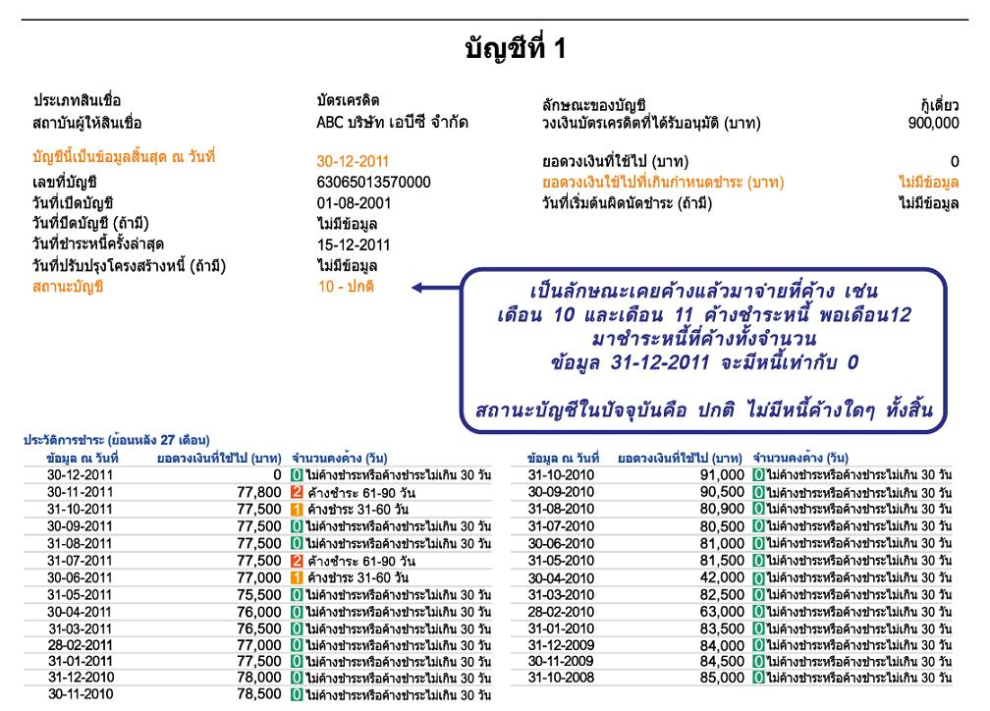
NCB Report

Slide 23
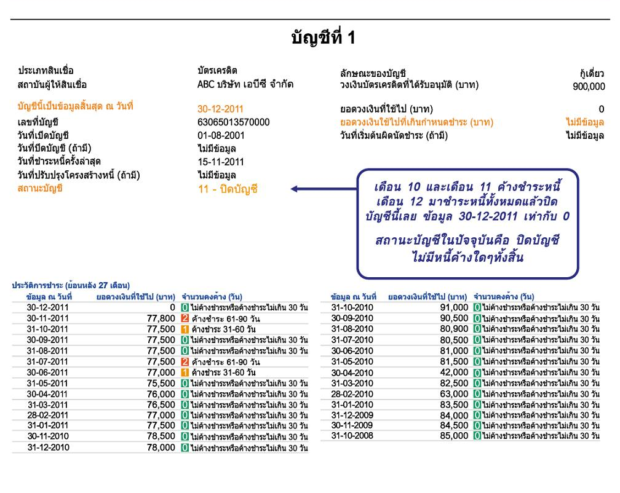
NCB Report

Slide 24
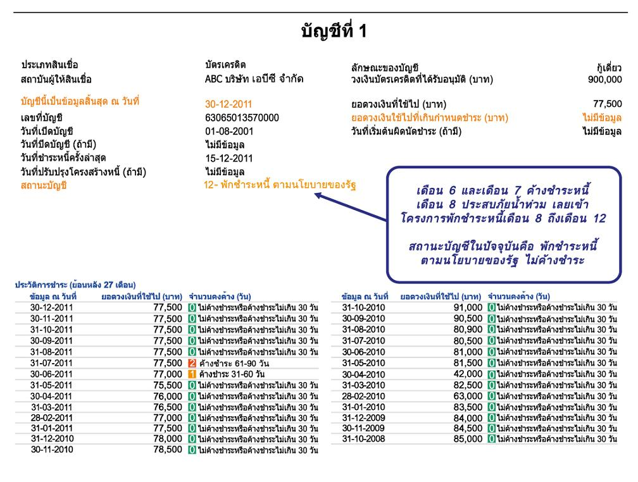
NCB Report

Slide 25
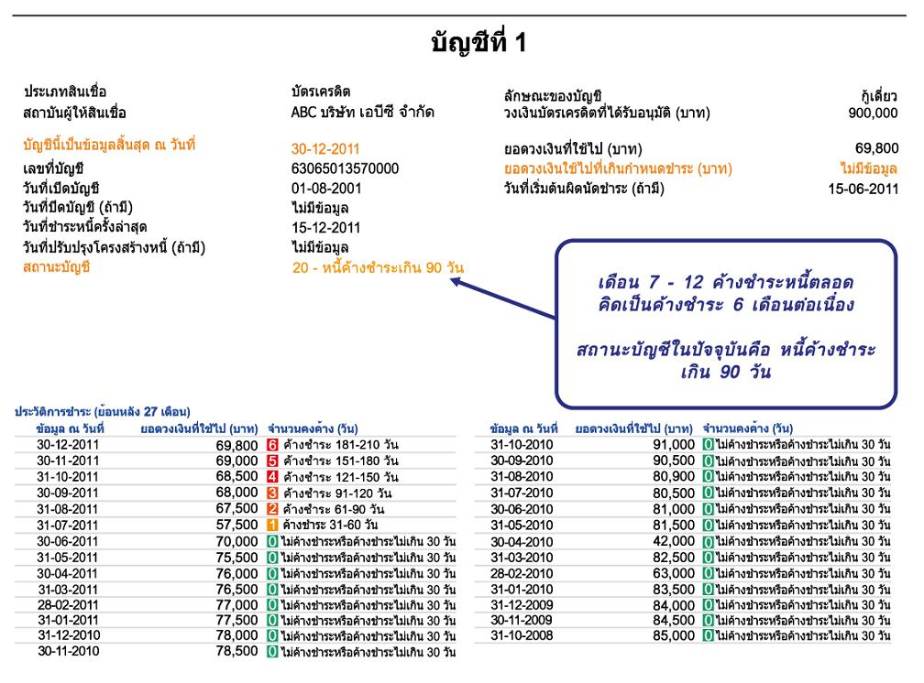
NCB Report

Slide 26
What Creditors Look for
Credit Rating (also using NCB Report as a guide)
Five Cs
  Character
    Borrower’s attitude toward credit obligations.
  Capacity
    Financial ability to meet the obligations (salary, statements, etc.)
  Capital
    Assets or Net worth
  Collateral
    Asset that you pledge to a financial institution to obtain a loan.
  Conditions
    General economic conditions that can affect your ability to repay a loan. (job security, etc.)

Slide 27
The situation
Jil brown is a little nervous about getting a credit card while she is still in college. She knows there re many people who have misused credit cards at her university. However, she decides to carefully weigh the advantages and disadvantages of having a credit card.
Notes: Jill brown is appropriately nervous about getting a credit card. If you do manage your credit wisely, your debt can quickly get out of control and cause added stress which can have adverse consequences on your financial health.

Slide 28
Advantages of credit
Advantages
  it enables Jill to enjoy goods and services now
  She may receive advance sale notices or other extras
  It may be easier for her to return merchandise
  It enables her to have shopping convenience and efficiency
  It is safer to use than carrying large amount of cash
  It provides a record of expenses
  Allows up to a 50 day float

Slide 29
Disadvantages of credit
Disadvantages
  The temptation to overspend
  Failure to pay can lead to loss of income, valuable property and Jill’s good reputation
  It can lead to long term financial problems
  It can damage family relation ships
  Does not increase total purchasing power
  Credit costs money

Slide 30
Type of Credit
Closed - End Credit
  Installment Sales Credit
  Installment Cash Credit
  Single Lump – Sum Credit
Open - End Credit
  Revolving Credit
  Incidental Credit

Slide 31
Installment Sales Credit
Jill purchases a used car and secures a loan from a bank where she makes payments of $450 per month over the next 36 months. Her payments include interest on the loan and partial payment of the principal on the loan.

Slide 32
Installment Cash Credit
Jill gets a $5,000 loan in cash from her bank. She plans on using the money for a summer vacation to Aruba. She will repay this loan in monthly payments of $430 over the next year.

Slide 33
Single Lump –Sum Credit
Jill’s mom purchases a new dinning room table and six chairs from a large furniture retailer. The cost of the furniture is $1,050. However, she decides to get a loan from he retailer that allows her to make one payment of $1,100 at the end of 90 days.

Slide 34
Revolving Credit
Jill’s brother, James, has a credit card with a line of credit of $10,000. Most months he uses it to charge about $500 in goods and services. He must make a minimum payment within 30 days of receiving the bill of $20. If he does not pay the entire balance, the he is charged interest at a rate of 19.5% compounded monthly.

Slide 35
Incidental Credit
James has a puppy named Brownie which requires frequent treatments at the vet’s office during the first year of his life. As a courtesy to James, his vet bills him once a month rather than making him pay for each visit separately.

Slide 36
Jill’s Cobranded Credit Card
Jill lovers to read and has applied for a Waldenbooks Visa card. She knows that she will get one $5 gift certificate to Waldenbooks for every $500 she puts on her credit card. She believes she sill be able to buy at least 5 free books a year with this credit card.

Slide 37
Can Jill Afford a loan?
Jill is thinking of taking out another small loan in order to purchase the new Apple iPad. She knows from her friend enrolled in the personal finance course that she needs to keep the following ratios in mind when applying for the loan.
Debt Payment to Income ratio:
Monthly debt payment (excluding house payment)/net monthly income
Debt to Equity ratio : total liabilities / net worth
In Jill’s case, case her debt to income ratio is 30%, and her debt to equity ratio is 8.

Slide 38
James Apples for a Loan
Character : his attitude towards credit obligations
Capacity : his financial ability to meet credit obligations
Capital : his assets and net worth
Collateral : A valuable asset pledged to ensure loan payments
Conditions : General economic conditions that affect his ability to repay a loan

Slide 39
Character
( Will you repay the loan?)
Does James pay his bills on time?
Has he used credit before?
Has he ever filed for bankruptcy?
Does he live within his means?
Does he own his own home?
How long has he lived at his current address?
How long has he been employed by his present employer?

Slide 40
Capacity
(Can you repay the loan?)
What is Jame’s job and what is his salary?
How reliable is that income?
Does he have any other sources of income?
How many dependents does he have?
What are the other claims on his income?
What are his current debts?

Slide 41
Capital
(What are your assets and net worth?)
James needs to list the value of all of his assets
James needs to list the value of all of his liabilities
James can then calculate his net worth

Slide 42
Collateral
(What if you don’t repay the loan?)
What assets can James use to secure the loan?
Do the assets used to secure the loan have any warranties/guarantees?
Do the assets used to secure the loan have sufficient insurance?
What is the age of the assets used to secure the loan?
Are there any claims to the title of the assets used to secure the loan?
What sources does he have besides income (savings, stocks, bonds, insurance, etc.)?

Slide 43
Conditions
(What general economic conditions can affect your repayment of the loan)?
How secure is Jame’s job?
How secure is the company that James works for?
What is the condition of the industry that James is employed in?

Slide 44
Thank you

