Slide 1
An Empirical Analysis of Cigarette Addition
By Gary S. BECKER, MICHAEL GROSSMAN,AND KEVIN M.MURPHY

Slide 2
Objective
To test a model of rational addiction, the paper examine whether lower past and future price for cigarettes raise current cigarette consumption.
To test whether the long-run elasticity of demand is almost twice as large as the short-run price elasticity.

Slide 3
Key difference of 2 models
Rational Model
Past consumption of some goods influences their current consumption by affecting the marginal utility of current and future consumption.
Cross price effects are negative and that long-run responses exceed short-run responses.
Myopic Model
Past consumption stimulate current consumption but individual ignore the future when making a consumption decision.
Past price has negative effect on current consumption but the implied that there is no effect on current price consumption.

Slide 4
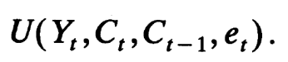
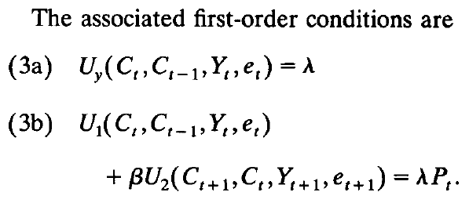
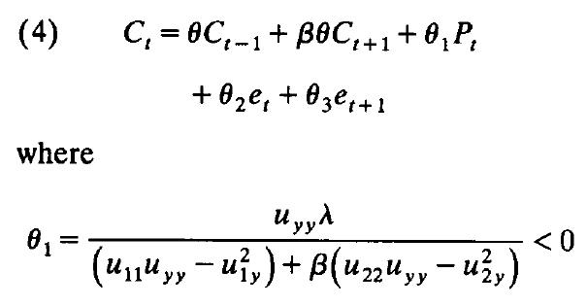
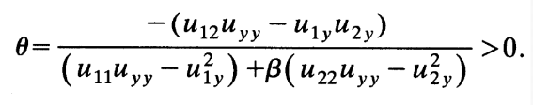
Basic model of Rational model
Current-period utility in period t
Equation 4) is the basis of the empirical analysis in this paper. It determines current cigarette consumption.
Past and future price are independent with the current consumption, holding Ct-1 and Ct+1 constant
-If Ѳ1 is negative then increase in current price decrease current consumption,
vice versa.
-If Ѳ is negative then greater past or future consumption decrease in current consumption, vice versa.
Here, Ct: quantity of cigarette consume in period t.
Ct-1 : quantity of cigarette consume in period t-1.
Yt: consumption of composite commodity of period t.
et: reflects the impact of unmeasured life-cycle variable on utility discounted at the rate r.
Notes:
Equation 3b) The marginal utility of current cigarette consumption, U1, plus the discounted marginal effect on next period’s utility of today’s consumption, U2, equals the current price multiplied by the marginal utility of wealth.
The equation shows that current consumption is independent of past and future price when Ct-1 and Ct+1 are held fixed since past prices directly affect past consumption and future prices directly affect future consumption

Slide 5

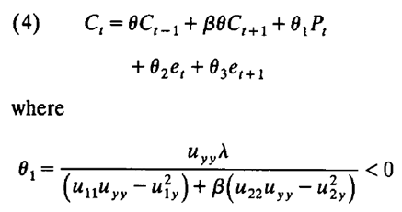
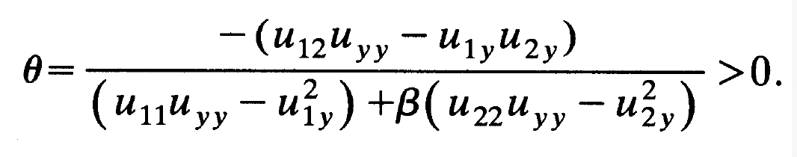
Basic model of Rational model
- These and other results can be seen more formally by solving the second-order difference of current consumption with respect to a permanent reduction in price beginning in period t in (4)
The solution results in an equation in which consumption in period t depend on prices in all periods.
Notes:
Theta one is negative because when current price increases, current consumption will drop.

Slide 6
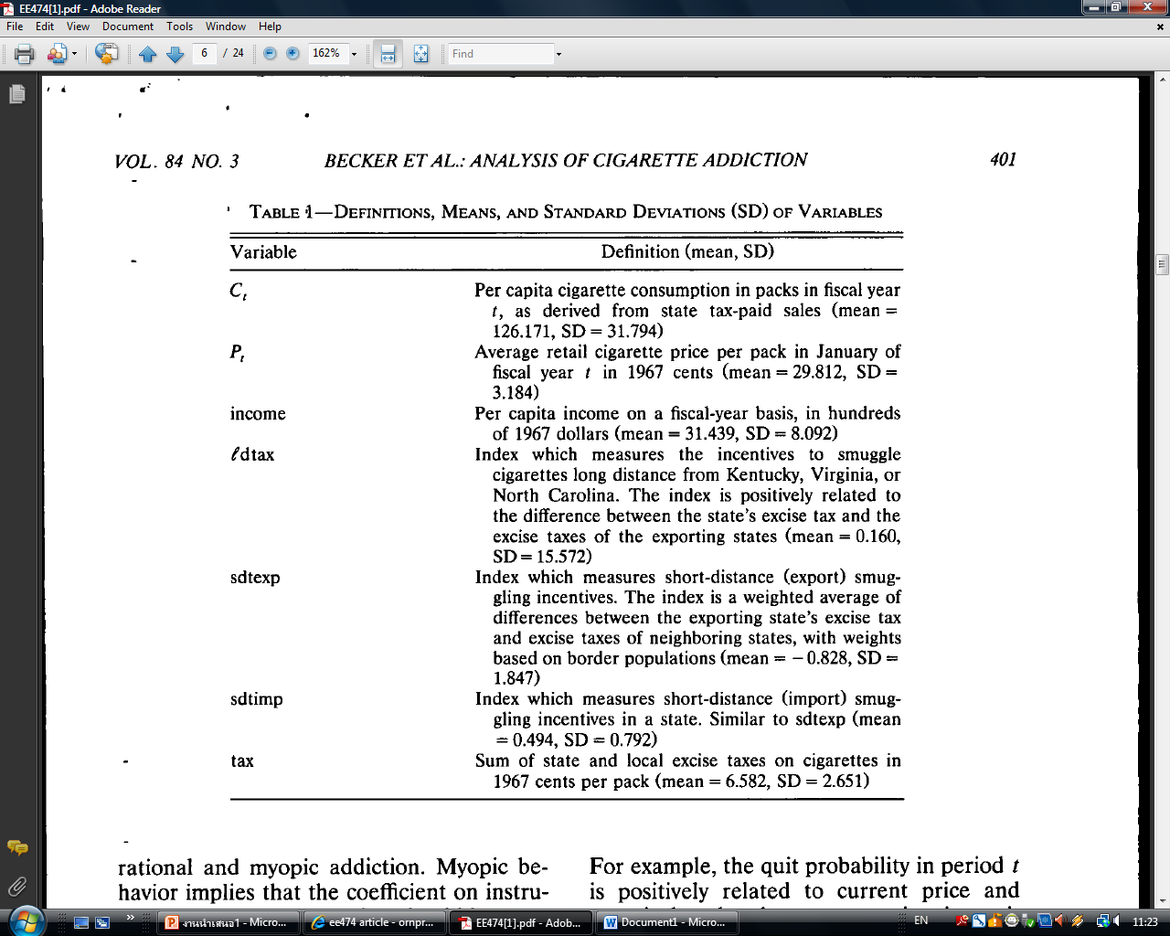
Data and Implementation
Time series data of cross section between 1955-1985
Estimating cigarette demand function from variables in TABLE1
1,581 potential observations in data set ( 31 years of data in 50 states and the District of Columbia)
BUT because of missing sales and price data, there are 1,517 actual number of observations

Slide 7
Data and Implementation
The diffusion of new information about health hazards of smoking may have greatly effected smoking over the period of our sample.
It includes time-specific dummy variable which unfortunately contain response in aggregate consumption to national changes in the price of cigarettes.
Normally, in each state each variable will be differed. So their estimates of price effects will be biased if the difference are correlated with tax or price differential across states.
When adjacent states have significantly different tax policies, there is an incentive to smuggle cigarettes across states.

Slide 8
Data and Implementation
The marginal utility of wealth
1. fixed over time
2. varies among
  Individuals and states -> State dummy variables
  unanticipated growth in wealth -> Time dummy variables
Unanticipated state-specific changes in real wealth overtime or deviation in real wealth from state and time-specific means are determined fully by deviations in real per capita income from state and time specific means
Notes:
BUT varies among individuals and states. Thus, state dummies capture this variation.
The coefficient of the time dummies reflect in part the effects of unanticipated growth in wealth which cause the marginal utility of wealth to change over time.
Holding state and time dummies constant, the coefficient of real per capita income reflects forces associated with state-specific change in the marginal utility of wealth over time

Slide 9
Empirical Results
Starting with myopic model, whether future prices are significant predictors of current consumption as it would be in the rational-addiction model.
Since consumer based their current consumption decision on expected future price, the actual future price suffers from the classical errors-in-variable problem which is uncorrelated with expected future price all other variables. Under the myopic framework, the coefficient estimate is still unbiased and represents a valid test of the myopic model.

Slide 10
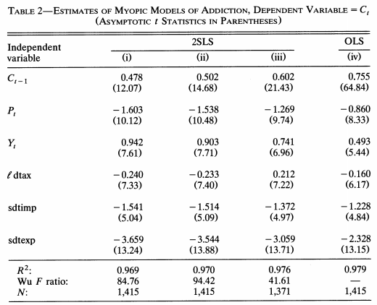
Empirical Results
Past consumption is treated as an endogenous variable in first three column.
Column (i) Past price plus other explanatory variables.
Column(ii) add the current and one-period lag values of the state cigarette tax
Column(iii) Add lags of the price and tax variables.

Slide 11
As we see in Table 2, current price is negatively related and income is positively related to current cigarette consumption. Past consumption is positively related to current consumption so the cigarette smoking is an addictive behavior.
But after adding one-period lead value of price, the result suggest that current consumption depends on future consumption.
Hence, it is worth trying to obtain structural estimate of rational-addiction demand functions.

Slide 12
Strategies in rational addiction model
First strategy is to use the actual future price as an instrument for future consumption, but we can’t actually forecast error in future price.
Second strategy is to restrict the set of instruments to lagged values of prices and taxes.
  1. The problem is people know the information about the future tax policy which directly affect future price before government take action.
  After adding lags of the price and tax variables
  2. Past price and taxes are not good predictors of the future price so it is insignificant to form cigarette demand function.

Slide 13
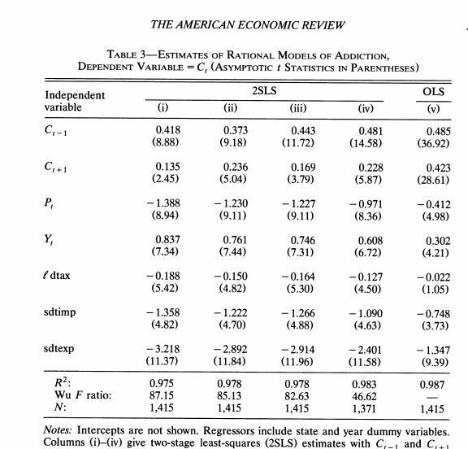
Table 3
Column(i)
  Use past and future price to determine past and future consumption
Column(ii)
  Add current and one-period lag values of the state cigarette
Column(iii)
  Add one-period lead value of tax
Column(iv)
Add lag of price and tax variables.

Slide 14
According to table 3, the estimated effect of past and future consumption on current consumption are significantly positive in the 2SLS models and the estimated price effects are significantly negative in all cases which is consistent with rational addiction model but inconsistent with myopic model.

Slide 15
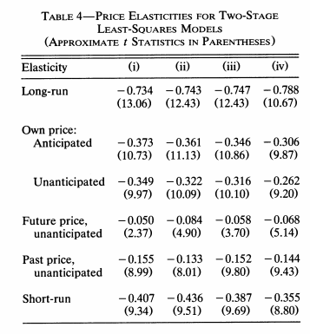
Focusing on 2SLS models
Long-run is almost twice elastic compare to short-run.
Anticipated price effect is relatively larger than unanticipated price effect on consumption.

Slide 16
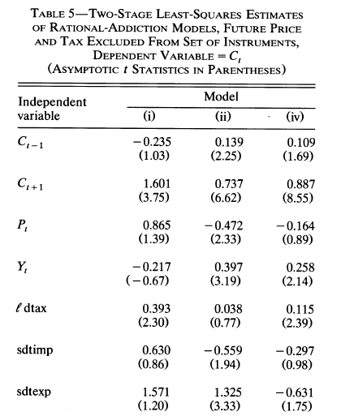
After we exclude one-period lead value of price and one-period lead value of the excise tax, the coefficient of current price and lagged-consumption fall dramatically while the future consumption rise dramatically. Long-run price elasticity is still relatively elastic than short-run but at the smaller magnitude.
The result are less supportive both myopic and rational addiction model comparing with the result in table 3.

Slide 17
Comparative Result
According to Table 3 and 5;
  Table 3 prefer the structural demand function in case that consumers have relevant information to forecast future cigarette price.
  Table 5 prefer the one believes in structural demand function that has the error in forecasting future cigarette price are enormous.

Slide 18
Monopoly and addiction
Cigarette companies have significant monopoly power.
A monopolist sets a price where marginal revenue is below marginal cost.
Setting the price low at the beginning is to encourage more consumers on the addictive goods.
As long as consumption is addictive, the future prices tend to exceed future marginal costs due to the monopoly power.
This analysis which incorporates addiction into pricing policy may be helpful in understanding the rise in cigarette prices.
Due to pricing policy or monopoly power, an increase in current prices would raise cigarette companies’ profits in the short run if they were pricing below the current profit-maximizing point.
The following consequence after the raise in price , much of drop in demand for cigarette in the short period of time.

Slide 19
Case in Thailand
The Thai Global Adult Tobacco Survey (GATS) 2011 showed an overall smoking prevalence of 24%, compared to 32% in 1991
However, there was a 1% increase in smoking prevalence among adult males from 45.6% to 46.6% between 2009-2011 but decrease in female adult smoking prevalence from 3.1% to 2.6%.
This was the first time in 20 years that smoking prevalence in Thailand showed any increase prompting the Thai Cabinet in June 2012 to approve the Ministry of Health’s National Tobacco Control Plan to increase tobacco taxes for the tenth time in 18 years.
Source: http://tobaccotax.seatca.org/country/thailand/
Notes:
Cigarette Price (2012)
Most popular local brand is Krongthip costs 2.16USD per pack
Most popular foreign brand is Marlboro costs 2.66USD per pack
Prompting the Thai Cabinet in June 2012 to approve the Ministry of Health’s National Tobacco Control Plan and also, on 21 August 2012, to increase tobacco taxes for the tenth time in 18 years, from 55% of the ex-factory price in 1992 to 87% in 2012.

Slide 20
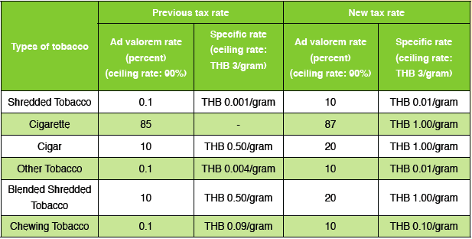
Case in Thailand
Comparison between the previous and new tobacco tax rate in 2012
Source: http://tobaccotax.seatca.org/country/thailand/

Slide 21
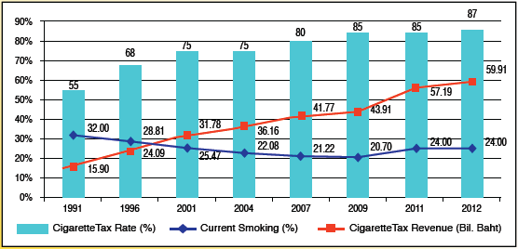
Case in Thailand
Impact of tax increase on tobacco tax revenue and smoking prevalence, 1991-2012
Source: http://tobaccotax.seatca.org/country/thailand/
Notes:
Through a range of tobacco control measures, Thailand reduced its number of smokers by 5.7 million persons between 1991-2011.
Despite several tax and price increases and slowly declining smoking prevalence rates, cigarette sales volumes have remained relatively constant, even as tax revenues have increased more than four-fold (from THB 15.44 billion in 1992 to THB 59.91 billion in 2012).
However, noting that the current adult smoking prevalence had slightly increased in 2011, the government mandated another tax increase in 2012 and began a process to amend and strengthen their tobacco control legislation.

Slide 22
Thank you

Slide 23
Members
  5504640102 Miss ASAMARUJEE SIMAPORN
  5504640326 Miss JATUPORN JITTAPIROM
  5504640912 Miss ORNPREEYA MANOVILAS
  5504641605 Mr SHUSIDTH VOLYARNGOSOL
  5504641977 Miss THEENIDA MAHATHANAPAT

