Slide 1
Topic 3 Part 1
The Theory of Demand
(Chapter 5)

Slide 2
Review of Concepts
Demand
The quantity of a good that consumers are willing and able to buy at a given price.
Law of Demand
Ceteris Paribus, as the price of a good increases, its quantity demanded falls.

Slide 3
Review of Concepts
Price Elasticity of Demand (PED)
A measure of the responsiveness of the quantity demanded of a good, given a change in its price.
Usually, PED is a negative number.
|PED| > 1 , the demand is price elastic.
|PED| < 1 , the demand is price inelastic.
|PED| = ∞, the demand is perfectly price elastic.
|PED| = 0 , the demand is perfectly price inelastic.

Slide 4
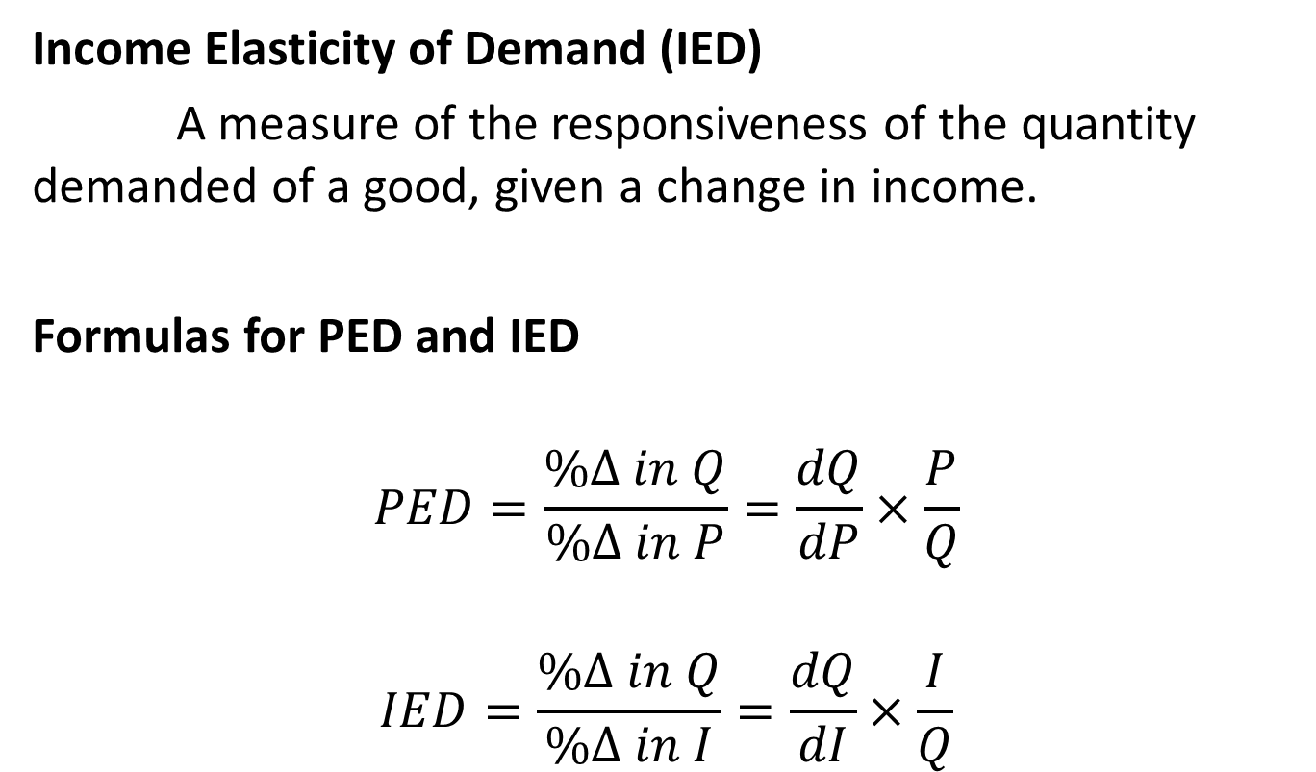
Review of Concepts
Income Elasticity of Demand (IED)
A measure of the responsiveness of the quantity demanded of a good, given a change in income.
Formulas for PED and IED
$$PED=\frac{\%∆ in Q}{\%∆ in P}=\frac{dQ}{dP}×\frac{P}{Q}$$
$$IED=\frac{\%∆ in Q}{\%∆ in I}=\frac{dQ}{dI}×\frac{I}{Q}$$

Slide 5
Review of Concepts
Using PED as a criterion, there are two types of goods:
Ordinary Good (PED < 0)
A good that follows the law of demand
That is, P↑ >>> Q↓
Giffen Good and Veblen Good (PED > 0)
A good that violates the law of demand
That is, P↑ >>> Q ↑

Slide 6
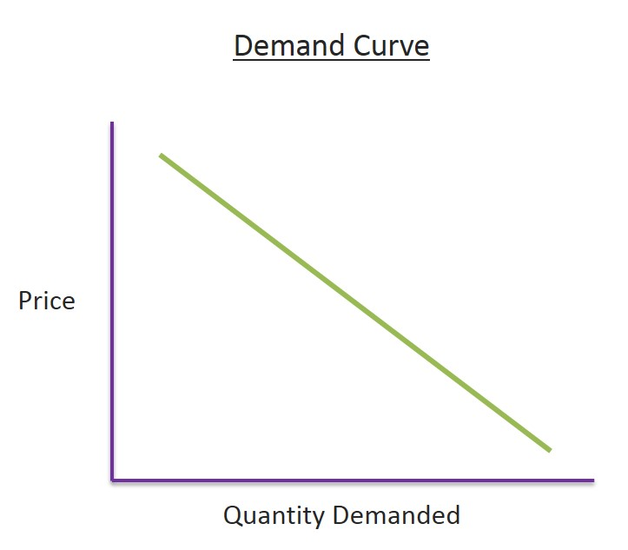
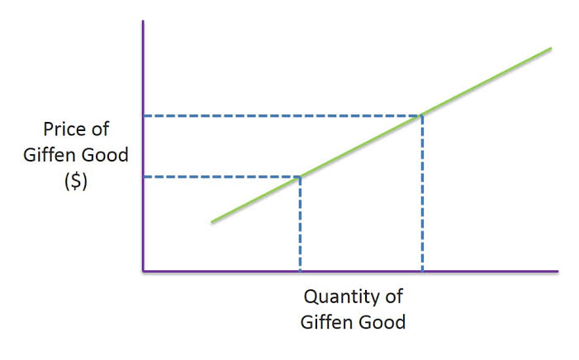
Review of Concepts
Ordinary Good Giffen Good

Slide 7
Review of Concepts
Using IED as a criterion, there are two main types of goods:
Normal Good (IED > 0)
A good that is consumed more when income increases
That is, I↑ >>> Q↑
Inferior Good (IED < 0)
A good that is consumed less when income increases
That is, I↑ >>> Q↓

Slide 8
Review of Concepts
There are two sub-types of normal goods (IED > 0):
Luxury Good (IED > 1)
A good for which demand increases more than proportionally as income rises
Necessity Good (0 < IED < 1)
A good for which demand increases less than proportionally as income rises

Slide 9
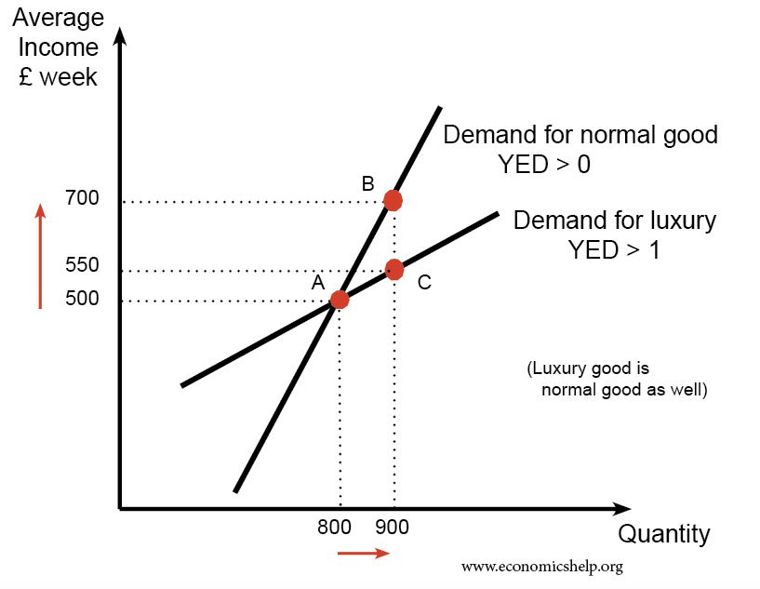
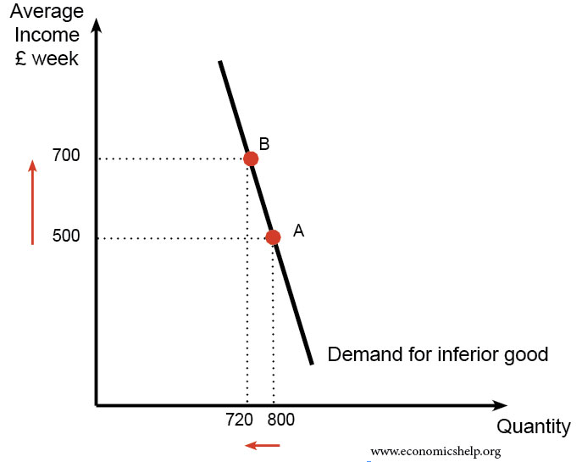
Review of Concepts
Normal Good Inferior Good
These lines are called “ENGEL Curves”.

Slide 10
Individual Demand Curve
We have learnt how to find the optimal choice.
Given income and prices of other goods, we know how much a consumer will demand of X for a given price of X, e.g. (X1, P1) and (X2, P2).
Note that (X1, P1) and (X2, P2) are essentially points on a demand curve.
Finding all points by varying the price of X allows us to draw the whole demand curve.

Slide 11
Price Consumption Curve (PCC)
shows the set of optimal baskets for every possible price of good x, holding all other prices and income constant.
The Price Consumption Curve for good X can be used to plot the quantity consumed of good X at any price of X.
This new plot is the consumer’s demand curve for good X.

Slide 12
Individual Demand Curve
Key Points 1
The consumer is maximizing utility at every point on the demand curve.
As Px falls, it causes the consumer to move down and to the right along the demand curve as utility increases in that direction.
The MRSxy (= Px/Py) falls along the demand curve as the price of x falls (assuming an interior solution).

Slide 13
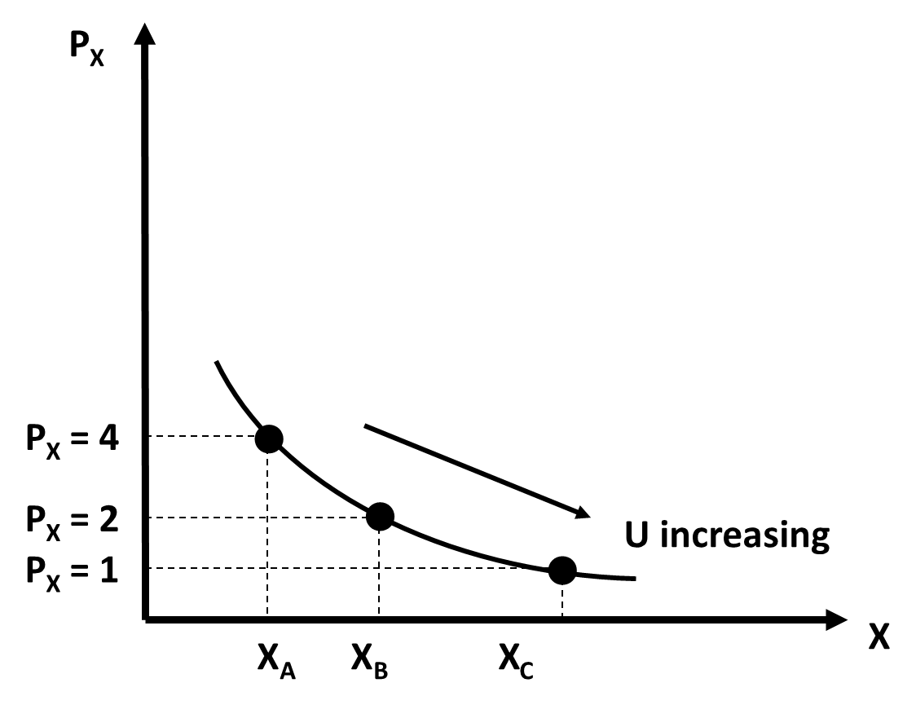
Individual Demand Curve
Key Points 1 (Explained)
As Px falls, it causes the consumer to move down and to the right along the demand curve as utility increases in that direction.
X_{A} corresponds to U1
X_{B} corresponds to U2
X_{C} corresponds to U3

Slide 14
Individual Demand Curve
Key Points 2
As MRSxy falls, this means the consumer is willing to trade smaller Y in exchange for one more unit of X.
The demand curve also shows the “willingness to pay”, and willingness to pay for an additional unit of X falls as more X is consumed.
When Px changes, we have a movement along the demand curve.

Slide 15
Price Consumption Curve
Price Consumption Curve can have different shapes.
  Upward-Sloping Curve
  Downward-Sloping Curve
  Horizontal Straight Line
  Backward-Bending Curve
Assuming a composite good on the Y-axis, these shapes tell us two things.
  PED of the good on the X-axis.
  How goods X and Y are related.

Slide 16
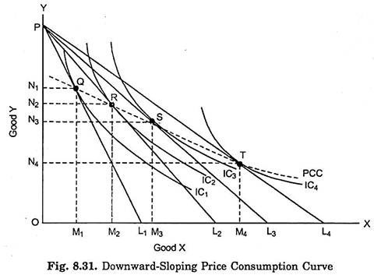
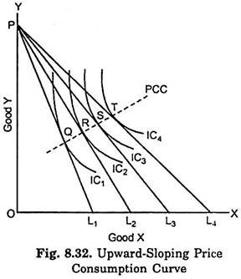
PCC and how goods X & Y are related
Consider the case where Px falls.
Y is a composite good with Py = 1.
We buy MORE X but LESS Y.
Thus, X and Y are substitutes
We buy MORE X and MORE Y.
Thus, X and Y are complements.

Slide 17
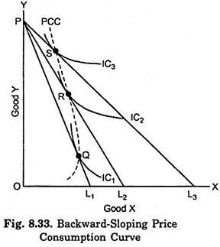
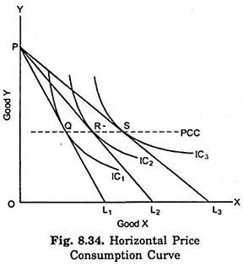
PCC and how goods X & Y are related
Consider the case where Px falls.
Y is a composite good with Py = 1.
We buy LESS X when Px falls.
Thus, X is a Giffen good.
Y is the same when Px changes.
Thus, X and Y are unrelated goods

Slide 18
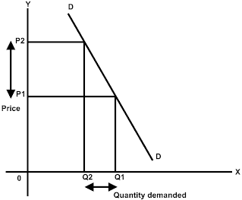
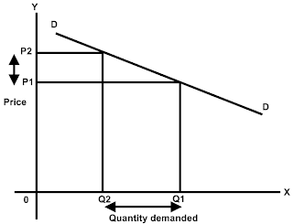
PCC and PED
To understand about PCC and PED, we must first understand the implications of PED.
Consider the case when Price falls (i.e. from P2 to P1).
Inelastic
Demand
Elastic
Demand
A
A
B
C
B
C
When Price falls, the expenditure on the good falls
i.e. A+B decreases to B+C
=> INELASTIC DEMAND
When Price falls, the expenditure on the good rises.
i.e. A+B increases to B+C
=> ELASTIC DEMAND

Slide 19
PCC and PED
Consider the case where Px falls.
Income = P, and Y is a composite good with Py = 1.
For simplicity, we will consider Points Q (before Px falls) and T (after Px falls).
At Q, we spend N1 on Y.
(At Q, there are N1 units of Y, which costs Py = $1 per unit.)
Our income = P, and we spend the rest on X, so we spend P – N1 on X.
At T, we spend N4 on Y.
Our income = P, and we spend the rest on X, so we spend P – N4 on X.
Here, after Px falls, our expenditure on X increases from P – N1 to P – N4.
Thus, the demand for X is price elastic.

Slide 20
PCC and PED
Consider the case where Px falls.
Income = P, and Y is a composite good with Py = 1.
Exp.
on X
after
Px
falls
For simplicity, we will consider Points Q (before Px falls) and T (after Px falls).
At Q, we spend N on Y.
Our income = P, and we spend the rest on X, so we spend P – N on X.
At T, we spend M on Y.
Our income = P, and we spend the rest on X, so we spend P – M on X.
M
N
Here, after Px falls, our expenditure on X decreases from P – N to P – M.
Thus, the demand for X is price inelastic.

Slide 21
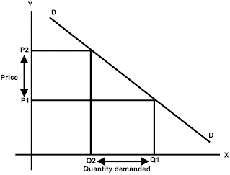
PCC and PED
Consider the case where Px falls.
Income = P, and Y is a composite good with Py = 1.
Unitary
Elastic
Demand
A
Exp on X
B
C
Exp on Y
When Price changes, the expenditure on the good does not change.
i.e. A+B is still equal to B+C
Here, after Px falls, we buy more X, but our expenditure on X remains the same.
Thus, demand is price unitary elastic.

Slide 22
Income Consumption Curve (ICC)
The ICC of good x is the set of optimal baskets for every possible level of income.
We can graph the points on the ICC as points from shifting the demand curve.

Slide 23
Engel Curves
The ICC for good x can be written as the quantity consumed of good x for any income level.
This is the Engel Curve for good x. When the income consumption curve is positively sloped, the slope of the Engel Curve is positive.
X is a normal good

Slide 24
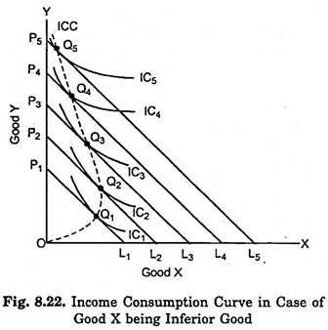
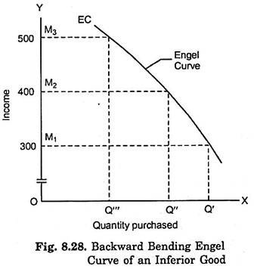
Engel Curves
X is an inferior good

Slide 25
ICC, Engel Curve, and Types of Goods
If the ICC shows that the consumer purchases more of good x as her income rises, good x is a normal good.
Equivalently, if the slope of the Engel curve is positive, the good is a normal good.
If the ICC shows that the consumer purchases less of good x as her income rises, good x is an inferior good.
Equivalently, if the slope of the Engel curve is negative, the good is an inferior good.

Slide 26
Backward-Bending Engel Curve
Backward-Bending Engel Curve
A good can be normal over some ranges and inferior over others.

