Slide 1
Additional insights on GDP

Slide 2
Why GDP does not measure well-being?
Several ways in which the measurement of GDP does not give an accurate picture of well-being.
  Some products are welfare-reducing (mostly in the longer-run)
  Loss of leisure
  Loss of human and social capital
  Welfare-reducing production methods
  Unequal distribution

Slide 3
Why GDP does not measure well-being?
The GDP dilemmas
Example;
  The Devastating Effects of Pollution in China
    http://www.youtube.com/watch?v=q4DtOhe2LfQ
  South Korea and Japan among the countries with highest suicide rate
    http://en.wikipedia.org/wiki/List_of_countries_by_suicide_rate
GDP cannot reflect some of the essential conditions, but should we abandon the use of GDP?

Slide 4
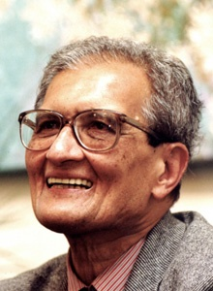
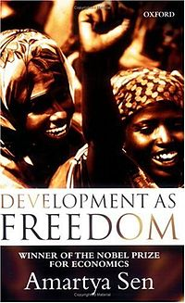
Moving away from GDP
The capability approach (Amartya Sen)
  Development is about expanding people’s freedom to achieve what they value in life.
    Income is only one of the means to expand people’s freedom.
  Other important aspects of freedom include, for example;
    Health and education
    Political freedom
    Safety-nets

Slide 5
Moving away from GDP: HDI
Operating the capability approach → the Human Development Index (HDI)
  Taking into account the multi-dimensionality of development, the index is measured by UNDP
    HDI find the average value of three indicators:
      life expectancy at birth
      An index reflecting a combination of the adult literacy rate and statistics on enrollments in education
      GDP per capita

Slide 6
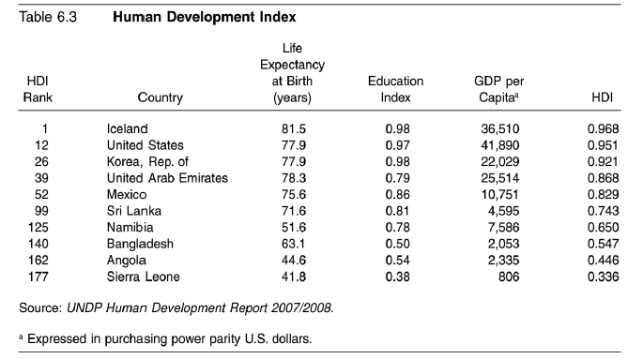
Human Development Index
http://hdr.undp.org/en/data/explorer/

Slide 7
Thailand among the countries with the lowest unemployment rate in the world, why?
http://www.bloomberg.com/news/articles/2015-02-02/thailand-s-unemployment-rate-is-a-ridiculously-low-0-6-here-s-why

