Slide 1
The impact of domestic and foreign R&D on TFP in developing countries
EE 462 Development Macroeconomics
Reference: Herzer, D. (2022). The impact of domestic and foreign R&D on TFP in developing countries. World Development, 151, 105754.

Slide 2
Summary (1)
Objectives:
  To test the predictions of Schumpeterian theory against the prediction of semi-endogenous theory regarding R&D and TFP relationship
  To compare the effects of domestic R&D and foreign R&D spillover on TFP in developing countries (LDCs)
  To compare the above difference between middle- and low-income countries
Methods:
  Use of panel data to test relationship between domestic R&D and foreign R&D on TFP

Slide 3
Summary (2)
Main findings:
  Evidence supports semi-endogenous growth theory’s prediction
  Domestic R&D has a greater effect on TFP in LDCs than foreign R&D.
  The effect of domestic R&D is greater in middle-income than in low-income countries.

Slide 4
Motivations
Domestic R&D may or may not have a major effect on TFP in these countries.
Why would domestic R&D have no effect on TFP?
Would foreign R&D effect TFP in developing countries? How?

Slide 5
Concepts
What does Schumpeterian growth model say?
What about semi-endogenous growth model?

Slide 6
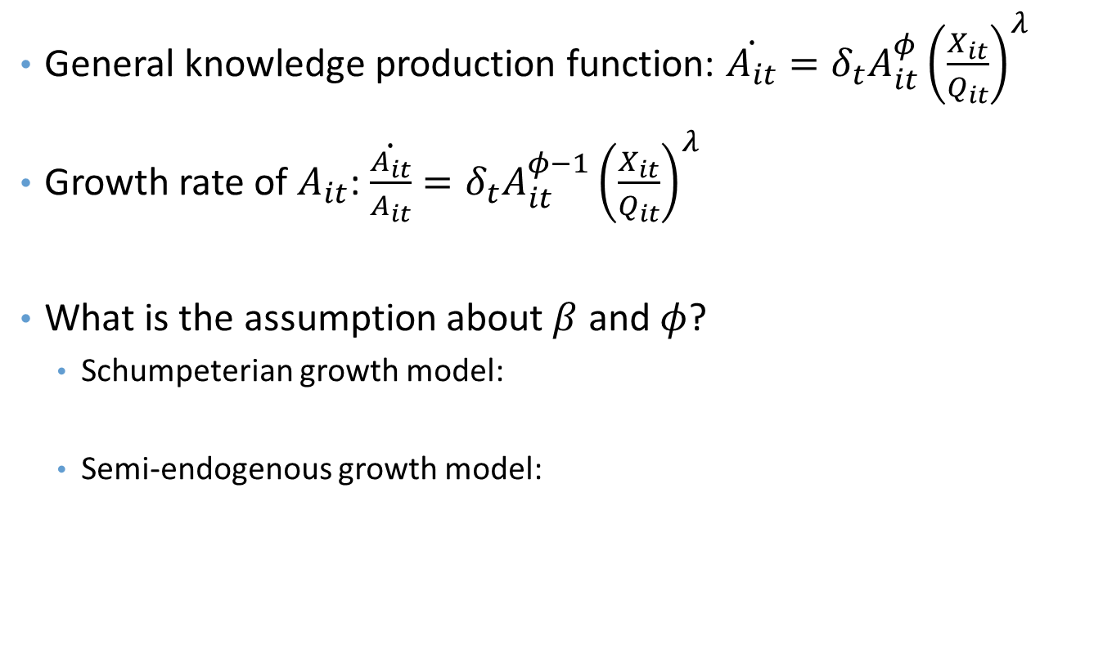
Theoretical Framework
General knowledge production function: $\dot{A_{it}}=δ_{t}A_{it}^{φ}{\left(\frac{X_{it}}{Q_{it}}\right)}^{λ}$
Growth rate of $A_{it}$: $\dot{\frac{A_{it}}{A_{it}}}=δ_{t}A_{it}^{φ−1}{\left(\frac{X_{it}}{Q_{it}}\right)}^{λ}$
What is the assumption about $β$ and $φ$?
  Schumpeterian growth model:
  Semi-endogenous growth model:

Slide 7
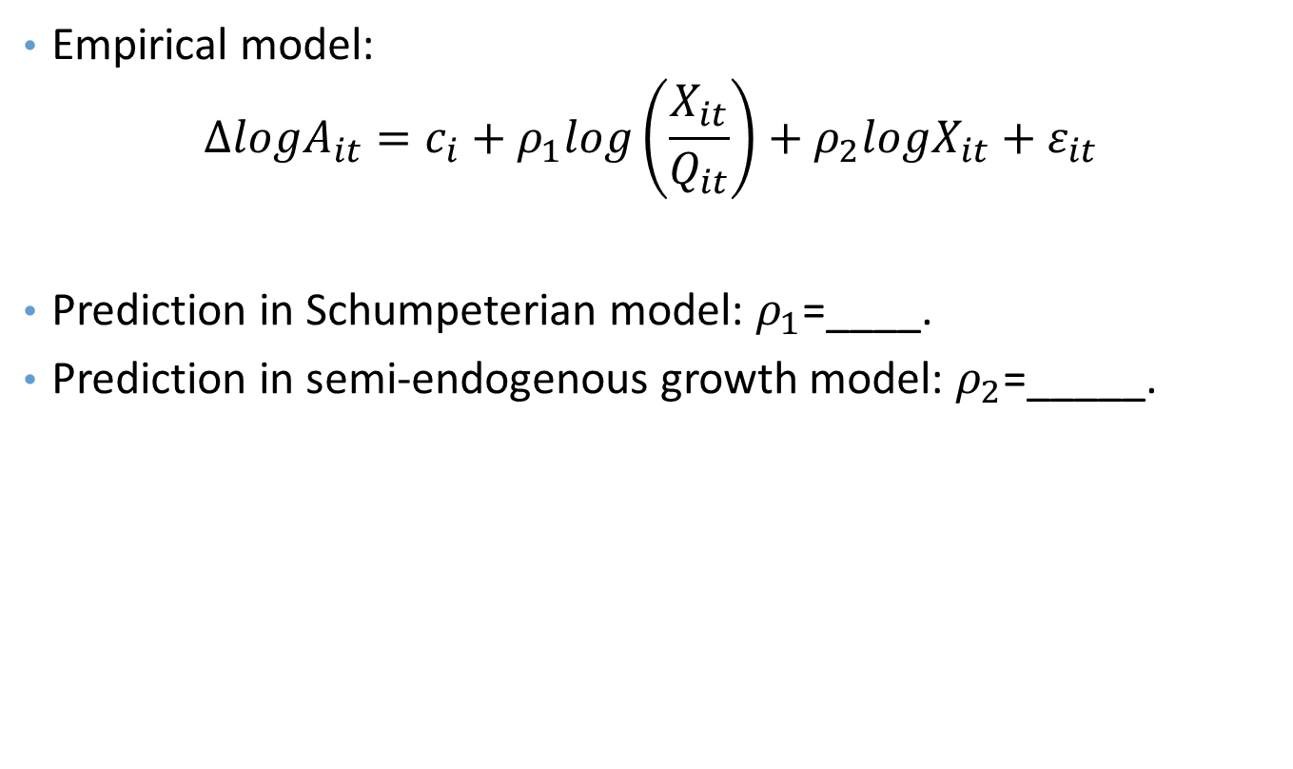
Theoretical Framework
Empirical model:
$$ΔlogA_{it}=c_{i}+ρ_{1}log\left(\frac{X_{it}}{Q_{it}}\right)+ρ_{2}logX_{it}+ε_{it}$$
Prediction in Schumpeterian model: $ρ_{1}$=____.
Prediction in semi-endogenous growth model: $ρ_{2}$=_____.

Slide 8
Variable Definitions
How are the following variables defined and measured?
  Domestic TFP
  Domestic R&D

Slide 9
What are the data sources?
How many countries and years are included in the study?
TFP – Real GDP, land, physical capital stock, employed workers, human capital, share of labor
Ratio of R&D to GDP
Bilateral trade data (to construct foreign R&D)
Others -

Slide 10
Empirical Strategy
What is the empirical strategy to identify the impact of domestic R&D and foreign R&D on TFP in LDCs?

Slide 11

Scatter Plots of $ΔlogTFP_{t}$ and $log⁡(\frac{R_{t}}{GDP_{t}})$
Is there any relationship between the ratio R/GPD and the growth rate of TFP?
Is there any relationship between the mean R&D and the mean of TFP?

Slide 12
Patterns of TFP and R&D
What are the patterns of the growth rate of TFP (a), the ratio R/GDP (b), the level of TFP (c), and the level of R&D?
Any contradiction or consistency with the two theories?

Slide 13
Result from Pooled DOLS model
Do the results columns (1) and (2) support Schumperterian growth theory?
Does the result in column (3) support Semi-endogenous growth theory?

Slide 14
Fixed Effect model
Which theory do the results in this table support? Explain.

Slide 15
Effects of domestic R&D and foreign R&D spillover
Is there any spillover effect of R&D from industrial to developing countries?

Slide 16
Do the effect of domestic R&D and foreign R&D differ? How?

Slide 17
What can we say about the spillover effect of foreign R&D in middle-income countries?

Slide 18
What can we say about the spillover effect of foreign R&D in lower-income countries?

