Slide 1
Development Project Management:
Lessons from the Field
Frank Pumipuntu
Regional Monitoring and Evaluation Specialist

Slide 2
Examples of Projects in the Developing World

Slide 3
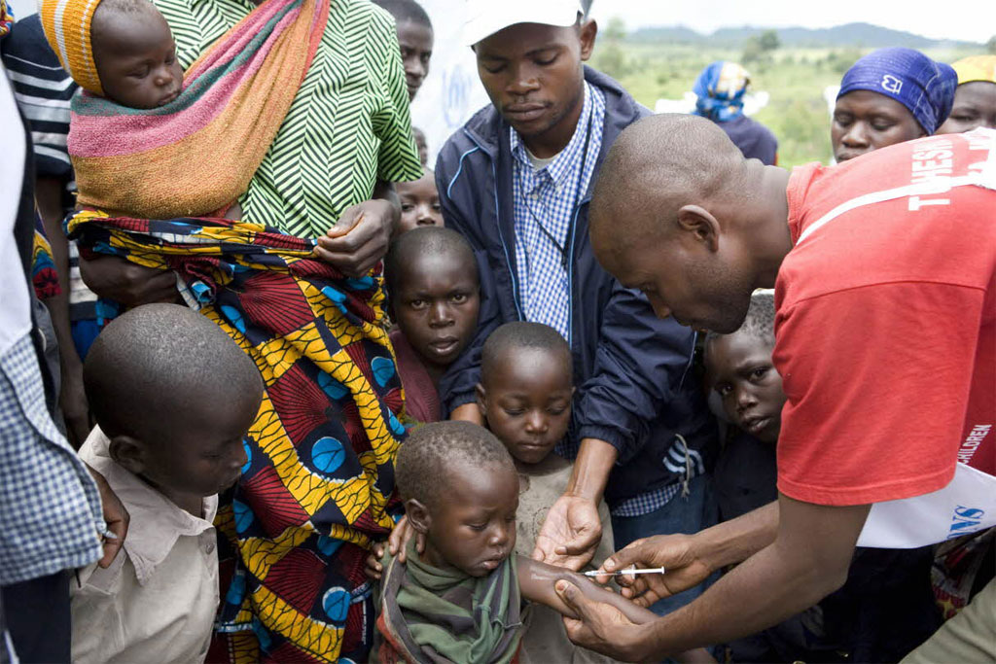
Health Projects
HIV
Malaria
Ebola
Basic health care
Etc

Slide 4
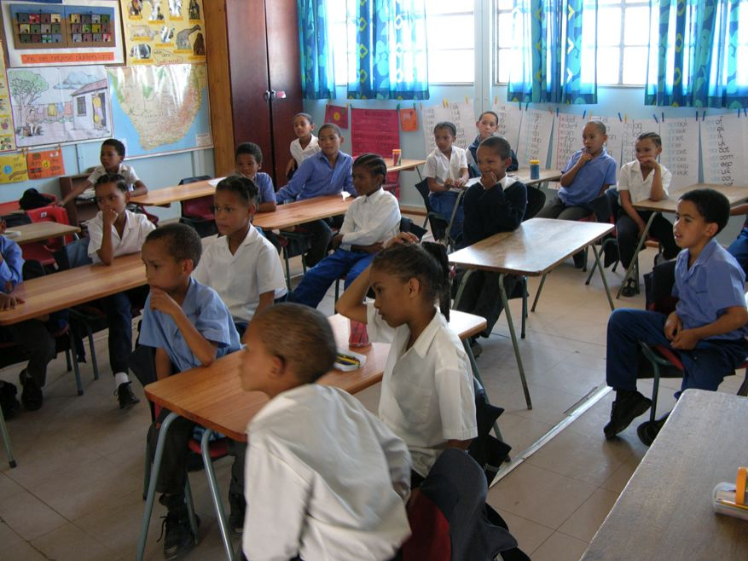
Education Projects
Primary
Secondary
Vocational (higher education)
University (higher education)
Workforce capacity building
Etc

Slide 5
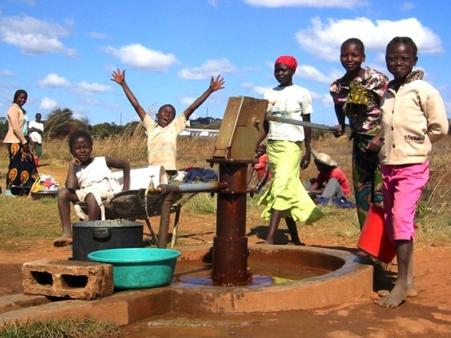
Infrastructure
Roads
Dams
Schools
Hospitals
Etc

Slide 6
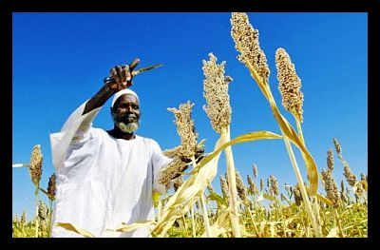
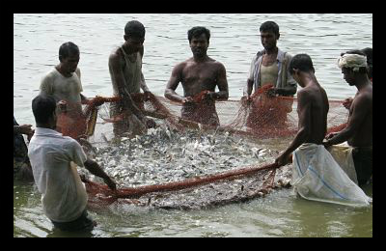
Agriculture & Aquaculture

Slide 7
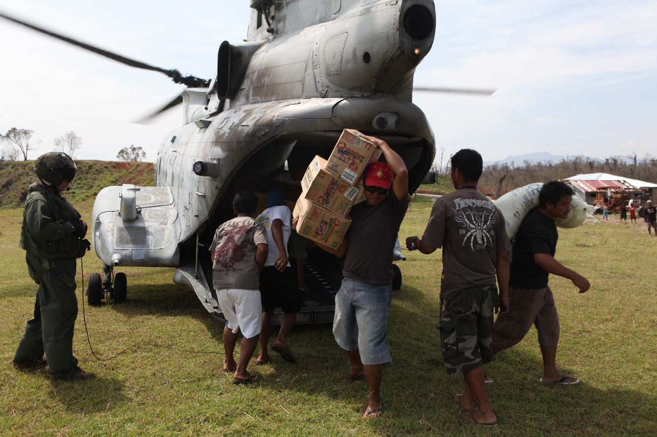
Humanitarian Assistance
Natural Disasters
Man-made disasters

Slide 8
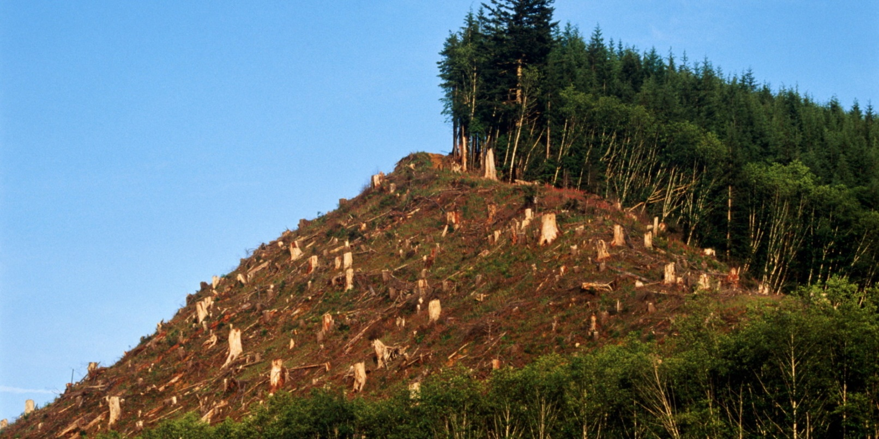
Environmental
Deforestation
Marine
Climate Change &
Global Warming

Slide 9
Theories in project management (Core Components)
Not always as planned
Planning
Changes
Plans
Performance Data
Controlling
Executing/ Implementing
Corrections

Slide 10
O & T
Strategy 1
Strategy 2
Strategy 3
Strategy 4
Action Plan
Objectives
VISION…..Mission Statement
S & W
Implementation
Structural Change
System Change
HR
Organizational Culture
Monitoring and Evaluation

Slide 11
Why is project management harder than it looks?

Slide 12
Environmental Factors
Things change all the time

Slide 13
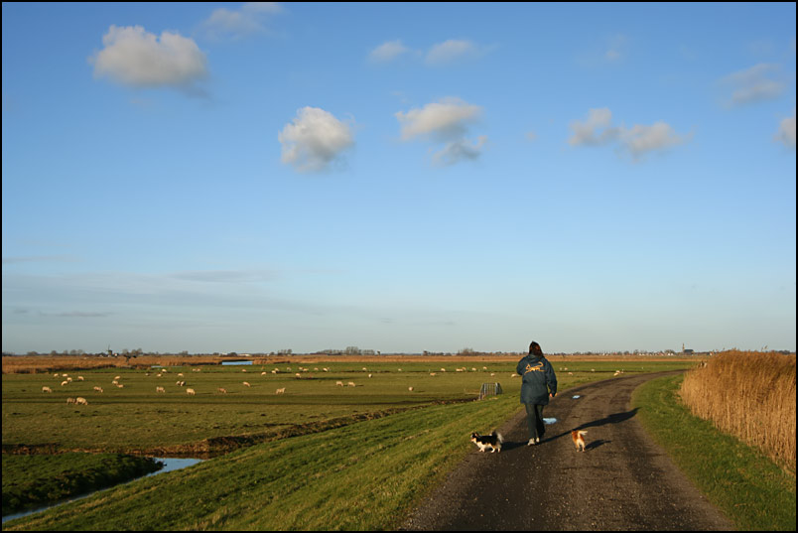

Slide 14
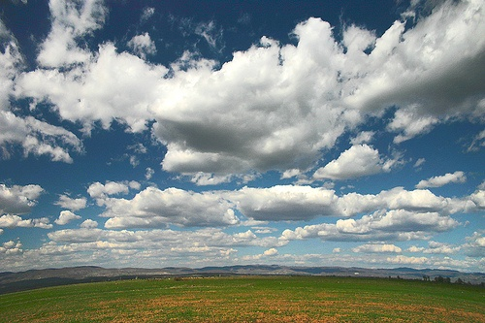

Slide 15
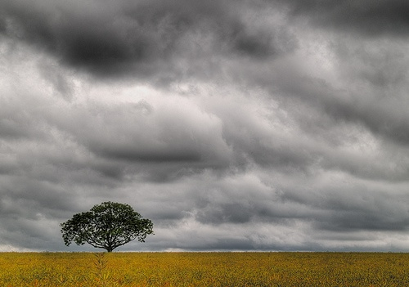

Slide 16
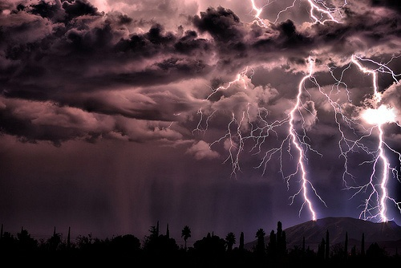

Slide 17
Managerial & Organizational Factors
Not everything we think is useful, is actually useful

Slide 18
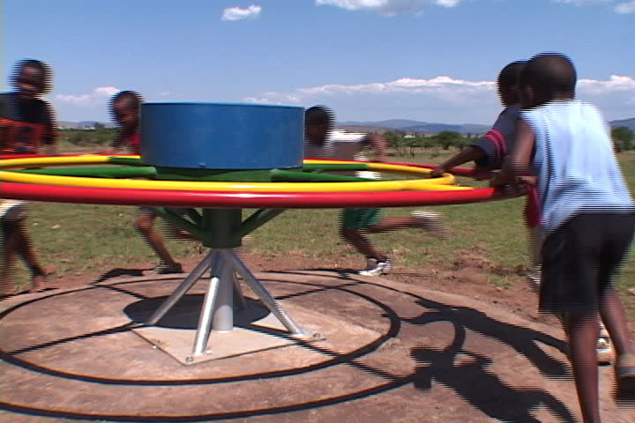

Slide 19
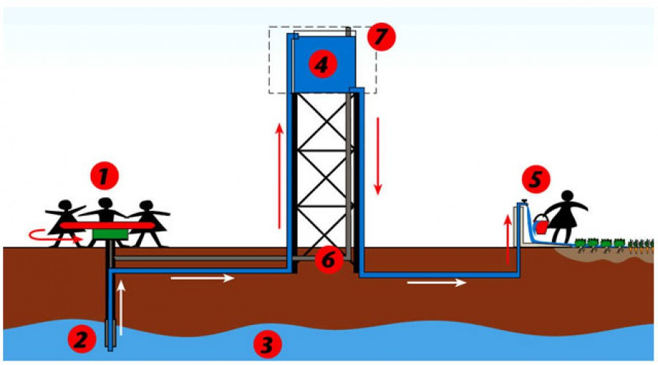

Slide 20
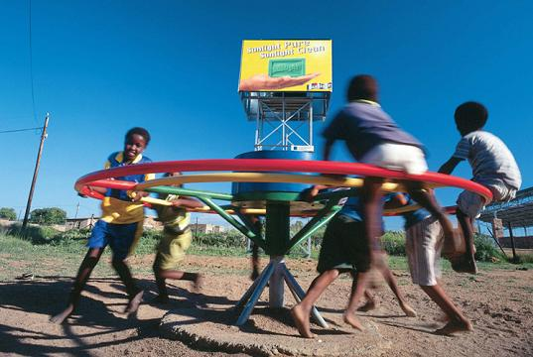

Slide 21
Political Factors

Slide 22
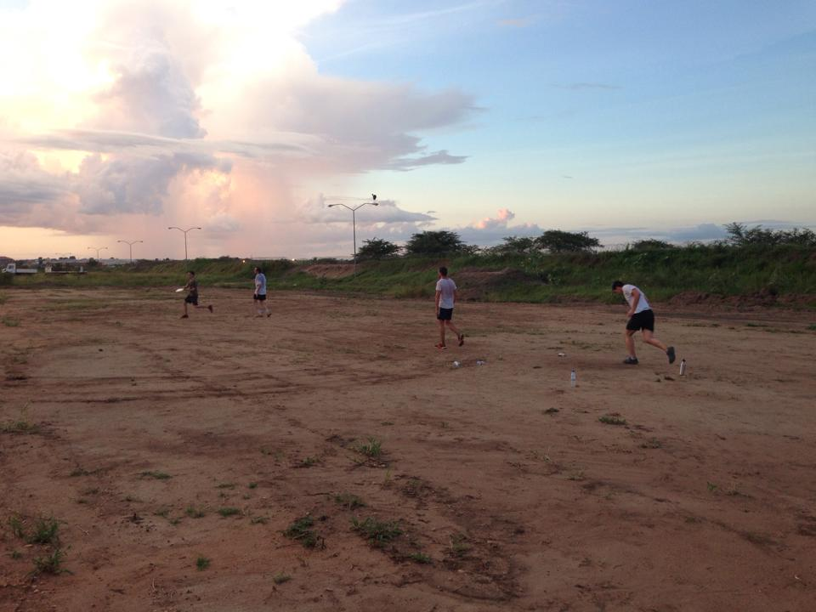
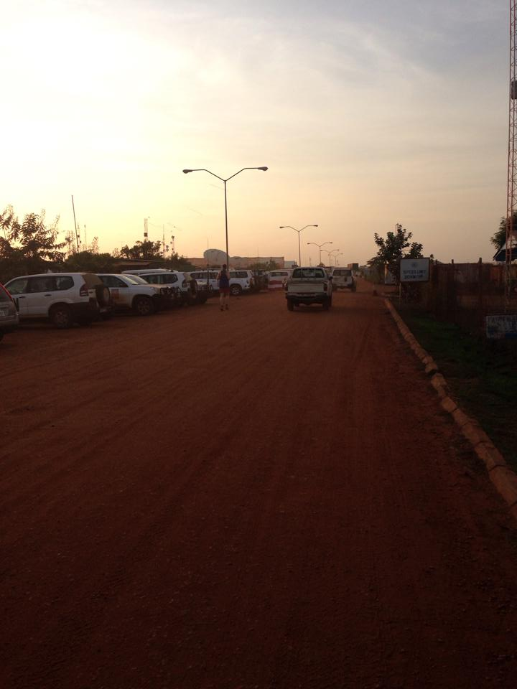

Slide 23
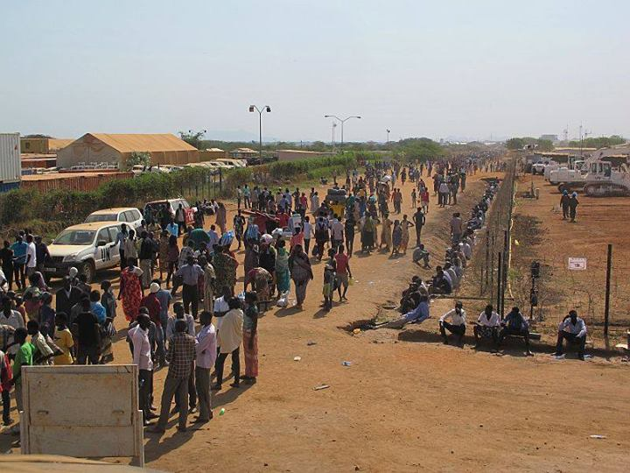

Slide 24
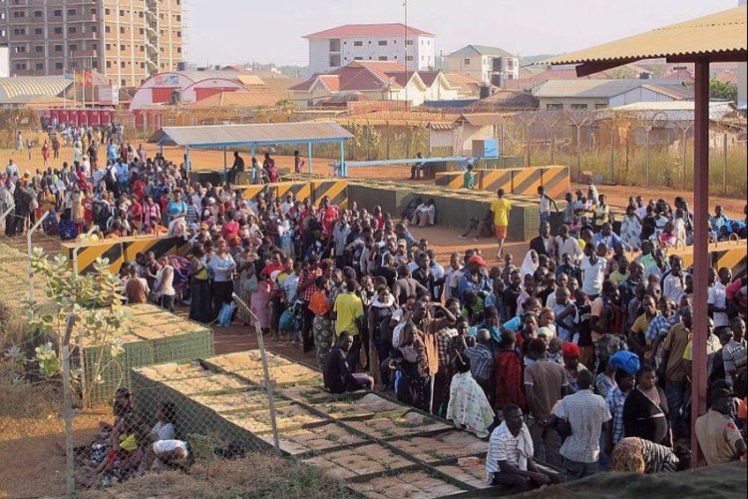

Slide 25
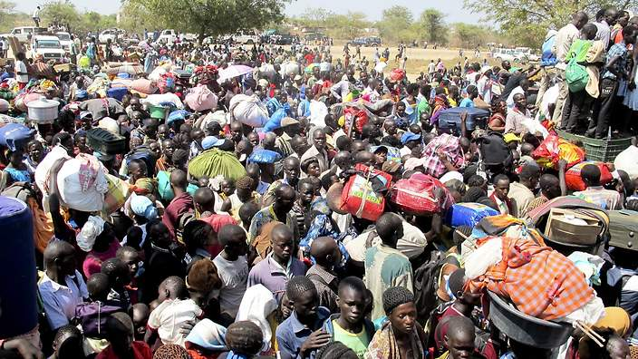

Slide 26
Cultural and Social Factors

Slide 27
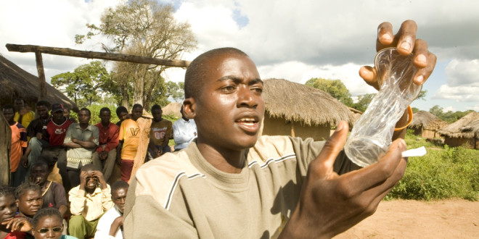

Slide 28
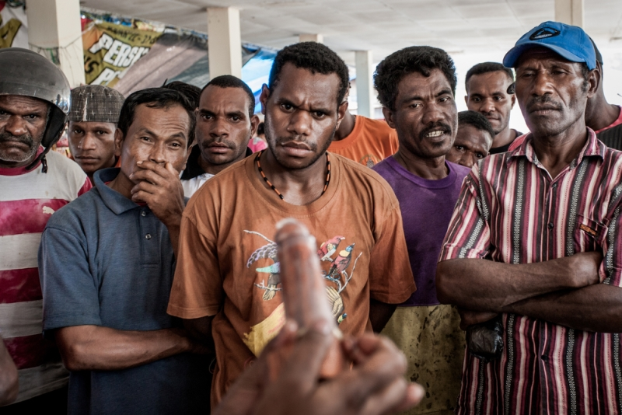
CENSORED

Slide 29
Technical Factors
Use of Technology
Designs
Engineering
Construction
Equipment installation
Etc

Slide 30
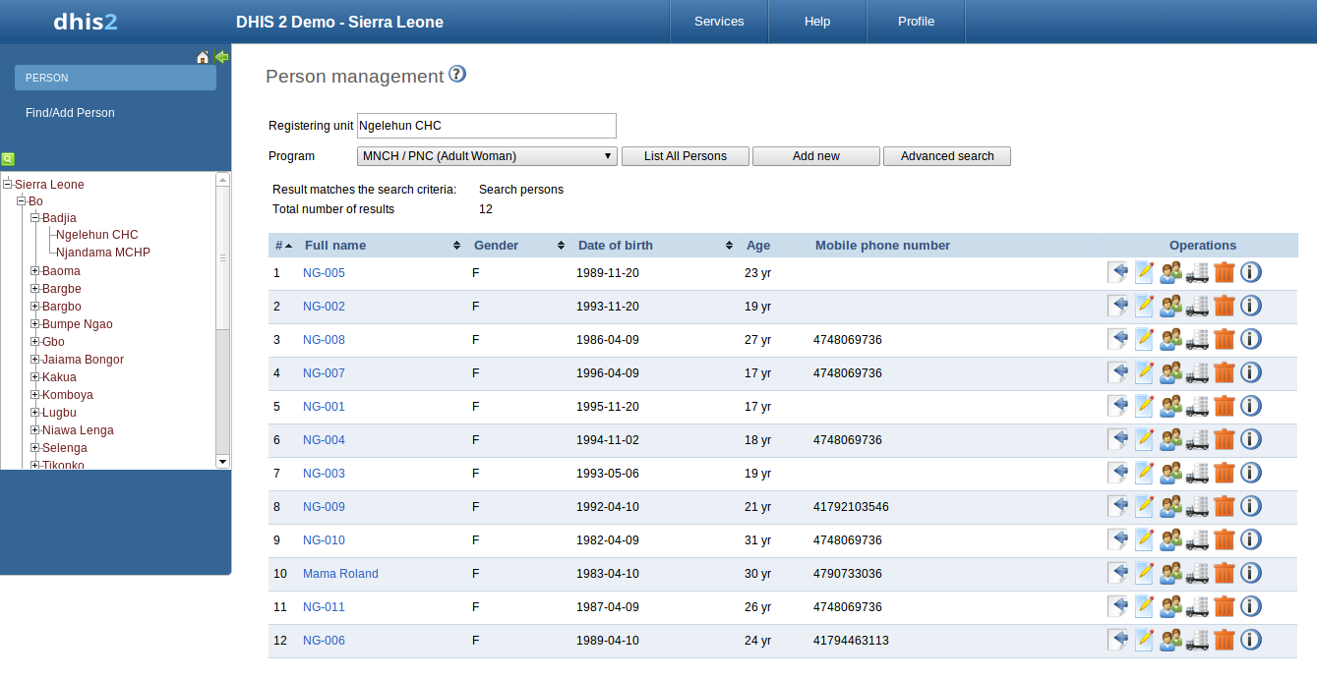
Example – DHIS online vs offline

Slide 31
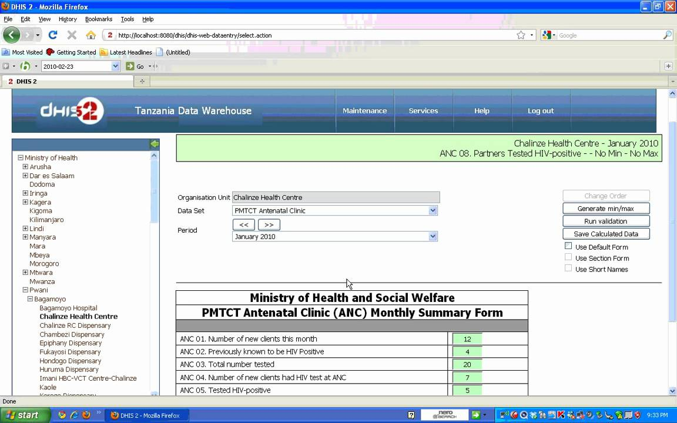

Slide 32
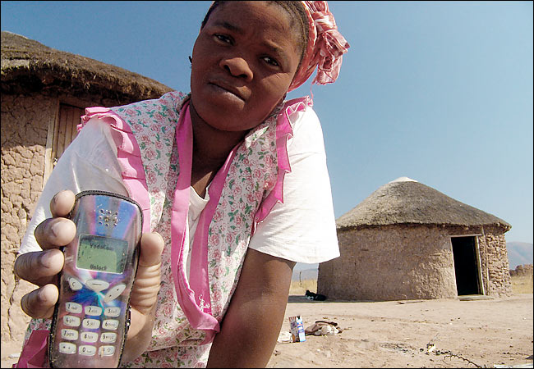
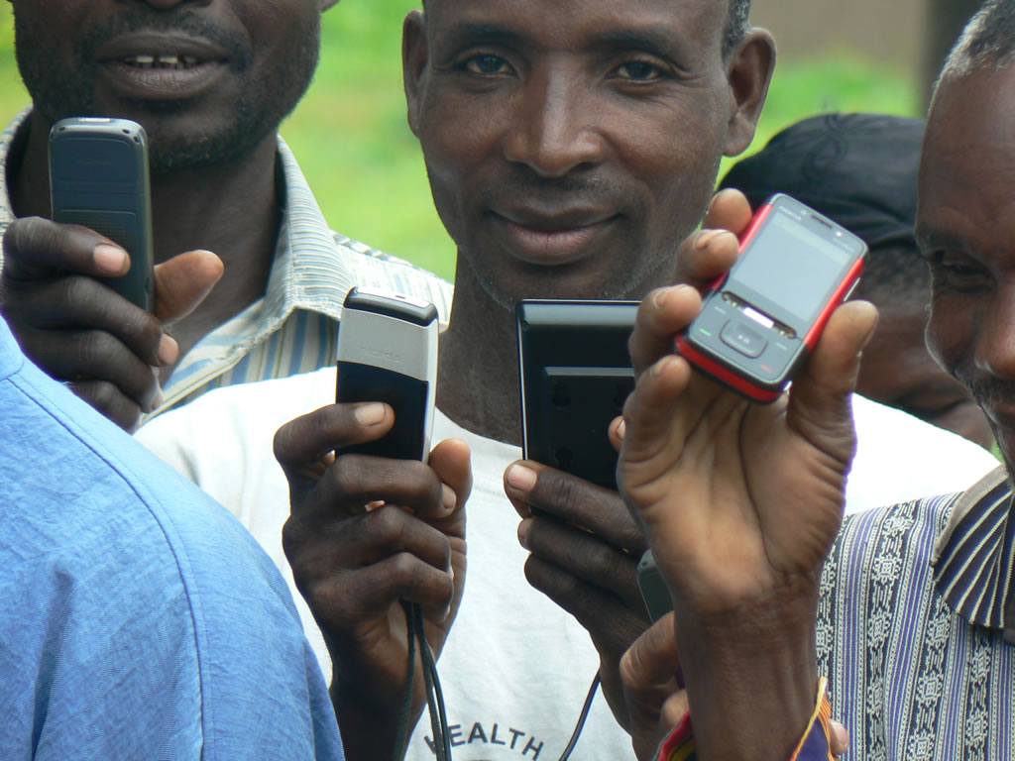
Example – signal coverage

Slide 33
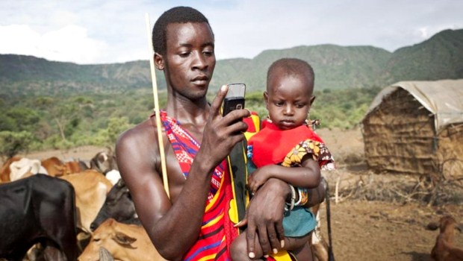

Slide 34
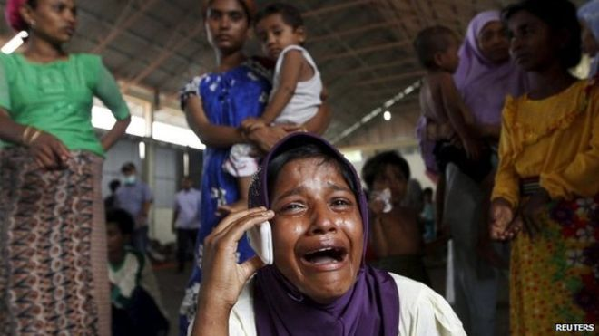
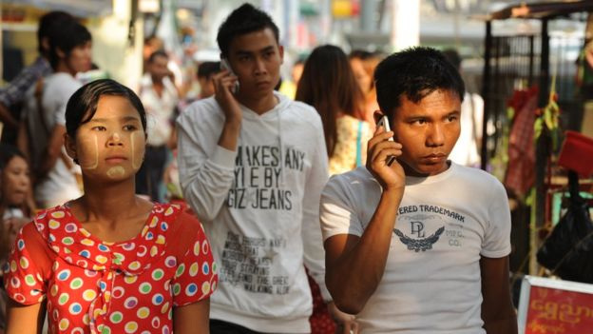
Example – signal burst in Burmese text messaging

Slide 35

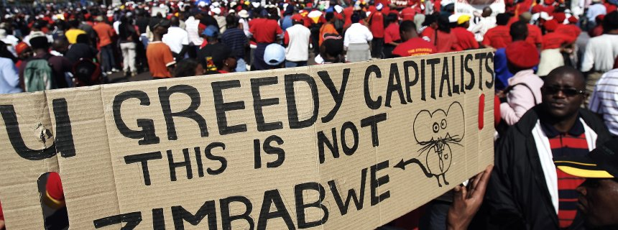
Economic factors
Economic factor
  Changes in domestic economic conditions
  Exchange rate vs budget planning

Slide 36
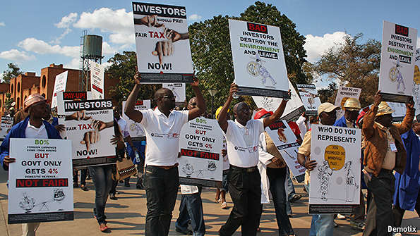
Legal factors
  Using children to work on merry-go-round water pump (abuse of child labor?)
  Taxation (UN doesn’t pay tax, but NGOs have to)

Slide 37
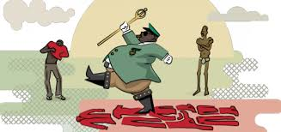
Corruption factors
Big issue in under developed countries
Be careful when you run into corruption related issues

Slide 38
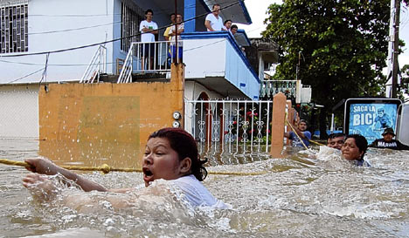
Physical factors
Natural disasters

Slide 39
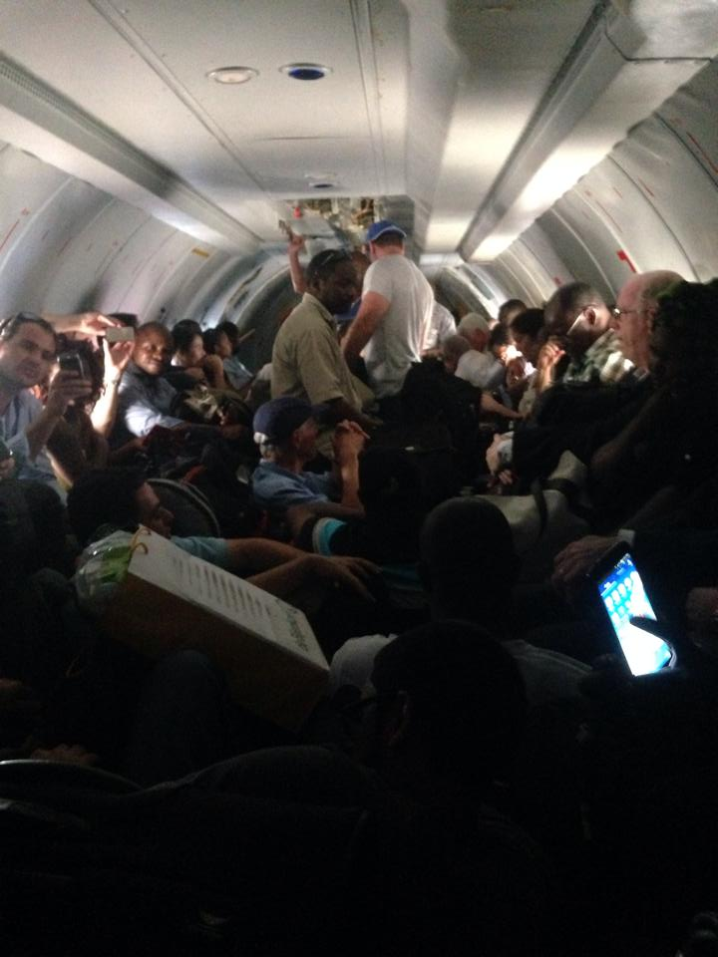
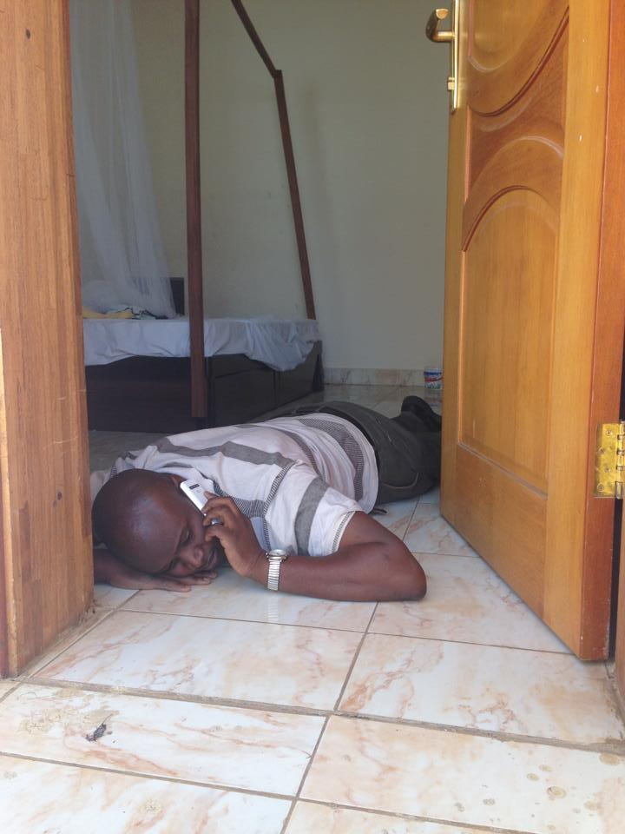
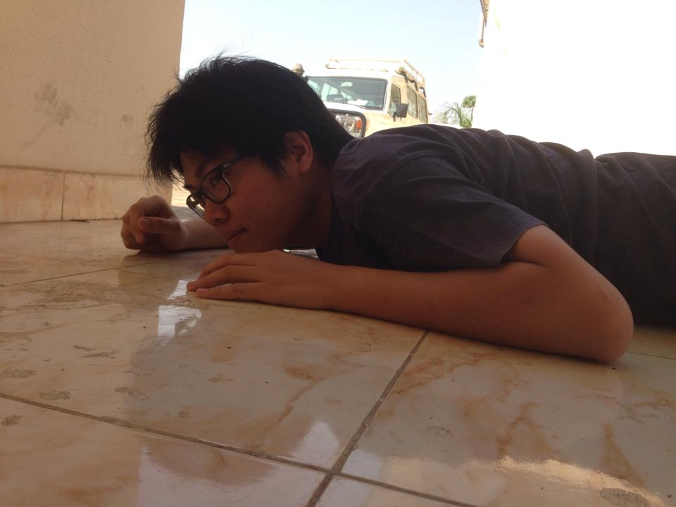
Terrorism
Military Coups

Slide 40

Always find a way to adapt

Slide 41
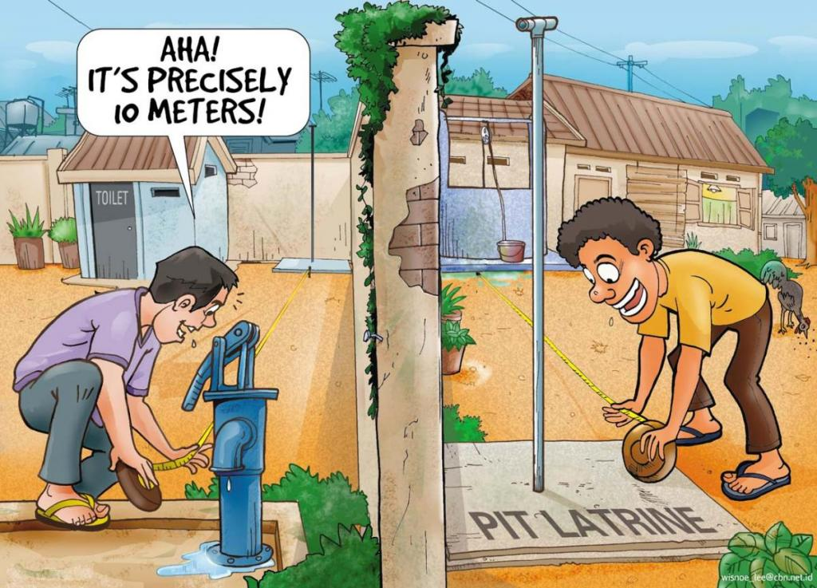

Slide 42
Exercise
Break into 4-5 groups (group of 4-5 people)
1 Piece of newspaper

