Slide 1
Source: Jansson (2013), Chapter 4
Optimal market area
Earlier we learned about production and cost functions of individual service provider
  production cost function f(q)
  distribution cost function g(m)
Now we try to combine these two cost functions and examine the result of basic trade-off to determine the optimal market area of a particular service producer.
Market area is the central concept of spatial economics and typically left out of consideration in mainstream economics, where instead the market form in the sense of competitive conditions in different industries is fundamental
In this part, we focus on the concept of market areas. It is explained why the sizes of market areas of different service providers are systematically very different.

Slide 2
Source: Jansson (2013), Chapter 5
Optimal market area
Assumptions (Fundamental model)
A particular country is divided into a number of regions, such that each region can be assumed to have a reasonably uniform population density
There are densely populated, mainly urban areas, and there are more or less sparsely populated regions.
One region is now considered a possible market to be supplied with a particular service.
Start from a situation in which there is no supply at all of this service in the region concerned, and take the point of view of a producer considering the establishment of a single plant.
Relevant questions are
  What production capacity should be chosen and
  How large market area should be covered in the distribution to minimize the sum of the average production and distribution costs.
If the whole region is to be supplied with the service concerned similar plants should be established in the middle of market areas of the same size until the total area of the region concerned is covered

Slide 3
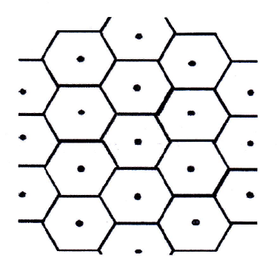
Slice of a service-supply system in a uniformly populated region
Source: Figure 5.1 in Jansson (2013), P.68

Slide 4
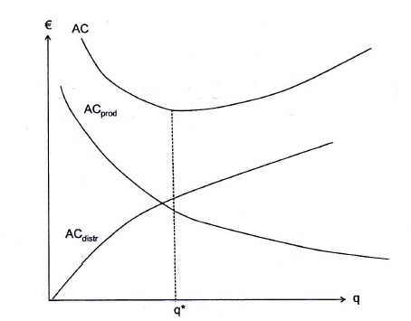
The basis trade-off between the production and distribution costs
Source: Figure 5.2 in Jansson (2013), P.69

Slide 5
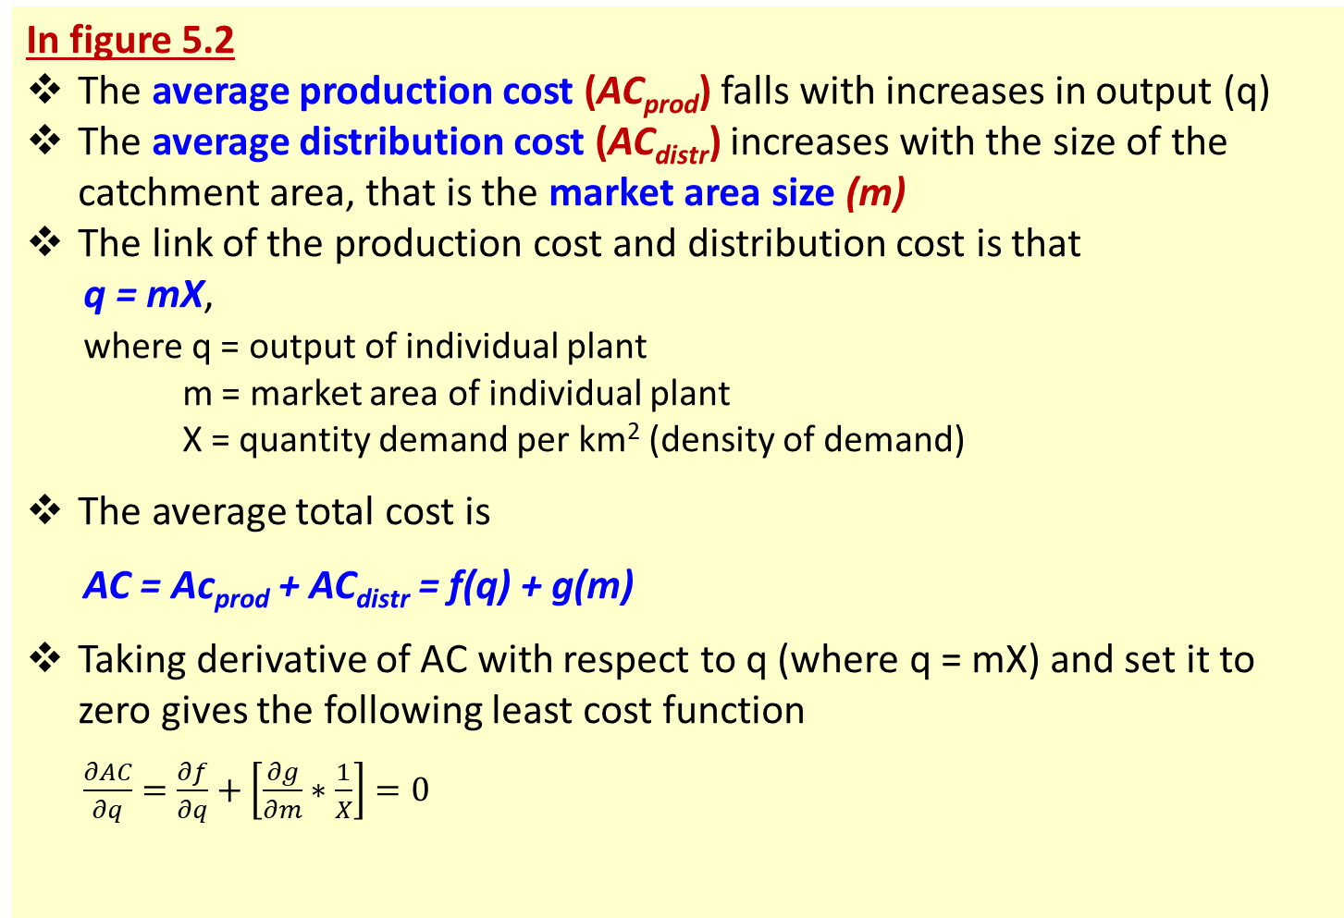
Source: Jansson (2013), Chapter 5
Optimal market area
In figure 5.2
The average production cost (AC_{prod}) falls with increases in output (q)
The average distribution cost (AC_{distr}) increases with the size of the catchment area, that is the market area size (m)
The link of the production cost and distribution cost is that
q = mX,
where q = output of individual plant
m = market area of individual plant
X = quantity demand per km² (density of demand)
The average total cost is
AC = Ac_{prod} + AC_{distr} = f(q) + g(m)
Taking derivative of AC with respect to q (where q = mX) and set it to zero gives the following least cost function
$\frac{∂AC}{∂q}=\frac{∂f}{∂q}+\left[\frac{∂g}{∂m}∗\frac{1}{X}\right]=0$

Slide 6
Source: Jansson (2013), Chapter 5
Optimal market area (catchment areas for public service providers)
In a welfare state (like Sweden)
  a majority of the total service consumption is tax-financed
  These services are provided free of charge
  Therefore, it is natural to regard X (density of demand or quantity demand per km²) as given, and just consider the number of plants in the service supply-systems that minimizes the total production and distribution costs of given level of demand.
It is quite interesting that the average market area size is widely different between service sub-sectors
  Typical neighborhood services: e. g. nurseries, primary school and public health centers.
  City district level: e.g. high school, a sports ground and a public swimming pool
  City level: e.g. municipal library, a theatre and various local authorities rendering different services to the citizens, and some cases a university
  County wide market area: e.g. big hospitals with a comprehensive range of facilities.
  National level: e.g. major museums, the opera, the national theatre, the supreme court (typically located in the capital)

Slide 7
Source: Jansson (2013), Chapter 5
Optimal market area (catchment areas for public service providers)
Why average market area size is widely different between service sub-sectors?
  Jurisdiction: the reception areas of schools, health care centers, and so on should be confined to the administrative areas of the financing body (such as different municipalities, countries, or state)
  Based on model of the production and distribution cost trade-off (explained in the next slides)

Slide 8
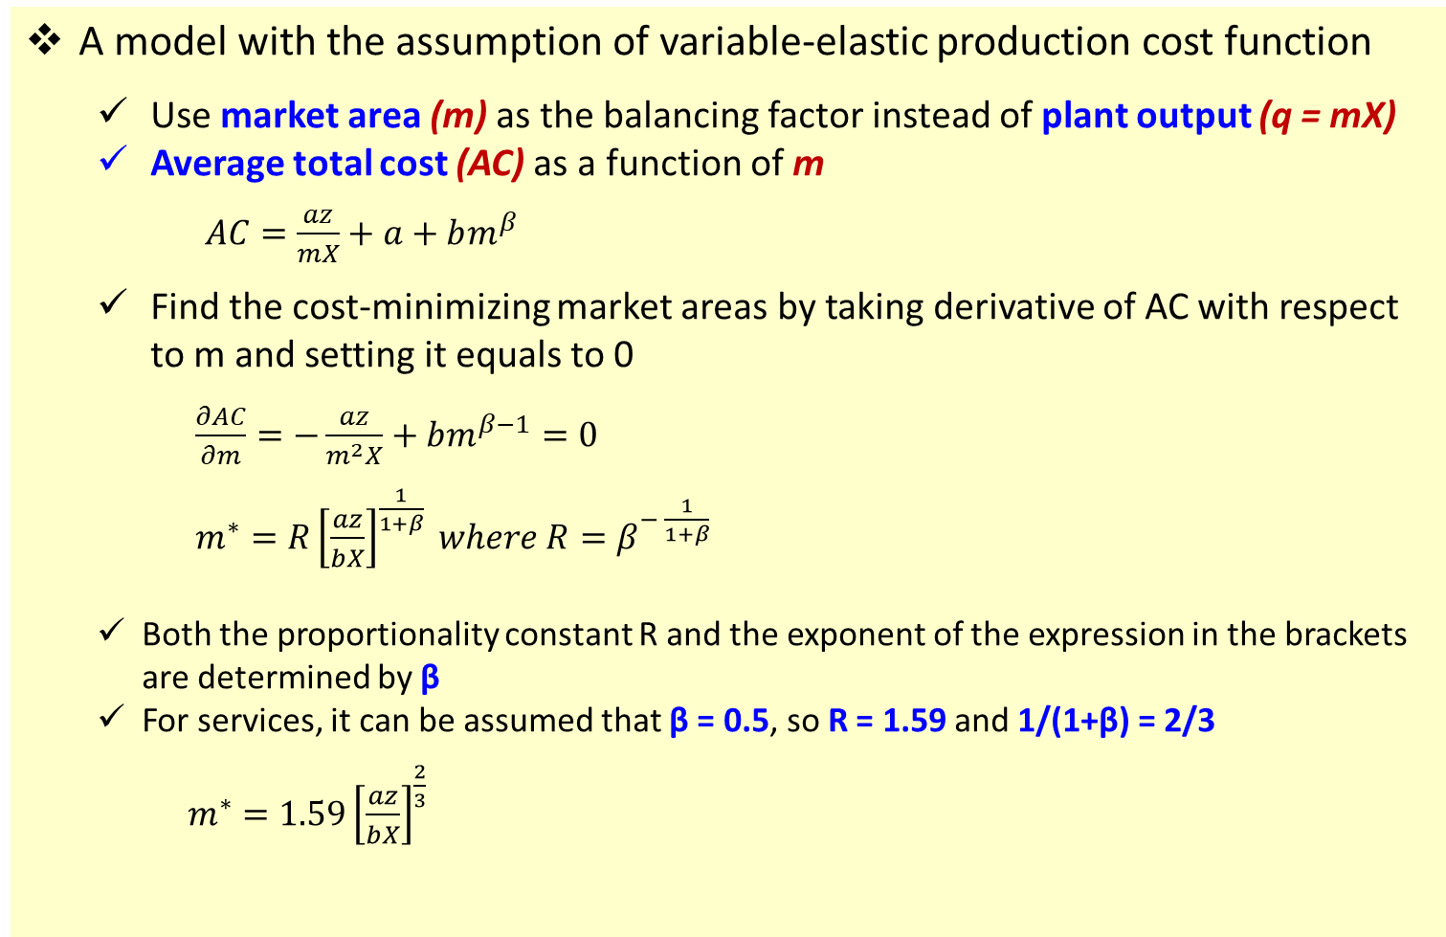
Source: Jansson (2013), Chapter 5
Optimal market area (catchment areas for public service providers)
A model with the assumption of variable-elastic production cost function
  Use market area (m) as the balancing factor instead of plant output (q = mX)
  Average total cost (AC) as a function of m
  $AC=\frac{az}{mX}+a+bm^{β}$
  Find the cost-minimizing market areas by taking derivative of AC with respect to m and setting it equals to 0
  $\frac{∂AC}{∂m}=−\frac{az}{m^{2}X}+bm^{β−1}=0$
  $m^{∗}=R{\left[\frac{az}{bX}\right]}^{\frac{1}{1+β}} where R=β^{− \frac{1}{1+β}}$
  Both the proportionality constant R and the exponent of the expression in the brackets are determined by β
  For services, it can be assumed that β = 0.5, so R = 1.59 and 1/(1+β) = 2/3
  $m^{∗}=1.59{\left[\frac{az}{bX}\right]}^{\frac{2}{3}}$
a = unit value
z = the plant size economies
b = mode-specific travel cost indicator
x = density of demand
m = market area

Slide 9
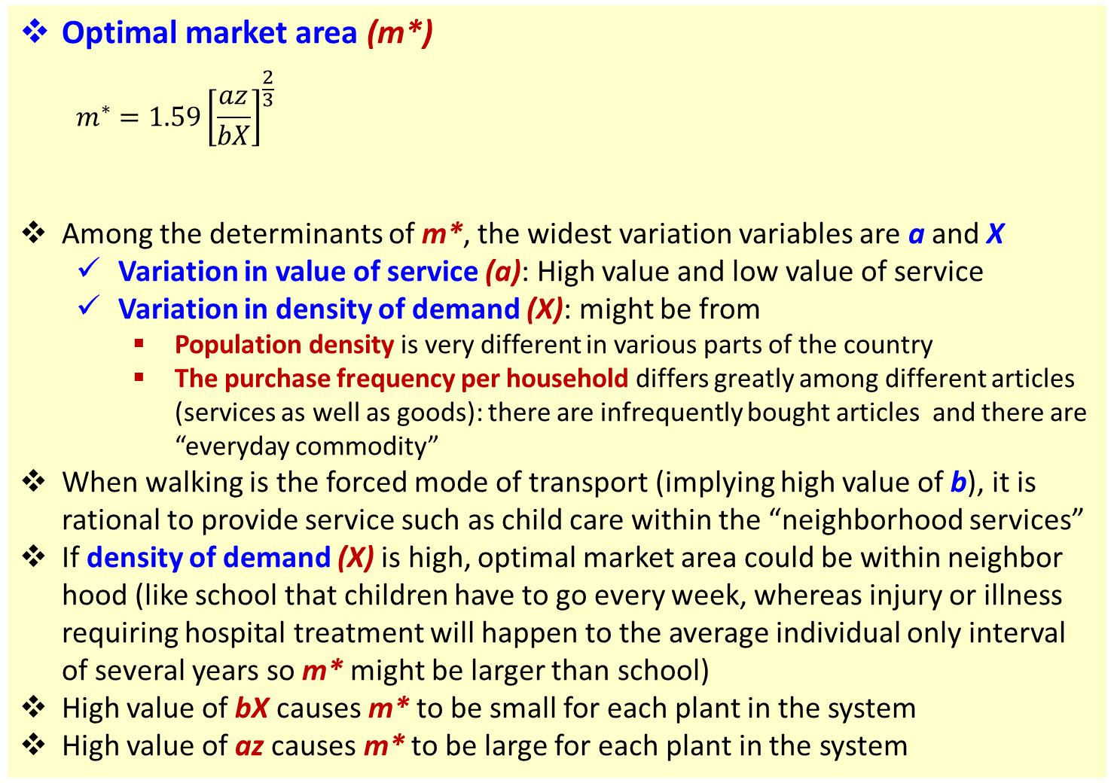
Source: Jansson (2013), Chapter 5
Optimal market area (catchment areas for public service providers)
Optimal market area (m*)
  $$m^{∗}=1.59{\left[\frac{az}{bX}\right]}^{\frac{2}{3}}$$
Among the determinants of m*, the widest variation variables are a and X
  Variation in value of service (a): High value and low value of service
  Variation in density of demand (X): might be from
    Population density is very different in various parts of the country
    The purchase frequency per household differs greatly among different articles (services as well as goods): there are infrequently bought articles and there are “everyday commodity”
When walking is the forced mode of transport (implying high value of b), it is rational to provide service such as child care within the “neighborhood services”
If density of demand (X) is high, optimal market area could be within neighbor hood (like school that children have to go every week, whereas injury or illness requiring hospital treatment will happen to the average individual only interval of several years so m* might be larger than school)
High value of bX causes m* to be small for each plant in the system
High value of az causes m* to be large for each plant in the system
a = unit value of service
z = the plant size economies
b = mode-specific travel cost indicator
x = density of demand
m = market area

Slide 10
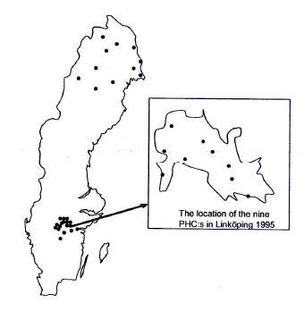
The location of public health centres (PHCs) in different parts of Sweden.
Supply system in the case of PHCs in three areas of different parts of Sweden
The sparsely populated, most northerly region of Sweden (county of Norrbotten)
The relatively densely populated county of Östergötland
The built-up area of Linköping, the chief town of Östergötland
Compared to Norrbotten,
  the density of demand of Östergötland is 17 times higher
  the density of demand of Linköping is 747 times higher
Compared to Linköping
  the average travel distance for PHC patients in Östergötland is 4 times longer
  the average travel distance for PHC patients in Norrbotten is 25 times longer
Source: Figure 5.3 in Jansson (2013), P.72

Slide 11
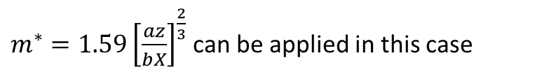
Catchment areas of Public Health Centres.
District | Density of demand: annual number of patients/km² | Average catchment area, km²
 |  | actual | Model estimated
(1) The county of Norrbotten | 4 | 7855 | 9503
(2) The county of Östergötland | 67 | 485 | 499
(3) The town of Linköping | 2986 | 13 | 17
$m^{∗}=1.59{\left[\frac{az}{bX}\right]}^{\frac{2}{3}}$ can be applied in this case
Source: Table 5.1 in Jansson (2013), P.73, original source from Wall (2001)

Slide 12
Source: Jansson (2013), Chapter 5
Market areas of private service provider
Optimal market areas could be found based on three approaches
  Supply system cost-minimization
  Chamberlinian monopolistic competition
  Clustering

Slide 13
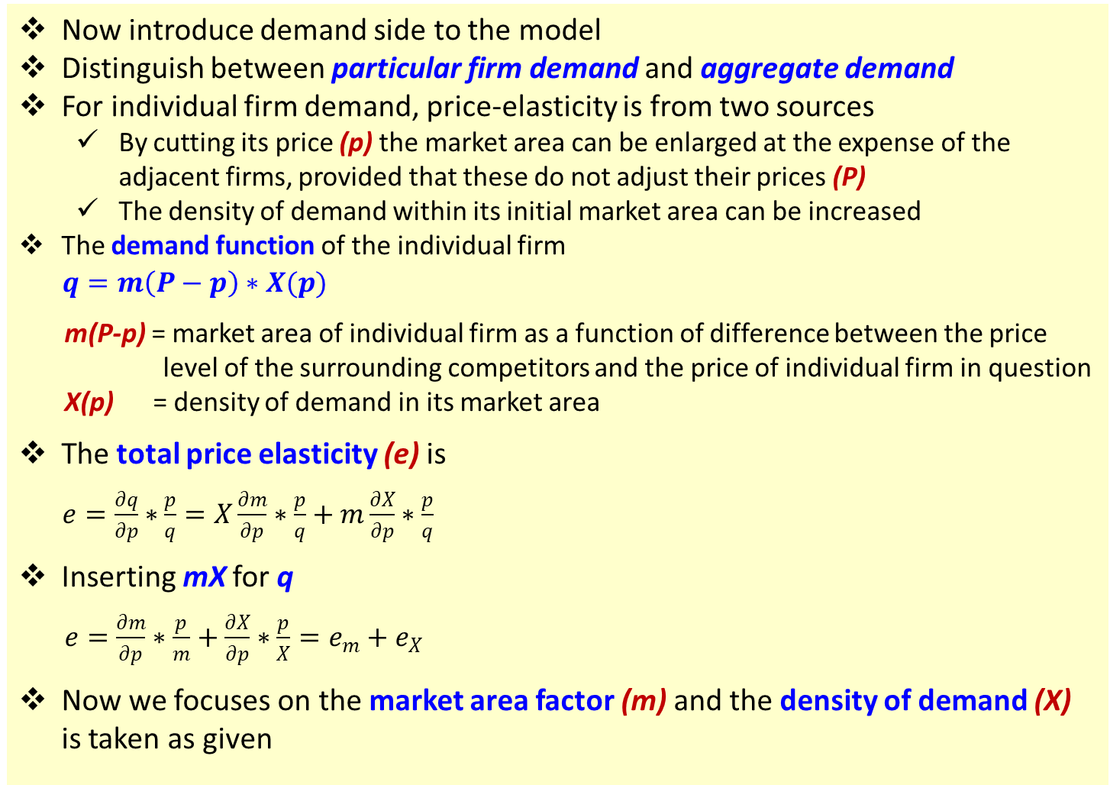
Source: Jansson (2013), Chapter 5
Chamberlinian model of the spatial industrial organization
Now introduce demand side to the model
Distinguish between particular firm demand and aggregate demand
For individual firm demand, price-elasticity is from two sources
  By cutting its price (p) the market area can be enlarged at the expense of the adjacent firms, provided that these do not adjust their prices (P)
  The density of demand within its initial market area can be increased
The demand function of the individual firm
$q=m\left(P−p\right)∗X(p)$
m(P-p) = market area of individual firm as a function of difference between the price
level of the surrounding competitors and the price of individual firm in question
X(p) = density of demand in its market area
The total price elasticity (e) is
$e=\frac{∂q}{∂p}∗\frac{p}{q}=X\frac{∂m}{∂p}∗\frac{p}{q}+m\frac{∂X}{∂p}∗\frac{p}{q}$
Inserting mX for q
$e=\frac{∂m}{∂p}∗\frac{p}{m}+\frac{∂X}{∂p}∗\frac{p}{X}=e_{m}+e_{X}$
Now we focuses on the market area factor (m) and the density of demand (X) is taken as given

Slide 14
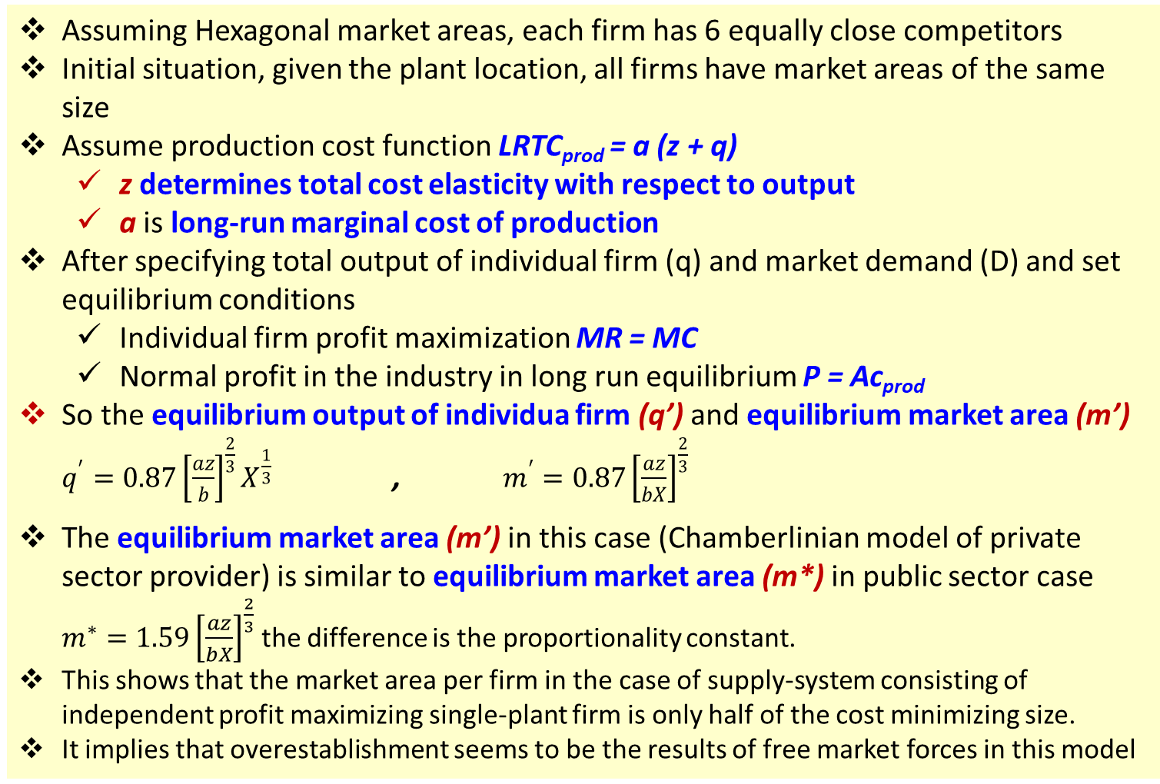
Source: Jansson (2013), Chapter 5
Chamberlinian model of the spatial industrial organization
Assuming Hexagonal market areas, each firm has 6 equally close competitors
Initial situation, given the plant location, all firms have market areas of the same size
Assume production cost function LRTC_{prod} = a (z + q)
  z determines total cost elasticity with respect to output
  a is long-run marginal cost of production
After specifying total output of individual firm (q) and market demand (D) and set equilibrium conditions
  Individual firm profit maximization MR = MC
  Normal profit in the industry in long run equilibrium P = Ac_{prod}
So the equilibrium output of individua firm (q’) and equilibrium market area (m’) $q^{′}=0.87{\left[\frac{az}{b}\right]}^{\frac{2}{3}}X^{\frac{1}{3}}$ , $m^{′}=0.87{\left[\frac{az}{bX}\right]}^{\frac{2}{3}}$
The equilibrium market area (m’) in this case (Chamberlinian model of private sector provider) is similar to equilibrium market area (m*) in public sector case $m^{∗}=1.59{\left[\frac{az}{bX}\right]}^{\frac{2}{3}}$ the difference is the proportionality constant.
This shows that the market area per firm in the case of supply-system consisting of independent profit maximizing single-plant firm is only half of the cost minimizing size.
It implies that overestablishment seems to be the results of free market forces in this model

Slide 15
Source: Jansson (2013), Chapter 5
The costs of clustering
The concept of “agglomeration benefits”
The observed concentrations of firms/plants in some new industries
Clusters are normally formed by producer service firms.
In the case of consumer services where agglomeration benefits can be assumed to be negligible.
The basic trade-off model,
  the question is “if the total costs, including all of the user efforts, were substantially higher in a cluster than with an evenly dispersed pattern of plant location, the latter pattern tends to arise”
  A comparison of the average total cost of an even dispersal of plants of an industry and a cluster of firms’ plant
The simple model’s assumptions
  It is assumed that customers are evenly spread over space
  The transportation cost per kilometer is the same everywhere
  We start from the cost-minimizing pattern of location, where each firm/plant has a market area of its own. Then we take 5 plants and put them in the middle of the total area covered by those five.
Sensitivity analysis shows that
  The unit value (a) and the demand density (X) are the most important factors

Slide 16
Relative additional cost (percentage) of a cluster of five compared to a total cost-minimizing dispersal of plants
Unit value proxy, a | Demand density, X
 | 1 | 10 | 100 | 1000 | 10000
1 | 117 | 110 | 98 | 80 | 57
10 | 98 | 80 | 57 | 35 | 19
100 | 57 | 35 | 19 | 10 | 6
1000 | 19 | 10 | 6 | 2 | 1
10000 | 6 | 2 | 1 | 0 | 0
Source: Table 5.2 in Jansson (2013), P.78
Note:
The table shows the relative cost additions for a wide range of unit value (a) and the demand density (X)
The calculation assume general travel by car, and total cost elasticity with respect to output or the plant size economies variable (z) is set as 5, value from previous research

Slide 17
Source: Jansson (2013), Chapter 5
The costs of clustering
From Table 5.2: interesting points are
It is striking how difference the figures are in the upper left and the lower right parts.
It does not matter very much if a number of providers of very high-value service (high value of a) are located in the same street in a densely populated town or city.
On the other hand, it is obvious that it would be very cost inefficient to allow a considerable number of low-value service providers in a more sparsely populated area to form a cluster

Slide 18
3. Supply and demand at the system level
When we learn about supply of service we talk about
  Average production cost function f(q) ,q is quantity of service
  Average distribution costs of the circle of consumers provided for by a representative service producer g(m) ,m is market area of a service provider
  The system analysis required for considerable trade-off between production and distribution costs, optimal market areas by assuming a constant density of demand (X)
In this part we will relax the constant density of demand assumption and look at
  The system cost function
  The system demand function
  Market equilibrium

Slide 19
Source: Jansson (2013), Chapter 7
The system cost function
The purpose of this section is to derive a long-run (total adjustment) system cost function
The production and distribution cost trade-off is the core of this derivation
Now, the density of demand (X), which kept constant in the previous discussion, is the central variable and determinant of the system cost

Slide 20
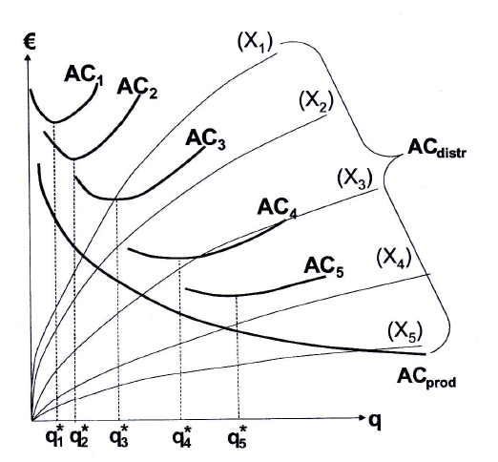
The production and distribution cost trade-off with respect to plant output for achieving the minimum average total cost for different values of the demand density (X_{i})
Source: Figure 7.1 in Jansson (2013), P. 91

Slide 21
Source: Jansson (2013), Chapter 7
The system cost function
Based on Figure 7.1 in Jansson (2013),
The figure shows how to move from the costs of an individual plant to the system cost level
It is not the regional demand that matters but the density of demand (X)
The figure shows a bundle of AC_{distr} curves, each associated to a particular level of the density of demand (X)
The higher the value of X the lower the distribution cost per unit. So the AC_{distr} successively falling as X increasing (from X₁ to X₂, X₃, X₄, X₅)
The Ac_{distr} have a shape that follows from assuming that the trip cost is proportional to distance
Where the slope of a particular distribution cost curve is equal to the absolute value of the slope of AC_{prod}, the cost-minimizing plant output (q*) is found for that particular demand density (X)
Note: The last point is from when we learned about basic trade-off between
average production cost and average distribution cost (explanation of
Figure 5.2 and relevant equations in Jansson (2013), chapter 5

Slide 22
Source: Jansson (2013), Chapter 7
The system demand function
The demand function that matches the system supply function is that the dependent variable should be the density of demand (X), the quantity of demand per km². As long as it can be assumed that the uniformly populated region in question is large enough to house a fair number of plants/firms
P.S. If the region concerned is a limited urban area, the appropriate
demand function can be defined to represent the whole town, and
the dependent variable (Q) stands for the demand of all people in
the whole town
The idea is that the result of the interplay of supply and demand in a particular region of uniform population density results in the same price charged and quantity produced at all plants in the region, and the focus is on the demand density

Slide 23
Source: Jansson (2013), Chapter 7
The system of demand function
Generalised Costs
In general, system cost is the sum of the producer costs and user costs
The users normally have to go to the place of production to get service, so far from what we learned this was called “distribution”
The cost to the user of taking possession of non-transportable goods consequently includes both the ordinary price charged by the producer at the place of production and the distribution cost borne by the user.
A corresponding complementary addition must be added to the demand side. This is standard procedure in transport economics, where “generalized cost” replaces price as the main argument in the demand function.
Generalised cost function is
GC = P + AC_{distr} + c
C is other possible user cost item that should be included in the generalized cost in supply and demand analysis of non-storable and non-transportable goods
  For this kind of good, production and consumption must be done not only at the same place but also simultaneously, which means consumer must sacrifice their time in the production → consumer time cost
  However, for now we ignore c by assuming that c is a constant which does not affect the basic producer and user cost trade-off

Slide 24
Source: Jansson (2013), Chapter 7
The system of demand function
A product of two factors
Now we explicitly specify the market demand function at the system level as a products of two factors
X_{i} = h(GC) * D_{i}
X_{i} = demand for a particular product per km² in region I
h(GC) = demand of the representative consumer
D_{i} = density of population in region i
In a national perspective, the demand of a representative consumer can be assumed to be the same for each particular product all over the country, while the population density obviously displays a very wide variation
For the choice of production plant capacity in the case of most transportable goods these extreme wide variations are relatively inconsequential because of low transport costs, but certainly a main concern for providing non-transportable goods

Slide 25
Source: Jansson (2013), Chapter 7
Market equilibrium
Based on Figure 7.2 in Jansson (2013)
Demand function and demand curve
From Demand function or density of demand (X) is from multiplying the individual demand by the population density
X_{i} = h(GC) * D_{i}
X_{i} = demand for a particular product per km² in region I
h(GC) = demand of the representative consumer
D_{i} = density of population in region i
  This means that the slope of the demand functions becomes successively flatter the higher the population density
    Non-urban regions represented by the three steep demand functions (X₁, X₂, and X₃)
    An urban region represented by the flatter demand function (X_{n})
  It is the individual demand of representative consumer that determines the elasticity of demand function of each particular region

Slide 26
Source: Jansson (2013), Chapter 7
Market equilibrium
Based on Figure 7.2 in Jansson (2013)
Demand function and demand curve
It can be assumed that each regional demand has the same starting point at the GC-axis called “reservation GC” such as the cost of a taxi trip of the same length if we consider demand and supply of local bus transport
In an actual case study of a particular region, just one regional demand is applicable. The regional demand must not be aggregated for matching the supply curve (for the study of the D&S of bus transport service, it would not make sense because the demand for local bus transport in one part of town cannot be satisfied by local bus transport in another part, let alone in another town)

Slide 27
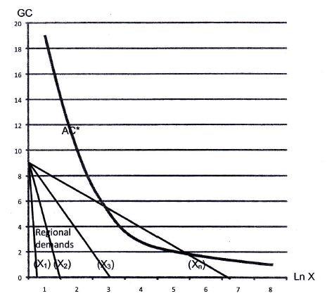
Typical supply and demand constellation for non-transportable goods in regions of different population density.
Source: Figure 7.2 in Jansson (2013), P. 99

Slide 28
Source: Jansson (2013), Chapter 7
Market equilibrium
Based on Figure 7.2 in Jansson (2013)
The system cost function and the AC-curve
The AC-curve is a constant-elastic average system cost function (representing a local bus transport system estimated in Jansson et al. (2013).
The system cost function can be assumed to be applicable everywhere, but it is just that different sections of the function would be relevant for different regions depending on the actual density of demand (X)

Slide 29
Source: Jansson (2013), Chapter 7
Market equilibrium
Based on Figure 7.2 in Jansson (2013)
Market equilibrium
Market equilibrium could be obtained where a regional demand curve and the supply curve intersect or at least tangent to each other
In Figure 7.2, it is only one demand curve in the bunch of regional demands that the requirement for equilibrium is met
This means to suggest that many regions in the sparsely populated parts of Sweden lack local bus transport altogether. Only the urban demand curve gives rise to a viable market.

Slide 30
Source: Jansson (2013), Chapter 7
Market equilibrium
The crucial difference
The difference between graph for non-transportable goods (Figure 7.2) and the structure of supply and demand of easily transportable goods
The easily transportable good case,
  The quantity along the horizontal axis does not represent density of demand (X) but the total demand facing the whole industry concerned (Q) which is a function of P since the distribution cost, including the cost of transport to wholesalers and retailers, is internalized in the producer’s total costs.
  The industry demand is the aggregate of all the regional demand functions
  The long-run AC curve can be assumed to be horizontal (constant) because it represents the plane section of a U-shaped curve of one or more producers operating at the minimum cost level
The non-transportable case (in Figure 7.2)
  The quantity along the horizonal axis is the density of demand (X)
  The regional demand is expressed as demand densities which cannot be added. Each local market must be dealt with one by one

Slide 31
2. Demand for services
Motive analysis of demand
Demand for service consumption and its income elasticity
Intermediate demand for service
  Reading: Zhou (2016) chapter 4

Slide 32
Source: Zhou (2016), Chapter 4
Demand for service consumption and its income elasticity
Factors that might affect demand for service consumption (macro level)
For example
  Consumer income and income growth
  Distribution of income
  e.g.
    Do higher, medium and lower income groups have similar demand for service?
    How might growing middle class income affect the country demand for service?
  Size of population
  Population age structure
  e.g. How aging population trend affect demand for service?
  Urbanization
  e.g. Do people live in urban areas and rural areas have similar demand for
  service?
  Consumer taste
  e.g. new consumption concept (leisure, experience, etc.)

Slide 33
Demand for service consumption and its income elasticity
Income elasticity of demand
Lower income groups have ________elasticity of demand for basic necessities
Higher income groups would consider durable consumer goods and services
According Maslow’s hierarchy of needs and Engel’s law,
  When income level is relatively low, most of consumer spending goes to food, clothing, shelter and other basic needs.
  As income level rises, people spend more in meeting needs for security, social interaction, earning respect, self-realization, etc. These needs are mostly based on services.
  So it is possible that the proportion of service in consumer spending will increase as income rises (some empirical evidences support this argument some don’t)
Note: Maslow’s hierarchy of needs:
  Maslow categorized people’s needs into “physiological”, “safety”, “belongingness” and “love”, “esteem” and “self-actualization” ascending like hierarchy, a developmental process from lower to higher levels.
  Maslow distinguishes the different layers of demand, but not distinguish between product demand and service demand
higher
Source: Zhou (2016), Chapter 4

Slide 34
Demand for service consumption and its income elasticity
Income elasticity of demand for service
To analyze income elasticity of demand for service, Zhou (2016) modified the categorization of people’s needs to “basic necessity”, “improvement”, “well-off”, “affluent” and “advanced” from low to high; at the same time, further differentiating product-based material needs and service-based non-material needs.
Zhou (2016) proposed 4 hypothesis regarding elasticity of demand for service
  Assumption 1: When product and service are in parallel levels of needs, their income elasticity will be basically the same; when the two are in different levels of needs, there will be visible differences in their income elasticity.
  Assumption 2: For both product and service, their primary needs have relatively low income elasticity while their secondary needs have relatively high income elasticity; so the higher the level of needs is, the higher the income elasticity is.
  Assumption 3: On any level of needs, product and service, in terms of types and sizes of demand, each has its own specific composition; corresponding to different level of needs, product and service, in terms of types and sizes of demand, are different.
  Assumption 4: In the composition of types and sizes of demand, the ratio of service demand increases geometrically as the level of needs advances; the ratio of product demand decreases geometrically as the level of needs reduces.
Source: Zhou (2016), Chapter 4

Slide 35
The hierarchy and structure of needs for product and service consumption
Source: Figure 4.1 in Zhou (2016)
According to Zhou (2016),
As the level of needs advances, types and sizes of product demand tend to decrease demonstrating a pyramidal structure, while those of service demand tend to increase demonstrating an inverted pyramidal structure.
The higher the level of needs, the higher the income elasticity.
As the level of needs goes up, the service demand ratio on the basis of the gradual increase of income elasticity will increase geometrically and will gradually play a dominant role in consumption demand.
Conclusion: As the income level increases and the level of needs goes up, types and sizes of service demand continuously extend and have higher income elasticity, which means that people’s consumption demand leans towards service and service with higher income elasticity, causing the proportion of service industry to rise and promoting economic development.

Slide 36
Intermediate demand for service
Final demand for service always plays a dominant role in the aggregate demand for service and an important role in promoting the development of the service an important role in promoting the development of the service.
However, the growth of income-based final demand for service, especially consumer demand is comparatively steady, approximately at a uniform speed, despite some fluctuations when certain spending spree rises.
In the circumstances of insignificant changes in consumptive demand structure, the accelerated development of the service industry is mainly promoted by rapid increase of intermediate demand for service.
As production systems, production factors and production links change, service activities penetrate into every part of the production links and complement with commodities in the industrial process, which makes the intermediate demand for service the most dynamic and the fastest-growing demand and renders service output a crucial factor in the economic development and operation and gives it a gradually prominent status in the service economy.
Source: Zhou (2016), Chapter 4

Slide 37
Intermediate demand for service
Factors that might affect intermediate demand for service (macro level)
Specialization of social production and technological advancement: in both manufacturing and service sectors
  In manufacturing, due to the development of the complexity and diversity of material production and the specialized division of labor in production, some service functions separate themselves from manufacturing to form independent producer services.
  As the sizes of the service industry grows, the intermediate demand for service between sectors within the service industry will increase, developing a powerful reproductive capacity in the service economy.
Level of economic development (income)?:
  In the agricultural era, the specialization of social production was low. When the industrial era came, with the development of roundabout production, the specialization of social production gradually enhanced and even suggested an accelerated feature. According to this logic, the intermediate demand for service derived from the specialization of social production is ultimately determined by the level of economic development (income level).
  However, it may not be appropriate to directly use the theory of income elasticity of demand to explain the growth of intermediate demand for service and the development of producer service.
Source: Zhou (2016), Chapter 4

