Slide 1


Chapter 1
Chapter 2
Assessing the Internal Marketing Situation
MK 312 Marketing Management
By
Aj. Suwalya K.
Semester 1/2017

Slide 2
Ch. 2 - Learning objectives
After studying this chapter you should be able to:
■ describe the difference between the Market Orientation View (MOV) and the Resource Based View (RBV)
■ discuss the connection between MOV/RBV and market driven/market driving
■ explain the ‘competitive triangle’
■ describe and discuss the drivers for customers’ ‘perceived value’ and ‘relative costs’.

Slide 3

Mission

Slide 4

The mission and vision statement
The foundation of any marketing plan is the firm’s mission and vision statement, which answers the question, ‘What business are we in and where should we go?’

Slide 5
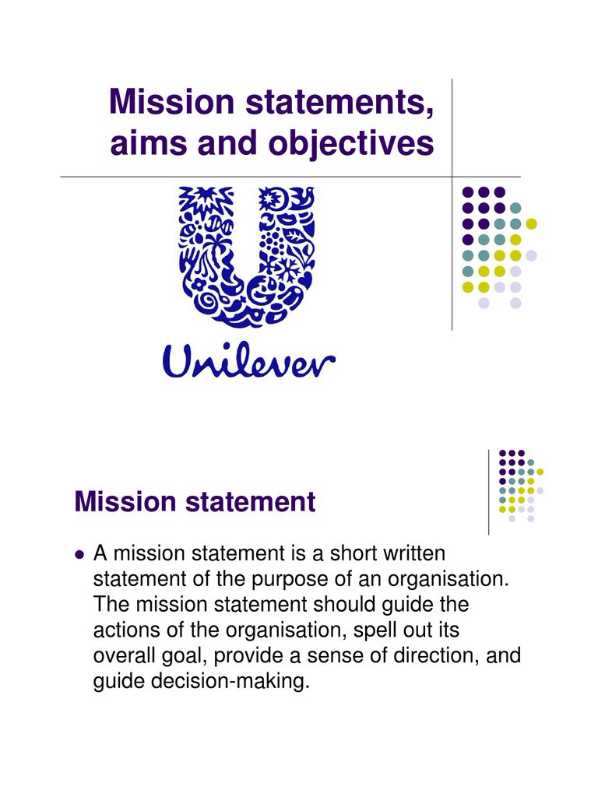

Slide 6
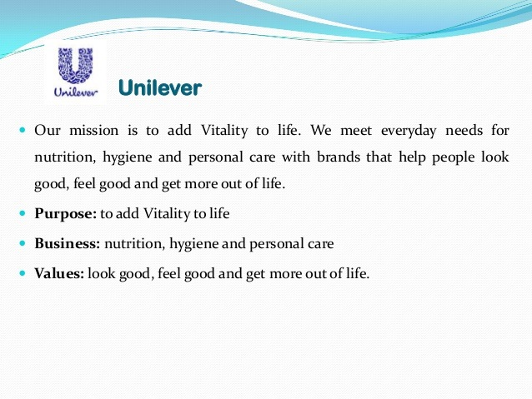

Slide 7
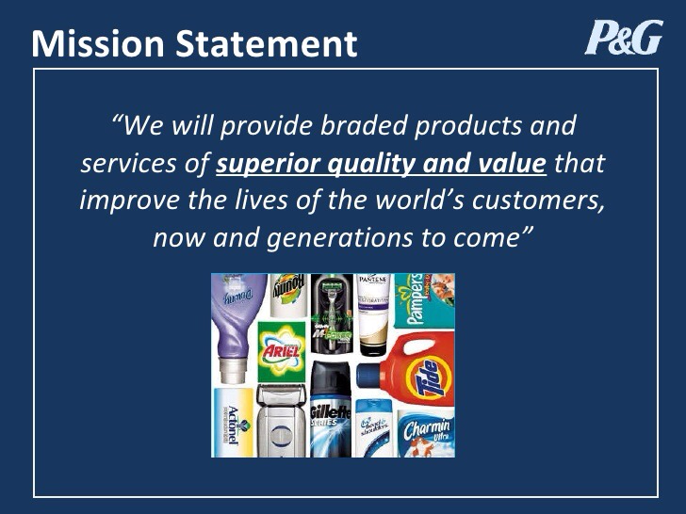

Slide 8


Slide 9
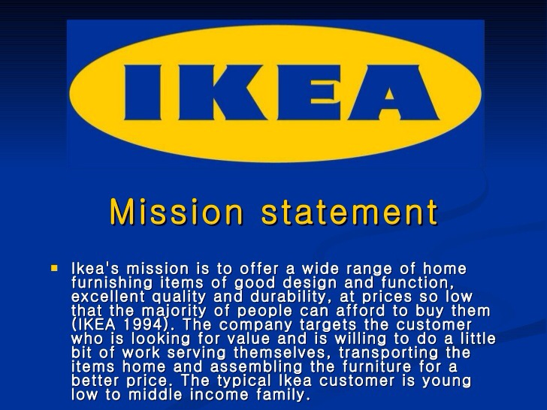

Slide 10

RBV vs. MOV

Slide 11

RBV vs. MOV
The Resource Based View (RBV) is an inside-out perspective
The Market Orientation View (MOV) is an outside-in perspective as illustrated below

Slide 12

Market Orientation View
A market orientation entails:
one or more departments engaging in activities geared toward developing an understanding of customers’ current and future needs and the factors affecting them,
(2) sharing of this understanding across departments, and
(3) the various departments engaging in activities designed to meet select customer needs.
In other words, a market orientation refers to the organization-wide generation, dissemination, and responsiveness to market intelligence.

Slide 13
Market Orientation View
In essence, market orientation refers to the way a firm implements the marketing concept.
In MOV it is also clear that a deep understanding of the competition in the market from the customer’s perspective is critical.
It should be emphasized that a market orientation is not the exclusive responsibility of a marketing department but, rather, is a company-wide mode of operation.

Slide 14
Market Orientation View
In MOV it is also clear that a deep understanding of the customers and the competition in the market is critical.
Viewing the product or service from the customer’s viewpoint is often difficult, but without such a perspective a marketing strategy is highly vulnerable to attack from unsuspected sources of competition.

Slide 15

Resource Based View
The RBV suggests that high performance strategy is dependent primarily on historically developed resource endowments
Resource-based marketing essentially seeks a long-term fit between the requirements of the market and the abilities of the organization to compete in it.

Slide 16
Resource Based View
The essential factor in is that opportunities are seized where the organization has an existing or potential advantage through its resource base, rather than just pursued ad hoc.
The RBV can also be linked to the core competencies issue considered below. It is about the understanding what a company is capable of achieving by exploiting its capabilities in the marketplace.

Slide 17
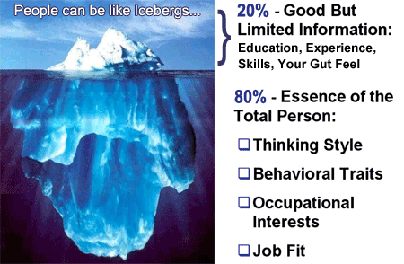
The types of resources and capabilities
Technical resources
Financial standing
Managerial skills
Organization
Information systems

Slide 18
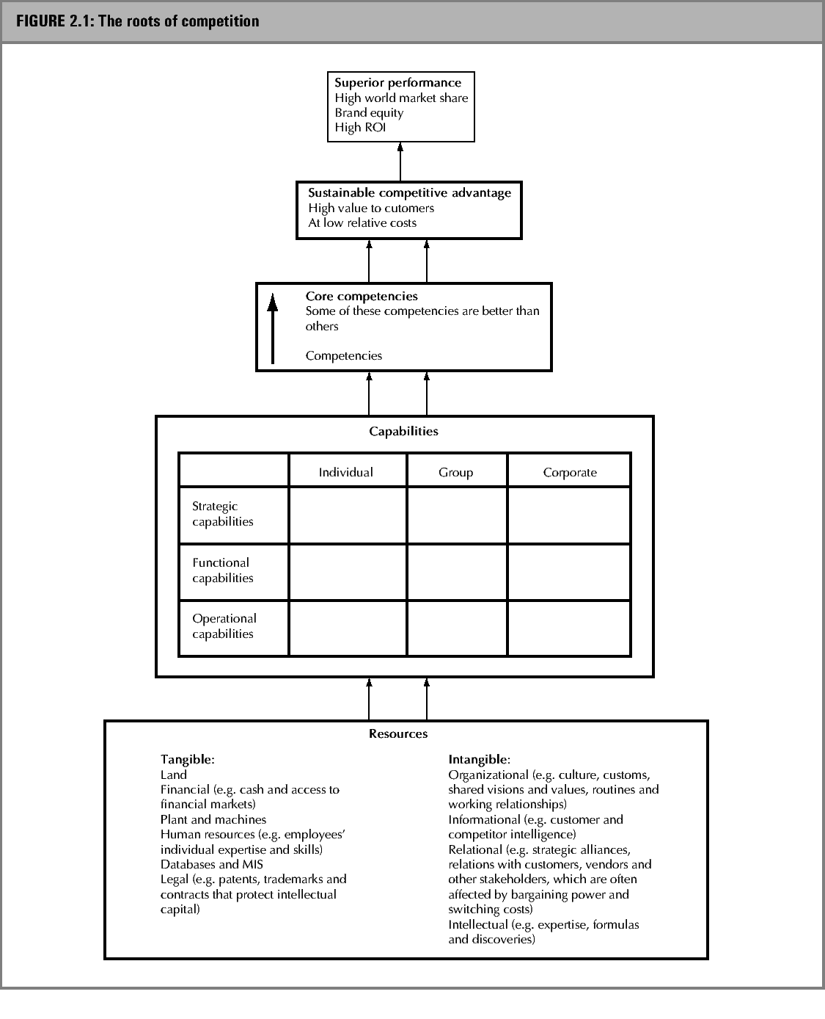
Figure 2.1: The roots of
competition

Slide 19
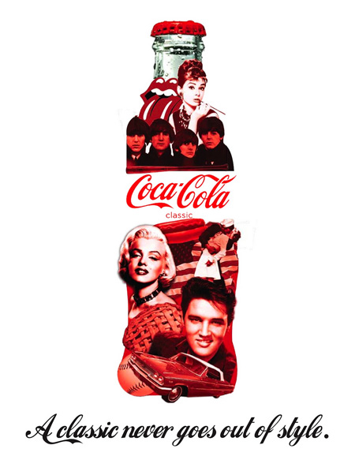
Resources
Resources are broken down into two fundamental categories:
Tangible resources: include those factors containing financial or physical value as measured by the firm’s balance sheets.
Intangible resources: those factors that are non-physical (non-financial) in nature and not in balance sheet.

Slide 20
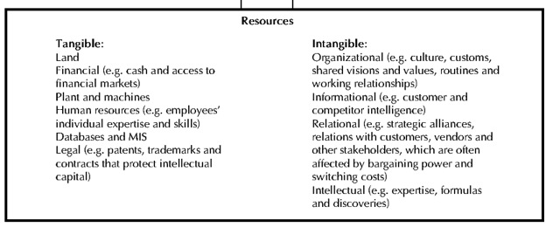
Tangible resources
Figure 2.1: The roots of
competition

Slide 21

Intangible resources
Intangible resources fall into two categories: assets and skills (capabilities).
“ If the intangible resource is something that the firm ‘has’, it is an asset. If the intangible resource is something that the firm ‘does’ it is a skill and it is being turned into a capability. However, the distinction between assets and capabilities may not be so easy to make.”

Slide 22

Intangible resources
Intangible assets such as copyrights, patents, registered designs and trademarks are all afforded legal protection through property rights. Such legal protection can create barriers to competitive duplication.

Slide 23

Capabilities
According to fig.2.1, capabilities can be seen as strategic, functional or operational.
  Strategic capabilities: underpin the definition of direction for the firm. They include issues such as the dominant logic or orientation guiding management (which will strongly influence strategic direction), the ability of the organization to learn (to acquire, assimilate and act on information) and the ability of senior managers to manage the implementation of strategy.

Slide 24

Capabilities
  Functional capabilities: lie in the execution of functional tasks. These include marketing capabilities and operations management capabilities.
  Operational capabilities: are concerned with undertaking individual line tasks, such as operating machinery, the application of information systems and completion of order processing.

Slide 25
Competencies
Second, capabilities may lie with individuals, with groups or at the corporate level.
  Individual competencies: are the skills and abilities of individuals within the organization. They include the ability of the individual to analyze critically and assess a given situation (whether this is a CEO assessing a strategic problem or the shop floor worker assessing the impact of a machine failure).

Slide 26
Competencies
Group competencies are where individual abilities come together in teams or ad hoc, informal, task related teams. While the abilities of individuals important, so too is their ability to work together constructively.
Corporate-level competencies relate to the abilities of the firm as a whole to undertake strategic, functional or operational tasks. This could include the ability of the firm to internalize learning, so that critical information is not held just by individuals, but shared throughout the firm.

Slide 27

Core competencies
The need to identify the ‘distinctive competency’ of a company is underlined by a very influential analysis of successful international businesses by Prahalad and Hamel (1990), who argue that a company is likely to be genuinely world class at perhaps five or six activities, and superior performance will come from focusing on those to the exclusion of others.

Slide 28

Core competencies
Prahalad and Hamel (1990) define core competencies as the underlying skills, technologies and competencies that can be combined in different ways to create the next generation of products and services

Slide 29

Core competencies
Three tests are suggested by Prahalad and Hamel for identifying core competencies.
1. A core competency should be difficult for competitors to copy. Clearly a competency that can be defended against competitors has greater value than a competency that other companies can share.
2. A core competency provides potential access to a wide variety of markets.
3 A. core competency should make a significant contribution to the benefits the customer derives from using the ultimate product or service.

Slide 30

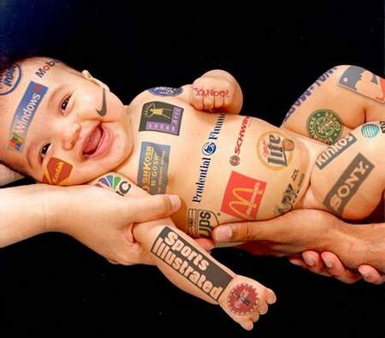
Points to be taken
It may be helpful to identify core competencies but then to see which of them are ‘differentiating capabilities’ (ie. which produce competitive advantage)

Slide 31
Points to be taken:
Activities are not the same as competencies:
  ‘quality products’ and ‘marketing strength’ are not competencies, they are attributes emerging from core competencies
  Ex. In the 1980’s General Electric focused on marketing to build a strong brand image, but lost out to Panasonic (Matsushita), which understood that excellence in components and assembly has greater impact on value added for the customer.

Slide 32
Points to be taken:
Avoid lists: by definition, core competencies should be no more than a handful of activities. Most successful companies have targeted one or two key activities – their identification is a major management issue.
Achieve management consensus: if competencies are to be nurtured and shared widely in the organization as the basis for strategy, the management must not be straightforward.

Slide 33
Points to be taken:
Leverage core competencies: it is not enough to identify core competencies and agree what they are. This is pointless unless they underpin all strategic decision making.
Share core competencies outside the organization: Focusing on core competencies may well favor the use of collaboration to link the value-adding competencies of other companies.

Slide 34

Market driven versus market driving
The market –driven approach is derived from the construct and principles of ‘market orientation’ that are in many ways synonymous with ‘market driven’.
However, instead of following the request of customer and adapting offerings, organizations sometimes need to undertake a more proactive approach in order to reshape, educate and lead the customer or, more generally, the market.
Academicians define this kind of orientation as
‘driving market’ or ‘market driving’

Slide 35
Market-driven vs. market-driving

Slide 36
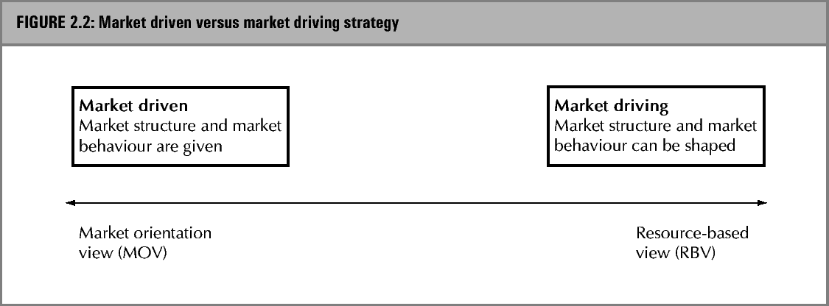
Market-driven vs. market-driving

Slide 37

Market driven approach
This is defined as ‘the activities of learning, understanding, and responding to stakeholder perceptions and behaviors within a given market structure’ while a market-driving approach is defined as ‘changing the composition and/or roles of players in a market and/or the behavior (s) of players in the market
      Exhibit 2.1 Reuter’s core competency is eroded pg. 33

Slide 38

The Competitive Triangle

Slide 39
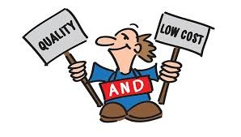
Major sources of competitive advantage: value and costs
Companies producing offerings with a higher perceived value and/or lower relative cost (compared to competitors) are said to have a competitive advantage and thus win the competitive game.
The ‘high perceived value’ advantage can be considered a differentiation, but the elements of this must be evaluated from a comparative customer perspective.

Slide 40

Major sources of competitive advantage: value and costs

Slide 41

Prime consideration of value lie in the question:
Does this resource contribute to creating value for customers?
  Value creation may be direct, such as through the benefits conveyed by superior technology, better service, meaningful brand differentiation and ready availability.

Slide 42

The competitive triangle
The underlying drivers for ‘perceived value’ (value drivers) are also listed in this figure.
The ‘perceived value’ (compared to price) together with the relative cost, is illustrated in Figure 2.3.

Slide 43
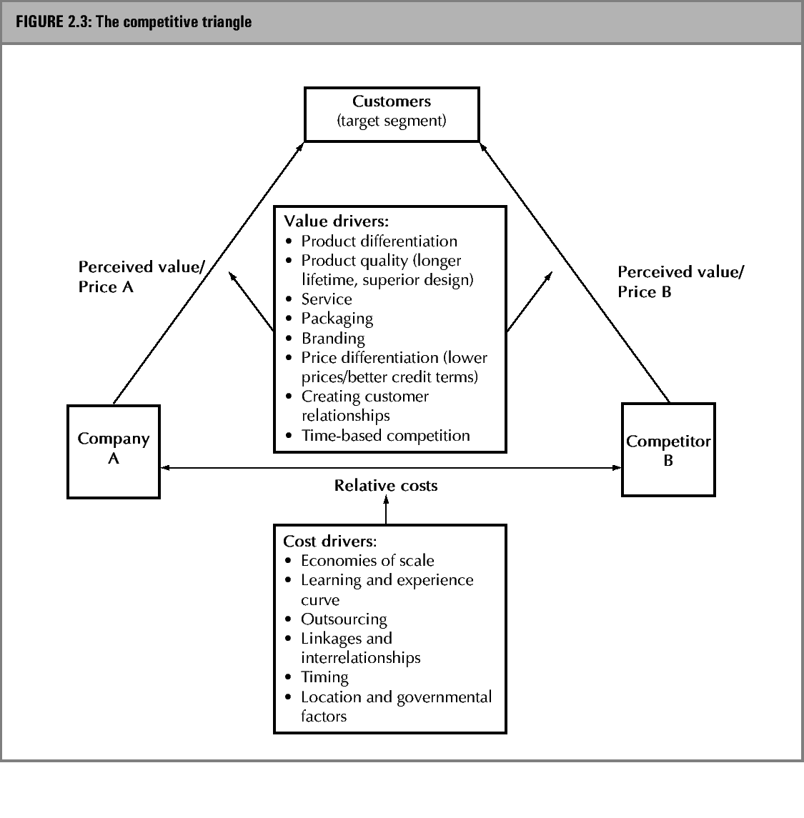
The competitive triangle

Slide 44
Value Drivers:
Product Differentiation: Product differentiation seeks to increase the value of the product or service to the customer.
Levitt (1986) suggested four levels of a product: core offer, expected offer, augmented offer and potential offer.
Differentiation is possible at all four levels

Slide 45
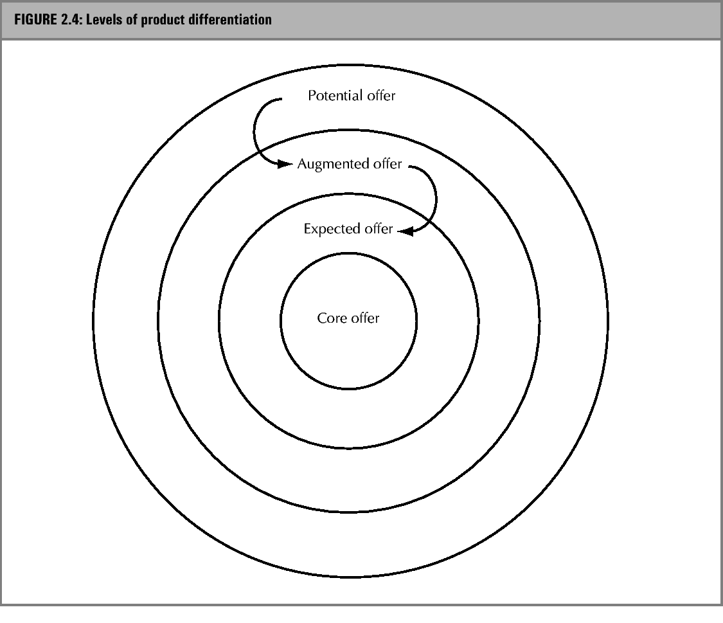
Levels of product differentiation

Slide 46
Four levels of a product
Core offer (basic offering)
  A different way of satisfying the same basic want or need. It is typically created by a change in the technology, the application of innovation
Expected offer
  Additional benefits normally provided with the core offer. This often involves improvements on expected features such as warrants, packaging quality or service (ie.lifetime guarantee)
Augmented offer
  Additional benefits not normally provided, but serving to differentiate from competitors’ offers. This could be credit facilities, additional features, branding, delivery and so on.
Potential offer
  Anything else that could (in future) be used to differentiate from existing competitors offerings. These features can, potentially, attract and hold customers.

Slide 47




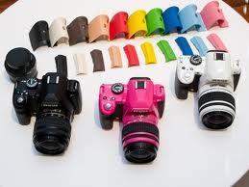
Core Benefit
the fundamental need or want that consumers satisfy by consuming the product or service.
Expected
is a set of attributes or characteristics that buyers normally expect and agree to when they purchase a product.
Augmented
Potential
includes additional product attributes, benefits, or related services that distinguish the product from competitors.
includes all the augmentations and transformations that a product might ultimately undergo in the future.

Slide 48
Value drivers
Product quality and service
  For manufactured products, quality can include durability, product features and superior design.
  For service it often comes down to tangible elements of service, the reliability and responsiveness of the service provider, promptness, assurance provided, and the empathy and caring attention (willingness to help) demonstrated.
  For a marketer it will be obvious that quality (satisfying customer needs) is a necessary objective, but may not be sufficient to gain a sale or ensure repeat business.

Slide 49

Value drivers
Branding: A brand name is an indication of what to expect from a product – a quality statement of a value-for money signal.
Price differentiation: Lower price as a means of differentiation can be a successful basis for strategy only when the company enjoys a cost advantage or where there are barriers to competing firms with lower cost structure competing at lower price.

Slide 50

Value drivers
Creating customer relationships: Creating closer bonds with customers through enhances service can help establish a position in the market that is easier to defend. (ie. closer links of JIT manufacturing systems supplier and buyer – newcomers more difficult to enter)

Slide 51
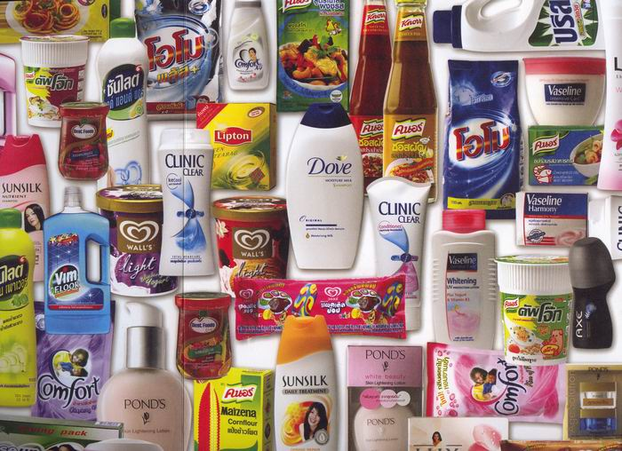
Value drivers
Packaging: can be used to differentiate the product
  Protects
  Stores
  Facilitates use
  Create image
  Promote

Slide 52
Value drivers
Time-base competition: focuses on gaining advantage by being faster than competitors – faster in responding to market changes, faster with new product development and introductions, faster in integrating new technology into products and faster in distribution and customer service.

Slide 53
The competitive triangle

Slide 54
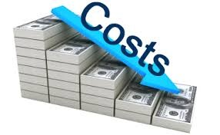

Cost drivers
Economies of scale: Economies of scale are perhaps the single most effective cost driver in many industries.

Slide 55
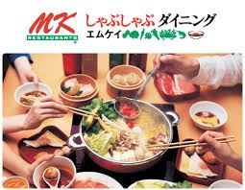
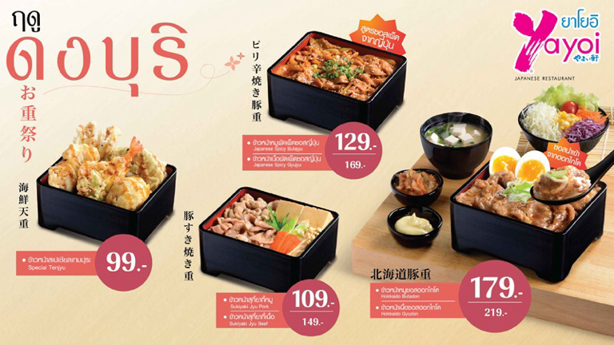

Slide 56
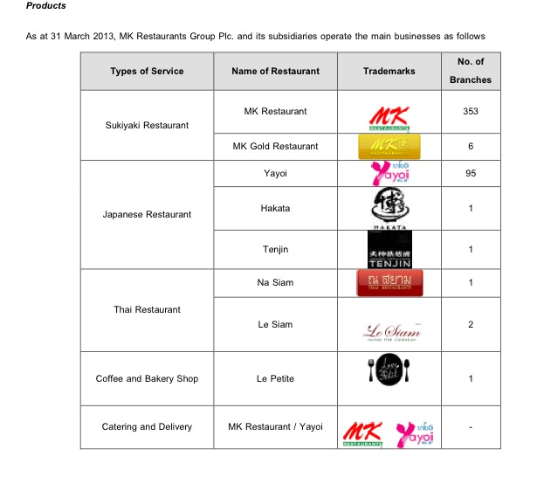
Source:ir.listedcompany.com

Slide 57
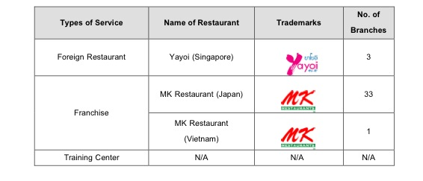
Source:ir.listedcompany.com

Slide 58
Cost drivers
Learning and experience curves: Further cost reductions may be achieved through learning and experience effects
  Learning refers to increases in efficiency that are possible at a given level of scale through an employee having performed the necessary takes may times before.
  Experience curves tell us that costs decline at a predictable rate as experience with a product increases. This reflect learning by doing, technological advances and economies of scale.

Slide 59

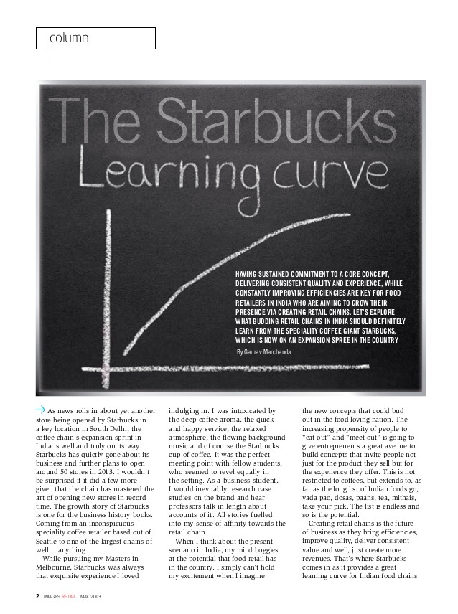

Slide 60

Cost drivers
Outsourcing: Labor cost can be an important component of total costs in low-skill, labor intensive industries such as product assembly and apparel manufacturing.
Linkages and interrelationships: External linkages with suppliers of factor inputs or distributors of the firm’s final products can also result in lower costs.

Slide 61

Cost drivers
Timing: through not always controllable, can lead to cost advantages. Often the first mover in an industry can gain cost advantages by securing prime locations, cheap or good-quality raw materials and/or technological leadership.

Slide 62

Cost drivers
Location and government factors: The final cost drivers are location (geographic location to take advantage of lower distribution, assembly, raw materials or energy costs) and institutional factors such as government regulations.

Slide 63
Group Homework #2
You are to find and analyze information on focal company and one main competitor on the following and present in powerpoint slides due next week (10 -15 mins)
Please note: some charts may not fit one page, therefore you could separate parts of the chart to fit a few pages in your presentations. But all elements in the assigned charts must be completed.

Slide 64
Group Homework #2
1. Corporate Mission
( on focal company and one main competitor)
The foundation of any marketing plan is the firm’s mission and vision statement, which answers the question, ‘What business are we in and where should we go?’

Slide 65
Group Homework #2
2. Analyze and fill the information in figure 2.1
(Please be specific)
2 charts - on focal company and one main competitor

Slide 66
Group Homework #2
3. Analyze and fill the information in figure 2.4
(Please be specific)
2 charts – on focal company and one main competitor
Note:Please focus on major products.

Slide 67
Group Homework #2
4. Analyze and fill the information in figure 2.4
(Please be specific)
2 charts – on focal company and one main competitor

Slide 68
Group Homework #2
5. Then you are to recap what are strong and weak points of your company compared to your main competitor.
6. Is your company market driving or market driven? Please justify.

Slide 69
Individual Homework #2
1. You are to find current, most up-to-date information on the internet that does not relate to your project but should be based on individual interests.
2. Your assignment should be no more than 1 page.
3.It must have source or reference from the information researched..
4.It could include charts, graphs, photos etc
What is the vision/mission statement for Nestle?
How does this justify what type of product they launch in the market?

