Slide 1
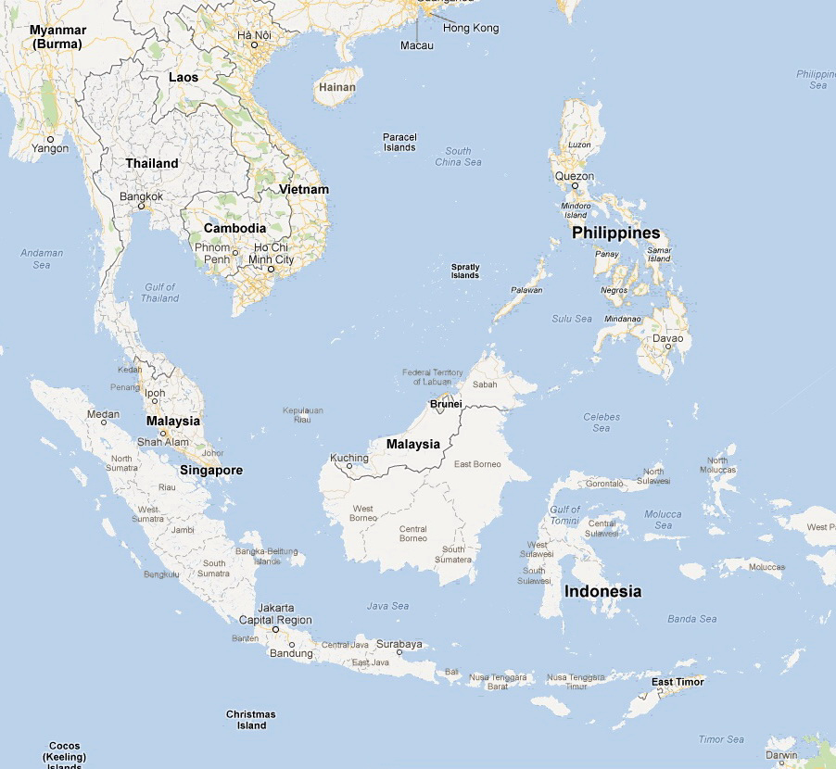
Energy and ASEAN
Daniel Ray Lewis

Slide 2
OBJECTIVE: At the end of the class there will be meeting of the ASEAN secretariat where we will set the objectives for ASEAN in terms of energy policy. Please consider the 8 following energy issues and their relevance for your country.
1) Basic needs – access to electricity, cooking fuels etc.
2) Energy subsidies – how, for whom, how much
3) Energy conservation – how to reduce use
4) Energy security – securing energy supply and protecting supply routes
5) Energy investment – how can we attract foreign investment while keeping benefit for our country
6) Energy integration – supporting movement of energy within ASEAN- e.g. electricity, natural gas.
7) Alternative Energies – supporting development of solar, wind, geothermal etc.
8) Energy and the environment – how to protect the natural environment and minimize global warming

Slide 3
Asian Subsidies for Energy (as a % of total government revenues)
Country | Petroleum | Electricity | Natural gas | Coal | Total
Bangladesh | 7.56 | 22.12 | 13.45 | 0 | 43.13
Bhutan | 1.39 | n.a. | n.a. | n.a. | 1.39
Brunei | 3.77 | 1.57 | 0 | 0 | 5.34
Cambodia | 0 | n.a. | n.a. | n.a. | 0
China | 0 | 0.68 | n.a. | n.a. | 0.68
India | 6.75 | 1.72 | 0.9 | 0 | 9.37
Indonesia | 14.51 | 3.69 | 0 | 0 | 18.2
Laos P.D.R. | 0 | n.a. | n.a. | n.a. | 0
Malaysia | 5.67 | 1.49 | 1.41 | 0 | 8.57
Myanmar | 9.35 | n.a. | n.a. | n.a. | 9.35
Pakistan | 1.02 | 10.23 | 19.89 | 0 | 31.14
Philippines | 0 | 0 | 0 | 0 | 0
Singapore | 0 | n.a. | n.a. | n.a. | 0
Thailand | 0.66 | 7.24 | 0.61 | 1.08 | 9.59
Vietnam | ? | High | ? | ? | 5%????
Source: IMF 2013 (data generally from 2011)

Slide 4
Potential for Future Military Conflict
Claimed by:
Philippines
Malaysia
China
Taiwan
Vietnam
Brunei
Spratly Islands: Total of 4 square kilometers of land area but potentially large oil and gas reserves
Straits of Malacca: 800 km stretch between Sumatra and Malaysia carries ¼ of the worlds goods and ¼ of oil shipped by sea.
Notes:
4th largest reserve bed for oil in the world
8% or more of all fish caught in world come from here.
270 vessels a day, 50% of all supertankers, 25% of the worlds oil pass through this area. Straits of Malacca is 1.5 km wide near singapore

Slide 5
Potential for Future Military Conflict
Chinese Oil-Gas Pipelines
Northern Corridor
Claimed by:
Philippines
Malaysia
China
Taiwan
Vietnam
Brunei
Kra Canal
Spratly Islands: Total of 4 square kilometers of land area but potentially large oil and gas reserves
Straits of Malacca: 800 km stretch between Sumatra and Malaysia carries ¼ of the worlds goods and ¼ of oil shipped by sea.
Notes:
4th largest reserve bed for oil in the world
8% or more of all fish caught in world come from here.
270 vessels a day, 50% of all supertankers, 25% of the worlds oil pass through this area. Straits of Malacca is 1.5 km wide near singapore

Slide 6
Basic Statistical Data
ASEAN Countries
Myanmar:
Pop 62 Million
GDP 832 USD
GDP growth 5.4%
Laos
Pop 7 Million
GDP 1204 USD
GDP growth 8.1%
Thailand:
Pop 65 Million
GDP 5,394 USD
GDP growth 3.8%
Philippines:
Pop 96 Million
GDP 2223 USD
GDP growth 5.6%
Vietnam:
Pop 89 Million
GDP 1,374 USD
GDP growth 6.4%
Cambodia
Pop 15 Million
GDP 852 USD
GDP growth 6.1%
Brunei:
Pop 0.4 Million
GDP 36,000 USD
GDP growth 2.3%
Malaysia:
Pop 29 Million
GDP 9,670 USD
GDP growth 6.1%
Singapore
Pop 5 Million
GDP 49,000 USD
GDP growth 9.5%
Indonesia:
Pop 241 Million
GDP 3509 USD
GDP growth 6.4%
Source: IMF World Outlook 2012 (2011 data)
Notes:
Oil: Malaysia 24th (0.39%) Vietnam 28th Indonesia 30th Thailand 51st (0.03%)
Gas Indonesia 14^{th (1.58%)} Malaysia 16th (1.24%) Vietnam 32nd (0.36) Thailand 39th (0.18%)
Coal Indonesia 15th (0.6%) Thailand 21st (0.1%)

Slide 7
Energy Reserves in ASEAN Countries
Myanmar:
Oil 50 Mbbl
Gas 283 Bm³
Coal --- Mtons
Thailand:
Oil 443 Mbbl
Gas 342 Bm³
Coal 1239 Mtons
Philippines:
Oil 168 Mbbl
Gas 109 Bm³
Coal --- Mtons
Vietnam:
Oil 4400 Mbbl
Gas 680 Bm³
Coal 150 Mtons
Brunei:
Oil 1100 Mbbl
Gas 391 Bm³
Coal --- tons
Malaysia:
Oil 5800 Mbbl
Gas 2350 Bm³
Coal --- Mtons
Indonesia:
Oil 4000 Mbbl
Gas 3001 Bm³ Coal 5529 Mtons
Source: BP statistical review 2012
Notes:
Oil: Malaysia 24th (0.39%) Vietnam 28th Indonesia 30th Thailand 51st (0.03%)
Gas Indonesia 14^{th (1.58%)} Malaysia 16th (1.24%) Vietnam 32nd (0.36) Thailand 39th (0.18%)
Coal Indonesia 15th (0.6%) Thailand 21st (0.1%)

Slide 8
Energy Imports and Efficiency in
ASEAN Countries
Myanmar:
Energy Exports 48.4%
Energy Efficiency: GDP/KOE NA
Thailand:
Energy Imports 40.3%
Energy Efficiency:
GDP/KOE 4.5
Philippines:
Energy Imports 39.6%
Energy Efficiency:
GDP/KOE 8.2
Vietnam:
Energy Exports 19.7%
Energy Efficiency:
GDP/KOE 4.2
Cambodia
Energy Imports 29.2%
Energy Efficiency: GDP/KOE 5.6
Brunei:
Energy Exports 506.4%
Energy Efficiency:
GDP/KOE 5.5
Malaysia:
Energy Exports 34.2%
Energy Efficiency:
GDP/KOE 5.4
Singapore
Energy Imports 99.8%
Energy Efficiency:
GDP/KOE 8.1
Indonesia:
Energy Exports 74.2%
Energy Efficiency:
GDP/KOE 4.5
Source: IMF World Outlook 2012
Notes:
Oil: Malaysia 24th (0.39%) Vietnam 28th Indonesia 30th Thailand 51st (0.03%)
Gas Indonesia 14^{th (1.58%)} Malaysia 16th (1.24%) Vietnam 32nd (0.36) Thailand 39th (0.18%)
Coal Indonesia 15th (0.6%) Thailand 21st (0.1%)

Slide 9
Electricity 7%
Laos
Myanmar
Gas 21%
Middle East (75% of 81%)
Oil 81%
Coal 46%
Indonesia and Australia
Energy Imports to Thailand
Data: EPPO 2011

Slide 10
Basic Needs: Energy Access in
ASEAN Countries
Myanmar:
Electrification 13%
Electric Use 104 KwH
Modern Cooking 3%
Laos
Electrification 55%
Electric Use NA
Modern Cooking 3%
Thailand:
Electrification 99%
Electric Use 2045 KwH
Modern Cooking 63%
Philippines:
Electrification 90%
Electric Use 593 KwH
Modern Cooking 49%
Vietnam:
Electrification 98%
Electric Use 290 KwH
Modern Cooking 34%
Cambodia
Electrification 24%
Electric Use 131 KwH
Modern Cooking 7%
Brunei:
Electrification 100%
Electric Use 8662 KwH
Modern Cooking 100%
Malaysia:
Electrification 99%
Electric Use 3614 KwH
Modern Cooking 80%
Singapore
Electrification 100%
Electric Use 7949 KwH
Modern Cooking 100%
Indonesia:
Electrification 65%
Electric Use 590 KwH
Modern Cooking 46%
Source: World Development Indicators WB 2009, EIA 2012, WHO UNDP 2009, WB AusAID 2011
Notes:
Oil: Malaysia 24th (0.39%) Vietnam 28th Indonesia 30th Thailand 51st (0.03%)
Gas Indonesia 14^{th (1.58%)} Malaysia 16th (1.24%) Vietnam 32nd (0.36) Thailand 39th (0.18%)
Coal Indonesia 15th (0.6%) Thailand 21st (0.1%)

Slide 11
Electricity Production in
ASEAN Countries
Myanmar:
Hydro 72% Coal 0%
Oil 9% Gas 20%
Capacity PC .03 KW
Laos
Hydro Mostly Coal Some
Oil NA Gas NA
Capacity PC .27 KW
Thailand:
Hydro 5% Coal 20%
Oil 0% Gas 70%
Capacity PC .74 KW
Philippines:
Hydro 16% Coal 27%
Oil 9% Gas 32%
Capacity PC .17 KW
Vietnam:
Hydro 36% Coal 18%
Oil 3% Gas 43%
Capacity PC .17 KW
Cambodia
Hydro 4% Coal 0%
Oil 96% Gas 0%
Capacity PC .02 KW
Brunei:
Hydro 0% Coal 0%
Oil 1% Gas 99%
Capacity PC .19.0 KW
Malaysia:
Hydro 6% Coal 31%
Oil 2% Gas 61%
Capacity PC .87 KW
Singapore
Hydro 0% Coal 0%
Oil 19% Gas 81%
Capacity PC 2.0 KW
Indonesia:
Hydro 7% Coal 42%
Oil 23% Gas 22%
Capacity PC .14 KW
Source: World Development Indicators WB 2009, EIA 2012
Notes:
Oil: Malaysia 24th (0.39%) Vietnam 28th Indonesia 30th Thailand 51st (0.03%)
Gas Indonesia 14^{th (1.58%)} Malaysia 16th (1.24%) Vietnam 32nd (0.36) Thailand 39th (0.18%)
Coal Indonesia 15th (0.6%) Thailand 21st (0.1%)

