Slide 1
Thailand and clmv
EE361 ECONOMIES of CLMV
Faculty of economics
Thammasat university

Slide 2
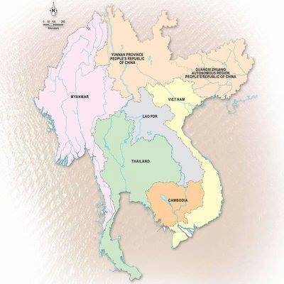
The Greater Mekong
subregion
Thailand is a part of the GMS―a region of commonalities and contrast
 | Land area (km2) | Population (million)
Cambodia | 176.2 | 16.5
Lao PDR | 230.8 | 7.2
Myanmar | 653.1 | 54.0
Vietnam | 310.0 | 96.5
Thailand | 510.9 | 69.6
Yunnan PRC | 394.0 | 48.6
Guangxi PRC | 237.6 | 48.4

Slide 3
Comparison of socioeconomic indicators
 | Cambodia | Lao PDR | Myanmar | Vietnam | Thailand
Population (in million) | 16.5 million | 7.2 million | 54.0 million | 96.5 million | 69.6 million
Urban population (% of total) | 23.8 | 35.6 | 30.8 | 36.6 | 50.6
Gross Domestic Product (2019) | $27.1 billion | $17.9 billion | $76.1 billion | $261.9 billion | $543.5 billion
GNI/capita (current) | $1,530 | $2,570 | $1,390 | $2,590 | $7,260
Under-5 mortality (/100,000 births) | 26.6 | 45.5 | 44.7 | 19.9 | 9.0
Life expectancy at birth | 69.8 years | 67.9 years | 67.1 years | 75.4 years | 77.15
Poverty rate (% of population) | 17.7% | 18.3% | 24.8% | 6.7% | 9.9%

Slide 4
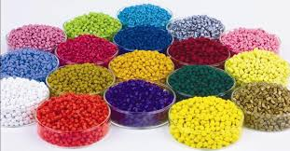

Thai–CLMV economic cooperation
Exports from Thailand used to dominate the GMS, comprising 70-90% of imports of CLMV (except Vietnam)
However, since 2010, Thai exports to CLMV have declined due to competition from PR China
Thai imports from CLMV include consumer products energy goods, electrical appliances, electronics, machinery parts
Thai exports include computers and components, finished oil, natural rubber and plastic pellets

Slide 5
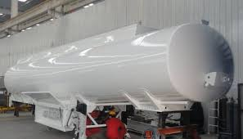

Thai–CLMV economic cooperation
Between 2005 and 2008, Thai imports from CLMV increased from Baht 568 billion to Baht 851 billion (increase of 50%)
During the same time Thai exports increased from Baht 558 billion to 867 billion (increase of 55%)

Slide 6

Thai–CLMV economic cooperation
$2.5 billion
$2.0 billion
$1.5 billion
$1.0 billion
$0.5 billion
Thai imports from CLMV countries

Slide 7
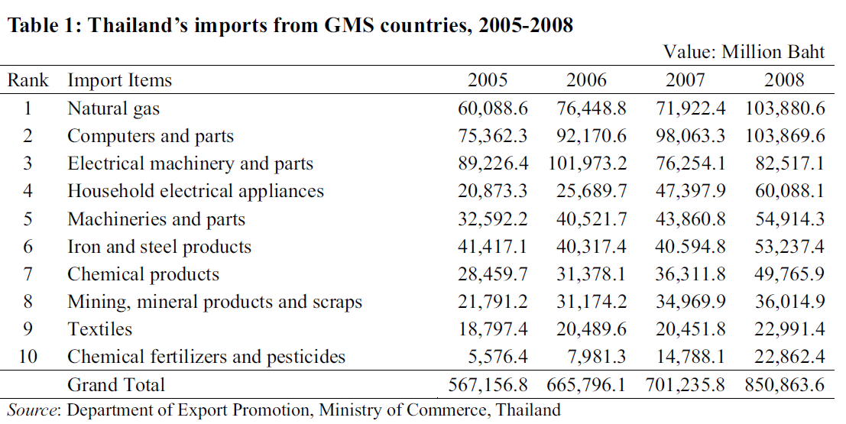
Thai–CLMV economic cooperation

Slide 8
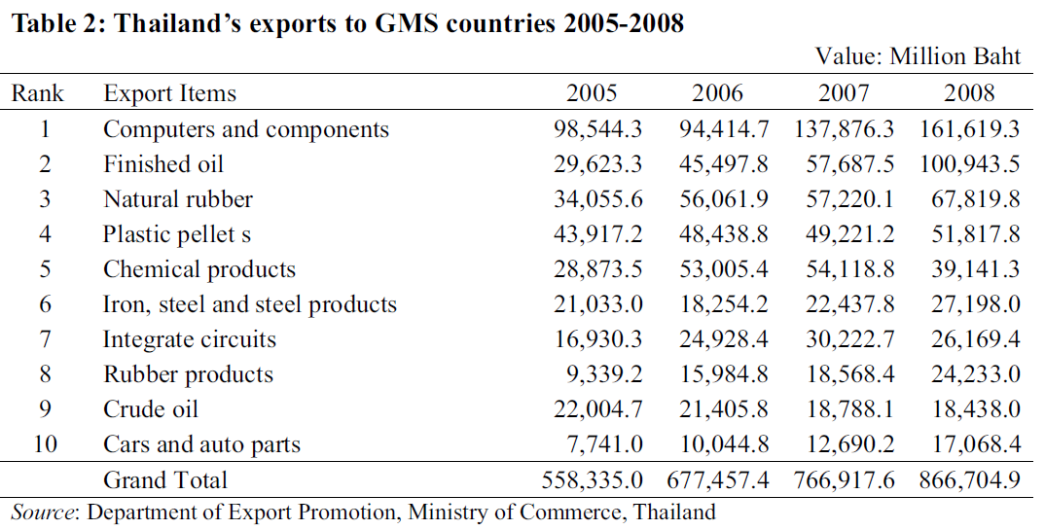
Thai–CLMV economic cooperation

Slide 9
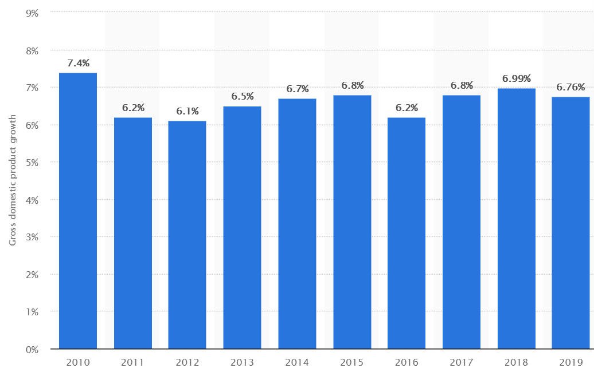
Thai–CLMV economic cooperation
Thailand and CLMV have different levels of economic development. As Thailand had been implementing a market-based economic system since the 1960s, its economy is much larger than CLMV’s, which experienced war and social conflicts, thereby opening up their economies on since the late 1980s.
In 2008, Thailand’s GDP was $250 billion compared to Vietnam’s ($100 billion) and Cambodia’s ($10 billion)
Annual GDP growth of CLMV Countries, 2010-2019

Slide 10

Thai–CLMV economic cooperation
Thai direct investments in CLMV comprise natural resource-related projects, agricultural production and agro-industries and service-based investments such as hotels, restaurants and tourism businesses
Thailand has also been extending ODA to neighboring countries, mostly in transportation (roads and bridge construction and rehabilitation), providing scholarships and training grants, and technical assistance

Slide 11
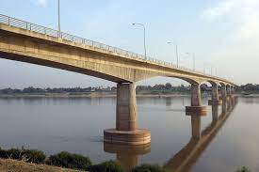
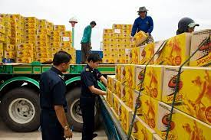
Thai–CLMV economic cooperation
Border trade between Thailand and neighboring countries have been flourishing due to their geographical advantages
The opening up of market-driven economies of CLMV, foreign investment and ODA from countries outside the GMS such as PR China, Japan and the Republic of Korea have been expanding
Proportionally, Thailand’s economic relationships with CLMV have been declining

Slide 12
Thai–CLMV economic cooperation
 | Cambodia | Lao PDR | Myanmar | Vietnam
Thai imports from | Plants and plant products Iron and steel products Lumber and processed wood | Lumber and processed woods Mining products and minerals Energy | Natural gas Lumber and processed wood Mining products and minerals | Crude oil Electronic products and machines Computers and parts Fisheries
Thai exports to | Finished oil Beverages Cement Refined sugar | Finished oil Cars and parts Textiles Iron and steel products | Finished oil Plant and animal products Plastic pellets Chemical products | Finished oil Plastic pellets Iron and steel
Thai Foreign investments | Hotel businesses Agro-industry | Livestock feed Rubber plantations Wood processing Hydropower | Agricultural processing Industry (gems) | Agribusiness and agro-industry Beverages
Thai ODA | Roads and bridge construction and maintenance | Railway Internet technology Scholarships | Road and bridge construction
Main investors | Malaysia Republic of Korea PR China Thailand | PR China Vietnam Thailand | Singapore Thailand United Kingdom | Japan PR China Republic of Korea

Slide 13
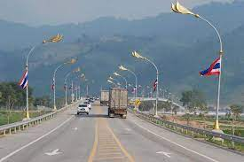

Thai–CLMV economic relationships
Since the end of the Vietnam war and the subsequent rapid economic development period of 1980s, the Thai government has proposed strategies and plans to support CLMV development and improve their standard of living
Effectiveness of these efforts have been rather mixed and circumstances have changed. During 1980-2000 Thailand was already a middle income country while CLMV countries were poor and undeveloped and poor; with average annual GDP growth of 7%, the countries are narrowing the gap

Slide 14
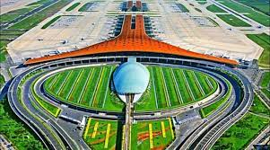
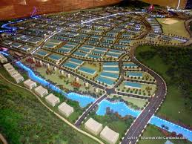
Thai–CLMV economic relationships
Vietnam is a leading ASEAN nation in establishing free-trade agreements with foreign partners, now numbering 17 in all, even though its economy has not yet been recognized as a free market economy
Cambodia and Lao PDR are both receiving large amounts of foreign investments from China for new and rehabilitation of infrastructure
CLMV countries have their own economic development plans; if Thailand wishes to be a part of the economic region, it will need to understand, absorb, respond to the needs of CLMV and become a part of the existing atmosphere of cooperation within the GMS

Slide 15
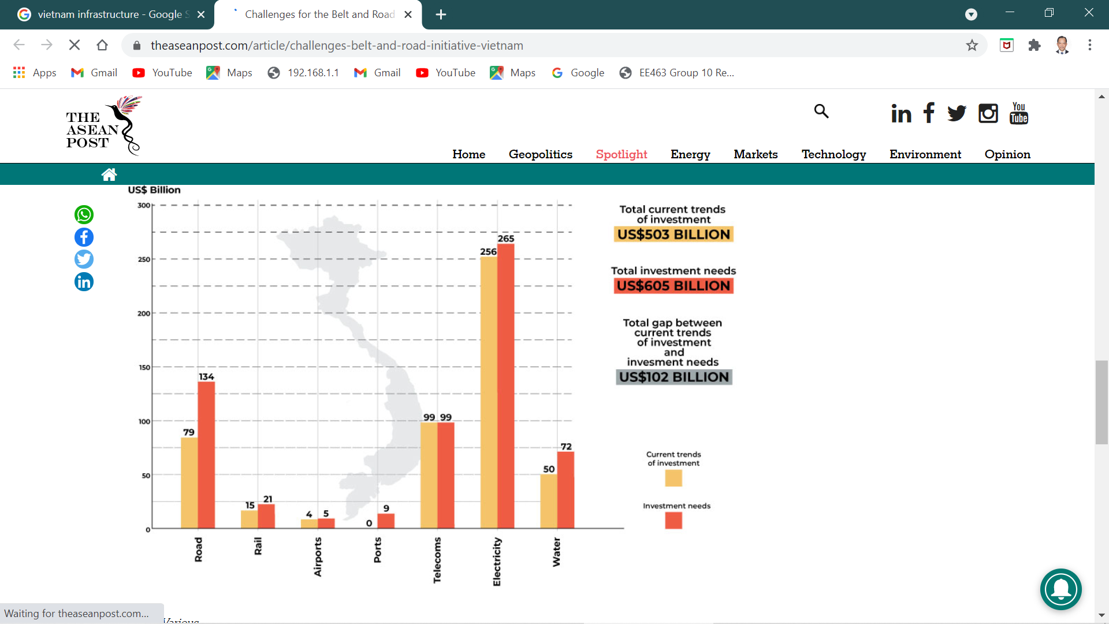
Thai–CLMV economic relationships
Vietnam’s infrastructure investment plan, 2016-2040

Slide 16
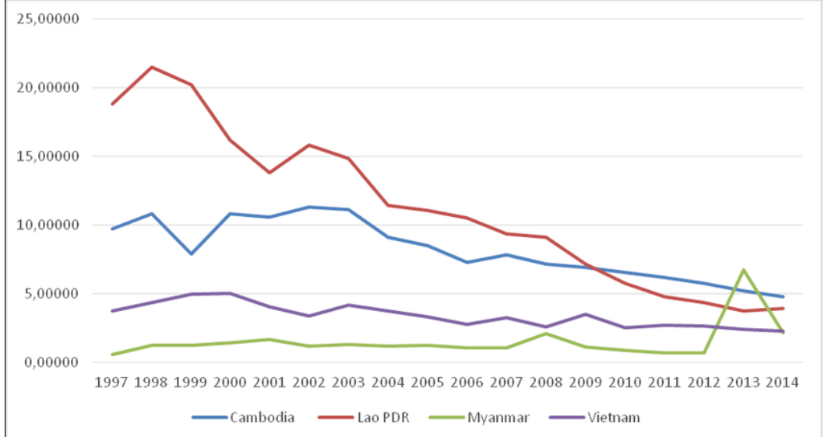
Thai–CLMV economic relationships
Foreign aid as Percentage of GDP, in CLMV Countries

Slide 17
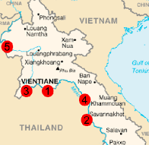
Future of Thai–CLMV cooperation
Apart from all the huge infrastructure projects, one way that Thailand could exert influence would be to assist the CLMV countries to realize smaller and deliverable projects in the agriculture and energy sectors
Examples: production and processing of agricultural products, renewable energy, sustainable hydropower development and development joint research in the field of agriculture, fishery, forestry, livestock, aquaculture and energy

Slide 18

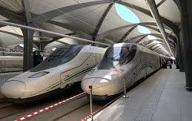
Future of Thai–CLMV cooperation
Lastly, Thailand should cooperate with Japan, PR China and the Republic of Korea, the key major Asian development partners, as well as various bilateral and multilateral financing institutions to help the CLMV with their existing projects

