Slide 1

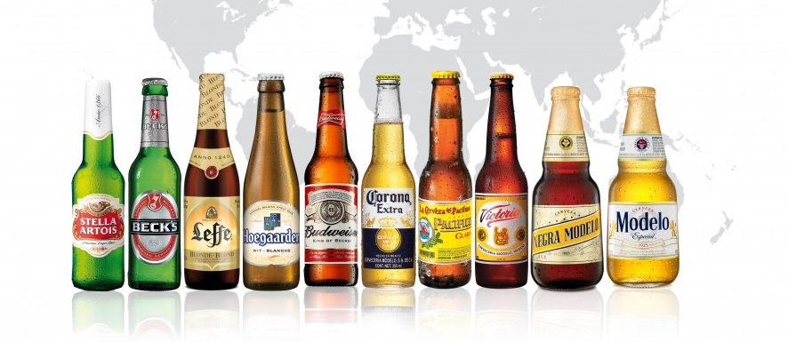
Anheuser-Busch InBev

Slide 2
Facts
World’s largest brewer with approximate market share of 25%
HQ in Belgium
155,000 employees over 25 countries
In 2013, Sales over 43.2 billion USD
18 brands generate over 1 billion USD per year

Slide 3

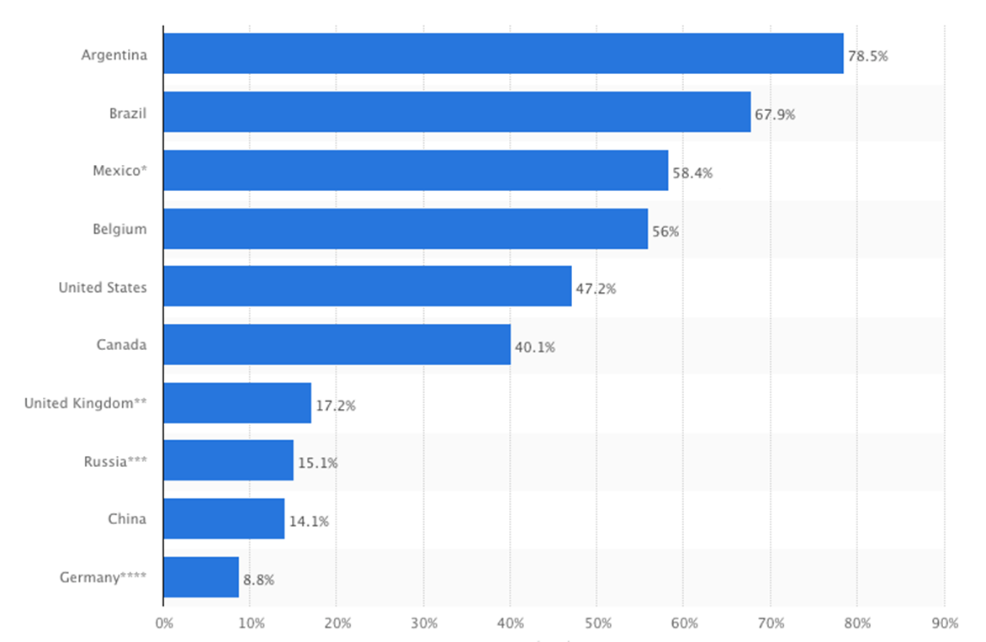
Facts
http://www.statista.com/statistics/199024/ab-inbev-beer-market-share-by-country

Slide 4
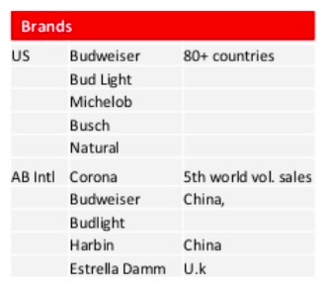

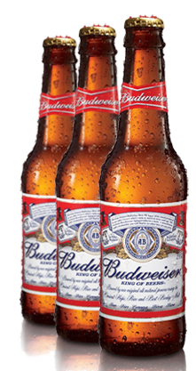
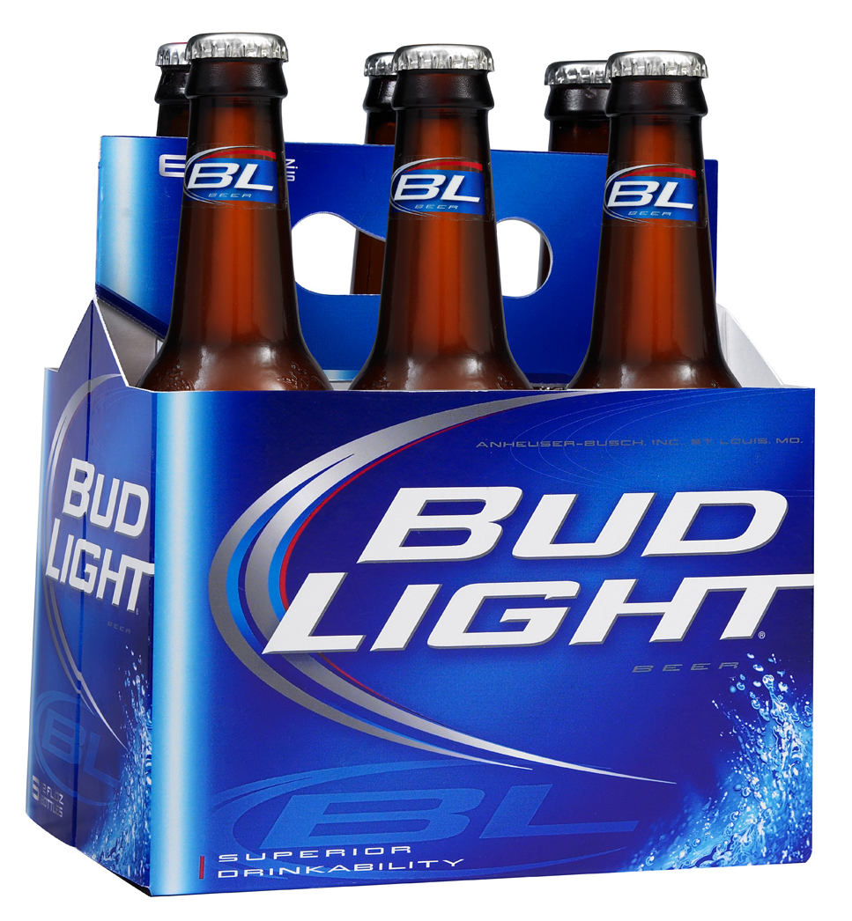
History
: Anheuser-Busch

Slide 5
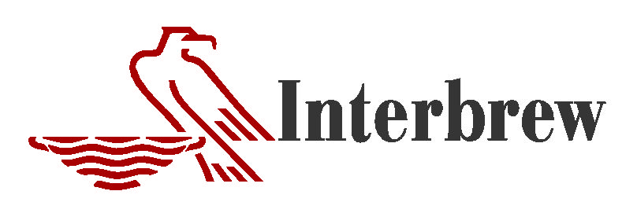

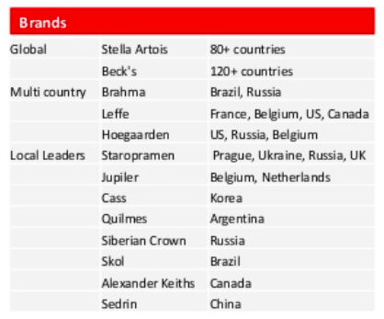
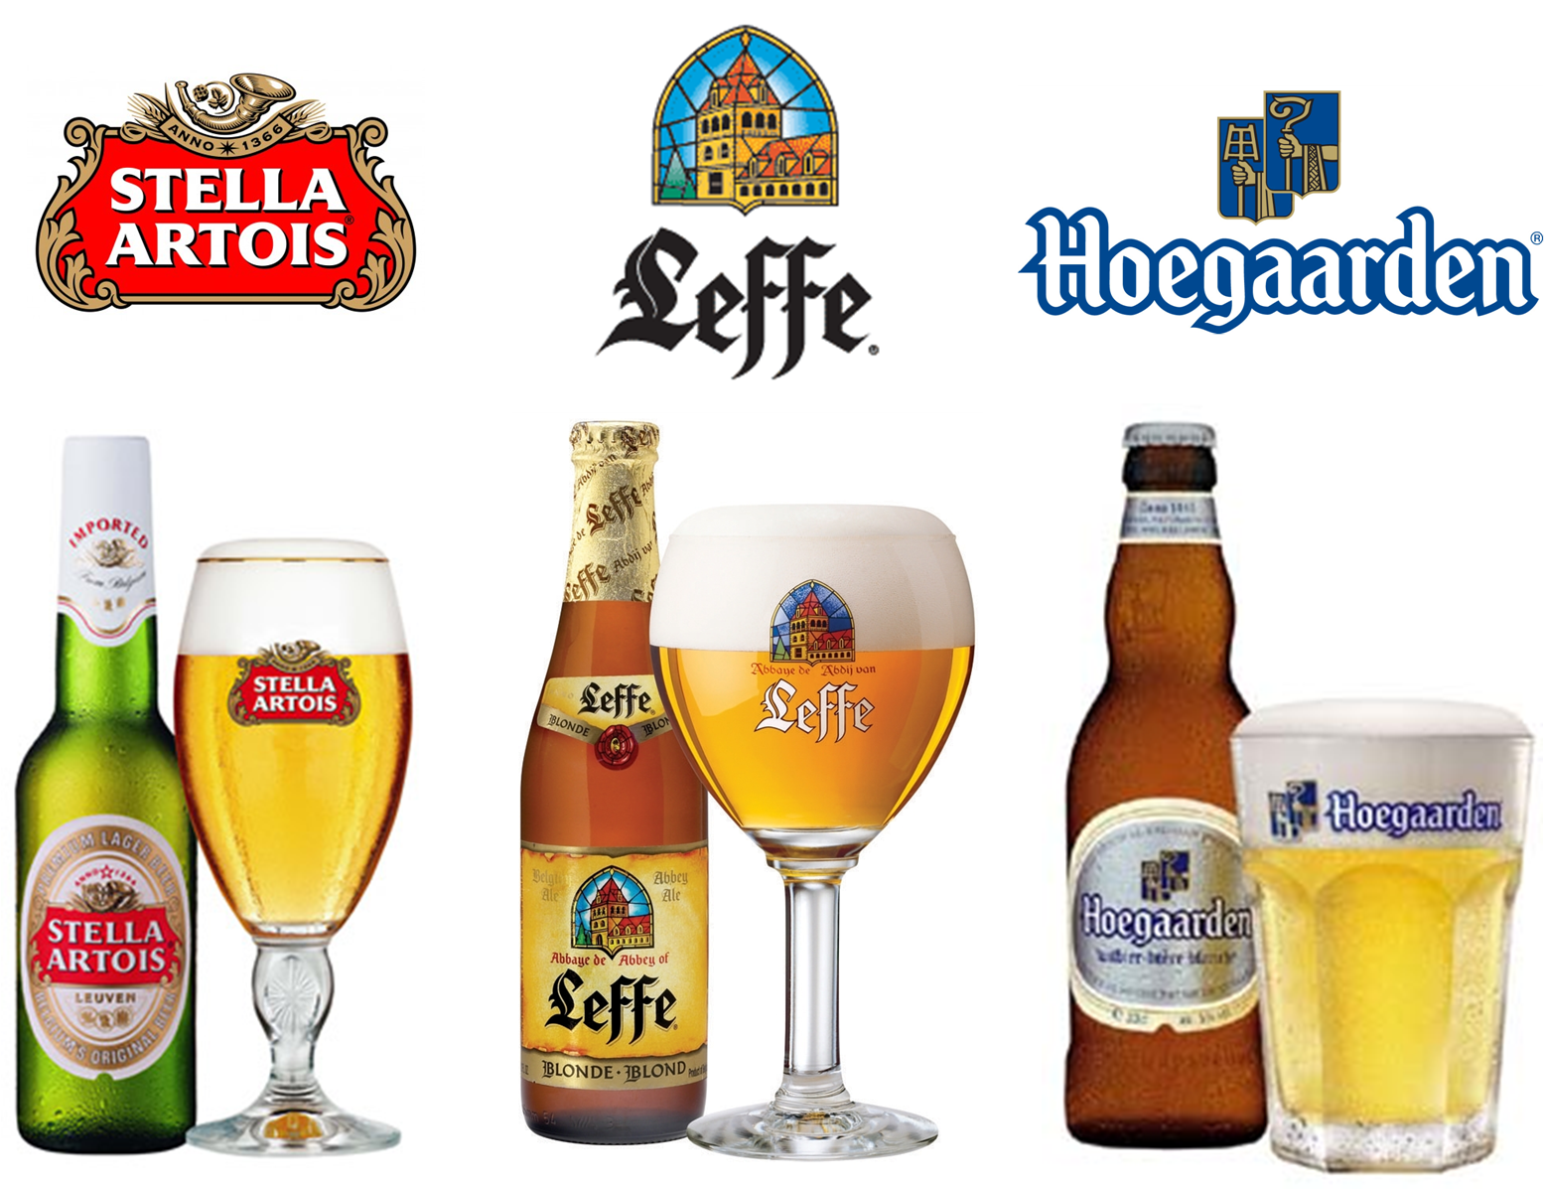
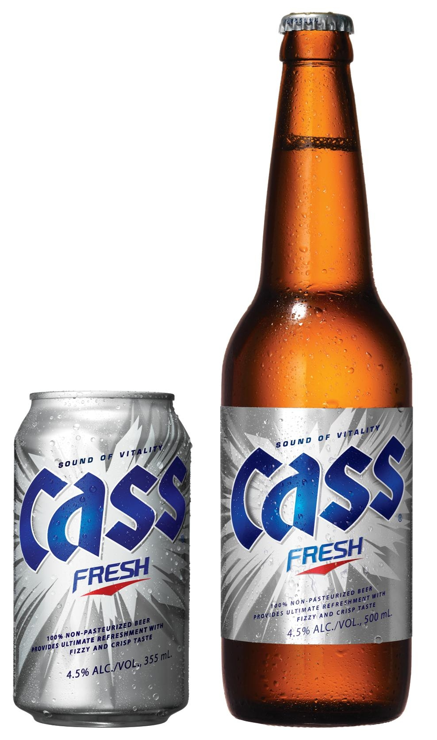
History
Inbev = +

Slide 6
Anheuser-Busch InBev
Ambev
Interbrew
Anheuser-Busch
InBev
(1999)
(1987)
(1860)
(2004)
(2008)

Slide 7
History
20 years ago the top ten brewers represented 22% of the world market share
Ten years ago the top 10 breweries have increased to 34% of the world market share
Today they are over 74%

Slide 8
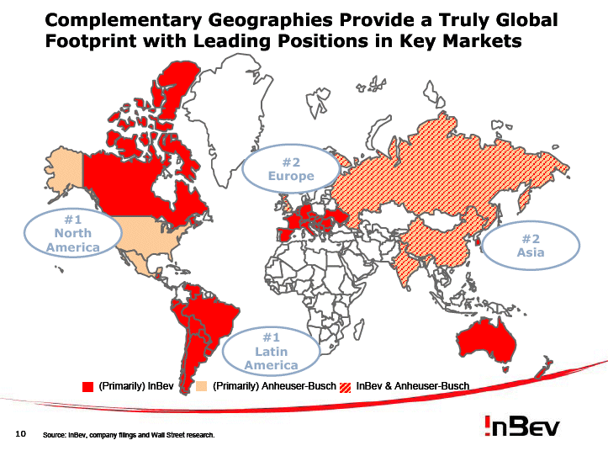

Slide 9
History
In 2006, InBev acquired the Fujian Sedrin brewery in China, making InBev the No. 3 brewer in China (the world's largest beer market)
In2014, AB Inbev completed the re-acquisition of the Oriental Brewery (OB), the largest brewer in South Korea

Slide 10
Why merger and acquisition ?
Expand the company
Shortcut to new market
Enhance their cost effectiveness in marketing, production, advertising, logistics, and distribution

Slide 11
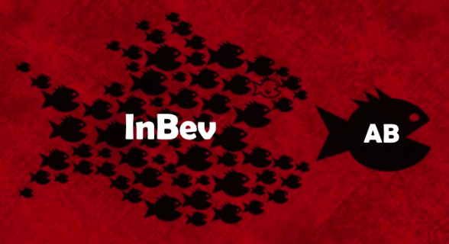
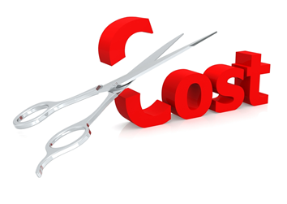
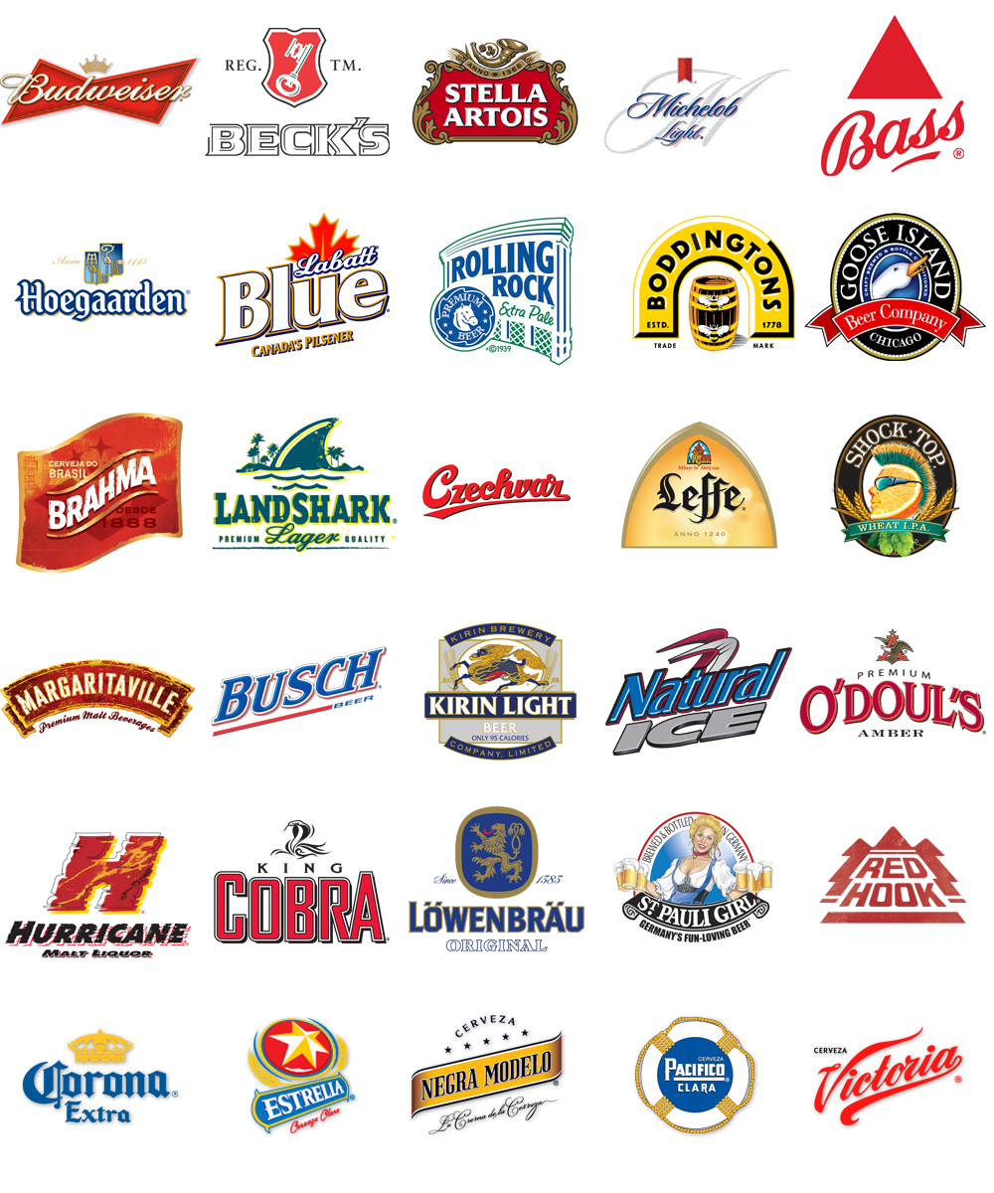
Strategies
Merger and Acquisition
Cost reduction
Brand Proliferation

Slide 12
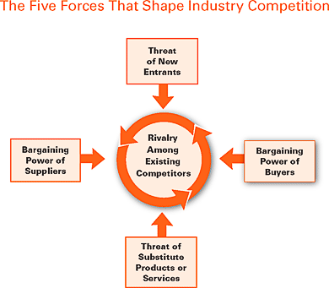
Does it easy for Inbev to enter in Thai Beer Market ?
Five Force Analysis

Slide 13
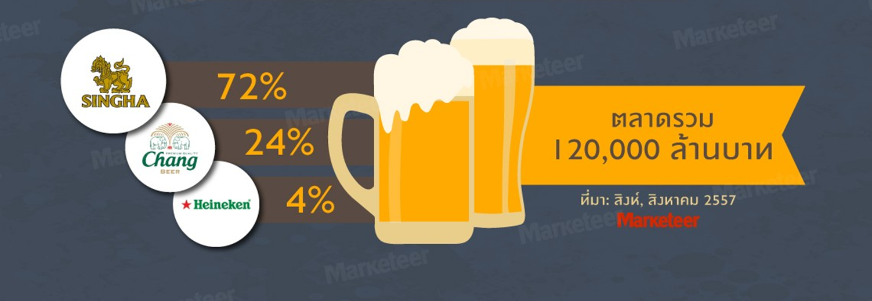

Rivalry among existing competitors
High intensity which is led by Singaha Beer, Chang Beer and Heineken.

Slide 14
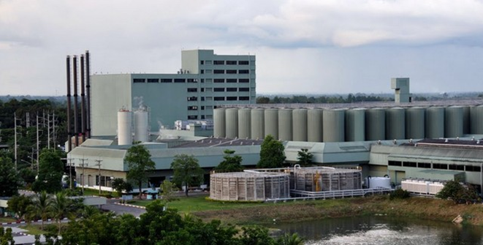

Threat of new entrant
High Cost
  Factory
Tax Collection
    Old method VS New method
    (value or volume) (value and volume)

Slide 15
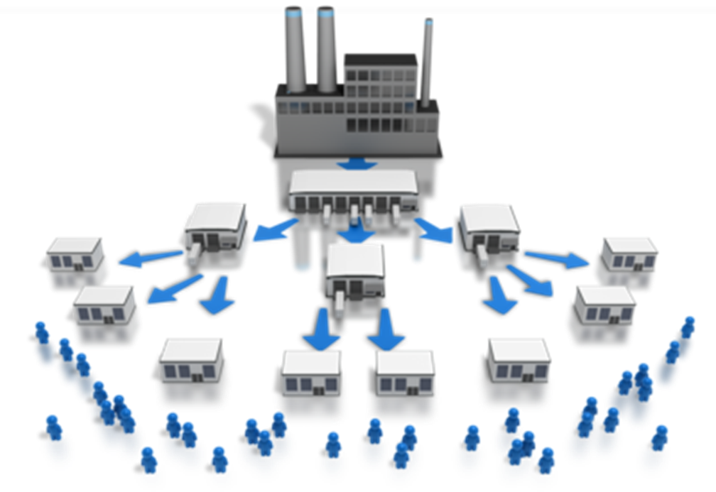
Threat of new entrant
Distribution channel

Slide 16

Bargaining power of supplier
High bargaining power of supplier since Inbev is new to Thailand

Slide 17
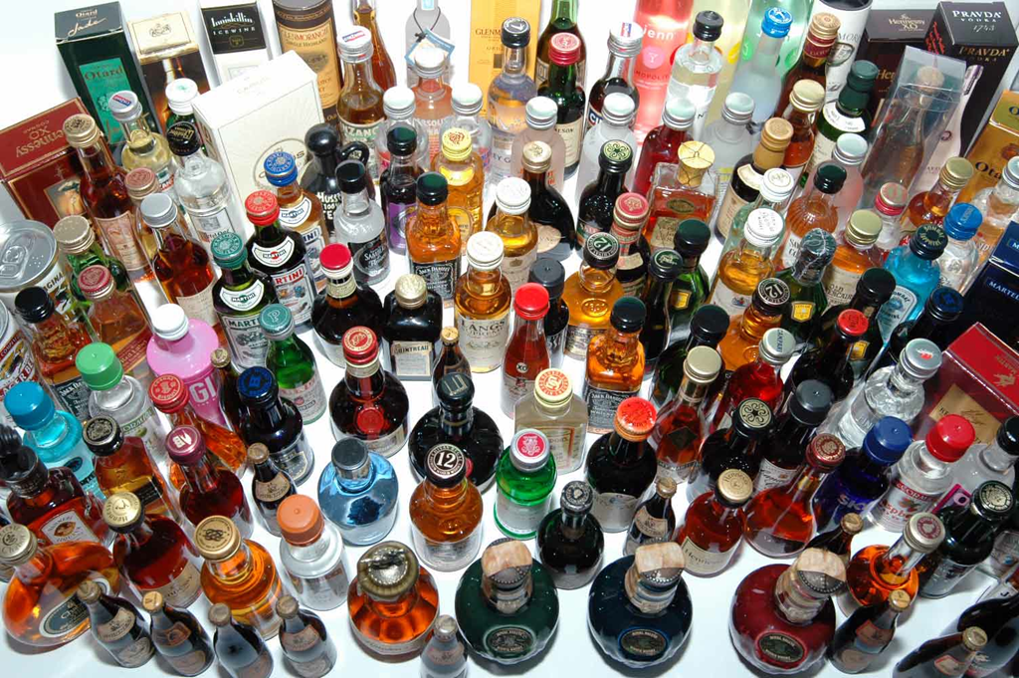
Threat of substitute product or service
Apart from beer, there are many liquors such as alcohol, wine, vodka and etc.

Slide 18
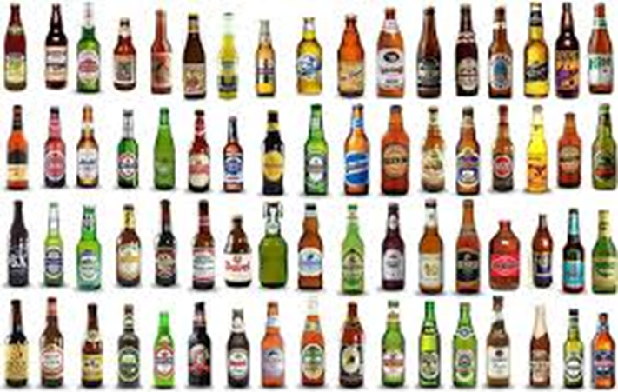
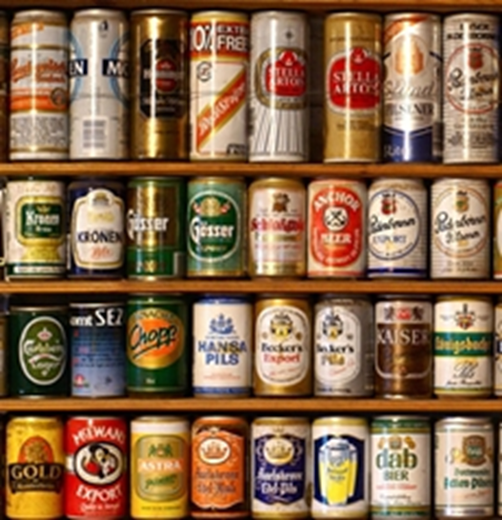
Bargaining power of customer
High bargaining power of customers since there are many options for customers to choose.

Slide 19
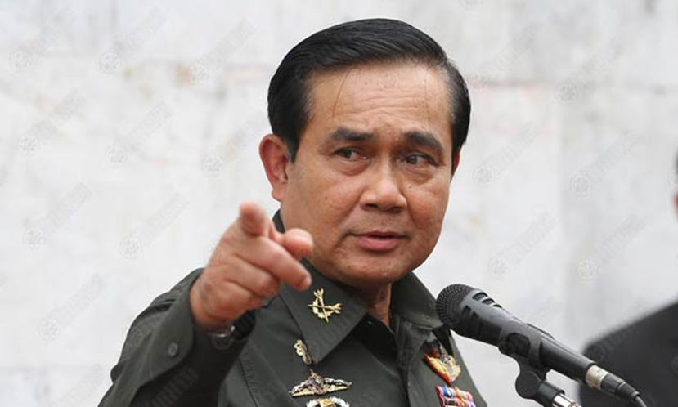
Opportunity in Thai Beer Market
Short run
1. Political
Issues
-Investment Climate &
Economic Recession

Slide 20

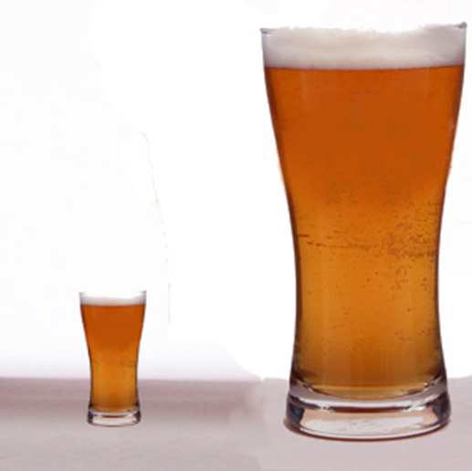
Short run
$3.63 billion for Thailand
$79 billion for China
$100 billion for US
$138.18 billion for EU
2. Market size

Slide 21
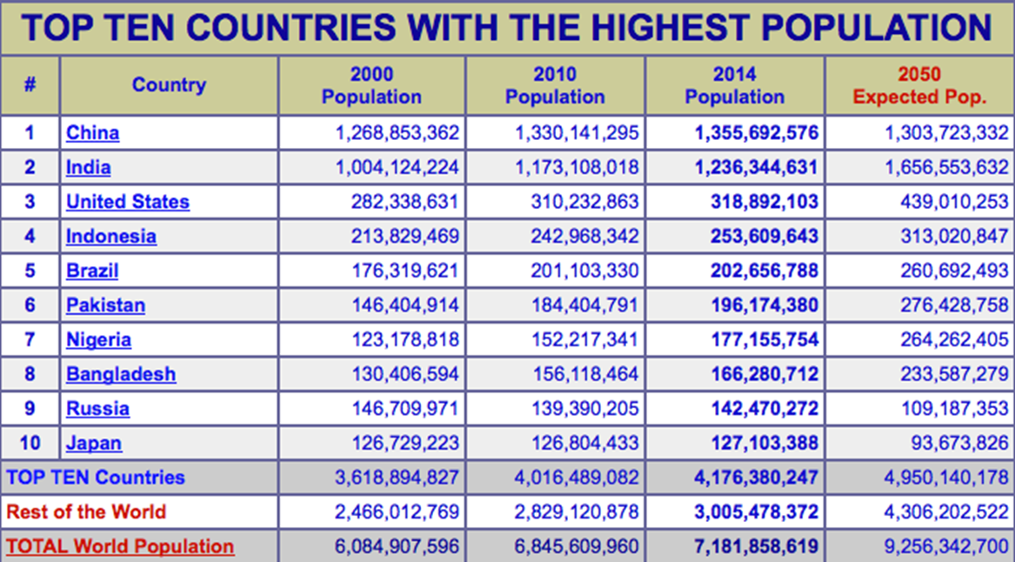
Long Run
- Population number: Thailand: 64,871,000

Slide 22


In conclusion, it is not worth
for InBev to enter into
Thai Beer Market

