Slide 1
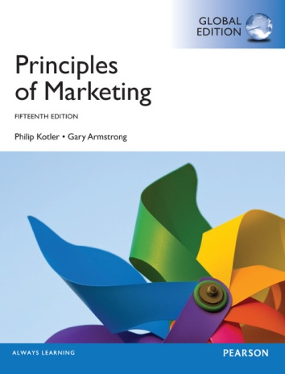
Chapters 14,15,16 & 17:Integrated Marketing Communications
MK 202 Fundamentals of Marketing
By
Aj. Suwalya K.

Slide 2
MK 202 Today’s Happenings
Integrated Marketing Communications
Break – Download Good and Bad Ads During the Break
Continue Lesson
Show Ad

Slide 3
There will be 3 Parts to this Handout
Part I: Communicating Customer Value: Integrated Marketing Communications Strategy
Part II: Media Mix
Part III: Get Better Advertising

Slide 4
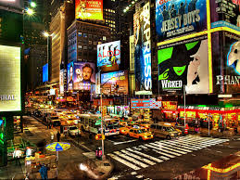
Part 1: Communicating Customer Value: Integrated Marketing Communications Strategy

Slide 5
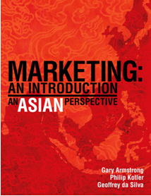
Texts

Slide 6
OBJECTIVE OUTLINE FOR PART I:
Objective 1: Define the five promotional mix tools for communicating customer value
PROMOTIONAL MIX
Objective 2: Discuss the changing communications landscape and the need for integrated marketing communications.
INTEGRATED MARKETING COMMUNICATIONS
Objective 3: Outline the communications process and the steps in developing effective marketing communications.
A VIEW OF THE COMMUNICATIONS PROCESS
STEPS IN DEVELOPING EFFECTIVE MARKETING COMMUNICATION
Objective 4: Explain the methods for setting the promotion budget and factors that effect the design of the promotion mix.
SETTING THE TOTAL PROMOTION BUDGET AND MIX
SOCIALLY RESPONSIBLE MARKETING COMMUNICATION

Slide 7
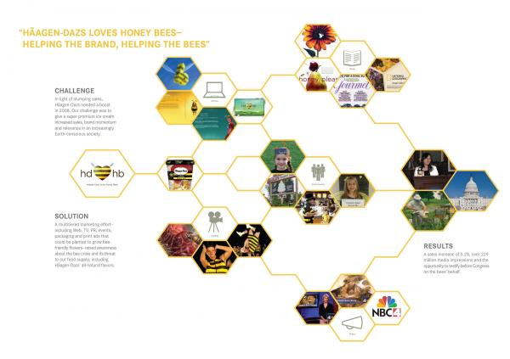


Opening Case Study- Haagen-Dazs: A Beautifully Integrated Marketing Communications Campaign
“Haagen-Dazs loves honey bees” integrated marketing campaign uses rich, well-coordinated blend of communications elements to successfully deliver Haagen –Dazs’ unique message and positioning.
“It’s the brand with heart and soul”, “We’re not only raising brand awareness, but making a difference in the world.”

Slide 8

Objective 1: Promotion Mix

Slide 9
The Promotion Mix or
Marketing Communications Mix
The promotion mix is the marketer’s bag of tools for communicating with customers and other
stakeholders. To deliver a clear and compelling
message, each tool must be carefully coordinated under the concept of integrated marketing communications

Slide 10
Definition: The Promotion Mix or
Marketing Communications Mix
The specific blend of promotional tools that the company uses to persuasively communicate customer value and build customer relationships.

Slide 11
Marketing Communications Mix
Advertising
  Any paid form of non personal presentation and promotion of ideas, goods, or services by an identified sponsor.
Sales Promotion
  Short-term incentives to encourage the purchase or sale of a product or service.
Public Relations (PR)
  Building good relations with the company’s various publics by obtaining favorable publicity, building up a good corporate image, and handling or heading off unfavorable rumors, stories, and events.

Slide 12
Marketing Communications Mix
Personal Selling
  Personal presentation by the firm’s sales force for the purpose of making sales and building customer relationships.
Direct Marketing
  Direct connections with carefully targeted individual consumers to both obtain an immediate response and cultivate lasting customer relationships—the use of telephone, mail, fax, e-mail, the Internet, and other tools to communicate directly with specific consumers.

Slide 13
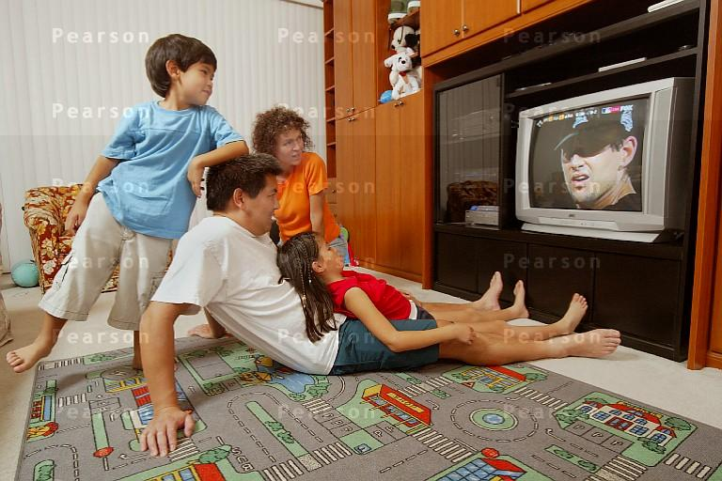
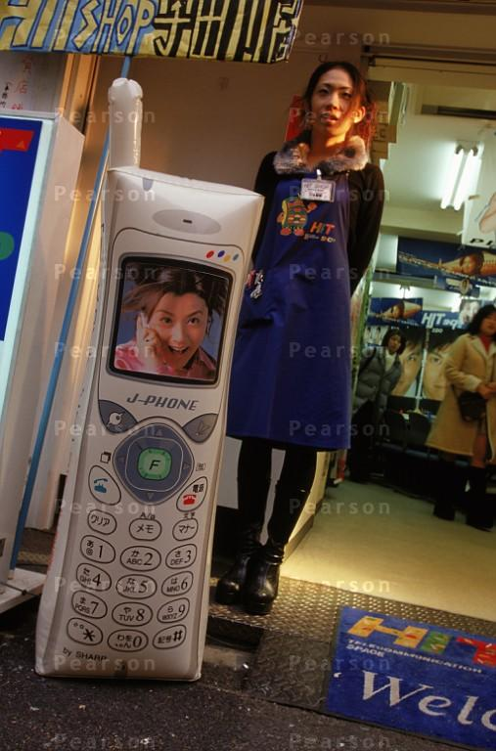
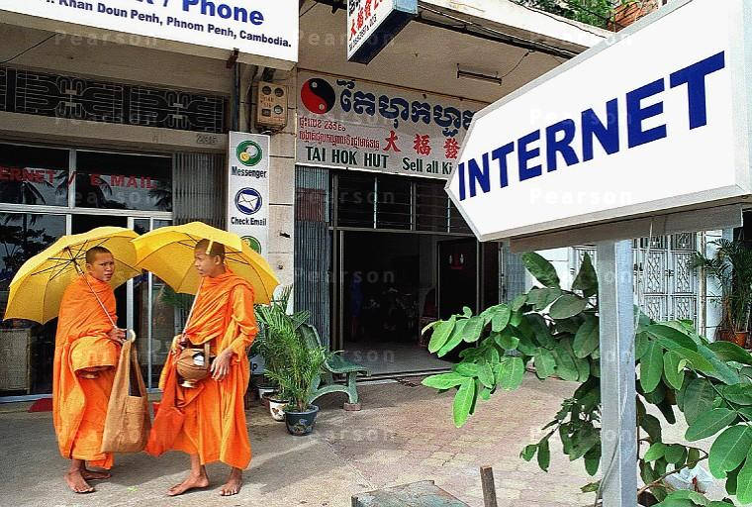
In order to communicate with customers in Asia, many different methods are used including media advertising, personal selling and even the Internet

Slide 14
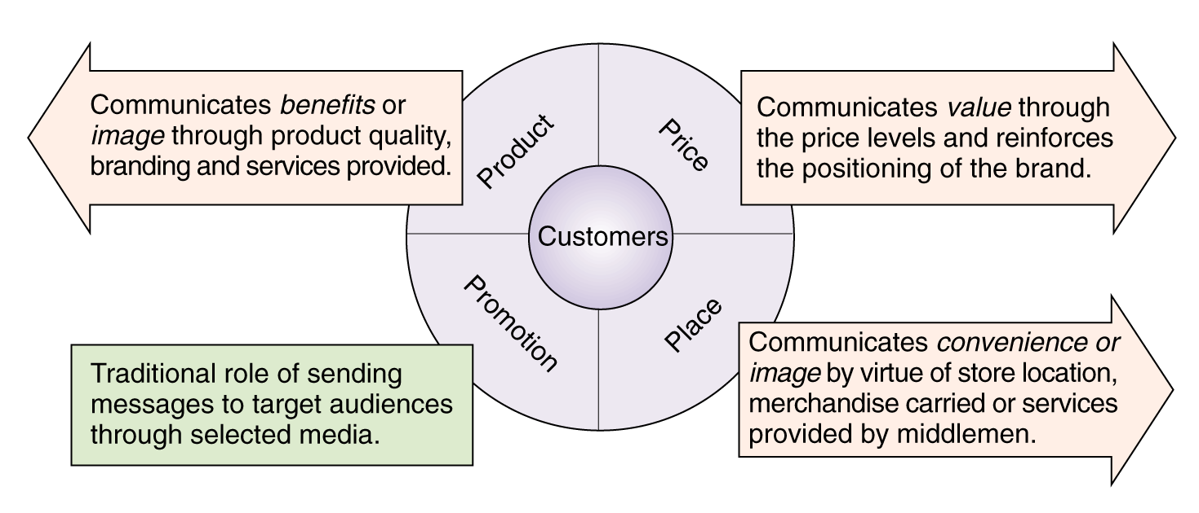
The “Communications Potential” of the Marketing Mix

Slide 15
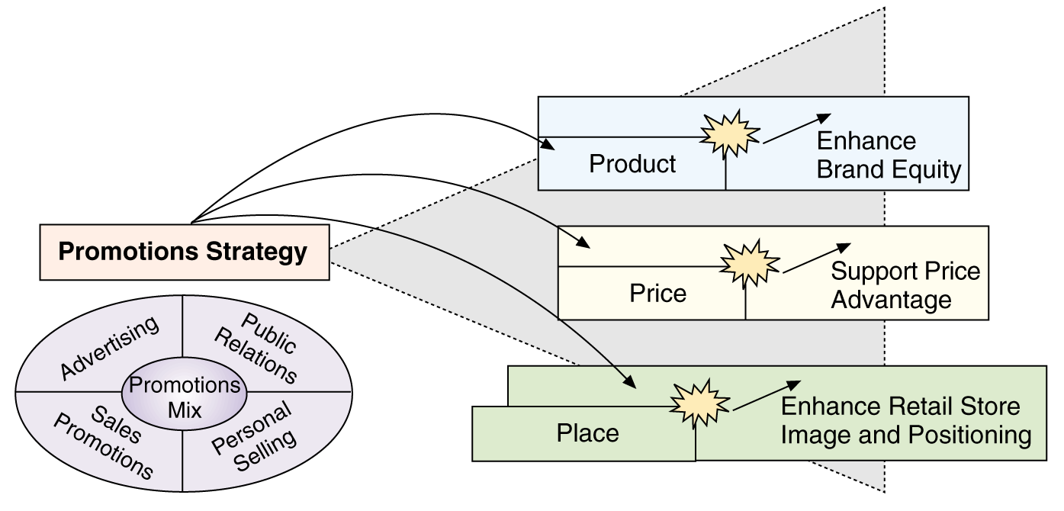
How Promotions Leverages Other Marketing Mix Variables

Slide 16
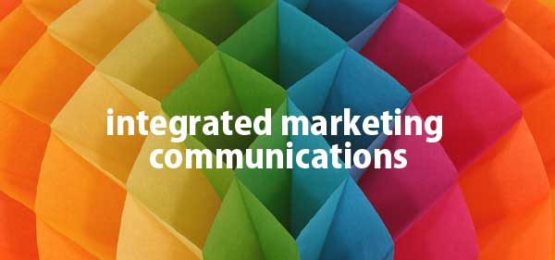
Objective 2: Integrated Marketing Communications
IMC

Slide 17
The Changing Communications Environment
Two factors are changing the face of today’s marketing communications:
As mass markets have fragmented, marketers
are shifting away from mass marketing
Vast improvements in information technology
are speeding the movement toward segmented
marketing

Slide 18
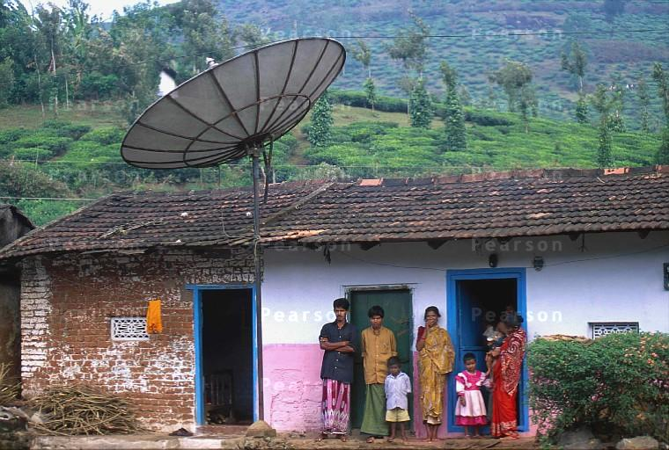
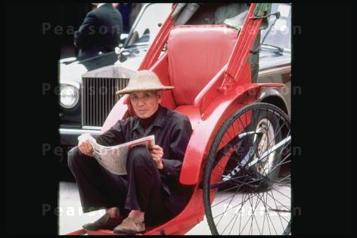
The challenge of communicating to vast rural and less affluent audiences in Asia is to know what types of media best suit those markets. Lack of affluence does not necessarily mean customers are not exposed to media and advertising

Slide 19


Kimberly-Clark – new IMC approaches
Targets new and expectant mothers through mommy blogs, Web sites,
print and online ads, e-mail, in-store promotions and in-hospital TV programming.

Slide 20
The need for IMC
Conflicting messages from different sources or promotional approaches can confuse company or brand images
The problem is particularly prevalent when functional specialists handle individual forms of marketing communications independently

Slide 21
The need for IMC
Using IMC, the company carefully
integrates and coordinates its many
communication channels to deliver
a clear, consistent, and compelling
message about the organization
and its products

Slide 22
The need for IMC
  The Internet must be integrated into the broader IMC mix
  Best bet is to wed traditional branding efforts with the interactivity and service capabilities of online communications
  GRADUAL BLENDING: of new and traditional media
  NEW MARKETING MODEL: will consist of a shifting mix of both traditional mass media and a wide array of exciting, new, more-targeted, and more personalized media.
  THE CHALLENGE: is to bridge the “media divide” that too often separates traditional media approaches from interactive and digital ones.

Slide 23
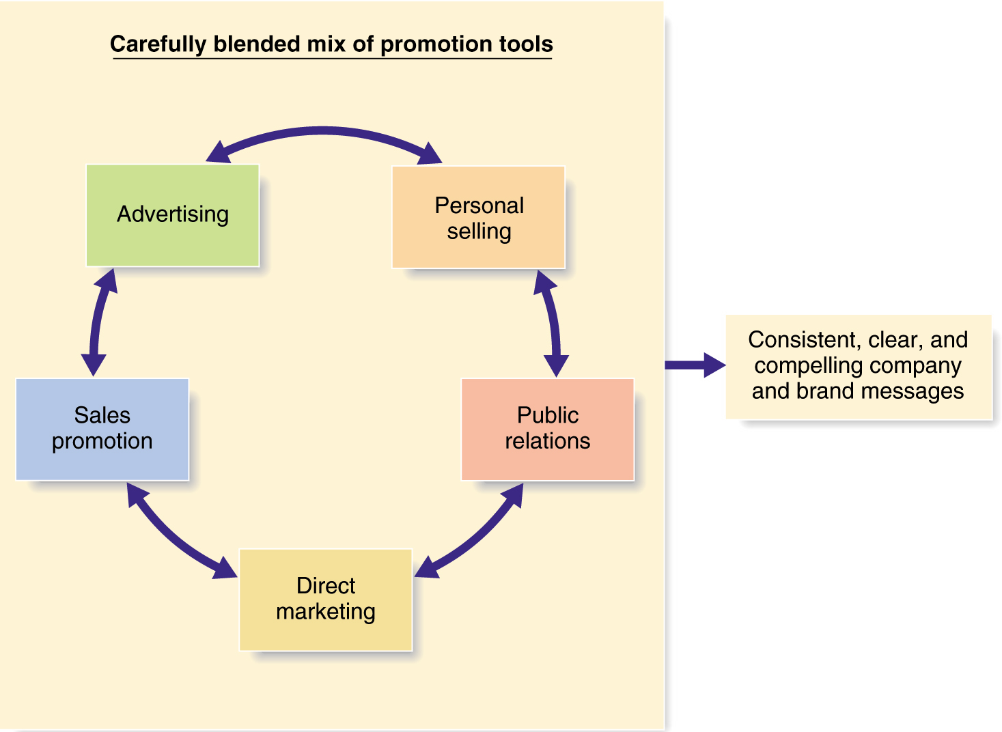
Integrated Marketing Communications
Figure 14.1
Today’s customers are bombarded by company messages from all directions. For example, think about all the ways you interact with companies such as Nike, Apple, or Coca-Cola. Integrated marketing communications means that companies must carefully coordinate all these customer touchpoints to ensure clear brand messages.

Slide 24
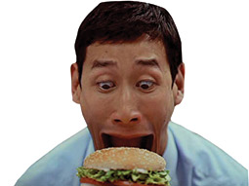
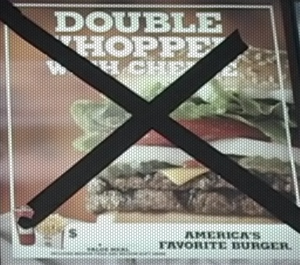

IMC: Burger King’s Whopper Freakout Campaign
Burger King’s richly integrated prolonged
Whopper Freakout campaign, which employed
A carefully coordinated mix of everything from
TV and radio ads to rich media ad banners
And a Freakout Web site, boosted store traffic
And Whopper sales by 20 percent.

Slide 25

Objective 3: A View of the Communications Process
Steps in Developing Effective Marketing Communication

Slide 26
The Communication Process
Communications efforts should be viewed from the perspective of managing customer relationships over time.
The communication process begins with an audit of all potential contacts a customer might have with the brand.
Effective communication requires knowledge of how communication works.

Slide 27
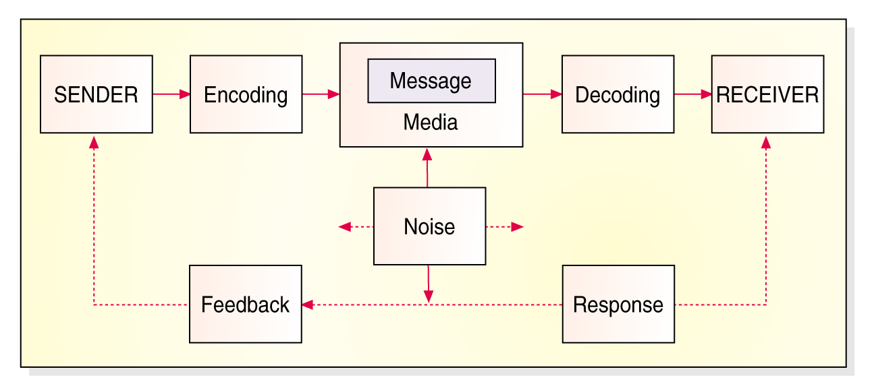
Elements in the Communications Process
Figure 14.2
There is a lot going on in this figure. For example, apply this model to McDonald’s To create great advertising-such as long-running “I’m lovin it” campaign- McDonald’s must thoroughly understand its customers and how communication works.
Sender’s field of
experience
Receiver’s field of
experience

Slide 28
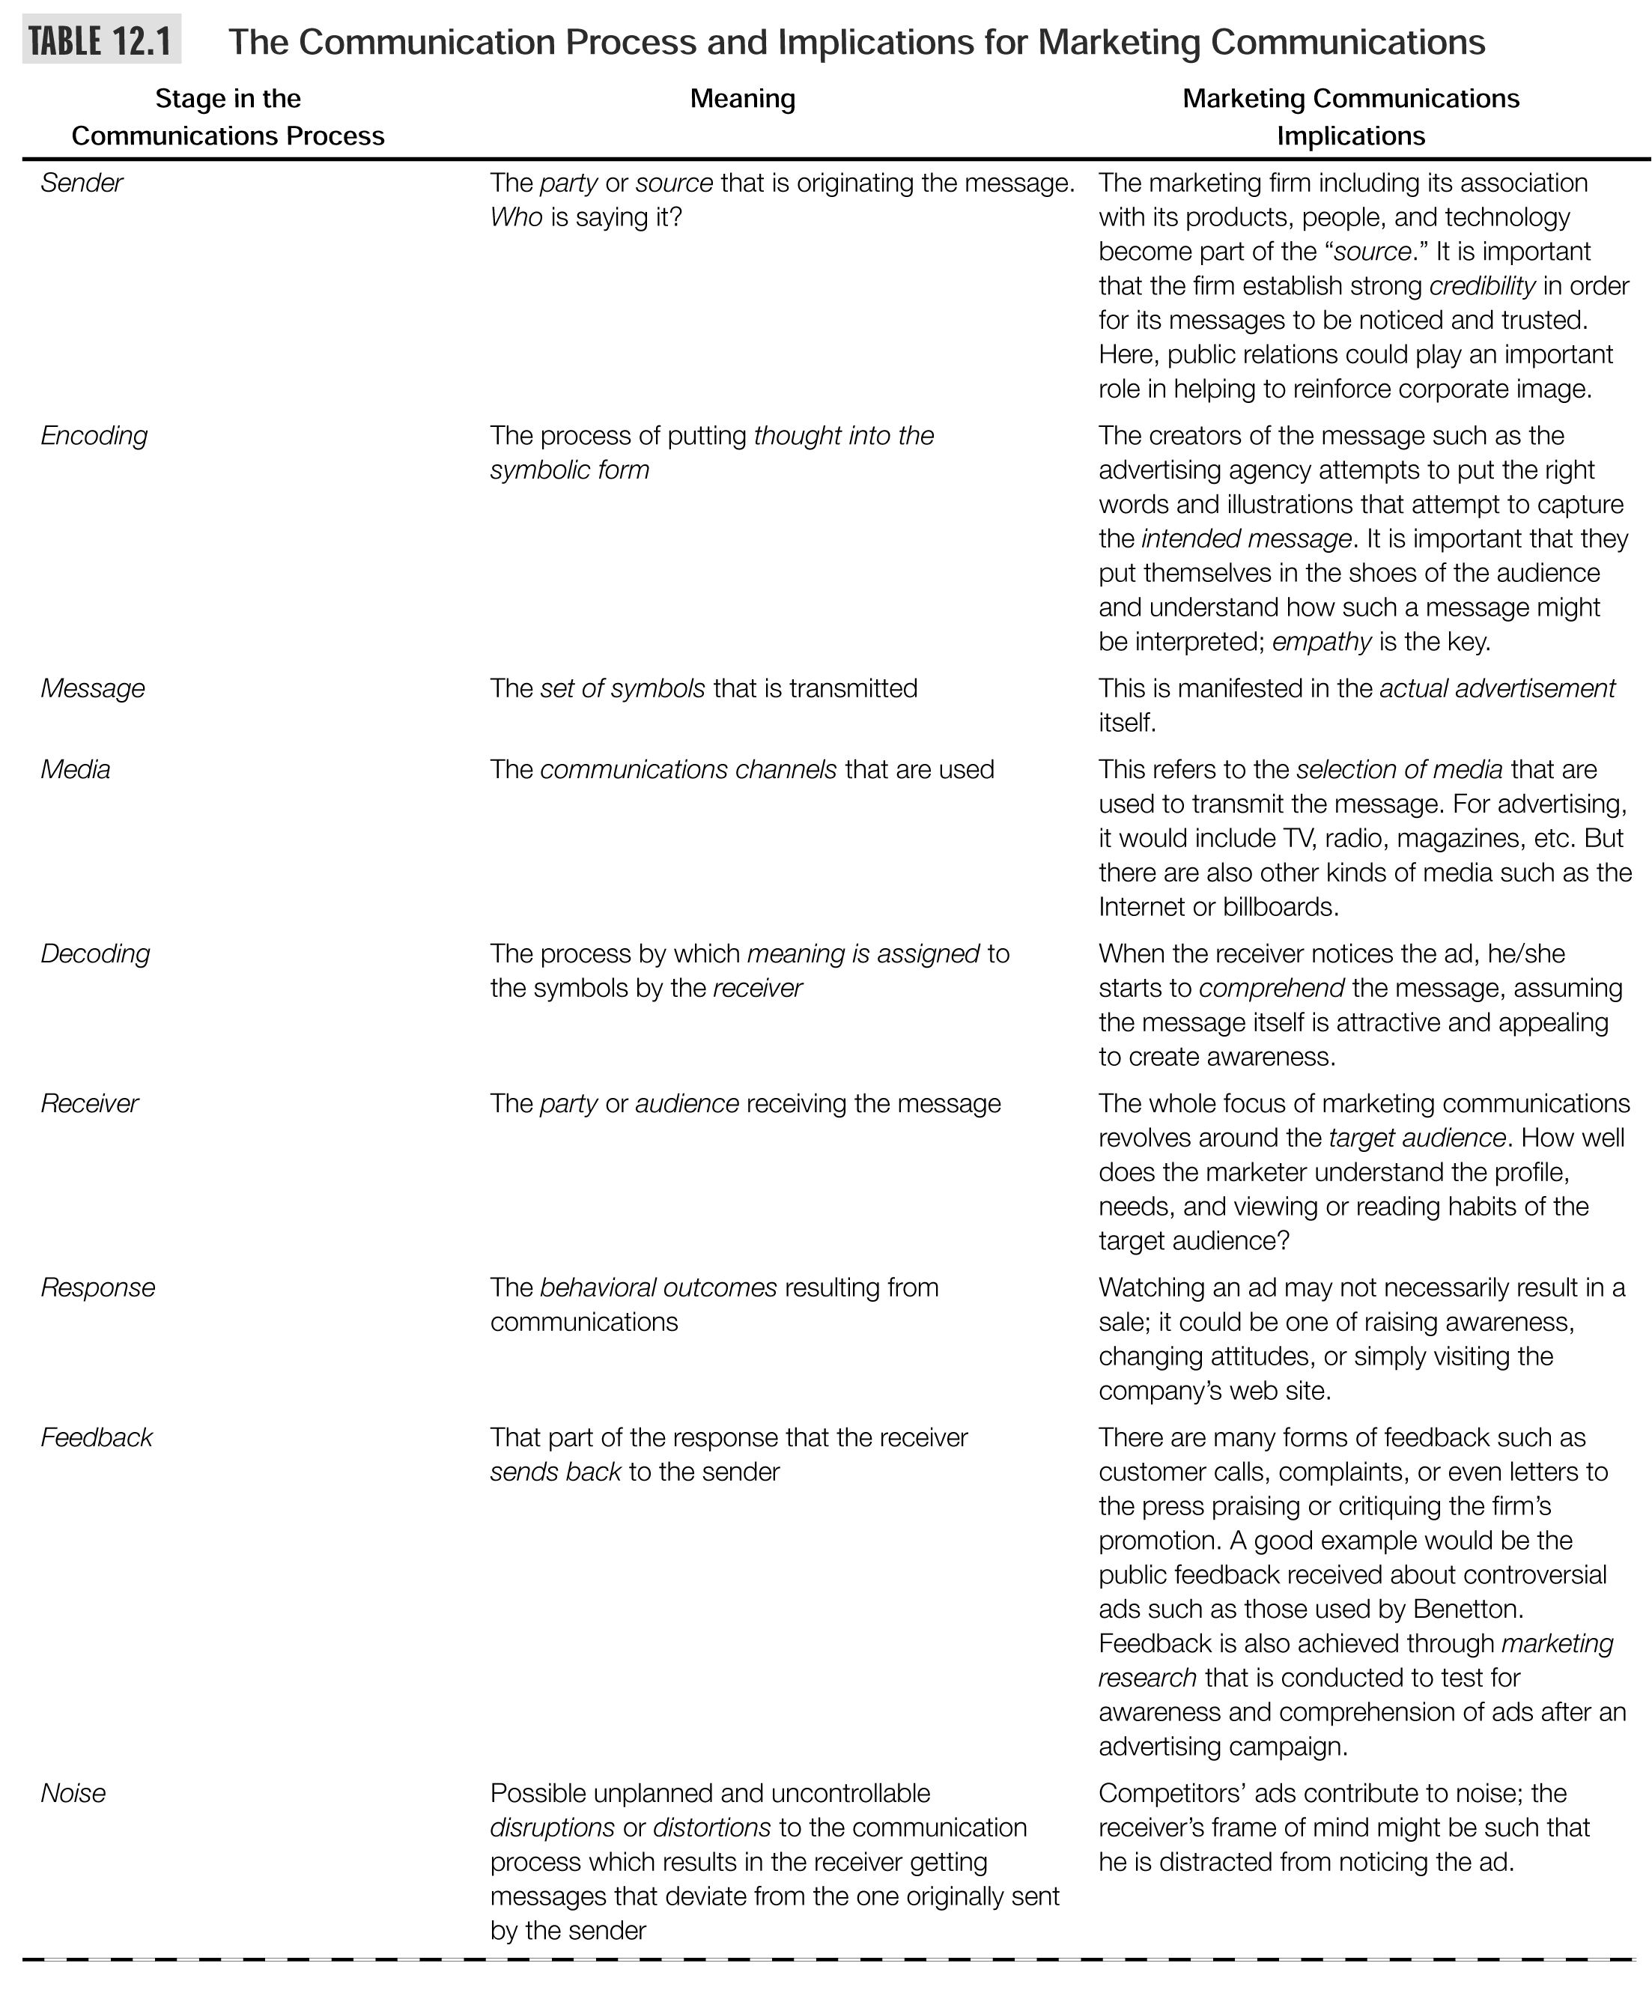

Slide 29
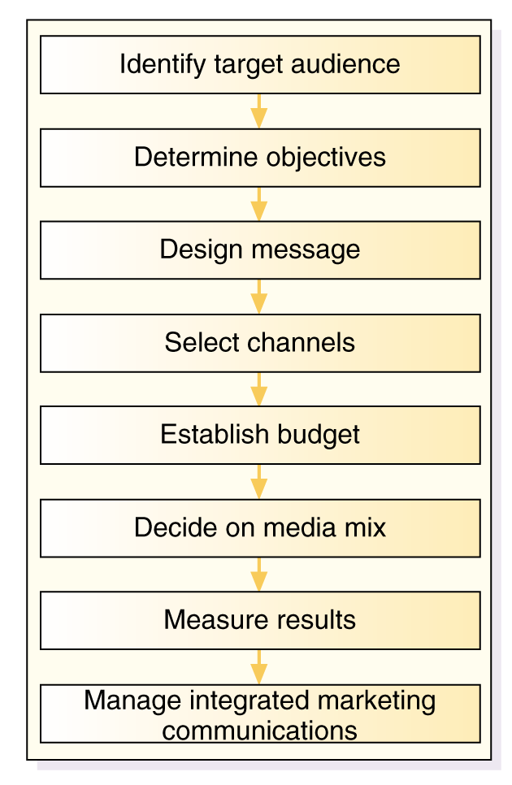
The Promotions Planning Process

Slide 30
The Promotions Planning Process

Slide 31
Developing Effective Communication
Step 1: Identifying the Target Audience
  Affects decisions related to what, how, when, and where message will be said, as well as who will say it
Step 2: Determining Communication
Objectives
  Six buyer readiness stages
Awareness
Knowledge
Liking
Preference
Conviction
Purchase

Slide 32
Developing Effective Communication
  Buyer readiness stages: the stages: The stages consumers normally pass through on the way to a purchase, including awareness, knowledge, liking, preference, conviction and finally the actually purchase.
Figure 14.2
A goal of marketing in general and of marketing
Communications in particular is to move target consumers
Through the buying process. Once again, it starts with understanding customer needs and wants
Believing this is the best
feeling
Awareness
Knowledge
Liking
Preference
Conviction
Purchase
Prefer over others

Slide 33
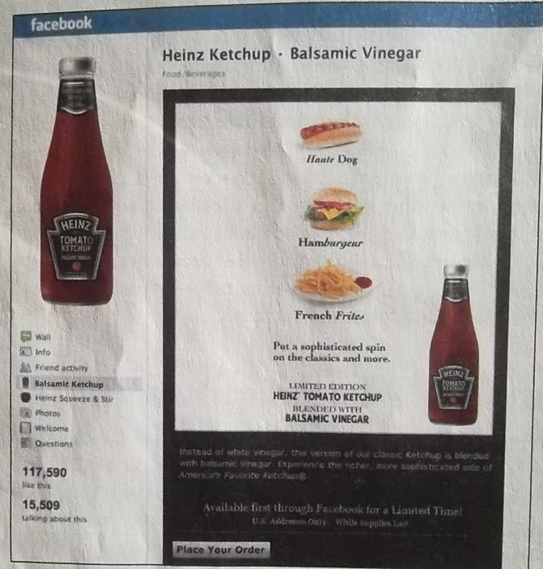
The new marketing communication model: Heinz introduced its new balsamic-vinegar-flavored ketchup using no traditional media, relying instead on its 825,000 Facebook followers to spread the word.

Slide 34
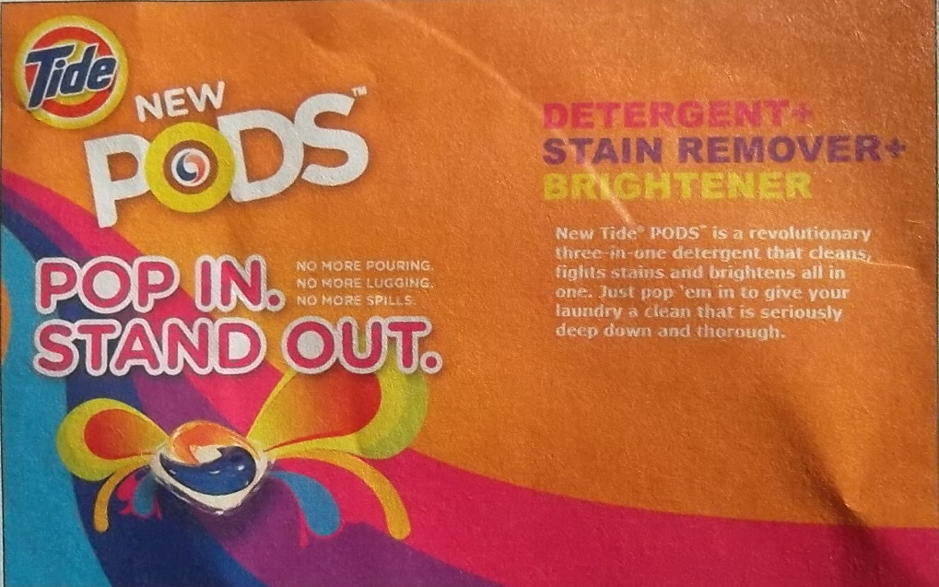
Moving consumers through the buyer-readiness stages: P&G used an extensive $150 million marketing campaign to create awareness and knowledge for its innovative new laundry product. Tide Pods.

Slide 35
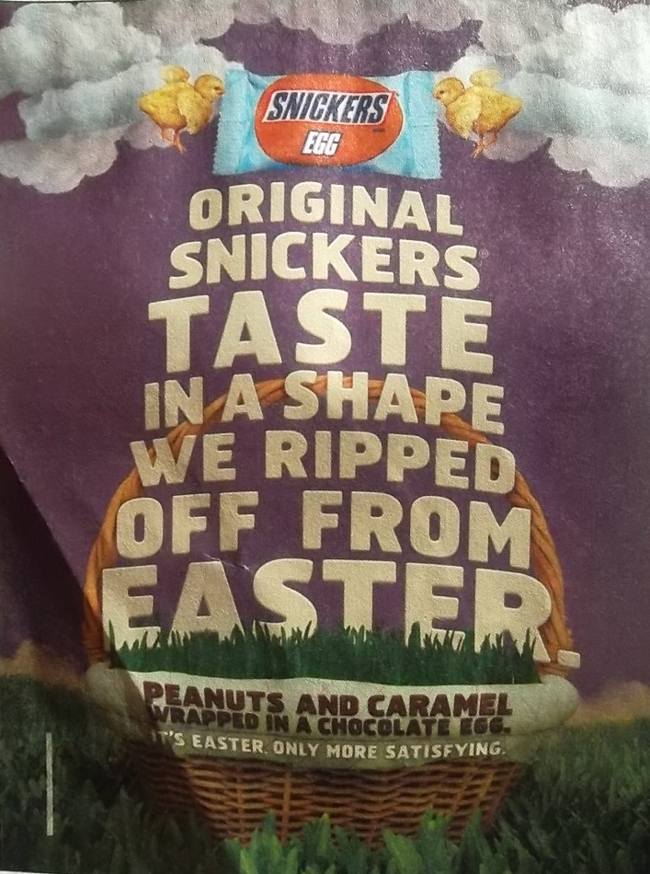
Message format: To attract attention, advertisers can use novelty and contrast, eye-catching pictures and headlines, or distinctive formats, as in the Snickers ad.

Slide 36

Developing Effective Communication
Step 3: Designing a Message
  AIDA framework guides message design
  Message content contains appeals or themes designed to produce desired results
    Rational appeals – Ex.Sunlight liquid Dishwash?
    Emotional appeals – Ex. Jubilee Diamonds?
      Love, pride, joy, humor, fear, guilt, shame
      or Moral appeal

Slide 37
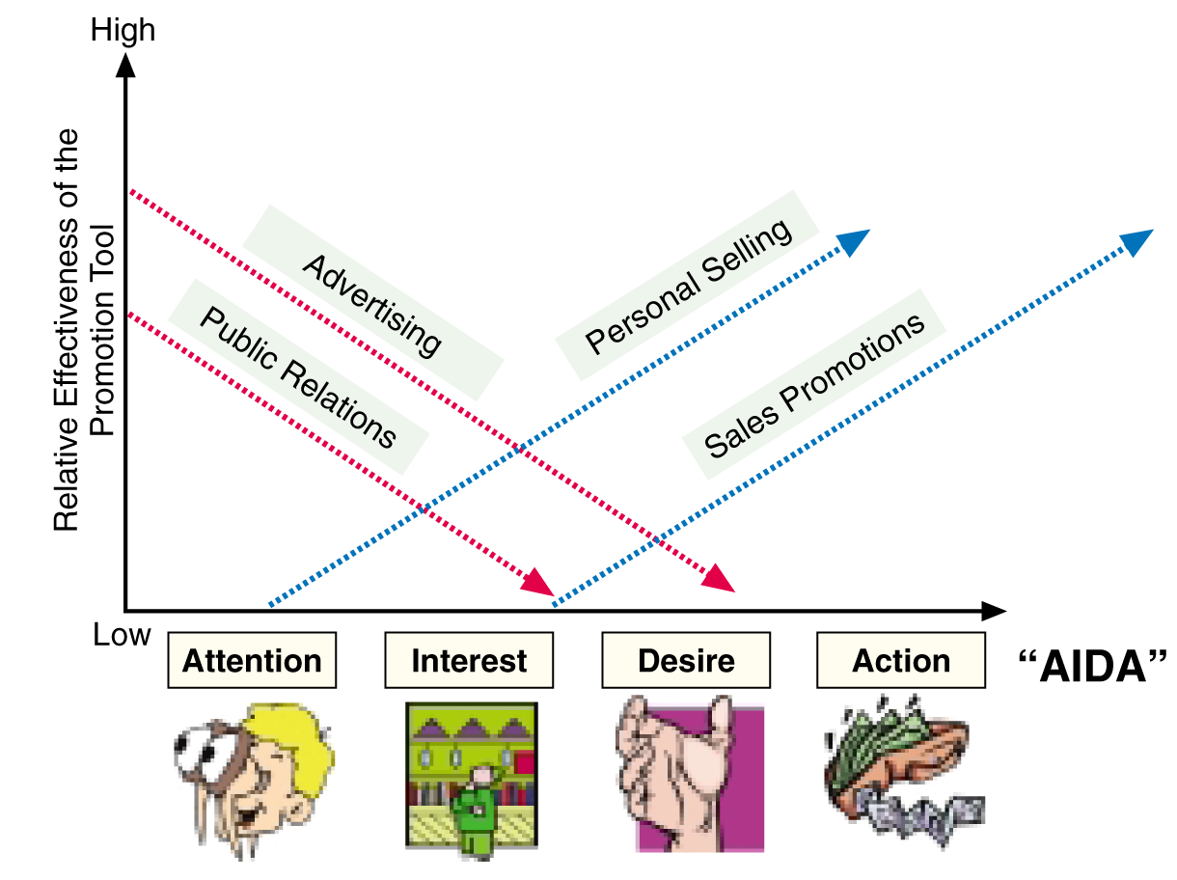
Deploying the Different Tools of Promotions to Coincide with Consumer Behavior (AIDA)
Figure 12.3 (C)

Slide 38
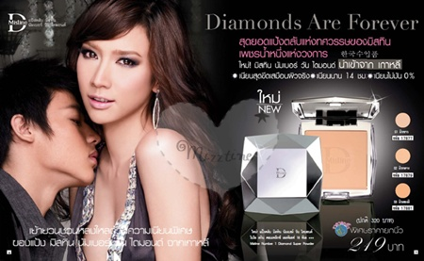
Developing Effective Communication
Step 3: Designing a Message
  Message Structure: Key decisions are required with respect to three message structure issues:
    Whether or not to draw a conclusion
    One-sided vs. two-sided argument
    Order of argument presentation
  Message Format: Design, layout, copy, color, shape, movement, words, sounds, voice, body language, dress, etc.

Slide 39
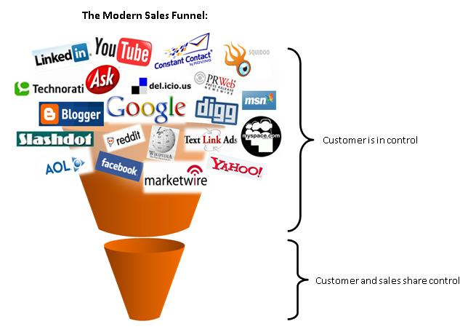

Developing Effective Communication
Step 4: Choosing Media
(and Media Mix)
  Personal communication channels
    Includes face-to-face, phone, mail, and Internet chat communications
    Word-of-mouth influence is often critical
    Buzz marketing cultivates opinion leaders
  Nonpersonal communication channels
    Includes media, atmosphere, and events
    Selecting Media Source – celebrities, endorsers

Slide 40
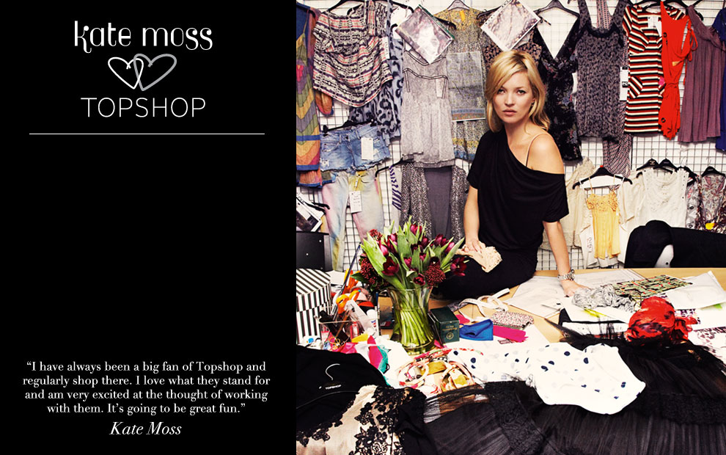
A range of clothing endorsed by model Kate Moss has been a huge selling point for retailer Topshop but allegations in her personal life could be damaging to their reputation and affect their sales.

Slide 41
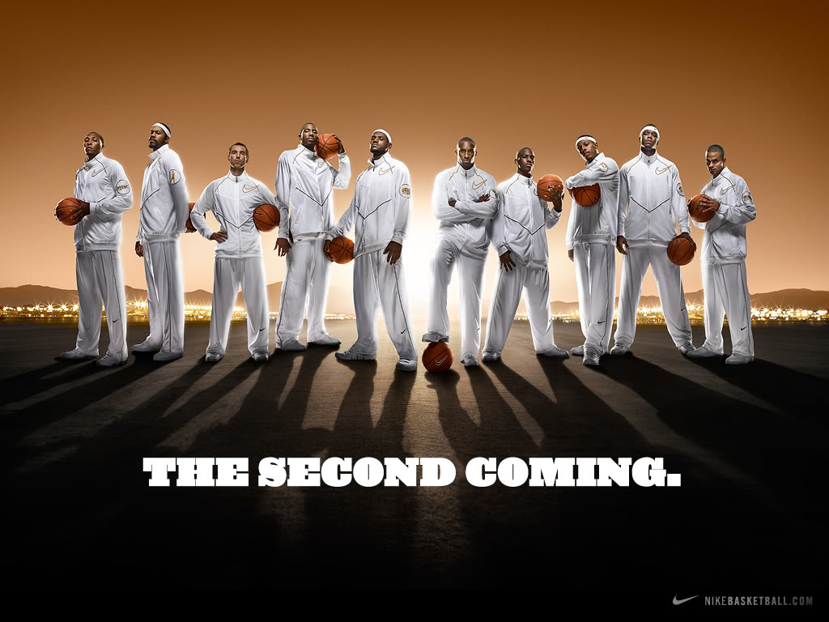
Celebrity endorsers: LeBron James, Kobe Bryant, and a host of other NBA superstars lend their images to Nike brands.

Slide 42
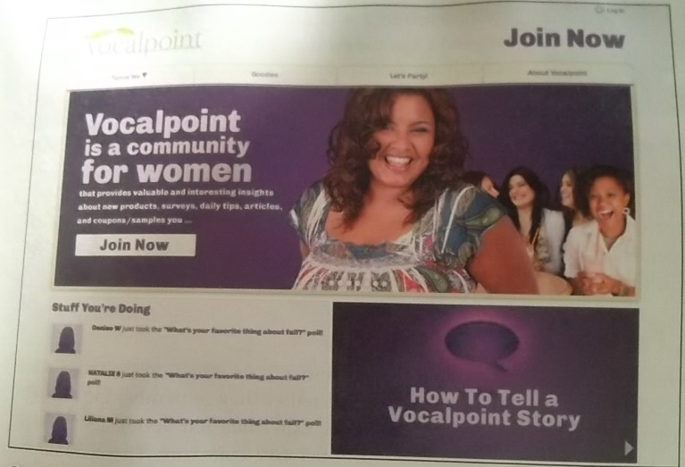
Buzz marketing: P&G has created a huge word-of-mouth marketing arm-Vocalpoint-consisting of 500,000 moms who create word-of-mouth for P&G and other brands.

Slide 43
The Promotions Planning Process

Slide 44

Objective 4: Setting the Total Promotion Budget and Mix
Socially Responsible Marketing

Slide 45
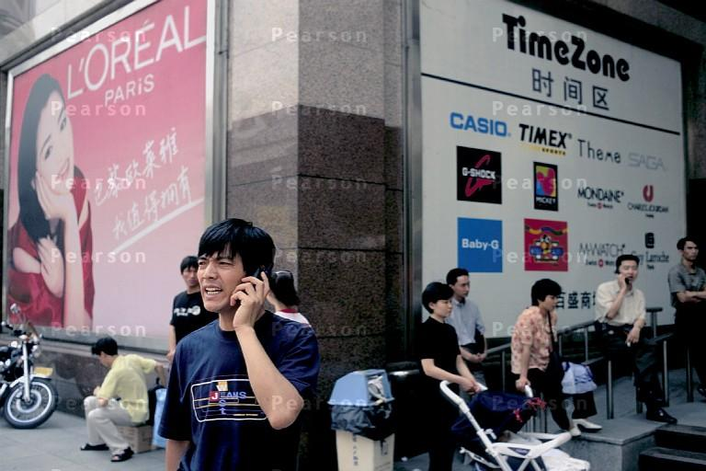
Most observers see China as registering the most dramatic increases in advertising expenditures as both global and local brands rush to capture the media landscape in major Chinese cities

Slide 46

Setting the Promotion Budget
Affordable
Based on What the Company Thinks it Can Afford
Percentage-of-Sales
Based on a Percentage of Current or Forecasted Sales or
as a percentage of the unit sales price
Competitive-Parity
Set Budget to Match Competitors
Objective-and-Task
Set Objectives, Determine Tasks to Achieve Objectives,
Sum of Task Costs Equals Budget

Slide 47
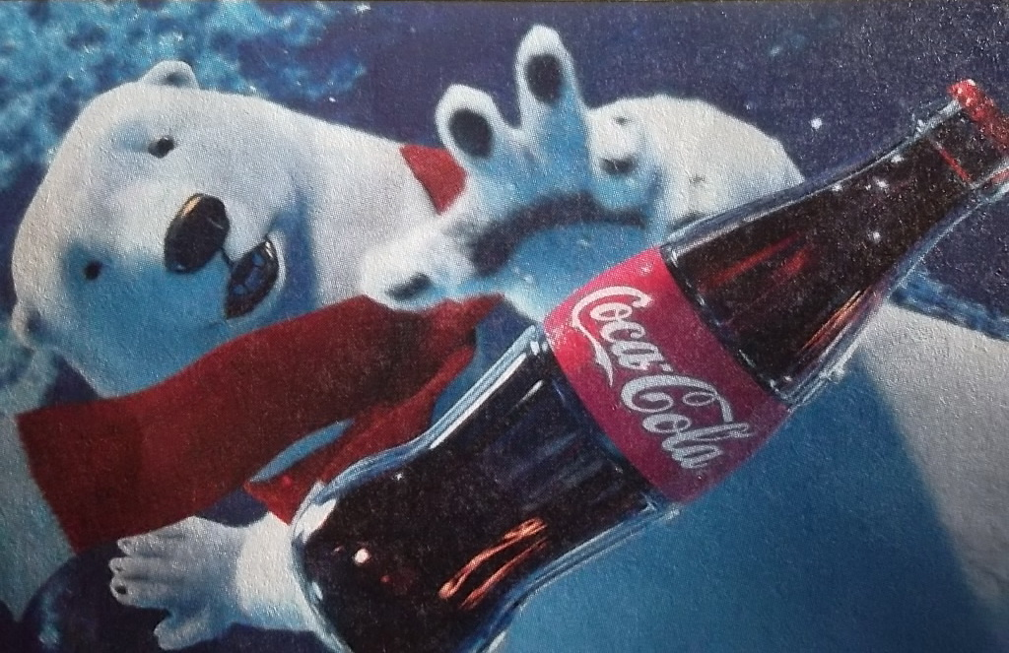
Setting the promotion budget is one of the hardest decisions facing company Coca-Cola spends hundreds of millions of dollars annually, but is that “half enough or twice too much”?

Slide 48

Socially Responsible Marketing
Marketers should go beyond what is “legal” and communicate openly and responsibly with customers. Good customer relationships are built on honesty and trust.

Slide 49
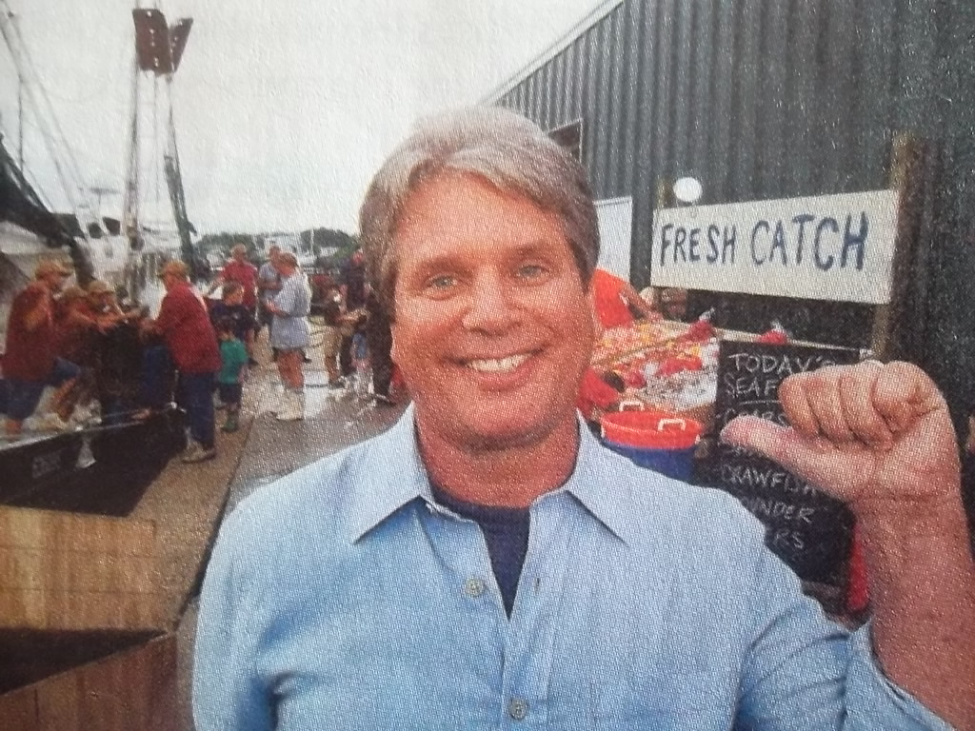
Promoting socially responsible programs and actions: to help restore tourism along the Gulf Coast, BP’s MyGulf campaign features local spokespeople discussing their state’s great beaches, fishing, and seafood and extending an invitation to vacation along the coast.

Slide 50
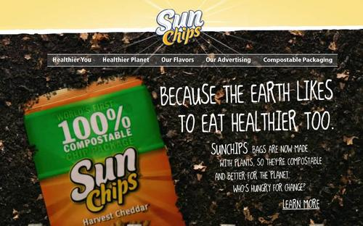
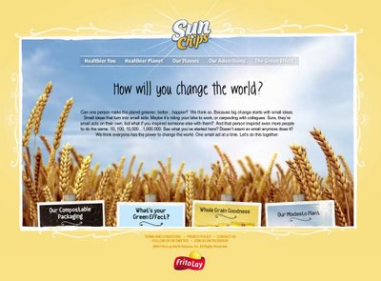
Socially Responsible Marketing
Promoting socially responsible actions:
Frito-Lay ran ads promoting the compostable
Packaging for its SunChips brand. It also promoted a program challenging consumers to create their own videos encouraging positive change in the world which it ran on national TV.

Slide 51
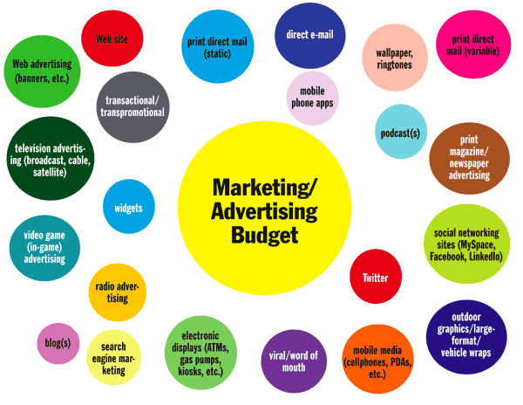
Part II: The Media Mix

Slide 52
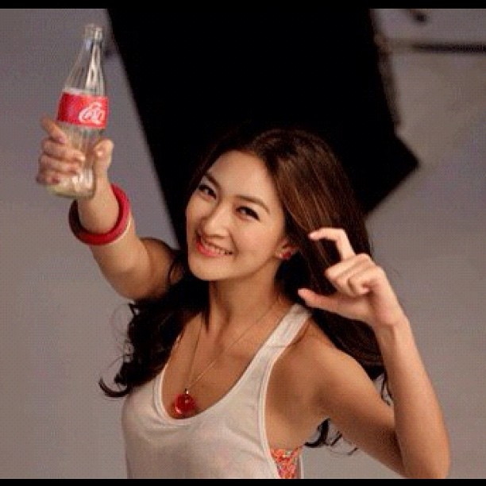
Advertising
Can reach masses of geographically dispersed buyers.
Can repeat a message many times.
Is impersonal, one-way communication.
Can be very costly for some media types.
Low cost per exposure, though overall costs are high
Consumers perceive advertised goods as more legitimate
Dramatizes company/brand
Builds brand image; may stimulate short-term sales

Slide 53

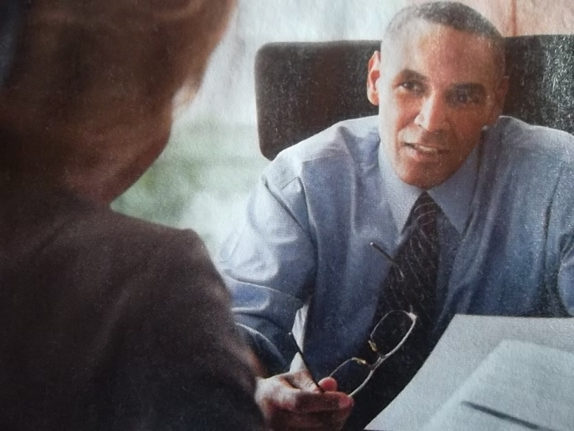
Personal Selling
Personal interaction allows for feedback and adjustments
Allows relationship building.
Most effective tool for building buyers’ preferences, convictions, and actions
Buyers are more attentive
Sales force represents a long-term commitment
Most expensive of the promotional tools
With personal selling, the customer feels a greater need to listen and respond, even if the response is a polite “No Thank you.”

Slide 54
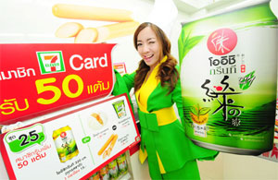
Sales Promotion
Makes use of a variety of formats: premiums, coupons, contests, etc.
Attracts attention, offers strong purchase incentives, dramatizes offers, boosts sagging sales
Offers strong incentives to buy.
Invites and rewards quick consumer response.
Stimulates quick response
Effects are short lived
Not effective at building long-term brand preferences

Slide 55

Sales Promotion
Sales promotion consists of short-term incentives to encourage the purchase or sales of a product or service.
The idea behind sales promotion is to generate immediate sales.

Slide 56
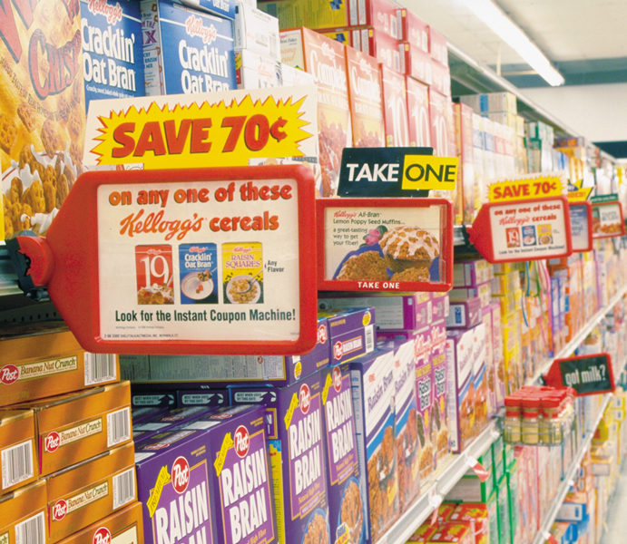
Sales Promotion
Today’s food marketers are using more and more push promotions, including consumer price promotions.

Slide 57
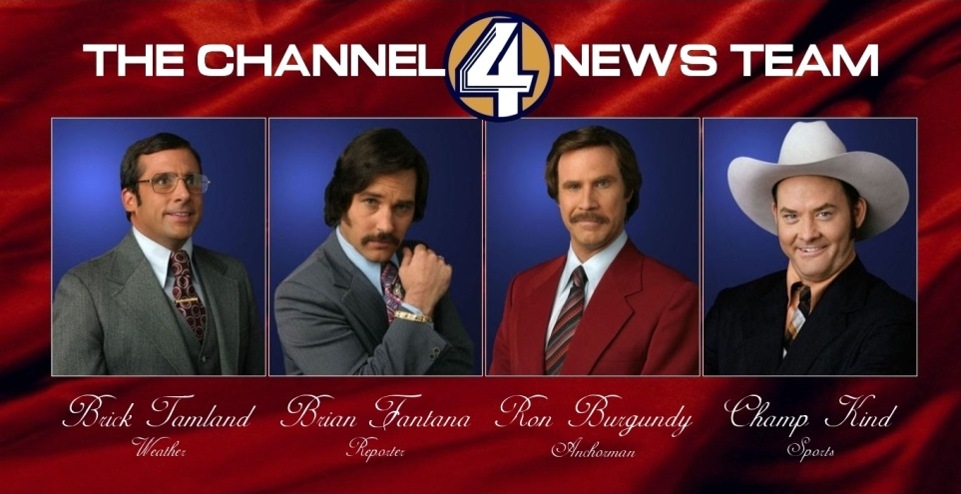
Public Relations
Very believable and credible
Reaches people who avoid salespeople and ads.
Can dramatize a company or product.
Tends to be used as an afterthought.
Planned use can be effective and economical.
Many forms: news stories, news features, events and sponsorships, etc

Slide 58

Public Relations(PR)
Public relations involves building good relations with the company’s various publics by obtaining favorable publicity, building up a good corporate image, and handling or heading off unfavorable rumors, stories, and events.

Slide 59

Public Relations (PR)
Role and Impact of Public Relations
  Strong impact on public awareness at lower cost than advertising
  Greater credibility than advertising
  Publicity is often underused
  Good public relations can be a powerful brand-building tool

Slide 60
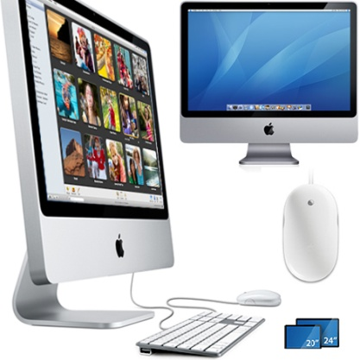
Public Relations Functions
Press relations or press agency
Product publicity
Public affairs
Lobbying
Investor relations
Development

Slide 61

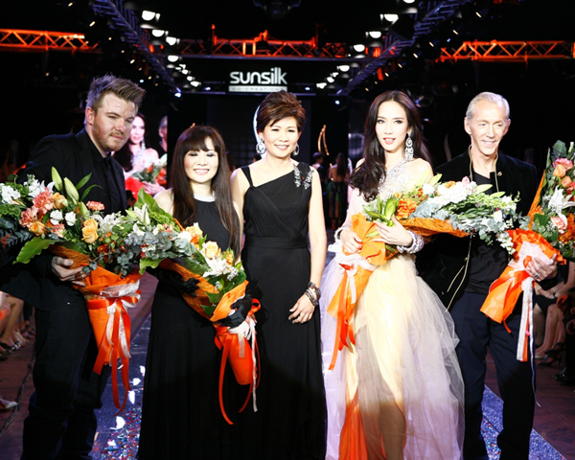
Public Relations Tools
Audiovisual materials
Corporate identity materials
Public service activities
Company Web site
News
Speeches
Special events
Buzz marketing
Mobile marketing
Written materials

Slide 62

Direct and Online Marketing
Many forms that share four characteristics:
  Nonpublic
  Immediate
  Customized
  Interactive
Well suited to highly targeted marketing.

Slide 63
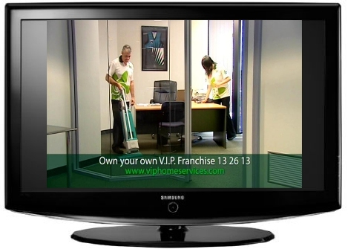

Promotion Mix Strategies
Push strategy: trade promotions and personal selling efforts push the product through the distribution channels.
Pull strategy: producers use advertising and consumer sales promotions to generate strong consumer demand for products.
vs

Slide 64
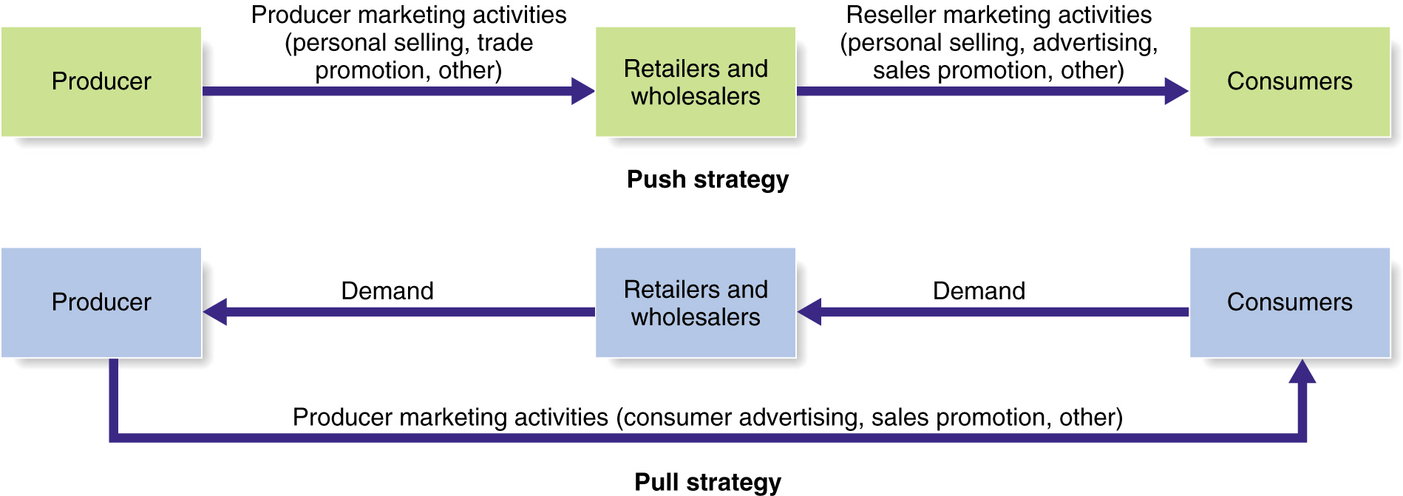
Push vs. Pull Promotion Strategy
Figure 14.4

Slide 65
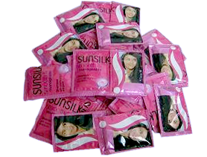
Consumer Sales Promotion Tools
Sample
Offers a trial amount of a product
Coupons
Savings when purchasing specified products
Cash Refunds
“Rebates”
Refund of part of the purchase price by mail
Price Packs
“Cents-Off Deals”
Reduced prices marked on the label or package by producer
Premiums
Goods offered free or low cost as an incentive to buy a product
Advertising
Specialties
Articles imprinted with an advertiser’s name given as gifts

Slide 66
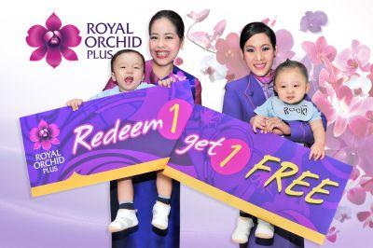
Consumer Sales Promotion Tools
Patronage Rewards
Cash or other award offered for regular use of a product or service
Point-of-Purchase
Promotions
Displays or demonstrations at the point of purchase or sale
Contest
Consumers submit an entry to be judged by a panel
Sweepstakes
Consumers submit their names for a drawing
Games
Consumers receive something each time they buy which may help them win a prize

Slide 67

Trade shows are a popular means of promotions in business marketing(B2B)

Slide 68
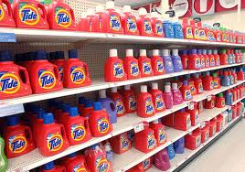
Trade Promotion
Objectives
Tools
Persuade resellers to carry a brand
Give a brand shelf space
Promote brand in advertising
Push brand to customers
Discounts
Allowances
Free Goods
Push Money
Specialty Advertising Items

Slide 69

Business Promotion
Objectives
Tools
Generate business leads
Stimulate purchases
Reward customers
Motivate salespeople
Conventions
Trade shows
Sales contests

Slide 70
The need for IMC
Whether it’s advertising, personal selling, sales promotion,
public relations, or direct marketing,
communications at
Each customer touchpoint must deliver
consistent messages and positioning.
An integrated promotion mix ensures that
Communications efforts occurs when, where,
and how customers
Need them.

Slide 71

Major Decisions in Advertising

Slide 72
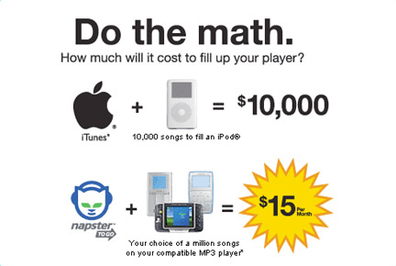
Setting Advertising Objectives
An advertising objective is a specific communication task to be accomplished with a specific target audience during a specific period of time.
Classified by purpose: Inform, Persuade, Compare, Remind

Slide 73

Purposes of Advertising
  Inform
    Introducing new products
  Persuade
    Becomes more important as competition increases
    Comparative advertising
  Remind
    Most important for mature products

Slide 74
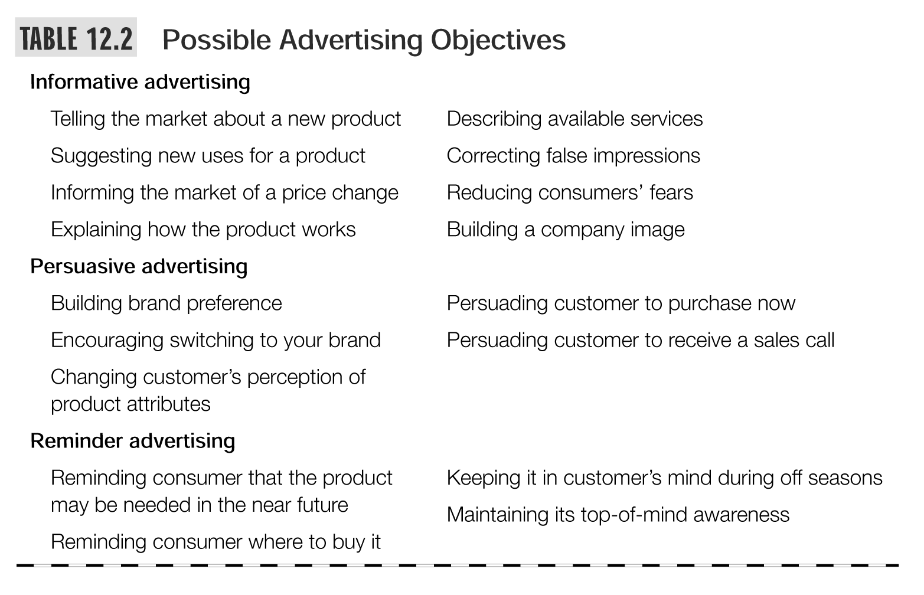

Slide 75
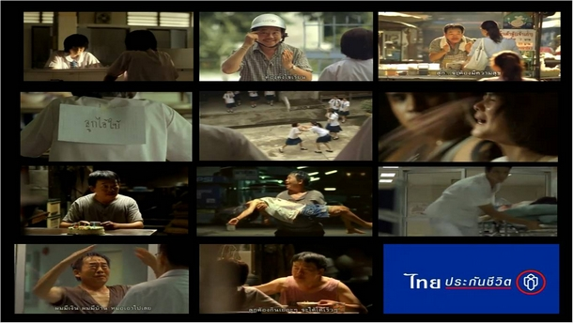


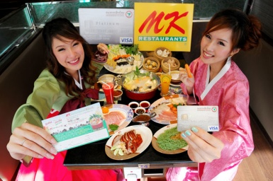
Message Execution
Slice of Life
Testimonial Evidence
or Endorsement
Lifestyle
Scientific Evidence
Typical
Approaches
Fantasy
Technical Expertise
Mood or Image
Personality Symbol
Musical

Slide 76


Message Execution
Choose a tone
Use memorable, attention-getting words
Choose correct format elements
  Illustration
  Headline
  Copy

Slide 77
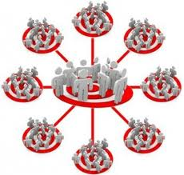
Selecting Advertising Media
Reach
  Percentage of people exposed to ad
Frequency
  Number of times a person is exposed to ad
Media Impact
  The qualitative value of a message exposure through a given medium

Slide 78


Slide 79


Deciding on Media Timing
Must decide how to schedule the advertising over the course of a year
  Follow seasonal pattern
  Oppose seasonal pattern
  Same coverage all year
Choose the pattern of the ads
  Continuity
  Pulsing

Slide 80

Creating ads for Asian markets must take cognizance of special cultural nuances in order to convey the right messages to target audiences

Slide 81

Part III: Get Better Advertising

Slide 82

Get Better Advertising: Brand Owner’s Perspective
What do we mean by good ads?
Better quality ads
  How to get the best work from the agency
  How to judge whether it will turn out well
For the right money
For the right time

Slide 83





Slide 84

Get Better Advertising: Brand Owner’s Perspective
How to get the best work from the agency?
  Clients with clear marketing strategies
  Clients who brief them well
  Clients they like and enjoy working for

Slide 85

Get Better Advertising: Brand Owner’s Perspective
Marketing Team (the Brand Owner)
Agency Client Service
Agency Creative Team
Production House

Slide 86
Get Better Advertising: Brand Owner’s Perspective
Why write a brief?
Discipline: to make sure you have though
Communication: So agency knows where to start
Reference: something to check the creative against

Slide 87

Get Better Advertising: Brand Owner’s Perspective
How to evaluate good advertising?
The “SMILE” APPROACH
S= simple, easy to understand
M= memorable, stick to consumer’s mind,
measures by a day after recall
I= interesting, employ new story, has new information to tell
L= Linked to the brand, cannot be mistaken to other brands/products
E= Emotionally involving

Slide 88

LET’S PRACTICE “SMILE”

Slide 89


