Slide 1
FACTORS AFFECTING
Condominium Prices
Presented by Jirat Sirirat 5904641627

Slide 2
TABLE OF CONTENTS
01
02
03
RESEARCH QUESTION
INDUSTRY ANALYSIS
THEORETICAL FRAMEWORK
04
05
06
METHODOLOGY
RESULT
CONCLUSION

Slide 3
RESEARCH QUESTION
“What are the factors driving the condominium prices located along the BTS line?”

Slide 4
INDUSTRY OVERVIEW
First Quarter of 2019, the total transactions in land and building rose by 3.8% y-o-y to $8.62 billion
Took massive hit from domestic and foreign aspects in 2019
By Q4 2019, condominium market drop 16%y0y for the entire year
Notes:
Demand continues to rise, but at a slower pace. Nationwide, land and building transactions rose by 3.8% y-o-y to THB 266.15 billion (US$8.62 billion) in the first quarter of 2019, following a 7.7% growth in 2018, according to the BoT. Residential construction activity is now falling.
Domestic negative impact came from poisonous impact causing
Foreign impact from THB appreciation
Chinese buyers refrain and decrease in demand from US China Trade war

Slide 5
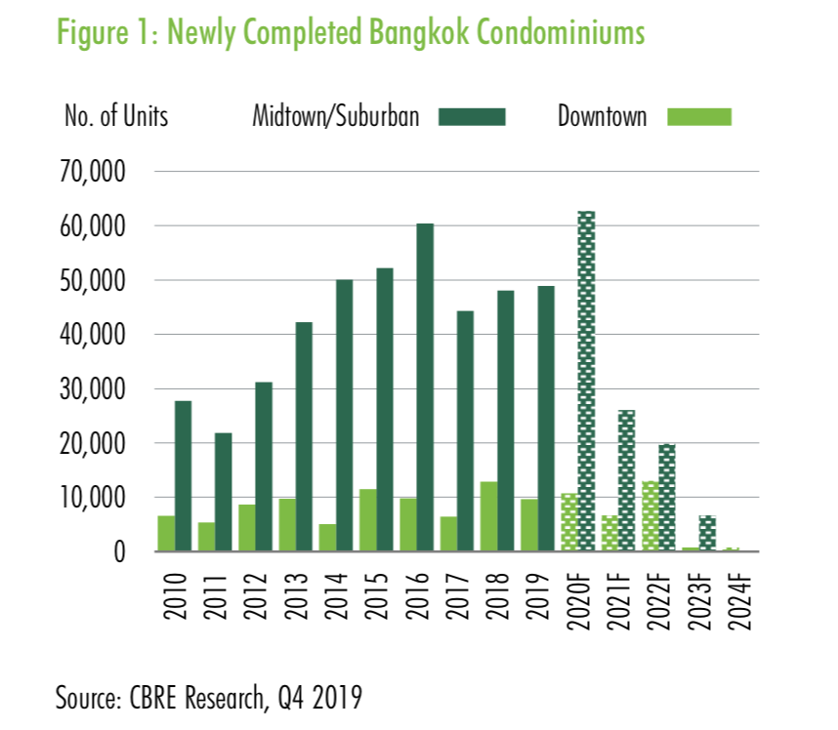
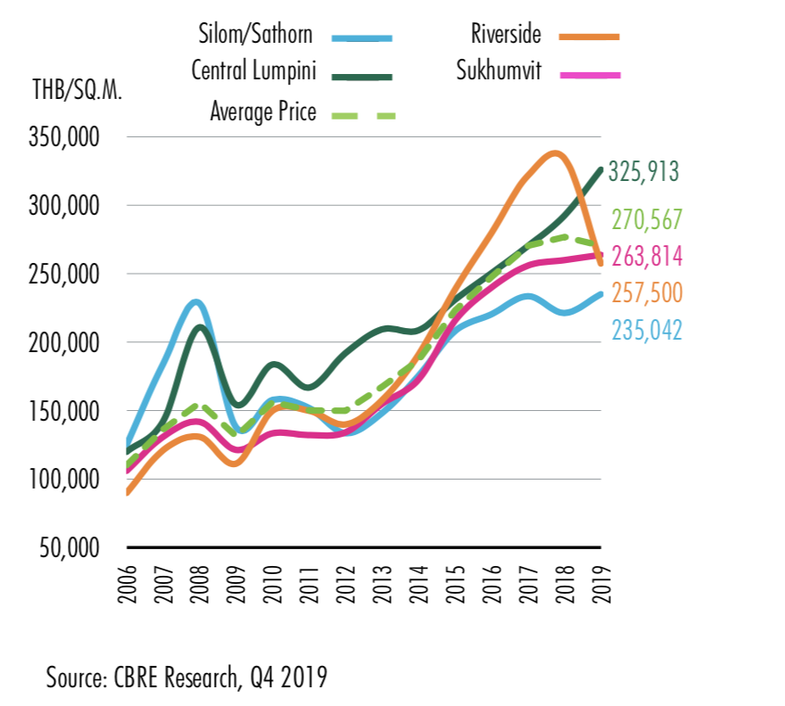
Trends among the constructions starts to drop in 2019 while the trend of urbanization and individualism continues to drive the asking price of condominiums in the downtowns up
Notes:
Total of newly launched units was 61,324 in 2019 for the whole year, reduced by 18,385 or 16% from 2018
Household debts remain high reducing the buying rate. The demand in the market is not favourable for developers
The trend in the producers are shifting towards the more price conscious segment among the consumers and the developers are trying to offloads the finished units

Slide 6
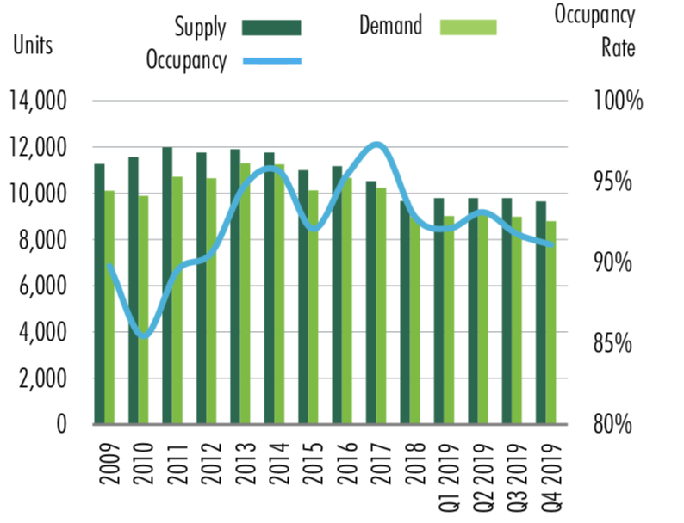
INDUSTRY OVERVIEW
Oligopolistic Structure with Top 10 largest players owning 59% Values
59% of Market shares units
Trends shifting towards affordability
Sukhumvit the most popular area for condos and apartment transactions with 58% of transactions units in value
Estimated to continue declining
Notes:
Occupancy rate continues to decline as demand falls

Slide 7
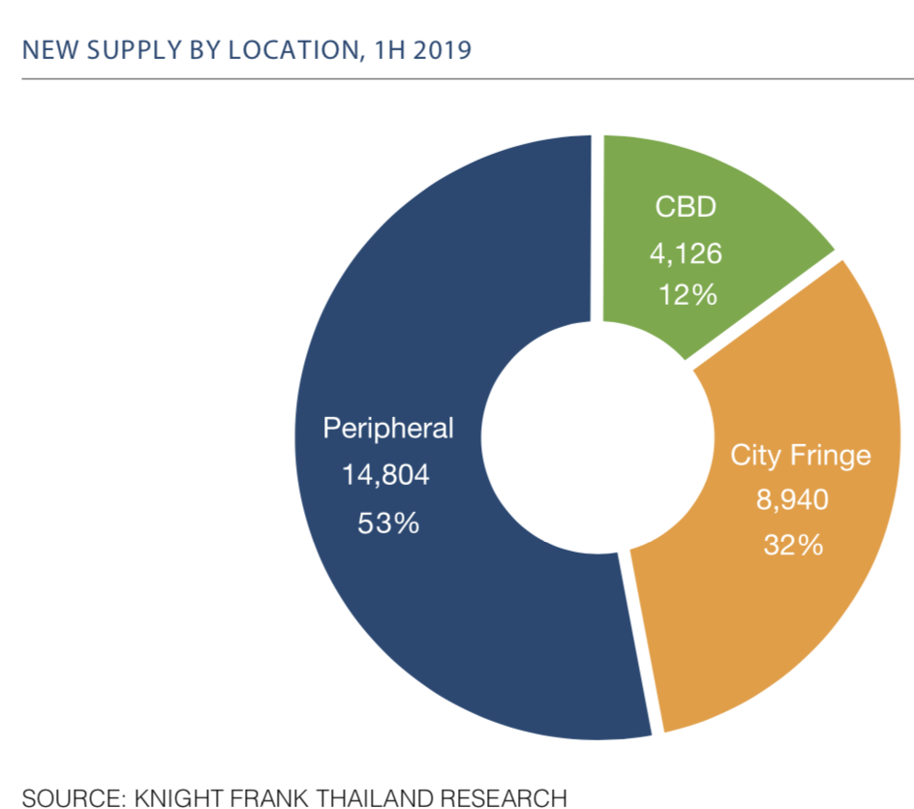
Notes:
Total 84% sales rate from the end of 2018
Demand continues to dampen
The price rise from 2018 by 2.5% and 2% for condominiums and fringe respectively

Slide 8
THEORETICAL FRAMEWORK
STRUCTURAL ATTRIBUTES
The attributes of the condominiums that are internal such as room size
LOCATIONAL ATTRIBUTES
Attributes that concerns the external aspects of the condominium, impacts from the location of the condominium

Slide 9
THEORETICAL FRAMEWORK
HEDONIC PRICING
Structural Attributes
LOCATIONAL ATTRIBUTES
SIZE
Size of the room of the collected samples in square meters
DISTANCE FROM CBD
Number of stations needed to travel from the closest BTS station
COMMON FEE
Fees paid annually for maintenance of shared facility
DISTANCE FROM BTS
Distance between the condominium and the closest BTS station in meters
YEAR OPENED
Number of years since the condo was opened for sale
DISTANCE FROM MRT
Distance between the condominium and the nearest MRT station
DEVELOPERS REPUTATION
Whether the developers are among the top 10 in Thailand or not
PARKING SPACE
Percentage of parking space to the whole amount of unit
Notes:
https://www.condonewb.com/insight/86/Where-Is-Bangkok-CBD This is where I got my information on CBD

Slide 10
METHODOLOGY
SECONDARY DATA COLLECTION
MULTIPLE LINEAR REGRESSION

Slide 11
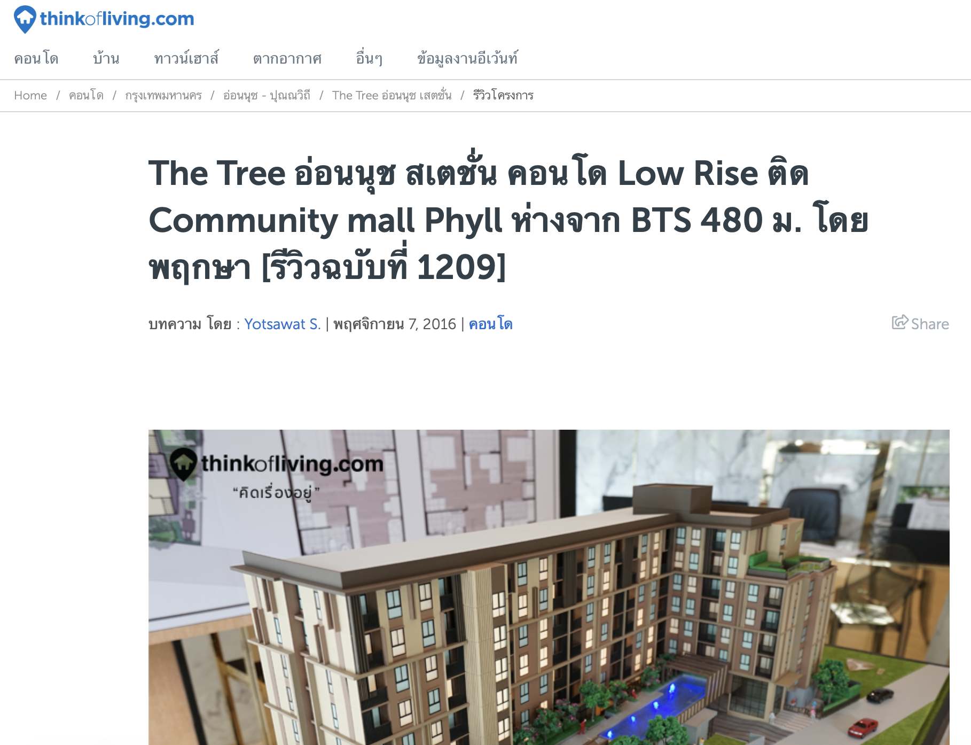
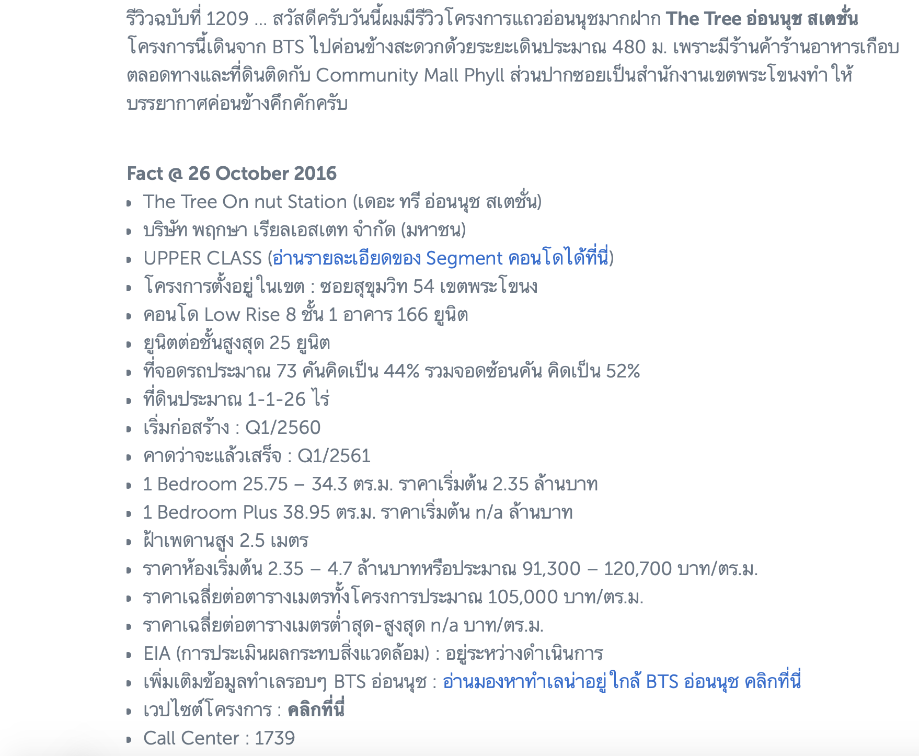
SECONDARY DATA COLLECTION

Slide 12
MULTIPLE LINEAR REGRESSION
Price of condominium =
β₀ + β₁(size) + β₂(fee) + β₃(Year) + β₄(Parking) + β₅(Firm) + β₆(CBD) + β₇(BTS) + β₈(MRT)+β₉(Class) + u

Slide 13
POPULATION OF THE STUDY
The total of 200 samples were collected in the room pattern of 1 bedroom and 1 bathroom as a standard
Samples collected from areas within walking radius (1,000 m.)of BTS stations along BTS line
STRUCTURAL ATTRIBUTE
LOCATIONAL ATTRIBUTES
SIZE
DISTANCE FROM CBD
COMMON FEE
YEAR OPENED
DISTANCE FROM BTS
DEVELOPERS REPUTATION
DISTANCE FROM MRT
PARKING SPACE
CLASS

Slide 14
POPULATION OF THE STUDY
STRUCTURAL ATTRIBUTE
Ultimate class | 8
Super Luxury class | 7
Luxury class | 6
High class | 5
Upper class | 4
Main class | 3
Economy class | 2
Super economy class | 1
CLASS
Class given by Think of living from price per square rate
SIZE
Size of the room of the collected samples in square meters
COMMON FEE
Fees paid annually for maintenance of shared facility
6.) Land And House
7.) Quality House
8.) Ananda development
9.) Property Perfect
10.) Origin Property
Top 10 Developers
1.) Pruksa
2.) Lumpini
3.) Sansiri
4.) Supalai
5.) AP thailand
YEAR OPENED
Number of years since the condo was opened for sale
DEVELOPERS REPUTATION
Whether the developers are among the top 10 in Thailand or not
PARKING SPACE
Percentage of parking space to the whole amount of unit

Slide 15
POPULATION OF THE STUDY
LOCATIONAL ATTRIBUTES
CBDs consists of
Main CBD: Ratchathewi to Chitlom
Northern CBD: Mo Chit
Extended CBD: Thong lor to Ekkamai
DISTANCE FROM CBD
Number of stations needed to travel from the closest BTS station
DISTANCE FROM BTS
Distance between the condominium and the closest BTS station in meters
DISTANCE FROM MRT
Distance between the condominium and the nearest MRT station
Samples collected from areas within walking radius (1,000 m.)of BTS stations along BTS line

Slide 16
VARIABLE DESCRIPTION
 | Description | Unit | Type of data
Size (β₁) | Size of the Condominium’s 1 bedroom type | Sqm | continuous(+)
Fee (β₂) | Common fees paid yearly | Baht per Sqm | continuous(+)
Year (β₃) | Years Opened(Age) | years | continuous(-)
Parking (β₄) | Parking space in percentage of residence | % | continuous(+)
Firm (β₅) | Whether the developers belong to top 10 or not | 0/1 | Dummy(+)
Class (β₉) | Classification given by reviewers | - | Dummy(+)

Slide 17
VARIABLE DESCRIPTION
 | Description | Unit | Type of data
BTS (β₇) | Distance to the closest BTS station | meters | continuous
MRT β₈) | Distance to the closest mrt station | meters | continuous
CBD (β₆) | Stations travelled needed to reach CBD | stations | discrete

Slide 18
RESULTS

Slide 19
Big Model Regression of Pricemb
 | Result
size(β₁) | 0.1770*** (0.1961)
fee(β₂) | 0.0330** (0.0110)
Year(β₃) | -0.1753*** (0.0479)
Parking (β₄) | 0.0031 (0.0065)
Firm (β₅) | 0.1869* (0.2278)
 | Result
CBD (β₆) | -0.0001592 (0.00041)
BTS (β₇) | -0.0000361 (0.000062)
MRT (β₈) | 0.06165 (0.0589)
Class (β₉) | 1.0320*** (0.1535)
R- squared = 0.8623
Notes:
After running white test to test for heteroskedasticity, i run the regression with robust standard errors to solve the heteroskedasticity which the results above is the result of MLR ran with robust std error

Slide 20
Small Model regression using internal factors
 | Result
size(β₁) | 0.17849*** (0.0202)
fee(β₂) | 0.03185** (0.0110)
Year(β₃) | -0.1832*** (0.0463)
Parking (β₄) | 0.0032 (0.0064)
Firm (β₅) | 0.2056 (0.2276)
Class (β₉) | 0.9987*** (0.1128)
R-squared = 0.8612
Notes:
R squared=0.8612

Slide 21
Small Model regression using external factors
 | Description
CBD (β₆) | -0.001984 (0.0010)
BTS (β₇) | -0.0007*** (0.00014)
MRT β₈) | -0.6733 (0.0711)
R-squared = 0.2442
Notes:
R Squared= 0.2442

Slide 22
Preliminary Conclusion
There are only internal aspects of the condominiums that are significant such as size, common fees and ratings
Distance to the mass transit stations are insignificant . Estimation says that there are condominiums far from CBD that are close to the stations with low prices
MYCONDO
ALONG BTS LINE

Slide 23
THANKS

Slide 24
Top Property developers
1. Sansiri
2. Land And House
3. Major Development
4. AP Thailand
5. Ananda development
6. SC asset
7. Noble Development
8. Supalai
9. Pace Development
10. Pruksa
11.

Slide 25
Top developers 2019
1.) Pruksa
2.) Lumpini
3.) Sansiri
4.) Supalai
5.) AP thailand
6.) Land And House
7.) Quality House
8.) Ananda development
9.) Property Perfect
10.) Origin Property
11.) SC Asset
12.) Noble Development
The Central Business districts include: Bts Chidlom to Ratchathewi and BTS saladaeng to Chong nonsi
Extended CBD: Thonglo to Ekkamai
Northern CBD: Mo Chit

