Slide 1

The Impact of AFTA on
Intra- AFTA Trade

Slide 2
Introduction
By 2010, Common Effective Preferential Tariff (CEPT) aims to reduce the trade tariff rate to be 0% for…
More than 99 %
At least 95 %
of products in original 6 ASEAN members
of products in the 4 new ASEAN members
Brunei
Indonesia
Malaysia
the Philippines
Singapore
Thailand
Vietnam
Laos
Myanmar
Cambodia

Slide 3
Objectives
To analyze the impact of AFTA, especially the impact of tariffs elimination, on
intra-ASEAN trade by using descriptive and econometric approaches.

Slide 4
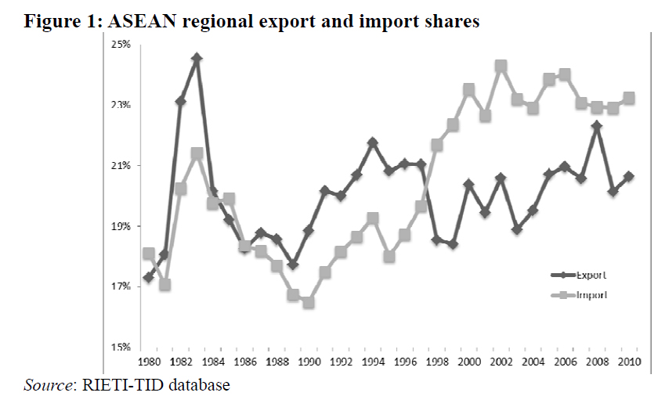
Literature Review
Statistical Analysis (By product)

Slide 5
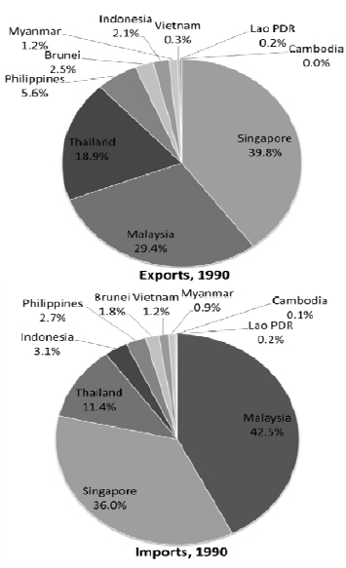
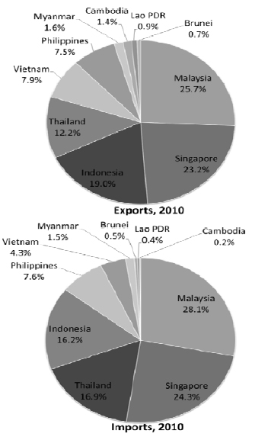
Statistical Analysis (By country)
Thailand,
Indonesia
& others
Singapore
&
Malaysia

Slide 6
Theories
Gravity Model
AFTA positive effect to the intra-ASEAN trade
No tariff elimination variable
Include tariff reduction variable
More accuracy

Slide 7
Conceptual Framework
Tariff reduction
The impact of the elimination of tariffs on trade volume of ASEAN members
Intra-ASEAN exp/imp value

Slide 8
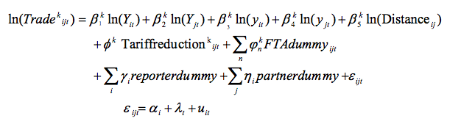
Methodology
Theory-based gravity model at product level by Anderson and Van Wincoop.
Equation for bilateral export/import flows of product k between each AFTA member country

Slide 9
Methodology
Variables
Coeeficient
1.GDP of country i
2.GDP of country j
3.GDP per capita of country i
4.GDP per capita of country j.
6.
5.
Positive
positive
positive
positive
negative
Positive or Zero

Slide 10
Estimate Impact of Tariff Reduction On Individual AFTA Member Countries
Change to interacted with the AFTA member country dummy.
Applying the Hausman-taylor estimation for error-components models.
=
The research test Fixed effect model vs. Hausman-taylor estimation and set:
Ho : Individual effects are correlated with the explanatory variable .
H1 : Otherwise
the result is the null hypothesis is accepted.

Slide 11
Results
Estimation Results for The Cases of Imports/ Exports
Of Each Product Within ASEAN
1
Imports: 39 products are significant and positive
2
Exports: 35 products are significant and positive
3
Energy materials or medical products are not affected

Slide 12
Results
Elasticity of Tariff Reduction for Imports/ Exports within ASEAN
4
The average elasticity of IMPORTS(0.38%) > EXPORTS (0.36%)
5
Elasticity of tariff reduction for EXPORTS are more in agricultural products and processed materials
6
Elasticity of tariff reduction for IMPORTS are more in electrical machinery and automobile equipment

Slide 13
Trade Creation Effects
for Individual ASEAN Member Countries
<
The expansion of trade volume for the new AFTA members (Cambodia, Myanmar, Vietnam)
The expansion of trade volume for original members (Brunei, Indonesia, Malaysia, Philippines, Singapore, Thailand).

Slide 14
Conclusion
positive and significant trade creation effects
The elasticity of tariff reduction: Import > export
Trade creation effects:
new ASEAN members < original members

Slide 15
Recommendations
Increasing AFTA utilization by:
Spreading the information about AFTA
Reducing cost of obtaining the certificates of origin
The elimination of Non-tariff measures(NTMs)
Improve infrastructure and develop competition between industries

Slide 16
Opinion

Slide 17
Discussion Questions
Since currently the process of eliminating intra-ASEAN trade tariff rate to be 0% for all types of products is not yet fully complete, what do you think will happen to Thailand if this process is fully completed?
Which country do you think will gain the most benefit from the intra-ASEAN trade tariff reduction once there is an emergence of AEC in 2015? And why?

Slide 18
“Thank you!”
Ornpreeya Manovilas 5504640912
Kewalin Laorsukphaiboon 5504640441
Nutta Rujirasenee 5504640839
Lalipat Tachapattarawat 5504640607
Asamarujee Simaporn 5504640102
Arpapat Noonpukdee 5504640086

