Slide 1

C H A P T E R 8
Profit Maximization
and Competitive Supply
CHAPTER OUTLINE
8.1 Perfectly Competitive Markets
8.2 Profit maximization
8.3 Marginal Revenue, Marginal Cost, and Profit Maximization
8.4 Choosing Output in the Short Run
8.5 The Competitive Firm’s Short-Run Supply Curve
8.6 The Short-Run Market Supply Curve
8.7 Choosing Output in the Long-Run
8.8 The Industry’s Long-Run Supply Curve
Prepared by:
Fernando Quijano, Illustrator

Slide 2
Perfectly Competitive Markets
8.1
PRICE TAKING
Because each individual firm sells a sufficiently small proportion of total market output, its decisions have no impact on market price.
● price taker Firm that has no influence over market price and thus takes the price as given.
PRODUCT HOMOGENEITY
When the products of all of the firms in a market are perfectly substitutable with one another—that is, when they are homogeneous—no firm can raise the price of its product above the price of other firms without losing most or all of its business.
In contrast, when products are heterogeneous, each firm has the opportunity to raise its price above that of its competitors without losing all of its sales.
The assumption of product homogeneity is important because it ensures that there is a single market price, consistent with supply-demand analysis.

Slide 3
FREE ENTRY AND EXIT
● free entry (or exit) Condition under which there are no special
costs that make it difficult for a firm to enter (or exit) an industry.
With free entry and exit, buyers can easily switch from one supplier to another, and suppliers can easily enter or exit a market.
When Is a Market Highly Competitive?
Many markets are highly competitive in the sense that firms face highly elastic demand curves and relatively easy entry and exit. But there is no simple rule of thumb to describe whether a market is close to being perfectly competitive.
Because firms can implicitly or explicitly collude in setting prices, the presence of many firms is not sufficient for an industry to approximate perfect competition.
Conversely, the presence of only a few firms in a market does not rule out competitive behavior.

Slide 4
Profit Maximization
8.2
Do Firms Maximize Profit?
The assumption of profit maximization is frequently used in microeconomics because it predicts business behavior reasonably accurately and avoids unnecessary analytical complications.
For smaller firms managed by their owners, profit is likely to dominate almost all decisions. In larger firms, however, managers who make day-to-day decisions usually have little contact with the owners.
Firms that do not come close to maximizing profit are not likely to survive. The firms that do survive make long-run profit maximization one of their highest priorities.
Alternative Forms of Organization
● cooperative Association of businesses or people jointly owned and operated by members for mutual benefit.
● condominium A housing unit that is individually owned but provides access to common facilities that are paid for and controlled jointly by an association of owners.

Slide 5
EXAMPLE 8.1
CONDOMINIUMS VERSUS COOPERATIVES IN NEW YORK CITY
While owners of condominiums must join with fellow condo owners to manage common, they can make their own decisions as to how to manage their individual units. In contrast, co-ops share joint liability on any outstanding mortgage on the co-op building and are subject to more complex governance rules.
Nationwide, condos are far more common than co-ops, outnumbering them by a factor of nearly 10 to 1. In this regard, New York City is very different from the rest of the nation—co-ops are more popular, and outnumber condos by a factor of about 4 to 1.
Many building restrictions in New York have long disappeared, and yet the conversion of apartments from co-ops to condos has been relatively slow.
The typical condominium apartment is worth about 15.5 percent more than a equivalent apartment held in the form of a co-op. Clearly, holding an apartment in the form of a co-op is not the best way to maximize the apartment’s value.
It appears that in New York, many owners have been willing to forgo substantial amounts of money in order to achieve non-monetary benefits.

Slide 6
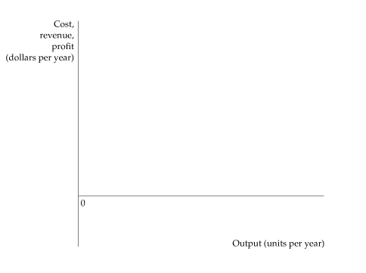
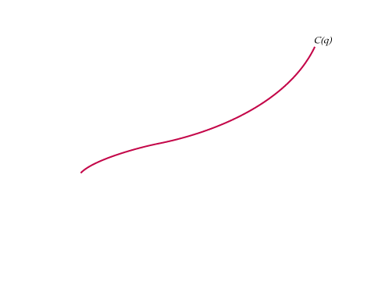
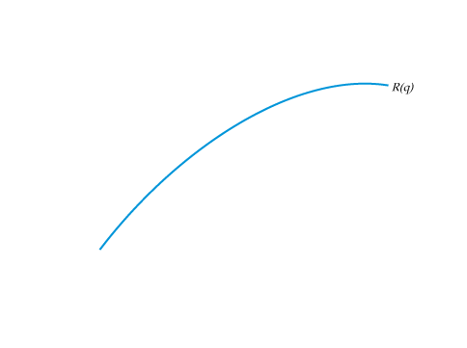
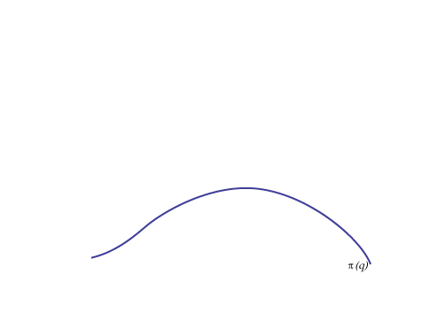
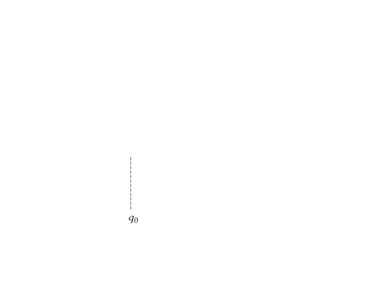
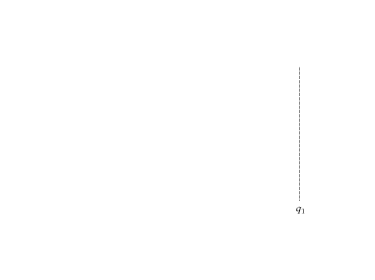
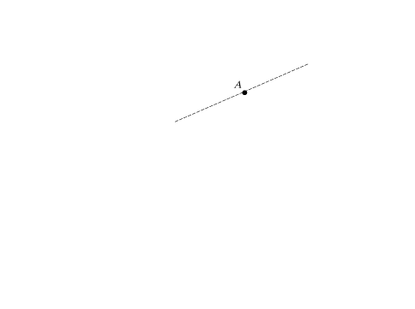
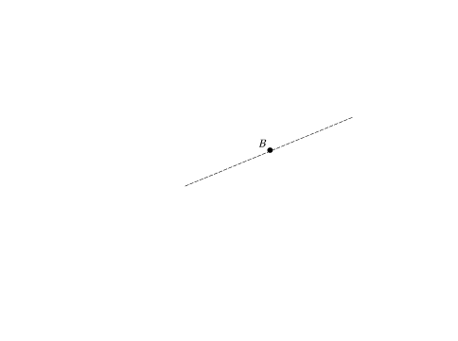
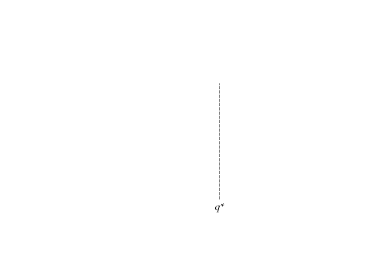
Marginal Revenue, Marginal Cost, and Profit Maximization
8.3
● profit Difference between total revenue and total cost.
π(q) = R(q) − C(q)
● marginal revenue Change in revenue resulting from a one-unit increase in output.
FIGURE 8.1
PROFIT MAXIMIZATON IN THE SHORT RUN
A firm chooses output q*, so that profit, the difference AB between revenue R and cost C, is maximized.
At that output, marginal revenue (the slope of the revenue curve) is equal to marginal cost (the slope of the cost curve).
Δπ/Δq = ΔR/Δq − ΔC/Δq = 0
MR(q) = MC(q)

Slide 7
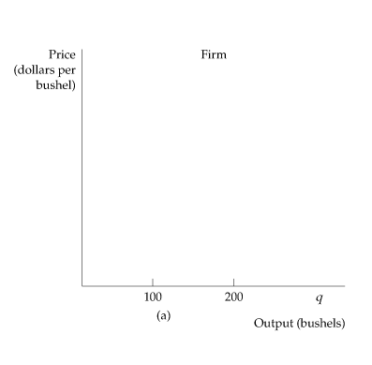
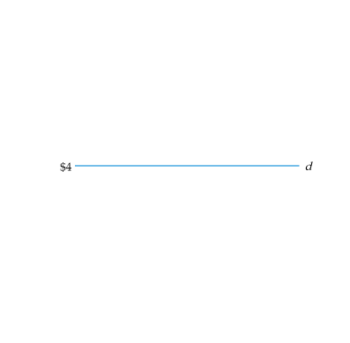
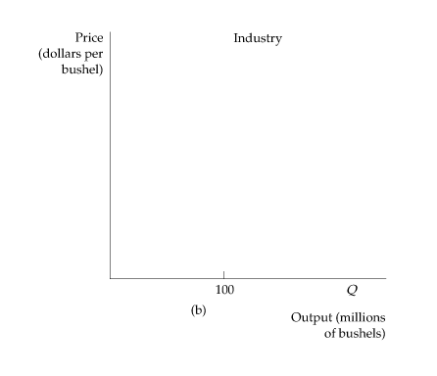
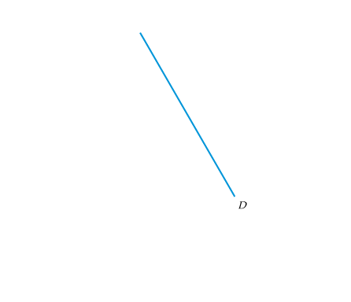
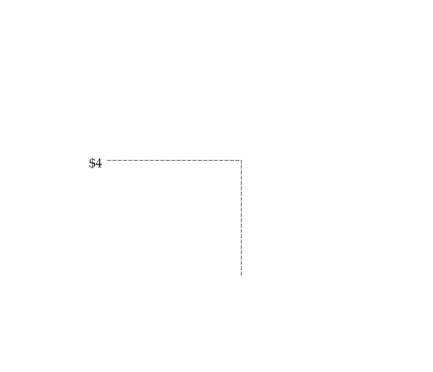
Demand and Marginal Revenue for a Competitive Firm
FIGURE 8.2
DEMAND CURVE FACED BY A COMPETITIVE FIRM
A competitive firm supplies only a small portion of the total output of all the firms in an industry. Therefore, the firm takes the market price of the product as given, choosing its output on the assumption that the price will be unaffected by the output choice.
In (a) the demand curve facing the firm is perfectly elastic,
even though the market demand curve in (b) is downward sloping.

Slide 8
Because each firm in a competitive industry sells only a small fraction
of the entire industry output, how much output the firm decides to sell
will have no effect on the market price of the product.
Because it is a price taker, the demand curve d facing an individual competitive firm is given by a horizontal line.
The demand curve d facing an individual firm in a competitive market is
both its average revenue curve and its marginal revenue curve. Along this
demand curve, marginal revenue, average revenue, and price are all equal.
Profit Maximization by a Competitive Firm
A perfectly competitive firm should choose its output so that marginal cost equals price:
MC(q) = MR = P

Slide 9

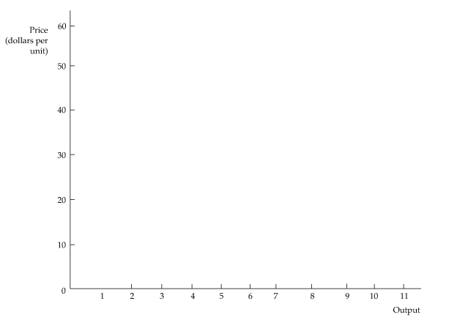
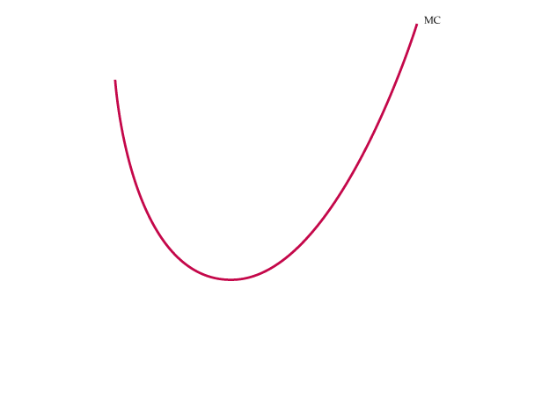


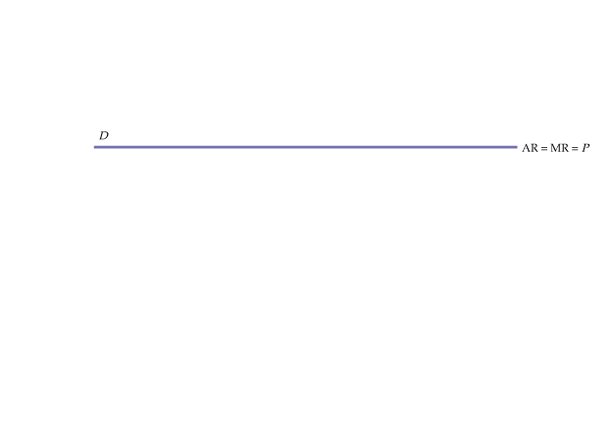
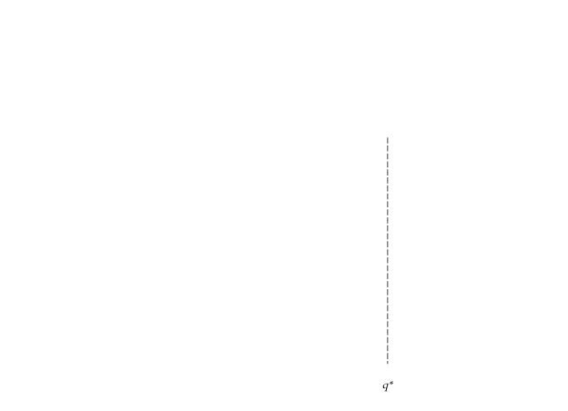
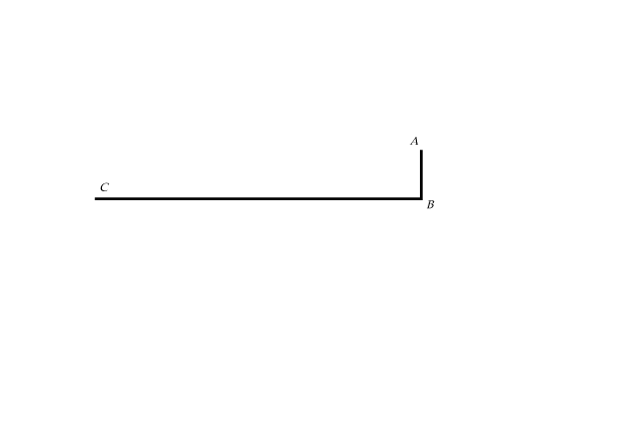
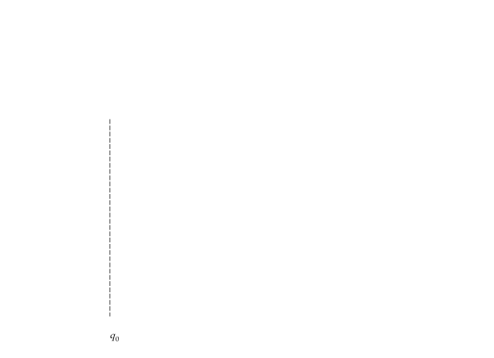
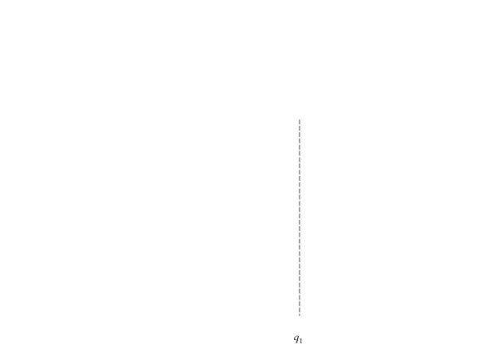
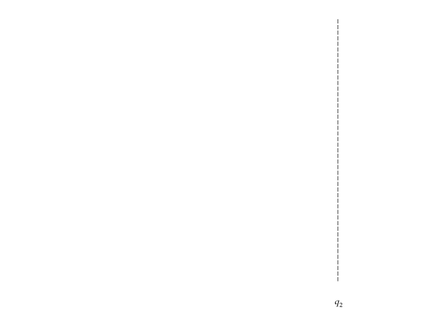
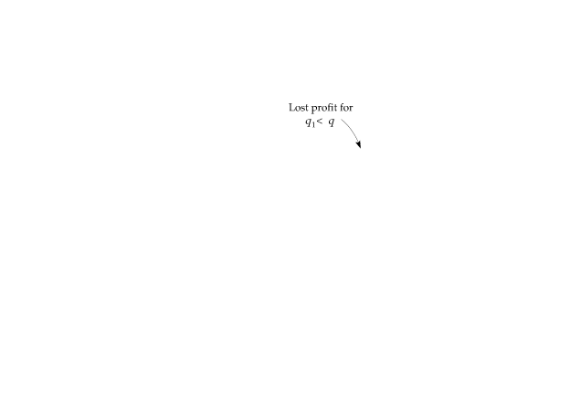
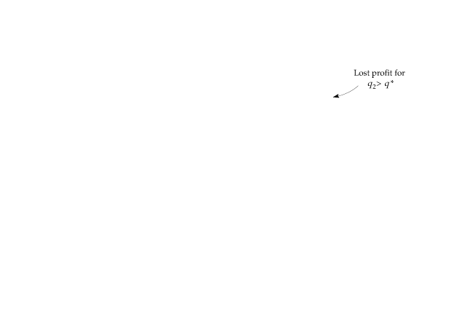

8.4
Choosing Output in the Short Run
Short-Run Profit Maximization by a Competitive Firm
FIGURE 8.3
A COMPETITIVE FIRM MAKING A POSITIVE PROFIT
In the short run, the competitive firm maximizes its profit by choosing an output q* at which its marginal cost MC is equal to the price P (or marginal revenue MR) of its product.
The profit of the firm is measured by the rectangle ABCD.
Any change in output, whether lower at q₁ or higher at q₂, will lead to lower profit.
Output Rule: If a firm is producing any output, it should produce at the level at which marginal revenue equals marginal cost.

Slide 10
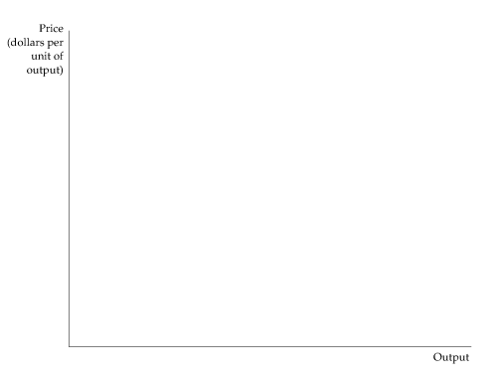
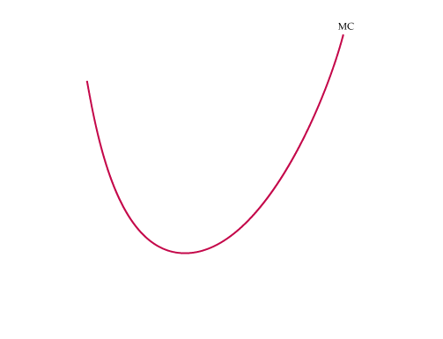


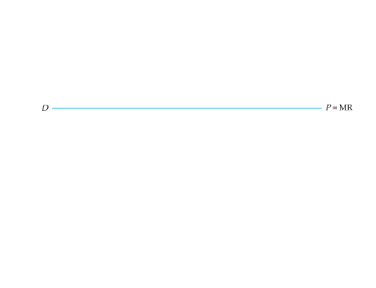
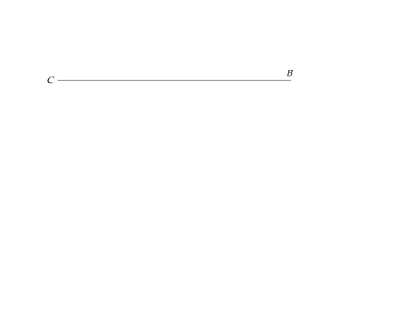
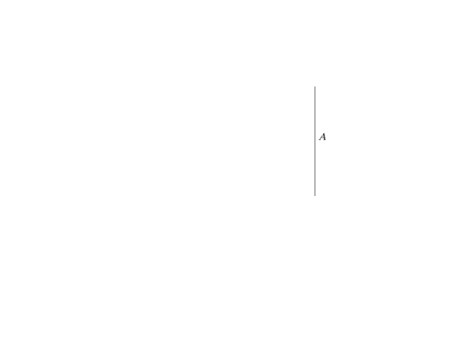

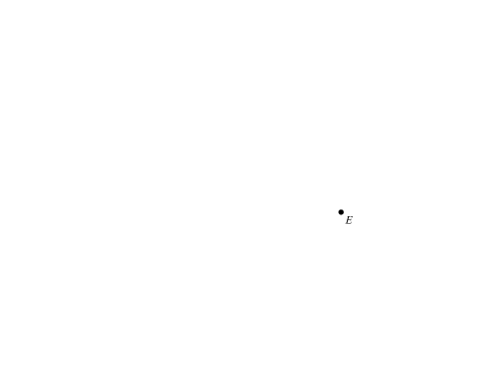
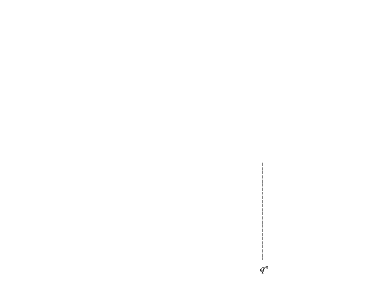
When Should the Firm Shut Down?
FIGURE 8.4
A COMPETITIVE FIRM INCURRING LOSSES
A competitive firm should shut down if price is below AVC.
The firm may produce in the short run if price is greater than average variable cost.

Slide 11
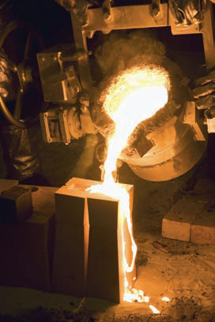
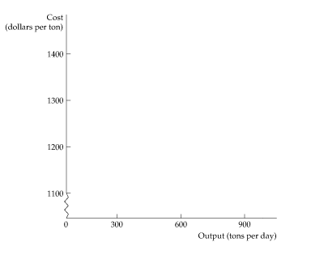





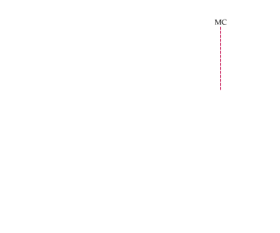
EXAMPLE 8.2
THE SHORT-RUN OUTPUT DECISION OF AN ALUMINUM SMELTING PLANT
How should the manager determine the plant’s profit maximizing output? Recall that the smelting plant’s short-run marginal cost of production depends on whether it is running two or three shifts per day.
FIGURE 8.5
THE SHORT-RUN OUTPUT OF AN ALUMINUM SMELTING PLANT
In the short run, the plant should produce 600 tons per day if price is above $1140 per ton but less than $1300 per ton.
If price is greater than $1300 per ton, it should run an overtime shift and produce 900 tons per day.
If price drops below $1140 per ton, the firm should stop producing, but it should probably stay in business because the price may rise in the future.

Slide 12
EXAMPLE 8.3
SOME COST CONSIDERATIONS FOR MANAGERS
The application of the rule that marginal revenue should equal marginal cost depends on a manager’s ability to estimate marginal cost. First, except under limited circumstances, average variable cost should not be used as a substitute for marginal cost.
Current output | 100 units per day, 80 of which are produced during the regular shift and 20 of which are produced during overtime
Materials cost | $8 per unit for all output
Labor cost | $30 per unit for the regular shift; $50 per unit for the overtime shift
For the first 80 units of output, average variable cost and marginal cost are both equal to $38 per unit. When output increases to 100 units, marginal cost is higher than average variable cost, so a manager who relies on average variable cost will produce too much.
Also, a single item on a firm’s accounting ledger may have two components, only one of which involves marginal cost.
Finally, all opportunity costs should be included in determining marginal cost.
These three guidelines can help a manager to measure marginal cost correctly. Failure to do so can cause production to be too high or too low and thereby reduce profit.

Slide 13
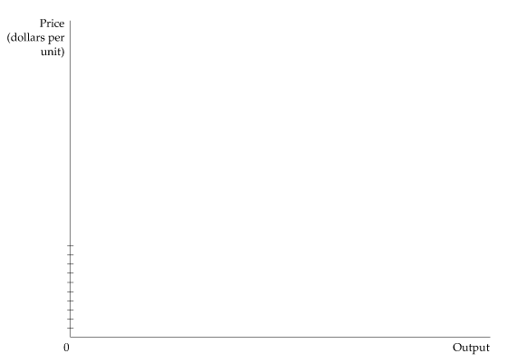
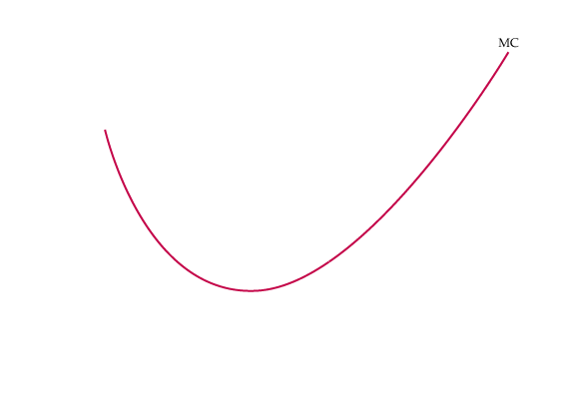


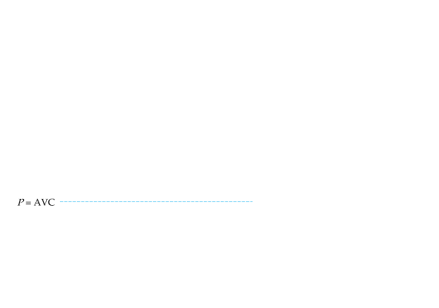
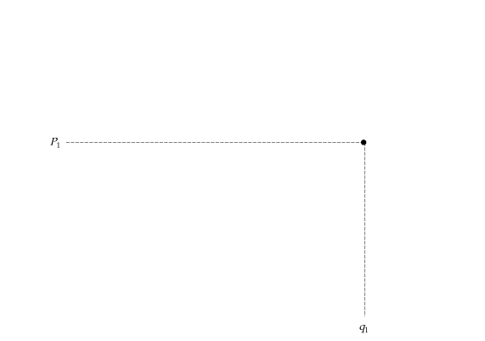
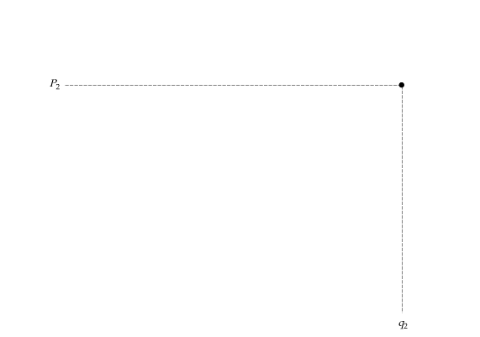

The Competitive Firm’s Short-run
Supply Curve
8.5
The firm’s supply curve is the portion of the marginal cost curve for which marginal cost is greater than average variable cost.
FIGURE 8.6
THE SHORT-RUN SUPPLY CURVE FOR A COMPETITIVE FIRM
In the short run, the firm chooses its output so that marginal cost MC is equal to price as long as the firm covers its average variable cost.
The short-run supply curve is given by the crosshatched portion of the marginal cost curve.

Slide 14

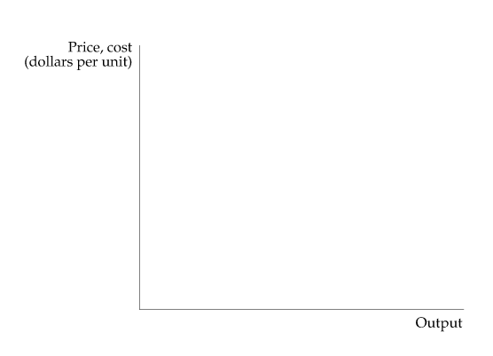
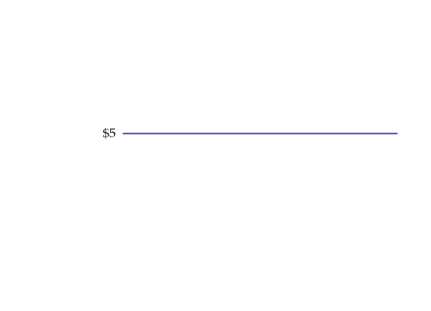
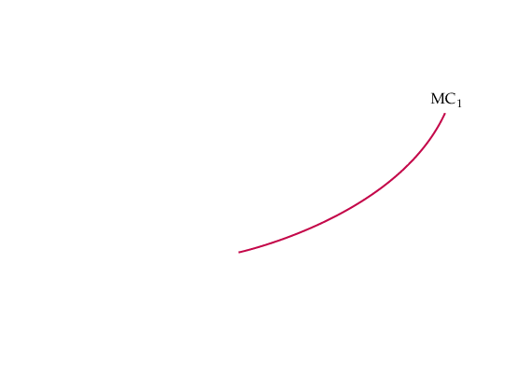
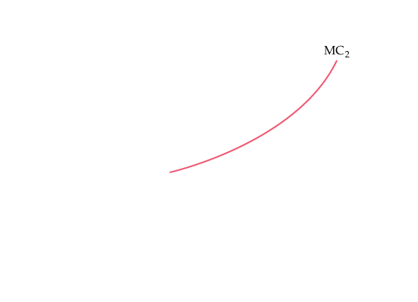
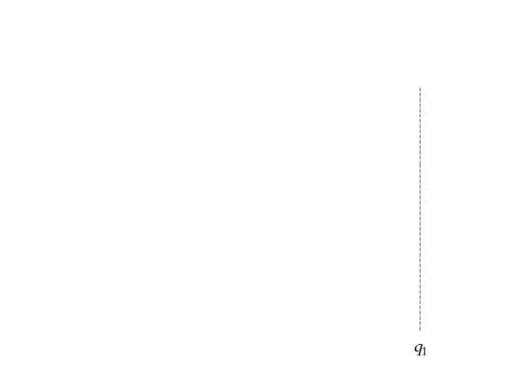
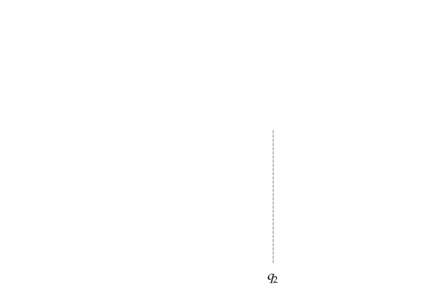
The Firm’s Response to an Input Price Change
FIGURE 8.7
THE RESPONSE OF A FIRM TO A CHANGE IN INPUT PRICE
When the marginal cost of production for a firm increases (from MC₁ to MC₂),
the level of output that maximizes profit falls (from q₁ to q₂).

Slide 15

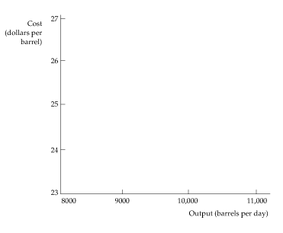
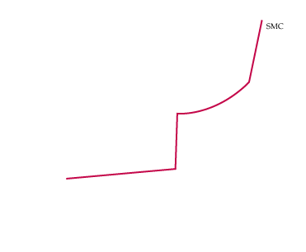


EXAMPLE 8.2
THE SHORT-RUN P RODUCTION OF
PETROLEUM PRODUCTS
Although plenty of crude oil is available, the amount that you refine depends on the capacity of the refinery and the cost of production.
FIGURE 8.8
THE SHORT-RUN PRODUCTION OF PETROLEUM PRODUCTS
As the refinery shifts from one processing unit to another, the marginal cost of producing petroleum products from crude oil increases sharply at several levels of output.
As a result, the output level can be insensitive to some changes in price but very sensitive to others.

Slide 16
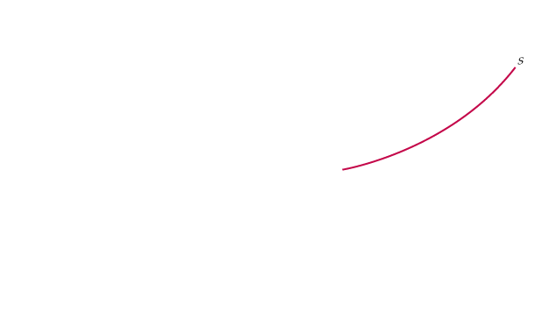
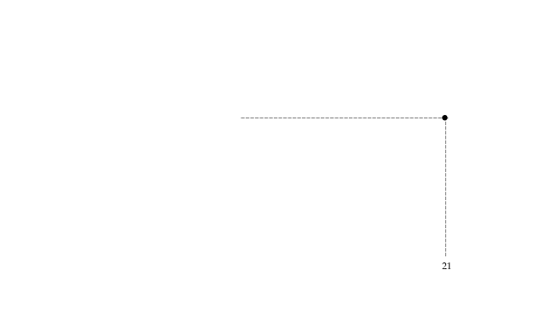
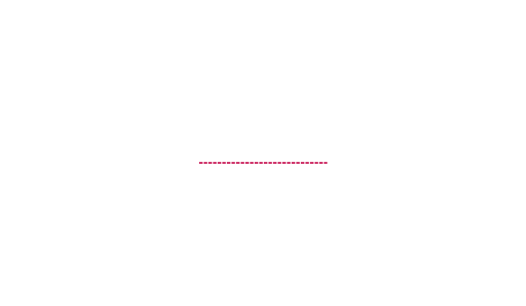












The Short-Run Market Supply Curve
8.6
FIGURE 8.9
INDUSTRY SUPPLY IN THE SHORT RUN
The short-run industry supply curve is the summation of the supply curves of the individual firms.
Because the third firm has a lower average variable cost curve than the first two firms, the market supply curve S begins at price P₁ and follows the marginal cost curve of the third firm MC₃ until price equals P₂, when there is a kink.
For P₂ and all prices above it, the industry quantity supplied is the sum of the quantities supplied by each of the three firms.
Elasticity of Market Supply
E_{s} = (ΔQ/Q)/(ΔP/P)

Slide 17
EXAMPLE 8.5
THE SHORT-RUN WORLD SUPPLY OF COPPER
Costs of mining, smelting, and refining copper differ because of differences
in labor and transportation costs and because of differences in the copper content of the ore.
TABLE 8.1 | THE WORLD COPPER INDUSTRY (2010)
COUNTRY |  | ANNUAL PRODUCTION (THOUSAND METRIC TONS) | MARGINAL COST (DOLLARS PER POUND)
Australia |  | 900 | 2.30
Canada |  | 480 | 2.60
Chile |  | 5,520 | 1.60
Indonesia |  | 840 | 1.80
Peru |  | 1285 | 1.70
Poland |  | 430 | 2.40
Russia |  | 750 | 1.30
US |  | 1120 | 1.70
Zambia |  | 770 | 1.50

Slide 18



EXAMPLE 8.5
THE SHORT-RUN WORLD SUPPLY OF COPPER
The world supply curve is obtained by summing each nation’s supply curve horizontally. The elasticity of supply depends on the price of copper. At relatively low prices, the curve is quite elastic because small price increases lead to large increases in the quantity of copper supplied. At higher prices—say, above $2.40 per pound—the curve becomes more inelastic because, at those prices, most producers would be operating close to or at capacity.
FIGURE 8.10
THE SHORT-RUN WORLD SUPPLY OF COPPER
The supply curve for world copper is obtained by summing the marginal cost curves for each of the major copper-producing countries.
The supply curve slopes upward because the marginal cost of production ranges from a low of 65 cents in Russia to a high of $1.30 in Canada.

Slide 19








Producer Surplus in the Short Run
● producer surplus Sum over all units produced by a firm of
differences between the market price of a good and the marginal cost of production.
FIGURE 8.11
PRODUCER SURPLUS FOR A FIRM
The producer surplus for a firm is measured by the yellow area below the market price and above the marginal cost curve, between outputs 0 and q*, the profit-maximizing output.
Alternatively, it is equal to rectangle ABCD because the sum of all marginal costs up to q* is equal to the variable costs of producing q*.

Slide 20






PRODUCER SURPLUS VERSUS PROFIT
Producer surplus = PS = R − VC
Profit = π = R − VC − FC
FIGURE 8.12
PRODUCER SURPLUS FOR A MARKET
The producer surplus for a market is the area below the market price and above the market supply curve, between 0 and output Q*.

Slide 21













8.7
Choosing Output in the Long Run
Long-Run Profit Maximization
FIGURE 8.13
OUTPUT CHOICE IN THE LONG RUN
The firm maximizes its profit by choosing the output at which price equals long-run marginal cost LMC.
In the diagram, the firm increases its profit from ABCD to EFGD by increasing its output in the long run.
The long-run output of a profit-maximizing competitive firm is the point at which long-run marginal cost equals the price.

Slide 22

Long-Run Competitive Equilibrium
ACCOUNTING PROFIT AND ECONOMIC PROFIT
Economic profit takes into account opportunity costs. One such opportunity cost is the return to the firm’s owners if their capital were used elsewhere. Accounting profit equals revenues R minus labor cost wL, which is positive. Economic profit $π$, however, equals revenues R minus labor cost wL minus the capital cost, Rk.
π = R − wL − rK
ZERO ECONOMIC PROFIT
● zero economic profit A firm is earning a normal return on its investment—i.e., it is doing as well as it could by investing its money elsewhere.
ENTRY AND EXIT
In a market with entry and exit, a firm enters when it can earn a positive long-run profit and exits when it faces the prospect of a long-run loss.

Slide 23
● long-run competitive equilibrium All firms in an industry are maximizing profit, no firm has an incentive to enter or exit, and price is such that quantity supplied equals quantity demanded.
When a firm earns zero economic profit, it has no incentive to exit the industry.
Likewise, other firms have no special incentive to enter.
A long-run competitive equilibrium occurs when three conditions hold:
1. All firms in the industry are maximizing profit.
2. No firm has an incentive either to enter or exit the industry because all firms are earning zero economic profit.
3. The price of the product is such that the quantity supplied by the industry is equal to the quantity demanded by consumers.

Slide 24












FIGURE 8.14
LONG-RUN COMPETITIVE EQUILIBRIUM
Initially the long-run equilibrium price of a product is $40 per unit, shown in (b) as the intersection of demand curve D and supply curve S₁.
In (a) we see that firms earn positive profits because long-run average cost reaches a minimum of $30 (at q₂).
Positive profit encourages entry of new firms and causes a shift to the right in the supply curve to S₂, as shown in (b).
The long-run equilibrium occurs at a price of $30, as shown in (a), where each firm earns zero profit and there is no incentive to enter or exit the industry.

Slide 25
FIRMS HAVING IDENTICAL COSTS
To see why all the conditions for long-run equilibrium must hold, assume that all firms have identical costs.
Now consider what happens if too many firms enter the industry in response to an opportunity for profit. The industry supply curve will shift further to the right, and price will fall.
Only when there is no incentive to exit or enter can a market be in long-run equilibrium.
FIRMS HAVING DIFFERENT COSTS
Now suppose that all firms in the industry do not have identical cost curves. Perhaps one firm has a patent that lets it produce at a lower average cost than all the others. In that case, it is consistent with long-run equilibrium for that firm to earn a greater accounting profit and to enjoy a higher producer surplus than other firms.
If the patent is profitable, other firms in the industry will pay to use it. The increased value of the patent thus represents an opportunity cost to the firm that holds it. It could sell the rights to the patent rather than use it. If all firms are equally efficient otherwise, the economic profit of the firm falls to zero.

Slide 26
THE OPPORTUNITY COST OF LAND
There are other instances in which firms earning positive accounting profit may be earning zero economic profit.
Suppose, for example, that a clothing store happens to be located near a large shopping center. The additional flow of customers can substantially increase the store’s accounting profit because the cost of the land is based on its historical cost. When the opportunity cost of land is included, the profitability of the clothing store is no higher than that of its competitors.
Economic Rent
● economic rent Amount that firms are willing to pay for an input less the minimum amount necessary to obtain it.
In competitive markets, in both the short and the long run, economic rent is often positive even though profit is zero.
Producer Surplus in the Long Run
In the long run, in a competitive market, the producer surplus that a firm earns on the output that it sells consists of the economic rent that it enjoys from all its scarce inputs.

Slide 27













FIGURE 8.15
FIRMS EARN ZERO PROFIT IN LONG-RUN EQUILIBRIUM
In long-run equilibrium, all firms earn zero economic profit.
In (a), a baseball team in a moderate-sized city sells enough tickets so that price ($7) is equal to marginal and average cost.
In (b), the demand is greater, so a $10 price can be charged. The team increases sales to the point at which the average cost of production plus the average economic rent is equal to the ticket price.
When the opportunity cost associated with owning the franchise is taken into account, the team earns zero economic profit.

Slide 28














8.8
The Industry’s Long-Run Supply Curve
Constant-Cost Industry
● constant-cost industry Industry whose long-run supply curve is horizontal.
FIGURE 8.16
LONG-RUN SUPPLY IN A CONSTANT COST INDUSTRY
In (b), the long-run supply curve in a constant-cost industry is a horizontal line S_{L}.
When demand increases, initially causing a price rise,
the firm initially increases its output from q₁ to q₂, as shown in (a).
But the entry of new firms causes a shift to the right in industry supply.
Because input prices are unaffected by the increased output of the industry, entry occurs until the original price is obtained (at point B in (b)).
The long-run supply curve for a constant-cost industry is, therefore, a horizontal line at a price that is equal to the long-run minimum average cost of production.

Slide 29

















8.8
The Industry’s Long-Run Supply Curve
Increasing-Cost Industry
● increasing-cost industry Industry whose long-run supply curve is upward sloping.
FIGURE 8.17
LONG-RUN SUPPLY IN AN INCREASING COST INDUSTRY
In (b), the long-run supply curve in an increasing-cost industry is an upward-sloping curve S_{L}.
When demand increases, initially causing a price rise,
the firms increase their output from q₁ to q₂ in (a).
In that case, the entry of new firms causes a shift to the right in supply from S₁ to S₂.
Because input prices increase as a result, the new long-run equilibrium occurs at a higher price than the initial equilibrium.
In an increasing-cost industry, the long-run industry supply curve is upward sloping.

Slide 30
Decreasing-Cost Industry
● decreasing-cost industry Industry whose long-run supply curve is downward sloping.
EXAMPLE 8.6
CONSTANT-, INCREASING-, AND DECREASING-COST
INDUSTRIES: COFFEE, OIL, AND AUTOMOBILES
You have been introduced to industries that have constant, increasing, and decreasing long-run costs.
We saw that the supply of coffee is extremely elastic in the long run. The reason is that land for growing coffee is widely available and the costs of planting and caring for trees remains constant as the volume grows. Thus, coffee is a constant-cost industry.
The oil industry is an increasing cost industry because there is a limited availability of easily accessible, large-volume oil fields.
Finally, a decreasing-cost industry. In the automobile industry, certain cost advantages arise because inputs can be acquired more cheaply as the volume of production increases.

Slide 31









The Effects of a Tax
FIGURE 8.18
EFFECT OF AN OUTPUT TAX ON A COMPETITIVE FIRM’S OUTPUT
An output tax raises the firm’s marginal cost curve by the amount of the tax.
The firm will reduce its output to the point at which the marginal cost plus the tax is equal to the price of the product.

Slide 32








FIGURE 8.19
EFFECT OF AN OUTPUT TAX ON INDUSTRY OUTPUT
An output tax placed on all firms in a competitive market shifts the supply curve for the industry upward by the amount of the tax.
This shift raises the market price of the product and lowers the total output of the industry.

Slide 33
Long-Run Elasticity of Supply
The long-run elasticity of industry supply is defined in the same way as
the short-run elasticity: It is the percentage change in output (Q/Q) that
results from a percentage change in price (P/P).
In a constant-cost industry, the long-run supply curve is horizontal, and the long-run supply elasticity is infinitely large. (A small increase in price will induce an extremely large increase in output.) In an increasing-cost industry, however, the long-run supply elasticity will be positive but finite.
Because industries can adjust and expand in the long run, we would generally expect long-run elasticities of supply to be larger than short-run elasticities.
The magnitude of the elasticity will depend on the extent to which input costs increase as the market expands. For example, an industry that depends on inputs that are widely available will have a more elastic long-run supply than will an industry that uses inputs in short supply.

Slide 34




EXAMPLE 8.7
THE SUPPLY OF TAXICABS IN NEW YORK
While reducing taxi fares will indeed cause a reduction in the quantity supplied, raising the price will not cause an increase in the quantity supplied. Why not? Because the number of medallions is fixed.
FIGURE 8.20
THE SUPPLY CURVE FOR NEW YORK TAXICABS
If there were no restriction on the number of medallions, the supply curve would be highly elastic. Cab drivers work hard and don’t earn much, so a drop in the price P (of a 5-mile ride) would lead many of them to find another job. Likewise, an increase in price would bring many new drivers into the market.
But the number of medallions—and therefore the number of taxicabs—is limited to 13,150, so the supply curve becomes vertical at this quantity.

Slide 35

THE LONG-RUN SUPPLY OF HOUSING
EXAMPLE 8.8
To begin, consider the supply of owner-occupied
housing in suburban or rural areas where land is
not scarce. In this case, the price of land does
not increase substantially as the quantity of
housing supplied increases. Likewise, costs
associated with construction are not likely to
increase because there is a national market for
lumber and other materials. Therefore, the long-
run elasticity of the housing supply is likely to be
very large, approximating that of a constant-cost industry.
The market for rental housing is different, however. The construction of rental housing is often restricted by local zoning laws. Many communities outlaw it entirely, while others limit it to certain areas. Because urban land on which most rental housing is located is restricted and valuable, the long-run elasticity of supply of rental housing is much lower than the elasticity of supply of owner-occupied housing. With urban land becoming more valuable as housing density increases, and with the cost of construction soaring, increased demand causes the input costs of rental housing to rise. In this increasing-cost case, the elasticity of supply can be much less than 1.

