Slide 1
Credit Risk in FI
Thanachote Rungsitivat

Slide 2
Credit Risk in Financial Institution
How Banks Evaluate Risk
Relate to Capital Requirements

Slide 3
How Banks Evaluate Risk
Business Credit Application
Facilities
Documentation
Wholesale Banking / Consumer Banking

Slide 4
Business Credit Application
Credit Scoring
Financial Performance/ Forecast Analysis
Client Appropriateness
  Link with what types of product could be offered

Slide 5
Credit Scoring
Retail banking – score based
Wholesale banking
  Using external ratings
  Using Internal Models
    These will impact capital requirements

Slide 6
Capital Requirement
Why???
Under Basel II Framework
  Capital / RWA
  Bank is given the model to compute their capital requirement
  Inputs to the model depends on the approach:
    Standardized
    IRB
    AIRB

Slide 7
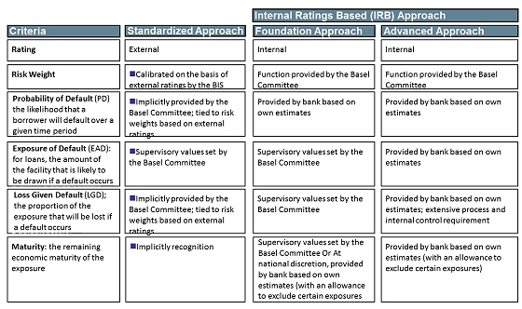
Basel II Approach to Credit Ratings

Slide 8
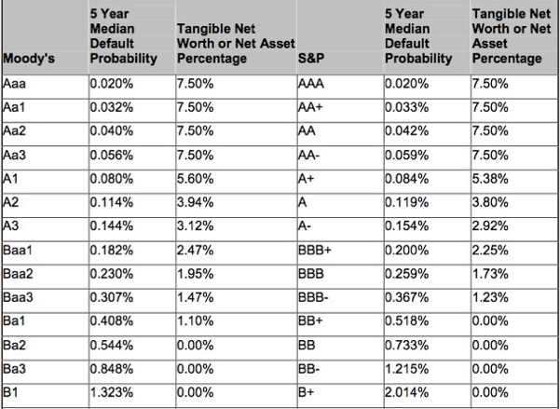
Probability of Default
Depends on the rating and statistics

Slide 9
Loss Given Default
LGD is the credit loss incurred if an obligor defaults.
Loss Given Default is facility-specific
Major Factors influence LGD
  Facility Type
  Exposure
  Tenor
  Collateral

Slide 10
Exposure at Default
Total value that a bank is exposed to at the time of default. Each underlying exposure that a bank has is given an EAD value and is identified within the bank's internal system.
Some facilities that banks provide to clients are committed lines. The exposure could therefore increase when client is in a difficult position (near default).
  Depends on product type

Slide 11
Risk
Settlement Risk
The risk that one party will fail to deliver the terms of a contract with another party at the time of settlement. Settlement risk can be the risk associated with default at settlement and any timing differences in settlement between the two parties.
  Payment system
  Correspondent Bank
    Transfer USD/THB
      Give THB first before payment system close (i.e 5pm)
      Wait for US market to open to get USD (i.e. 9 pm)
Pre-Settlement Risk
The risk that one party of a contract will fail to meet the terms of the contract and default before the contract's settlement date, prematurely ending the contract.
  Replacement Cost
  FX Forward
    Mark to market

Slide 12
Facilities
Loan
FX Spot – Settlement Risk
FX Forward – Pre-settlement and Settlement Risk
Derivatives – Pre-settlement and Settlement Risk

Slide 13
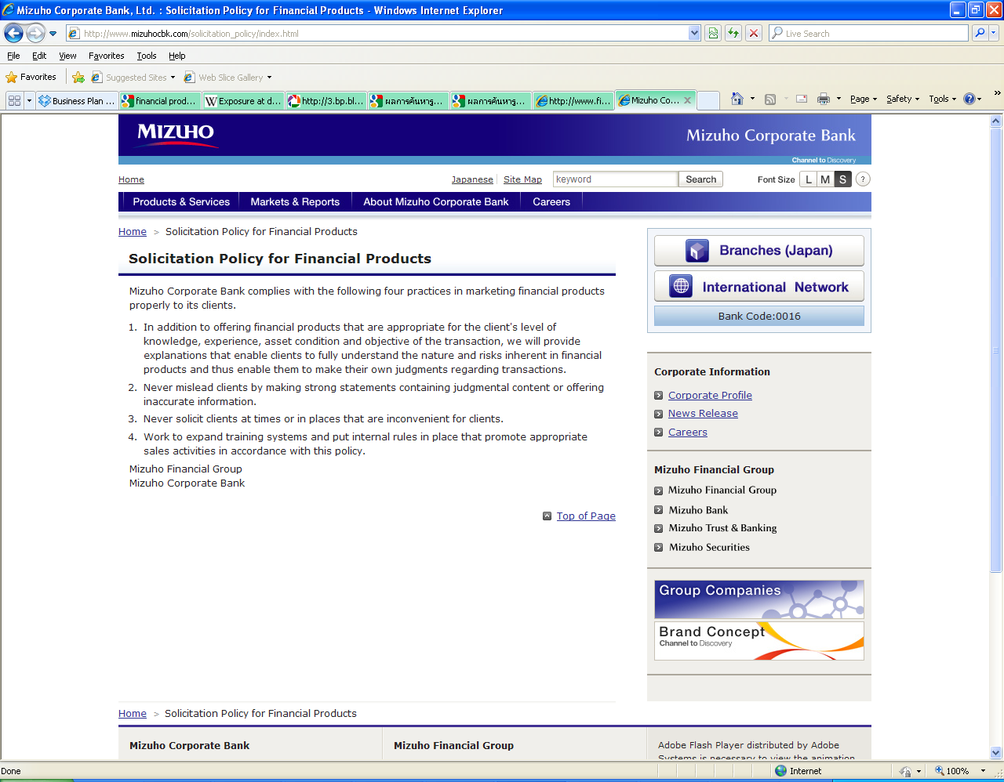
Financial Product Offerings
Focus on Appropriateness

Slide 14
Risk Evaluation on FIs
Banks/ Non-Banks FI
  Funds
  Brokers/Dealers
  Insurance
    Life
    Non life

Slide 15
Funds
Individual legal entity (not related to the fund manager)
Pay the fee to fund manager for management
Fund Manager does not take any losses
Risk
  Individual investment policy
  Performance of the management i.e. Fund Manager
  Systematic risk

Slide 16
Funds
Regulated by the SEC in Thailand
Investment policy
  Open end (liquidity)
  Close end
  Equity
  Fixed Income
  Derivatives
Leverage
Management Fee
Return Policy
Hedging Policy
Validity of the Benchmark

Slide 17
Funds
Quantitative Evaluation
  NAV Performance
  Compare to the benchmark
  Investment mix vs what was in the prospectus
  Funds of funds
Qualitative Evaluation
  Track record of fund manager
  Any news on the investment
  Capital control?
  Changes in credit rating of investment

Slide 18
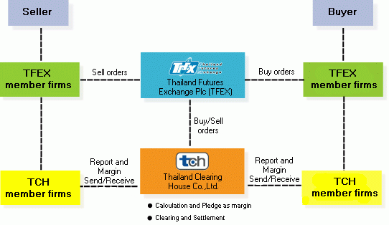
Brokerage
What they do?
Regulated under SEC
For Broker companies
  Settlement risk
  Transacting with clearing house
  TFEX example

Slide 19
Brokerage
Margin Loan
  Policy of providing loan (xx% of equity of client)
  Loan to Value ratio
  Types of securities that allow cash margin
  NPL
Other types of income
  Fee income

Slide 20
Insurance
Key qualitative factors are:
• Sovereign and country-related constraints
• Industry profile and operating environment
• Market position and size/scale
• Ownership
• Corporate governance and management
Key quantitative factors are:
• Capitalization and leverage
• Debt service capabilities and financial flexibility
• Financial performance and earnings
• Investment and asset risk
• Asset/liability and liquidity management
• Reserve adequacy
• Reinsurance, risk mitigation, and catastrophe risk

Slide 21
Insurance – Country specific
Premium ceiling
Government entities entering the market
Lack of sharing of historical database

Slide 22
Insurance - Industry profile
Cyclicality of year-to-year results.
Intense competition in most sectors.
Challenges in predicting, pricing, and reserving for losses from products with long reporting and claims settlement tails.
Exposures to large “low frequency, high severity” losses such as property catastrophes.
Reinsurance – management of risk

Slide 23
Documentation
Banking Facility Letter
  Committed/ Uncommitted Lines
International Swaps and Derivatives Association (ISDA)
Credit support annex (CSA)

Slide 24
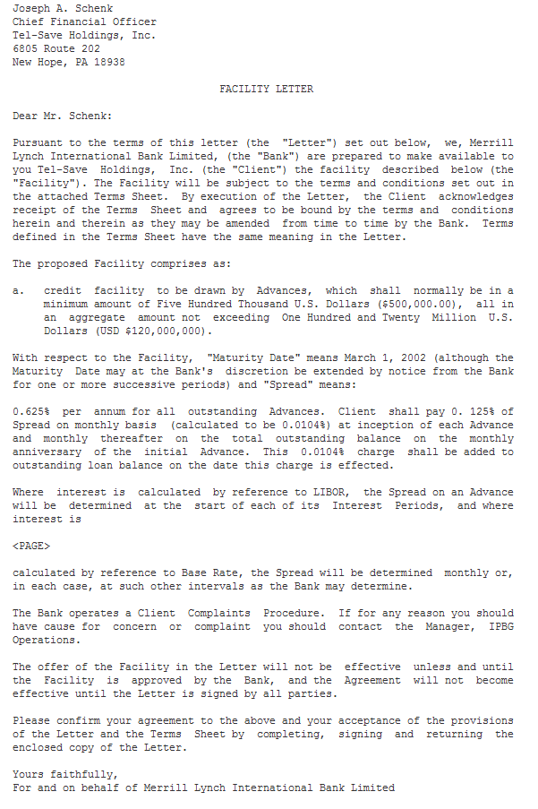
Banking Facility Letter

Slide 25
ISDA
The International Swaps and Derivatives Association (ISDA) is a trade organization of participants in the market for over-the-counter derivatives. It is headquartered in New York, and has created a standardized contract (the ISDA Master Agreement) to enter into derivatives transactions.
ISDA was initially created in 1985 as the International Swap Dealers Association and subsequently changed its name switching swap dealers to Swaps and Derivatives. This change was made to focus more attention on their efforts to improve the more broad derivatives markets and away from strictly interest rate swap contracts.
The ISDA Master Agreement is typically used between a derivatives dealer and their counterparty when discussions begin surrounding a derivatives trade.

Slide 26
ISDA - Netting
Possibly the most important aspect of the ISDA Master Agreement is that the Master Agreement and all the Confirmations entered into under it form a single agreement. This is very important (especially for regulated financial companies) as it allows the parties to an ISDA Master Agreement to aggregate the amounts owing by each of them under all of the Transactions outstanding under that ISDA Master Agreement and replace them with a single net amount payable by one party to the other.
The more important use of netting is close-out netting under Section 6(e) of the ISDA Master Agreement. Pursuant to this section, when an ISDA Master Agreement (or, more accurately the outstanding Transactions under it) is terminated (normally following a credit event of some kind), the value of each of the Terminated Transactions is assessed and converted into the Termination Currency (which should have been specified in the schedule to the ISDA Master Agreement) and any outstanding Unpaid Amounts are taken into account. The Settlement Amounts (which may be positive or negative depending which party is 'in-the-money' with respect to a particular Terminated Transaction) and unpaid amounts (again positive or negative, depending on who owes them) are added up and a single figure in the Termination Currency is determined payable by one party or the other.
Credit events

Slide 27
CSA
ISDA also produces a credit support annex which further permits parties to an ISDA Master Agreement to mitigate their credit risk by requiring the party which is 'out-of-the-money' to post collateral (usually cash, government securities or highly rated bonds) corresponding to the amount which would be payable by that party were all the outstanding Transactions under the relevant ISDA Master Agreement terminated. Collateral other than cash is usually discounted for risk, that is, the pledger would have to post collateral in excess of the potential settlement amount.
Threshold
Minimum Transfer Amount
Risk from 20 years become 14 days

Slide 28
Q&A
THANK YOU

